Slide 1
Implementation of a two stage drying model for liquid drops containing insoluble solids in OpenFOAM for spray drying application
University of Genoa, Polytechinc School DIME
Department of Mechanical, Energy, Management and Transportation Engineering
Candidate: Giovanni Beati
Supervisor: Prof. Ing. Jan Oscar Pralits (Unige)
Co Supervisor: Dott. Ing. Matteo Colli (Unige)
Marco Atzori (KTH)
July 2017

Slide 2
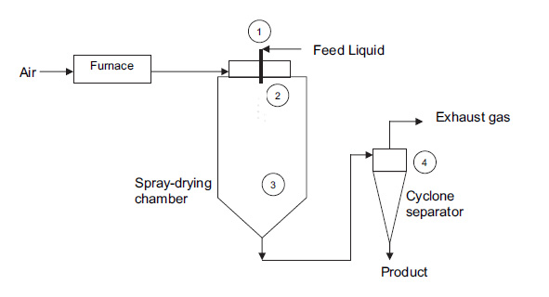
What is Spray Drying
Spray Drying is a widely use industrial process that involves the transformation of a liquid feed containing solid fraction into particles by supplying the feed as a spray into a chamber with a hot drying agent.

Slide 3
What is Spray Drying
CFD
Spray Drying is a widely use industrial process that involves the transformation of a liquid feed containing solid fraction into particles by supplying the feed as a spray into a chamber with a hot drying agent.
Droplets coloured with temperature ( $T_{min}$=19 °C , $T_{max}$=197 °C)

Slide 4
Thesis purpose and outline
This work is part of a project started last year by Stefano Pastorino in collaboration with the DICCA department. In his master thesis, he first began to treat spray drying modelling in OpenFOAM.

Slide 5
Thesis purpose and outline
This work is part of a project started last year by Stefano Pastorino in collaboration with the DICCA department. In his master thesis, he first began to treat spray drying modelling in OpenFOAM.
Purpose Study and implementation of the two stage drying model in a CFD code (OpenFOAM)

Slide 6
Thesis purpose and outline
This work is part of a project started last year by Stefano Pastorino in collaboration with the DICCA department. In his master thesis, he first began to treat spray drying modelling in OpenFOAM.
Purpose Study and implementation of the two stage drying model in a CFD code (OpenFOAM)
STEP 1: Python implementation of the two-stage model for a motionless droplet + comparison with experimental data.

Slide 7
Thesis purpose and outline
This work is part of a project started last year by Stefano Pastorino in collaboration with the DICCA department. In his master thesis, he first began to treat spray drying modelling in OpenFOAM.
Purpose Study and implementation of the two stage drying model in a CFD code (OpenFOAM)
STEP 1: Python implementation of the two-stage model for a motionless droplet + comparison with experimental data.
STEP 2: OpenFOAM implementation: the two-stage drying model is applied along the droplets trajectories.

Slide 8
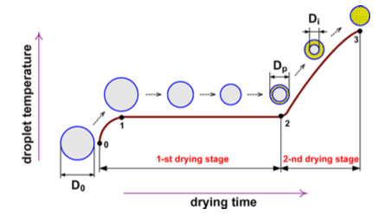
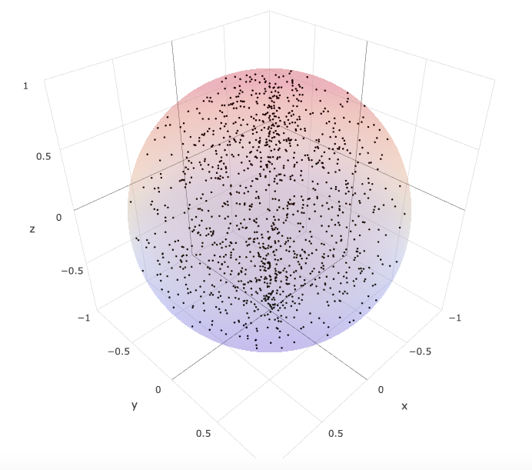
Two Stage Evaporation Model
The drying kinetic of liquid drops containing solid can be separated in two main stages.
1-ST Drying stage: Evaporation occurs on the surface resulting in droplet diameter shrinking until $X_{cr}$ is reached.
*Mezhericher, Levy, Borde 2007

Slide 9
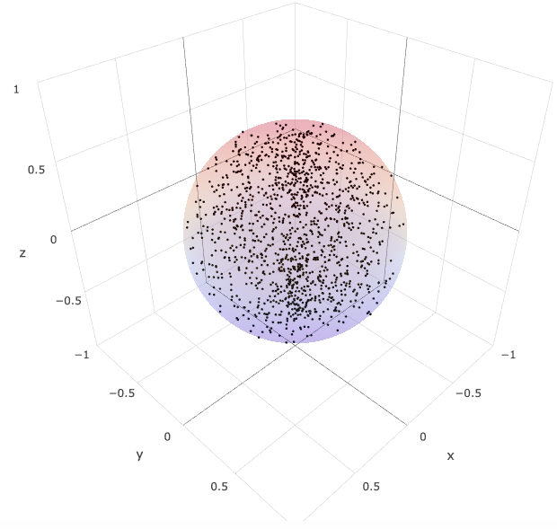
Two Stage Evaporation Model
The drying kinetic of liquid drops containing solid can be separated in two main stages.
1-ST Drying stage: Evaporation occurs on the surface resulting in droplet diameter shrinking until $X_{cr}$ is reached.
*Mezhericher, Levy, Borde 2007

Slide 10
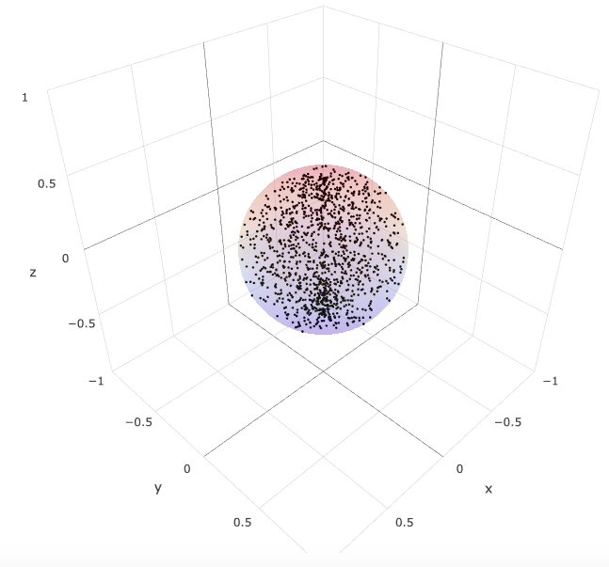
Two Stage Evaporation Model
The drying kinetic of liquid drops containing solid can be separated in two main stages.
1-ST Drying stage: Evaporation occurs on the surface resulting in droplet diameter shrinking until $X_{cr}$ is reached.
*Mezhericher, Levy, Borde 2007

Slide 11
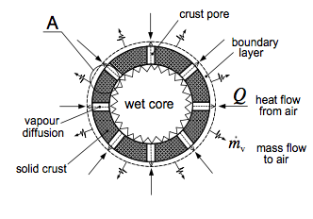
Two Stage Evaporation Model
The drying kinetic of liquid drops containing solid can be separated in two main stages.
2-ST Drying stage: When $X_{cr}$ is reached a solid crust surrounds a wet core: water vapour diffuses through the crust pores.
*Mezhericher, Levy, Borde 2007

Slide 12
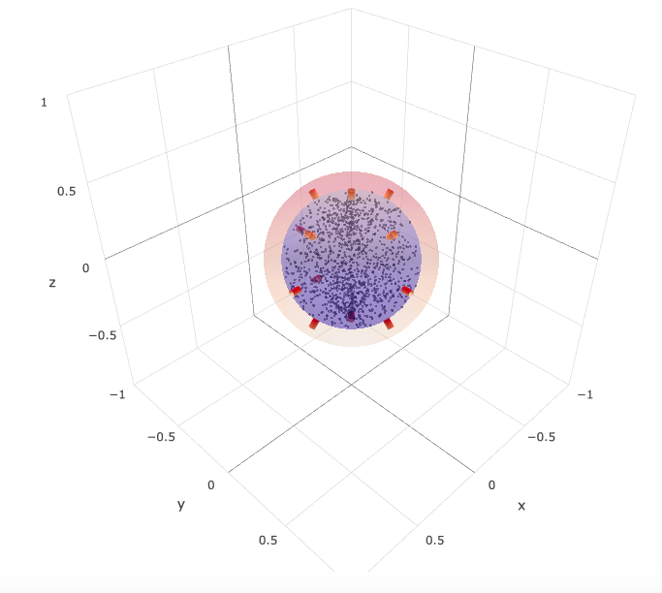
Two Stage Evaporation Model
The drying kinetic of liquid drops containing solid can be separated in two main stages.
2-ST Drying stage: When $X_{cr}$ is reached a solid crust surrounds a wet core: water vapour diffuses through the crust pores.
*Mezhericher, Levy, Borde 2007

Slide 13
Two Stage Evaporation Model
The drying kinetic of liquid drops containing solid can be separated in two main stages.
2-ST Drying stage: When $X_{cr}$ is reached a solid crust surrounds a wet core: water vapour diffuses through the crust pores.
*Mezhericher, Levy, Borde 2007

Slide 14
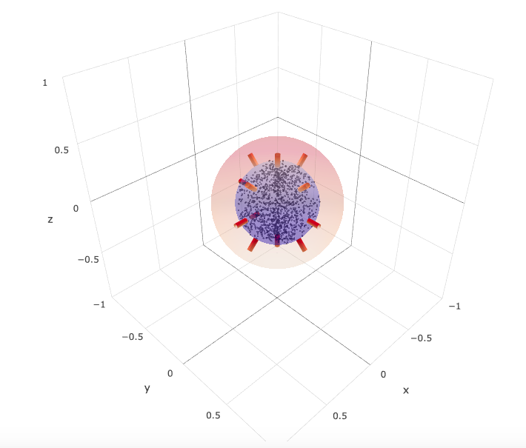
Two Stage Evaporation Model
The drying kinetic of liquid drops containing solid can be separated in two main stages.
2-ST Drying stage: When $X_{cr}$ is reached a solid crust surrounds a wet core: water vapour diffuses through the crust pores.
*Mezhericher, Levy, Borde 2007

Slide 15
The first drying stage
Initial values*:
Motionless Droplet:
Water drop + Silica nanoparticles
D= 2 mm
T= 19 °C
c=30% (initial solid content)
$X$=2.3 (moisture content)
m=4.3 mg
*Nesic and Vodnik, 1989
Drying air:
Relative Humidity=0.4%
T=178 °C
|U|=1.4 m/s
$X$= $\frac{m_{w}}{m_{s}}$ (First drying stage occurs until $X=X_{cr}$)
$X_{cr}$ is the critical moisture content derived from a certain average solid to liquid ratio.

Slide 16
The first drying stage
Droplet equation:
Convective heat transfer (h):
Mass transfer equations:
Convective mass transfer ($h_{mass}$):

Slide 17
The first drying stage
Droplet equation:
Convective heat transfer (h):
Mass transfer equations:
Convective mass transfer ($h_{mass}$):

Slide 18
The first drying stage
Droplet equation:
Convective heat transfer (h):
Mass transfer equations:
Convective mass transfer ($h_{mass}$):

Slide 19
The first drying stage
Droplet equation:
Convective heat transfer (h):
Mass transfer equations:
Convective mass transfer ($h_{mass}$):

Slide 20
The first drying stage
Moving boundary problem: it requires an implicit itherative algorithm
Landau’s transformation:
Transformed equation:
Transformed BC:

Slide 21
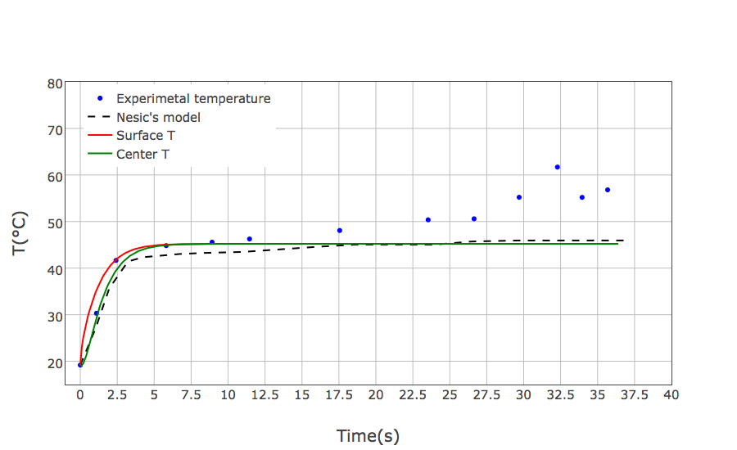
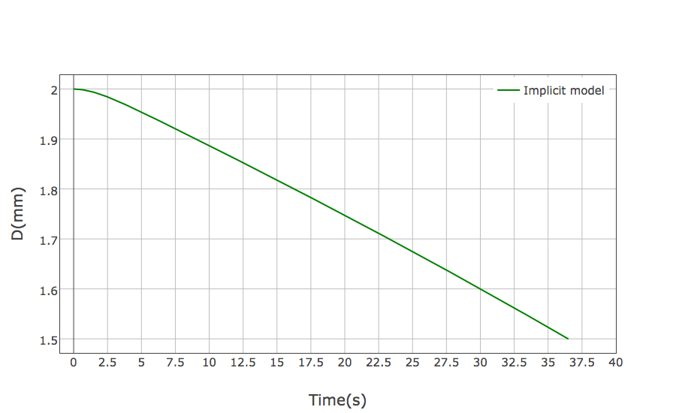
The first drying stage
*Comparison with Nesic and Vodnik, 1989

Slide 22
The second drying stage
Wet core equation:
Crust equation :

Slide 23
The second drying stage
Wet core equation:
Crust equation :

Slide 24
The second drying stage
Mass transfer equation: the evaporation rate is expressed as:
Moving crust-wet core interface:
Landau’s tranformation and implicit itherative algorithm are required to solve both wet core and crust energy equations

Slide 25
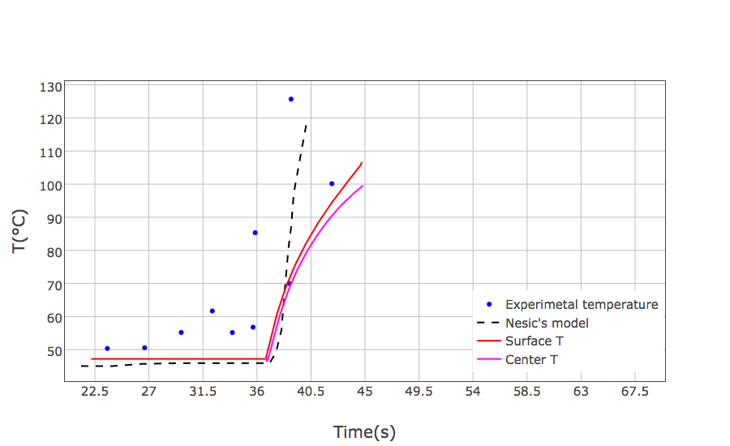
The second drying stage
Differences from experimental data due to difficulties to model the vapour diffusion through the crust pores.
*Comparison with Nesic and Vodnik, 1989

Slide 26
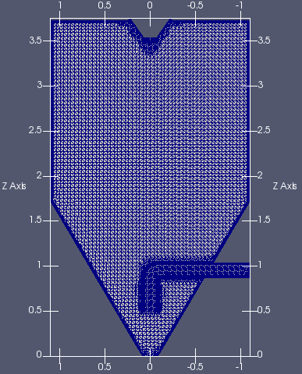
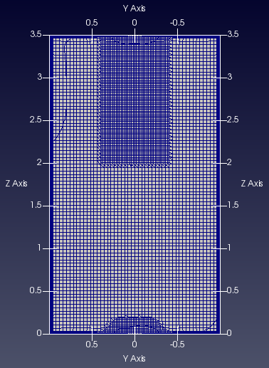
CFD: Spray Drying Modelling
Original Geometry
Modified Geometry
Simplifications in the geometry have been adopted to have a cheaper study case
The purpose is now to implement the two stage drying model in OpenFOAM (Open Source CFD code)
Notes:
Avevo a disposizione la geomtria originale ……

Slide 27
CFD: Spray Drying Modelling
Original Geometry
Modified Geometry
Simplifications in the geometry have been adopted to have a cheaper study case
The purpose is now to implement the two stage drying model in OpenFOAM (Open Source CFD code)
Notes:
Avevo a disposizione la geomtria originale ……

Slide 28
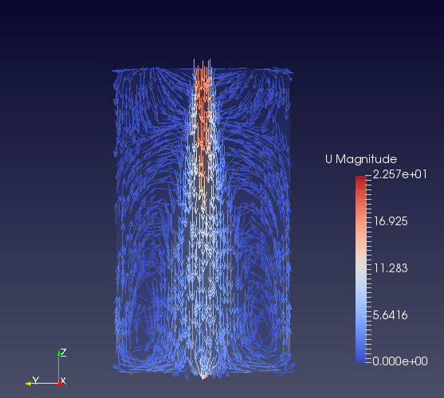
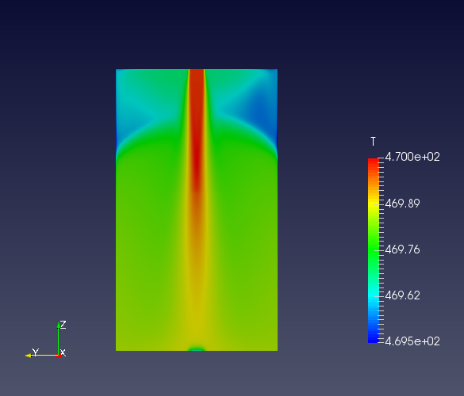
CFD: Spray Drying Modelling
Particles have been injected when a steady state condition for the base flow has been obtained.
Numerical model:
Mesh 460k cells
buoyantPimpleFoam solver
k-ω SST
Steady state reached at 170 s
Notes:
Le particelle saranno iniettate in alto al centro soltanto quando….

Slide 29
CFD: Mutiphase flow with particles
Multiphase flow:
Air: continuous phase (Eulerian approach)
Particles: dispersed phase (Lagrangian approach)
Particles hypotesis:
Sphere
Diluite regime
One-way coupling: continuous phase → dispersed phase

Slide 30
CFD: Mutiphase flow with particles
How does the CFD code perform the Lagrangian particle tracking ?
For each droplet the equation of dynamic is solved:
Assumption:
Only the drag force evaluated through a drag coefficient $C_{D}$is considered:

Slide 31
Implementation of the new Lagrangian solver
Implementation of a new OpenFOAM application
Add to the already existing buoyantPimpleFoam solver (for the solution of the Eulerian field) the Lagrangian tracking of particles with the two stage evaporation model included.
This resulted in the buoyantKinematicParcelFoam solver.

Slide 32
Implementation of the new Lagrangian solver
Definition of the Lagrangian time-step δt< Δt

Slide 33
Implementation of the new Lagrangian solver
Definition of the Lagrangian time-step δt< Δt
Evaluation of the new position:
$$x^{n+1}=x^{n}+\text{δ}\text{t} u_{p}^{n}$$

Slide 34
Implementation of the new Lagrangian solver
Definition of the Lagrangian time-step δt< Δt
Evaluation of the new position:
$$x^{n+1}=x^{n}+\text{δ}\text{t} u_{p}^{n}$$
Two stage drying model
Assignement of new: R, T, X (moisture content)

Slide 35
Implementation of the new Lagrangian solver
Definition of the Lagrangian time-step δt< Δt
Evaluation of the new position:
$$x^{n+1}=x^{n}+\text{δ}\text{t} u_{p}^{n}$$
Two stage drying model
Assignement of new: R, T, X (moisture content)
Update the cell based properties for the new position and evaluation of the new particle velocity ${ u}_{p}^{n+1}$

Slide 36
Implementation of the new Lagrangian solver
First drying stage simplifications:
With micron sized droplets the temperature profile is neglected*
The droplet equation of energy conservation becomes:
Smaller computational costs
*According to Mezhericher et al., 2012

Slide 37
Implementation of the new Lagrangian solver
First drying stage simplifications:
With micron sized droplets the temperature profile is neglected*
The droplet equation of energy conservation becomes:
Second drying stage simplifications:
The droplet is considered to be completely dried without further evaporation.
The particle equation of energy conservation is now:
Smaller computational costs
*According to Mezhericher et al., 2012

Slide 38
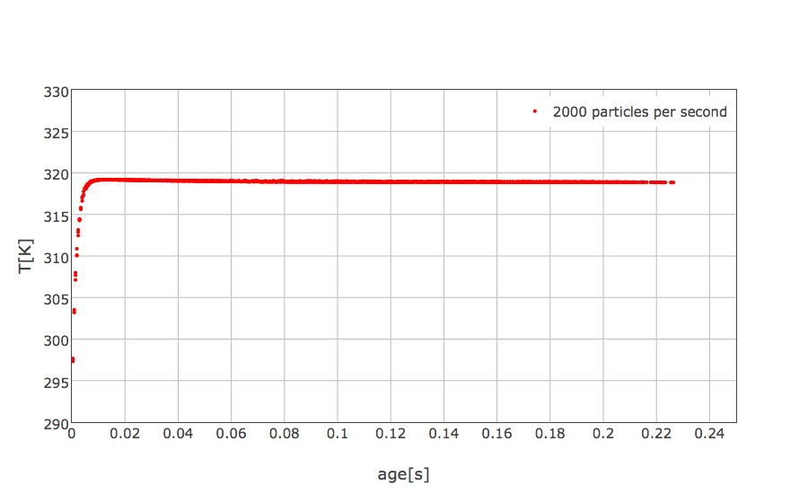
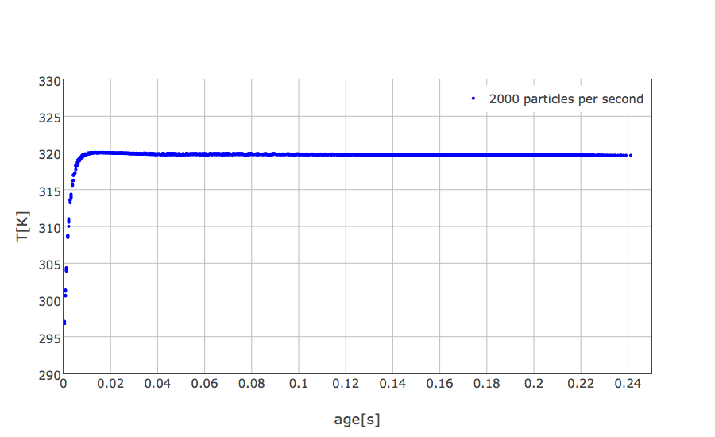
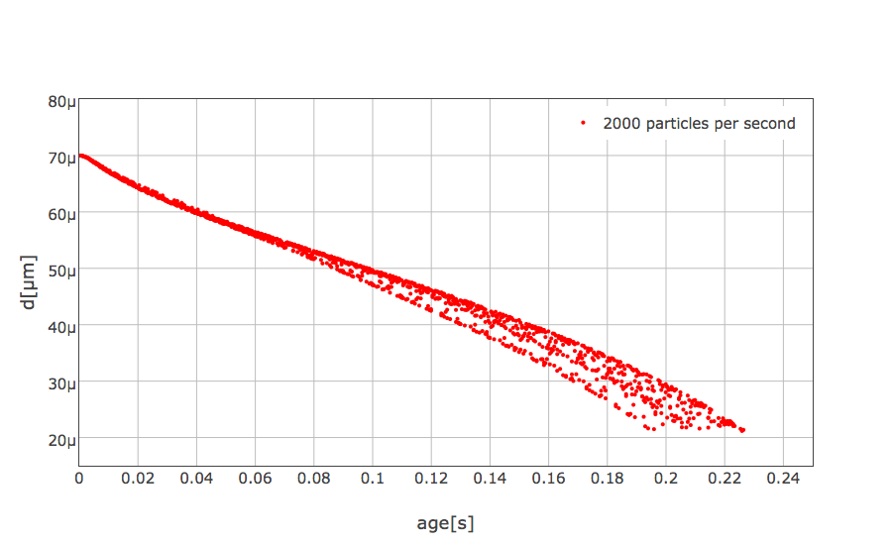
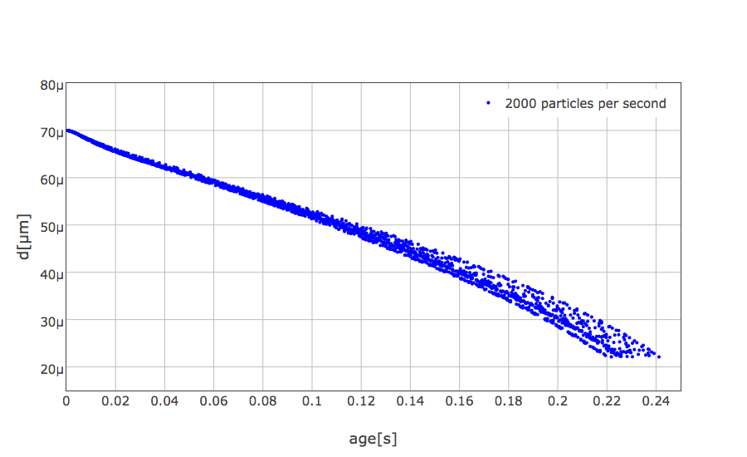
buoyantKinematicParcelFoam c=0,3%
reactingParcelFoam

Slide 39
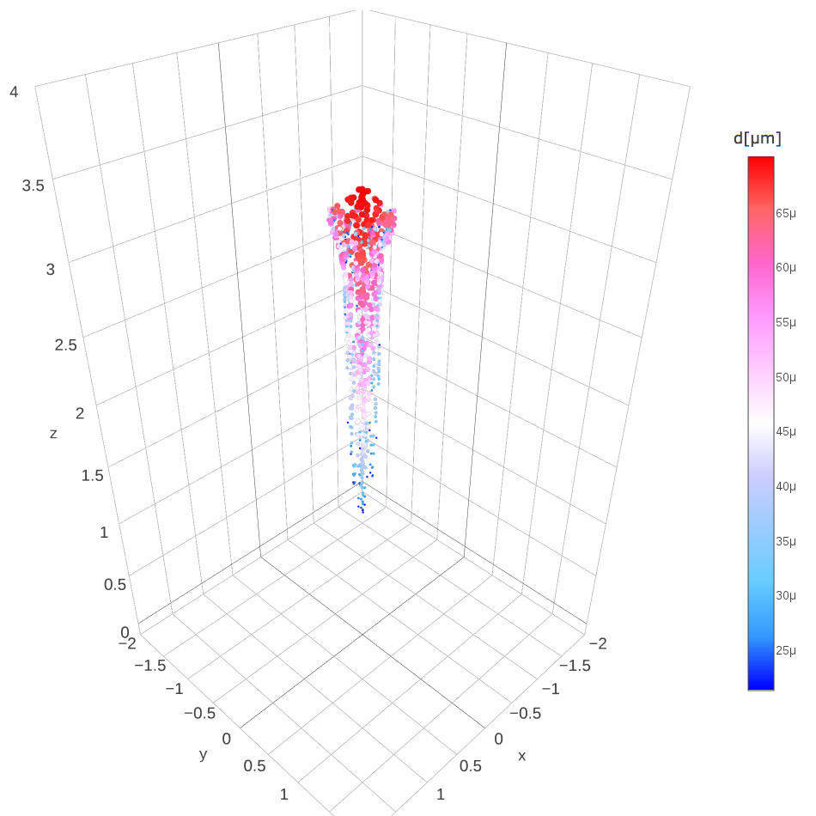
buoyantKinematicParcelFoam c=0.3%
reactingParcelFoam

Slide 40
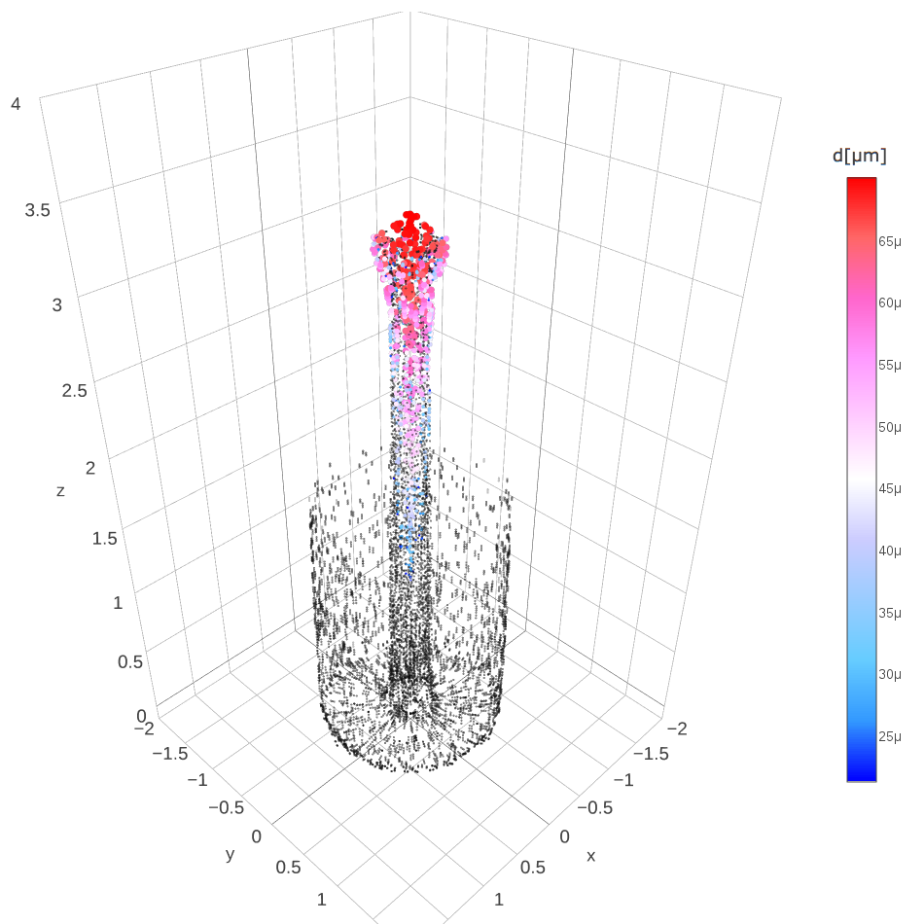
buoyantKinematicParcelFoam c=0.3%
reactingParcelFoam

Slide 41
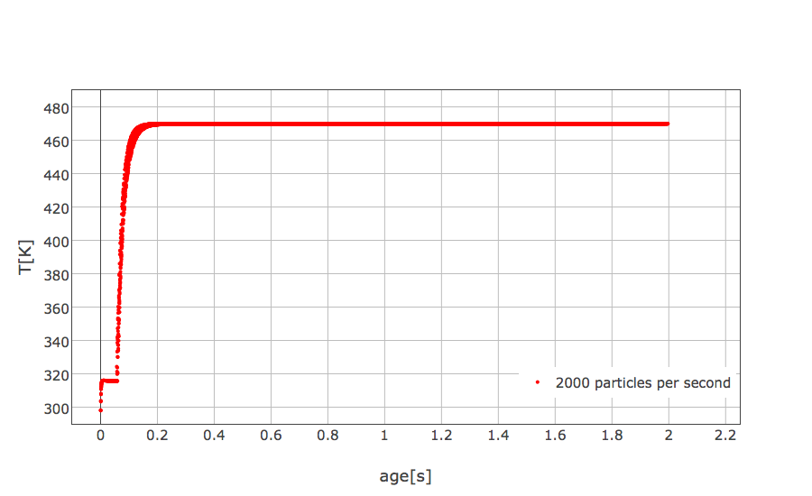
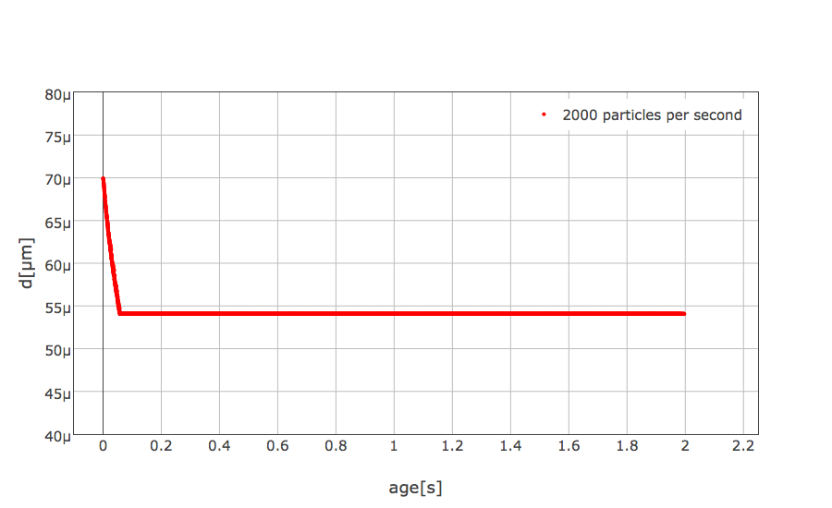
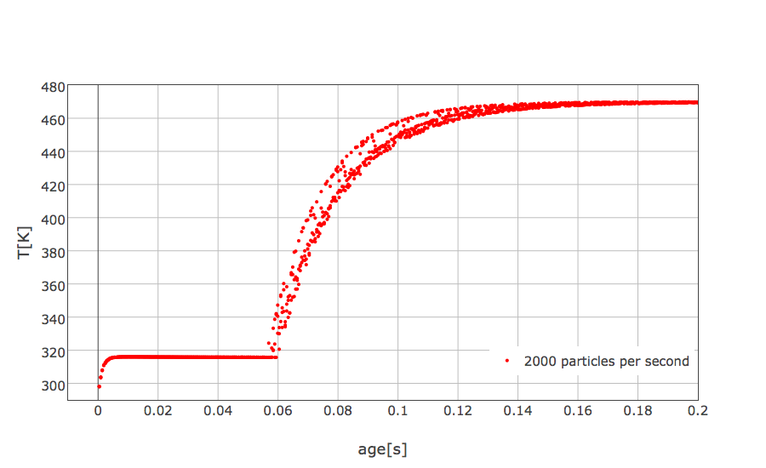
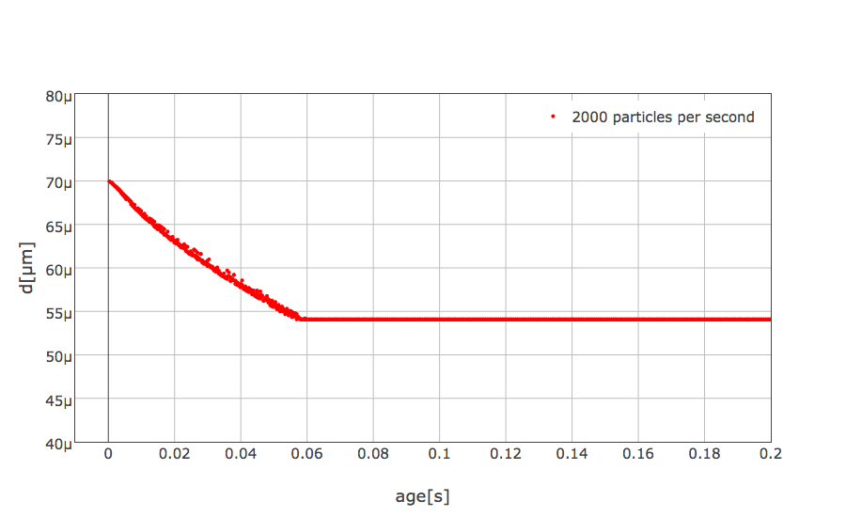
buoyantKinematicParcelFoam c=30%

Slide 42
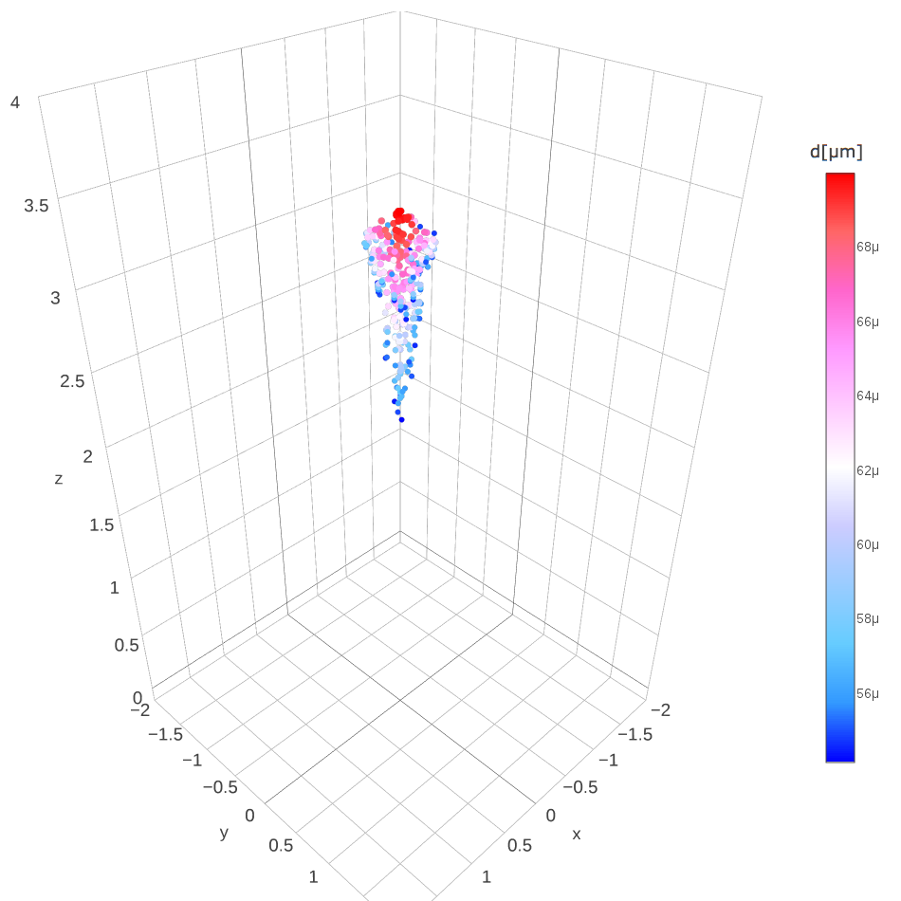
buoyantKinematicParcelFoam c=30%

Slide 43
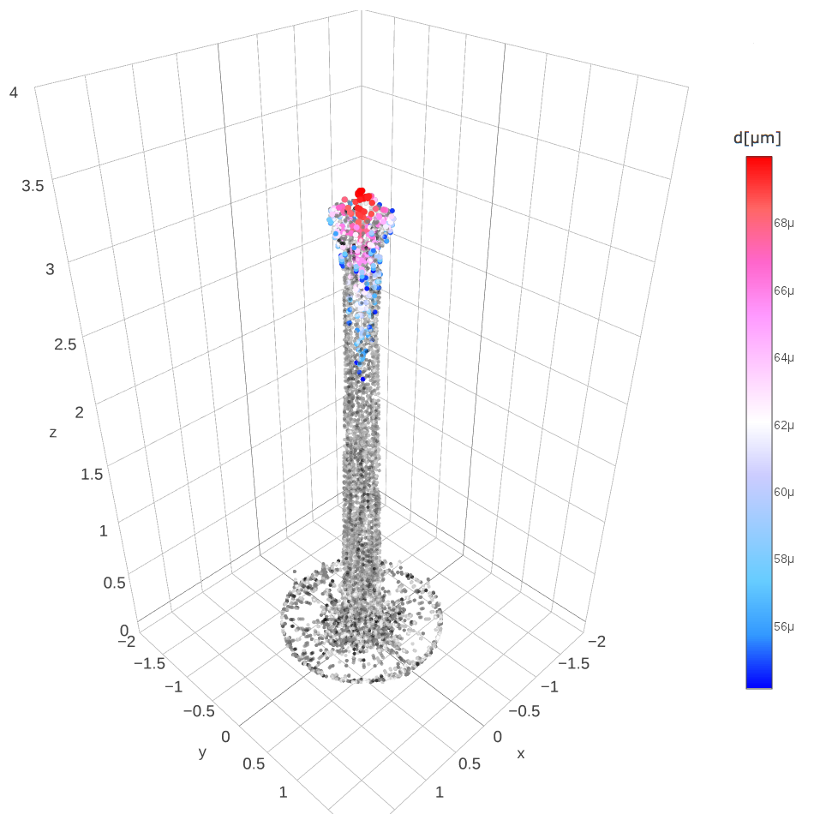
buoyantKinematicParcelFoam c=30%

Slide 44
Conclusions
The two stage drying model has been studied and implemented in a simplified environment showing good agreement with experimental data especially for the first drying stage.
Then the model has been integrated in OpenFOAM resulting in the new application buoyantKinematicParcelFoam.

Slide 45
Future developments
The OpenFOAM implementation should be improved in order to:
make the application more user friendly through the use of dictionaries for the droplets features.
Implementation in OpenFOAM of a more detailed second drying stage.
Tests using the geometry already presented by Stefano Pastorino.

