Slide 1
University of Genoa
Polytechnic School
Department of Civil, Chemical and Environmental Engineering
MASTER DEGREE IN CHEMICAL AND PROCESS ENGINEERING
BIODEGRADABLE ENGINEERED VASCULAR PROSTHESES: A VALIDATION COMPARATIVE STUDY IN BIOREACTOR
Supervisors:
Prof. Patrizia Perego
Prof. Jan Oscar Pralits
Dr. Pier Francesco Ferrari
Candidates:
Agnese Gamberini
Chiara Repetto
Co-supervisor:
Dr. Maria Bolla
28th October 2022
1
Academic year 2021-2022

Slide 2
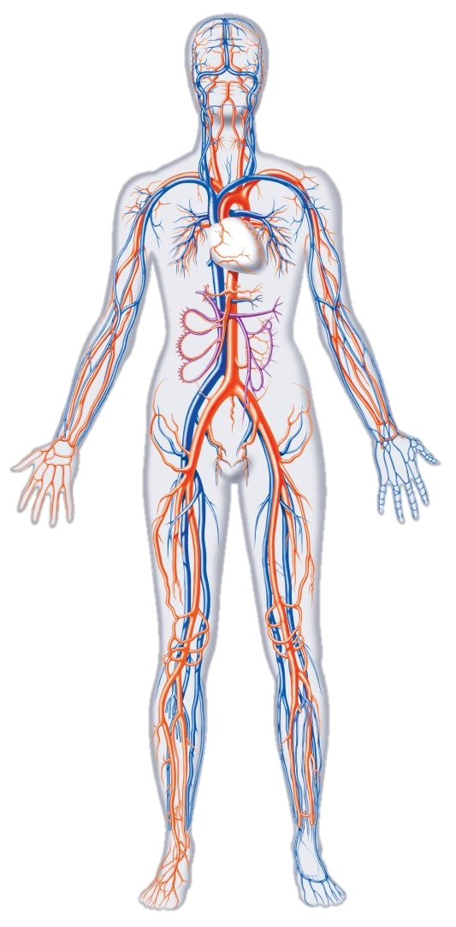
MASTER DEGREE IN CHEMICAL AND PROCESS ENGINEERING
Biodegradable engineered vascular prostheses: a validation comparative study in bioreactor
VASCULAR PATHOLOGIES
Cardiovascular diseases are the leading cause of death for both sexes
Peripheral arterial disease
Aneurysm
About 17.9 million people died because of CVDs (2019), representing 32% of all global deaths. Of these deaths, 85% were due to heart attack and stroke.
Thrombosis
28th October 2022
2
Agnese Gamberini, Chiara Repetto

Slide 3
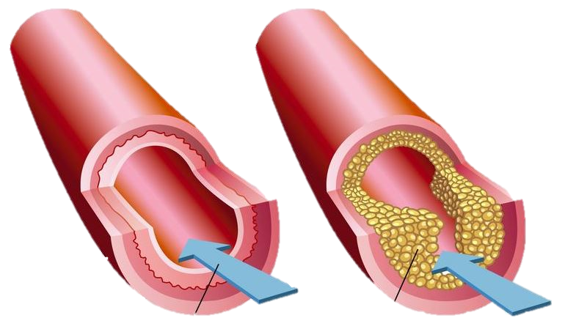
MASTER DEGREE IN CHEMICAL AND PROCESS ENGINEERING
Biodegradable engineered vascular prostheses: a validation comparative study in bioreactor
ATHEROSCLEROSIS
CATHETERIZATION
BALLOON ANGIOPLASTY
CLASSICAL STRATEGIES
It is a pathological condition characterized by alterations of the vessels that lose their elasticity due to the accumulation of calcium, cholesterol, inflammatory cells and fibrotic material
STRATEGIES
USE OF BYPASS
PROSTHESIS
Blood flow
Aterioschlerotic plaque
28th October 2022
3
Agnese Gamberini, Chiara Repetto

Slide 4
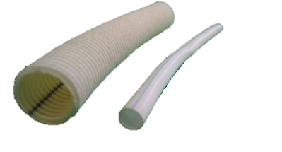
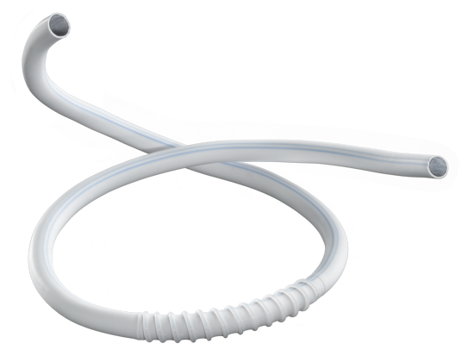
MASTER DEGREE IN CHEMICAL AND PROCESS ENGINEERING
Biodegradable engineered vascular prostheses: a validation comparative study in bioreactor
VASCULAR SUBSTITUTES
MEDIUM / LARGE CALIBER
SMALL CALIBER
Dint>6 mm
Dint<6 mm
Difficulties in design
Lack of vascularization
and thrombogenic risk
Aorta and its ramification
Blood vessels of the lower and upper limbs
Dacron (PET)
Teflon (ePTFE)
MATERIALS
INNOVATIVE APPROACH
Polyurethanes
PCL+PGS (mixture)
28th October 2022
4
Agnese Gamberini, Chiara Repetto

Slide 5
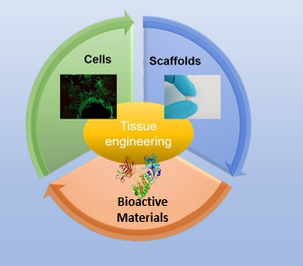
MASTER DEGREE IN CHEMICAL AND PROCESS ENGINEERING
Biodegradable engineered vascular prostheses: a validation comparative study in bioreactor
VASCULAR TISSUE ENGINEERING
Engineered prostheses with bioactive compounds that can overcome the problems that common vascular scaffolds show in vivo.
The current challenge lies in producing prostheses on which
cells can grow, completely regenerating the new vessel
28th October 2022
5
Agnese Gamberini, Chiara Repetto

Slide 6
MASTER DEGREE IN CHEMICAL AND PROCESS ENGINEERING
Biodegradable engineered vascular prostheses: a validation comparative study in bioreactor
OBJECTIVE
STEP 1
STEP 2
The main objective of this work is to fabricate an engineered vascular prosthesis
Study the behavior of the vascular electrospun prostheses and approach in conditions similar to physiological and pathological ones
REQUIREMENTS
Biological | Mechanical | Additional
Biocompatible | High flexibility | Small caliber
Biodegradable | Porosity | Functionalized with bioactive compounds
Inert, non-toxic | Suturable | Approved materials (FDA)
Home-made bioreactor
High-performance bioreactor
28th October 2022
6
Agnese Gamberini, Chiara Repetto

Slide 7
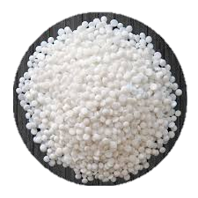
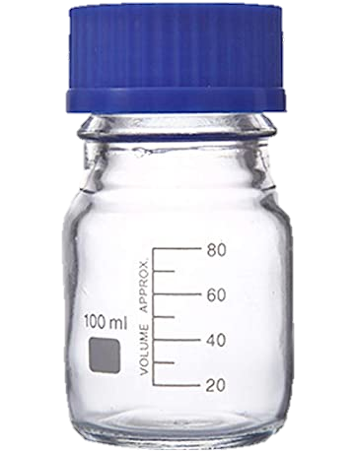
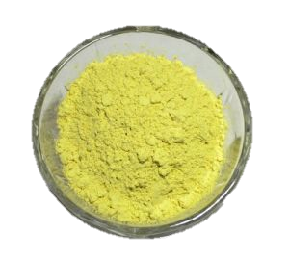
MASTER DEGREE IN CHEMICAL AND PROCESS ENGINEERING
Biodegradable engineered vascular prostheses: a validation comparative study in bioreactor
MATERIALS AND METHODS
PREPARATION OF POLYMER SOLUTION
20% (m/v)
20% (m/v)
Poly(caprolactone)
1:1
Poly(glycerol sebacate)
PCL
PGS
QUERCETIN+ETHANOL
0.05% (m/v)
CHLOROFORM:ETHANOL
ratio 9:1 (v/v)
28th October 2022
7
Agnese Gamberini, Chiara Repetto

Slide 8
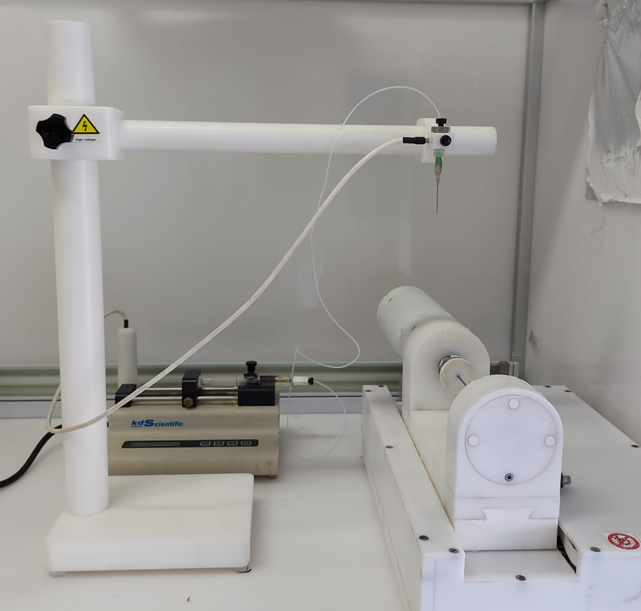
MASTER DEGREE IN CHEMICAL AND PROCESS ENGINEERING
Biodegradable engineered vascular prostheses: a validation comparative study in bioreactor
MATERIALS AND METHODS
ELECTROSPINNING
Polymeric solution passes through a capillary, in an electric field and electrospun on a rotating collector which has a diameter of
2 mm or 5 mm
PARAMETER | DIAMETER (2 mm) | DIAMETER (5 mm)
V (volume) | 1.5 mL | 2 mL
R (rate) | 2.20 mL/h | 1.1 mL/h
D (needle-collector distance) | 18 cm | 18 cm
V (voltage) | 17.0 kV | 17.0 kV
v_{r} (rotation speed) | 500 rpm | 500 rpm
v_{t} (translation speed) | 600 mm/min | 600 mm/min
t (time) | 40 min | 1.50 h
28th October 2022
8
Agnese Gamberini, Chiara Repetto

Slide 9
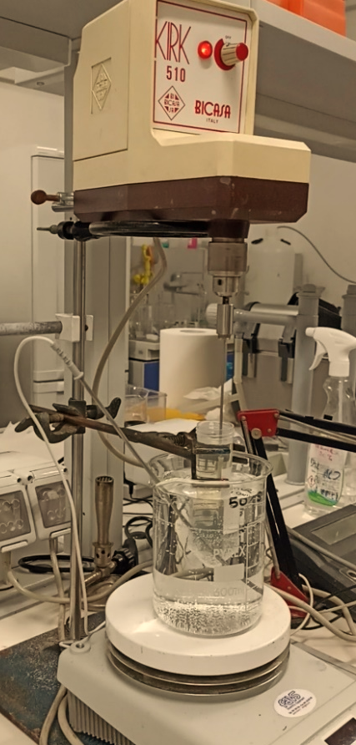
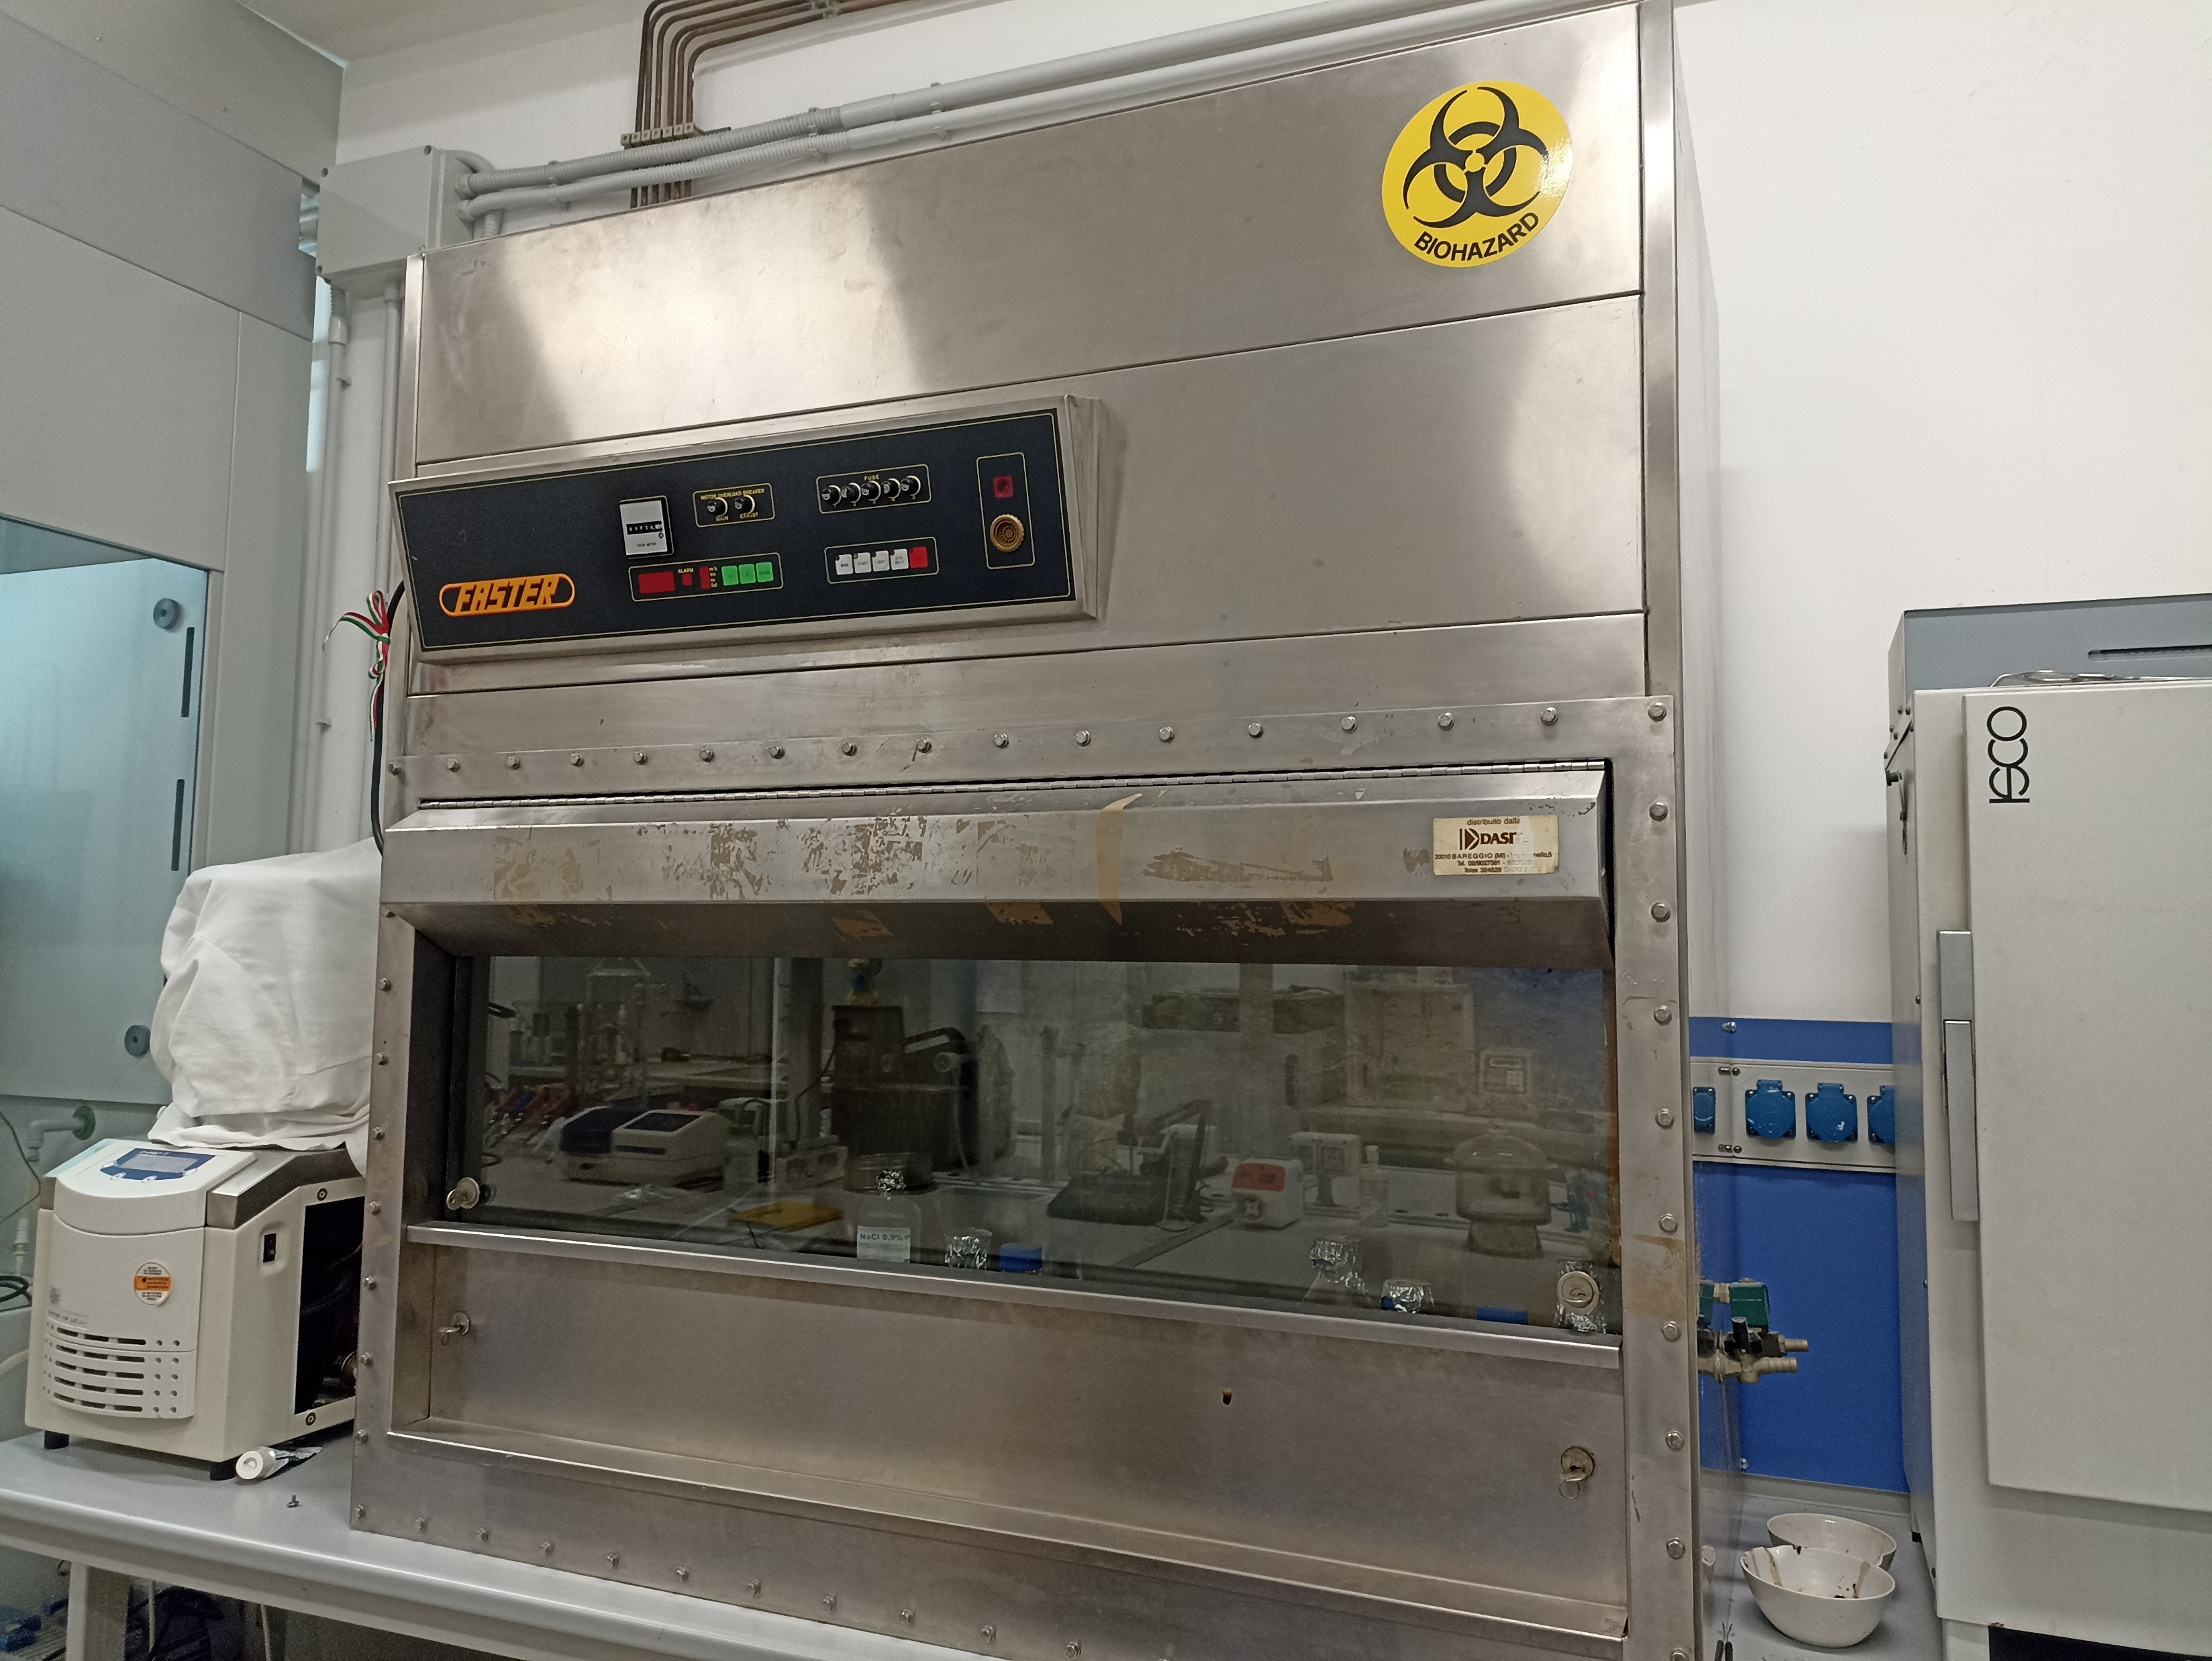
MASTER DEGREE IN CHEMICAL AND PROCESS ENGINEERING
Biodegradable engineered vascular prostheses: a validation comparative study in bioreactor
MATERIALS AND METHODS
To reduce the porosity and permeability of the construct, preventing possible blood leakage
GELATIN COATING
T = 37°C
t = 1h
Mechanical stirrer
V = 135 rpm
Collector
Gelatin
Becker with water
Prosthesis
Heating and magnetic stirrer
- Sterilization under UV rays
- t = 1h
28th October 2022
9
Agnese Gamberini, Chiara Repetto

Slide 10
MASTER DEGREE IN CHEMICAL AND PROCESS ENGINEERING
Biodegradable engineered vascular prostheses: a validation comparative study in bioreactor
MATERIALS AND METHODS
BURST PRESSURE TEST
To understand the maximum working pressure that the prosthesis can tolerate
SAMPLE | PRESSURE (mmHg) | PERMEABILITY (%)
PCL:PGS 1:1 | 150 | 100
PCL:PGS 1:1 + G + Q | 150 | 0
 | 225 | 100
Prostheses were connected to a pump working with water that increases water pressure since it achieves a maximum pressure value
28th October 2022
10
Agnese Gamberini, Chiara Repetto

Slide 11
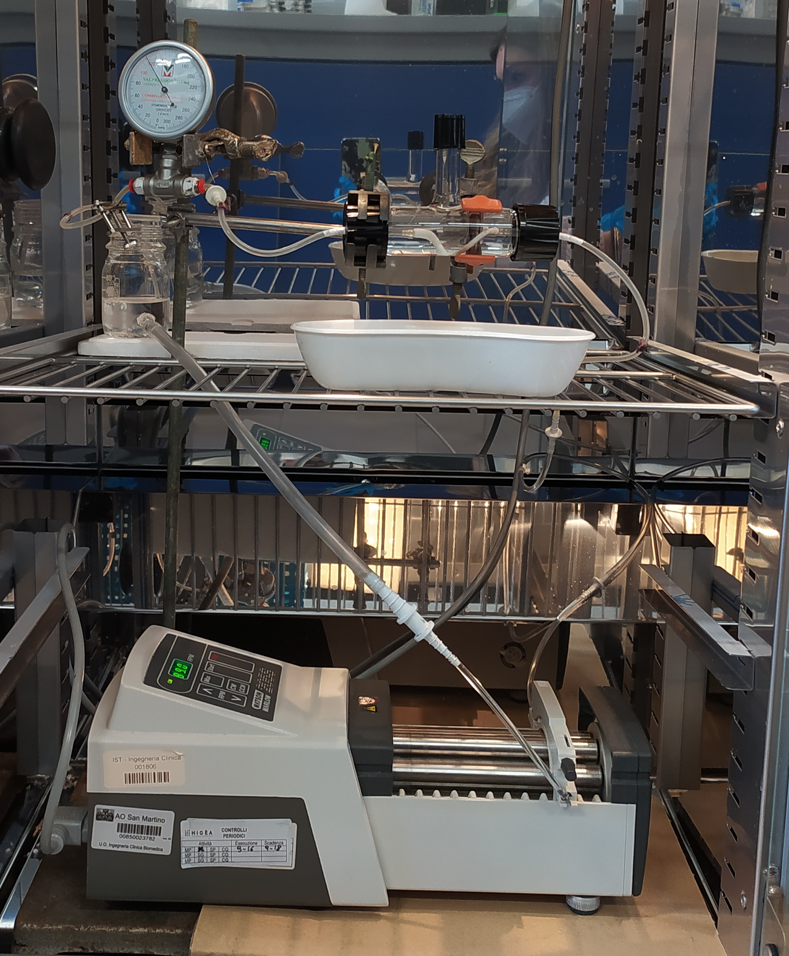
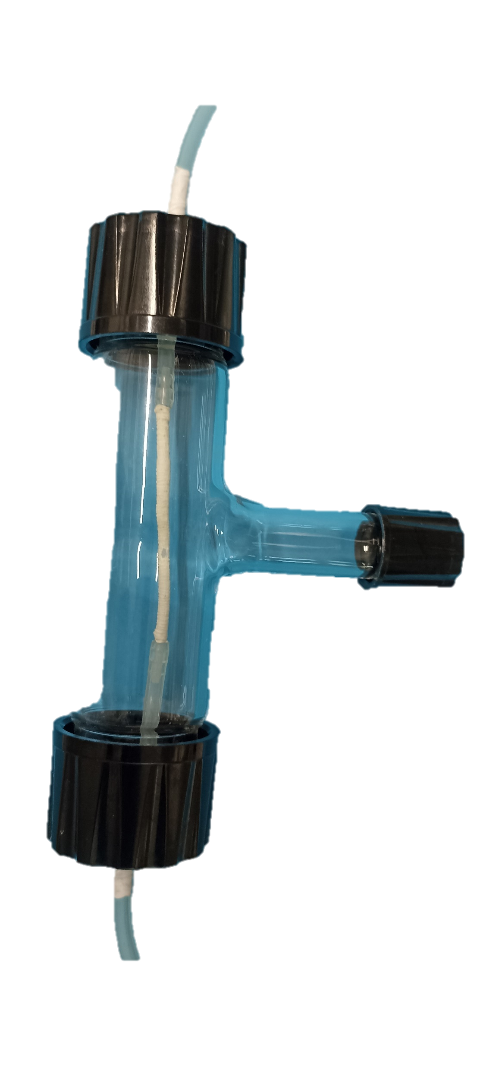
MASTER DEGREE IN CHEMICAL AND PROCESS ENGINEERING
Biodegradable engineered vascular prostheses: a validation comparative study in bioreactor
MATERIALS AND METHODS
HOMEMADE BIOREACTOR
80 mmHg
80-120 mmHg
Samples were collected to determine the release of gelatin and quercetine
120 mmHg
Pressure gauge
T = 37°C
Reservoir
Chamber containing the prosthesis
Flow rate was constant
Phosphate Buffered Saline
Peristaltic pump
28th October 2022
11
Agnese Gamberini, Chiara Repetto

Slide 12
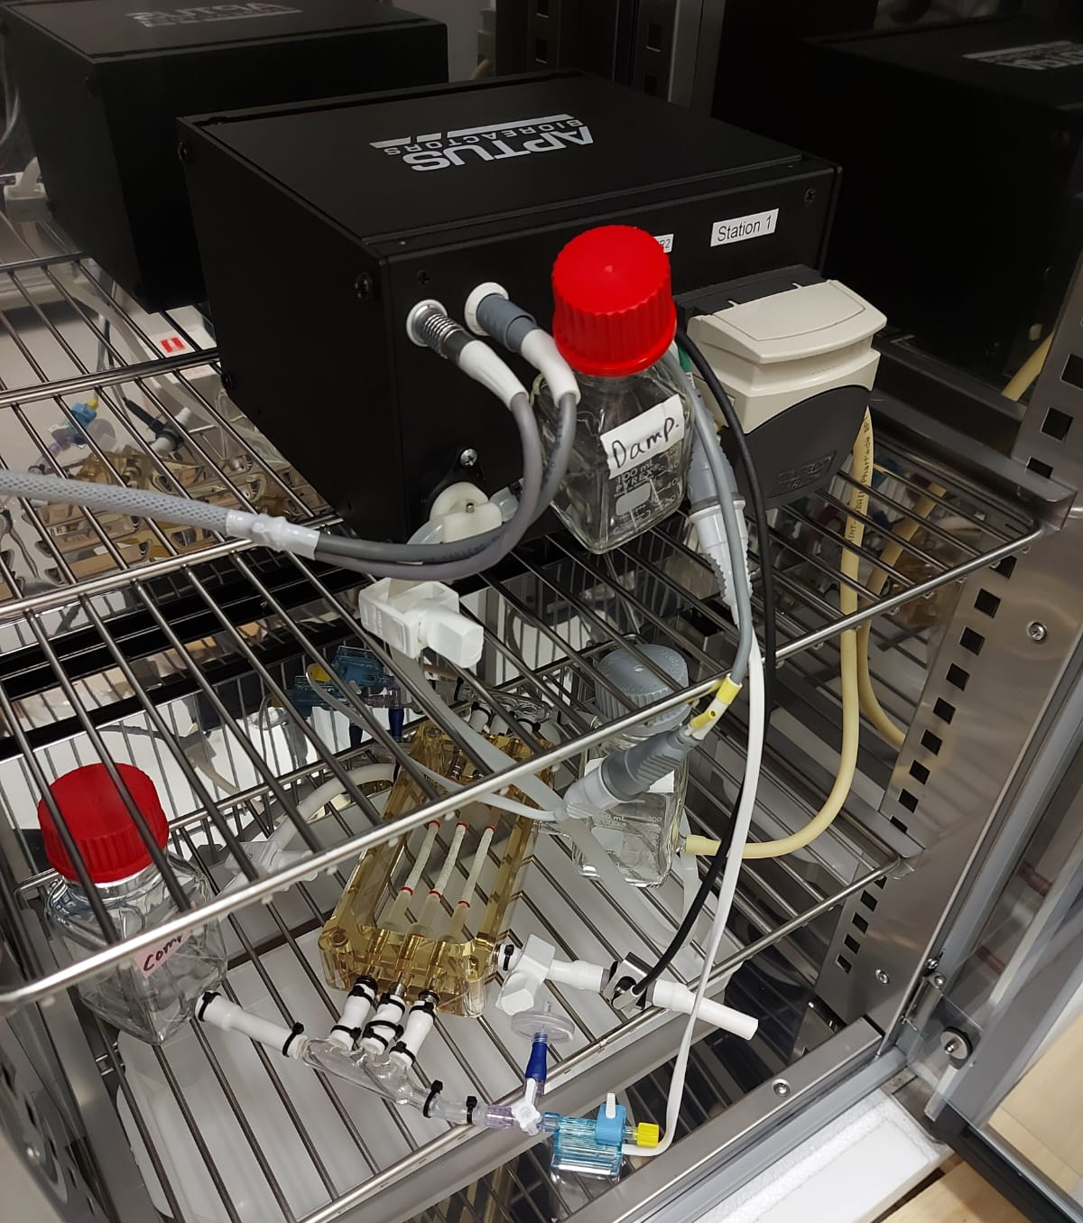
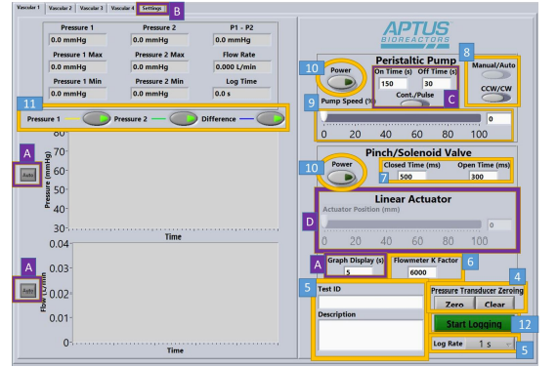
MASTER DEGREE IN CHEMICAL AND PROCESS ENGINEERING
Biodegradable engineered vascular prostheses: a validation comparative study in bioreactor
MATERIALS AND METHODS
HIGH-PERFORMANCE BIOREACTOR
Samples were collected to determine the release of gelatin and quercetine
80-120 mmHg
T = 37°C
Flow rate was constant
Phosphate Buffered Saline
Peristaltic
pump
Damper
Reservoir
Chamber containing
the prostheses
Compliance chamber
28th October 2022
12
Agnese Gamberini, Chiara Repetto

Slide 13
MASTER DEGREE IN CHEMICAL AND PROCESS ENGINEERING
Biodegradable engineered vascular prostheses: a validation comparative study in bioreactor
28th October 2022
13
Agnese Gamberini, Chiara Repetto

Slide 14
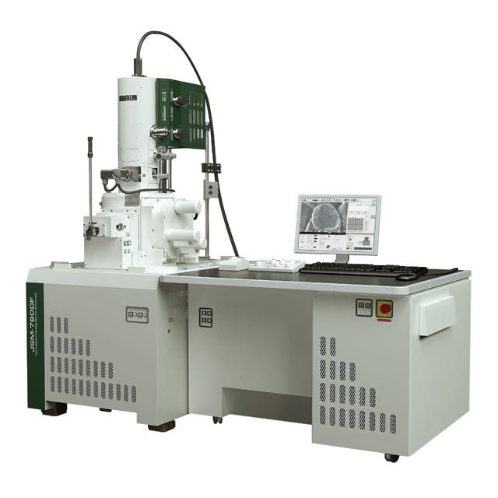
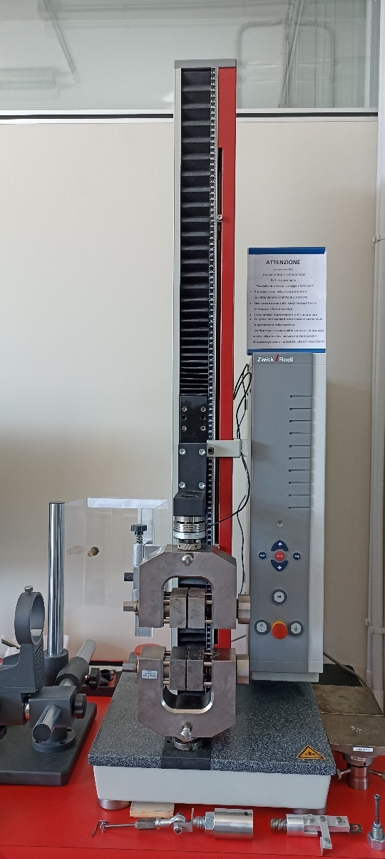
MASTER DEGREE IN CHEMICAL AND PROCESS ENGINEERING
Biodegradable engineered vascular prostheses: a validation comparative study in bioreactor
MATERIALS AND METHODS
MORPHOLOGY
MECHANICAL ANALYSIS
Allows vertical elongation of the prosthesis until failure in the uniaxial direction
Scanning electron microscopy (SEM) analysis
Dimensional analysis of the fibers through the ImageJ software
28th October 2022
14
Agnese Gamberini, Chiara Repetto

Slide 15
MASTER DEGREE IN CHEMICAL AND PROCESS ENGINEERING
Biodegradable engineered vascular prostheses: a validation comparative study in bioreactor
MATERIALS AND METHODS
RELEASE OF GELATIN
RELEASE OF QUERCETIN
Bicinchoninic acid assay (BCA)
Spectrophotometric analysis
Abs (λ) = 562 nm
Spectrophotometric analysis Abs (λ) = 370 nm
28th October 2022
15
Agnese Gamberini, Chiara Repetto

Slide 16
MASTER DEGREE IN CHEMICAL AND PROCESS ENGINEERING
Biodegradable engineered vascular prostheses: a validation comparative study in bioreactor
MATERIALS AND METHODS
$Re=\frac{ ρUD}{μ}$ < 2000
Flow is laminar
STEADY STATE
$$\frac{∂}{∂t}=0$$
Hp of Newtonian fluid
Constant pressure gradient
$$τ_{w}=−μ\frac{4U}{R}$$
Poiseuille flow
28th October 2022
16
Agnese Gamberini, Chiara Repetto

Slide 17
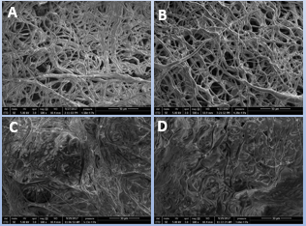
MASTER DEGREE IN CHEMICAL AND PROCESS ENGINEERING
Biodegradable engineered vascular prostheses: a validation comparative study in bioreactor
RESULTS AND DISCUSSION
Morphology
Mechanical analysis
PRESSURE | FIBER DIAMETER (µm)
80 mmHg | 4.589 ± 0.53
80-120 mmHg | 4.572 ± 0.91
120 mmHg | 4.524 ± 0.15
Control Sample (PCL:PGS) | 3.46 ± 0.48
PRESSURE (mmHg) | YOUNG’S MODULUS (MPa) | TENSILE STRENGTH (MPa) | ELONGATION (%)
80 mmHg | 2.11 ± 1.60 | 1.01 ± 0.29 | 87.55 ± 28.52
120 mmHg | 4.02 ± 0.32 | 1.22 ± 0.29 | 89.44 ± 16.52
80-120 mmHg | 2.86 ± 1.30 | 1.36 ± 0.39 | 91.88 ± 30.58
80-120 mmHg (HPB) | 4.66 ± 1.85 | 1.39 ± 0.92 | 50.54 ± 23.26
Human artery | 2.58 ± 0.34 | 1.13 ± 0.06 | 46.54 ± 11.31
Possible future in vivo applications
Similar values
Internal surface of the control sample
External surface of the control sample
Inner surface (PCL: PGS + gelatin+ quercetin),
External surface (PCL: PGS + gelatin + quercetin).
HPB: high performance bioreactor
28th October 2022
17
Agnese Gamberini, Chiara Repetto

Slide 18
MASTER DEGREE IN CHEMICAL AND PROCESS ENGINEERING
Biodegradable engineered vascular prostheses: a validation comparative study in bioreactor
RESULTS AND DISCUSSION
DEGRADATION
Pressure | Degradation (%) | Fluid uptake (%)
80 mmHg | 28.75 ± 3.18 | 285.45 ± 12.98
120 mmHg | 29.13 ± 4.41 | 279.58 ± 39.85
80-120 mmHg | 40.62 ± 26.11 | 228.68 ± 3.05
80-120 mmHg (HPB) | 33.76 ± 2.60 | 240.32 ± 20.16
Prosthesis | Degradation (%) | Fluid uptake (%)
PCL:PGS | 35.00 ± 3.70 | 164.40 ± 41.97
With quercetin | 32.51 ± 2.53 | 274.19 ± 27.61
$$τ_{w}=−μ\frac{4U}{R}$$
28th October 2022
18
Agnese Gamberini, Chiara Repetto

Slide 19
MASTER DEGREE IN CHEMICAL AND PROCESS ENGINEERING
Biodegradable engineered vascular prostheses: a validation comparative study in bioreactor
RESULTS AND DISCUSSION
RELEASE OF GELATIN
28th October 2022
19
Agnese Gamberini, Chiara Repetto

Slide 20
MASTER DEGREE IN CHEMICAL AND PROCESS ENGINEERING
Biodegradable engineered vascular prostheses: a validation comparative study in bioreactor
RESULTS AND DISCUSSION
RELEASE OF GELATIN
28th October 2022
20
Agnese Gamberini, Chiara Repetto

Slide 21
MASTER DEGREE IN CHEMICAL AND PROCESS ENGINEERING
Biodegradable engineered vascular prostheses: a validation comparative study in bioreactor
RESULTS AND DISCUSSION
RELEASE OF QUERCETIN
28th October 2022
21
Agnese Gamberini, Chiara Repetto

Slide 22
MASTER DEGREE IN CHEMICAL AND PROCESS ENGINEERING
Biodegradable engineered vascular prostheses: a validation comparative study in bioreactor
RESULTS AND DISCUSSION
RELEASE OF QUERCETIN
28th October 2022
22
Agnese Gamberini, Chiara Repetto

Slide 23
MASTER DEGREE IN CHEMICAL AND PROCESS ENGINEERING
Biodegradable engineered vascular prostheses: a validation comparative study in bioreactor
CONCLUSIONS and FUTURE PERSPECTIVES
In the future:
Dynamic conditions
Non-Newtonian fluid
In the presence of vessel cells in bioreactor
SEM → Micrometric fibers are randomly electrospun
Release of the biomolecule → Adequate to the objectives
Degradation and mechanical properties → Consistent with the behavior that the prostheses could have once implanted
But high-performance bioreactor:
Optimize the processes
Simpler process for the operators
Similar to be applied in vivo application
In both bioreactors, the results obtained have almost similar trends
28th October 2022
23
Agnese Gamberini, Chiara Repetto

Slide 24
MASTER DEGREE IN CHEMICAL AND PROCESS ENGINEERING
Biodegradable engineered vascular prostheses: a validation comparative study in bioreactor
THANKS FOR YOUR ATTENTION!
24
Agnese Gamberini, Chiara Repetto

