Slide 1


AERODYNAMIC OPTIMIZATION OF REAR AND FRONT FLAPS ON A CAR
University of Genova – Polytechnic School
Advanced fluid dynamics course
2015/2016
Student: Giannoni Alberto
Professor: Ing. Jan Pralits
Co-Professor: Ing. Matteo Colli

Slide 2
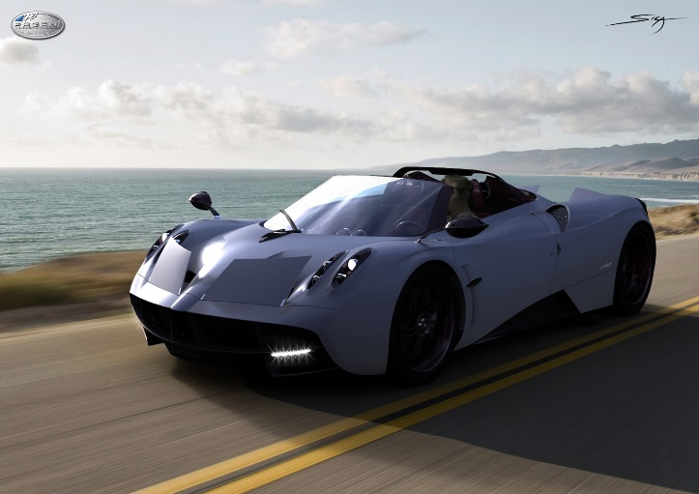
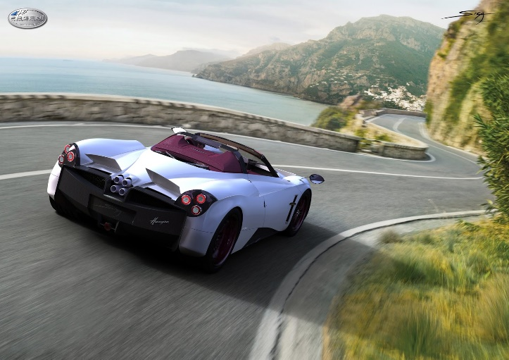
PRESENTATION OF THE WORK
Active and smart aerodynamic is becoming essential for sports cars.
Moving flaps at the rear and the front seemed to be the most efficient way to ensure stability and downforce without increasing drag too much.
In this project we would like to investigate performances of four flaps installed on a real-size car through the OpenSource CFD Software .

Slide 3
Development of the analysis
1. Geometry creation in a CAD program and modification of flap’s angles
2. Mesh generation and refinement for the whole cases
3. CFD simulation using OpenFoam software
4. Convergence study and post-processing
5. CL and CD evaluation
6. Looking for the optimal value of angles
Sequence of phases:

Slide 4
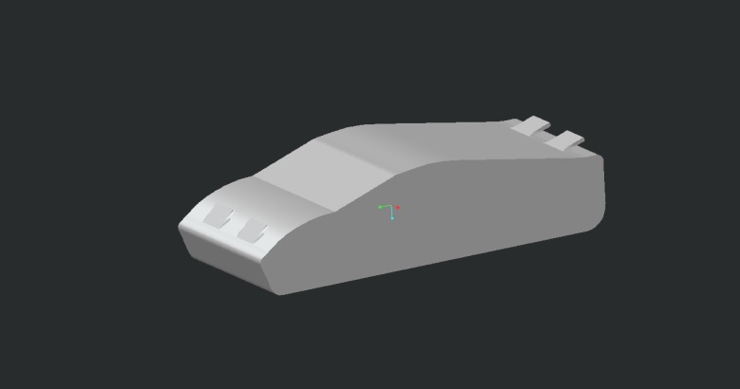

1) Geometries Creation
Geometry was implemented in ProE software respecting the actual dimensions of a sport car on market sale:
Length: | 4.81 m
Height: | 1.16 m
Width: | 2.03 m
Then six combination of incidence angles were created for the future optimization work:
FRONT ANGLE | REAR ANGLE
40 | 15
40 | 30
40 | 40
50 | 15
50 | 30
50 | 40
STL File

Slide 5
2) Mesh generation and refinement
Meshing is the most important part in CFD, necessary to solve N-S equations
OpenFoam comes with a powerful tool for that:
blockMesh for a background mesh
snappyHexMesh for the iterative refinement:
specific and better refinement in certain zone
such as wake region.
First step: cells that don’t lie into the region outside the car with at least 50% of volume are removed.
Second step: moving cell vertex points onto surface geometry to remove the jagged castellated surface from the mesh.
Third step: addition of a specified number of layers following the geometry

Slide 6
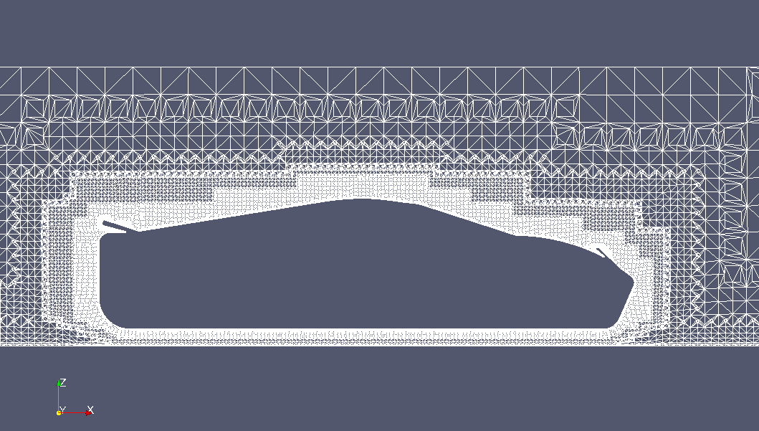
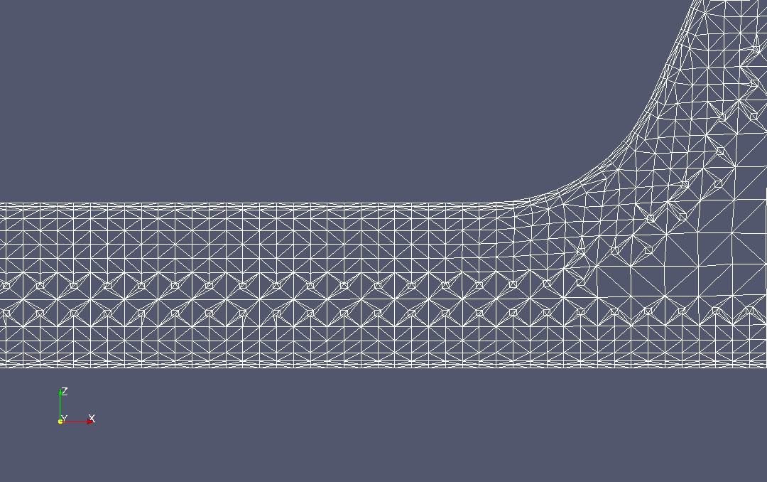
2) Mesh generation and refinement
4 layers nearby the ground
2 layers nearby the car
Additional refinement
with RefineWallLayer
3,9 million of cells

Slide 7
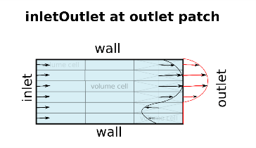
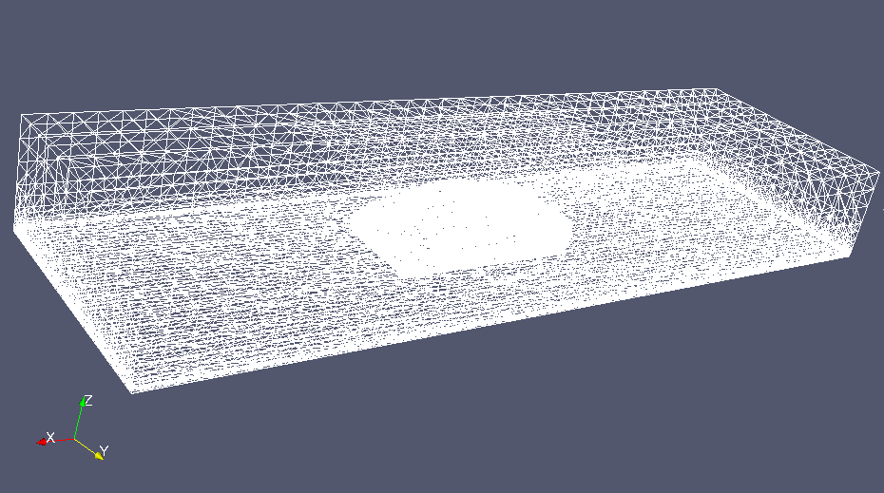
3) CFD Simulation in OpenFoam
OpenFoam solves N-S equation using turbulence models RANS equations
Extra terms modelling k-ω SST model
Solver SimpleFoam: incompressible, steady-state, turbulent flows.
Boundary Conditions
Pressure normal gradient equal to
zero for the Inlet and the Ground.
Front, back and top are slip condition,
Outlet has a fixed zero value.
Velocity normal component equal to
zero for front, back and the top of the domain.
Fixed value for the Inlet and the Ground.
Outlet is InletOutlet.
back
outlet
ground
V = 27.78 [m/s] (100km/h) | Re ≈ 7450000
L ≈ 4 [m]
ν = 1.5x10⁻⁵ [m²/s]
inlet
front

Slide 8
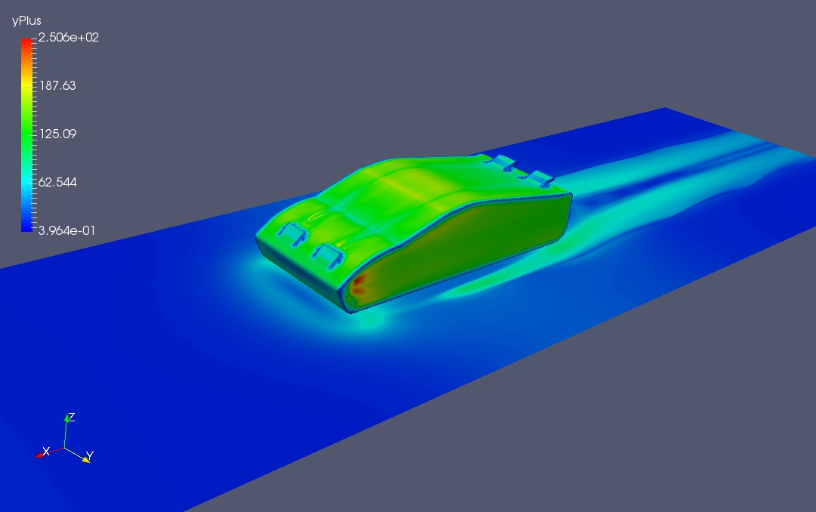
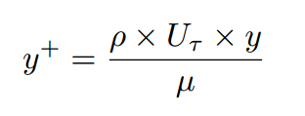
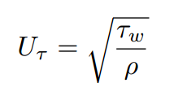
4) Post-Processing: Yplus
After the simulation has run the checking of some parameters is required to validate the solution, otherwise the grid or some values in solving methods (fvScheme/solution) should be changed.
A boundary layer optimization was carried out based on the y⁺ parameter. This is defined as wall distance units , using the following equation:
Where y is the distance to the first cell centre normal to the wall, and U_{τ} is the friction velocity and is equal to:
It is normally considered an acceptable value if less than 300.

Slide 9
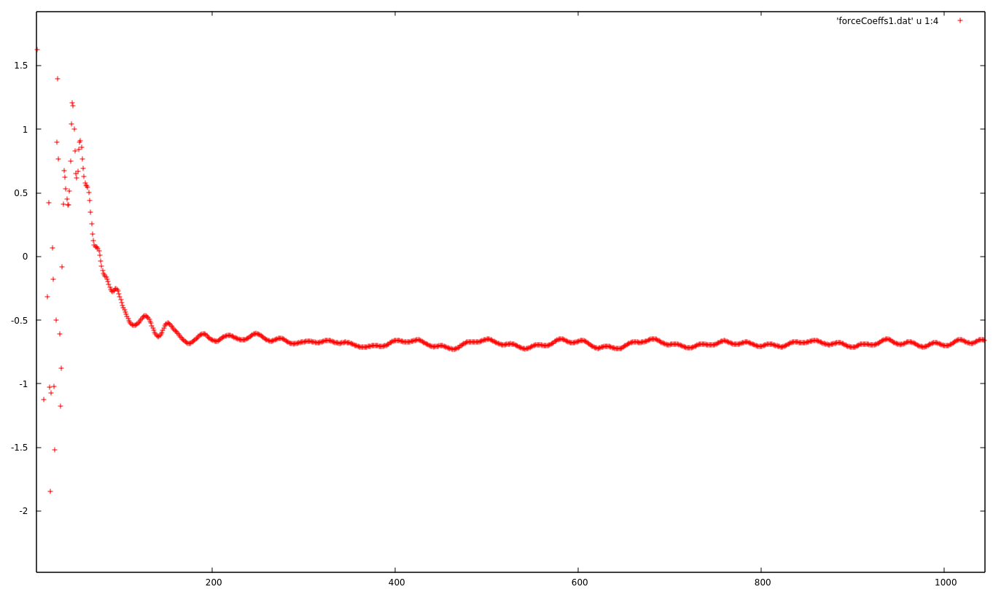
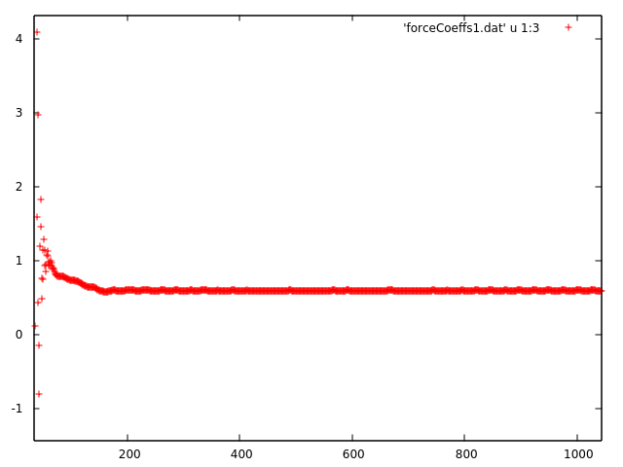
4) Post-Processing: CL and CD
CL and CD were processed for each geometry implementing the appropriate dictionary in system folder. Obvoiusly is necessary that those values tend to converge after the first iterations.
Using gnuplot it is possible to verify it:

Slide 10
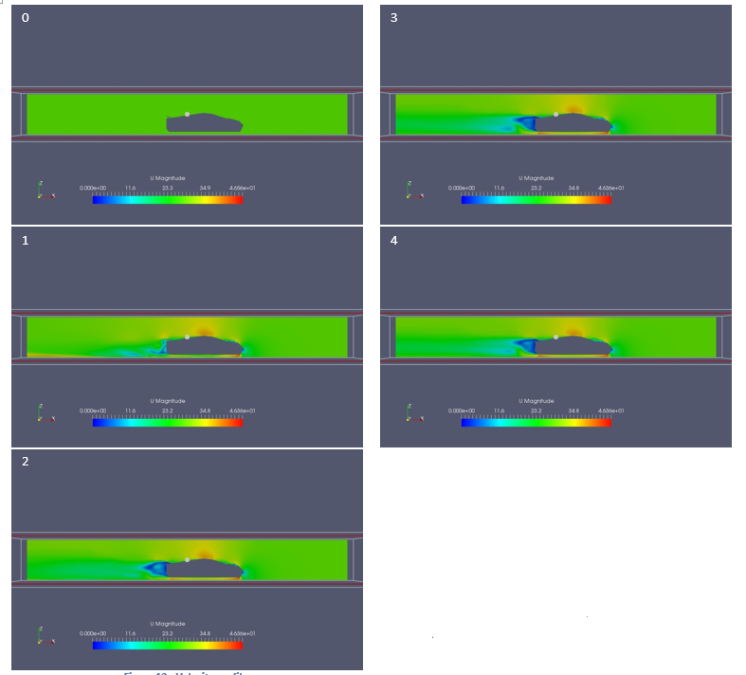
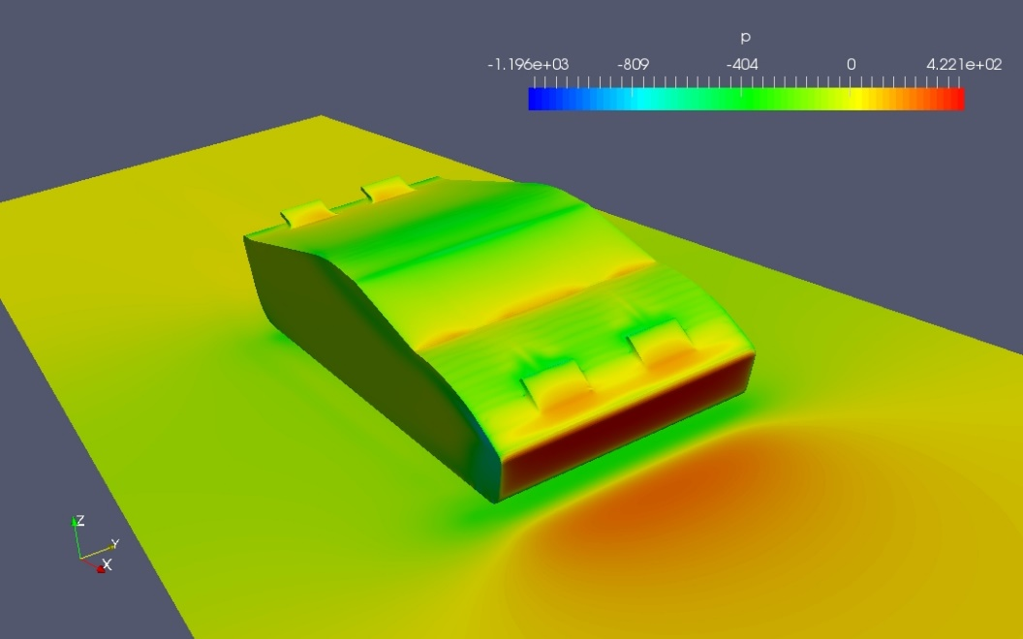
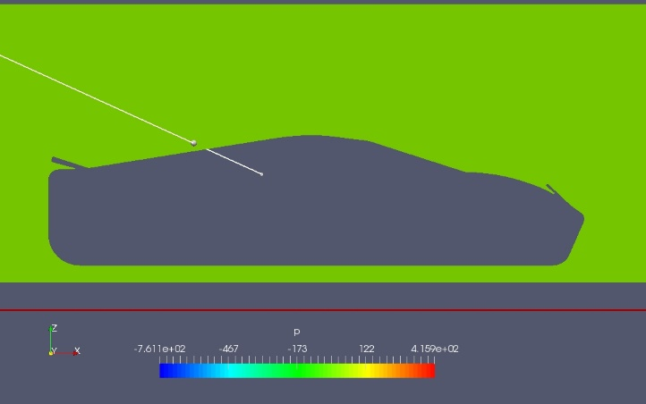
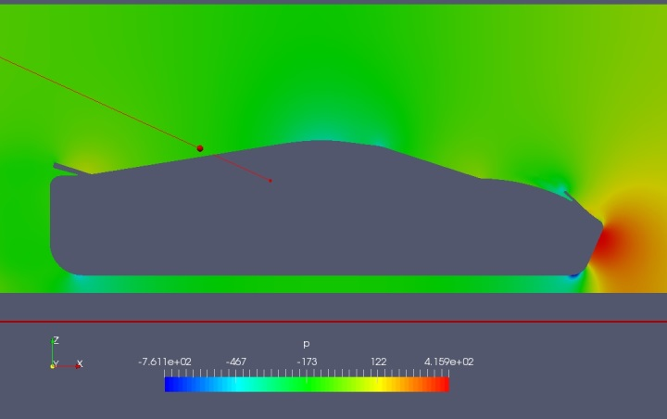
5) Results: first geometry
High velocity region underneath the car due to the section restriction.
C_{L} | C_{D}
-0.67 | 0.59
Wake development at several iterations

Slide 11
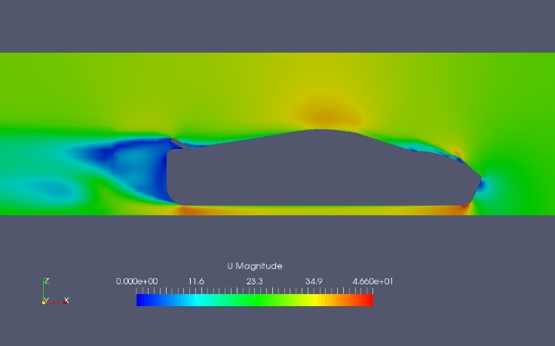
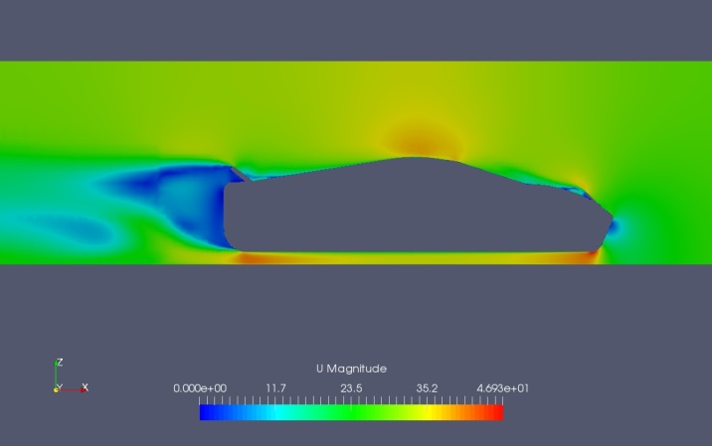
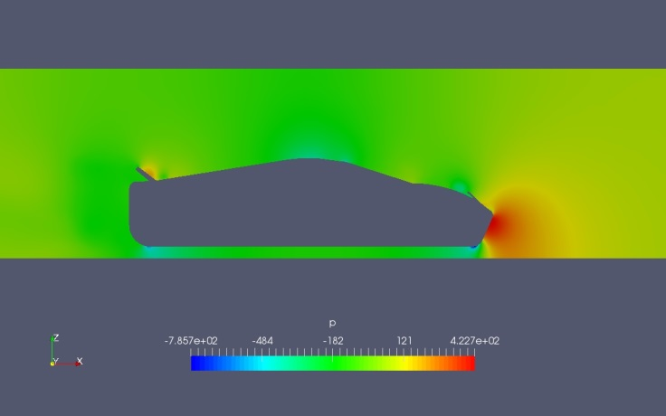

5) Results: other geometries
40°-30° degrees
40°-40° degrees
C_{L} | C_{D}
-0.81 | 0.63
C_{L} | C_{D}
-0.93 | 0.67

Slide 12
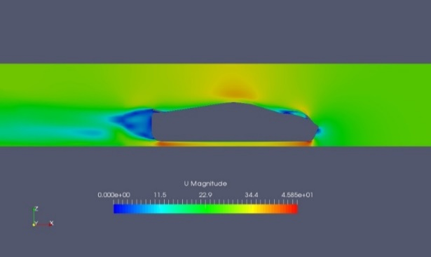
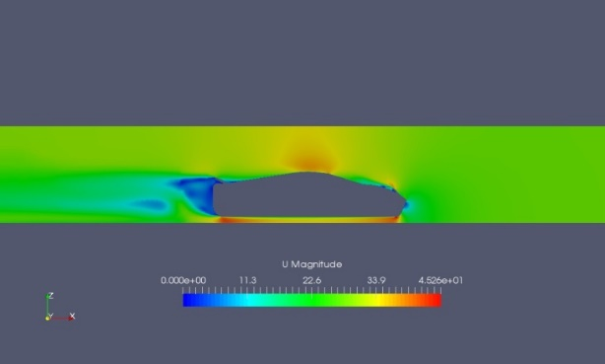
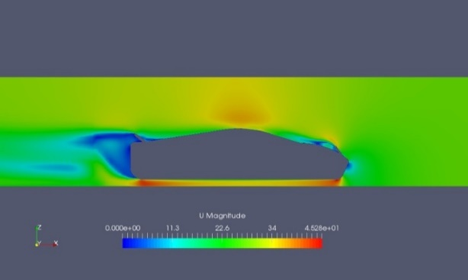
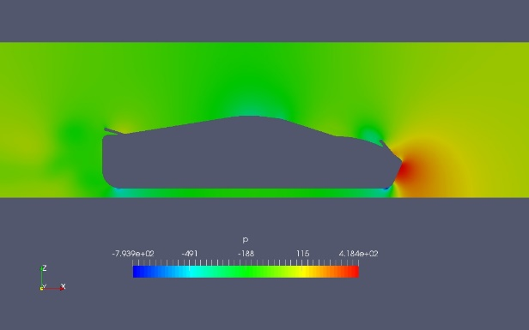
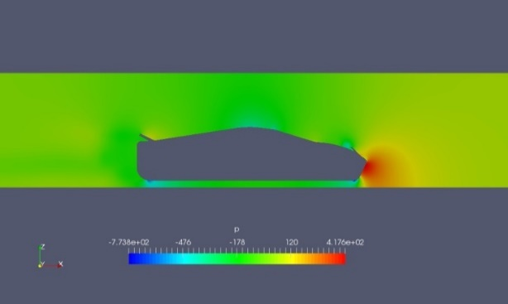
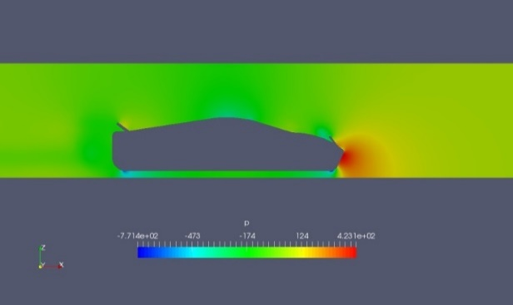
5) Results: other geometries
50°-15° degrees
50°-30° degrees
50°-40° degrees
C_{L} | C_{D}
-0.81 | 0.61
C_{L} | C_{D}
-1.06 | 0.659
C_{L} | C_{D}
-1.1 | 0.68

Slide 13
6) Performance optimization
Purpose of the project:
Evaluate aerodynamic coefficients for a car with four flaps varying their angles among discrete values.
CL with zero inclination for all of the flaps is already negative.
Decide a combination of angles that maximize CL without introducing too many losses.

Slide 14
7) Future developments
This was a simplified analysis of the problem as an initial case study: a more complicated one could be carried out certainly with:
a more detailed geometry and a more refined mesh,
velocity of the car should be increased till 200 or 300 km/h,
non-aligned inlet flow should be investigate to simulate cornering that is the main situation in which stability must be provided by the flaps.
THANKS FOR YOUR ATTENTION

