Slide 1
FOILING MOTH CENTERBOAD ON OpenFOAM
COURSE: ADVANCED FLUID DYNAMICS
PROFESSOR: JAN PRALITS
STUDENT: ALESSANDRO CHIAPPALONE

Slide 2
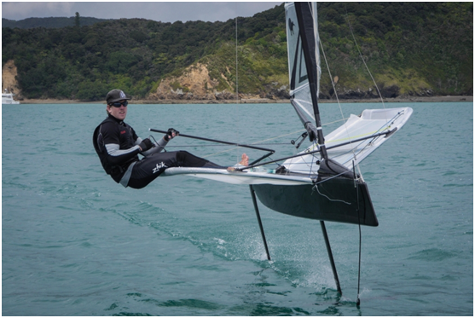
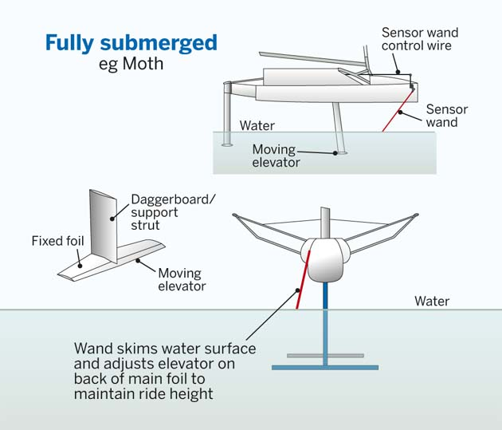
INTRODUCTION
WHAT IS A MOTH ?
FEATURES:
LIGHT
FAST
FUNNY
HOW CAN IT FLY?

Slide 3
SETTING THE PROBLEM
TARGETS:
Study of fluid dynamics around the centerboard with a flow of 5m/s
Determination of Cl and Cd for the centerboard in 5 different geometries
Determination of the minimun Cl for a total weight of 100 kg
FUNDAMENTALS PARAMETERS:
Variable | Mean | Unit | Value
c | Water Velocity | [m/s] | 5
L | Characteristic Length | [m] | 0,11
υ | Kinematic Viscosity | [m²/s] | 1.2 10⁻⁶
Re | / | / | 458332

Slide 4
NUMERICAL SOLVER
EQUATION TO SOLVE:
SOLVER CHOSED: SimpleFoam
Based on RANS analysis

Slide 5
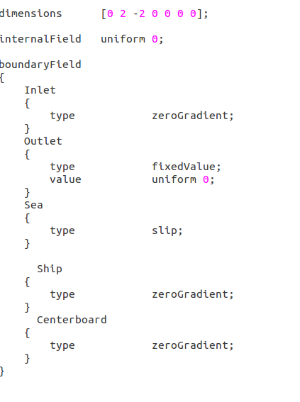
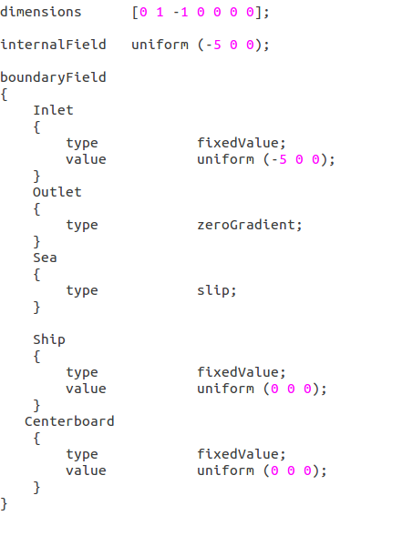
BOUNDARY CONDITIONS
PRESSURE
VELOCITY
The fluid domain is represented by a parallelepiped with an X side of 12 [m] an Y side of 2.4 [m] and a Z side of 2.5 [m]. X is the streamwise direction, Z axe is the lift direction (vertical).

Slide 6
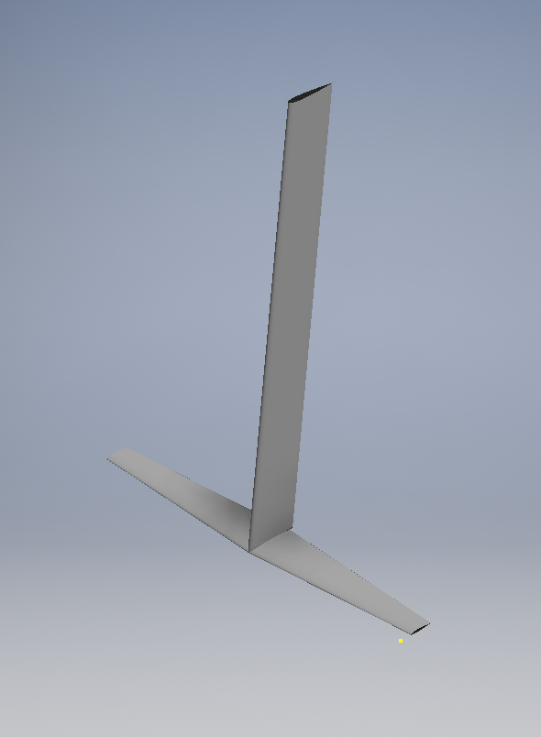
GEOMETRY
CREATED BY USING THE INVENTOR CAD SOFTWARE
BASED ON GARDA TOP 3 GEOMETRY
 | Section | Span [mm] | Chord[mm]
Centreboard | NACA 0012 | 1000 | 120
Centreboard Foil | NACA 63412 | 860 | 110

Slide 7
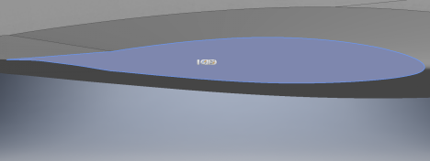
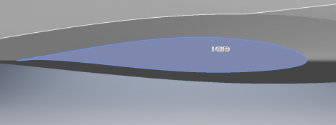
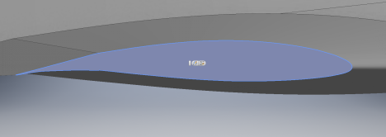
GEOMETRY
Trailing edge flap’s angle | CAD Model
-10°
-5°
0°
5°
10°
TO STUDY THE Cl VARIATION HAS BEEN USED 5 DIFFERENT GEOMETRIES

Slide 8
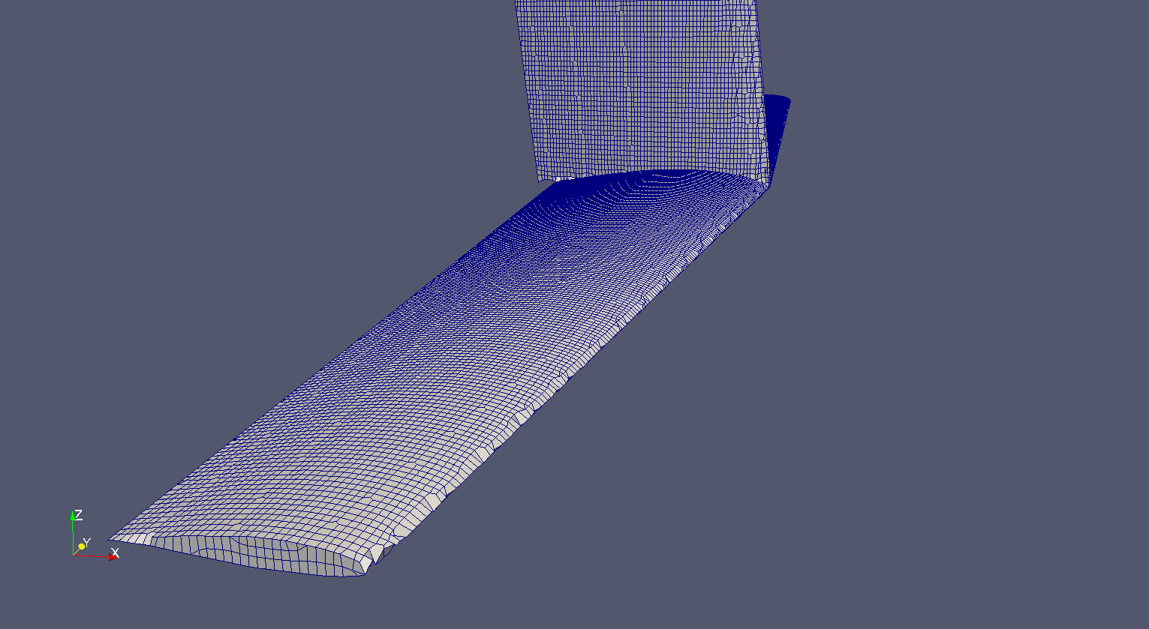
MESHING
:Mesh has been done in 4 steps:
BlockMesh command to make a mesh of the control volume
[54 8 8]
Research of the best compromise between refinement surfaces edges and the calculator’s power.

Slide 9
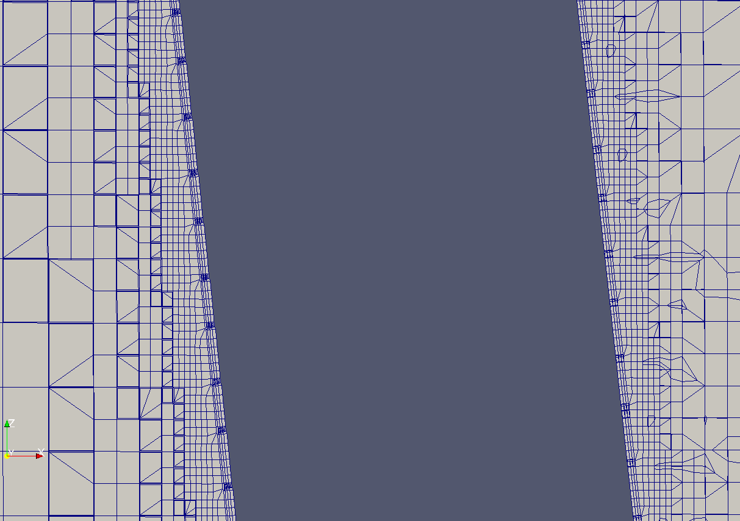
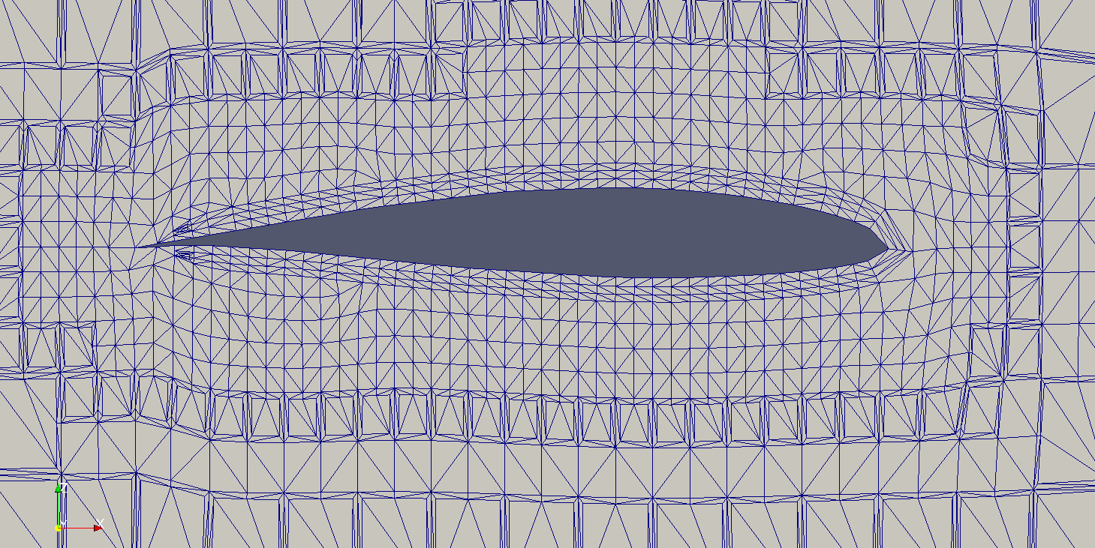
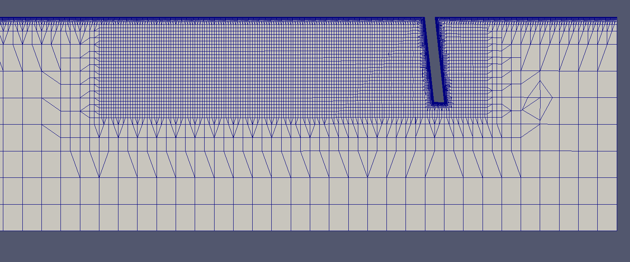
MESHING
USE The addLayer tool to refine the mesh close the surfaces
Increase the refinement beside the centerboard where there is turbulence.

Slide 10
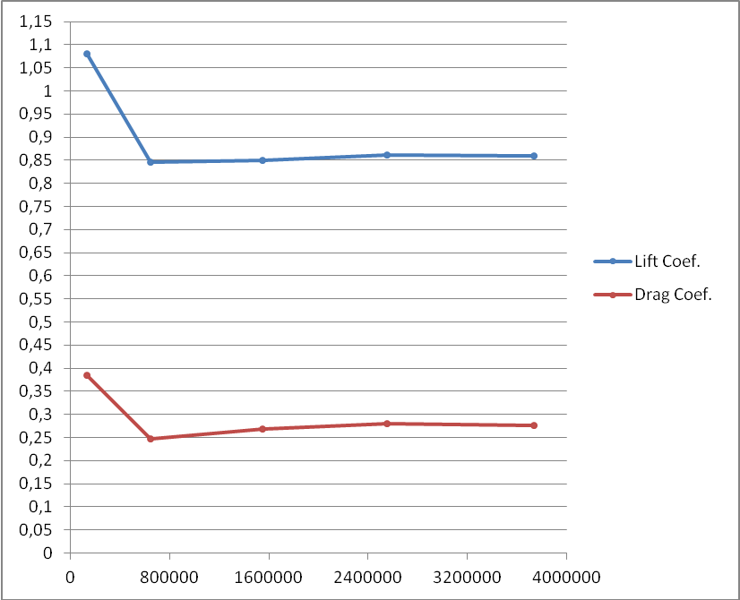
RESULTS
Numerical simulations always need a grid convergence study.
This study was done only on the geometry with 0° for trailing edge flaps but it’s applicable also on the other geometries.
Cell’s number | C_{L} | C_{D}
136000 | 1,0802 | 0,384936
643000 | 0,84637 | 0,248135
1550000 | 0,849123 | 0,269452
2550000 | 0,860901 | 0,279953
3740000 | 0,859068 | 0,276287

Slide 11
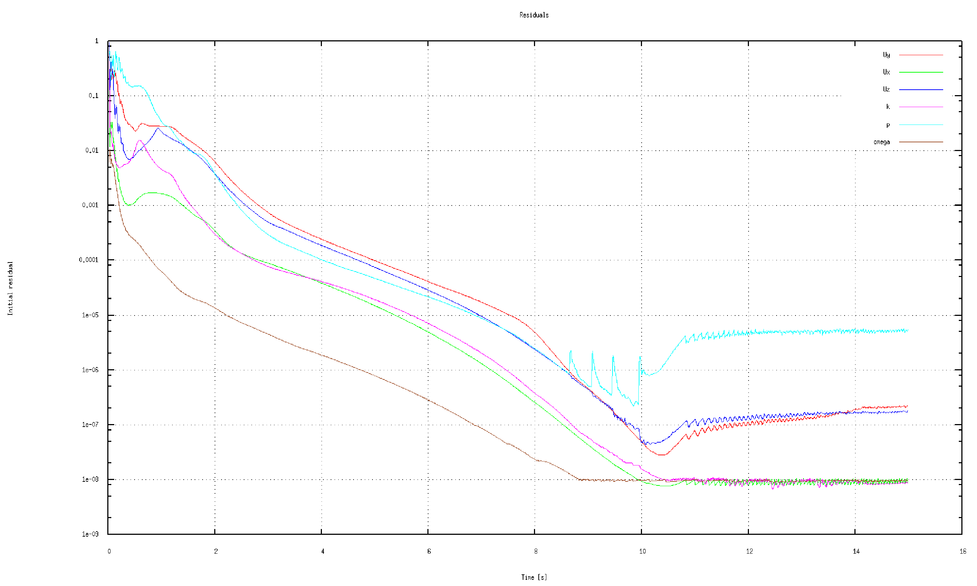
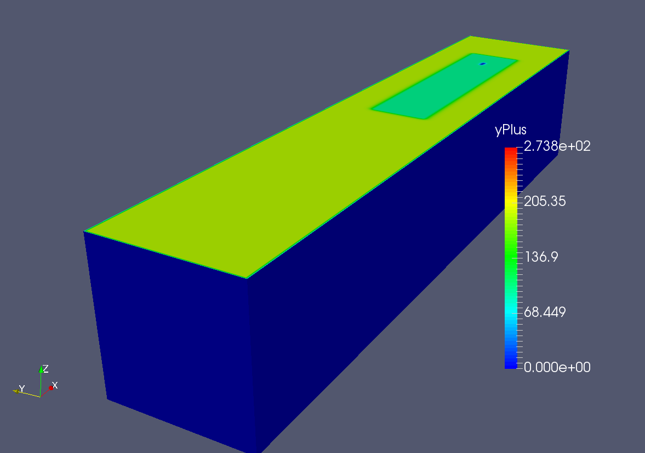
RESULTS
Some parameter are important for a good simulation
The yPlus: is a non dimensional quantity calculated close to wall. To have a good simulation this value must to be between 10 and 300.
Residuals and time-step continuity: Residuals have to be much lower as possible to obtain a good simulation. Generally the residuals should be lower than 10⁻⁴ – 10⁻⁵. To respect the mass conservation law it is essential that this value is lower as possible. Usually a number lower than 10 ⁻¹¹ – 10⁻¹² is acceptable.
How is possible to obatain this value?
Trailing edge flap’s angle | Centerboard’s yPlus max | Ship’s yPlus max
-10 | 295 | 186
-5 | 280 | 150
0 | 175 | 165
5 | 255 | 145
10 | 260 | 165
It is necessary to work on the mesh and in particular on the layers near the walls. (RefineWallLayer)

Slide 12
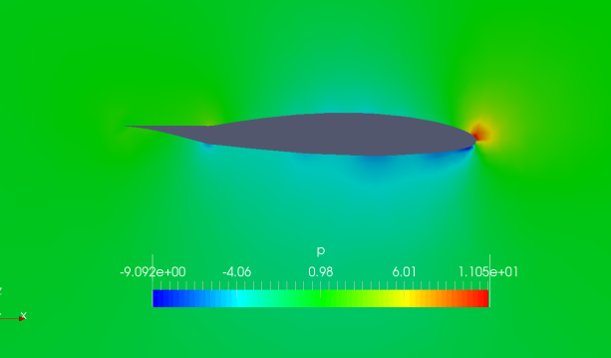
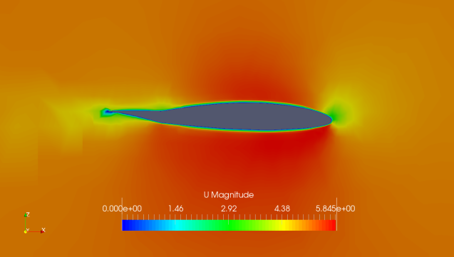
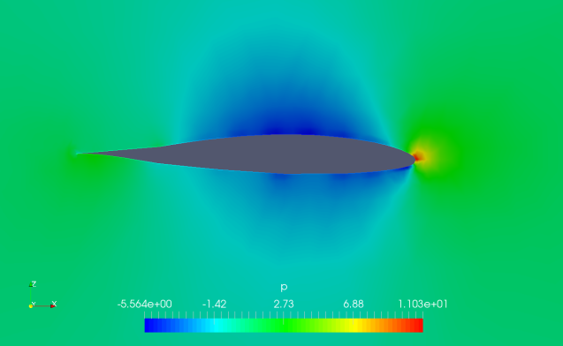
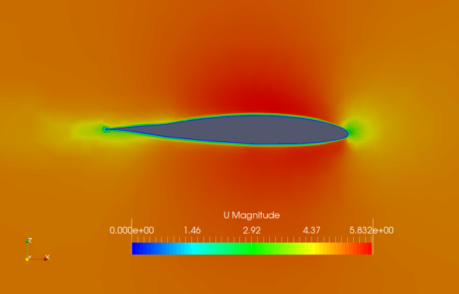
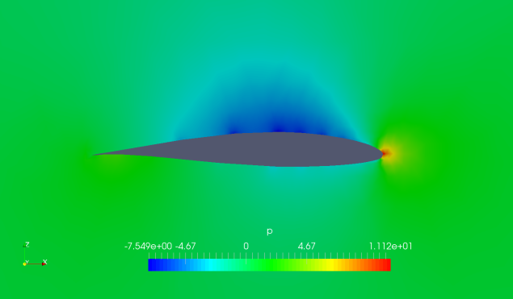
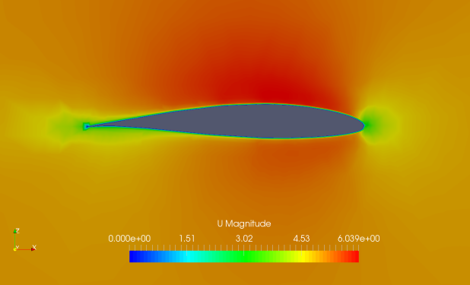
RESULTS
Pressure and Velocity:
Flap’s angle | Pressure Distribution | Velocity Distribution
-10°
-5°
0°

Slide 13
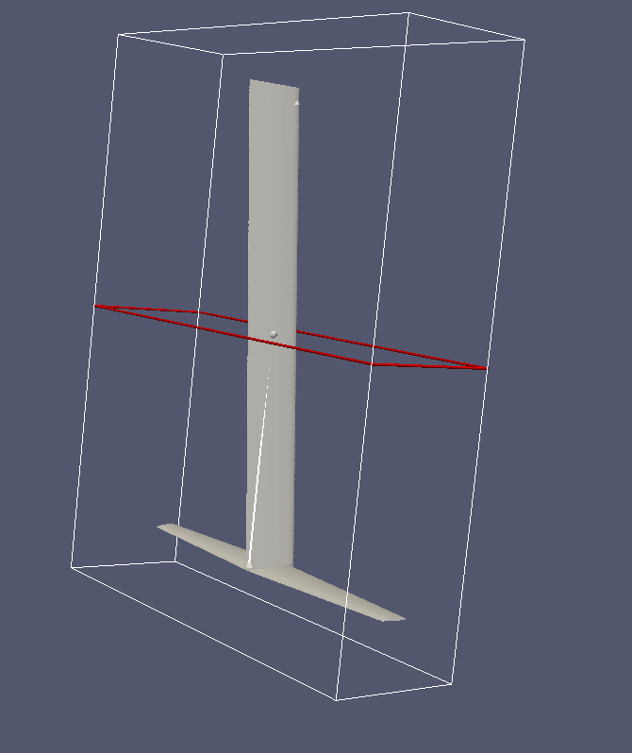
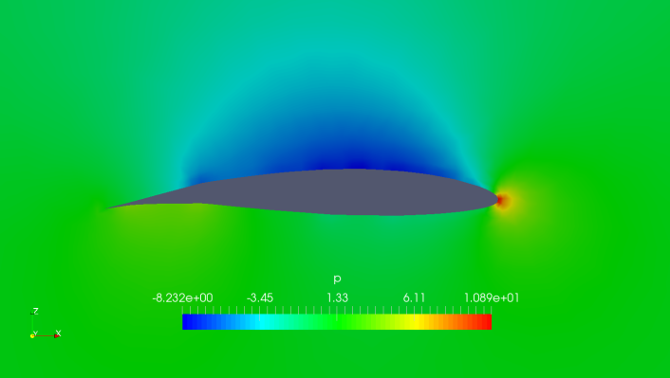
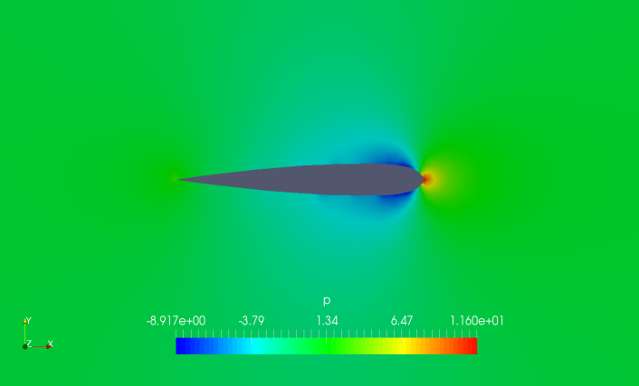
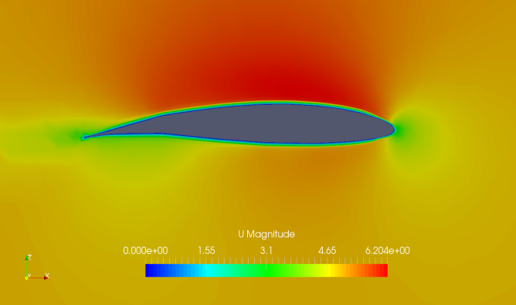
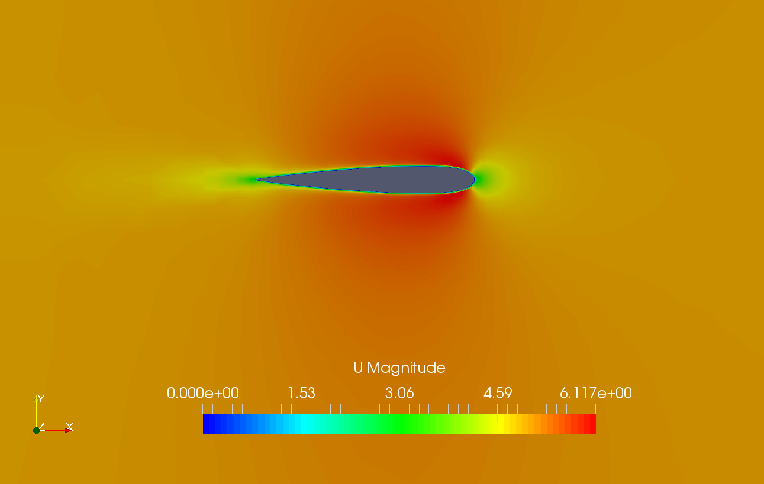
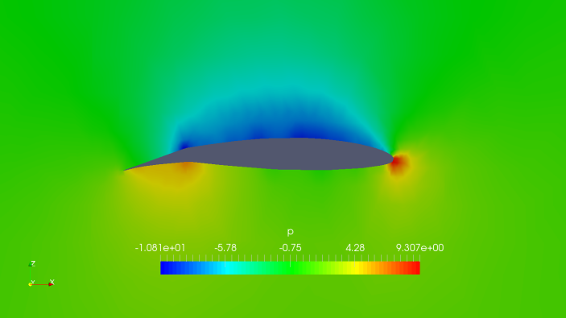
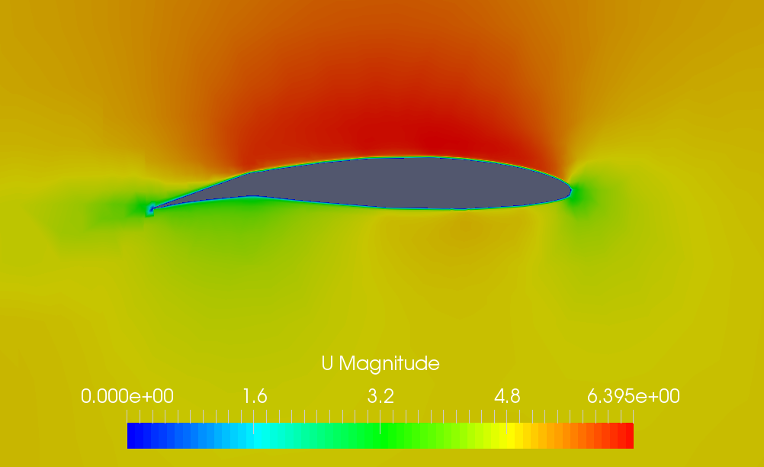
5°
10°
And for the symmetric profile?

Slide 14
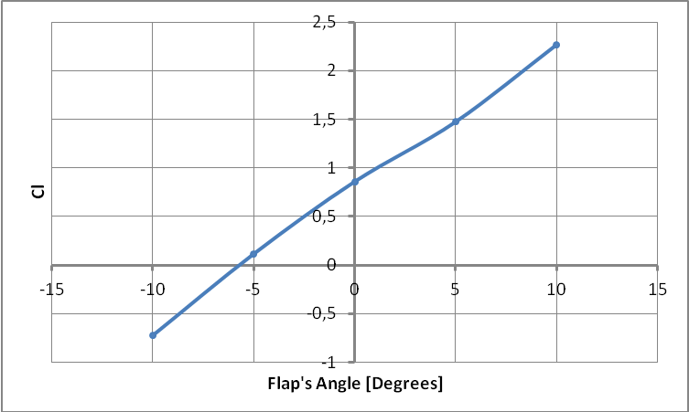
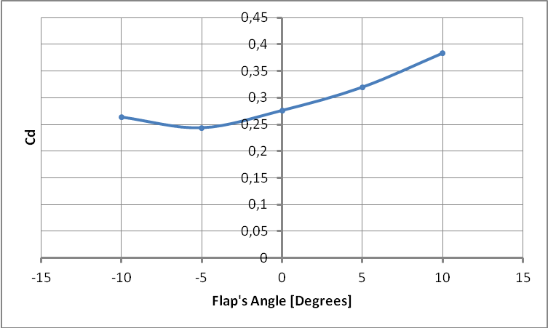
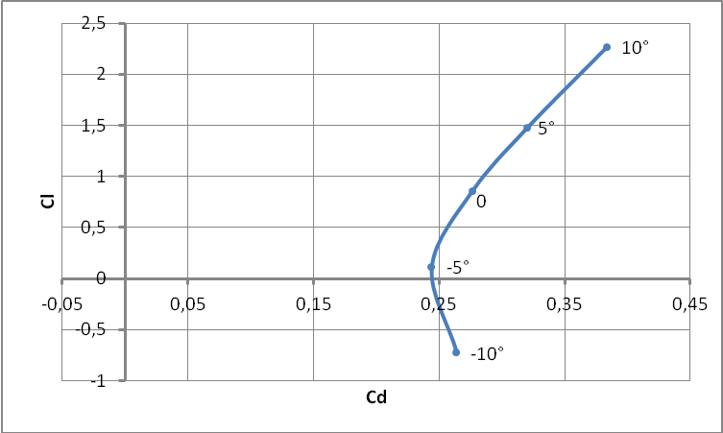
RESULTS
WATH ABOUT THE Cl-Cd VALUES AND TRENDS ?

Slide 15
RESULTS
To find the minimum value needed of C_{L} for 5 m/s we supposed a total weight of 100 kg (boat + skipper).
The solution give:
C_{L}= 0.834
Variable | Mean | Unit | Value
c | Water Velocity | [m/s] | 5
A | Approximated foil area | [m²] | 0,094
ρ | Water Density | [Kg/m³] | 1000
mg | Boat Weight Force | [N] | 981
where

Slide 16
CONCLUSION
We obtained that :
Lift is generated with a NACA 63412 in each case except the case with -10° flap’s angle.
The angle with lower drag and a positive lift is -5°
To lift a total weight of 100 kg ( boat + skipper) it is necessary work with a flap angle higher than 0° with a speed of 5 m/s
FUTURE DEVELOPMENTS
The flap’s angle is determined by the speed of the ship trough the sensor called wand (reported in figure 1.1. )
The hull surging over the sea level causes a big drag fall which is not considered in this study.
Improve the speed variation to study lift and drag in function of the hull’s velocity.

Slide 17
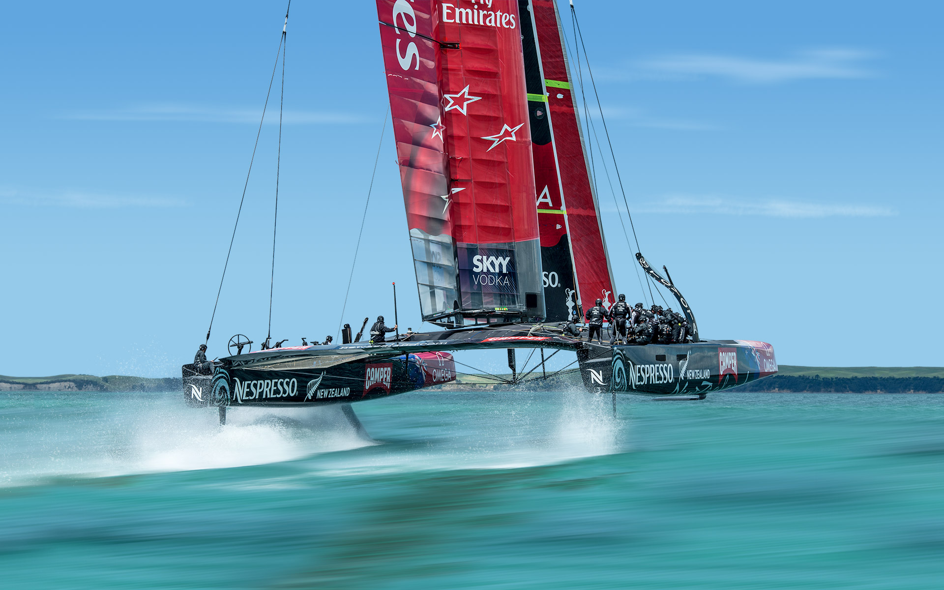
THANKS FOR THE ATTENTION

