Slide 1
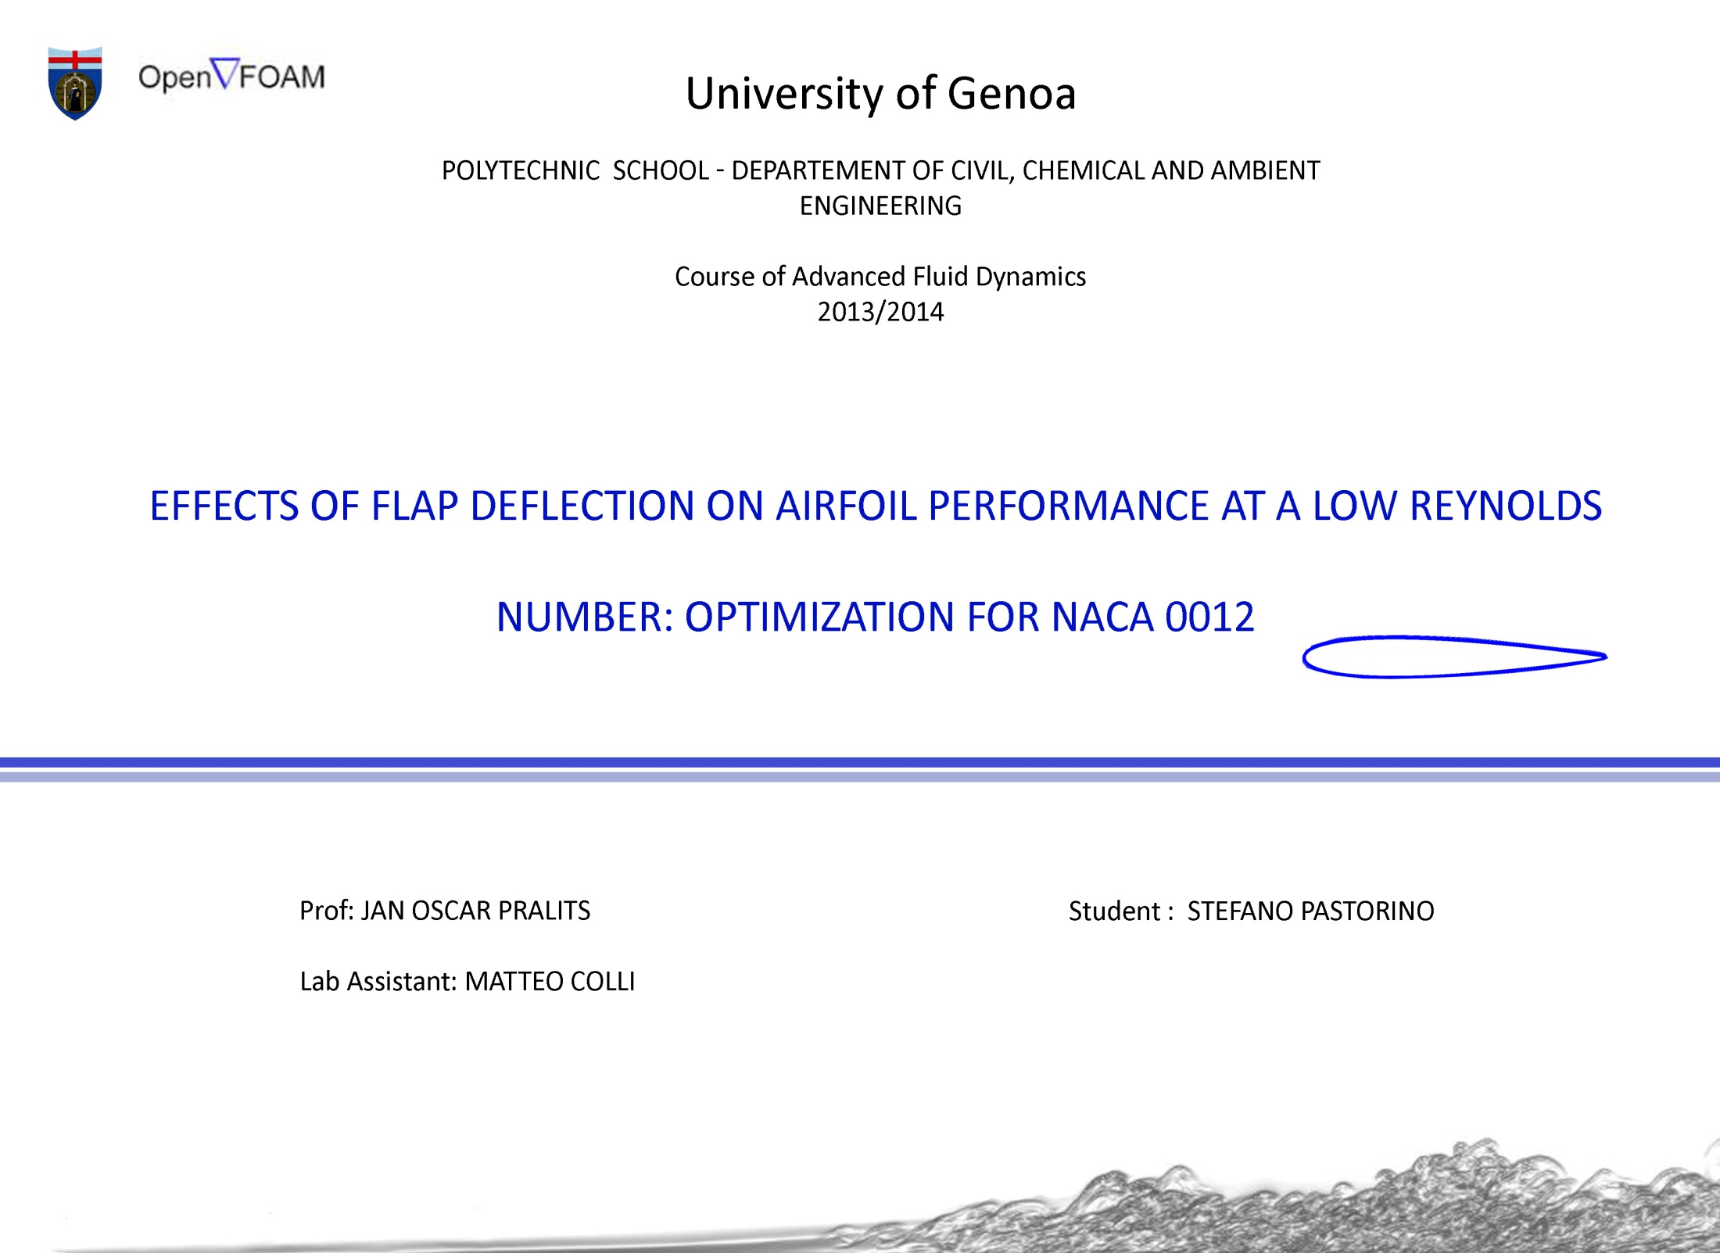

Slide 2
The analysis of the two dimensional subsonic flow over a NACA 0012 airfoil using OpenFoam is presented.
Sequence of steps:
1) Create the geometry and the flap
2) Mesh and grid generation
3) Find the angle of attack that
causes visible flow separation
4) Vary the flap position from -9°
to +15° in order to minimize
the drag coefficient
Aim of the work

Slide 3
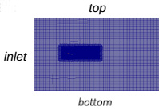
Simulations have been performed using the Navier-Stokes equations.
Hp : _ Incompressible flow
_ Costant viscosity
Initial conditions
Relative pressure field: p = 0
Uniform velocity field in x direction:
v = 0.005 m/s (Re=500)
Boundary conditions
Null normal gradient of pressure for the
inlet, top and bottom of the domain
Null normal velocity components
for the top and the bottom of the domain

Slide 4
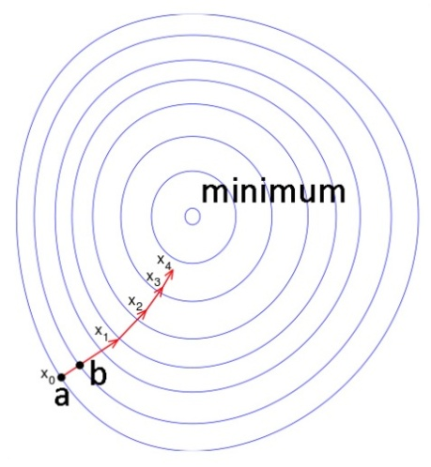
The optimization of the problem is reduced to one parameter: the flap position
handmade optimization by varying each flap position from -9° to +15° with steps of +3°
Optimization could have been done automatically by using Steepest Descent method:
F(x ) is defined and differentiable in a neighborhood of a point a , then F(x ) decreases fastest if one goes from a in the direction of the negative gradient of F at a , −∇ F(a) .
b=a−δ∇ F(a)
F(a)≥F(b)
xn+1=xn−δn∇ F(xn), n≥0
we have F(x0)≥F(x1)≥F(x2)≥... so the sequence converges to the desired local minimum. In our case the iterative procedure should be:
is the n-th angle of the flap
is the step length of the n iteration

Slide 5
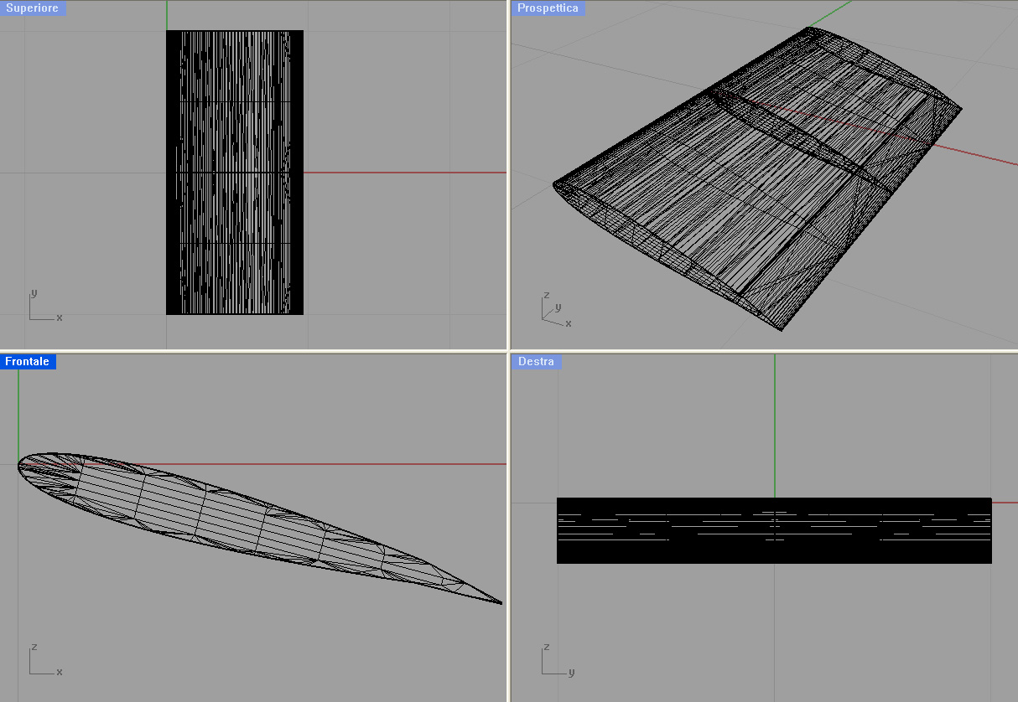
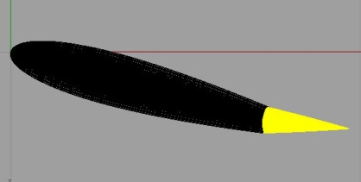
Geometry creation
The NACA 0012 has been created starting from the profile coordinates using a CAD software
The length of the posterior flap is 20% of the chord
Mesh and grid generation
The OpenFOAM® CFD Toolbox is an open source CFD software package
IcoFoam
It solves the incompressible laminar Navier-Stokes equations using the PISO algorithm
BLOCKMESH
It creates a background mesh of hexahedral cells
SNAPPYHEXMESH
It modifies the mesh by conforming it to the airfoil’s surface by iteratively refining a starting mesh and morphing the resulting split-hex mesh to the surface

Slide 6
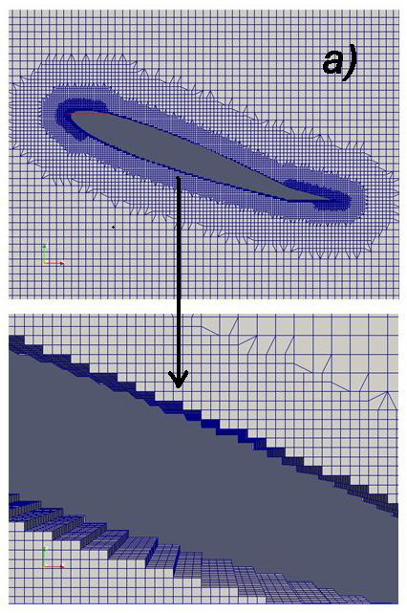
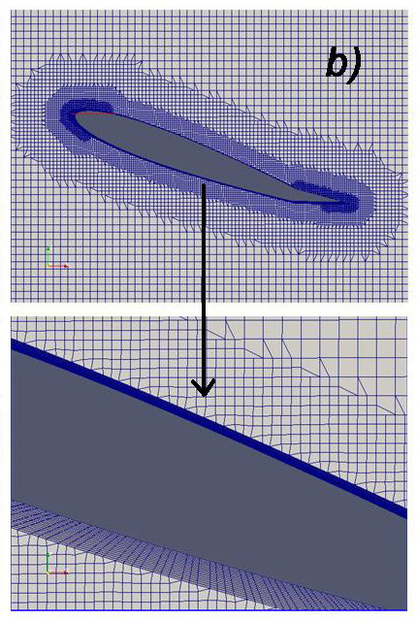
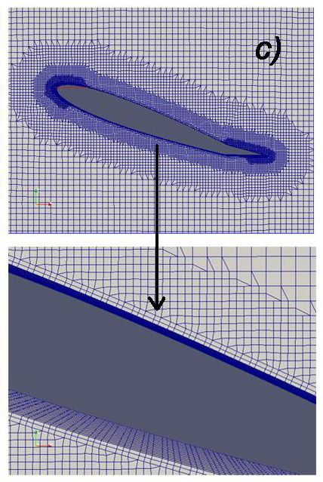
Cell removal between the airfoil and the domain:
First refinement level: cells are retained if 50% or more of their volume lies within
the region (intersection between domain and airfoil’s volume)
Second refinement level: the jagged surface is removed from the mesh, cell vertex
points move to the surface geometry
Third refinement level: this step introduces an additional layers of hexahedral cells
aligned to the boundary surface

Slide 7
Numerical simulations always need a grid convergence study
search for the optimal cell size
Simulations have been tested varying the number of cells of the principal grid in x and z direction varied, instead grid dimensions remained the same
The optimal number of cells has been 220 in x direction (along the side of 22) and 120 in z direction (along the side of 12)
It's important to consider the numerical stability of the problem
set the right Courant number
It means that the fluid particles move from one cell to another within one time step (at most)
Is the time step size
and
are the dimensions of the grid cell at each location
and
are the average linear velocities at that location respectively in x and z direction
icoFoam solver
has been monitored in order to not exceed the limit of 0.3
with a
= 0.1s and a total simulation of 3600s

Slide 8
Search for the critical angle of attack
Flow separation starts between α=+10° and α=+15°
Von Karman vortex street starts at α=+15°, but the critical angle for which Von Karman vortex street is well rendered is α=+20°
In fact for vorticity at α=+20° :
pressure
velocity

Slide 9
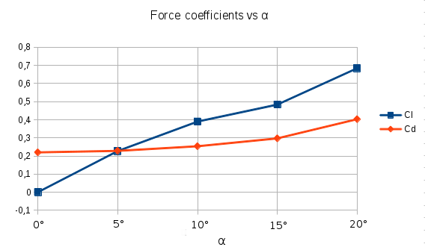
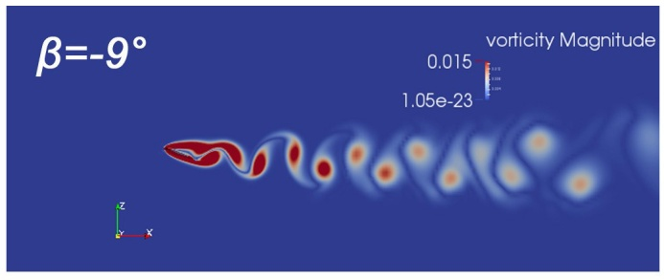
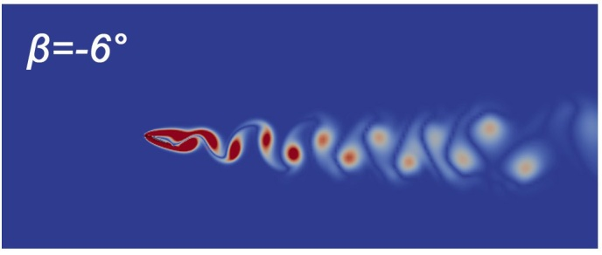
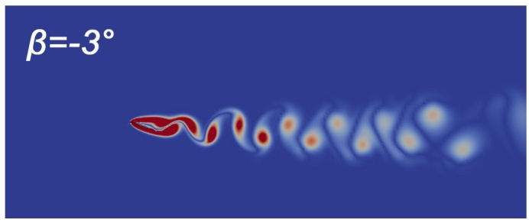
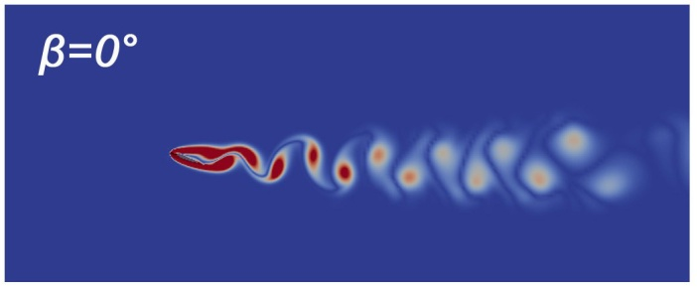
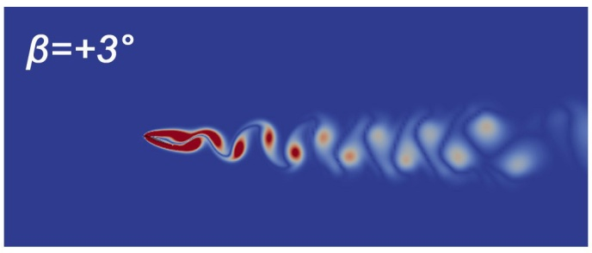
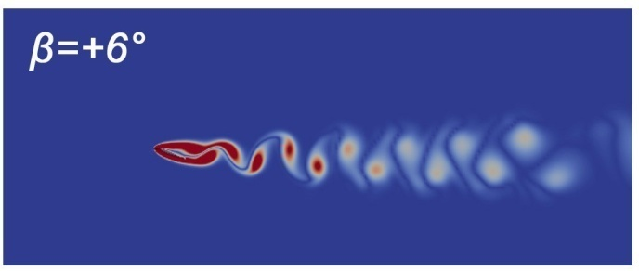
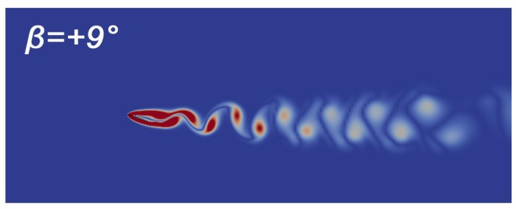
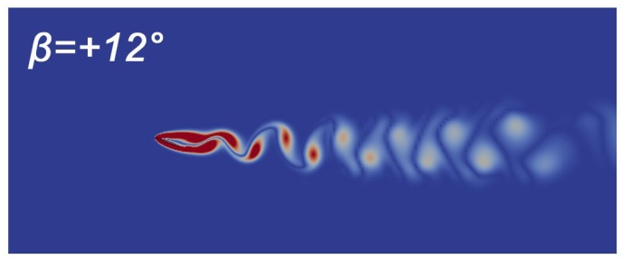
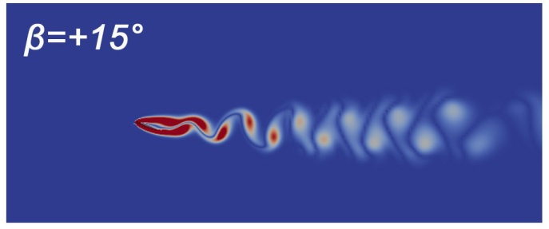
Varying the flap position
Optimization’s goal is to minimize the highest value of drag coefficient that is:
Simulations will be launched for α=+20°
the flap doesn't avoid flow separation, but
vorticity magnitude decreases from -9° to +15°

Slide 10
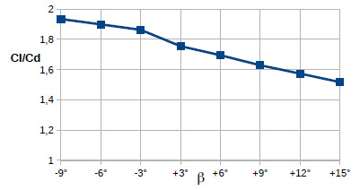
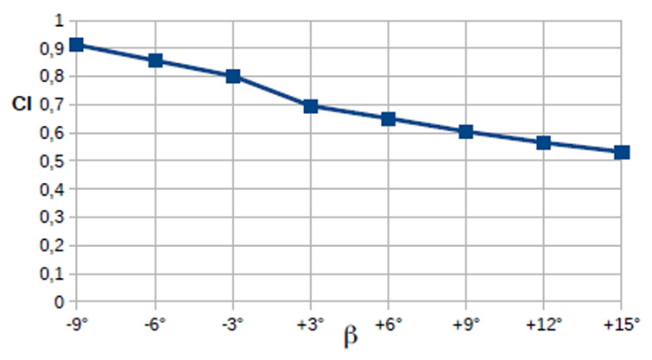
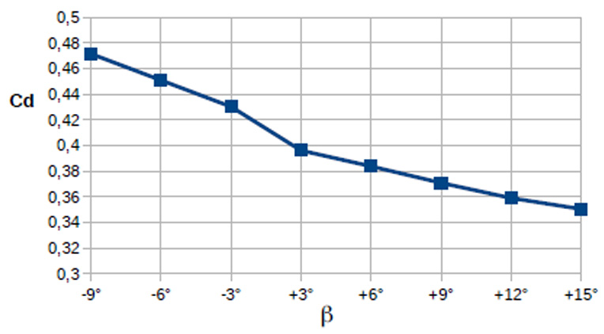
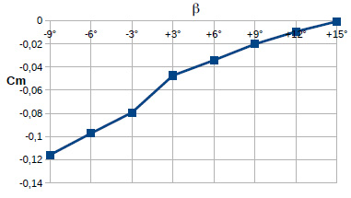
Trends of force coefficients
The separated region decreases from -9° to +15°, but it makes it slowly provoking the same slow reduction for the lift coefficient decreases more quickly than the drag coefficient in the same range.
The optimal value of the drag coefficient is for β = +15° , in according with the vorticity decrease
Negative means that the airfoil tends to lower the leading edge because the barycenter is more advanced than the point of application of the lift.

Slide 11
The optimal flap position that minimize the drag coefficient of the airfoil (for α =20°) is β = +15° :
The goal of this work is achieved
The optimization reduces
to
pressure
velocity
vorticity

Slide 12
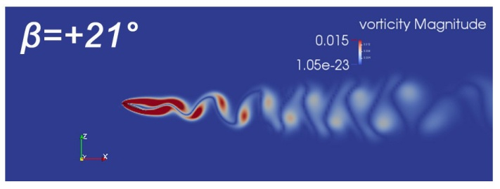
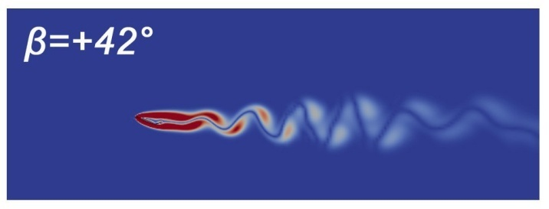
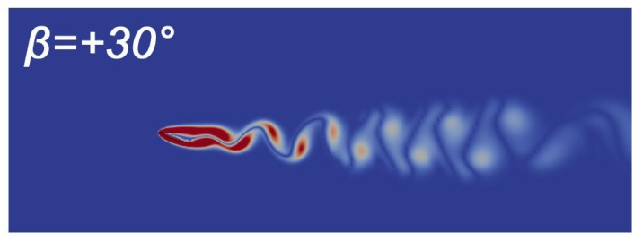
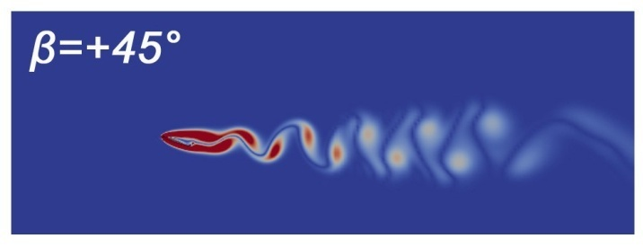
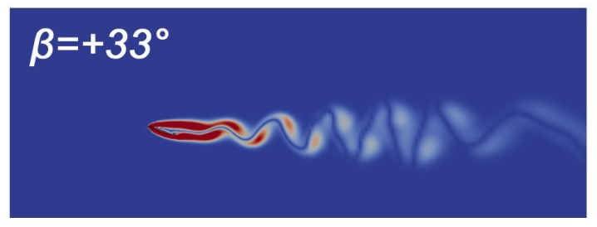
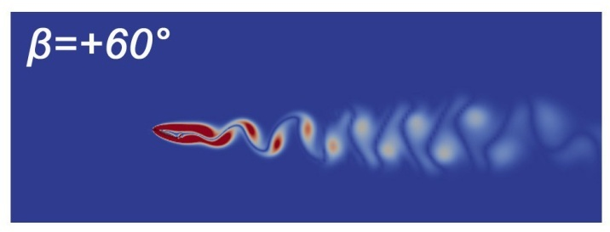
Higher angles of flap
More simulations are launched for higher angles of flap
New aim of the work
search for a minimum value for and joined to the the analysis of the footprint of vorticity
vorticity magnitude decreases until
β = +42°

Slide 13
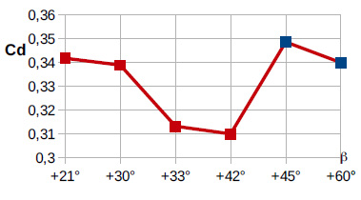
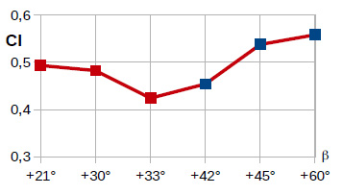
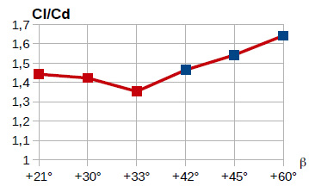
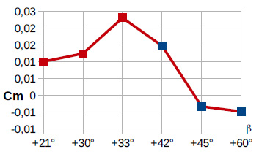
Trends of force coefficients
red points the
trend is similar to the
respective one for low
angles of flap
blue points the
trend is conditioned by
a new flow separation
on the flap

Slide 14
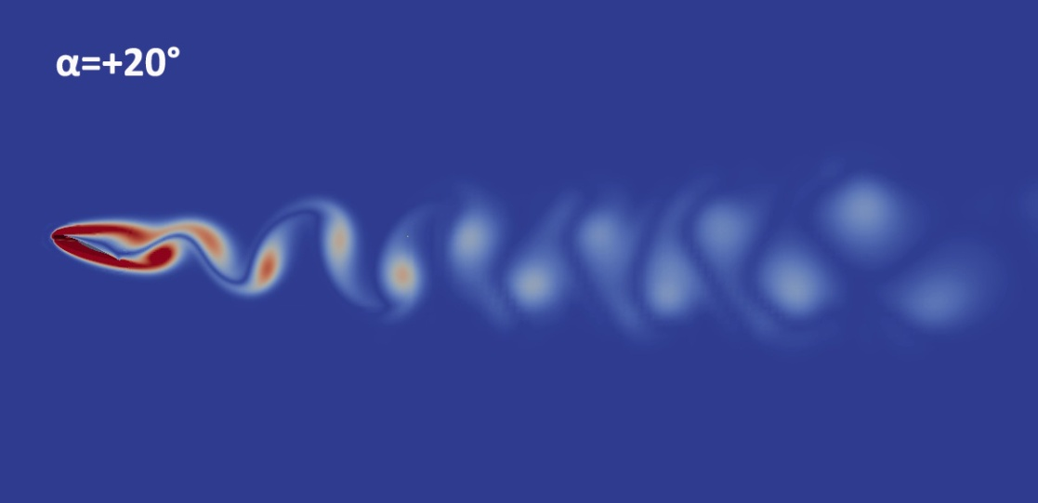
Conclusion:
angle of attack that causes an evident flow separation
and a high value of α=+20° ;
optimization of the (+20°) by varying the flap position
from -9° to +15°
search for the minimum value of for high values of β

Slide 15
Next steps:
calculations will be evaluated for higher Reynolds numbers
a new work based on the study about the creation and the growth
of the region of separeted flow on the flap for high values of β will
be realized.
Thanks for your attention

