Slide 1
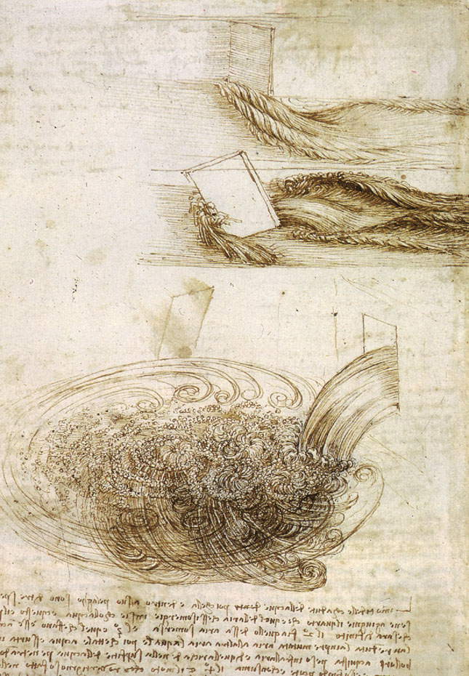
Leonardo da Vinci pioneered the flow visualization genre about 500 years ago.
The illustrations above (Studies of water passing obstacles and falling c. 1508-1509) represents perhaps the world's first use of visualization as a scientific tool to study a turbulent flow.

Slide 2
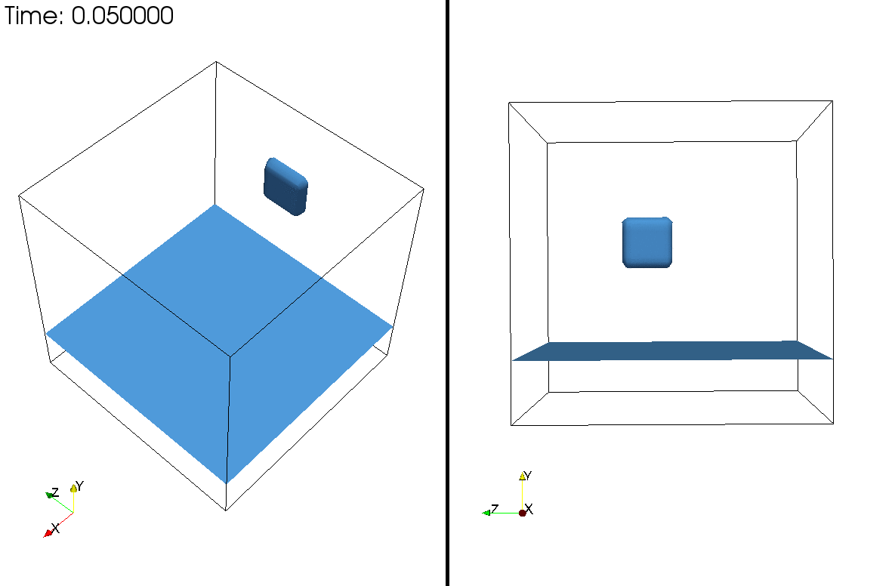

Slide 3
