Slide 1





A crash course in fluid mechanics
La Spezia, 27th February, 2015
University of Genoa, DICCA
Dipartimento di Ingegneria Civile, Chimica e Ambientale

Slide 2

Your Lecturer
Alessandro Bottaro
http://www.dicca.unige.it/bottaro
alessandro.bottaro@unige.it
bottaro@wolfdynamics.com

Slide 3
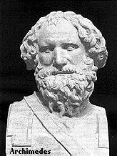
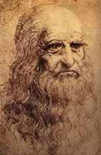
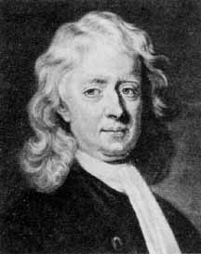
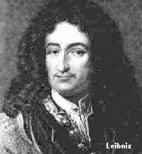
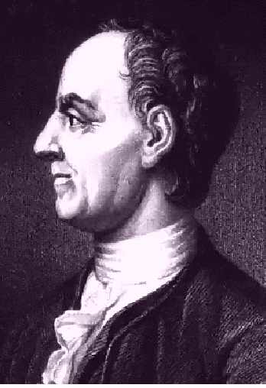
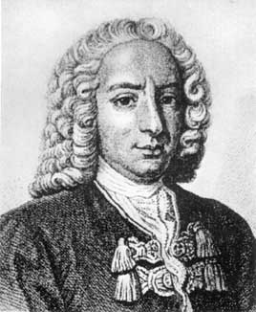
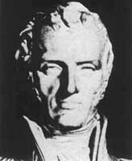
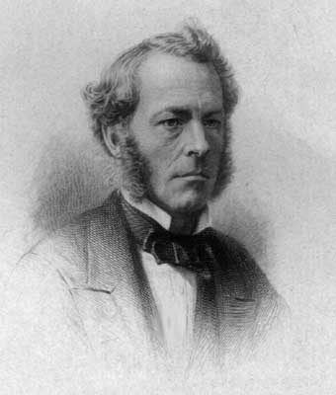
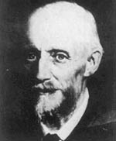
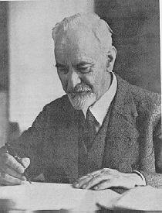
Introduction
Fluid Mechanics
Faces of Fluid Mechanics : some of the greatest minds of history have tried to solve the mysteries of fluid mechanics
Archimedes
Da Vinci
Newton
Leibniz
Euler
Bernoulli
Navier
Stokes
Reynolds
Prandtl

Slide 4
Introduction
Fluid Mechanics
From mid-1800’s to 1960’s, research in fluid mechanics focused upon
  Analytical methods
    Exact solution to Navier-Stokes equations (~ 80 known for simple problems, e.g., laminar pipe flow)
    Approximate methods, e.g., Ideal flow, Boundary layer theory
  Experimental methods
    Scale models: wind tunnels, water tunnels, towing-tanks, flumes,...
    Measurement techniques: pitot probes; hot-wire probes; anemometers; laser-doppler velocimetry; particle-image velocimetry
    Most man-made systems (e.g., airplane) engineered using build-and-test iteration.
1950’s – present : rise of computational fluid dynamics (CFD)

Slide 5
Basic concepts

Slide 6
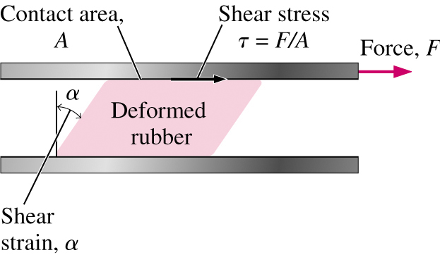
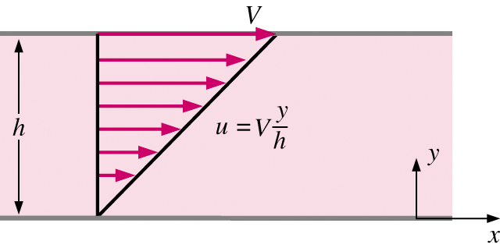
What is a fluid?
A fluid is a substance in the gaseous or liquid form
Distinction between solid and fluid?
  Solid: can resist an applied shear by deforming. Stress is proportional to strain
  Fluid: deforms continuously under applied shear. Stress is proportional to strain rate
Solid
Fluid

Slide 7
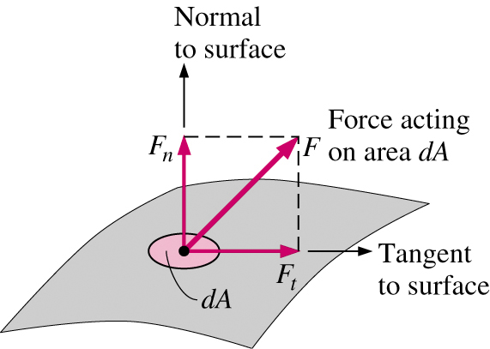
What is a fluid?
Stress is defined as the force per unit area.
Normal component: normal stress
  In a fluid at rest, the normal stress is called pressure
Tangential component: shear stress

Slide 8
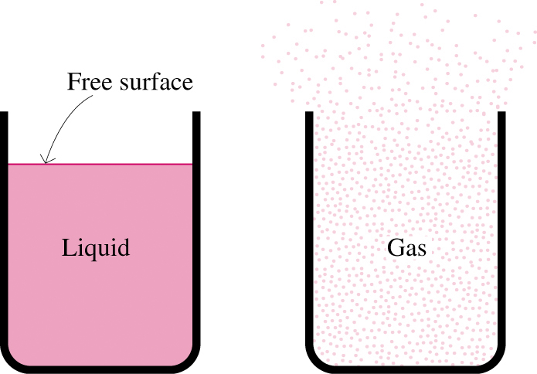
What is a fluid?
A liquid takes the shape of the container it is in and forms a free surface in the presence of gravity
A gas expands until it encounters the walls of the container and fills the entire available space. Gases cannot form a free surface
Gas and vapor are often used as synonymous words

Slide 9
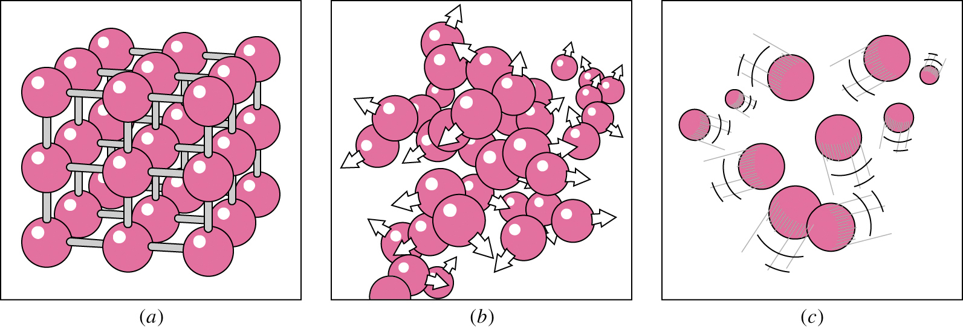
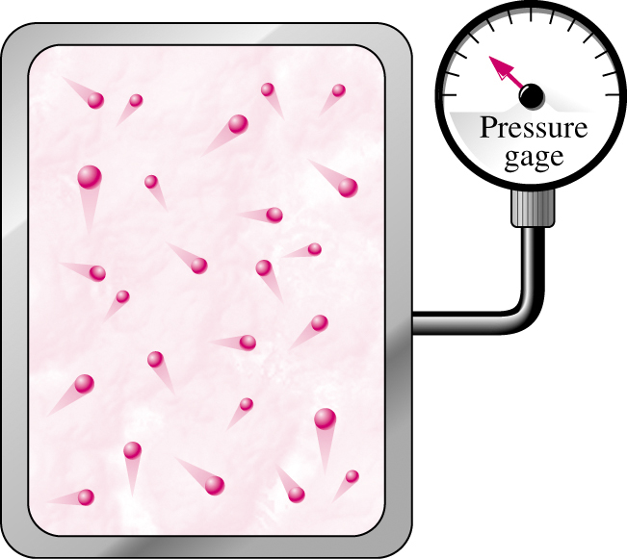
What is a fluid?
solid
strong → weak
intermolecular bonds
liquid
gas
Pressure can be measured on
a macroscopic scale …

Slide 10
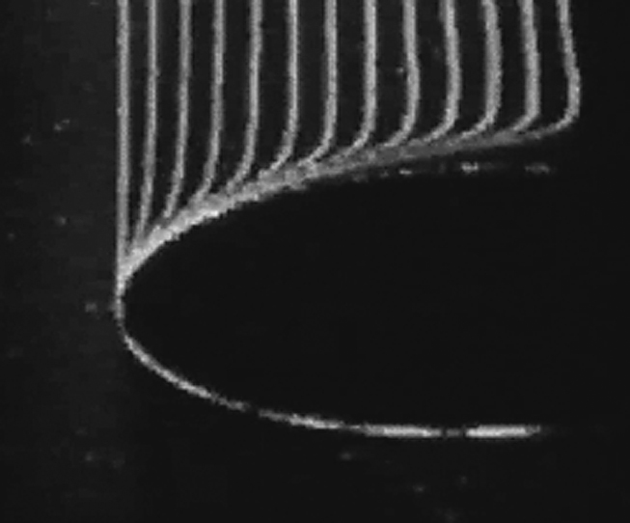
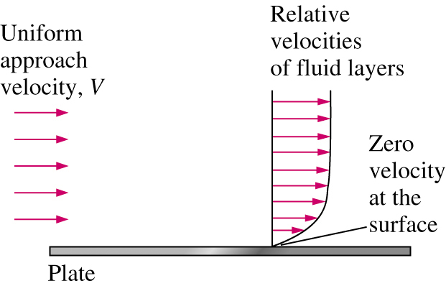
No-slip condition
No-slip condition: A fluid in direct contact with a solid ``sticks'‘ to the surface due to viscous effects
Responsible for generation of wall shear stress τ_{w}, surface drag D= ∫τ_{w} dA, and the development of the boundary layer
The fluid property responsible for the no-slip condition is viscosity
Important boundary condition in formulating initial boundary value problem (IBVP) for analytical and computational fluid dynamics analysis

Slide 11


Classification of Flows
We classify flows as a tool in making simplifying assumptions to the governing partial-differential equations, which are known as the Navier-Stokes equations (for Newtonian fluids)
  Conservation of Mass
  Conservation of Momentum

Slide 12
Classification of Flows
We classify flows as a tool in making simplifying assumptions to the governing partial-differential equations, which are known as the Navier-Stokes equations (for Newtonian fluids)
  Conservation of Mass
  Conservation of Momentum

Slide 13
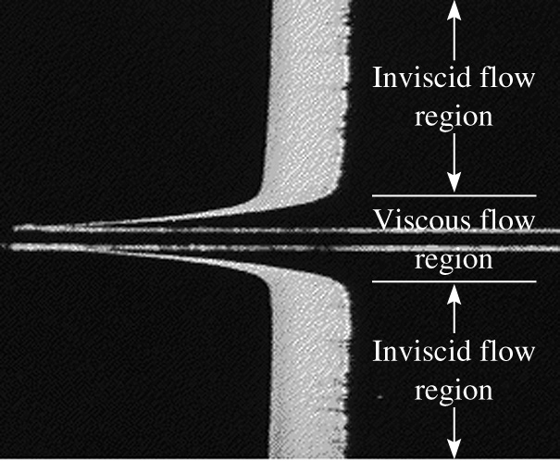

Viscous vs. Inviscid Regions of Flow
Regions where frictional effects are significant are called viscous regions. They are usually close to solid surfaces.
Regions where frictional forces are small compared to inertial or pressure forces are called inviscid

Slide 14
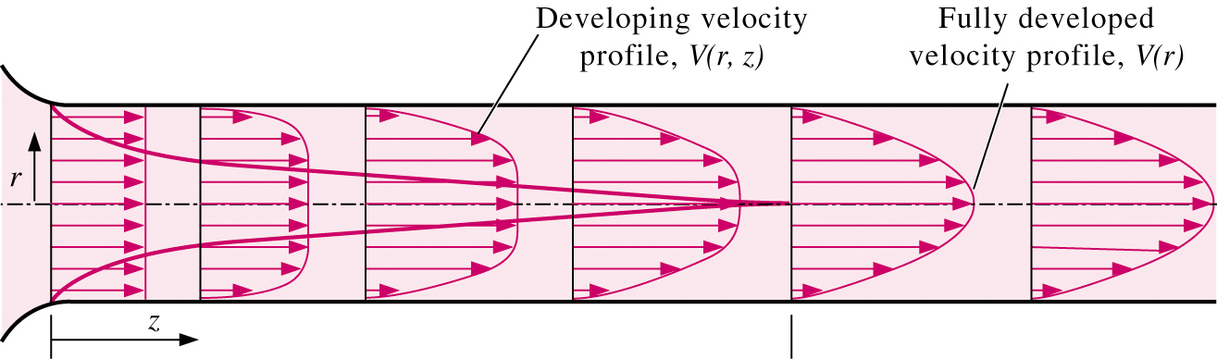
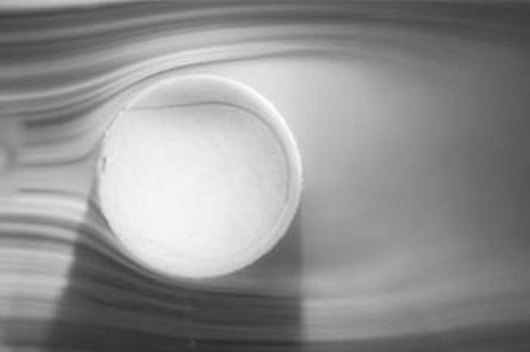
Internal vs. External Flow
Internal flows are dominated by the influence of viscosity throughout the flowfield
For external flows, viscous effects are limited to the boundary layer and wake.

Slide 15
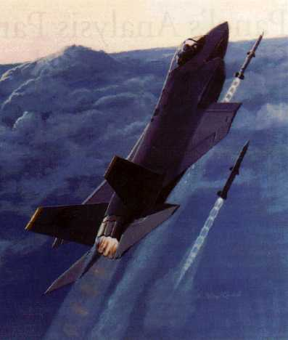
Compressible vs. Incompressible Flow
A flow is classified as incompressible if the density remains nearly constant.
Liquid flows are typically incompressible.
Gas flows are often compressible, especially for high speeds.
Mach number, Ma = V/c is a good indicator of whether or not compressibility effects are important.
  Ma < 0.3 : Incompressible
  Ma < 1 : Subsonic
  Ma = 1 : Sonic
  Ma > 1 : Supersonic
  Ma >> 1 : Hypersonic

Slide 16
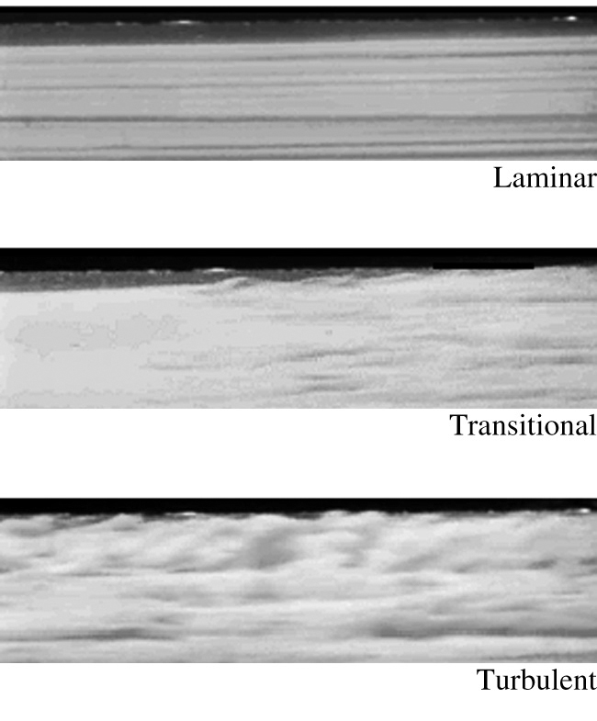
Laminar vs. Turbulent Flow
Laminar: highly ordered fluid motion with smooth streamlines.
Turbulent: highly disordered fluid motion characterized by velocity fluctuations and eddies.
Transitional: a flow that contains both laminar and turbulent regions
The Reynolds number, Re= ρUL/μ is the key parameter in determining whether or not a flow is laminar or turbulent.

Slide 17
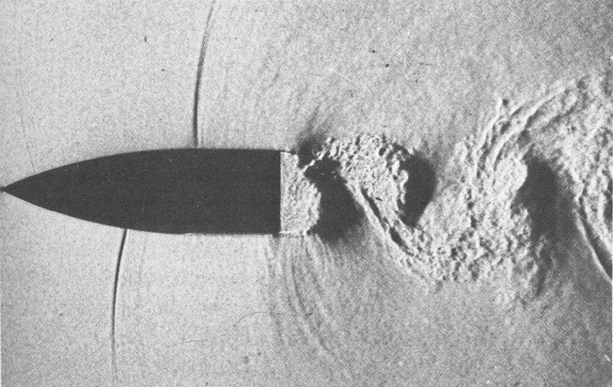

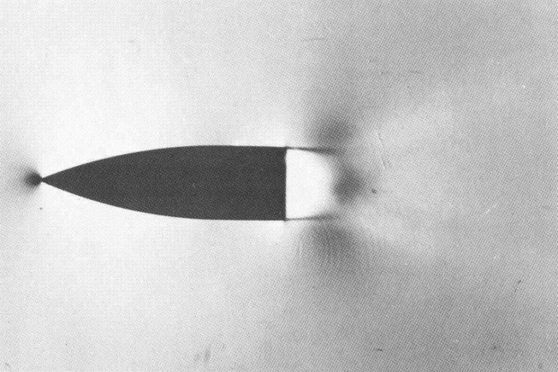
Steady vs. Unsteady Flow
Steady implies no change at a point with time. Transient terms in N-S equations are zero
Unsteady is the opposite of steady.
  Transient usually describes a starting, or developing flow.
  Periodic refers to a flow which oscillates about a mean.
Unsteady flows may appear steady if “time-averaged”

Slide 18
One-, Two-, and Three-Dimensional Flows
N-S equations are 3D vector equations.
Velocity vector, U(x,y,z,t)= [U_{x}(x,y,z,t),U_{y}(x,y,z,t),U_{z}(x,y,z,t)]
Lower dimensional flows reduce complexity of analytical and computational solution
Change in coordinate system (cylindrical, spherical, etc.) may facilitate reduction in order.
Example: for fully-developed pipe flow, velocity V(r) is a function of radius r and pressure p(z) is a function of distance z along the pipe.

Slide 19
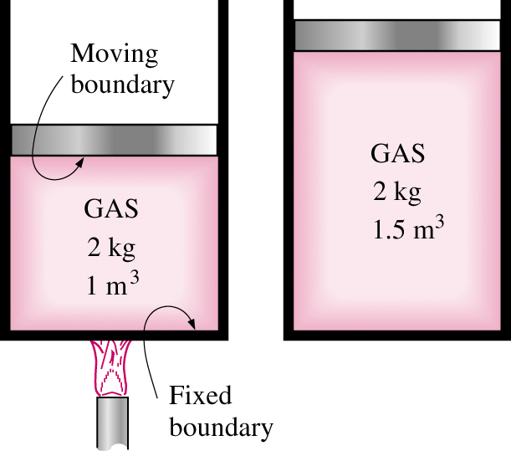
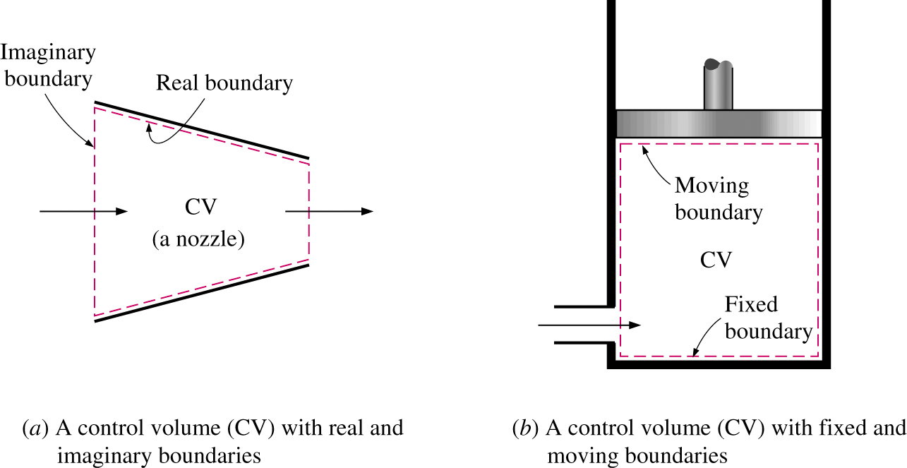
System and Control Volume
A system is defined as a quantity of matter or a region in space chosen for study.
A closed system consists of a fixed amount of mass.
An open system, or control volume, is a properly selected region in space.

Slide 20
Dimensions and Units
Any physical quantity can be characterized by dimensions.
The magnitudes assigned to dimensions are called units.
Primary dimensions include: mass m, length L, time t, and temperature T.
Secondary dimensions can be expressed in terms of primary dimensions and include: velocity V, energy E, and volume V.
Unit systems include English system and the metric SI (International System). We'll use only the SI system.
Dimensional homogeneity is a valuable tool in checking for errors. Make sure every term in an equation has the same units.

Slide 21
Accuracy, Precision, and Significant Digits
Engineers must be aware of three principals that govern the proper use of numbers.
Accuracy error : Value of one reading minus the true value. Closeness of the average reading to the true value. Generally associated with repeatable, fixed errors.
Precision error : Value of one reading minus the average of readings. Is a measure of the fineness of resolution and repeatability of the instrument. Generally associated with random errors.
Significant digits : Digits that are relevant and meaningful. When performing calculations, the final result is only as precise as the least precise parameter in the problem. When the number of significant digits is unknown, the accepted standard is 3. Use 3 in all homework and exams.

Slide 22
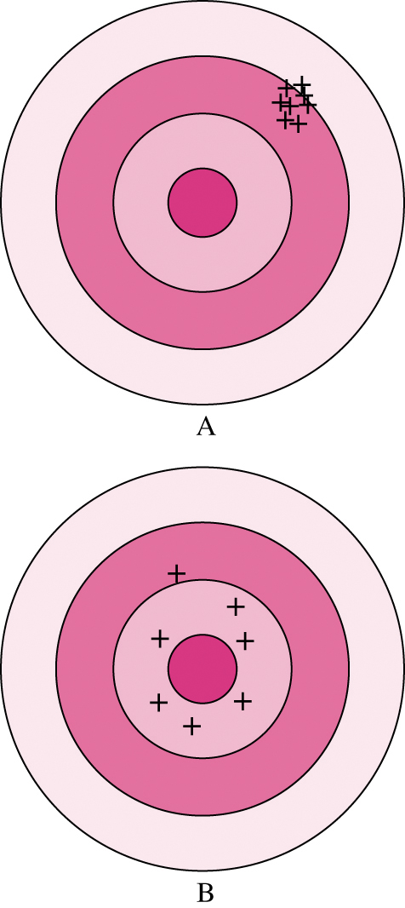
Example of Accuracy and Precision
Shooter A is more precise but less
accurate, while shooter B is more
accurate, but less precise.

Slide 23
Physical characteristics
Any characteristic of a system is called a property.
  Familiar: pressure P, temperature T, volume V, and mass m.
  Less familiar: viscosity, thermal conductivity, modulus of elasticity, thermal expansion coefficient, vapor pressure, surface tension.
Intensive properties are independent of the mass of the system. Examples: temperature, pressure, and density.
Extensive properties are those whose value depends on the size of the system. Examples: Total mass, total volume, and total momentum.
Extensive properties per unit mass are called specific properties. Examples include specific volume v = V/m and specific total energy e=E/m.

Slide 24
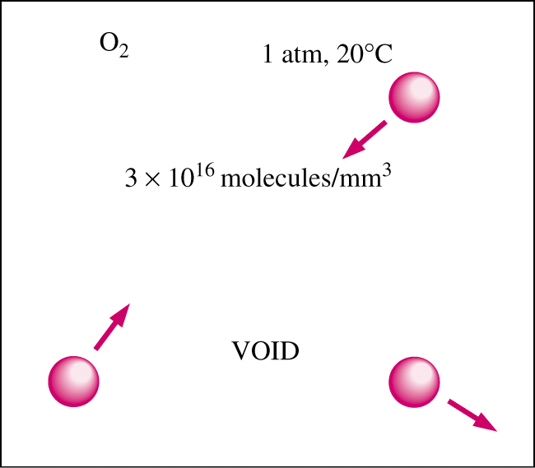
Continuum
Atoms are widely spaced in the gas phase.
However, we can disregard the atomic nature of a substance.
View it as a continuous, homogeneous matter with no holes, that is, a continuum.
This allows us to treat properties as smoothly varying quantities.
Continuum is valid as long as size of the system is large in comparison to distance between molecules.

Slide 25
Density and Specific Gravity
Density is defined as the mass per unit volume ρ = m/V. Density has units of kg/m³
Specific volume is defined as v = 1/ρ = V/m.
For a gas, density depends on temperature and pressure.
Specific gravity, or relative density is defined as the ratio of the density of a substance to the density of some standard substance at a specified temperature (usually water at 4°C), i.e., SG=ρ/ρ_{H20}. SG is a dimensionless quantity.
The specific weight is defined as the weight per unit volume, i.e., γ_{s} = ρg where g is the gravitational acceleration. γ_{s} has units of N/m³.

Slide 26
Density of Ideal Gases
Equation of State: equation for the relationship between pressure, temperature, and density.
The simplest and best-known equation of state is the ideal-gas equation.
P v = R T or P = ρ R T
Ideal-gas equation holds for most gases.
However, dense gases such as water vapor and refrigerant vapor should not be treated as ideal gases.

Slide 27
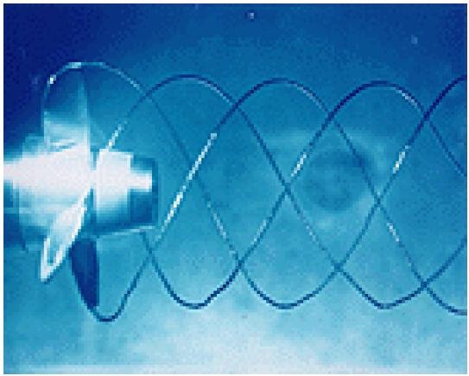
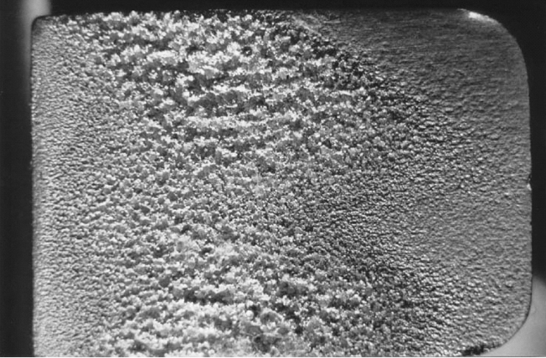
Vapor Pressure and Cavitation
Vapor Pressure P_{v} of a pure substance is defined as the pressure exerted by its vapor in phase equilibrium with its liquid at a given temperature
If P drops below P_{v}, liquid is locally vaporized, creating cavities of vapor.
Vapor cavities collapse when local P rises above P_{v}.
Collapse of cavities is a violent process which can damage machinery.
Cavitation is noisy, and can cause structural vibrations.

Slide 28
Energy and Specific Heats
Total energy E is comprised of numerous forms: thermal, mechanical, kinetic, potential, electrical, magnetic, chemical, and nuclear.
Units of energy are joule (J) or British thermal unit (BTU).
Microscopic energy
  Internal energy u is for a non-flowing fluid and is due to molecular activity.
  Enthalpy h=u+Pv is for a flowing fluid and includes flow energy (Pv).
Macroscopic energy
  Kinetic energy ke=V²/2
  Potential energy pe=gz
In the absence of electrical, magnetic, chemical, and nuclear energy, the total energy is e_{flowing}=h+V²/2+gz.

Slide 29
Coefficient of Compressibility
How does fluid volume change with P and T?
Fluids expand as T ↑ or P ↓ ; fluids contract as T ↓ or P ↑
Need fluid properties that relate volume changes to changes in P and T.
  Coefficient of compressibility or bulk modulus of elasticity
  α = 1/K = coefficient of isothermal compressibility
  Coefficient of volume expansion
Combined effects of P and T can be written as
K_{ideal} _{gas} = P

Slide 30
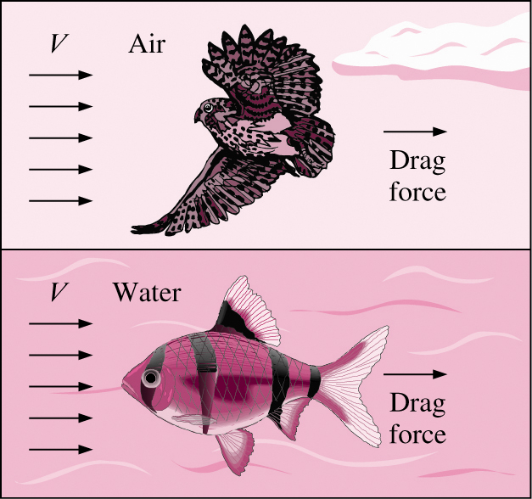
Viscosity
Viscosity is a property that represents the internal resistance of a fluid to motion.
The force a flowing fluid exerts on a body in the flow direction is called the drag force, and the magnitude of this force depends, in part, on viscosity.

Slide 31
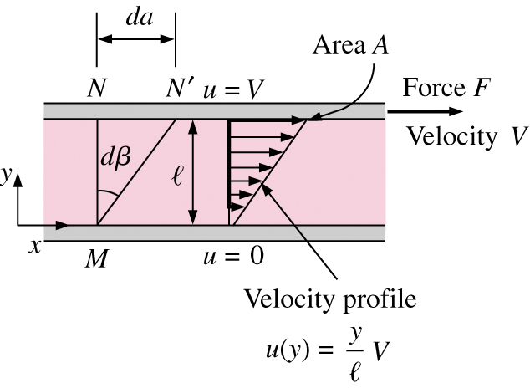
Viscosity
To obtain a relation for viscosity, consider a fluid layer between two very large parallel plates separated by a distance ℓ
Definition of shear stress is τ = F/A.
Using the no-slip condition,
u(0) = 0 and u(ℓ) = V, the velocity profile and gradient are u(y)= Vy/ℓ and du/dy=V/ℓ
Shear stress for Newtonian fluid:
τ = μ du/dy
μ is the dynamic viscosity and has
units of kg/m·s, Pa·s, or poise
(1 poise = 0.1 Pa S).
The viscosity of water at 20°C is 1 cP
(cP = centiPoise)
The kinematic viscosity of water at
20°C is 1 cSt (cSt = centiStoke)
(1 St = 1 cm²/s)

Slide 32
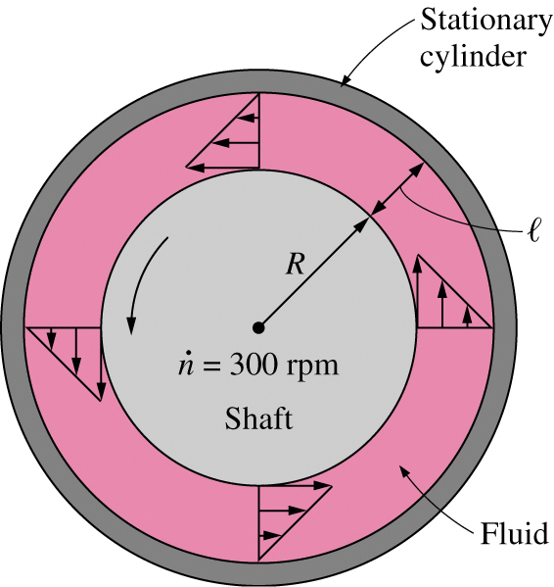
Viscometry
How is viscosity measured? A rotating viscometer.
  Two concentric cylinders with a fluid in the small gap ℓ.
  Inner cylinder is rotating, outer one is fixed.
Use definition of shear force:
If ℓ/R << 1, then cylinders can be modeled as flat plates.
Torque T = FR, and tangential velocity V=ωR
Wetted surface area A=2πRL.
Measure T and ω to compute μ

Slide 33
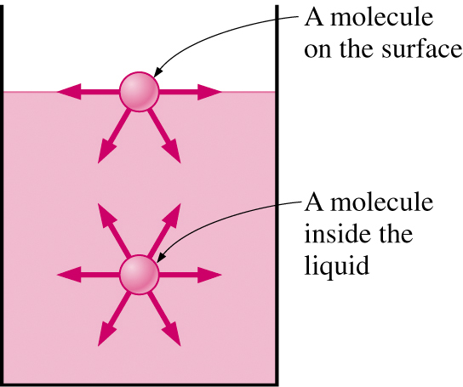
Surface Tension
Liquid droplets behave like small spherical balloons filled with liquid, and the surface of the liquid acts like a stretched elastic membrane under tension.
The pulling force that causes this is
  due to the attractive forces between molecules
  called surface tension σ_{s}.
Attractive force on surface molecule is not symmetric.
Repulsive forces from interior molecules causes the liquid to minimize its surface area and attain a spherical shape.

Slide 34
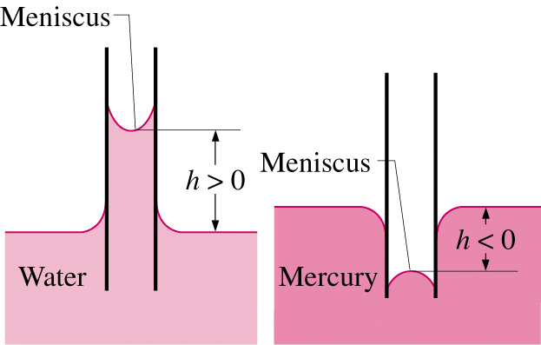
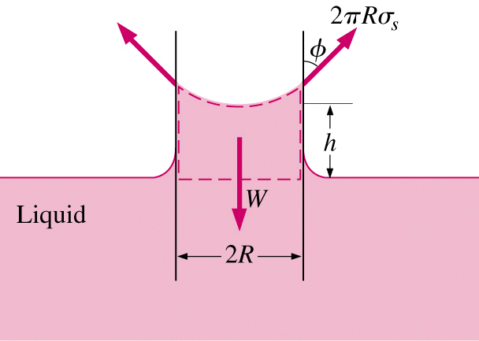
Capillary Effect
Capillary effect is the rise or fall of a liquid in a small-diameter tube.
The curved free surface in the tube is call the meniscus.
Water meniscus curves up because water is a wetting fluid.
Mercury meniscus curves down because mercury is a nonwetting fluid.
Force balance can describe magnitude of capillary rise.

Slide 35
Fluids Kinematics

Slide 36
Overview
Fluid Kinematics deals with the motion of fluids without considering the forces and moments which create the motion.
Items discussed here:
  Material derivative and its relationship to Lagrangian and Eulerian descriptions of fluid flow.
  Flow visualization.
  Plotting flow data.
  Fundamental kinematic properties of fluid motion and deformation.
  Reynolds Transport Theorem

Slide 37
Lagrangian Description
Lagrangian description of fluid flow tracks the position and velocity of individual particles.
Based upon Newton's laws of motion.
Difficult to use for practical flow analysis.
  Fluids are composed of billions of molecules.
  Interaction between molecules hard to describe/model.
However, useful for specialized applications
  Sprays, particles, bubble dynamics, rarefied gases.
  Coupled Eulerian-Lagrangian methods.
Named after Italian mathematician Joseph Louis Lagrange (1736-1813).

Slide 38
Eulerian Description
Eulerian description of fluid flow: a flow domain or control volume is defined by which fluid flows in and out.
We define field variables which are functions of space and time.
  Pressure field, P=P(x,y,z,t)
  Velocity field,
  Acceleration field,
  These (and other) field variables define the flow field.
Well suited for formulation of initial boundary-value problems (PDE's).
Named after Swiss mathematician Leonhard Euler (1707-1783).

Slide 39
Acceleration Field
Consider a fluid particle and Newton's second law,
The acceleration of the particle is the time derivative of the particle's velocity.
However, particle velocity at a point is the same as the fluid velocity,
To take the time derivative of, chain rule must be used.

Slide 40
Acceleration Field
Since
In vector form, the acceleration can be written as
First term is called the local acceleration and is nonzero only for unsteady flows.
Second term is called the advective acceleration and accounts for the effect of the fluid particle moving to a new location in the flow, where the velocity is different.

Slide 41
Material Derivative
The total derivative operator d/dt is call the material derivative and is often given special notation, D/Dt.
Advective acceleration is nonlinear: source of many phenomenon and primary challenge in solving fluid flow problems.
Provides ``transformation'' between Lagrangian and Eulerian frames.
Other names for the material derivative include: total, particle, Lagrangian, Eulerian, and substantial derivative.

Slide 42
Flow Visualization
Flow visualization is the visual examination of flow-field features.
Important for both physical experiments and numerical (CFD) solutions.
Numerous methods
  Streamlines and streamtubes
  Pathlines
  Streaklines
  Timelines
  Refractive techniques
  Surface flow techniques

Slide 43
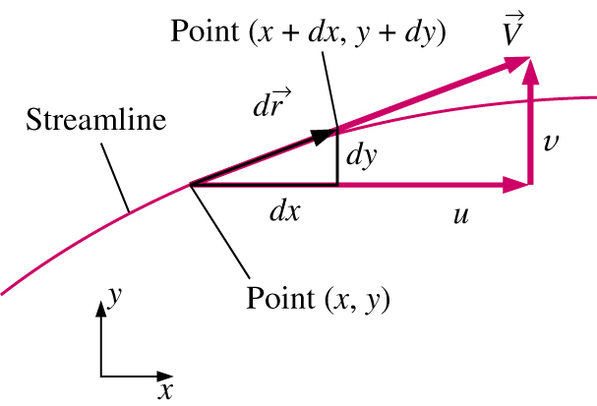
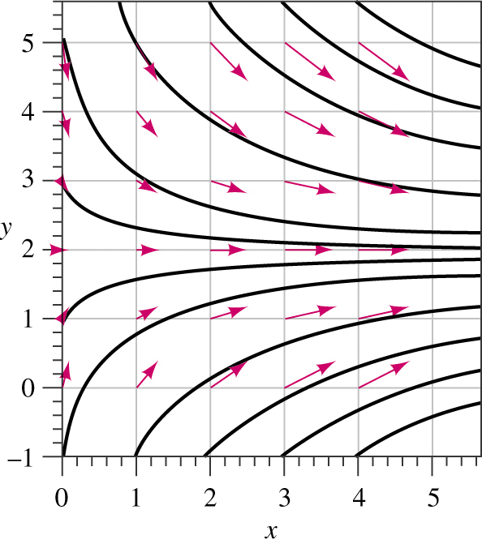
Streamlines
A Streamline is a curve that is everywhere tangent to the instantaneous local velocity vector.
Consider an arc length
must be parallel to the local velocity vector
Geometric arguments results in the equation for a streamline

Slide 44
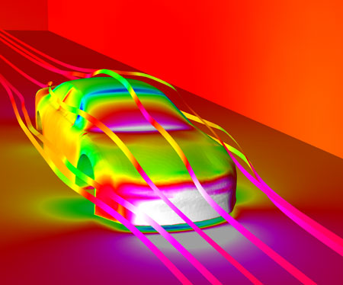
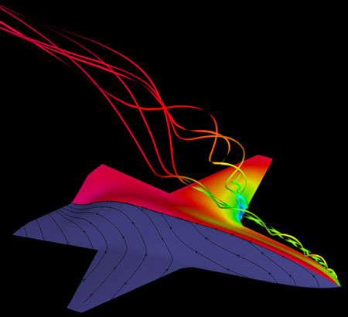
Streamlines
Airplane surface pressure contours, volume streamlines, and surface streamlines
NASCAR surface pressure contours and streamlines

Slide 45
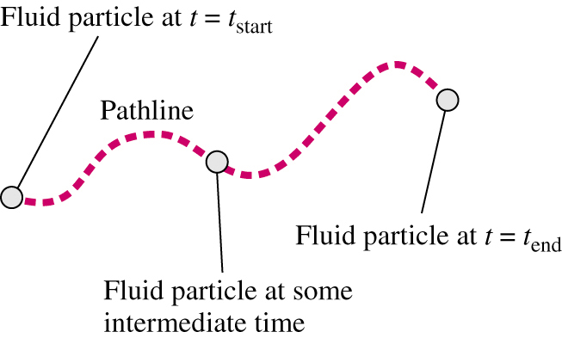
Pathlines
A Pathline is the actual path traveled by an individual fluid particle over some time period.
Same as the fluid particle's material position vector
Particle location at time t:
Particle Image Velocimetry (PIV) is a modern experimental technique to measure velocity field over a plane in the flow field.

Slide 46
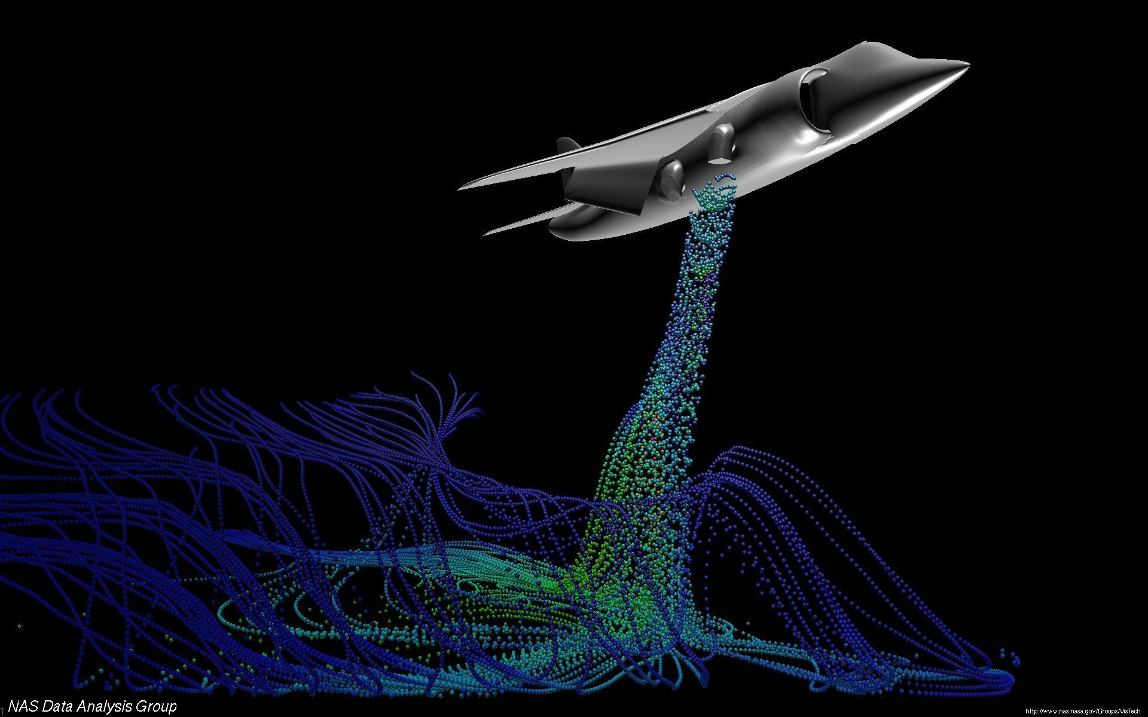
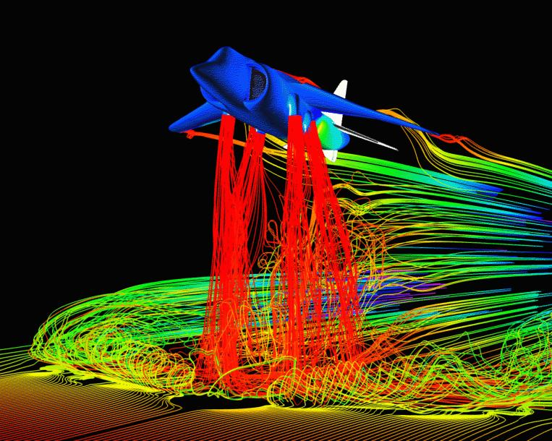
Streaklines
A Streakline is the locus of fluid particles that have passed sequentially through a prescribed point in the flow.
Easy to generate in experiments: dye in a water flow, or smoke in an airflow.

Slide 47
Comparisons
For steady flow, streamlines, pathlines, and streaklines are identical.
For unsteady flow, they can be very different.
  Streamlines are an instantaneous picture of the flow field
  Pathlines and Streaklines are flow patterns that have a time history associated with them.
  Streakline: instantaneous snapshot of a time-integrated flow pattern.
  Pathline: time-exposed flow path of an individual particle.

Slide 48
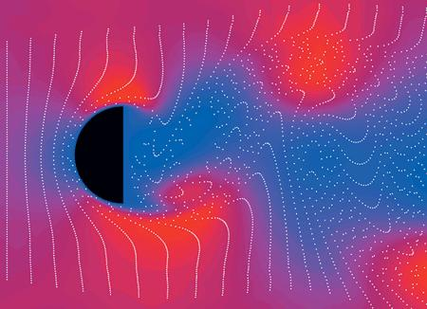
Timelines
A Timeline is the locus of fluid particles that have passed sequentially through a prescribed point in the flow.
Timelines can be generated using a hydrogen bubble wire.

Slide 49
Plots of Data
A Profile plot indicates how the value of a scalar property varies along some desired direction in the flow field.
A Vector plot is an array of arrows indicating the magnitude and direction of a vector property at an instant in time.
A Contour plot shows curves of constant values of a scalar property for magnitude of a vector property at an instant in time.

Slide 50
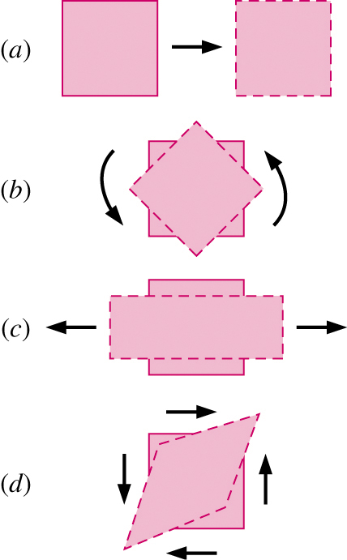
Kinematic Description
In fluid mechanics, an element may undergo four fundamental types of motion.
  Translation
  Rotation
  Linear strain
  Shear strain
Because fluids are in constant motion, motion and deformation is best described in terms of rates
  velocity: rate of translation
  angular velocity: rate of rotation
  linear strain rate: rate of linear strain
  shear strain rate: rate of shear strain

Slide 51
Rate of Translation and Rotation
To be useful, these rates must be expressed in terms of velocity and derivatives of velocity
The rate of translation vector is described as the velocity vector. In Cartesian coordinates:
Rate of rotation at a point is defined as the average rotation rate of two initially perpendicular lines that intersect at that point. The rate of rotation vector in Cartesian coordinates:

Slide 52
Linear Strain Rate
Linear Strain Rate is defined as the rate of increase in length per unit length.
In Cartesian coordinates
Volumetric strain rate in Cartesian coordinates
Since the volume of a fluid element is constant for an incompressible flow, the volumetric strain rate must be zero.

Slide 53
Shear Strain Rate
Shear Strain Rate at a point is defined as half of the rate of decrease of the angle between two initially perpendicular lines that intersect at a point.
Shear strain rate can be expressed in Cartesian coordinates as:

Slide 54
Shear Strain Rate
We can combine linear strain rate and shear strain rate into one symmetric second-order tensor called the strain-rate tensor.

Slide 55
Shear Strain Rate
Purpose of our discussion of fluid element kinematics:
  Better appreciation of the inherent complexity of fluid dynamics
  Mathematical sophistication required to fully describe fluid motion
Strain-rate tensor is important for numerous reasons. For example,
  Develop relationships between fluid stress and strain rate.
  Feature extraction and flow visualization in CFD simulations.

Slide 56
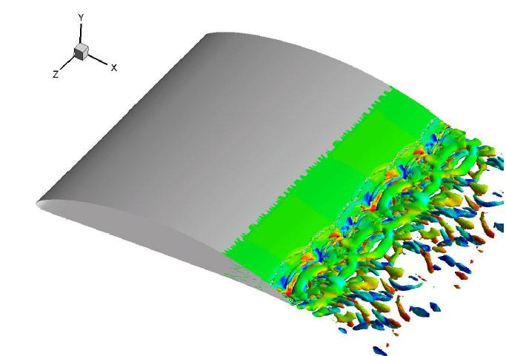
Shear Strain Rate
Example: Visualization of trailing-edge turbulent eddies
for a hydrofoil with a beveled trailing edge
Feature extraction method is based upon eigen-analysis of the strain-rate tensor.

Slide 57
Vorticity and Rotationality
The vorticity vector is defined as the curl of the velocity vector
Vorticity is equal to twice the angular velocity of a fluid particle.
Cartesian coordinates
Cylindrical coordinates
In regions where ζ = 0, the flow is called irrotational.
Elsewhere, the flow is called rotational.

Slide 58
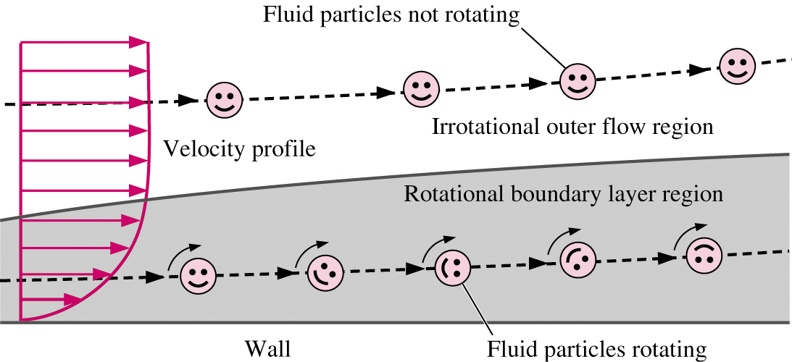
Vorticity and Rotationality

Slide 59
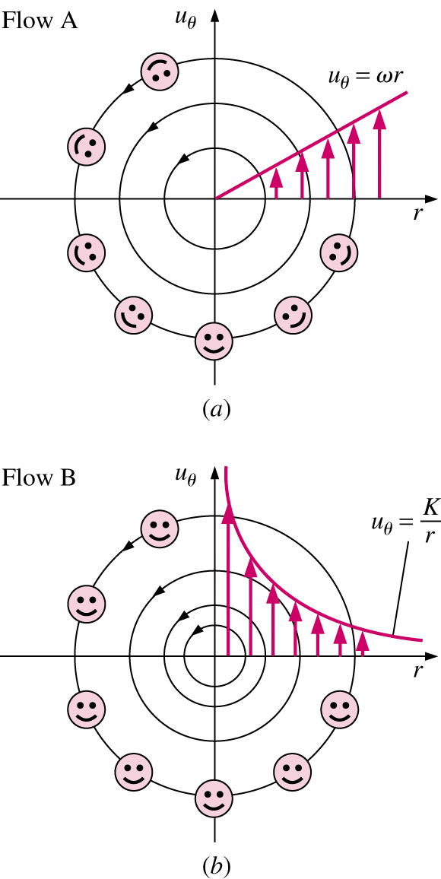
Comparison of Two Circular Flows
Special case: consider two flows with circular streamlines

Slide 60
Reynolds—Transport Theorem (RTT)
A system is a quantity of matter of fixed identity. No mass can cross a system boundary.
A control volume is a region in space chosen for study. Mass can cross a control surface.
The fundamental conservation laws (conservation of mass, energy, and momentum) apply directly to systems.
However, in most fluid mechanics problems, control volume analysis is preferred over system analysis (for the same reason that the Eulerian description is usually preferred over the Lagrangian description).
Therefore, we need to transform the conservation laws from a system to a control volume. This is accomplished with the Reynolds transport theorem (RTT).

Slide 61
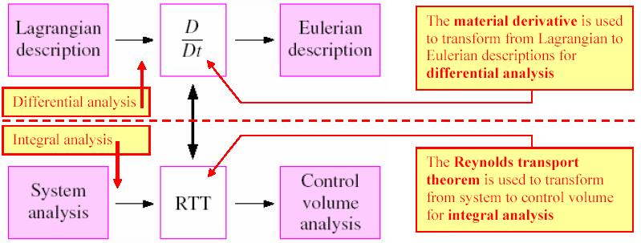
Reynolds—Transport Theorem (RTT)
There is a direct analogy between the transformation from Lagrangian to Eulerian descriptions (for differential analysis using infinitesimally small fluid elements) and the transformation from systems to control volumes (for integral analysis using large, finite flow fields).

Slide 62
Reynolds—Transport Theorem (RTT)
Material derivative (differential analysis):
General RTT, nonfixed CV (integral analysis):
Typically, RTT is applied to conservation of mass, energy, linear momentum and angular momentum.
.
.
 | Mass | Momentum | Energy | Angular momentum
B, Extensive properties | m |  | E
b, Intensive properties | 1 |  | e

Slide 63
Reynolds—Transport Theorem (RTT)
Interpretation of the RTT:
  Time rate of change of the property B of the system is equal to (Term 1) + (Term 2)
  Term 1: the time rate of change of B of the control volume
  Term 2: the net flux of B out of the control volume by mass crossing the control surface
.

Slide 64
RTT Special Cases
For moving and/or deforming control volumes,
Where the absolute velocity V in the second term is replaced by the relative velocity
V_{r} = V -V_{CS}
V_{r} is the fluid velocity expressed relative to a coordinate system moving with the control volume.
.

Slide 65
Balance equations in differential form

Slide 66

Conservation of Mass
From Reynolds Transport Theorem (RTT)
We’ll examine two methods to derive differential form of conservation of mass
  Divergence (Gauss) Theorem
  Differential CV and Taylor series expansions

Slide 67

Conservation of Mass
Divergence Theorem
Divergence theorem allows us to transform a volume integral of the divergence of a vector into an area integral over the surface that defines the volume.

Slide 68




Conservation of Mass
Divergence Theorem
Rewrite conservation of mass
Using divergence theorem, replace area integral with volume integral and collect terms
Integral holds for ANY CV, therefore:

Slide 69


Conservation of Mass
Differential CV and Taylor series
First, define an infinitesimal control volume dx dy dz around a central point P
Next, we approximate the mass flow rate into or out of each of the 6 faces using Taylor series expansions around the center point, e.g., at the right face
P
Ignore terms higher than order dx

Slide 70
Conservation of Mass
Differential CV and Taylor series
Infinitesimal control volume
of dimensions dx, dy, dz
Area of right
face = dy dz
Mass flow rate through
the right face of the
control volume

Slide 71

Conservation of Mass
Differential CV and Taylor series
Now, sum up the mass flow rates into and out of the 6 faces of the CV
Plug into integral conservation of mass equation
Net mass flow rate into CV:
Net mass flow rate out of CV:

Slide 72


Conservation of Mass
Differential CV and Taylor series
After substitution,
Dividing through by volume dxdydz
Or, if we apply the definition of the divergence of a vector

Slide 73



Conservation of Mass
Alternative form
Use product rule on divergence term

Slide 74


Conservation of Mass
Cylindrical coordinates
There are many problems which are simpler to solve if the equations are written in cylindrical-polar coordinates
Easiest way to convert from Cartesian is to use vector form and definition of divergence operator in cylindrical coordinates

Slide 75



Conservation of Mass
Cylindrical coordinates

Slide 76
Conservation of Mass
Special Cases
Steady compressible flow
Cartesian
Cylindrical

Slide 77




Conservation of Mass
Special Cases
Incompressible flow
and ρ = constant
Cartesian
Cylindrical

Slide 78
Conservation of Mass
In general, continuity equation cannot be used by itself to solve for flow field, however it can be used to
  Determine if velocity field is incompressible
  Find missing velocity component

Slide 79



The Stream Function
Consider the continuity equation for an incompressible 2D flow
Substituting the clever transformation
Gives
This is true for any smooth
function ψ(x,y)

Slide 80
The Stream Function
Why do this?
  Single variable ψ replaces (u,v). Once ψ is known, (u,v) can be computed.
  Physical significance
    Curves of constant ψ are streamlines of the flow
    Difference in ψ between streamlines is equal to volume flow rate between streamlines

Slide 81






The Stream Function
Physical Significance
Recall that along a streamline
∴ Change in ψ along streamline is zero

Slide 82


The Stream Function
Physical Significance
Difference in ψ between streamlines is equal to volume flow rate between streamlines
(by definition, no flow can cross a
streamline)

Slide 83

Newton’s Laws
Newton’s laws are relations between motions of bodies and the forces acting on them.
  First law: a body at rest remains at rest, and a body in motion remains in motion at the same velocity in a straight path when the net force acting on it is zero.
  Second law: the acceleration of a body is proportional to the net force acting on it and is inversely proportional to its mass.
  Third law: when a body exerts a force on a second body, the second body exerts an equal and opposite force on the first.

Slide 84

Forces Acting on a CV
Forces acting on CV consist of body forces that act throughout the entire body of the CV (such as gravity, electric, and magnetic forces) and surface forces that act on the control surface (such as pressure and viscous forces, and reaction forces at points of contact).
Body forces act on each volumetric portion dV of the CV.
Surface forces act on each portion dA of the CS.

Slide 85





Body Forces
The most common body force is gravity, which exerts a downward force on every differential element of the CV
The different body force
Typical convention is that
acts in the negative z-direction,
Total body force acting on CV

Slide 86



Surface Forces
Surface forces are not as simple to analyze since they include both normal and tangential components
Diagonal components σ_{xx}, σ_{yy}, σ_{zz} are called normal stresses and are due to pressure and viscous stresses
Off-diagonal components σ_{xy}, σ_{xz}, etc., are called shear stresses and are due solely to viscous stresses
Total surface force acting on CS

Slide 87


Conservation of Linear Momentum
Recall CV form from Chap. 6
Using the divergence theorem to convert area integrals
Body Force
Surface Force
σ_{ij} = stress tensor

Slide 88


Conservation of Linear Momentum
Substituting volume integrals gives,
Recognizing that this holds for any CV, the integral may be dropped
This is Cauchy’s Equation
Can also be derived using infinitesimal CV and Newton’s 2nd law

Slide 89




Conservation of Linear Momentum
Alternate form of the Cauchy Equation can be derived by introducing
Inserting these into Cauchy Equation and rearranging gives
(Chain Rule)

Slide 90
Conservation of Linear Momentum
Unfortunately, this equation is not very useful
  10 unknowns
    Stress tensor, σ_{ij} : 6 independent components
    Density ρ
    Velocity, V : 3 independent components
  4 equations (continuity + momentum)
  6 more equations required to close problem!

Slide 91
Navier-Stokes Equation
First step is to separate σ_{ij} into pressure and viscous stresses
Situation not yet improved
  6 unknowns in σ_{ij} ⇒ 6 unknowns in τ_{ij} + 1 in P, which means that we’ve added 1!
Viscous (Deviatoric)
Stress Tensor

Slide 92


Navier-Stokes Equation
Reduction in the number of variables is achieved by relating shear stress to strain-rate tensor.
For Newtonian fluid with constant properties (with )
(toothpaste)
(paint)
(quicksand)
Newtonian fluid includes most common
fluids: air, other gases, water, gasoline
Newtonian closure is analogous
to Hooke’s Law for elastic solids

Slide 93
An excursus in rheology
“Rheology is the study of the flow of materials that behave in an interesting or unusual manner. Oil and water flow in familiar, normal ways, whereas mayonnaise, peanut butter, chocolate, bread dough, and silly putty flow in complex and unusual ways. In rheology, we study the flows of unusual materials.”
“… all normal or Newtonian fluids (air, water, oil, honey) follow the same scientific laws. On the other hand, there are also fluids that do not follow the Newtonian flow laws. These non-Newtonian fluids, for example mayo, paint, molten plastics, foams, clays, and many other fluids, behave in a wide variety of ways. The science of studying these types of unusual materials is called rheology”
(toothpaste)
(paint)
(quicksand)
Faith Morrison, “The News and Information Publication of The Society of Rheology”, Vol 73(1) Jan 2004, pp 8-10

Slide 94
Examples of Complex Fluids
Foods
  Emulsions (mayonaisse, ice cream)
  Foams (ice cream, whipped cream)
  Suspensions (mustard, chocolate)
  Gels (cheese)
Biofluids
  Suspension (blood)
  Gel (mucin)
  Solutions (spittle)
Personal Care Products
  Suspensions (nail polish, face scrubs)
  Solutions/Gels (shampoos, conditioners)
  Foams (shaving cream)
Electronic and Optical Materials
  Liquid Crystals (Monitor displays)
  Melts (soldering paste)
Pharmaceuticals
  Gels (creams, particle precursors)
  Emulsions (creams)
  Aerosols (nasal sprays)
Polymers

Slide 95
Rheology’s Goals
Establishing the relationship between applied forces and geometrical effects induced by these forces at a point (in a fluid).
  The mathematical form of this relationship is called the rheological equation of state, or the constitutive equation.
  The constitutive equations are used to solve macroscopic problems related to continuum mechanics of these materials.
  Any equation is just a model of physical reality.

Slide 96
Rheology’s Goals
Establishing the relationship between rheological properties of material and its molecular structure (composition).
  Related to:
    Estimating quality of materials
    Understanding laws of molecular movements
    Intermolecular interactions
  Interested in what happens inside a point during deformation of the medium.
  What happens inside a point?

Slide 97
(Material) Structure
More or less well-organized and regularly spaced shapes
Arrangements, organization or intermolecular interactions
Structured Materials – properties change due to the influence of applied of applied forces on the structure of matter
Rheology sometimes is referred to as mechanical spectroscopy.
“Structure Mechanisms” are usually proposed, analogous to reaction mechanisms in reaction kinetics
Structural probes are used to support rheological studies and proposed mechanisms.
Do Newtonian fluids suffer structural changes?

Slide 98
Rheological analysis is based on the use of continuum theories
meaning that:
  There is no discontinuity in transition from one geometrical point to another, and the mathematical analysis of infinitesimal quantities can be used; discontinuities appear only at boundaries
  Properties of materials may change in space (due to gradients) but such changes occur gradually
    changes are reflected in space dependencies of material properties entering equations of continuum theories
  Continuity theories may include an idea of anisotropy of properties of material along different directions.

Slide 99
Rheology as an Interdisciplinary Science
Physics
Chemistry
Rheology
(of Liquids)
Mechanics
of
Continuum
Technology/
Engineering

Slide 100
Common Non-Newtonian Behavior
shear thinning (pseudoplastic)
shear thickening (dilatant)
yield stress
viscoelastic effects
  Weissenberg effect
  Fluid memory
  Die swell

Slide 101

Shear Thinning
shear thinning – tendency of some materials to decrease in viscosity when driven to flow at high shear rates, such as by higher pressure drops
Increasing shear rate

Slide 102
Shear Thickening
shear thickening – tendency of some materials to increase in viscosity when driven to flow at high shear rates

Slide 103
Phenomenological Modeling of Shear Thinning and Thickening
Generalized Newtonian Equation:
Power Law Model:
  m = μ ; n = 1 Newtonian
  m n > 1 shear thickening, dilatant
  m n < 1 shear thinning, pseudoplastic
Advantages: simple, success at predicting Q vs ΔP
Disadvantages: does not describe Newtonian Plateau at small shear rates
.

Slide 104
Modeling of Shear Thinning and Thickening
Carreau-Yasuda Model
  a – affects the shape of the transition region
  λ – time constant determines where it changes from constant to power law
  n – describes the slope of the power law
  η₀, η∞ - describe plateau viscosities
Advantages: fits most data
Disadvantages: contains 5 parameters, do not give molecular insight into polymer behavior

Slide 105
Yield Stress
Tendency of a material to flow only when stresses are above a threshold stress
Bingham Model:
  τ_{y} = yield stress, always positive
  μ₀ = viscosity at higher shear rates

Slide 106

Elastic and Viscoelastic Effects
Weissenberg Effect (rod climbing effect)
  does not flow outward when stirred at high speeds

Slide 107
Elastic and Viscoelastic Effects
Fluid Memory
  Conserve their shape over time periods or seconds or minutes
  Elastic like rubber
  Can bounce or partially retract
  Example: clay (plastilina)

Slide 108
Elastic and Viscoelastic Effects
Viscoelastic fluids subjected to a stress deform
  when the stress is removed, it does not instantly vanish
  internal structure of material can sustain stress for some time
  this time is known as the relaxation time, varies with materials
  due to the internal stress, the fluid will deform on its own, even when external stresses are removed
  important for processing of polymer melts, casting, etc..

Slide 109

Elastic and Viscoelastic Effects – Die Swell
  as a polymer exits a die, the diameter of liquid stream increases by up to an order of magnitude
  caused by relaxation of extended polymer coils, as stress is reduced from high flow producing stresses present within the die to low stresses, associated with the extruded stream moving through ambient air

Slide 110
BACK TO GOOD OLD ‘‘SIMPLE’’ NEWTONIAN FLUIDS, IN THE INCOMPRESSIBLE FLOW LIMIT

Slide 111


Navier-Stokes Equation
Substituting Newtonian closure into stress tensor gives
Using the definition of ε_{ij}
=

Slide 112


Navier-Stokes Equation
Substituting σ_{ij} into Cauchy’s equation gives the Navier-Stokes equations
This results in a closed system of equations!
  4 equations (continuity and momentum equations)
  4 unknowns (U, V, W, p)
Incompressible NSE
written in vector form

Slide 113
Navier-Stokes Equation
In addition to vector form, incompressible N-S equation can be written in several other forms
  Cartesian coordinates
  Cylindrical coordinates
  Tensor notation

Slide 114

Navier-Stokes Equation
Cartesian Coordinates
Continuity
X-momentum
Y-momentum
Z-momentum

Slide 115


Navier-Stokes Equation
Tensor and Vector Notation
Tensor and Vector notation offer a more compact form of the equations.
Continuity
Tensor notation
Vector notation
Conservation of Momentum
Tensor notation
Vector notation
Repeated indices are summed over j
(x₁ = x, x₂ = y, x₃ = z, U₁ = U, U₂ = V, U₃ = W)

Slide 116
Differential Analysis of Fluid Flow Problems
Now that we have a set of governing partial differential equations, there are 2 problems we can solve
  Calculate pressure (P) for a known velocity field
  Calculate velocity (U, V, W) and pressure (P) for known geometry, boundary conditions (BC), and initial conditions (IC)

Slide 117

Exact Solutions of the NSE
There are about 80 known exact solutions to the NSE
The can be classified as:
  Linear solutions where the convective
  term is zero
  Nonlinear solutions where convective term is not zero
Solutions can also be classified by type or geometry
  Couette shear flows
  Steady duct/pipe flows
  Unsteady duct/pipe flows
  Flows with moving boundaries
  Similarity solutions
  Asymptotic suction flows
  Wind-driven Ekman flows

Slide 118
Boundary conditions
Boundary conditions are critical to exact, approximate, and computational solutions.
  BC’s used in analytical solutions are discussed here
    No-slip boundary condition
    Interface boundary condition
  These are used in CFD as well, plus there are some BC’s which arise due to specific issues in CFD modeling.
    Inflow and outflow boundary conditions
    Symmetry and periodic boundary conditions

Slide 119




No-slip boundary condition
For a fluid in contact with a solid wall, the velocity of the fluid must equal that of the wall

Slide 120




Interface boundary condition
When two fluids meet at an interface, the velocity and shear stress must be the same on both sides
If surface tension effects are negligible and the surface is nearly flat

Slide 121




Interface boundary condition
Degenerate case of the interface BC occurs at the free surface of a liquid.
Same conditions hold
Since μ_{air} << μ_{water},
As with general interfaces, if surface tension effects are negligible and the surface is nearly flat P_{water} = P_{air}

Slide 122

Example exact solution (Ex. 9-15)
Fully Developed Couette Flow
For the given geometry and BC’s, calculate the velocity and pressure fields, and estimate the shear force per unit area acting on the bottom plate
Step 1: Geometry, dimensions, and properties

Slide 123

Example exact solution
Fully Developed Couette Flow
Step 2: Assumptions and BC’s
  Assumptions
    Plates are infinite in x and z
    Flow is steady, ∂/∂t = 0
    Parallel flow, V=0
    Incompressible, Newtonian, laminar, constant properties
    No pressure gradient
    2D, W=0, ∂/∂z = 0
    Gravity acts in the -z direction,
  Boundary conditions
    Bottom plate (y=0) : u=0, v=0, w=0
    Top plate (y=h) : u=V, v=0, w=0

Slide 124


Example exact solution
Fully Developed Couette Flow
Note: these numbers refer
to the assumptions on the
previous slide
Step 3: Simplify
3
6
Continuity
This means the flow is “fully developed”
or not changing in the direction of flow
X-momentum
2
Cont.
3
6
5
7
Cont.
6

Slide 125




Example exact solution
Fully Developed Couette Flow
Step 3: Simplify, cont.
Y-momentum
2,3
3
3
3,6
7
3
3
3
Z-momentum
2,6
6
6
6
7
6
6
6

Slide 126




Example exact solution
Fully Developed Couette Flow
Step 4: Integrate
X-momentum
integrate
integrate
Z-momentum
integrate

Slide 127



Example exact solution
Fully Developed Couette Flow
Step 5: Apply BC’s
  y=0, u=0=C₁(0) + C₂ ⇒ C₂ = 0
  y=h, u=V=C₁h ⇒ C₁ = V/h
  This gives
  For pressure, no explicit BC, therefore C₃ can remain an arbitrary constant (recall only ∇P appears in NSE).
    Let p = p₀ at z = 0 (C₃ renamed p₀)
Hydrostatic pressure
Pressure acts independently of flow

Slide 128


Example exact solution
Fully Developed Couette Flow
Step 6: Verify solution by back-substituting into differential equations
  Given the solution (u,v,w)=(Vy/h, 0, 0)
  Continuity is satisfied
    0 + 0 + 0 = 0
  X-momentum is satisfied

Slide 129




Example exact solution (Ex. 9-15)
Fully Developed Couette Flow
Finally, calculate shear force on bottom plate
Shear force per unit area acting on the wall
Note that τ_{w} is equal and opposite to the
shear stress acting on the fluid τ_{yx}
(Newton’s third law).

Slide 130

Adimensionalization of equations and boundary conditions
[appearance of (at least 52!) dimensionless numbers]

Slide 131

K
K
s
s

Slide 132


The compressible equations

Slide 133


Slide 134


Slide 135


Slide 136


Slide 137


Slide 138
Reynolds equations (turbulence)

Slide 139

A crash introduction to turbulence modeling in OpenFOAM®
The majority of natural and engineering flows are turbulent, hence the necessity of modeling turbulence.
Notes:
A buoyant plume of smoke rises from a stick of incense. At first the plume is smooth and laminar, but even in quiescent air, tiny perturbations can sneak into the flow, causing the periodic vortical whorls seen near the top of the photo. Were the frame even taller, we would see this transitional flow become completely chaotic and turbulent. Despite having known the governing equations for such flow for over 150 years, it remains almost impossible to predict the point where flow will transition for any practical problem, largely because the equations are so sensitive to initial conditions. In fact, some of the fundamental mathematical properties of those equations remain unproven. (Photo credit: M. Rosic)

Slide 140

Buoyant plume of smoke rising from a stick of incense
Photo credit: https://www.flickr.com/photos/jlhopgood/
Notes:
A buoyant plume of smoke rises from a stick of incense. At first the plume is smooth and laminar, but even in quiescent air, tiny perturbations can sneak into the flow, causing the periodic vortical whorls seen near the top of the photo. Were the frame even taller, we would see this transitional flow become completely chaotic and turbulent. Despite having known the governing equations for such flow for over 150 years, it remains almost impossible to predict the point where flow will transition for any practical problem, largely because the equations are so sensitive to initial conditions. In fact, some of the fundamental mathematical properties of those equations remain unproven. (Photo credit: M. Rosic)

Slide 141

A crash introduction to turbulence modeling in OpenFOAM®
Buoyant plume of smoke rising from a stick of incense
Photo credit: M. Rosic
Notes:
A buoyant plume of smoke rises from a stick of incense. At first the plume is smooth and laminar, but even in quiescent air, tiny perturbations can sneak into the flow, causing the periodic vortical whorls seen near the top of the photo. Were the frame even taller, we would see this transitional flow become completely chaotic and turbulent. Despite having known the governing equations for such flow for over 150 years, it remains almost impossible to predict the point where flow will transition for any practical problem, largely because the equations are so sensitive to initial conditions. In fact, some of the fundamental mathematical properties of those equations remain unproven. (Photo credit: M. Rosic)

Slide 142

A crash introduction to turbulence modeling in OpenFOAM®
Tugboat riding on the turbulent wake of a ship
Photo credit: https://www.flickr.com/photos/oneeighteen/

Slide 143

A crash introduction to turbulence modeling in OpenFOAM®
Turbulent waters
Photo credit: https://www.flickr.com/photos/thepaegan

Slide 144

A crash introduction to turbulence modeling in OpenFOAM®
Spring vortex in turbulent waters
Photo credit: https://www.flickr.com/photos/kenii/

Slide 145

A crash introduction to turbulence modeling in OpenFOAM®
Wake turbulence behind individual wind turbines
Photo credit: NREL's wind energy research group.
Notes:
Wake turbulence behind individual wind turbines can be seen in the fog in this aerial photo of the Horns Rev wind farm off the Western coast of Denmark. Data collected from wind farms such as this one provide validation to simulation models.

Slide 146

A crash introduction to turbulence modeling in OpenFOAM®
Von Karman vortices created when prevailing winds sweeping east across the northern Pacific Ocean encounters Alaska's Aleutian Islands
Photo credit: USGS EROS Data Center Satellite Systems Branch.

Slide 147

A crash introduction to turbulence modeling in OpenFOAM®
Von Karman Vortex Streets in the northern Pacific Photographed from the International Space Station
Photo credit: NASA
Notes:
Von Karman Vortex Streets in the northern Pacific Photographed from the International Space Station by NASA astronaut Dan Burbank, January 8, 2012

Slide 148

A crash introduction to turbulence modeling in OpenFOAM®
Trailing vortices
Photo credit: Steve Morris. AirTeamImages.

Slide 149



A crash introduction to turbulence modeling in OpenFOAM®
Vortices on a 1/48-scale model of an F/A-18 aircraft inside a Water Tunnel
Photo credit: NASA Dryden Flow Visualization Facility. http://www.nasa.gov/centers/armstrong/multimedia/imagegallery/FVF
Notes:
This image shows a plastic 1/48-scale model of an F/A-18 aircraft inside the "Water Tunnel"
© Copyright on the images is held by the contributors. Apart from Fair Use, permission must be sought for any other purpose.
http://www.nasa.gov/centers/armstrong/multimedia/imagegallery/FVF

Slide 150

A crash introduction to turbulence modeling in OpenFOAM®
Wind Tunnel Test of New Tennis Ball
Photo credit: NASA http://tennisclub.gsfc.nasa.gov/tennis.windtunnelballs.html
Notes:
http://tennisclub.gsfc.nasa.gov/tennis.windtunnelballs.html

Slide 151

A crash introduction to turbulence modeling in OpenFOAM®
Bullet at Mach 1.5
Photo credit: Andrew Davidhazy. Rochester Institute of Technology.
Notes:
BULLET AT MACH 1.5
Andrew Davidhazy
Rochester Institute of Technology
© Copyright on the images is held by the contributors. Apart from Fair Use, permission must be sought for any other purpose.

Slide 152

A crash introduction to turbulence modeling in OpenFOAM®
Flow visualization over a spinning spheroid
Photo credit: Y. Kohama.
Notes:
Any time there is relative motion between a solid and a fluid, a small region near the surface will see a large change in velocity. This region, shown with smoke in the image above, is called the boundary layer. Here air flows from right to left over a spinning spheroid. At first, the boundary layer is laminar, its flow smooth and orderly. But tiny disturbances get into the boundary layer and one of them begins to grow. This disturbance ultimately causes the evenly spaced vortices we see wrapping around the mid-section of the model. These vortices themselves become unstable a short distance later, growing wavy before breaking down into complete turbulence. (Photo credit: Y. Kohama)

Slide 153

A crash introduction to turbulence modeling in OpenFOAM®
Flow around an airfoil with a leading-edge slat
Photo credit: S. Makiya et al.
Notes:
Flow around an airfoil with a leading-edge slat is visualized above. At this Reynolds number, alternating periodic vortices are shed in its wake. Understanding how multi-element airfoils and control surfaces affect local flow is important in controlling aircraft aerodynamics. When multiple instabilities interact—like those in the wing’s boundary layer interacting with the wake’s—it can generate disturbances that are problematic in flight. Being able to predict and avoid such behavior is important for safe aircraft. (Photo credit: S. Makiya et al.)

Slide 154

A crash introduction to turbulence modeling in OpenFOAM®
Modeling turbulence is not an easy task.
There is no universal turbulence model, hence you need to know the capabilities and limitations of the turbulence models.
Turbulence can be wall bounded or free shear. Depending of what you want to simulate, you will need to choose an appropriate turbulence model and simulation techniques.
Simulating turbulent flows in any CFD solver requires selecting a turbulence model, providing initial conditions and boundary conditions for the closure equations of the turbulent model, and selecting a near-wall modeling.
You also need to choose the discretization scheme of the turbulent equations.

Slide 155

A crash introduction to turbulence modeling in OpenFOAM®
“Essentially, all models are wrong, but some are useful”
G.E.P Box
Equations cannot be derived from fundamental principles.
All turbulence models contain some sort of empiricism.
Some calibration to observed physical solutions is contained in the turbulence models.
Also, some intelligent guessing is used.
A lot of uncertainty is involved!

Slide 156
A crash introduction to turbulence modeling in OpenFOAM®
Turbulence near the wall - Law of the wall

Slide 157
A crash introduction to turbulence modeling in OpenFOAM®
Energy spectrum for a turbulent flow – log-log scales

Slide 158
A crash introduction to turbulence modeling in OpenFOAM®
Turbulence near the wall

Slide 159
A crash introduction to turbulence modeling in OpenFOAM®
Turbulence near the wall

Slide 160
A crash introduction to turbulence modeling in OpenFOAM®
Turbulence near the wall

Slide 161
A crash introduction to turbulence modeling in OpenFOAM®
Overview of turbulence modeling approaches
RANS
URANS
SAS
DES
LES
DNS
Increasing computational costs
Increasing complexity

Slide 162


A crash introduction to turbulence modeling in OpenFOAM®
Overview of turbulence modeling approaches
RANS
LES
RANS/URANS | DES/LES | DNS
Solves the time-averaged NSE. All turbulent spatial scales are modeled. Many models are available. One equation models, two equation models, Reynolds stress models, transition models, and so on. This is the most widely approach for industrial flows. Unsteady RANS (URANS), use the same equations as the RANS but with the transient term retained. It can be used in 2D and 3D cases. | Solves the filtered unsteady NSE. SGS scales are modeled, GS are resolved. Resolves the temporal scales, hence requires small time-steps. For most industrial applications, it is computational expensive. However, thanks to the current advances in parallel and scientific computing it is becoming affordable. Many models are available. It is intrinsically 3D and asymmetric. | Solves the unsteady laminar NSE. Solves all spatial and temporal scales; hence, requires extremely fine meshes and small time-steps. No modeling is required. It is extremely computational expensive. Not practical for industrial flows. It is intrinsically 3D and asymmetric.

Slide 163
A crash introduction to turbulence modeling in OpenFOAM®
Short description of some of the turbulence models available in commercial CFD codes
Model | Short description
Spalart-Allmaras | Suitable for external aerodynamics, tubomachinery and high speed flows. Good for mildly complex external/internal flows and boundary layer flows under pressure gradient. Performs poorly for free shear flows and flows with strong separation.
Standard k–epsilon | Robust. Widely used despite the known limitations of the model. Performs poorly for complex flows involving severe pressure gradient, separation, strong streamline curvature. Suitable for initial iterations, initial screening of alternative designs, and parametric studies.
Realizable k–epsilon | Suitable for complex shear flows involving rapid strain, moderate swirl, vortices, and locally transitional flows (e.g. boundary layer separation, massive separation, and vortex shedding behind bluff bodies, stall in wide-angle diffusers, room ventilation). It overcome the limitations of the standard k-epsilon model.
Standard k–omega | Superior performance for wall-bounded boundary layer, free shear, and low Reynolds number flows compared to models from the k-epsilon family. Suitable for complex boundary layer flows under adverse pressure gradient and separation (external aerodynamics and turbomachinery).
SST k–omega | Offers similar benefits as standard k–omega. Not overly sensitive to inlet boundary conditions like the standard k–omega. Provides more accurate prediction of flow separation than other RANS models.

Slide 164
A crash introduction to turbulence modeling in OpenFOAM®
Turbulence models available in commercial CFD software
If you have absolutely no idea of what model to use, I highly recommend you the family models or the realizable
Remember, when a turbulent flow enters a domain, turbulent boundary conditions and initial conditions must be specified.
Also, if you are dealing with wall bounded turbulence you will need to choose the near-wall treatment. You can choose to solve the viscous sub-layer or use wall functions.
You will need to give the appropriate boundary conditions to the near-wall treatment.

Slide 165

A crash introduction to turbulence modeling in OpenFOAM®
Near-wall treatment and wall functions

Slide 166
A crash introduction to turbulence modeling in OpenFOAM®
Near-wall treatment and wall functions
No wall-functions
Wall-functions
Generally speaking, wall functions is the approach to use if you are more interested in the mixing in the outer region, rather than the forces on the wall.
By the way, wall functions should never be used if . What is ? We are going to talk about this later on.
If accurate prediction of forces or heat transfer on the wall are key to your simulation (aerodynamic drag, turbomachinery blade performance, heat transfer) you might not want to use wall functions.

Slide 167
A crash introduction to turbulence modeling in OpenFOAM®
Near-wall treatment and wall functions
If the first node normal to the wall is in the viscous sub-layer region, you do not use wall functions. This approach is computationally expensive.
Instead, if the first node normal to the wall is in the log-law layer, you need to use wall functions.
When positioning the first node normal to the wall, try to avoid as much as possible the buffer layer, this is the transition region and things are not very clear there.

Slide 168

A crash introduction to turbulence modeling in OpenFOAM®
Turbulence model overview

Slide 169
A crash introduction to turbulence modeling in OpenFOAM®
Turbulence model overview
It is called because it solves two additional equations for modeling the turbulence, namely, the turbulent kinetic energy and the specific kinetic energy .

Slide 170
A crash introduction to turbulence modeling in OpenFOAM®
Turbulence model overview
At the end of the day, we want to determine the turbulent eddy viscosity
The turbulent eddy viscosity is used to compute the Reynolds stress tensor,
The Reynolds stress tensor is derived from the Boussinesq Approximation.

Slide 171
A crash introduction to turbulence modeling in OpenFOAM®
Incompressible RANS equations
The following equations are the incompressible Reynolds-Averaged Navier-Stokes equations (RANS). These are the equations we want to solve.
where is the Reynolds stress tensor and is given by,
To arrive to these equations, we used Reynolds averaging.

Slide 172

A crash introduction to turbulence modeling in OpenFOAM®
Turbulence model free-stream boundary conditions

Slide 173
A crash introduction to turbulence modeling in OpenFOAM®
Turbulence model free-stream boundary conditions
The initial value for the turbulent kinetic energy can be found as follows
The initial value for the specific kinetic energy can be found as follows
Where is the viscosity ratio and is the turbulence intensity.

Slide 174
A crash introduction to turbulence modeling in OpenFOAM®
Turbulence model free-stream boundary conditions
If you are totally lost, you can use these reference values. They work most of the times, but it is a good idea to have some experimental data or initial estimate.
By the way, use these guidelines for external aerodynamics only.
 | Low | Medium | High
 | 1.0 % | 5.0 % | 10.0 %
 | 1 | 10 | 100

Slide 175

A crash introduction to turbulence modeling in OpenFOAM®
Turbulence model wall functions

Slide 176
A crash introduction to turbulence modeling in OpenFOAM®
Turbulence model wall functions
Follow these guidelines if you are struggling to find the boundary conditions for the near-wall treatment.
I highly recommend you to read the source code and find the references used to implement the model.
As for the free-stream boundary conditions, you need to give the boundary conditions for the near-wall treatment.
When it comes to near-wall treatment, you have three options:
  Use wall functions:
  Use scalable wall functions, this only applies with the family models:
  Resolve the boundary layer (no wall functions):

Slide 177

A crash introduction to turbulence modeling in OpenFOAM®
wall distance units

Slide 178
A crash introduction to turbulence modeling in OpenFOAM®
wall distance units
To compute the wall distance units , use the following equation
Where is the distance to the first cell center normal to the wall, and is the friction velocity and is equal to
  where is the wall shear stresses.

Slide 179
A crash introduction to turbulence modeling in OpenFOAM®
wall distance units
We never know a priori the value.
What we usually do is to run the simulation for a few time-steps or iterations, and then we get an estimate of the value.
After determining where we are in the boundary layer (viscous sub-layer, buffer layer or log-law layer), we take the mesh as a good one or we modify it if is deemed necessary.
It is an iterative process and it can be very time consuming.
Have in mind that it is quite difficult to get uniform values at the walls. This does not mean that what you have done is wrong, use common sense.
To get an initial estimate of the distance from the wall to the first cell center , you can proceed as follows,

Slide 180
A crash introduction to turbulence modeling in OpenFOAM®
Estimating normal wall distance
To estimate the distance from the wall to the first cell center you can proceed as follows,
1.
2.
Skin friction coefficient of a flat plate
3.
4.
5.

Slide 181

A crash introduction to turbulence modeling in OpenFOAM®
Turbulence modeling guidelines and tips

Slide 182
A crash introduction to turbulence modeling in OpenFOAM®
Turbulence modeling guidelines and tips
Compute Reynolds number and determine whether the flow is turbulent.
Estimate before generating the mesh.
Run the simulation for a few time steps and get a better prediction of and correct your initial prediction of .
The realizable or models are good choices for general applications.
If you are interesting in modeling the smallest eddies, DES or LES is the right choice.
If you do not have any restriction in the near wall treatment method, use wall functions.
Choose your near-wall modeling strategy ahead of time and check and values to make sure the near-wall mesh is suitable.

Slide 183

A few applications

Slide 184


A crash introduction to turbulence modeling in OpenFOAM®
LES simulation
Iso-surfaces of Q criterion. Walls colored by instantaneous pressure.

Slide 185

A crash introduction to turbulence modeling in OpenFOAM®
LES simulation
Cut plane with instantaneous velocity magnitude. Walls colored by instantaneous pressure.

Slide 186


A crash introduction to turbulence modeling in OpenFOAM®
LES simulation
Instantaneous velocity magnitude.
Instantaneous vorticity magnitude.

Slide 187

A crash introduction to turbulence modeling in OpenFOAM®
LES simulation
Mesh and instantaneous velocity magnitude.

Slide 188
A crash introduction to turbulence modeling in OpenFOAM®
LES simulation
Energy spectrum and -5/3 slope.

Slide 189


A crash introduction to turbulence modeling in OpenFOAM®
LES simulation vs. RANS simulation
LES
RANS
LES
RANS
LES simulations are colored by instantaneous values.
RANS simulations are colored by mean values.

Slide 190

A crash introduction to turbulence modeling in OpenFOAM®
LES simulation vs. RANS simulation
LES (instantaneous velocity)
RANS

Slide 191

A crash introduction to turbulence modeling in OpenFOAM®
LES simulation vs. RANS simulation
LES (instantaneous velocity)
RANS

Slide 192

A crash introduction to turbulence modeling in OpenFOAM®
LES simulation vs. RANS simulation
LES (Mean velocity)
RANS

Slide 193

A crash introduction to turbulence modeling in OpenFOAM®
DES simulation
Iso-surfaces of Q criterion.

Slide 194

A crash introduction to turbulence modeling in OpenFOAM®
SAS simulation
Iso-surfaces of vorticity magnitude.

Slide 195

A crash introduction to turbulence modeling in OpenFOAM®
URANS simulation
Iso surfaces of Q criteron.
Iso-surfaces of Q criterion.

Slide 196
Computational Fluid Dynamics (CFD)

Slide 197
Introduction
Practice of engineering and science has been dramatically altered by the development of
  Scientific computing
  Mathematics of numerical analysis
  The Internet
Computational Fluid Dynamics is based upon the logic of applied mathematics
  provides tools to unlock previously unsolved problems
  is used in nearly all fields of science and engineering
    Aerodynamics, acoustics, bio-systems, cosmology, geology, heat transfer, hydrodynamics, river hydraulics, etc…

Slide 198
Introduction
We are in the midst of a new Scientific Revolution as significant as that of the 16th and 17th centuries when Galilean methods of systematic experiments and observation supplanted the logic-based methods of Aristotelian physics
Modern tools, i.e., computational mechanics, are enabling scientists and engineers to return to logic-based methods for discovery and invention, research and development, and analysis and design

Slide 199


Introduction
History of computing
Mastodons of computing, 1945-1960
  Early computer engineers thought that only a few dozen computers required worldwide
  Applications: cryptography (code breaking), fluid dynamics, artillery firing tables, atomic weapons
  ENIAC, or Electronic Numerical Integrator Analyzor and Computer, was developed by the Ballistics Research Laboratory in Maryland and was built at the University of Pennsylvania's Moore School of Electrical Engineering and completed in November 1945

Slide 200



Introduction
High-performance computing
Top 500 computers in the world compiled: www.top500.org
Computers located at major centers connected to researchers via Internet

Slide 201
Outline
CFD Process
  Model Equations
  Discretization
  Grid Generation
  Boundary Conditions
  Solve
  Post-Processing
  Uncertainty Assessment

Slide 202
Model Equations
Most commercial CFD codes solve the continuity, Navier-Stokes, and energy equations
    Coupled, non-linear, partial differential equations
    For example, incompressible form

Slide 203
Discretization
Grid Generation
Flow field must be treated as a discrete set of points (or volumes) where the governing equations are solved.
Many types of grid generation: type is usually related to capability of flow solver.
  Structured grids
  Unstructured grids
  Hybrid grids: some portions of flow field are structured (viscous regions) and others are unstructured
  Overset (Chimera) grids

Slide 204



Structured Grids

Slide 205




Structured Overset Grids
Submarine
Surface Ship Appendages
Moving Control Surfaces
Artificial Heart Chamber

Slide 206



Unstructured Grids
Structured-Unstructured Nozzle Grid
Branches in Human Lung

Slide 207
Discretization
Algebraic equations
To solve NSE, we must convert governing PDE’s to algebraic equations
  Finite difference methods (FDM)
    Each term in NSE approximated using Taylor series, e.g.,
  Finite volume methods (FVM)
    Use CV form of NSE equations on each grid cell !
    Most popular approach, especially for commercial codes
  Finite element methods (FEM)
    Solve PDE’s by replacing continuous functions by piecewise approximations defined on polygons, which are referred to as elements.

Slide 208
Boundary Conditions
Typical conditions
  Wall
    No-slip (u = v = w = 0)
    Slip (tangential stress = 0, normal velocity = 0)
    With specified suction or blowing
    With specified temperature or heat flux
  Inflow
  Outflow
  Interface Condition, e.g., Air-water free surface
  Symmetry and Periodicity
Usually set through the use of a graphical user interface (GUI) – click & set

Slide 209

Solve
Run CFD code on computer
  2D and small 3D simulations can be run on desktop computers (e.g., FlowLab)
  Unsteady 3D simulations still require large parallel computers
Monitor Residuals
  Defined two ways
    Change in flow variables between iterations
    Error in discrete algebraic equation
R

Slide 210
Uncertainty Assessment
Process of estimating errors due to numerics and modeling
  Numerical errors
    Iterative non-convergence: monitor residuals
    Spatial errors: grid studies and Richardson extrapolation
    Temporal errors: time-step studies and Richardson extrapolation
  Modeling errors (turbulence modeling, multi-phase physics, closure of viscous stress tensor for non-Newtonian fluids)
    Only way to assess is through comparison with benchmark data which includes EFD uncertainty assessment.

Slide 211
Conclusions
Capabilities of Current Technology
  Complex real-world problems solved using Scientific Computing
  Commercial software available for certain problems
  Simulation-based design (i.e., logic-based) is being realized.
  Ability to study problems that are either expensive, too small, too large, or too dangerous to study in laboratory
    Very small: nano- and micro-fluidics
    Very large: cosmology (study of the origin, current state, and future of our Universe)
    Expensive: engineering prototypes (ships, aircraft)
    Dangerous: explosions, response to weapons of mass destruction

Slide 212
Conclusions
Limitations of Current Technology
  For fluid mechanics, many problems not adequately described by Navier-Stokes equations or are beyond current generation computers.
    Turbulence
    Multi-phase physics: solid-gas (pollution, soot), liquid-gas (bubbles, cavitation); solid-liquid (sediment transport)
    Combustion and chemical reactions
    Non-Newtonian fluids (blood; polymers)
  Similar modeling challenges in other branches of engineering and the sciences

Slide 213
Conclusions
Because of limitations, need for experimental research is great
However, focus has changed
  From
    Research based solely upon experimental observations
    Build and test (although this is still done)
  To
    High-fidelity measurements in support of validation and building new computational models.
Currently, the best approach to solving engineering problems often uses simulation and experimentation

Slide 214


Thank you for your attention

