Slide 1




An experimental setup to investigate intermittency in pipe systems
Università degli Studi di Genova
Corso di Laurea Magistrale in Ingegneria Meccanica Energia & Aeronautica
Relatori:
Prof. Alessandro Bottaro
Prof. R.I. Sujith
Candidato:
Diego Zangrillo
Luglio 2015

Slide 2



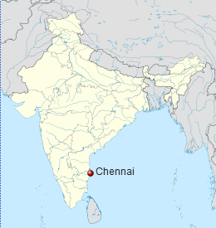
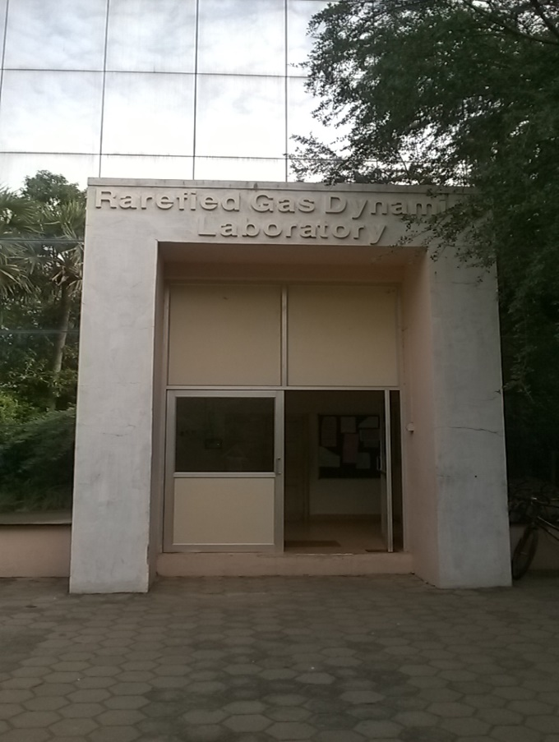
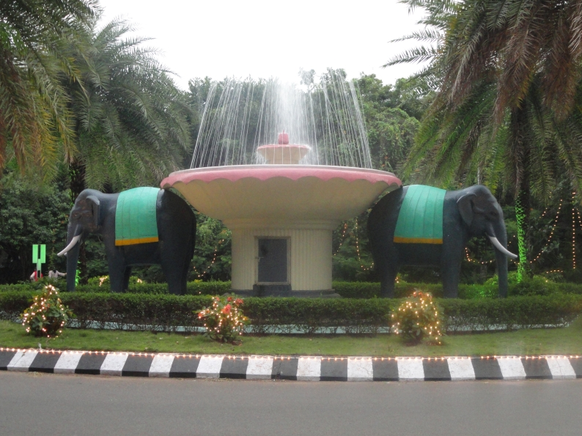

Indian Institute of Technology Madras

Slide 3
Purpose of the work
Investigate Aeroacoustic Intermittency in a very simple experimental setup to understand, predict and avoid it in real systems
For example:
In compressor stations of gas transport
In combustor of aircraft engines
In safety valves on boilers

Slide 4
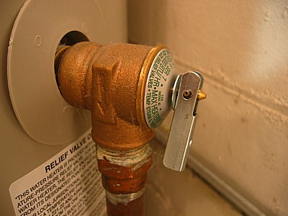
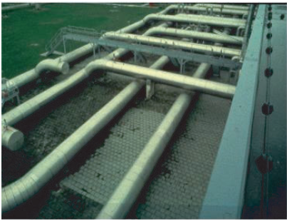
Example of events which happened in the past because of Aeroacoustic Instabilities:
Oklahoma Gas and Electric Company:
safety valves installed on boilers
The steam dryer in the boiling water reactor (BWR) of Quad Cities Unit 2 (QC2)
D. Tonon, A. Hirschberg, J. Golliard and S. Ziada, Aeroacoustics of pipe systems with closed branches, Eindhoven University of Technology, 2010

Slide 5
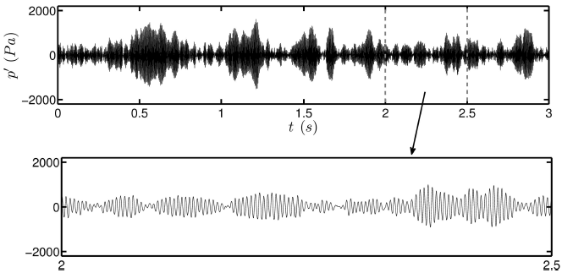
Between chaos and order: Intermittency

Slide 6
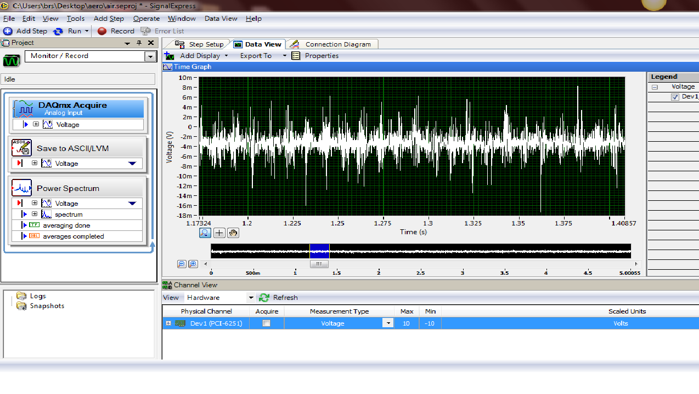
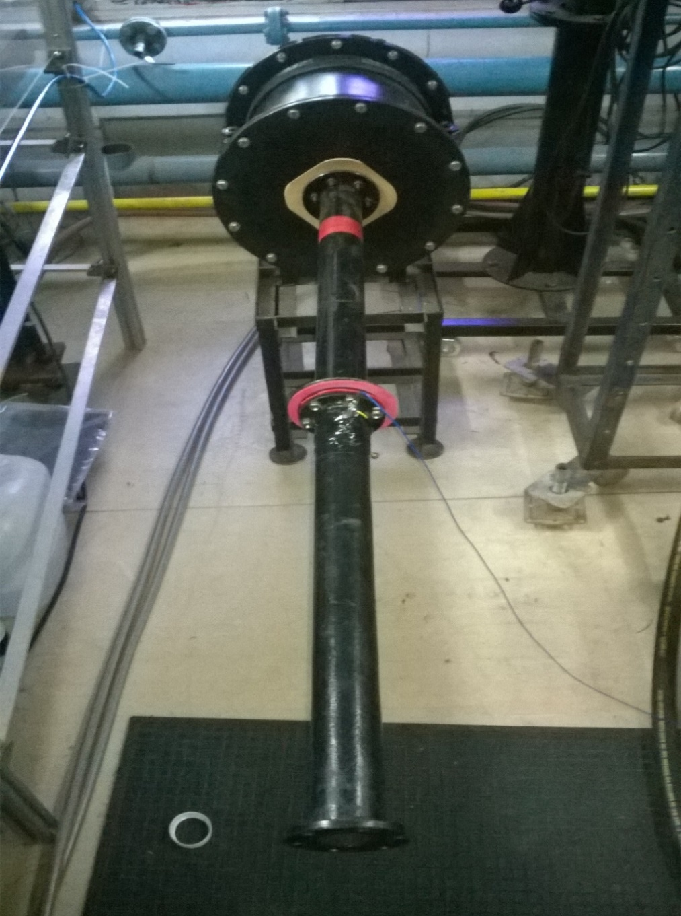
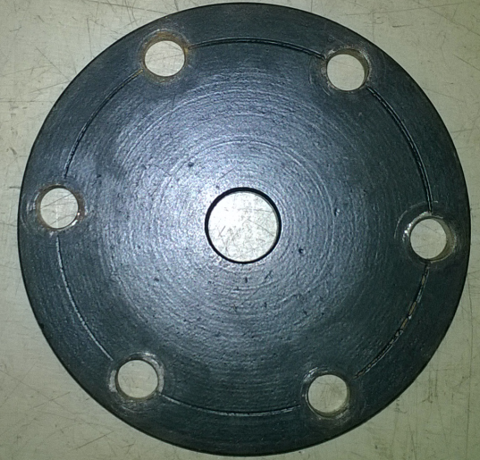
Experimental Setup
Settling chamber
orifice
Sampling Time= 30 s
F_{s} = 10 KHz
microphone
Dimensions:
L = 600 mm
D = 50 mm
d₀= 10 mm
t = 5 mm
L_{c} = 300 mm
d_{c} = 300 mm
open end

Slide 7
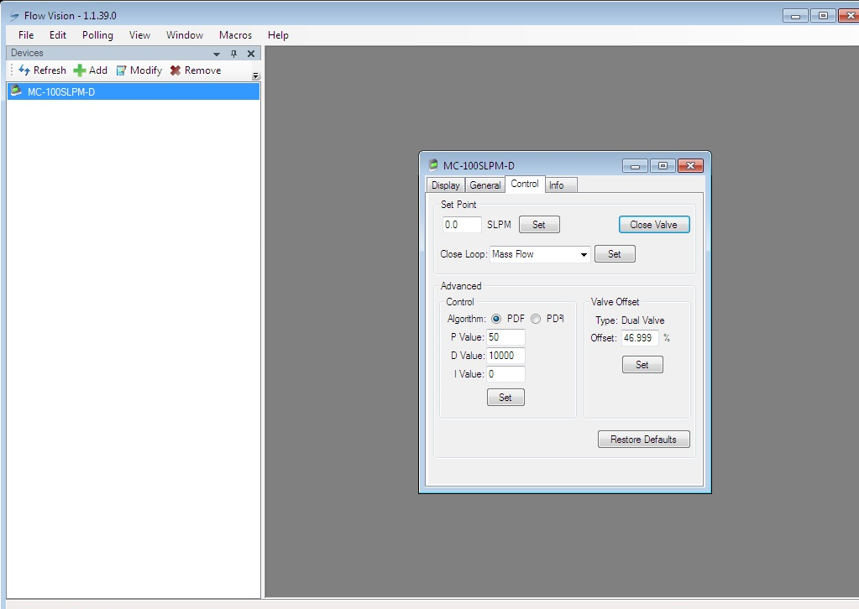
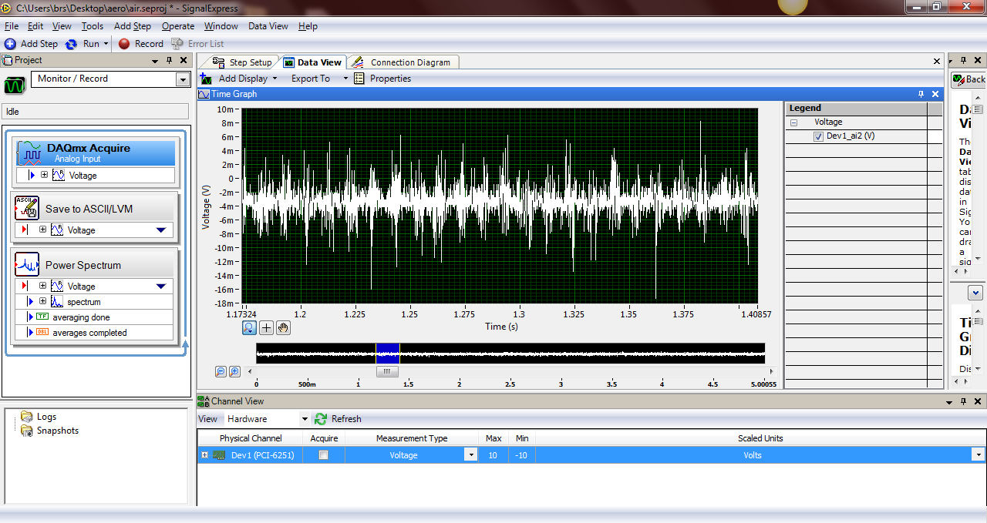
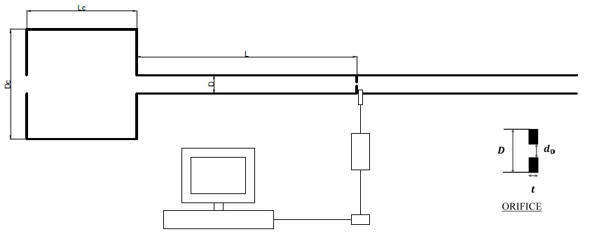
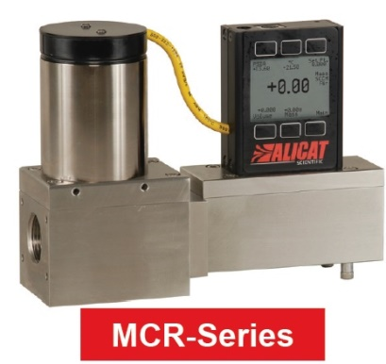
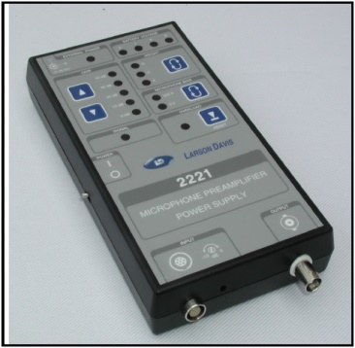
Acquiring System

Slide 8
Data Analysis
Fast Fourier Transform
Hurst exponent
Recurrence Plot
Recurrence Quantification Analysis

Slide 9
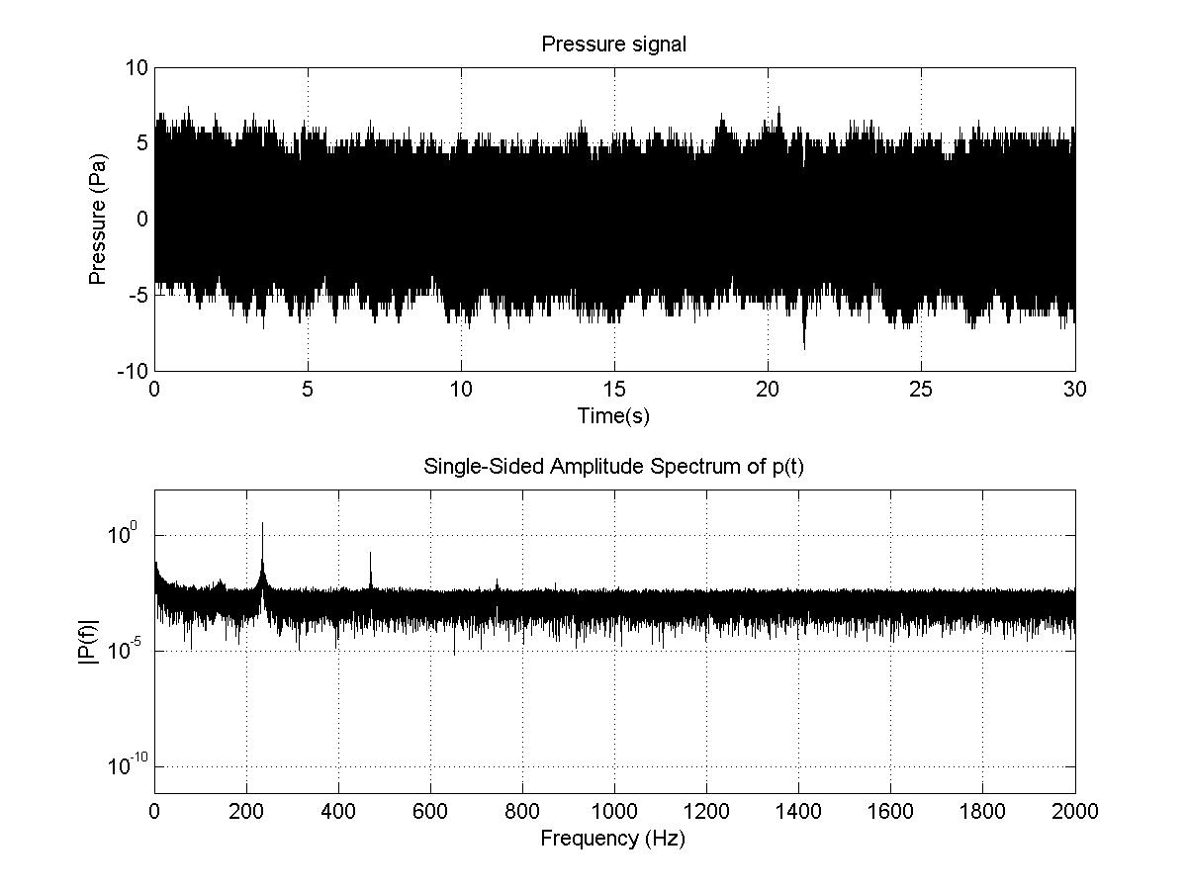

In Orifice
Case (A)
Re = 3097
Ma = 0.014
Case (B)
Re = 4588
Ma = 0.021
Case (C)
Re = 4818
Ma = 0.022
Case (D)
Re = 5047
Ma = 0.023
Case (A)

Slide 10
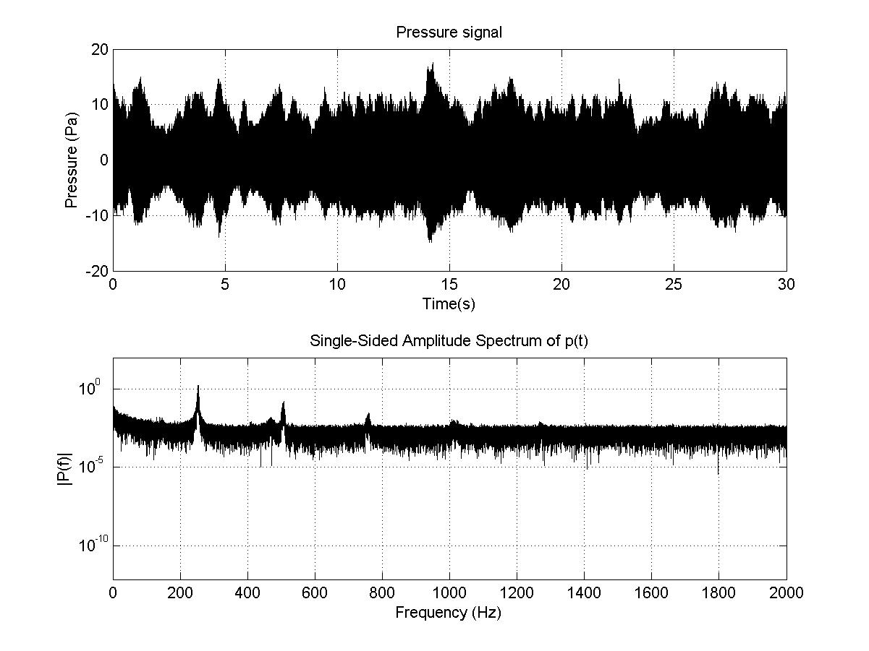
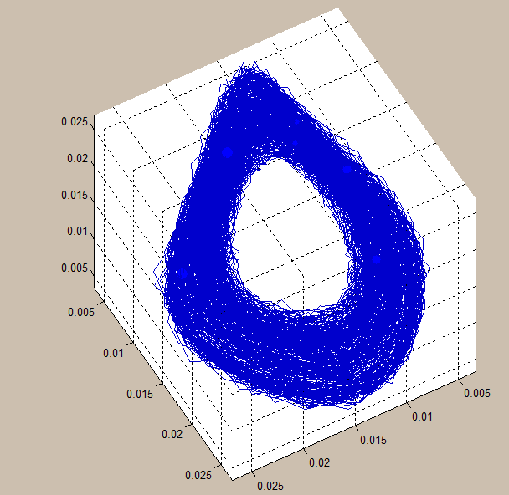
In Orifice
Case (A)
Re = 3097
Ma = 0.014
Case (B)
Re = 4588
Ma = 0.021
Case (C)
Re = 4818
Ma = 0.022
Case (D)
Re = 5047
Ma = 0.023
Case (B)

Slide 11
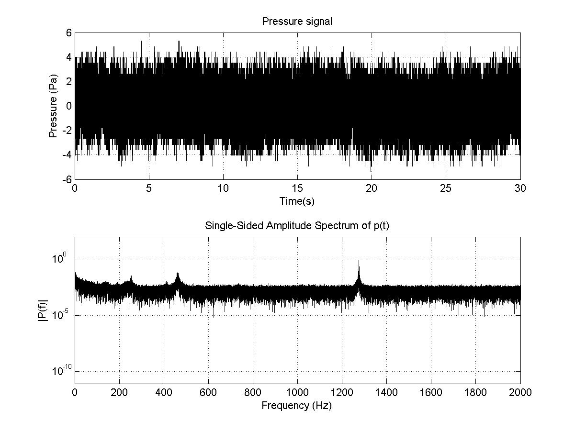
In Orifice
Case (A)
Re = 3097
Ma = 0.014
Case (B)
Re = 4588
Ma = 0.021
Case (C)
Re = 4818
Ma = 0.022
Case (D)
Re = 5047
Ma = 0.023
Case (C)

Slide 12
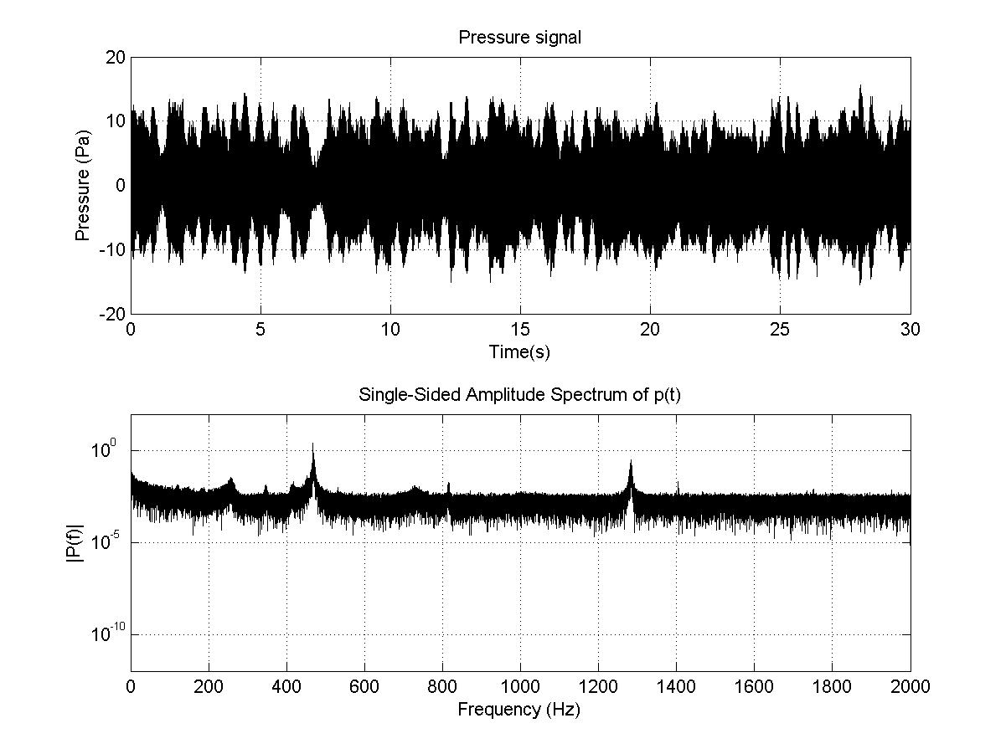
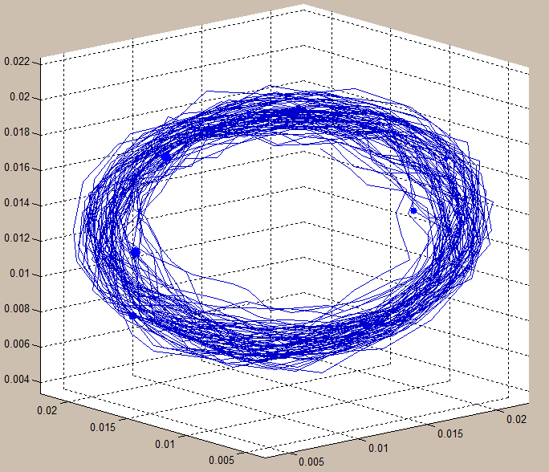
In Orifice
Case (A)
Re = 3097
Ma = 0.014
Case (B)
Re = 4588
Ma = 0.021
Case (C)
Re = 4818
Ma = 0.022
Case (D)
Re = 5047
Ma = 0.023
Case (D)

Slide 13
Frequency vs Air Flow Rate vs Amplitude
C
D
B
A

Slide 14
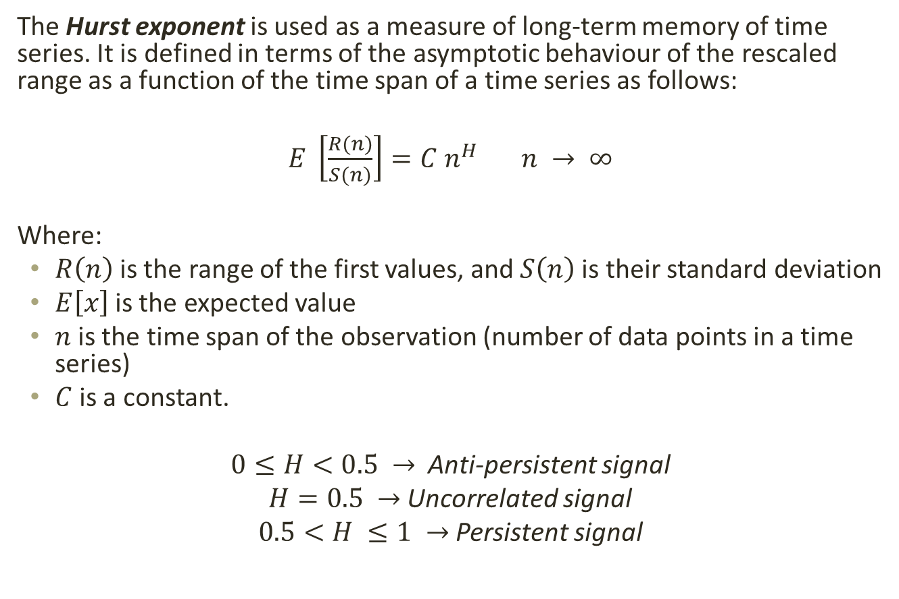
Hurst Exponent
The Hurst exponent is used as a measure of long-term memory of time series. It is defined in terms of the asymptotic behaviour of the rescaled range as a function of the time span of a time series as follows:
$E \left[\frac{R(n)}{S(n)}\right]=C n^{H} n → ∞$
Where:
$R\left(n\right)$is the range of the first values, and $S\left(n\right)$is their standard deviation
$E\left[x\right]$is the expected value
$n$is the time span of the observation (number of data points in a time series)
$C$is a constant.
$0≤H<0.5 →$ Anti-persistent signal
$H=0.5 →$ Uncorrelated signal
$0.5<H ≤1 →$ Persistent signal

Slide 15
Hurst Exponent

Slide 16
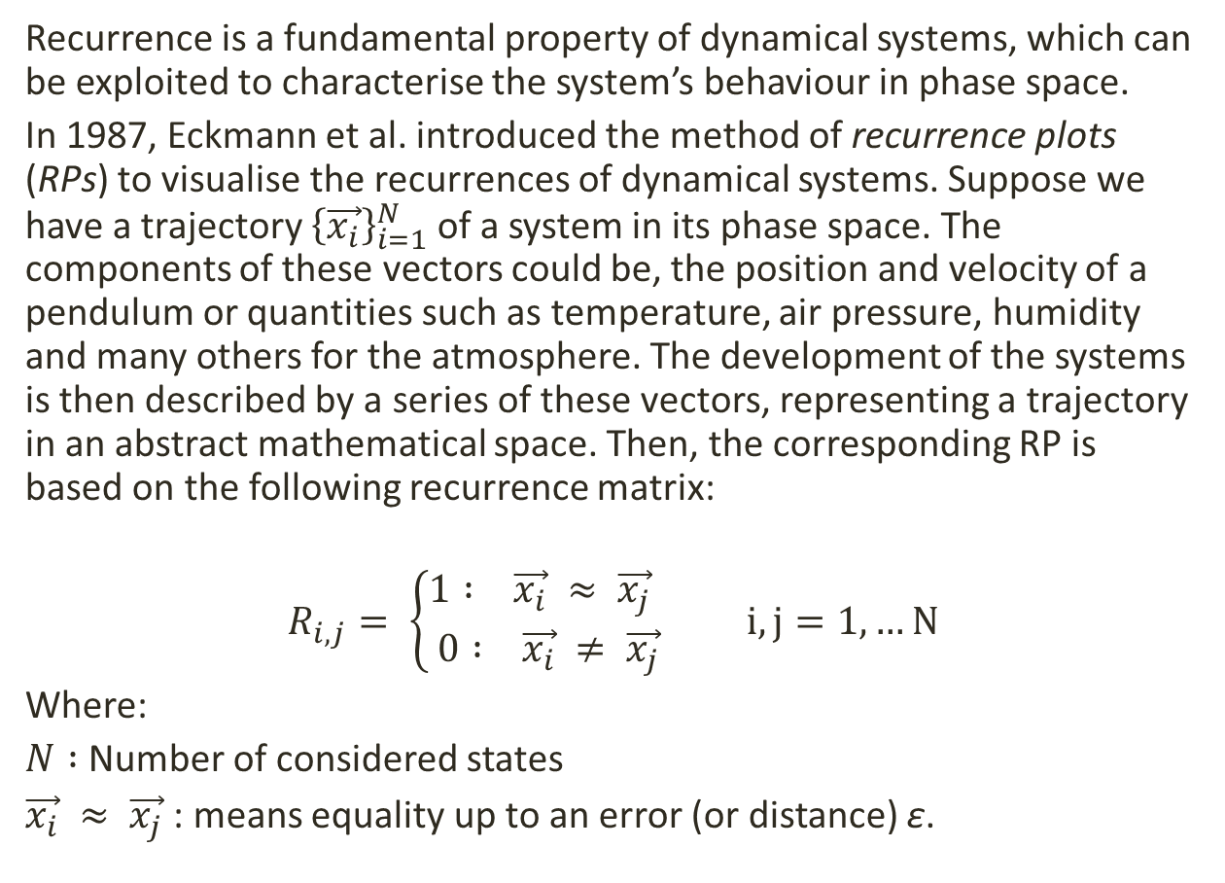
Recurrence Plot
Recurrence is a fundamental property of dynamical systems, which can be exploited to characterise the system’s behaviour in phase space.
In 1987, Eckmann et al. introduced the method of recurrence plots (RPs) to visualise the recurrences of dynamical systems. Suppose we have a trajectory ${\left\{\vec{x_{i}}\right\}}_{i=1}^{N}$of a system in its phase space. The components of these vectors could be, the position and velocity of a pendulum or quantities such as temperature, air pressure, humidity and many others for the atmosphere. The development of the systems is then described by a series of these vectors, representing a trajectory in an abstract mathematical space. Then, the corresponding RP is based on the following recurrence matrix:
$$R_{i,j}= \left\{\begin{aligned}1 : \vec{x_{i}} ≈ \vec{x_{j}} \\ 0 : \vec{x_{i}} ≠ \vec{x_{j}}\end{aligned}\right. i, j=1,…N$$
Where:
$N :$ Number of considered states
$\vec{x_{i}} ≈ \vec{x_{j}}$: means equality up to an error (or distance) ε.
Ref: N. Marwan, M. Carmen Romano, M. Thiel, J. Kurths, Recurrence plots for the analysis of complex systems, University of Potsdam, 2006

Slide 17
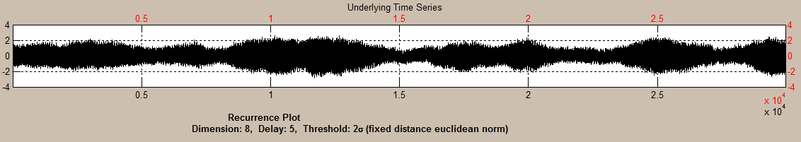
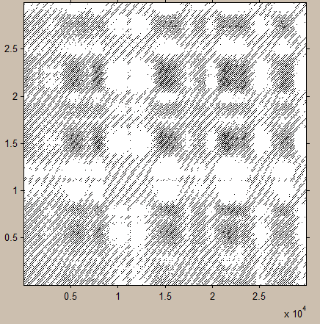

Slide 18
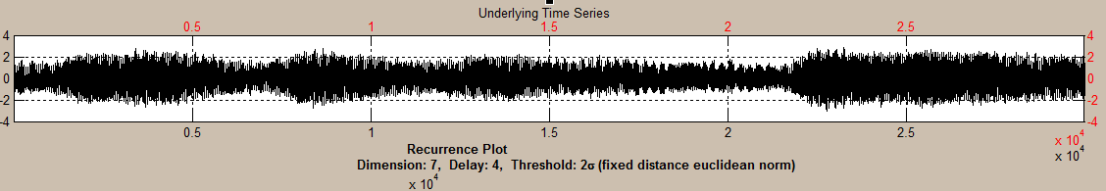
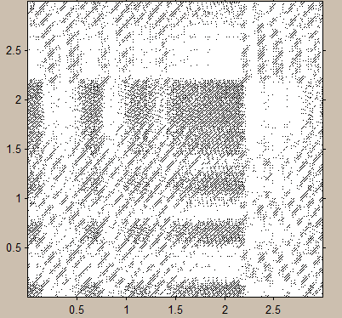

Slide 19
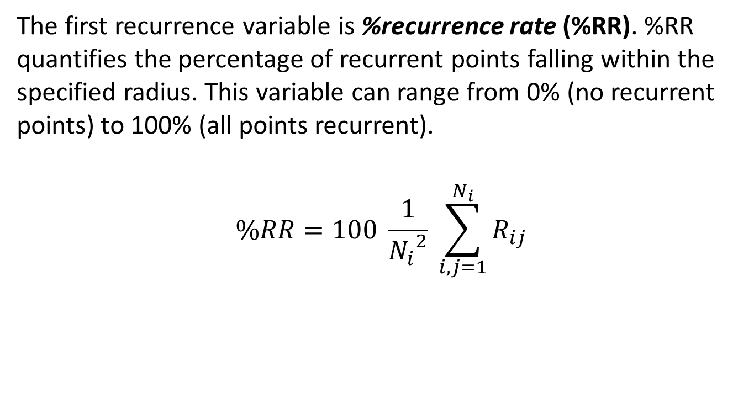
RQA parameters
The first recurrence variable is %recurrence rate (%RR). %RR quantifies the percentage of recurrent points falling within the specified radius. This variable can range from 0% (no recurrent points) to 100% (all points recurrent).
$$\%RR=100 \frac{1}{{N_{i}}^{2}} \sum_{i,j=1}^{N_{i}}{R_{ij}}$$
Ref: C. L. Webber Jr, J. P. Zbilut, Recurrence Quantification Analysis of Nonlinear Dynamical Systems

Slide 21
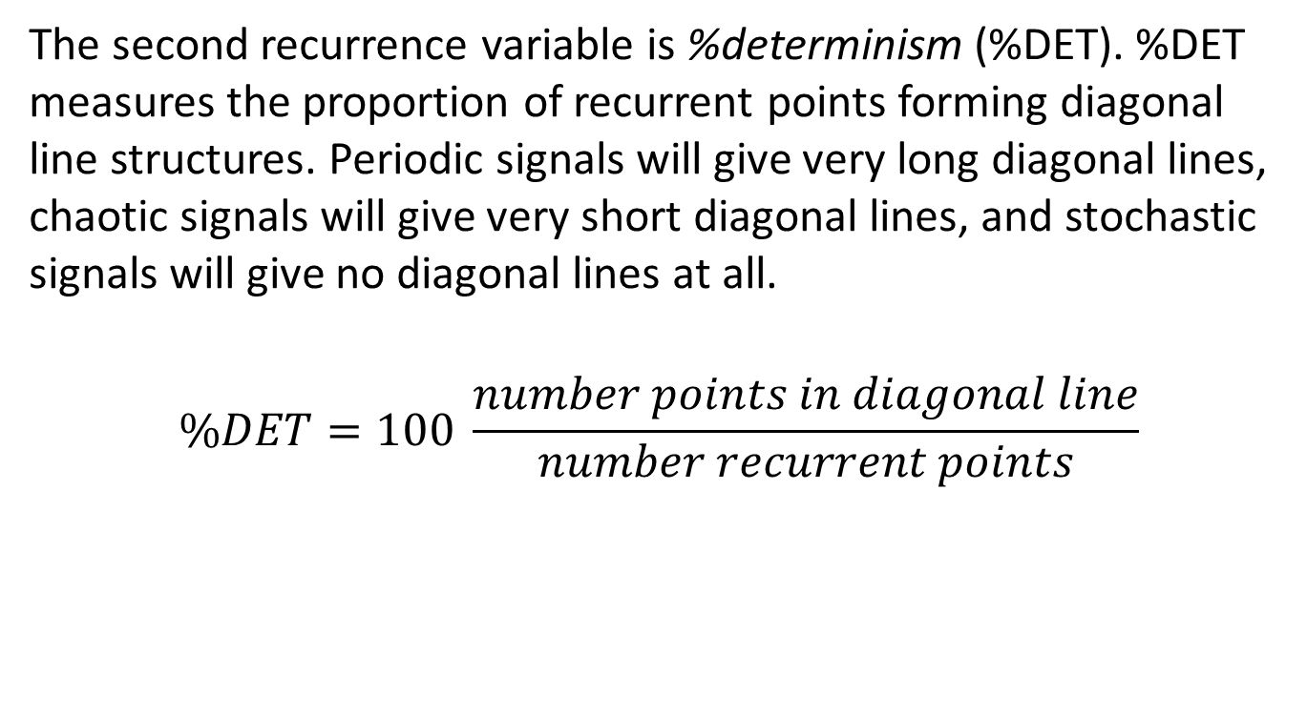
RQA parameters
The second recurrence variable is %determinism (%DET). %DET measures the proportion of recurrent points forming diagonal line structures. Periodic signals will give very long diagonal lines, chaotic signals will give very short diagonal lines, and stochastic signals will give no diagonal lines at all.
$$\%DET=100 \frac{number points in diagonal line}{number recurrent points}$$
Ref: C. L. Webber Jr, J. P. Zbilut, Recurrence Quantification Analysis of Nonlinear Dynamical Systems

Slide 23
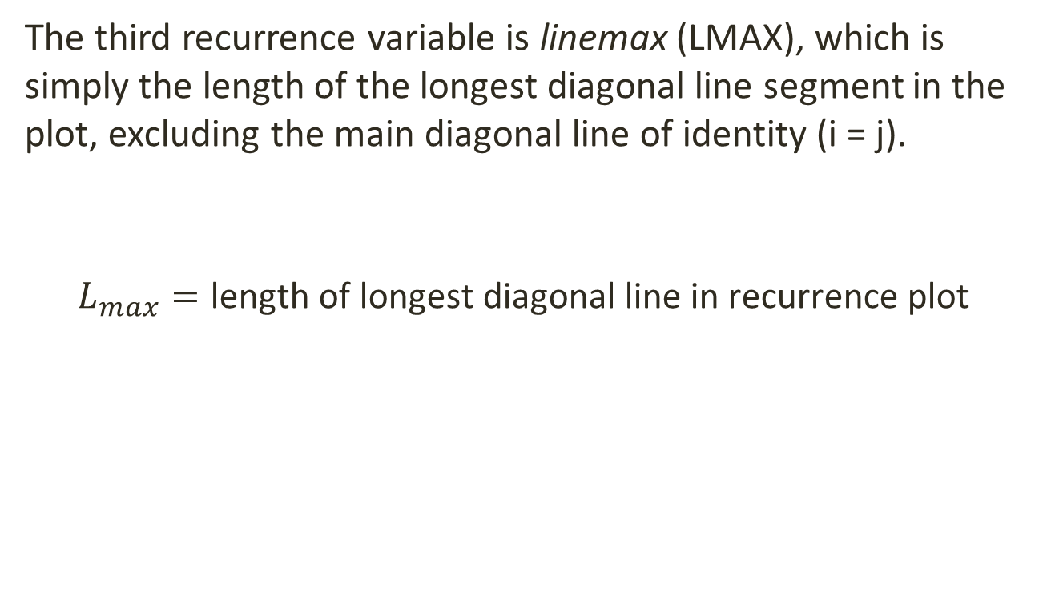
RQA parameters
The third recurrence variable is linemax (LMAX), which is simply the length of the longest diagonal line segment in the plot, excluding the main diagonal line of identity (i = j).
$$L_{max}=\text{length} \text{of} \text{longest} \text{diagonal} \text{line} \text{in} \text{recurrence} \text{plot}$$
Ref: C. L. Webber Jr, J. P. Zbilut, Recurrence Quantification Analysis of Nonlinear Dynamical Systems

Slide 25
Conclusions and future developments
Intermittency found in a simple aeroacoustic system
Need to focus on the first transition
Detection of the intermittency type

Slide 26
Thanks for your attention

Slide 27
An experimental setup to investigate intermittency in pipe systems
Università degli Studi di Genova
Corso di Laurea Magistrale in Ingegneria Meccanica Energia & Aeronautica
Relatori:
Prof. Alessandro Bottaro
Prof. R.I. Sujith
Candidato:
Diego Zangrillo
Luglio 2015

Slide 28
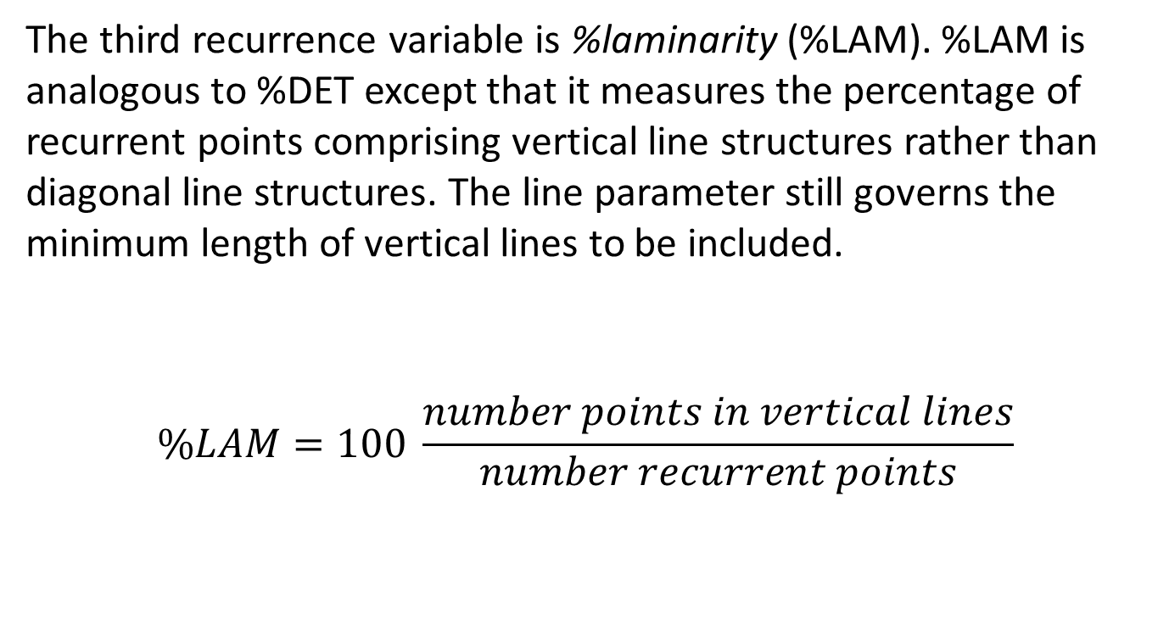
RQA parameters
The third recurrence variable is %laminarity (%LAM). %LAM is analogous to %DET except that it measures the percentage of recurrent points comprising vertical line structures rather than diagonal line structures. The line parameter still governs the minimum length of vertical lines to be included.
$$\%LAM=100 \frac{number points in vertical lines}{number recurrent points}$$

Slide 30
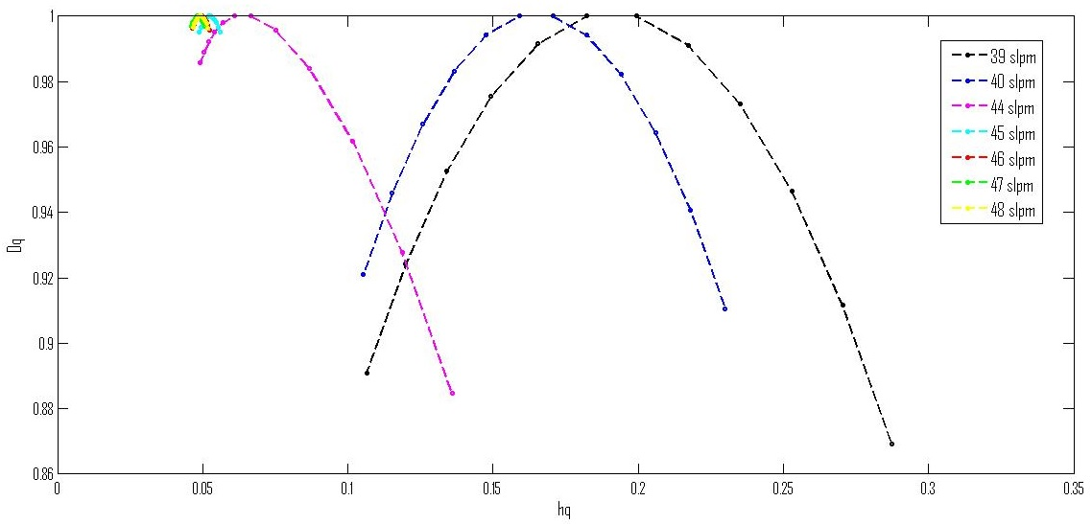
Multifractal Spectrum: I transition

