Slide 1


Student: Luca Cò Supervisor: Prof. Alessandro Bottaro Correlator: Prof. Nicolas Mazellier
Drag reduction and terminal velocity
measurements on superhydrophobic spheres
University of Genova – Polytech Orleans
Bachelor’s thesis
Genova, 24th July 2015

Slide 2
Outline
Ultra Ever Dry® painture
Wettability and superhydrophobicity
Wenzel and Cassie-Baxter state
Laboratory
Measurements
Conclusions and future applications

Slide 3
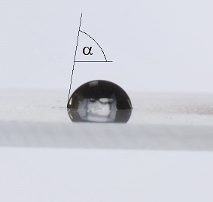
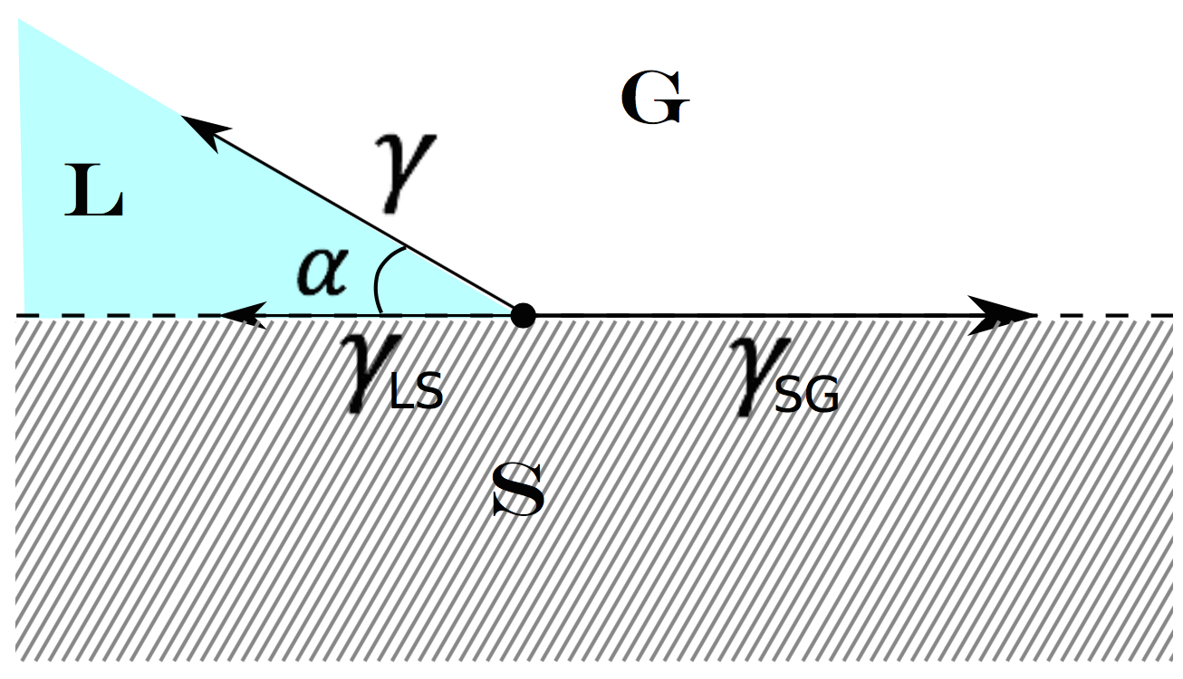
Static contact angle
A = γ_{SG} − γ_{LS} = γ_{GL} cos α

Slide 4
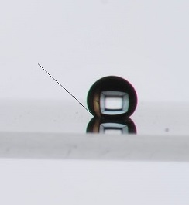
Static contact angle
hydrophilic , high wettability , 0° < α < 90°
Hydrophobic, low wettability , α > 90°
Superhydrophobic, very low wettability, α > 150°

Slide 5

Wenzel state
cos α_{W} = r cos α
r A = γ_{GL} cos α_{W}

Slide 6

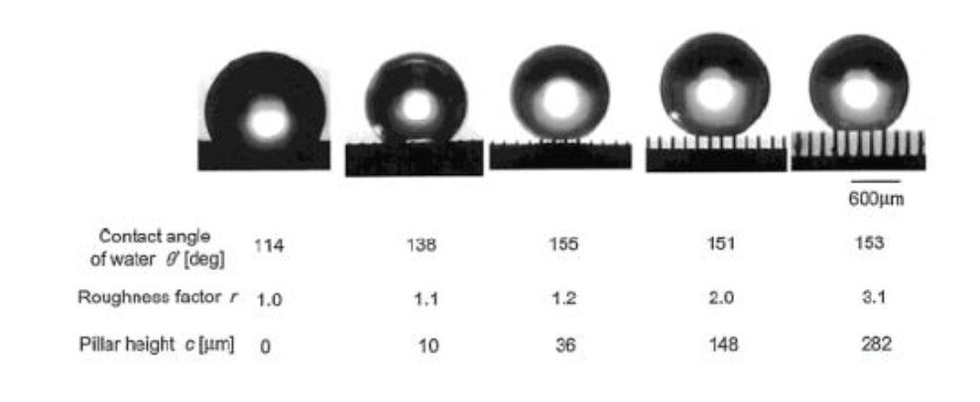

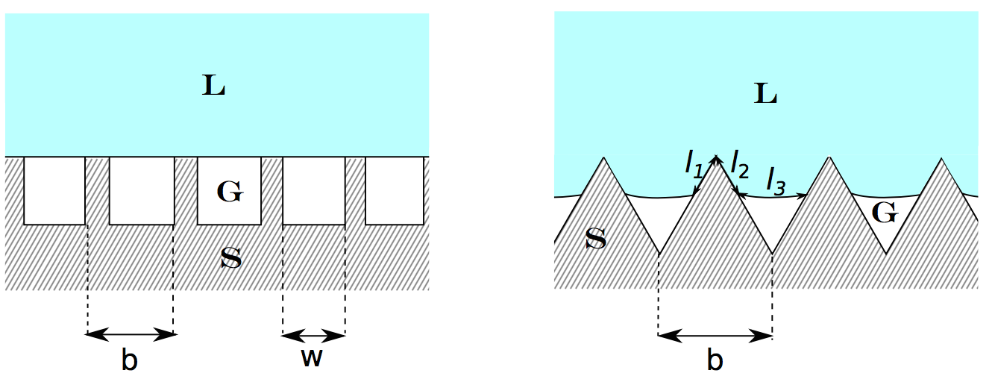
Cassie-Baxter State
Lotus leaf
cos α_{F} = f₁ cos α − f₂
f₁ = 1 − w/b
f₂ = w/b

Slide 7
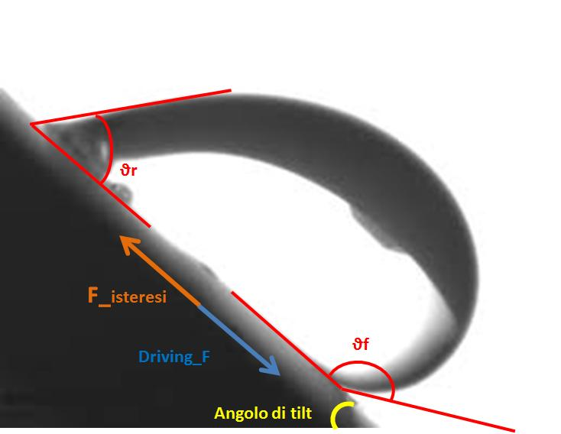
Tilt angle
Δϑ = θ_{f} – θ_{r}
Δϑ <10 ° for superhydrophobic surfaces

Slide 8
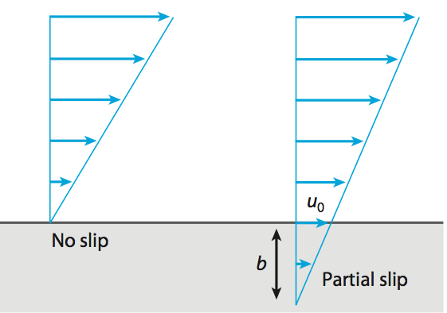

Slip lenght

Slide 9
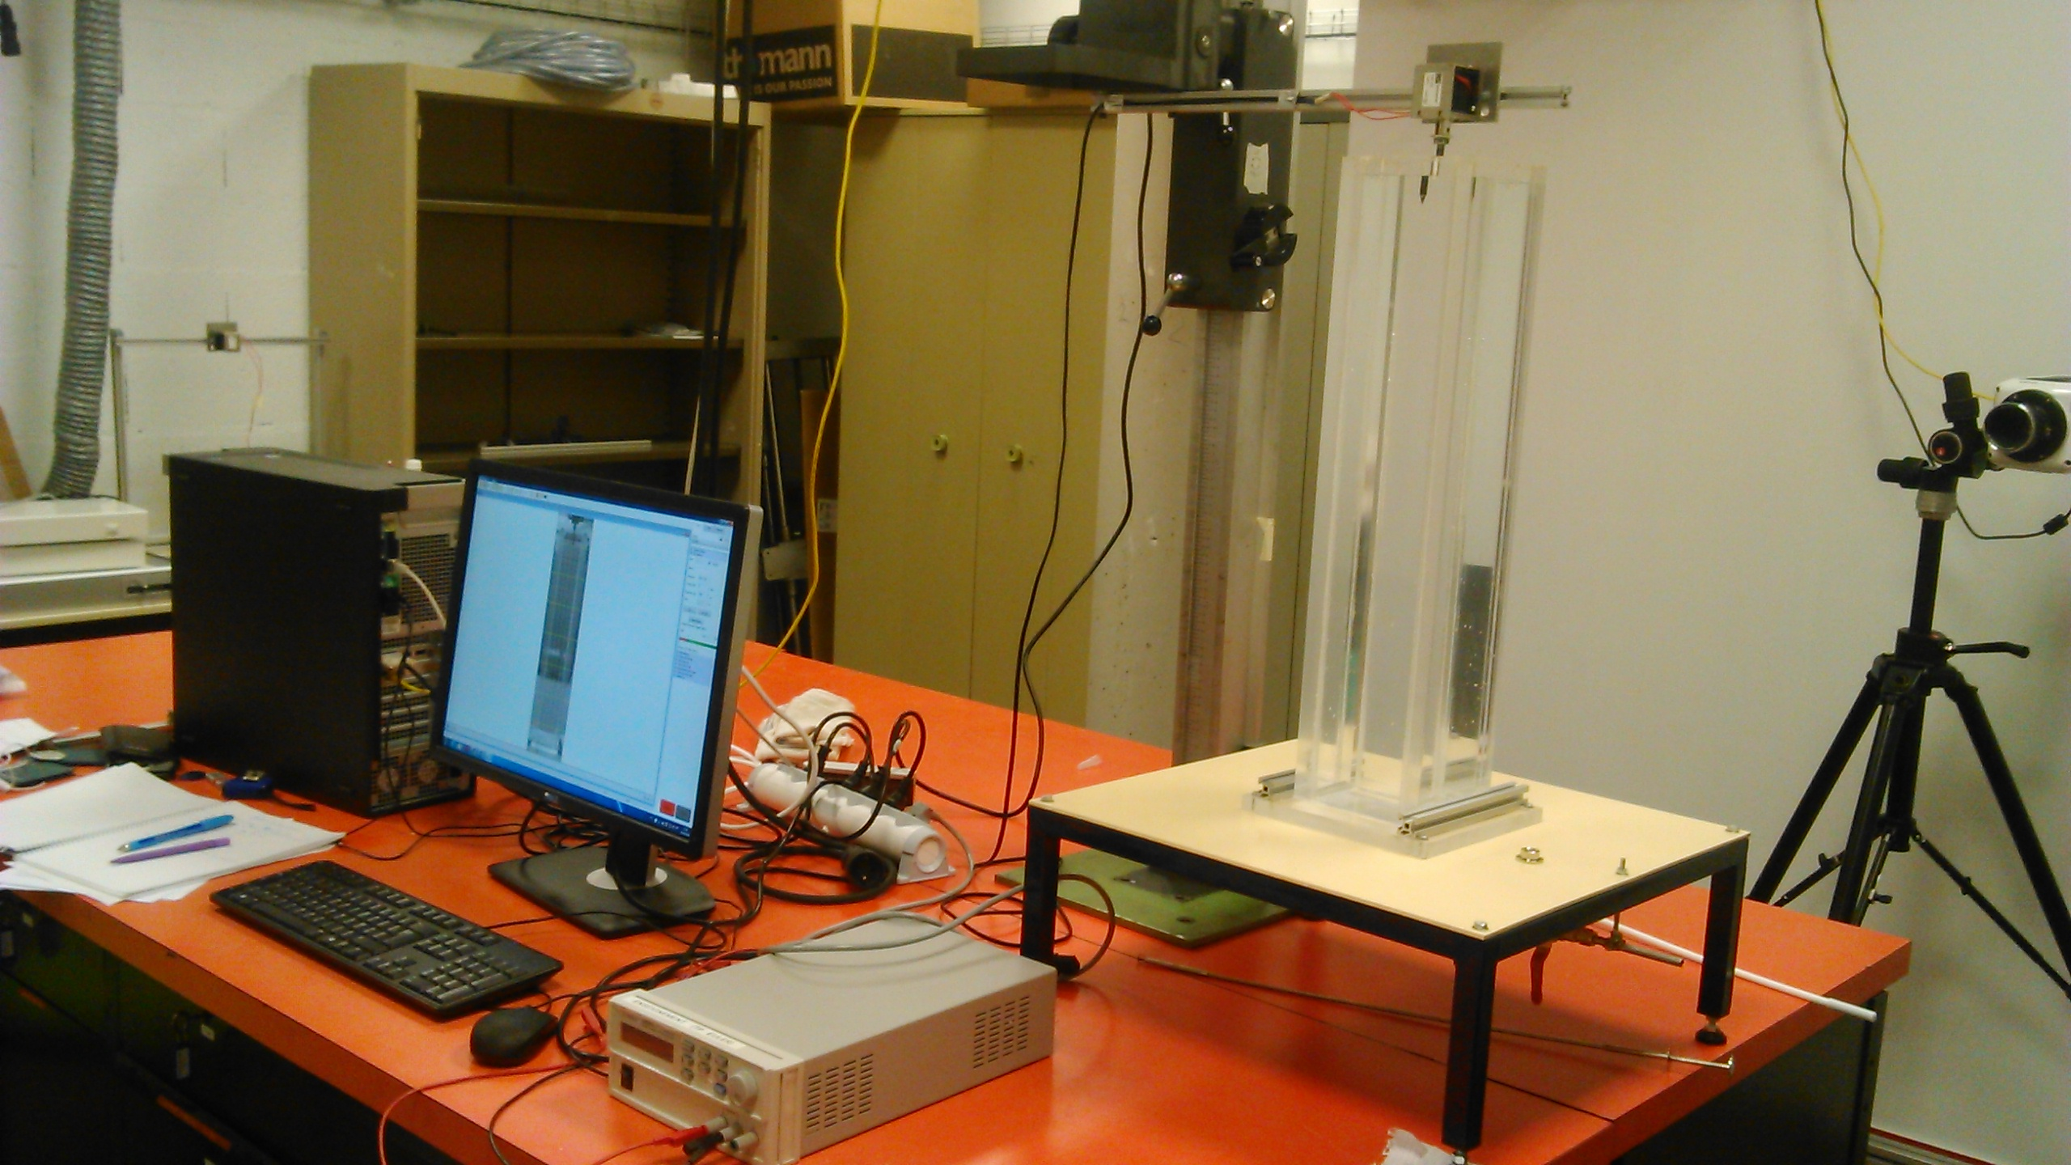
Laboratory

Slide 10
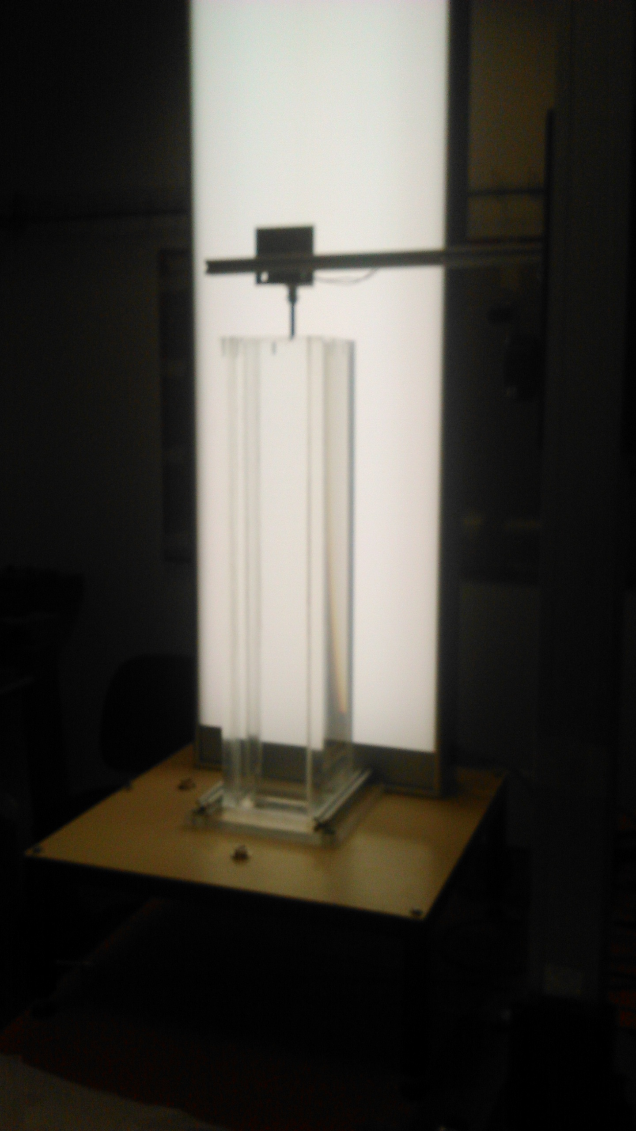
Laboratory

Slide 11
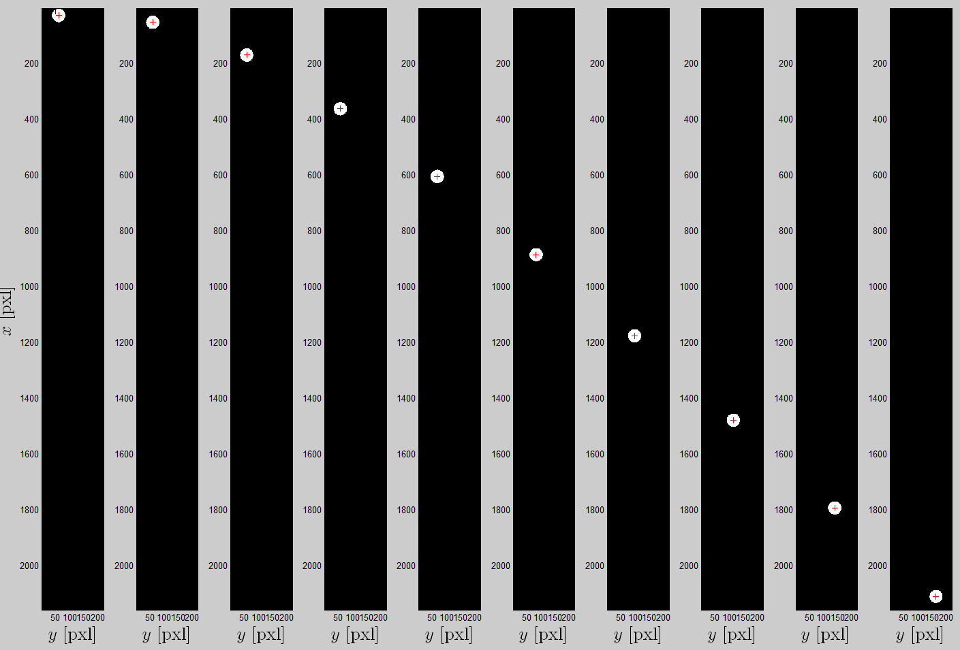

Slide 12
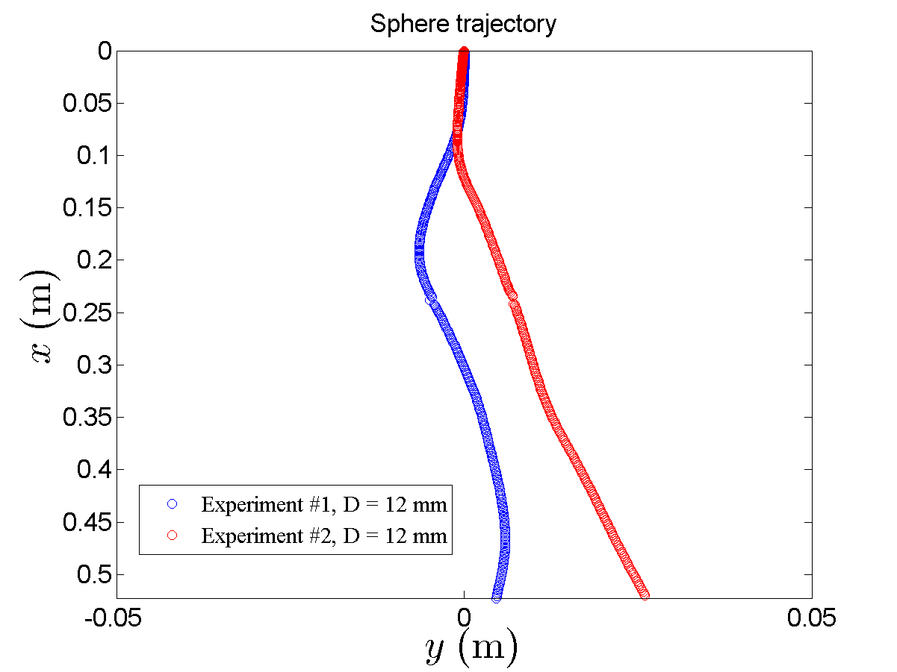

Slide 13
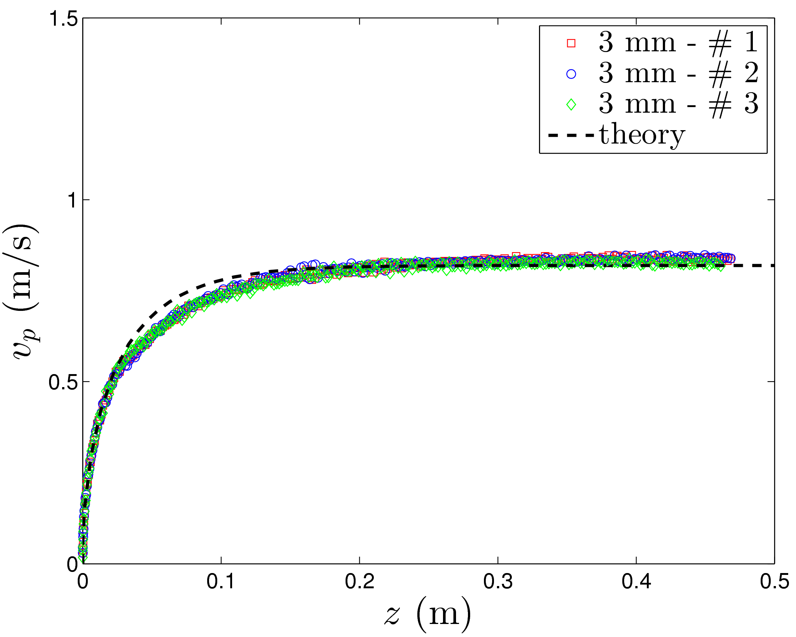
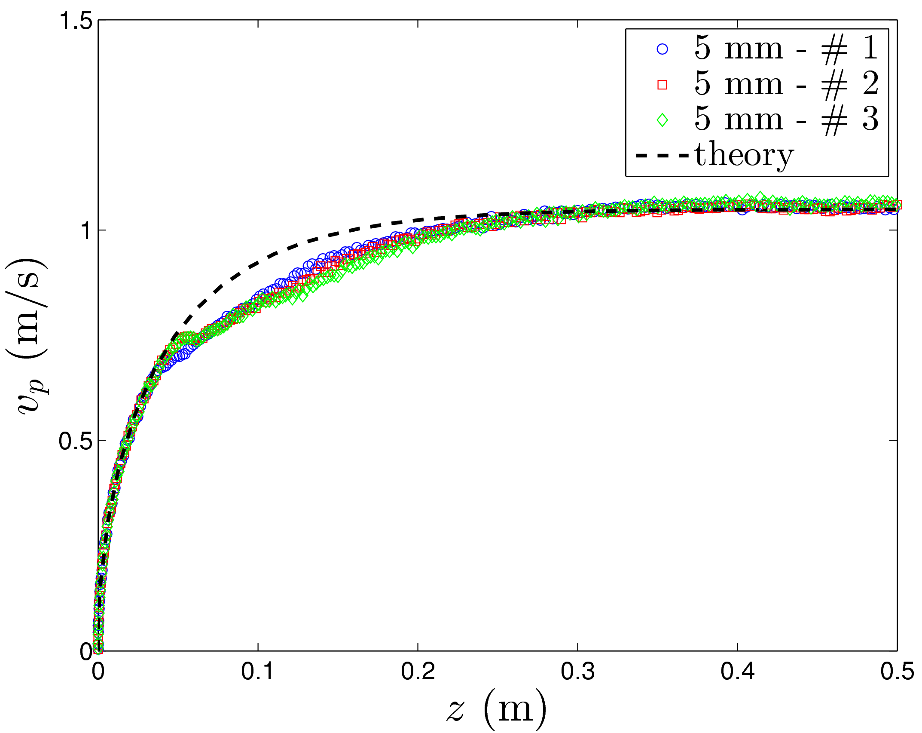
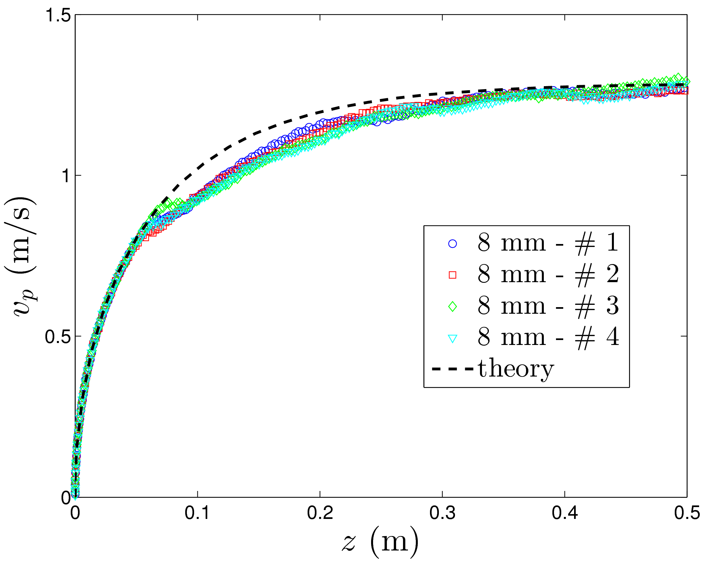
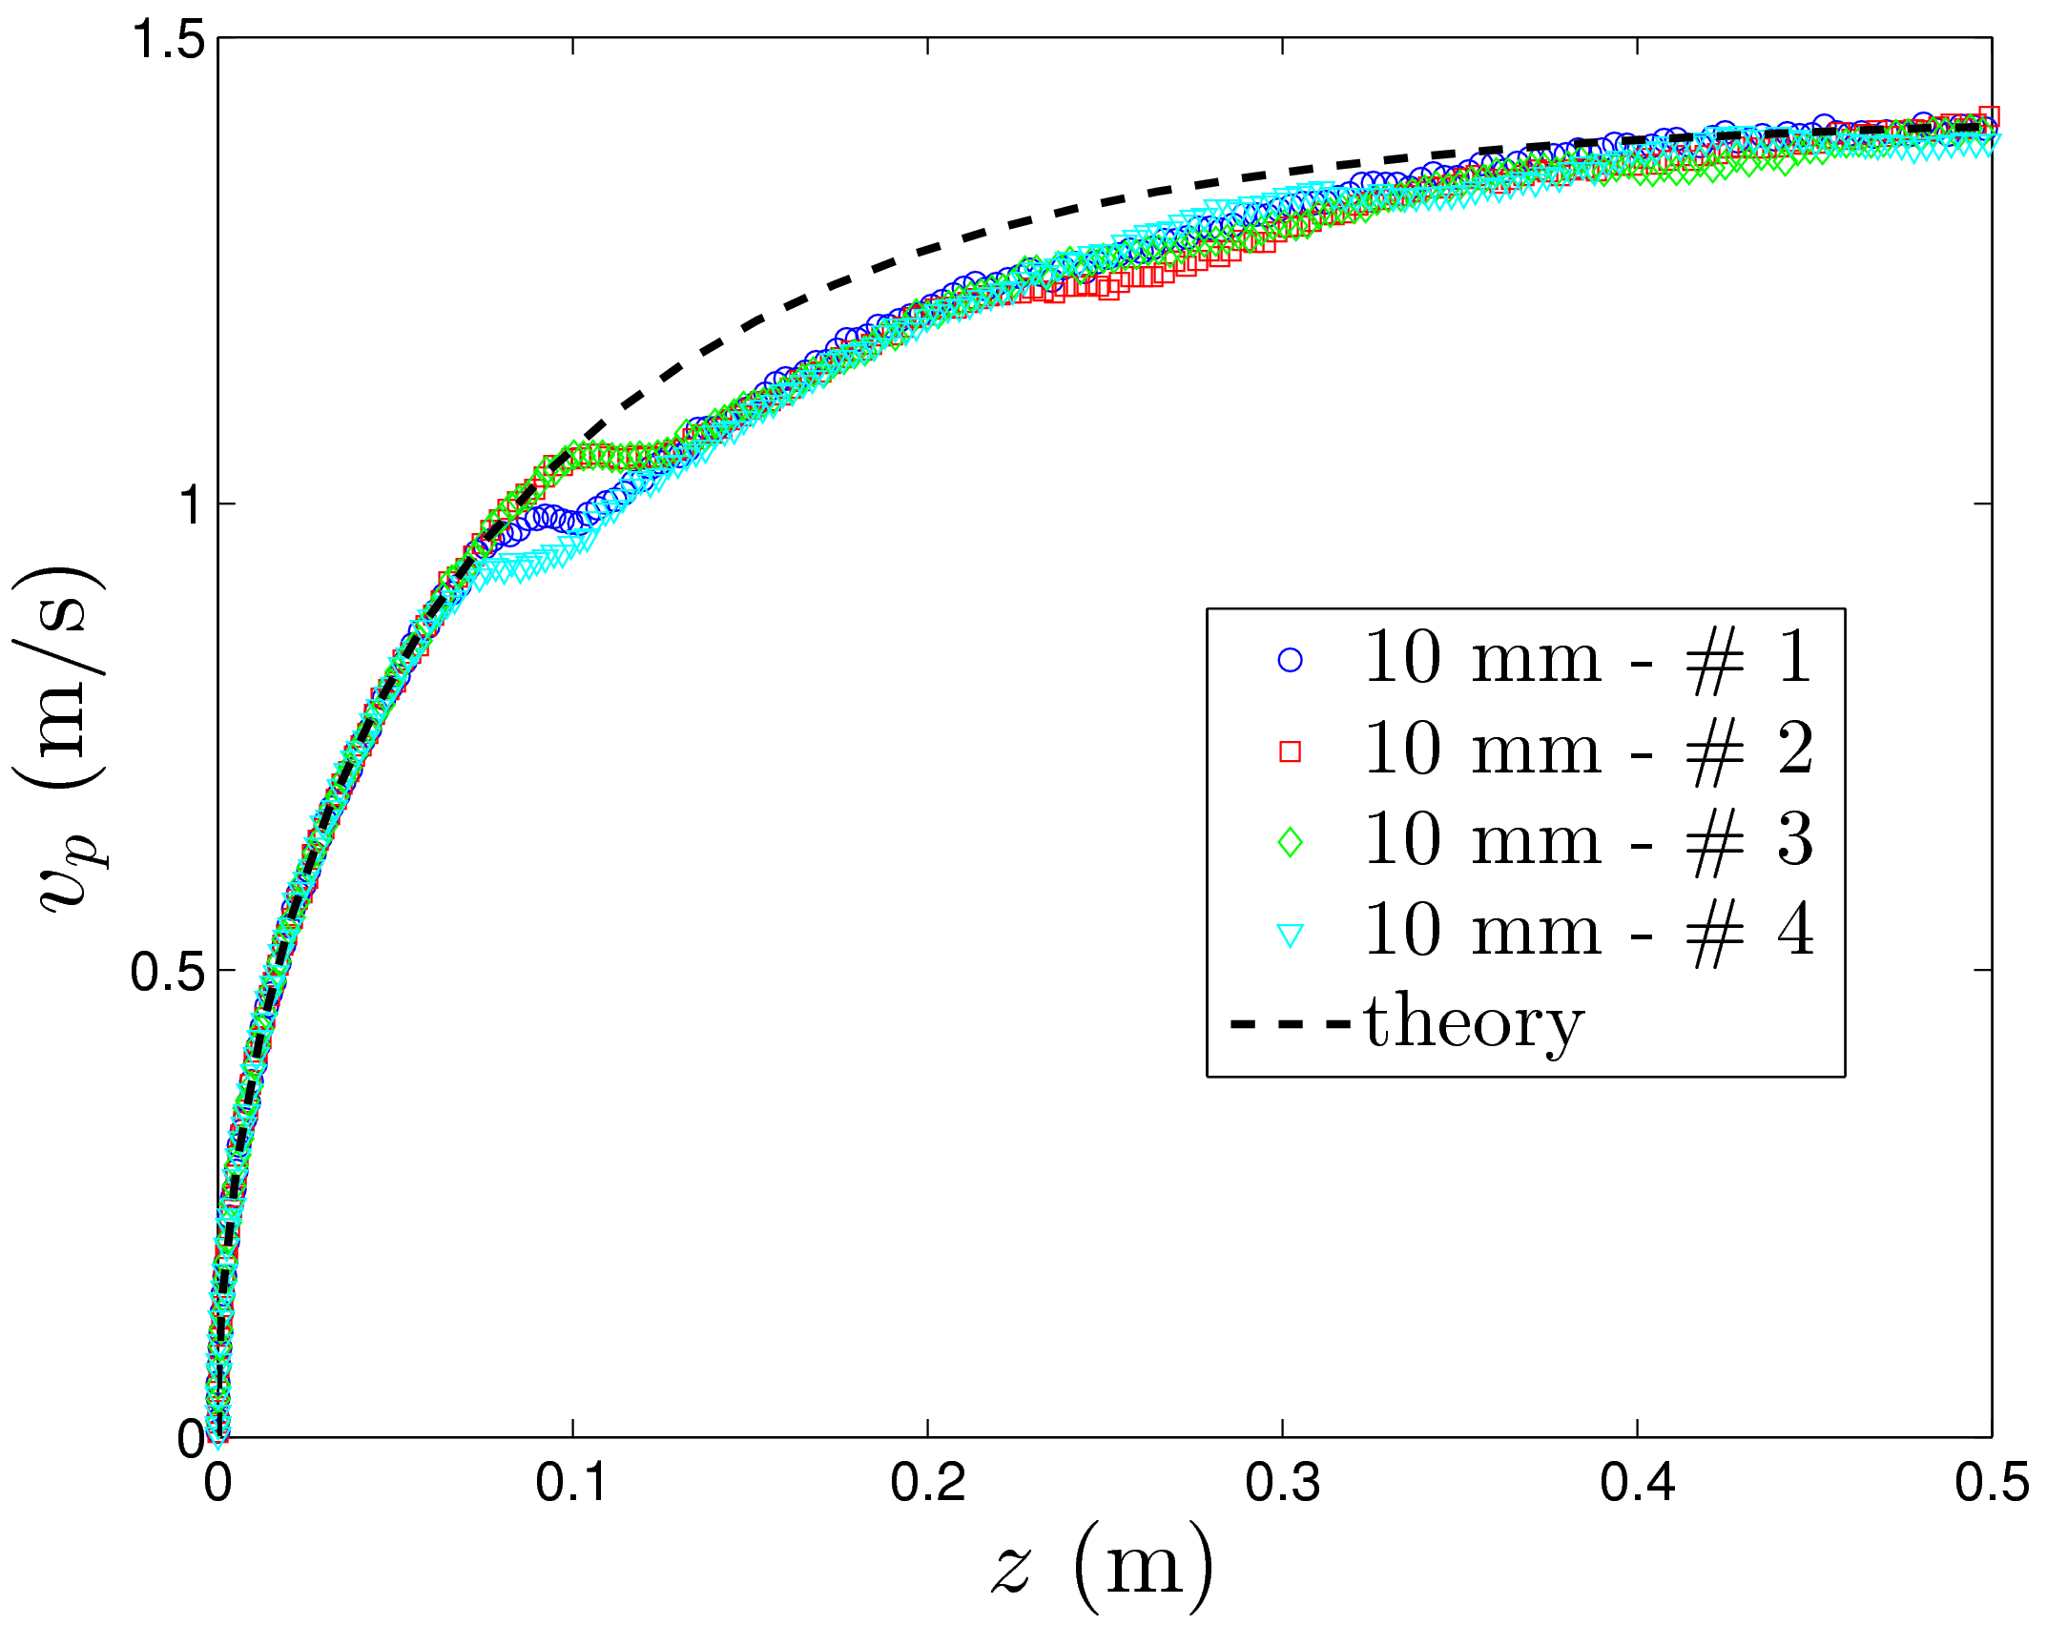
Results
Initial tests with different spheres falling in water

Slide 14
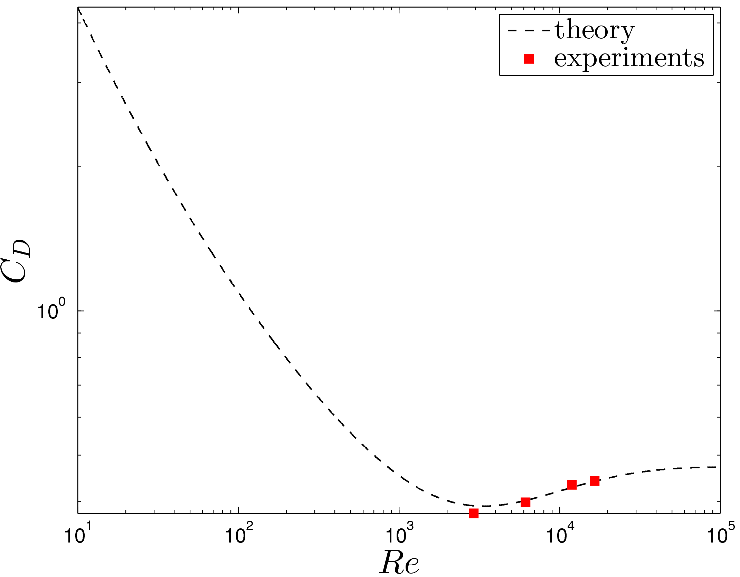
Results
Initial tests with different spheres falling in water

Slide 15
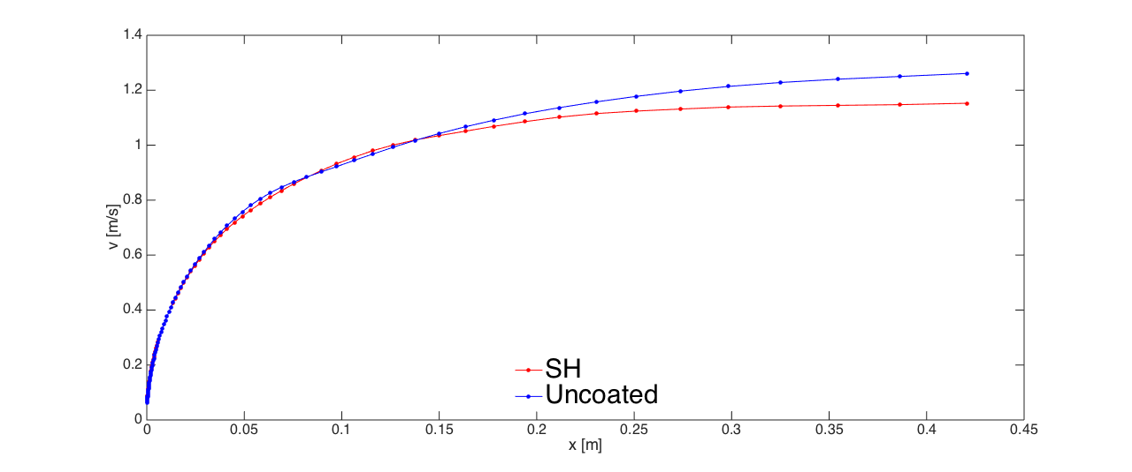
Results
Overlap of SH and uncoated 10mm sphere falling in water
 | Terminal velocity [m/s] | Re
Uncoated | 1,261 | 14112
SH | 1,153 | 12903

Slide 16
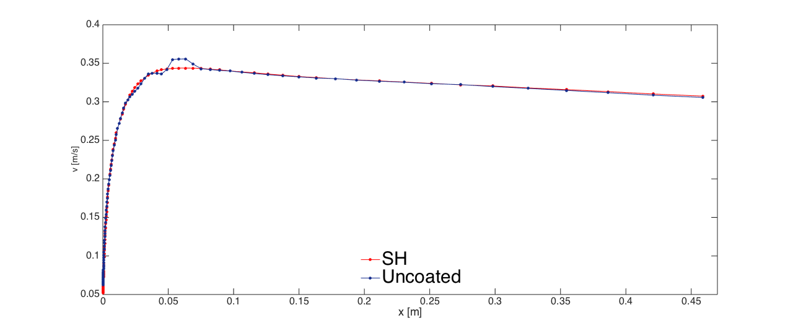
Results
Overlap of SH and uncoated 10mm sphere falling in glycerol
 | Terminal velocity [m/s] | Re
Uncoated | 0,3057 | 3,675
SH | 0,3074 | 3,696

Slide 17
Conclusions and future applications

