Slide 1

Scuola Politecnica
Dipartimento di Ingegneria Meccanica, Energetica
Gestionale e dei trasporti
14 SETTEMBRE 2023
Transmission of sound through porous media
Relatore: Prof. Alessandro Bottaro
Correlatore: Dott.ssa Jiasen Wei
Candidato: Rachele Valcalda

Slide 2
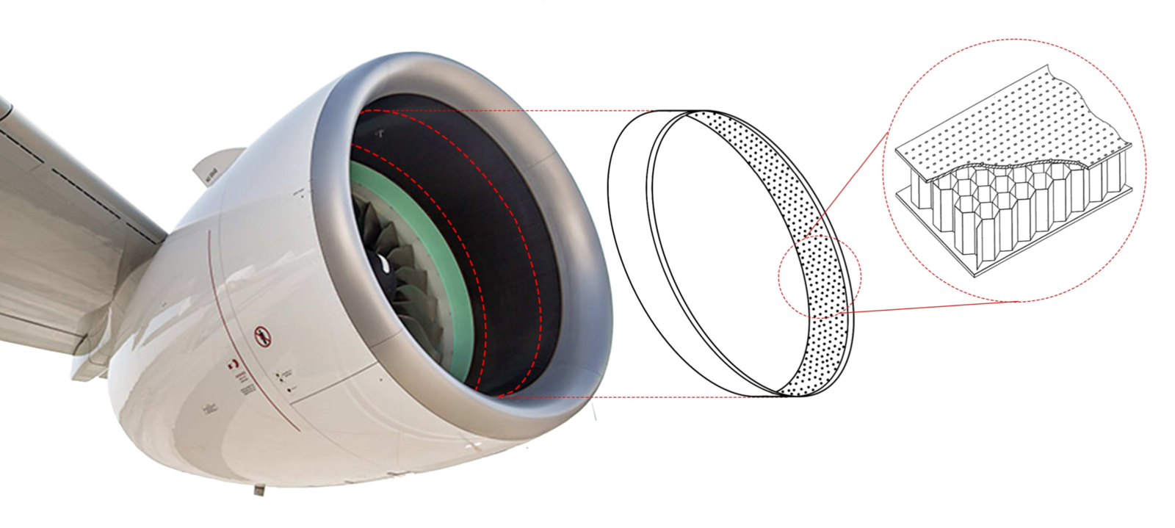
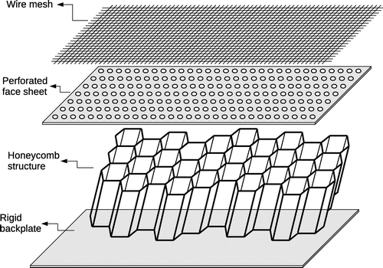
Acoustic liners
Reduce engine noise
Cheap
Light

Slide 3
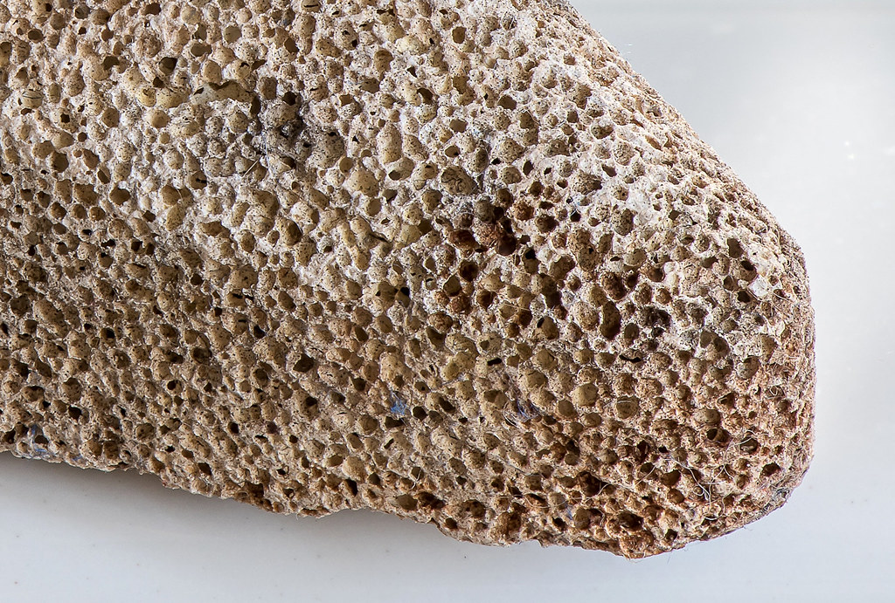
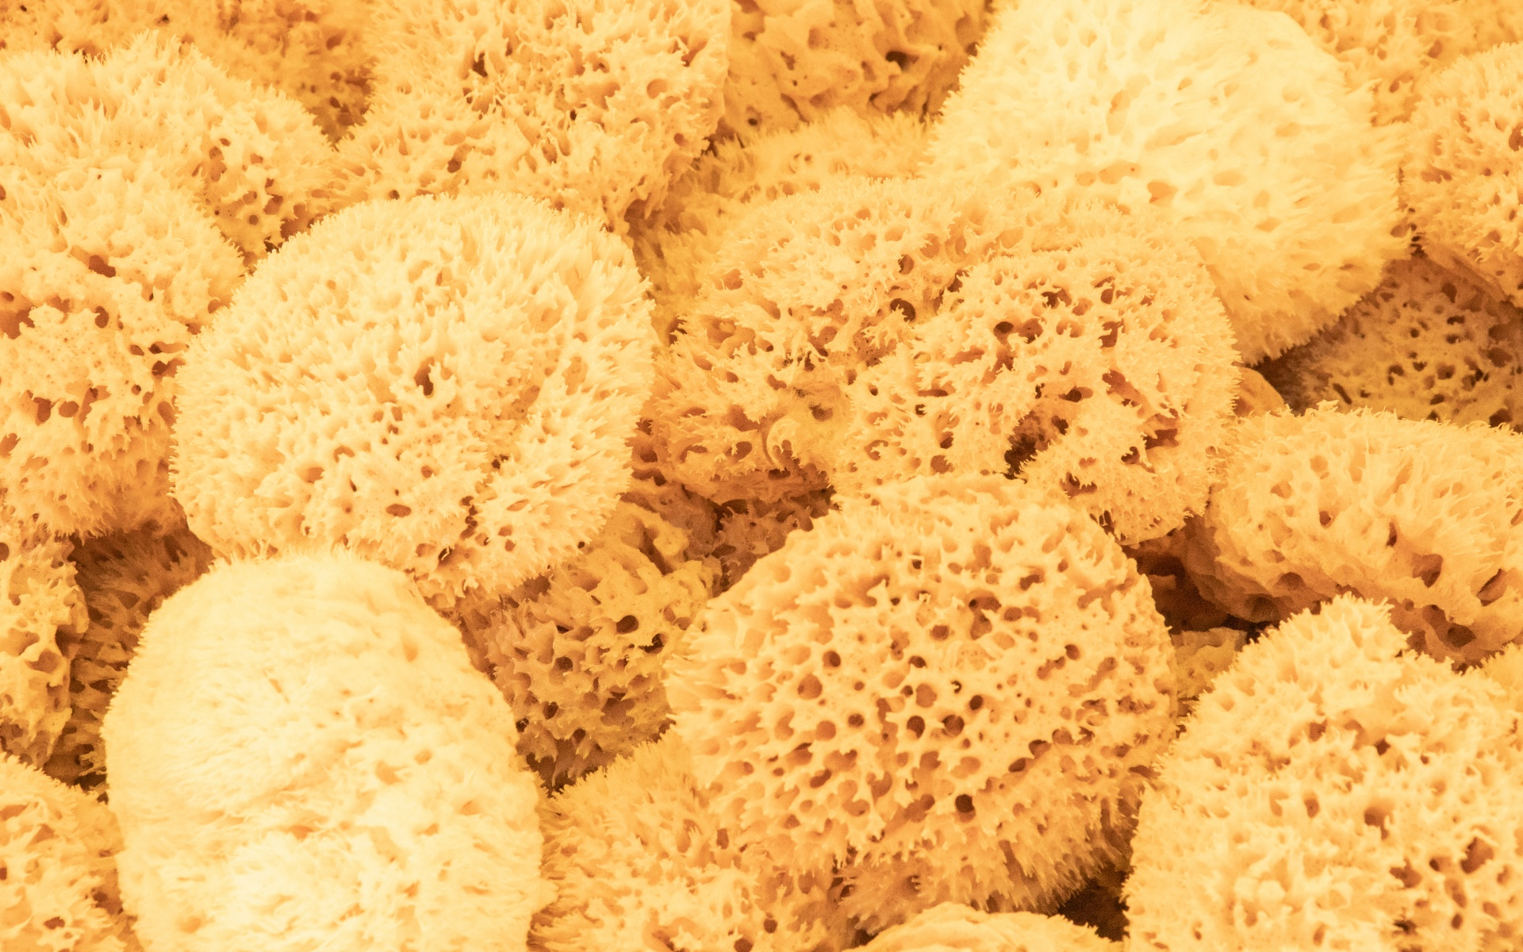
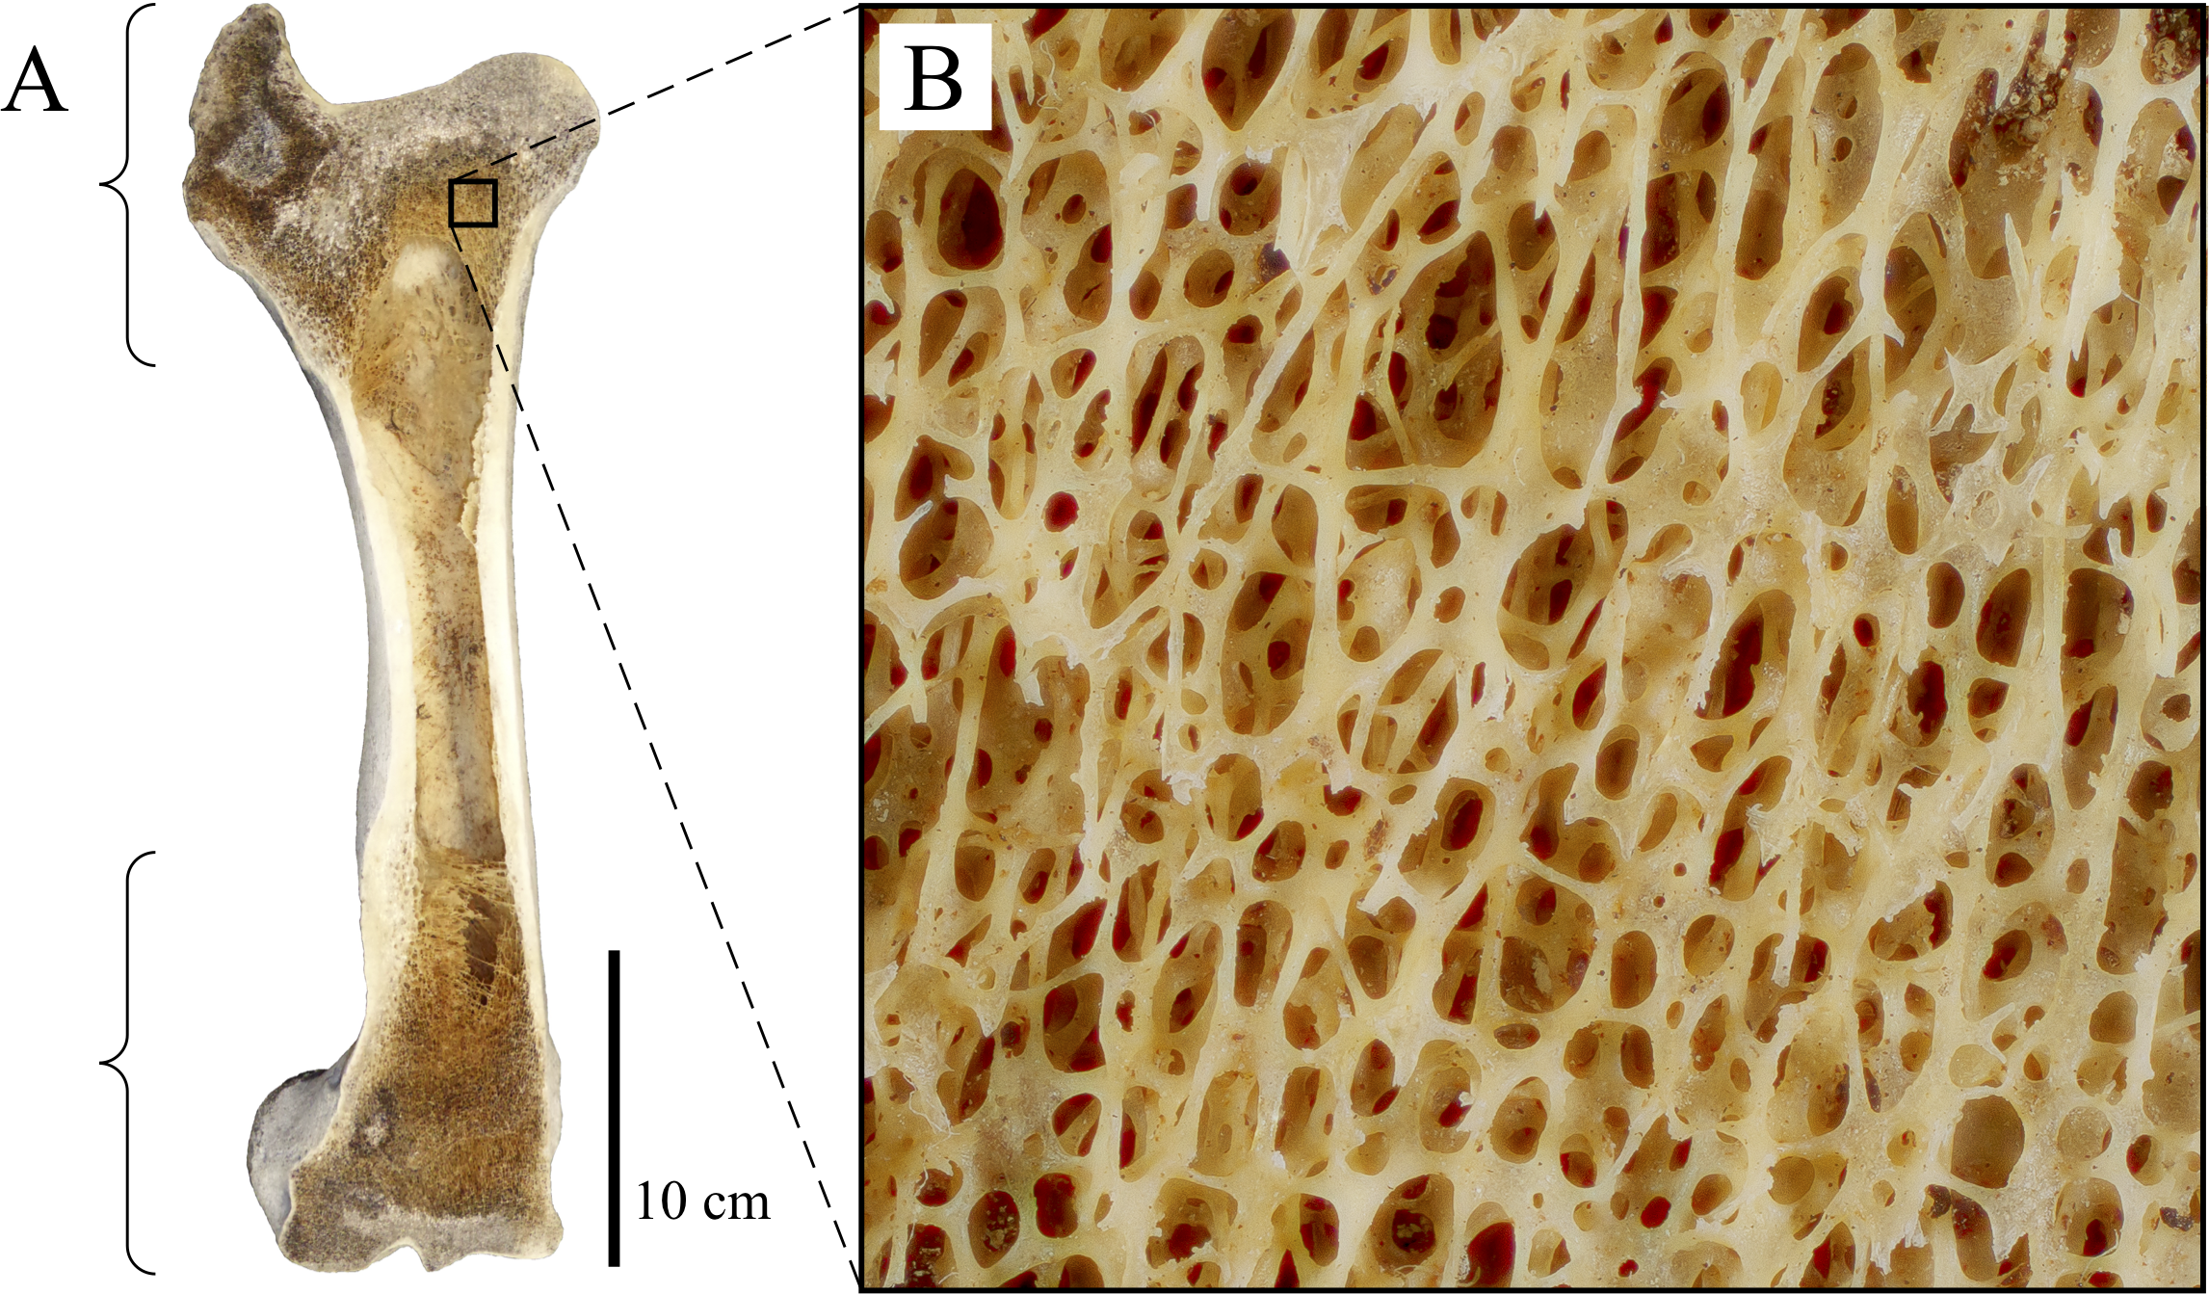

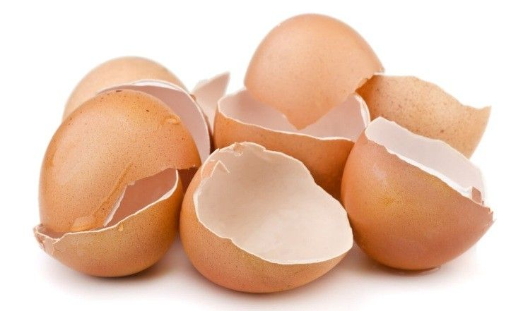
Porous material

Slide 4
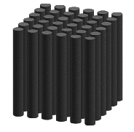
Purpose of this thesis
To study the behavior of acoustic waves propagating through a prototypical acoustic liner
To derive the acoustic wave equation
To find the effective medium equation
To validate the model with COMSOL Multiphysics
To study the limits of the model

Slide 5
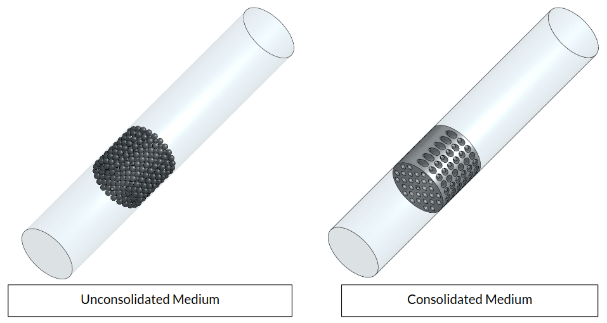
Porous media
A porous medium is a material that contains microscale voids or pores.
It is formed by two phases, a solid matrix and a void space, filled by one or more fluids
Porosity φ: fraction of volume occupied by the fluid over the total volume

Slide 6


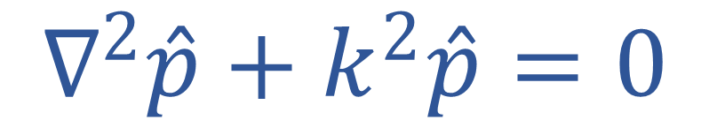
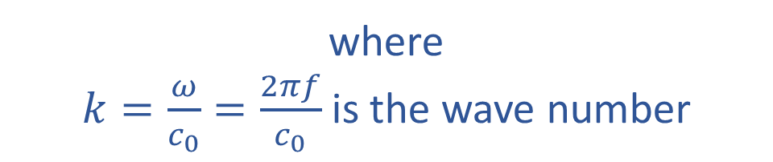
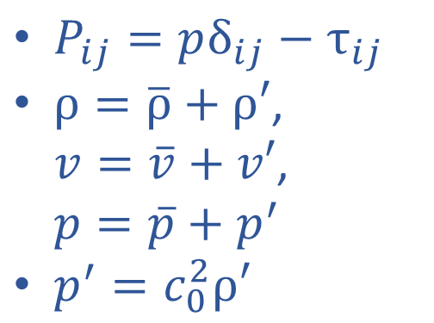
Acoustic wave equation
- mass conservation
- momentum conservation
$$∇^{2}\hat{p}+k^{2}\hat{p}=0$$
where
$k=\frac{ω}{c_{0}}=\frac{2πf}{c_{0}}$ is the wave number
$P_{ij}=pδ_{ij}−$ $τ_{ij}$
$ρ=\overline{ρ}+ρ′$,
$v=\overline{v}+v′$,
$p=\overline{p}+p^{′}$
$p^{′}=c_{0}^{2}ρ′$

Slide 7
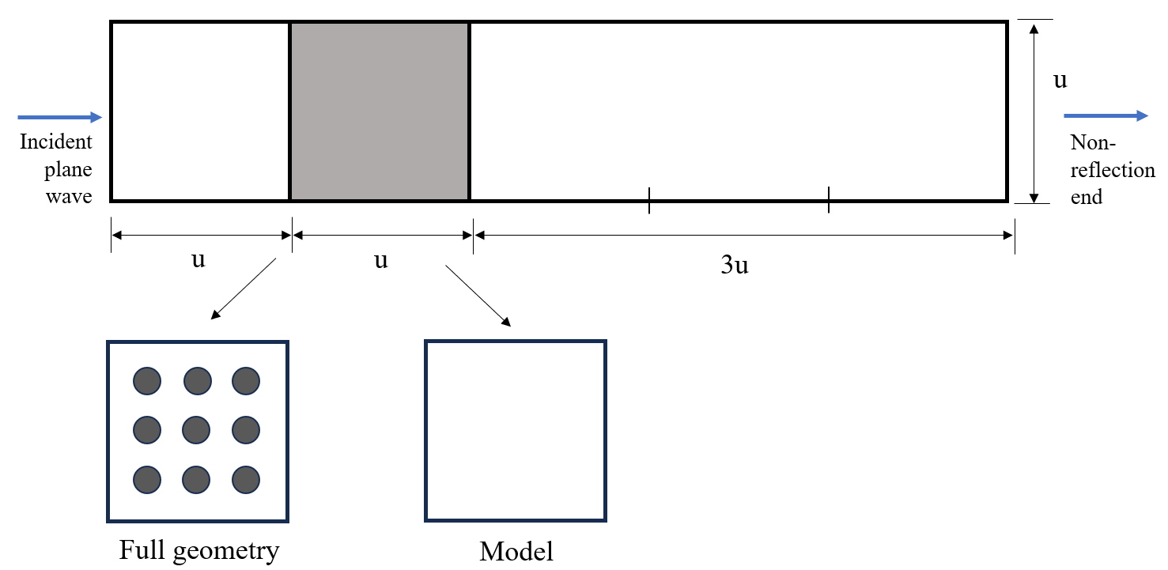
Homogenization model
Effective media

Slide 8
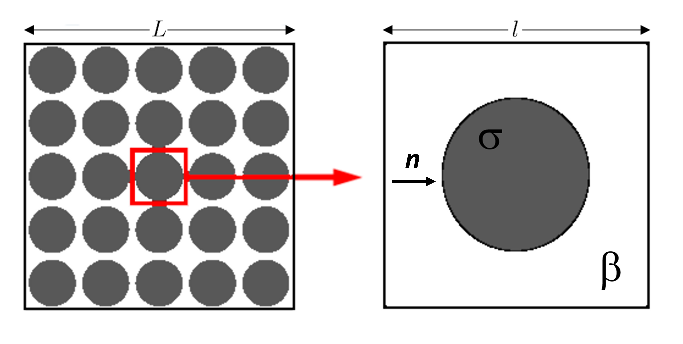
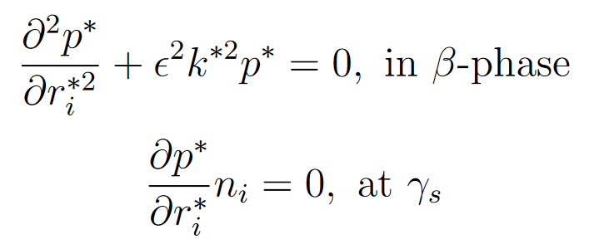
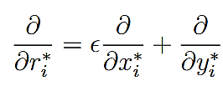

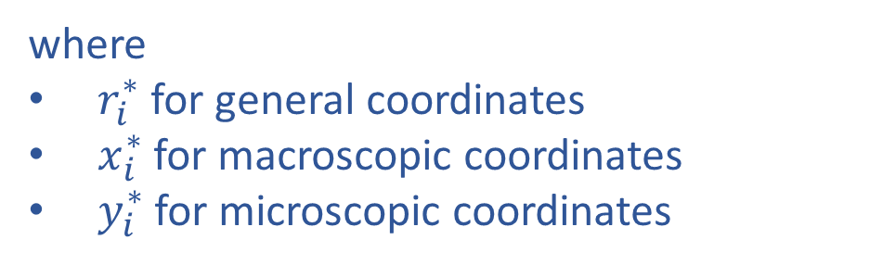
$$γ_{s}$$
Homogenization method
<<1
where
$r_{i}^{∗}$ for general coordinates
$x_{i}^{∗}$ for macroscopic coordinates
$y_{i}^{∗}$ for microscopic coordinates

Slide 9

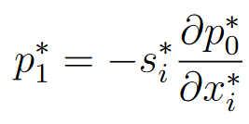
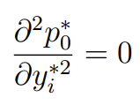
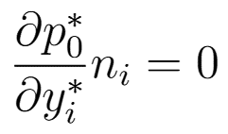
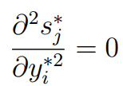
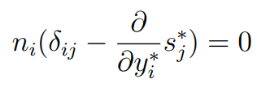
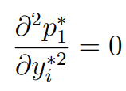

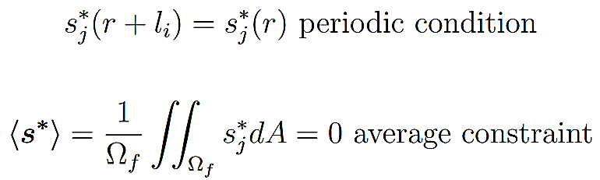
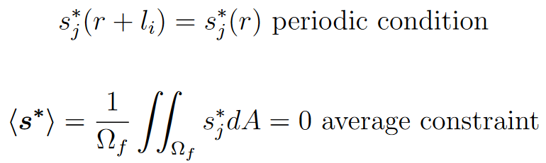
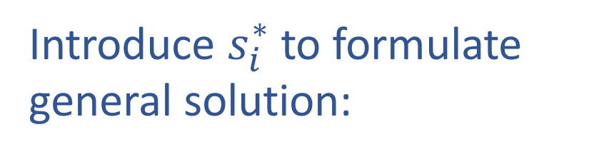
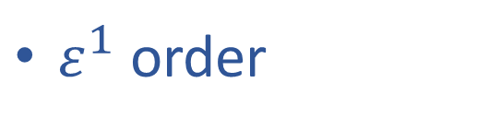


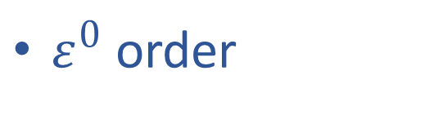
Effective medium equation
Power expansion of $p^{∗}$
Introduce $s_{i}^{∗}$ to formulate general solution:
$ε^{0}$ order
Problem of $s_{i}^{∗}$ in unit cell:
$ε^{1}$ order
Periodic condition:
Average constraint:

Slide 10
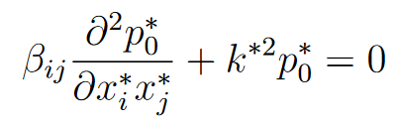
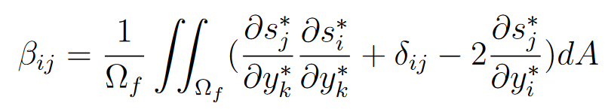
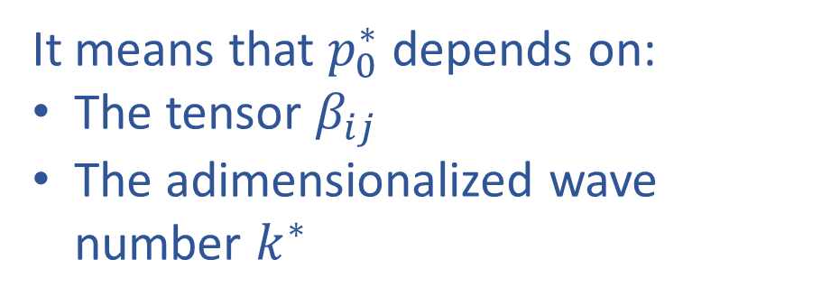
Macroscopic model
where
It means that $p_{0}^{∗}$ depends on:
The tensor $β_{ij}$
The adimensionalized wave number $k^{∗}$

Slide 11
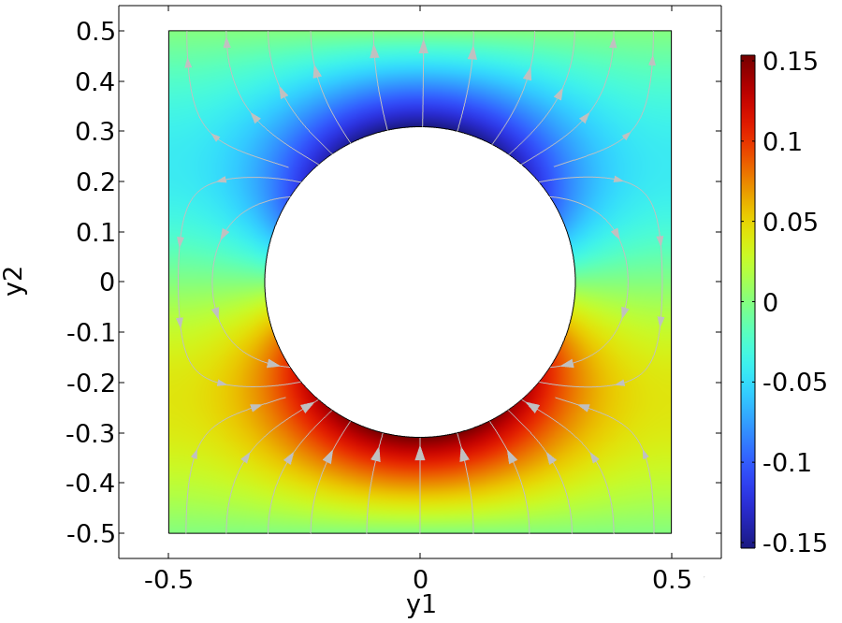
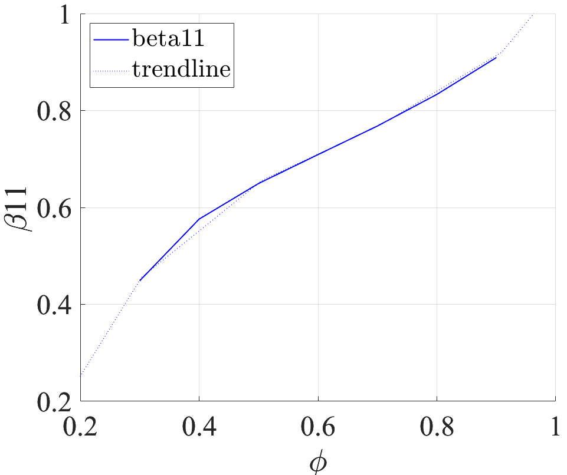
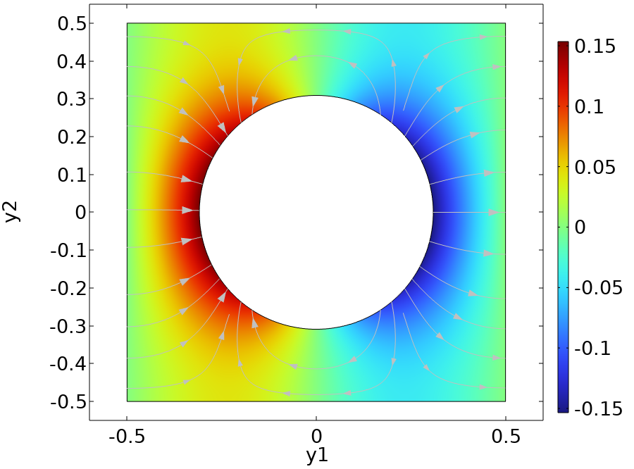


Unit cell solution: isotropic case
$$s_{1}^{∗}:$$
$$s_{2}^{∗}:$$

Slide 12
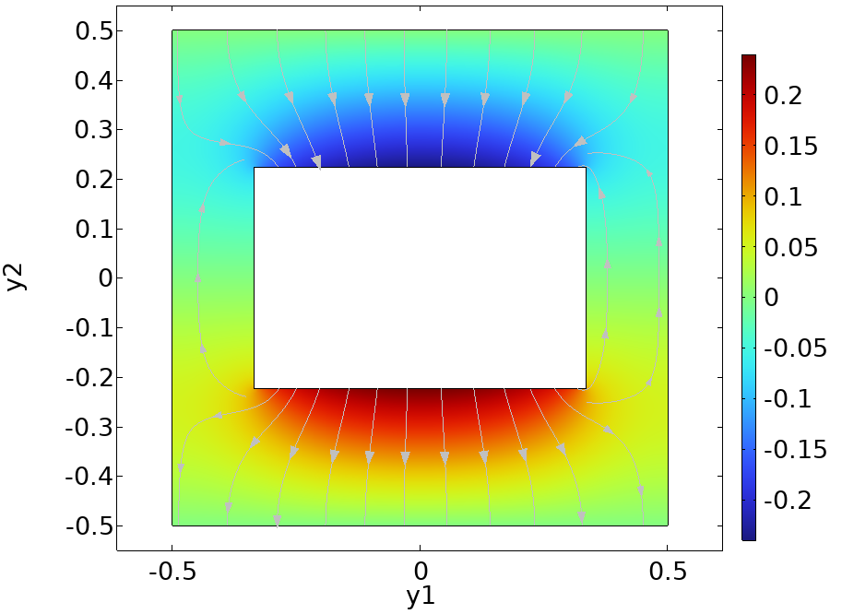
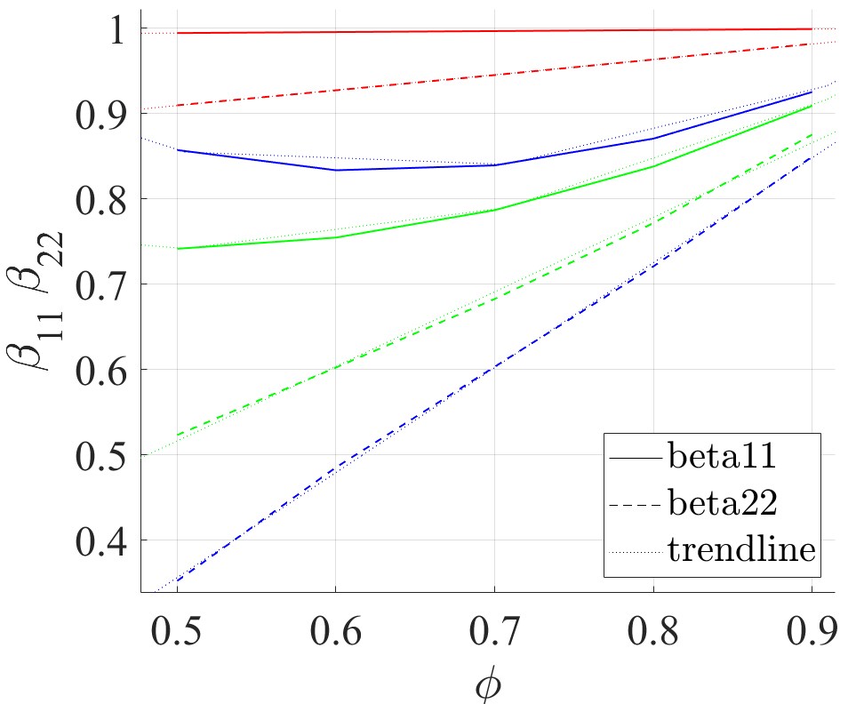
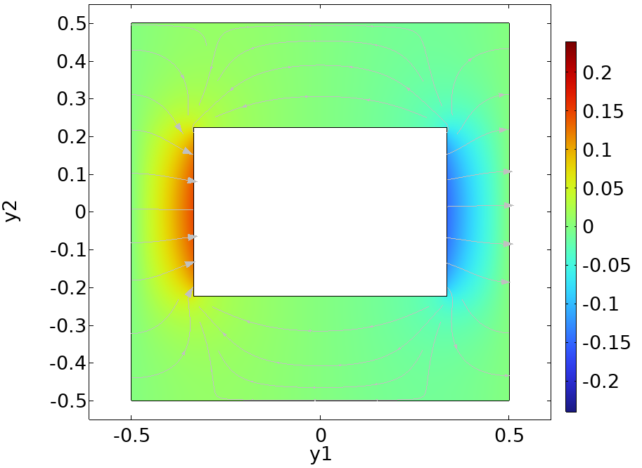
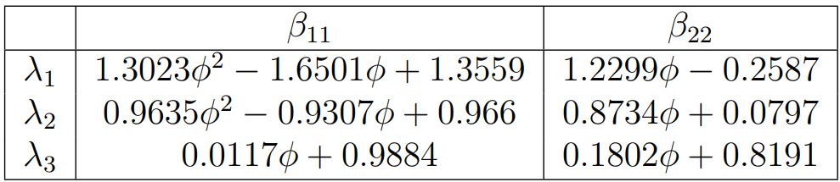
Unit cell solution: non-isotropic case
$$s_{1}^{∗}:$$
λ=3:2, λ=6:5, λ=1:0.2
$$s_{2}^{∗}:$$
ϕ

Slide 13
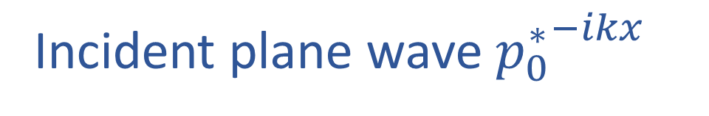
Numerical simulation
Incident plane wave ${p_{0}^{∗}}^{−ikx}$
Effective media

Slide 14
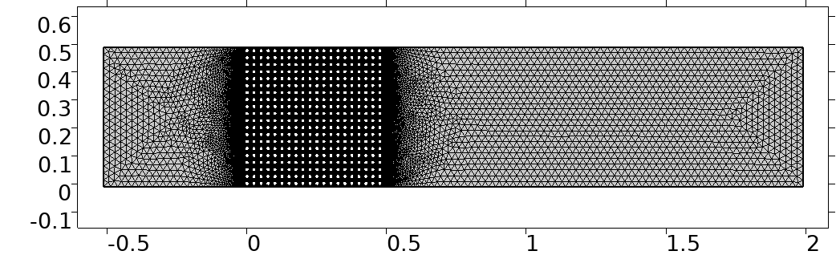
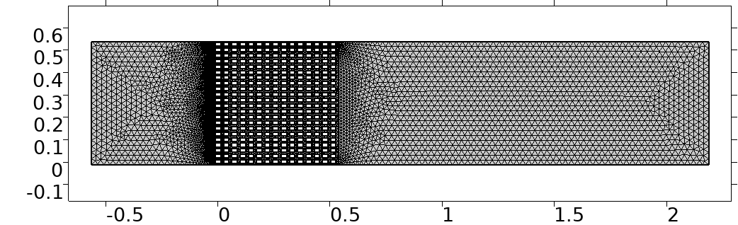
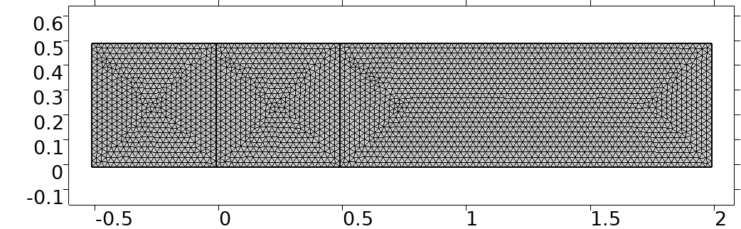
Meshes
Tested cases:
Five different incident wave frequencies:
20 Hz
50 Hz
100 Hz
200 Hz
1000 Hz
Two values of porosity:
≈0.6, ≈ 0.9

Slide 15
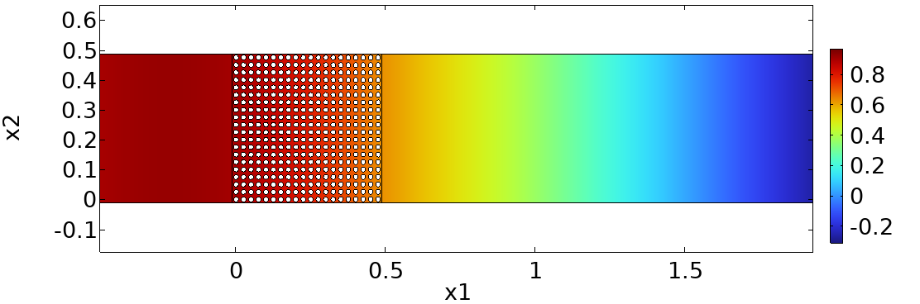
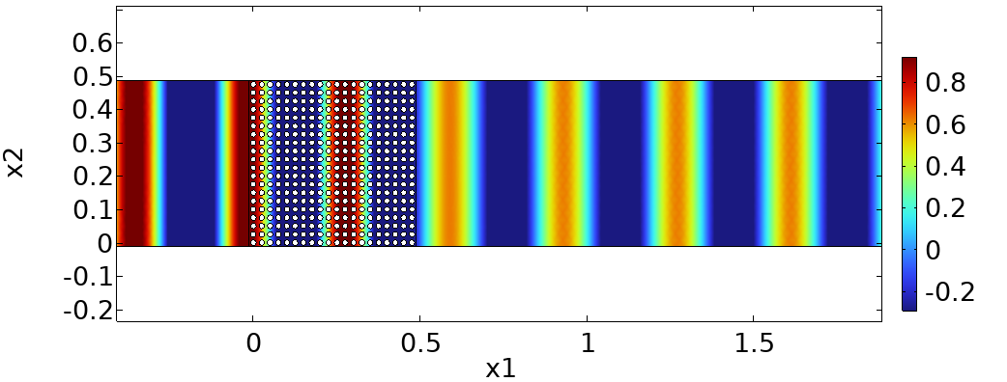
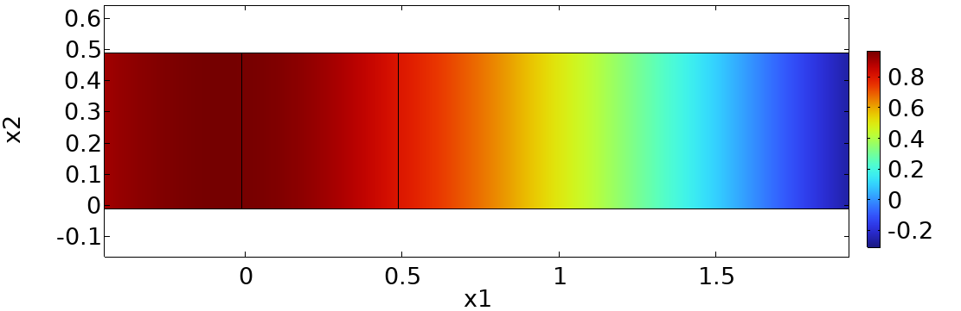
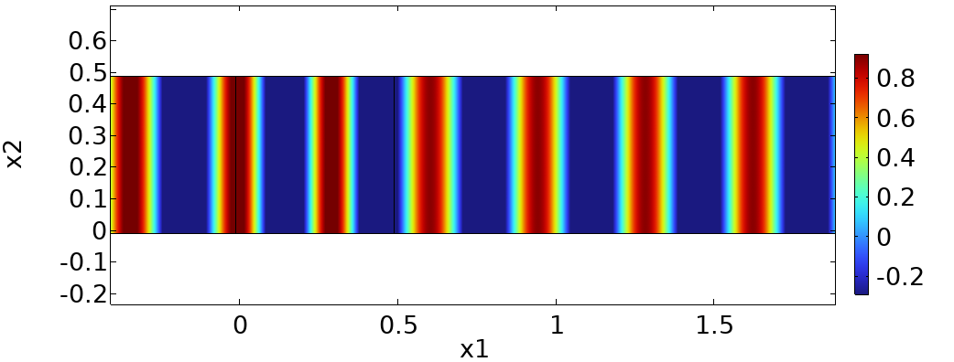


Simulation results: a comparison
$$f=50Hz$$
$$f=1000Hz$$

Slide 16
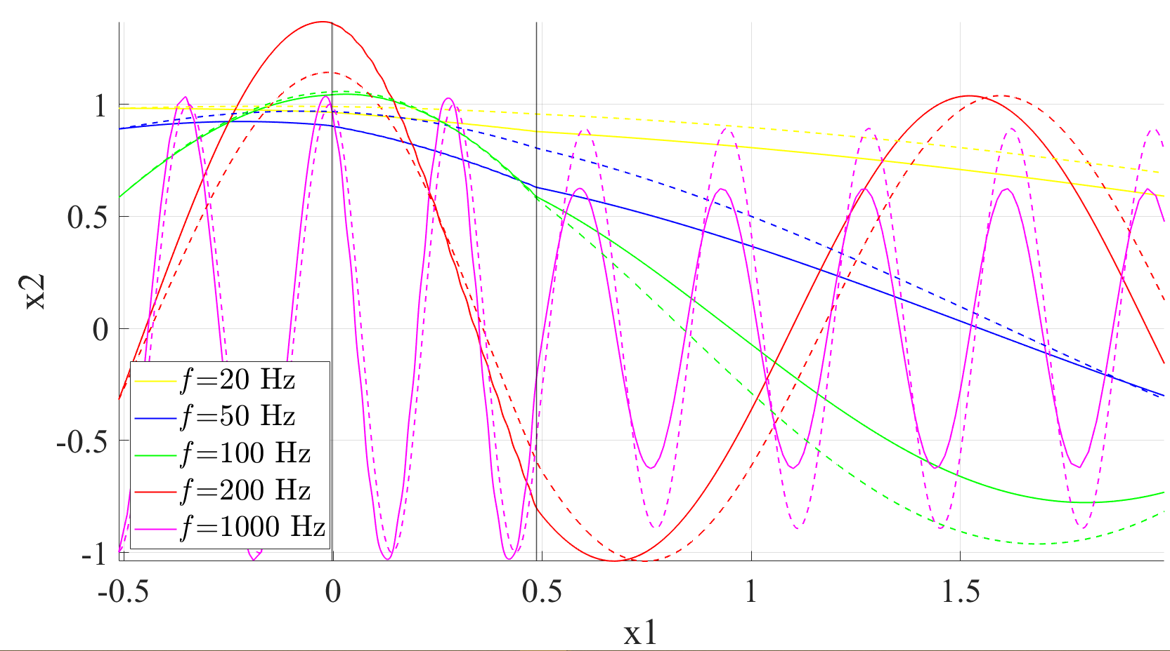
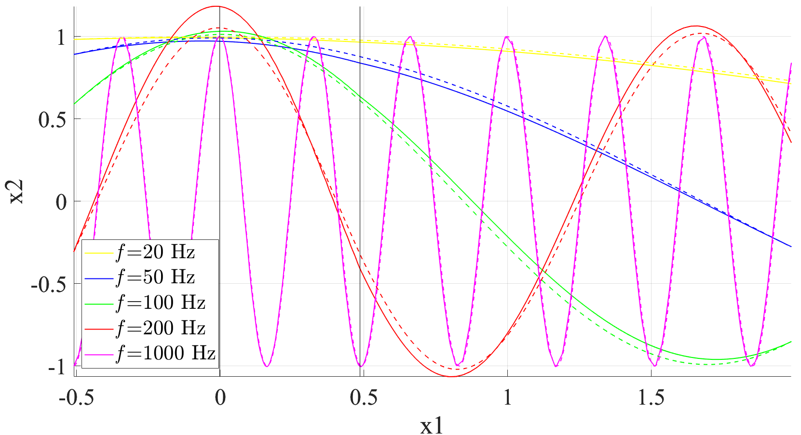
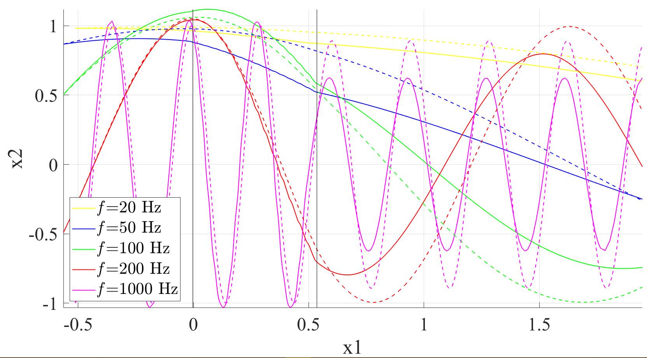
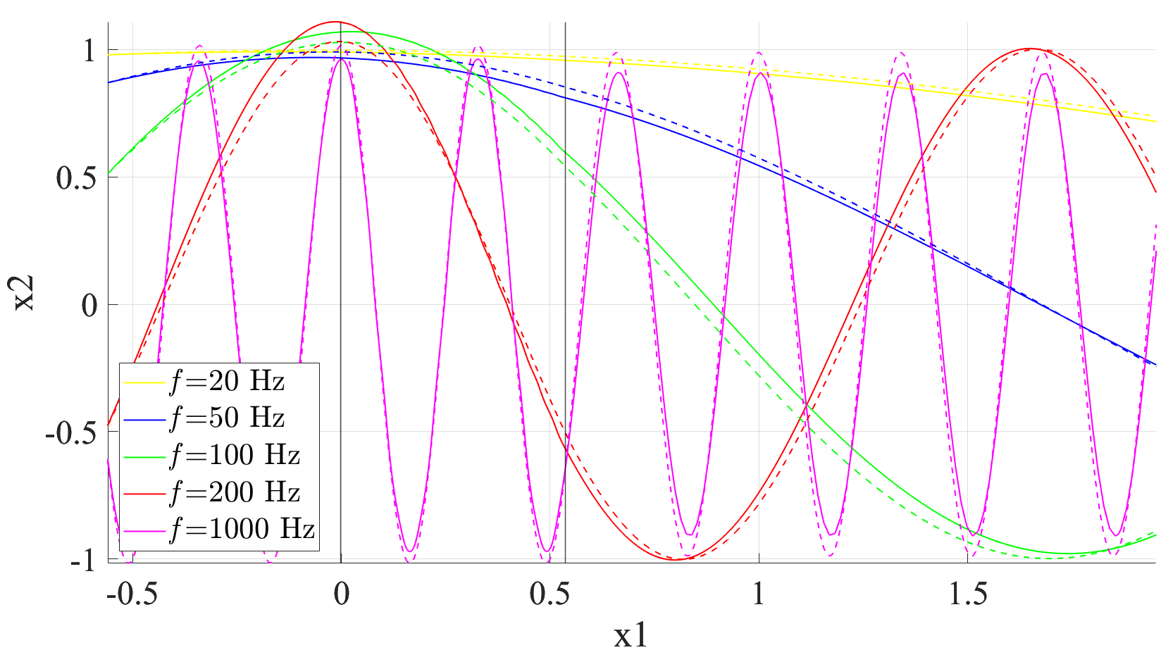
Low porosity
High porosity
Circular cylinders
Rectangular prisms

Slide 17
Conclusions
The model is more effective when:
Porosity of media is higher
Frequency of acoustic wave is lower
The error is due to the lack of interface condition and failure of long wave assumption for high-frequency waves.

