Slide 1



Data assimilation in thermoacoustic instability with Lagrangian optimization
${\text{T}\text{.} \text{Traverso}}^{1,2}$, ${\text{A}\text{.} \text{Bottaro}}^{1}$, ${\text{L}\text{.} \text{Magri}}^{2}$
$${}_{}^{1}{\begin{aligned}\text{Universit}\text{à }\text{degli} \text{S}\text{tudi} \text{di} \text{Genova} \\ \end{aligned}}$$
$${}_{}^{2}{\begin{aligned}\text{University} \text{of} \text{Cambridge} \\ \end{aligned}}$$
12th European Fluid Mechanics Conference, Vienna, 2018

Slide 2
Structure of the talk
Thermoacoustics: Motivation and background
A low-order thermoacoustic model
How to make a qualitative model quantitatively accurate
  Data assimilation with Lagrangian optimization
  Transient dynamics vs dynamics at regime
  Data assimilation at regime
  Data assimilation during transient dynamics
  A more effective cost functional
Conclusions

Slide 3
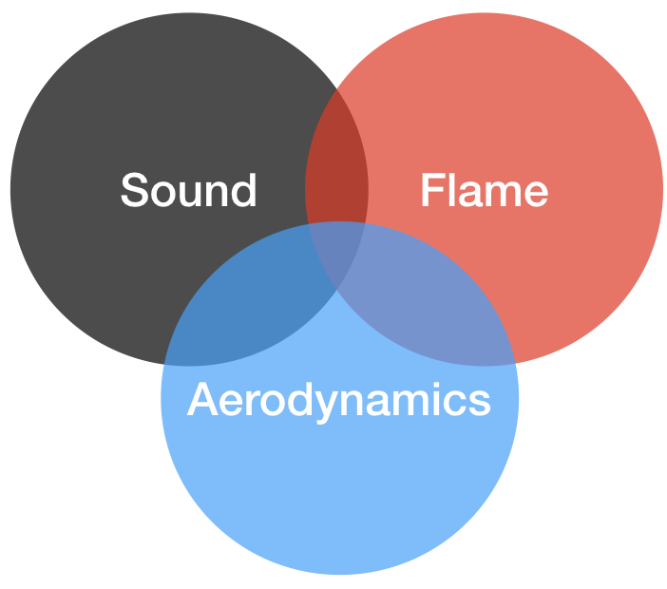
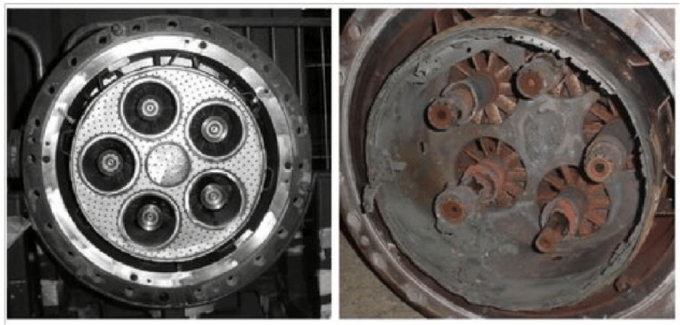
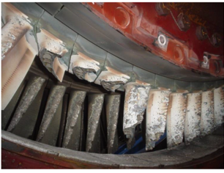
Thermoacoustic oscillations are one of the biggest challenges faced by gas-turbine manufacturers
Thermoacoustic oscillations are a multi-physical phenomenon, which is difficult to predict
Uncontrolled oscillations can be detrimental, if not catastrophic
Thermoacoustic instabilities
Lieuwen & Yang, 2005
Poinsot, PROCI, 2017
Notes:
Cleaner aeronautical gas turbines are designed to burn in a lean regime to reduce NOx emissions, therefore they burn very unsteadily .
Although such an environment is complex, three main physical subsystems can be identified: the acoustics, the injectors/bluff body fluid dynamics and the flame dynamics (combustion).
These subsystems interact with each other contributing differently, but fundamentally, to combustion instabilities.
these phenomena are unwanted as they result in high maintenance and replacement costs.

Slide 4
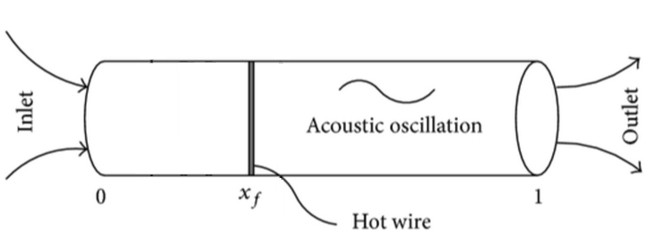
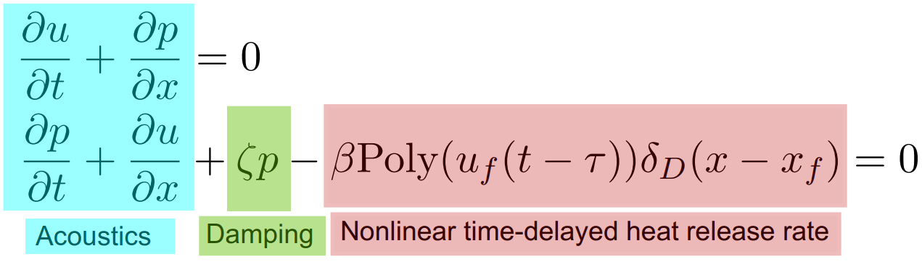
A low-order, nonlinear thermoacoustic model captures the time-delayed physics, which is the key physical mechanism of thermoacoustic instabilities
Longitudinal acoustics
Uniform mean flow
Zero Mach number
Ideal boundary conditions
Momentum equation
Energy equation
Notes:
Say what beta and tau are!
longitudinal acoustics because cut on frequency is higher (acoustics is 1D because H<<L )
the flame is modelled by a time delayed polynomial by words refer to the schematic
BC: ∂u/∂x and p are both set to zero at the ends of the tube

Slide 5
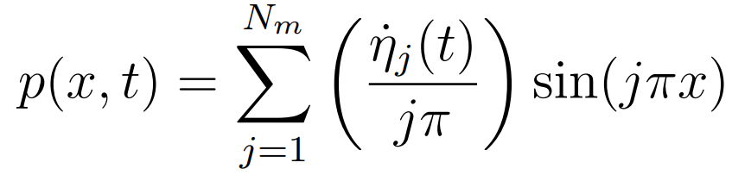
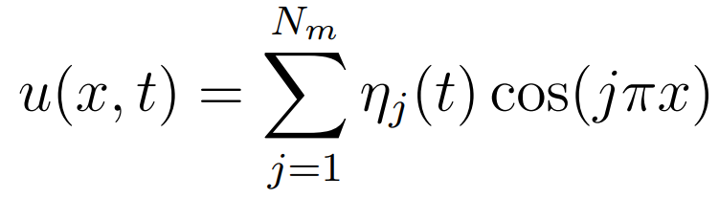
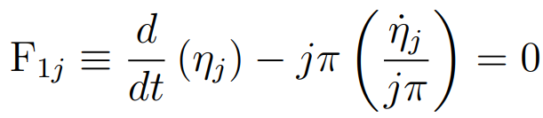

The thermoacoustic model is discretized with the natural acoustic modes
Expansion in natural acoustic modes
Discretized governing equations
Notes:
Galerkin discretization provides a set of nonlinearly coupled oscillators. The coupling occurs through the heat release
Galerkin discretized eqs with comments by words
Eta bar replaced with Uf(t-tau)
The polynomial law which mimics a kings law, which was derived for electrically heated grid

Slide 6
How to make a qualitative model quantitatively accurate?

Slide 7
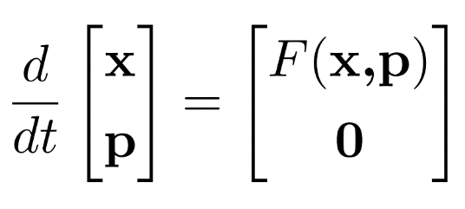
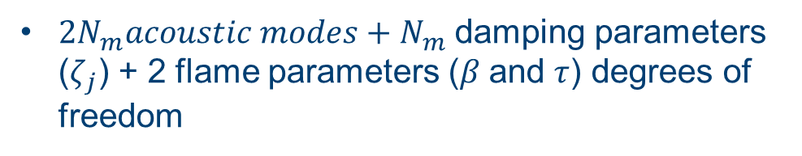
First, we augment the system to calibrate on the fly the flame parameters
Parameters are regarded as constant variables
$2N_{m}acoustic modes+N_{m}$ damping parameters ($ζ_{j}$) + 2 flame parameters ($β$and $τ$) degrees of freedom

Slide 8
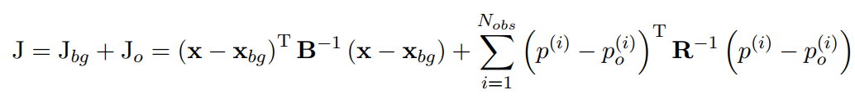
Second, we optimize the statistical distance between the background and observations to obtain the optimal set of initial conditions and flame parameters
Notes:
Explain B and R and the assumptions (Gaussian noise)
Comments by words: In the twin experiment, we know the truth because it is generated by the model. It is a way to simulate synthetic experimental data and test the algorithm

Slide 9
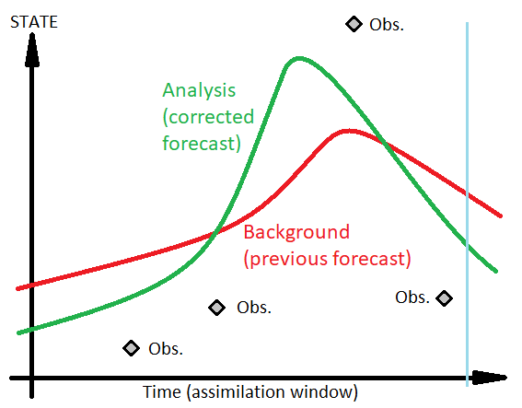
Second, we optimize the statistical distance between the background and observations to obtain the optimal set of initial conditions and flame parameters
Background
Statistical distance between analysis and background at t = 0
Observations
Statistical distance between analysis and observations when observations are available
B and R are covariance matrices
Notes:
Explain B and R and the assumptions (Gaussian noise)
Comments by words: In the twin experiment, we know the truth because it is generated by the model. It is a way to simulate synthetic experimental data and test the algorithm

Slide 10
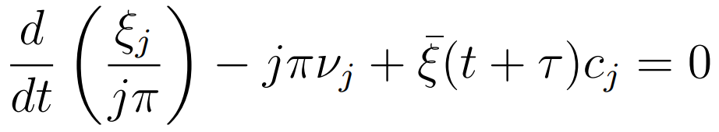
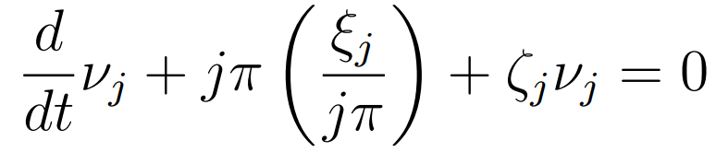
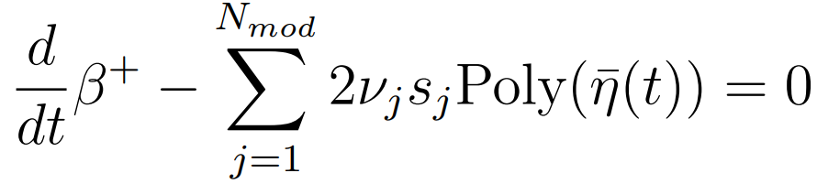
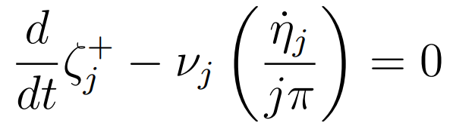
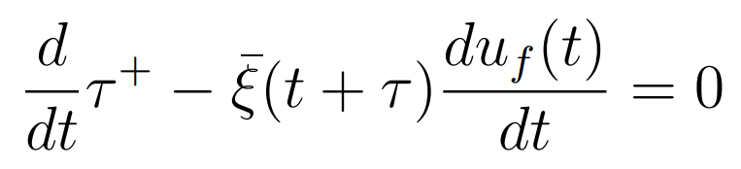
The gradient is calculated by solving the adjoint equations of the state-augmented system
Adjoint momentum
Adjoint energy
Adjoint heat release rate
Adjoint damping factor
Adjoint time delay
e.g. Magri, Juniper, JFM, 2013
Notes:
Say what xi nu are (Lagrange multipliers of…)
Xi bar meaning
Betaplus meaning
- tau+ meaning

Slide 11
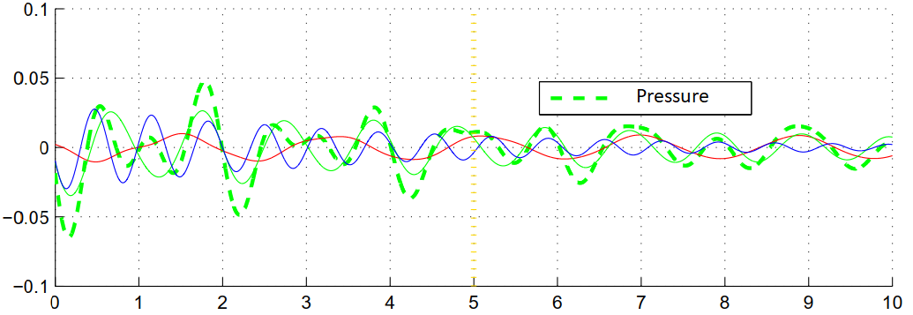
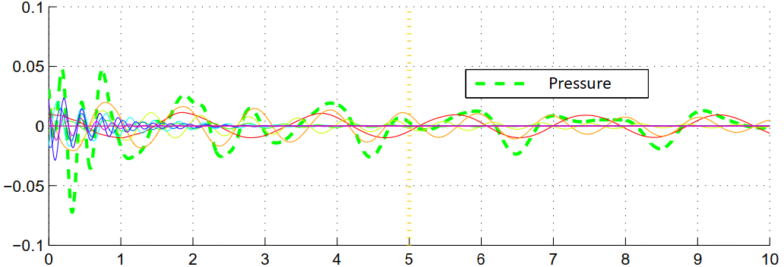
The transient dynamics strongly depends on the number of modes. The higher the number, the more intricate the interaction. However, after the transient, the dynamics are dominated by the first modes
3 Modes
P
10 Modes
Time
Notes:
3 modes, 10 modes and 50 modes (dynamics are very similar up to 50 modes in the transient)
Data assimilation is about using light models (few modes) and to correct them on the fly. We can do this successfully at regime.
We are going to assimilate data in both transient and at regime, so here we can see when and how the transient dynamics are captured by the model

Slide 12
Assimilation of thermoacoustic data:
The twin experiments

Slide 13
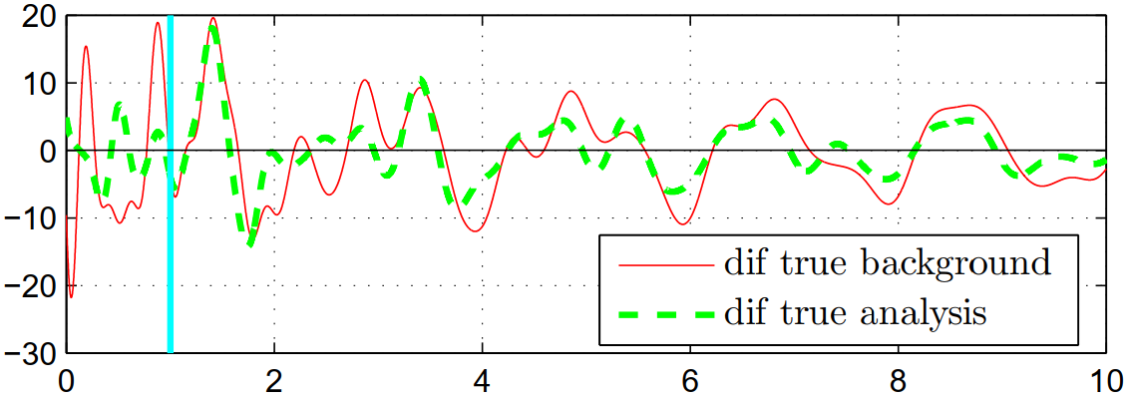
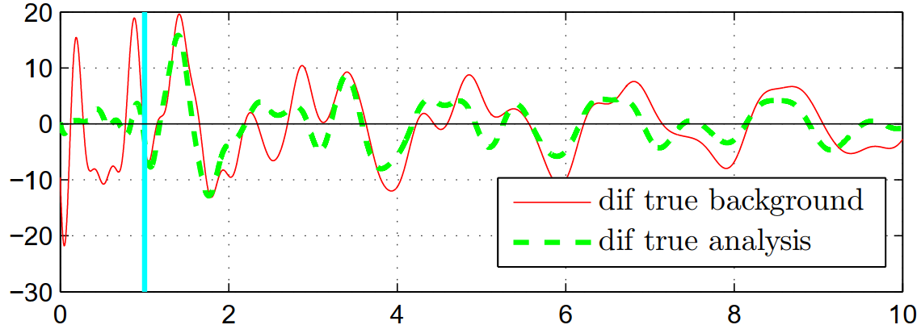

During the transient, using more observations does not improve the analysis
10 Modes
50 Observations
$$∆P$$
When many modes interact the true pressure signal can result from more different trajectories
250 Observations
Time
Notes:
Say observations are hidden not to be c
Assimilating the transient dynamics has a short-time benefit because of nonlinear mode interaction
onfusing

Slide 14
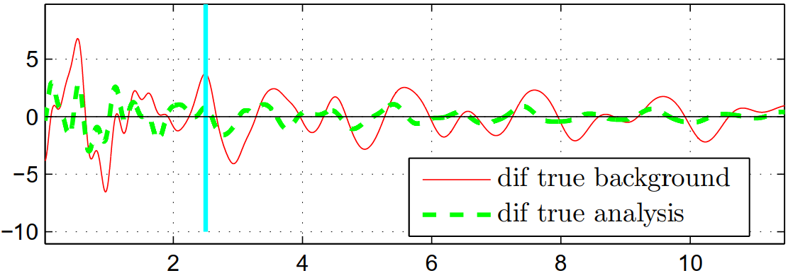
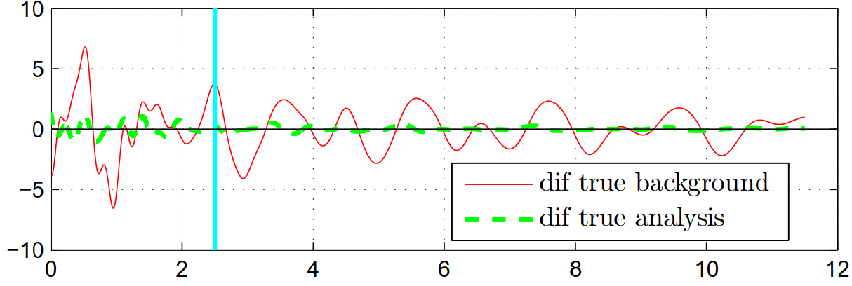
At regime, using more observations improves the analysis
10 Modes
50
Observations
$$∆P$$
250
Observations
Time

Slide 15
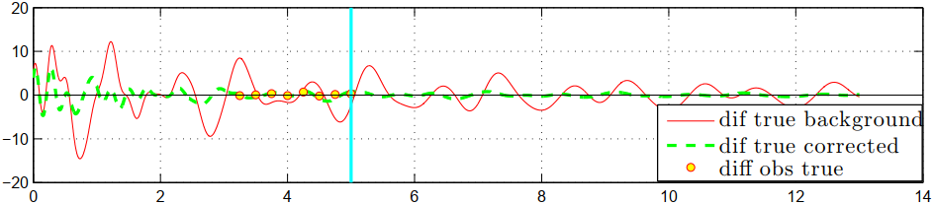
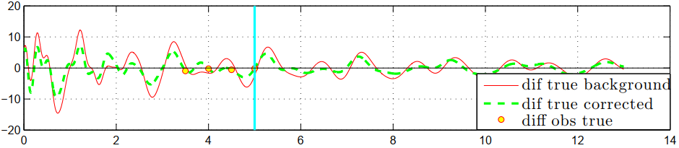


At regime, the analysis can be improved using a low assimilation frequency of observations because the dynamics are dominated by the first modes
10 Modes
Sampling frequency
= 4
$$∆P$$
Sampling frequency
= 2
Time
Highest frequency at regime is $f=\frac{Nm π}{2π}=2$
For the Shannon theorem f=4 is necessary to improve the forecast
Lower sampling frequency does not improve the analysis
Notes:
State that here I can show the observations as we have few of them

Slide 16
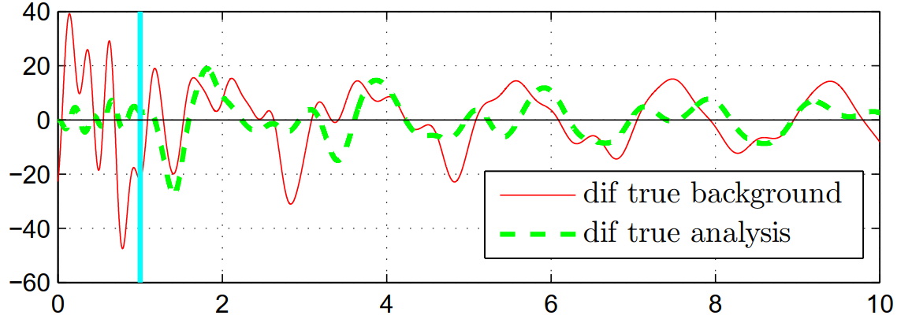
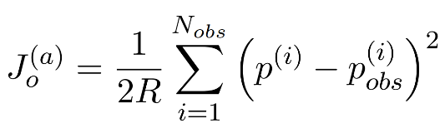
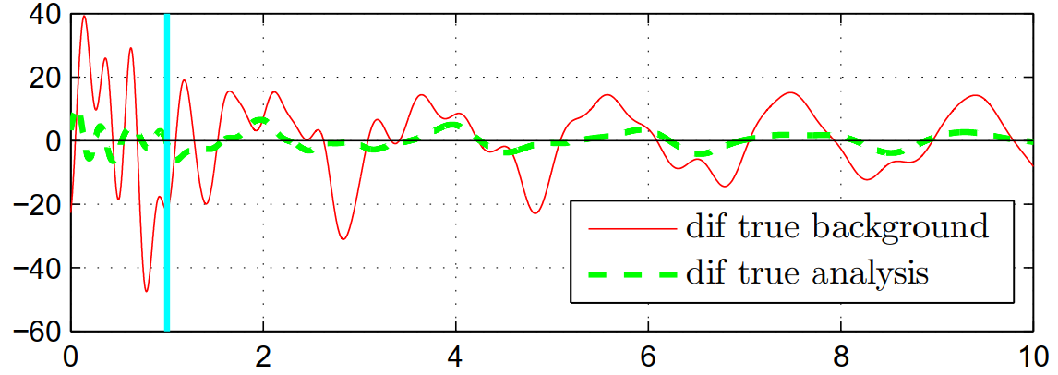
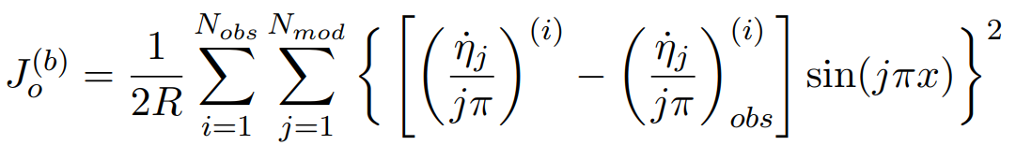

We can define cost functionals to constrain the pressure or pressure modes. The latter is more effective for data assimilation of thermoacoustics instabilities
10 Modes
Measurements of the pressure
$$∆P$$
Measurements of the pressure modes
Time
Notes:
experimentally the sensors usually measure the pressure, but with spectral analysis we can get the mode dynamics too.
Intuitively, constraining the pressure modes is more effective because we are constraining and updating more dynamics

Slide 17
Conclusions
We proposed data assimilation with Lagrangian optimization to make a qualitative thermoacoustic model quantitatively accurate
Assimilating the transient dynamics has a short-time benefit because of nonlinear mode interaction
Assimilating the dynamics at regime has a long-time improvement because the physics is dominated by a handful of modes
The minimum number of observations is constrained by the Shannon theorem
We suggest a more effective cost functional based on the spectral content of the pressure
Next: Assimilate experimental data

Slide 18
Back up slides

Slide 19


Thank you for your attention
$${}_{}^{1}{\begin{aligned}\text{Universit}\text{à }\text{degli} \text{S}\text{tudi} \text{di} \text{Genova} \\ \end{aligned}}$$
$${}_{}^{2}{\begin{aligned}\text{University} \text{of} \text{Cambridge} \\ \end{aligned}}$$
${\text{Tullio} \text{Traverso}}^{1,2}$, ${\text{Alessandro} \text{Bottaro}}^{1}$, ${\text{Luca} \text{Magri}}^{2}$

Slide 20
First, we augment the system to include the flame parameters in the assimilation. Second, we use external observations to “train” the model
Augmented system
Definition of a cost functional, J
Low-order thermoacoustic model
Prediction (background solution)
Optimization of statistical distance
Improved state and parameters (analysis)
Guess on initial conditions and parameters (tau, beta)
Observations
(external data)
Notes:
CHANGE TAU AND BETA TO the correct Greek symbols

Slide 21
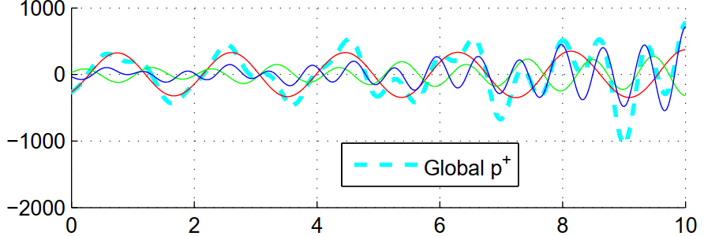
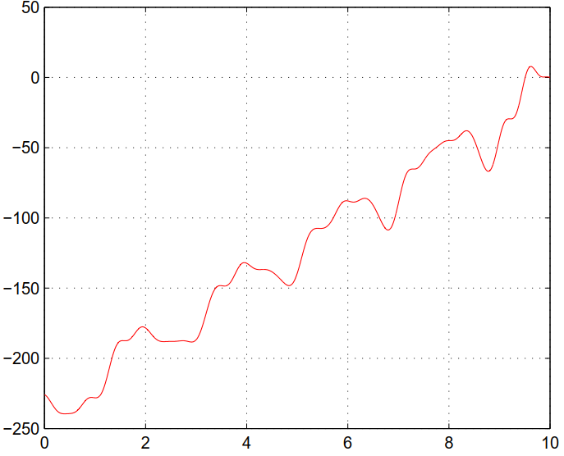

The Adjoint time series
Oscillating variables reflect this behaviour in their adjoint (Lagrange multipliers)
Adjoint pressure modes
Time
The sensitivity of J with respect to the heat release parameter (β) increases with time
Physical interpretation: J is sensitive to the total energy input
$$β^{+} (adjoint β)$$
Time
Notes:
Avoid word “global”

