Slide 1
Investigations into Alternative Cooling Air Supply Concepts for the Last Stage Blade of a Heavy-Duty Gas Turbine
Alberto Tanghetti

Slide 2
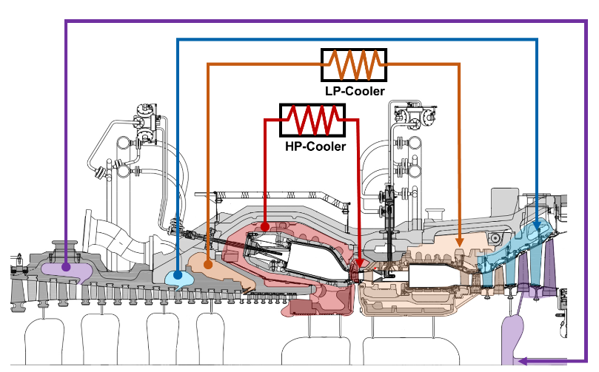
Secondary Air Flows
Secondary Air Flows: flows, which do not pass over airfoil surfaces and combustor
‘Blood circuit’ of the Gas Turbine
Used to cool down hot components of the GT
Used to seal cavities against hot gas ingestion
Reduce performance of GT
Ideally: CA line for each blade & vane
Lower compressor work
Lower CA temperature
Not feasible → CA lines are grouped together

Slide 3
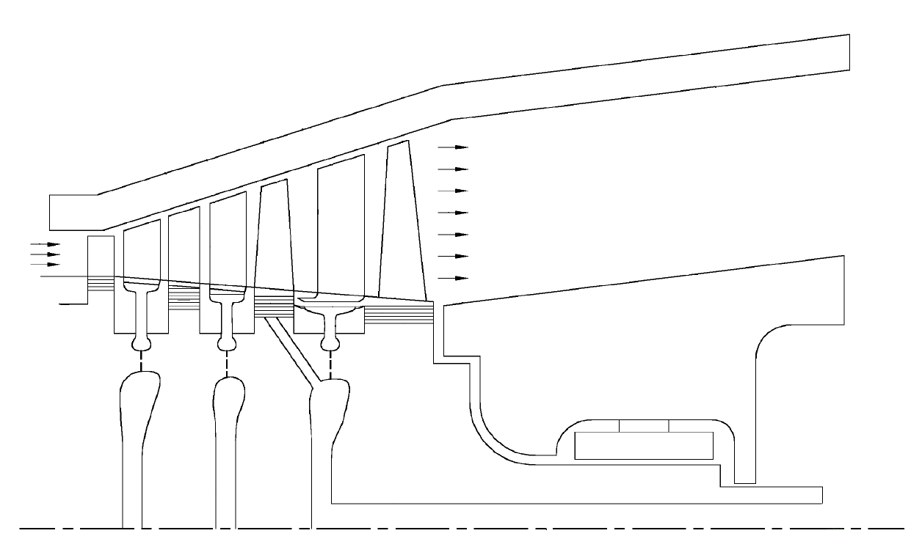
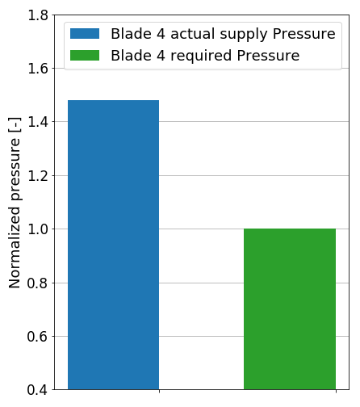
Last stage CA feed system
Blade 3 & 4 are supplied through a bleed from the GT compressor
Problems:
Supply pressure driven by Blade 3 requirements
CA pressure for Blade 4 higher than required
Blade 4
Blade 3
Bearings casing
RHS cavity
CA from GT compressor bleed
Bearings
Disk 4
Disk 3
Work done to pressurise B4 CA accounts as losses

Slide 4
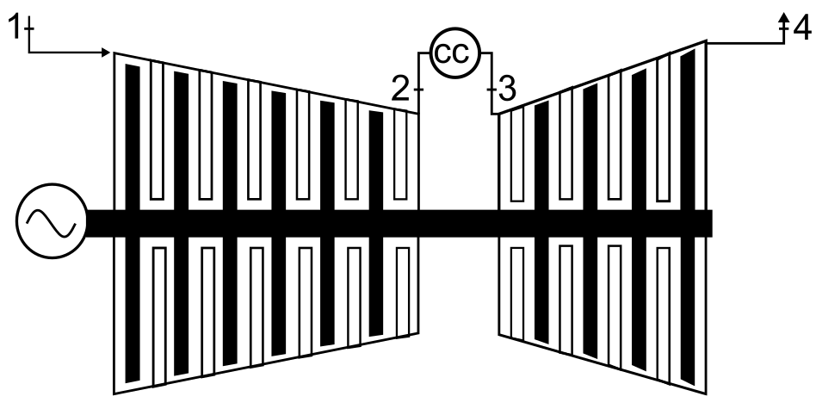
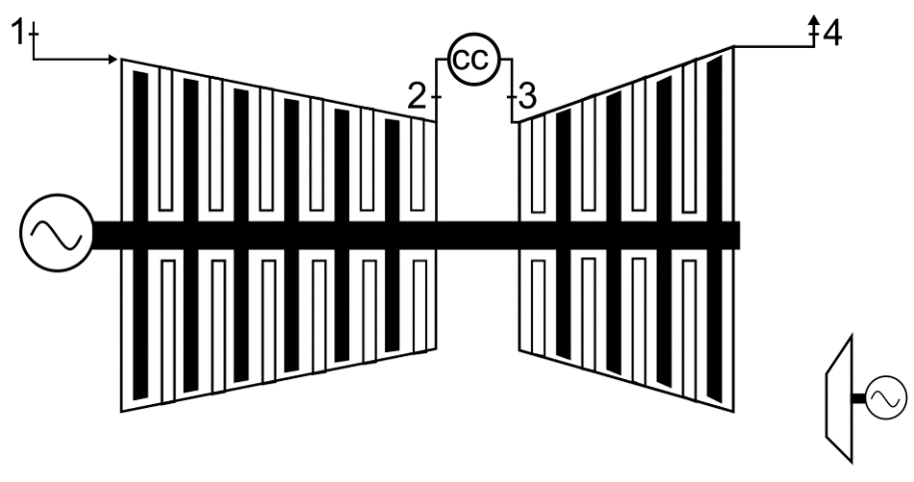
Alternative CA feed system for Blade 4
Blade 3 is supplied through a bleed from the GT compressor
Blade 4 is supplied with CA from an external compressor
Blade 4
Blade 3
CA to B3 & B4
CA from external compressor
RHS cavity
Bearings
CA from GT compressor bleed
Disk 4
CA to B3
CA to B4
Disk 3
Higher core mass flow → Higher GT power
Lower Blade 4 supply pressure & temperature → Increase of GT net efficiency

Slide 5
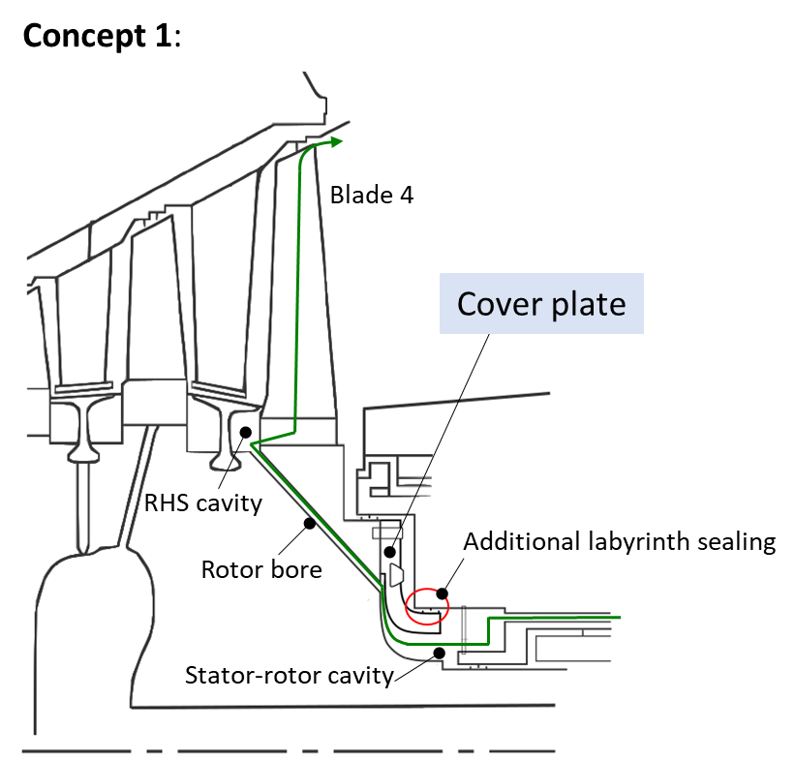
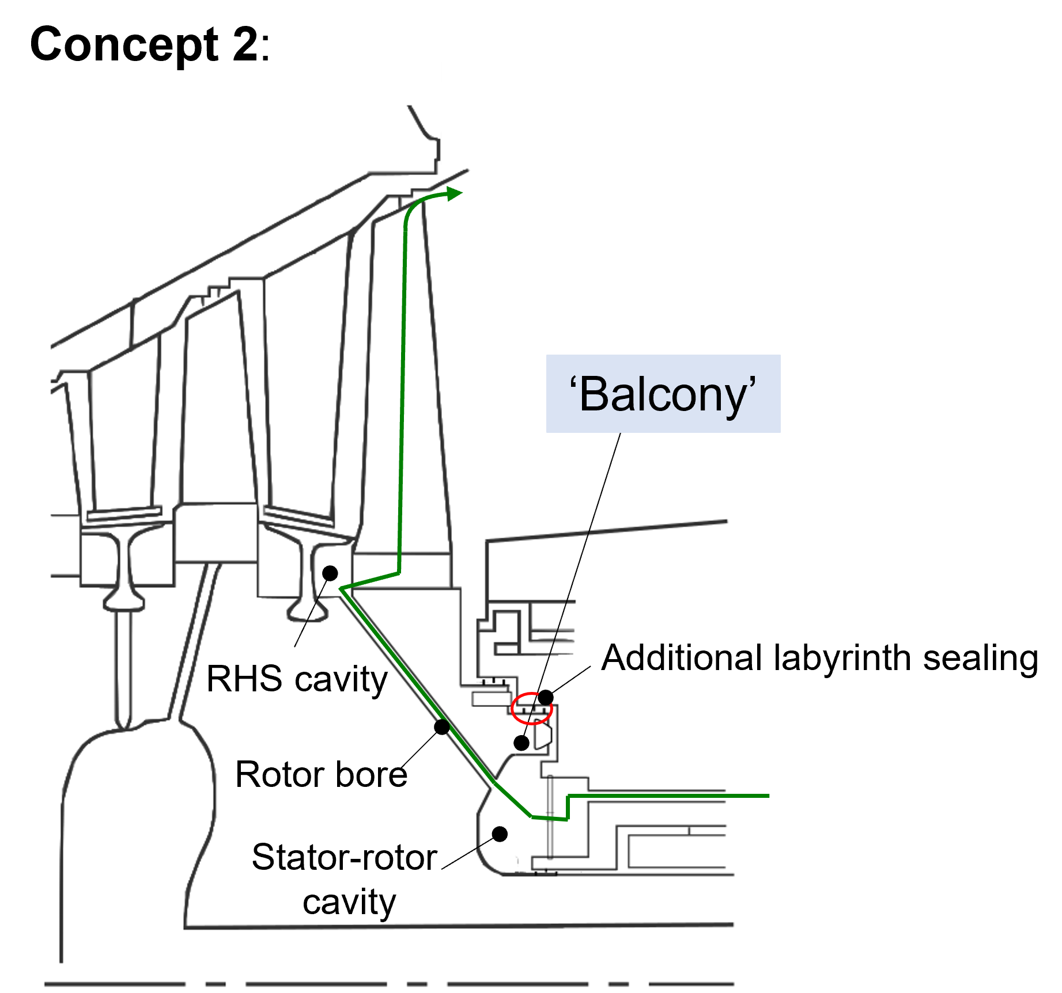
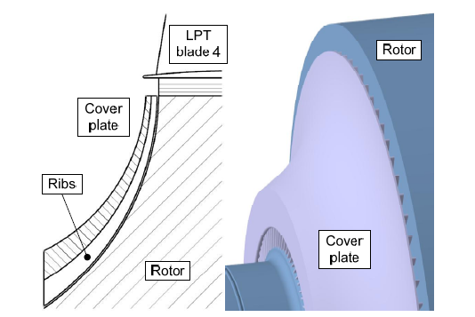
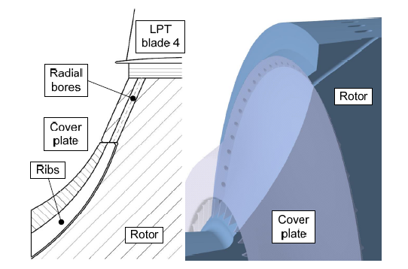
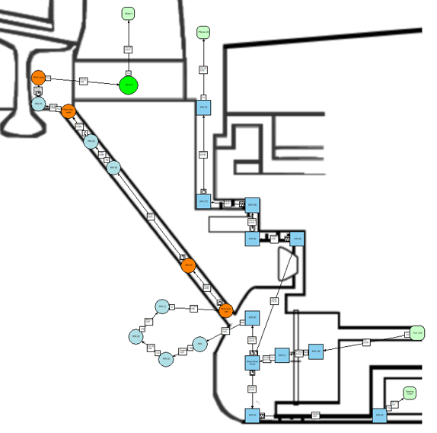
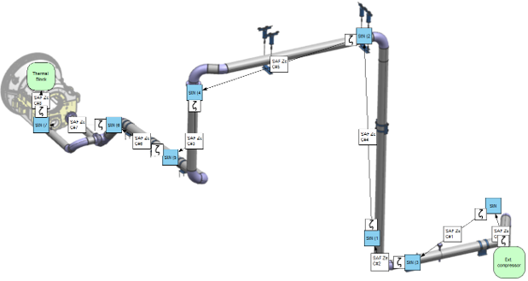
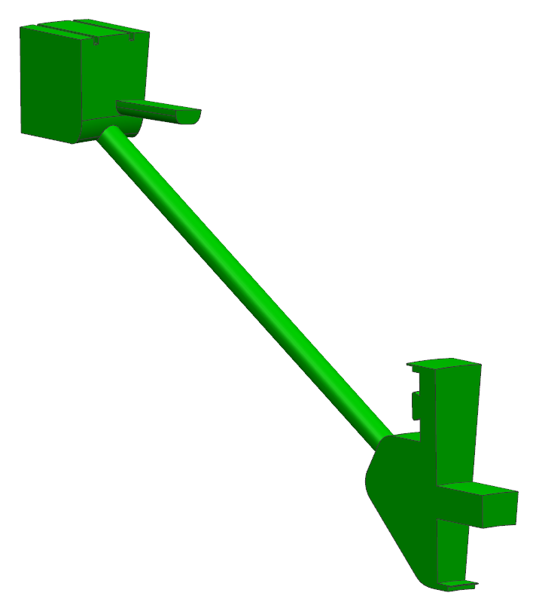
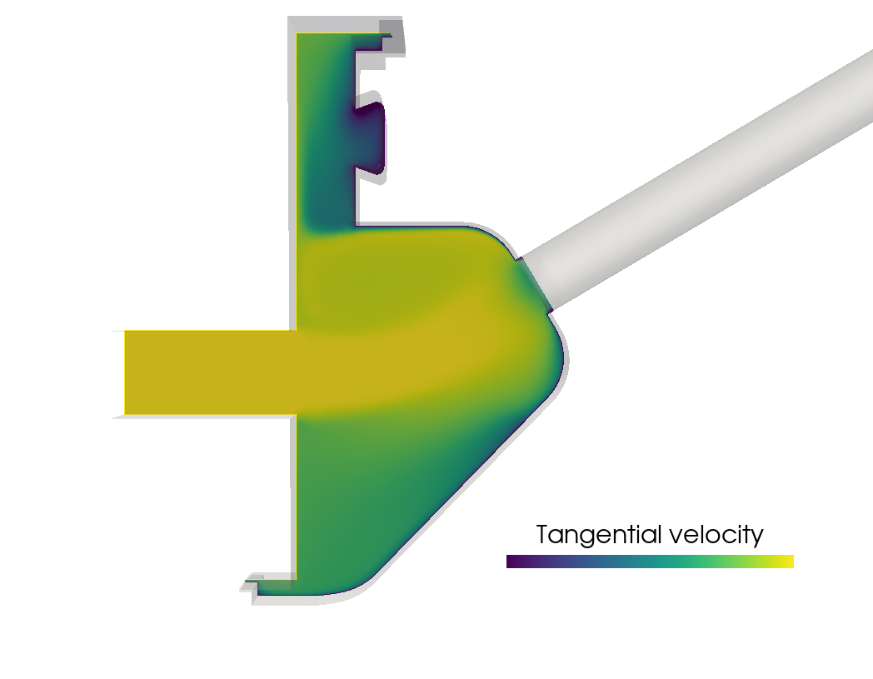
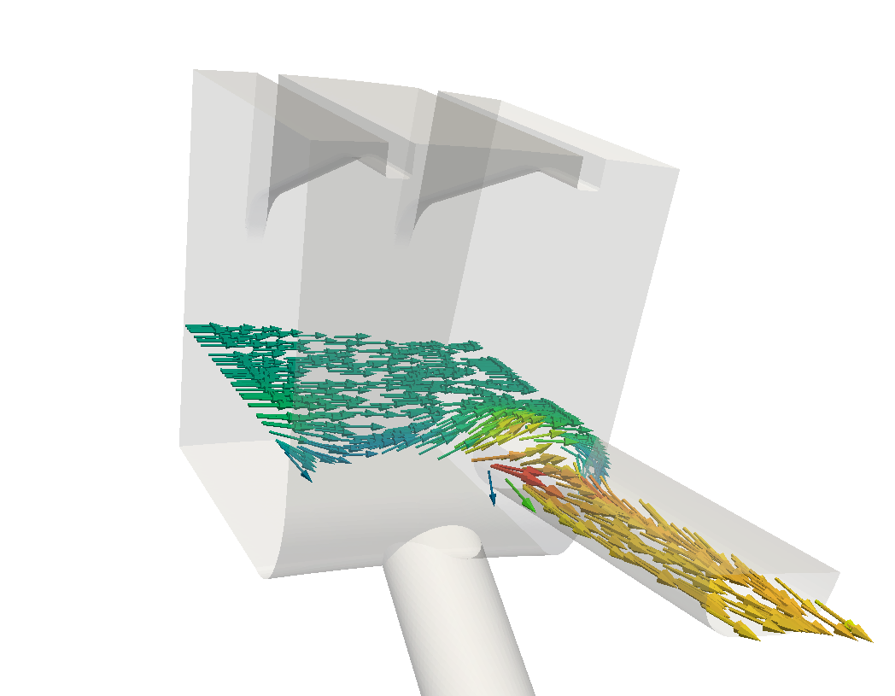
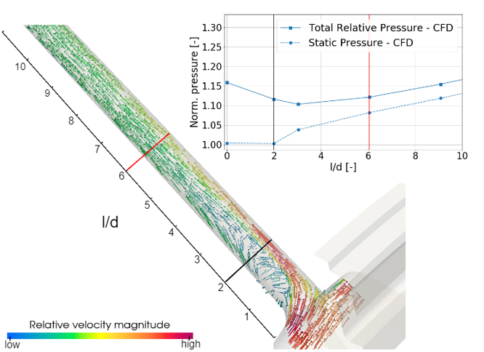
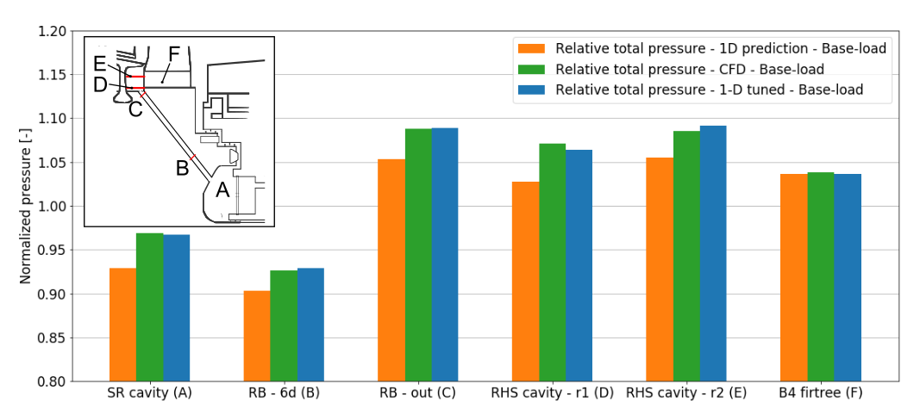
Thesis overview
Literature review and design of different concepts
1-D flow network
CFD analysis
Re-calibration of 1-D flow network

Slide 6
Thesis overview
Selected concept
1-D flow network assembly
CFD analysis
Rotor bore inlet
Re-calibration of the 1-D flow network

Slide 7
Selected concept
1-D flow network assembly
CFD analysis
Rotor bore inlet
Re-calibration of the 1-D flow network

Slide 8
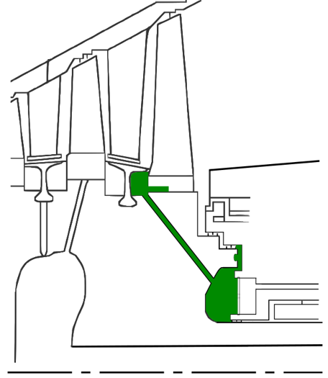
Selected concept
Blade 4
Feed from external compressor
Pressure in stator-rotor cavity to meet B4 CA requirements
Rotor bore to feed Blade 4
Cavity sealed with labyrinths against low pressure region
Leakage to purge rotor-end disk surface
Leakage to purge bearing casing
‘Balcony’
RHS cavity
Additional labyrinth sealing
From external compressor
Rotor bore
Stator-rotor
cavity
Bearings
$$ω$$

Slide 9
Selected concept
1-D flow network assembly
CFD analysis
Rotor bore inlet
Re-calibration of the 1-D flow network

Slide 10
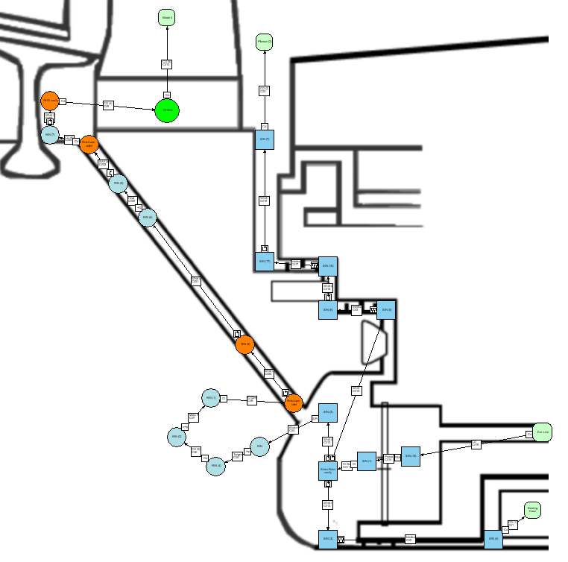
1-D flow network assembly
Internal line
B4
SAS line modelled with lumped parameters:
Pressure loss coefficients
Discharge coefficients
Labyrinth sealing elements
Total pressure and temperature imposed as BCs
Results: Pressure, temperature and mass flow distributions
Labyrinth sealings elements
Friction coefficient
to model RB friction losses
For standard connections (friction losses, bendings in pipes) → Good correlations are available
For other elements, e.g. discharge coefficient at rotor bore inlet → Detailed investigation (CFD) needed
Discharge coefficient
to model RB inlet losses

Slide 11
Selected concept
1-D flow network assembly
CFD analysis
Rotor bore inlet
Re-calibration of the 1-D flow network

Slide 12
CFD analysis
Critical locations, for which loss assumptions need to be checked:
Inlet of rotating bore
Inlet of Blade 4 firtree channel
Method:
CFD to compute pressure losses/discharge coefficients
Update 1-D network
B4 firtree inlet
Rotor bore inlet

Slide 13
CFD analysis
Fluid domain
CAD model

Slide 14
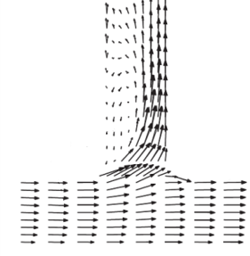
CFD analysis
u
Separation
bubble
$$c_{θ}=u$$
$$w_{θ}=0$$
Fluid domain
$$c_{θ}=0$$
$w_{θ}=$ $u$
Relative flow field
CAD model

Slide 15
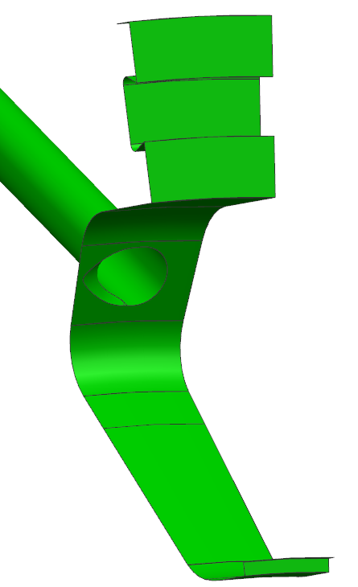
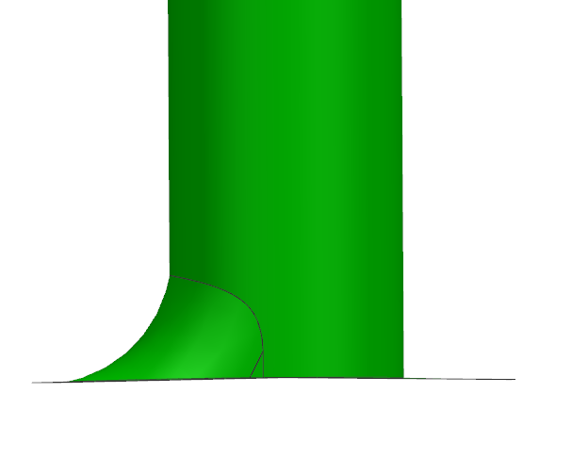
CFD analysis
u
Separation
bubble
$$c_{θ}=u$$
$$w_{θ}=0$$
Fluid domain
$$c_{θ}=0$$
$w_{θ}=$ $u$
Relative flow field
CAD model

Slide 16
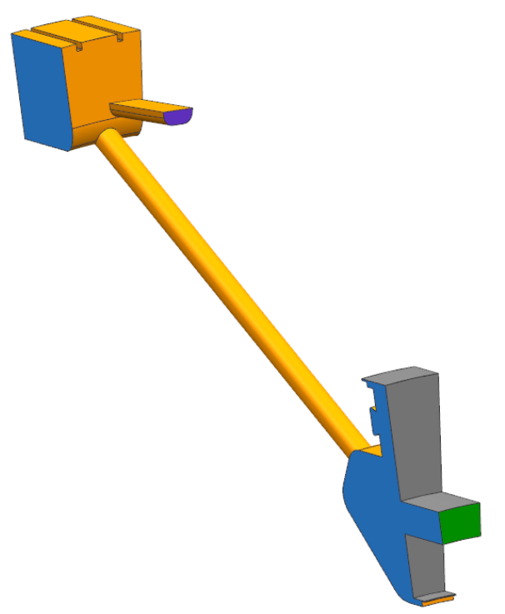
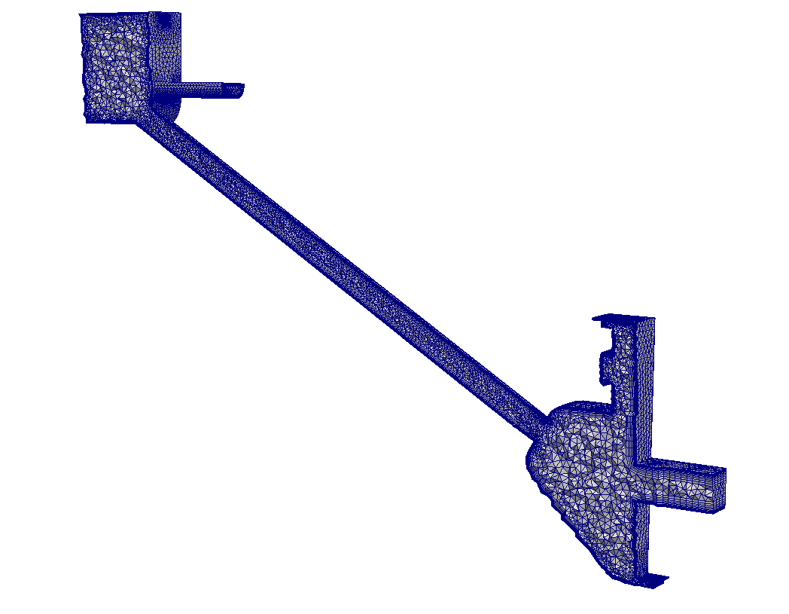
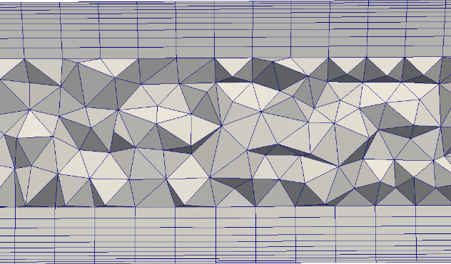
CFD analysis – BCs and mesh
Firtree outlet
(Static pressure)
Periodic surface
u
Labyrinth seal outlet
(Target mass flow)
Rotoric wall
Statoric wall
Inlet
(Mass flow)
Periodic surface
Labyrinth seal outlet
(Target mass flow)

Slide 17
Selected concept
1-D flow network assembly
CFD analysis
Rotor bore inlet
Re-calibration of the 1-D flow network

Slide 18
Rotor bore inlet
Separation bubble due to high β$=atan⁡(\frac{w_{θ}}{w_{ax}})$
Losses extend up to 6 d from inlet
$$w_{ax}$$
$$w_{θ}$$

Slide 19
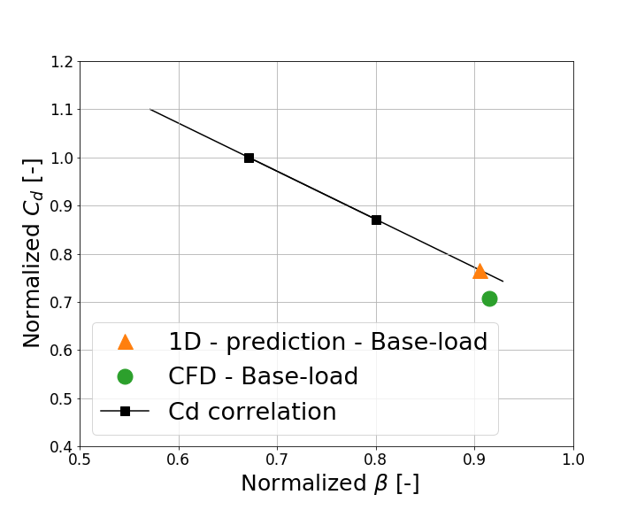
Rotor bore inlet
$C_{d}$element used to model RB inlet losses
$C_{d}$ lower than predicted
$$w_{ax}$$
$$w_{θ}$$
β$=atan⁡(\frac{w_{θ}}{w_{ax}})$

Slide 20
Selected concept
1-D flow network assembly
CFD analysis
Rotor bore inlet
Re-calibration of the 1-D flow network

Slide 21
Re-calibration of the 1D flow-network
1D flow-network is re-calibrated to match the results of the CFD analysis
CA required supply pressure higher than predicted

Slide 22
Re-calibration of the 1D flow-network
1D flow-network is re-calibrated to match the results of the CFD analysis
CA required supply pressure higher than predicted

Slide 23
Conclusion and outlook
New concept for the alternative CA feed system
Requirements for mass flow and pressure are met
1D flow network re-calibrated with CFD analysis
Required supply pressure from external compressor higher than expected
Next steps:
Further investigations regarding the mechanical integrity and the lifetime of disk 4
Iteration with the Turbine Blade Cooling department to reassess Blade 4 CA
Selection of the external compressor
Validation of the alternative CA feed system in a test rig

Slide 24
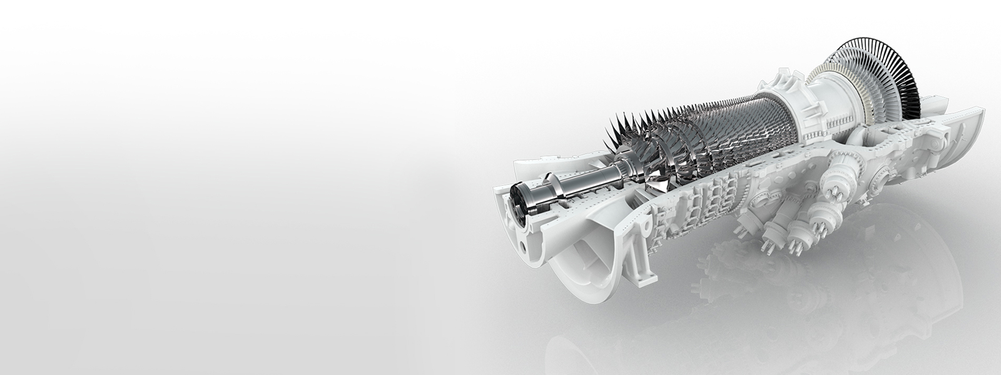
Thank you for your attention!

