Slide 1
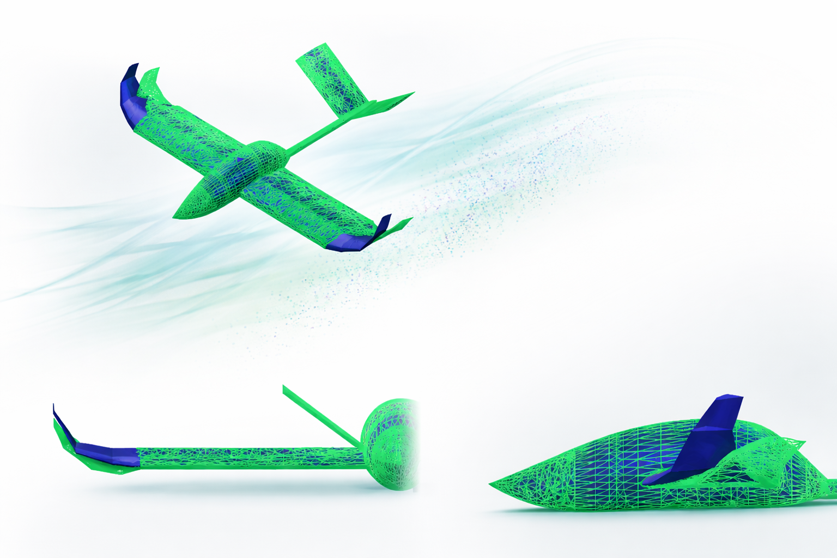


Surrogate-Based Shape Optimisation for Aircraft Design: Implementation in CEASIOMpy
Author:
Marco Ilmi Rushani
Supervisors:
Prof. A. Bottaro
Ing. Jan B. Vos
Dr. Giacomo Benedetti
Notes:
Prova prova

Slide 2
Introduction & Motivation
Context
Conceptual aircraft design requires rapid evaluation of many configurations
Challenge
High-fidelity simulations are computationally expensive
Solution
Enable fast and efficient design space exploration using surrogate models

Slide 3
OUTLINE
Conceptual Aircraft Design Environment
CEASIOMpy Framework
Surrogate Modelling – Intuition
Surrogate Modeling Toolbox (SMT)
Validation Case: ONERA M6 Wing
Application: UAV Winglet Optimisation
Conclusions and future work

Slide 4



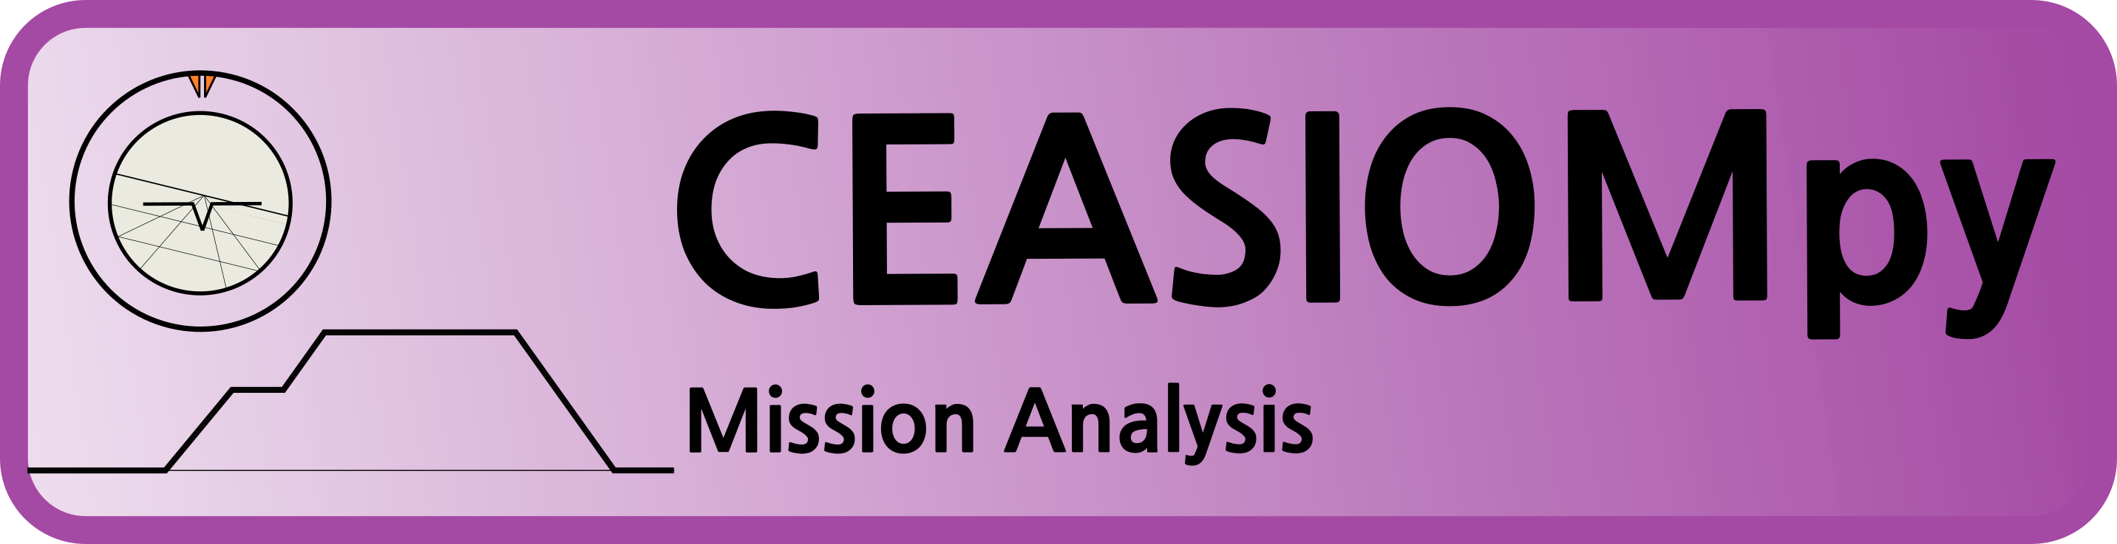
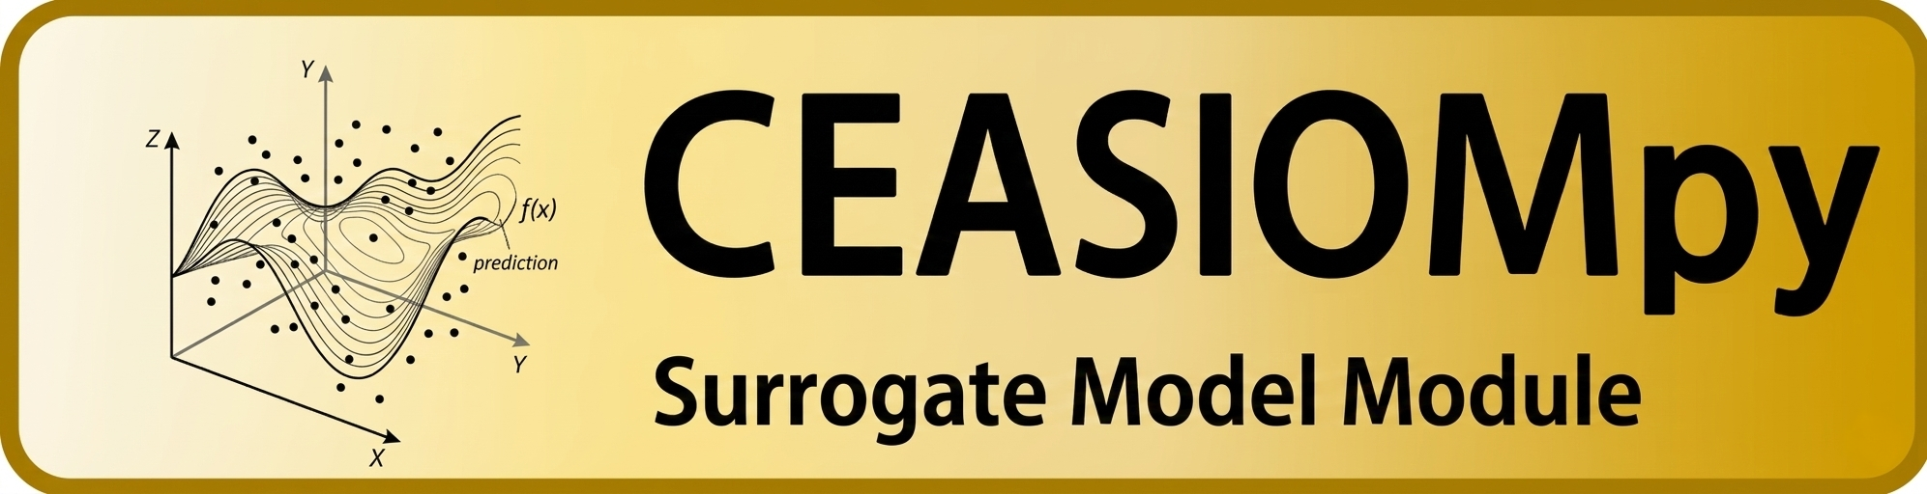
Conceptual Aircraft Design Environment

Slide 5
OUTLINE
Introduction & Motivation
Introduction & Motivation
CEASIOMpy Framework
Surrogate Modelling – Intuition
Surrogate Modeling Toolbox (SMT)
Validation Case: ONERA M6 Wing
Application: UAV Winglet Optimisation
Conclusions and future work
Surrogate modeling: A Simple Example

Slide 6
Surrogate modeling: A Simple Example
Problem: Optimizing Coffee Quality → Objective: Maximize Taste Score
DESIGN VARIABLES: Coffee amount, Water temperature, Brewing time
| RANGE
8 - 12 gr
85 – 96 °
20 – 35 s
DESIGN VARIABLES
Coffee amount
Water temperature
Brewing time
_
DESIGN OF EXPERIMENTS
Next step: DESIGN OF EXPERIMENTS

Slide 7
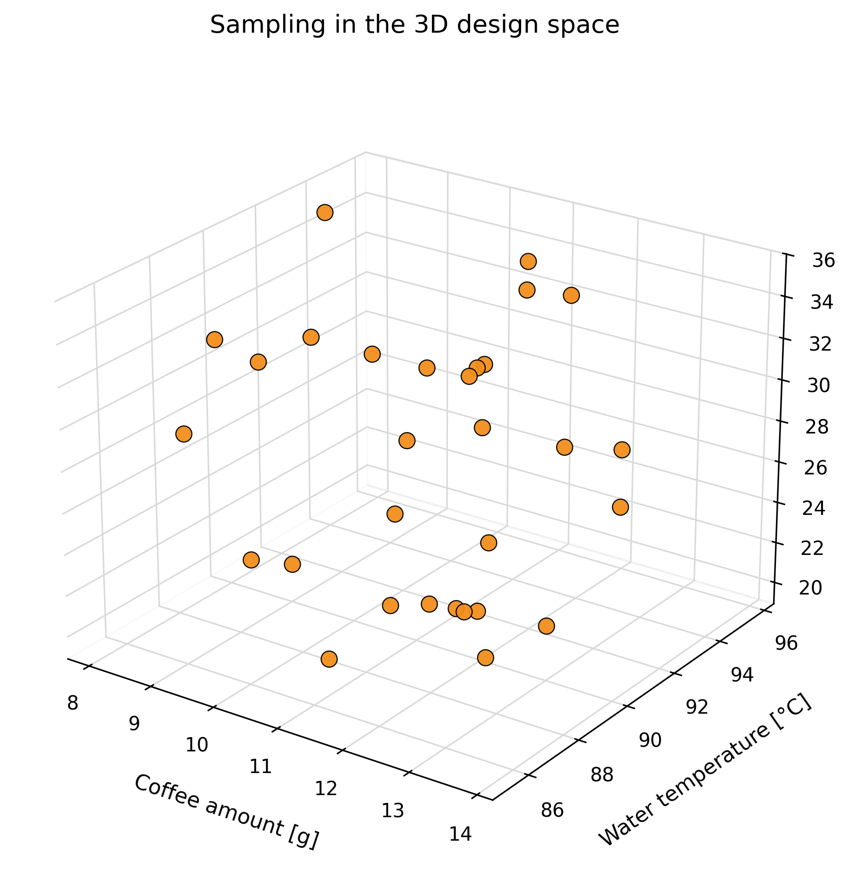
Problem: Optimizing Coffee Quality → Objective: Maximize Taste Score
DESIGN VARIABLES: Coffee amount, Water temperature, Brewing time
DESIGN VARIABLES: Coffee amount, Water temperature, Brewing time
DESIGN OF EXPERIMENTS
_
DESIGN OF EXPERIMENTS
→ Sampling
Experiment | Coffee (g) | Temp (°C) | Time (s)
1 | 9.1 | 87.3 | 22.4
2 | 12.4 | 93.5 | 30.1
3 | 10.8 | 91.2 | 26.8
4 | 13.2 | 94.1 | 33.0
... | ... | ... | ...
30 | 11.3 | 92.0 | 27.5
3) EXPERIMENTS
Next step: EXPERIMENTS

Slide 8
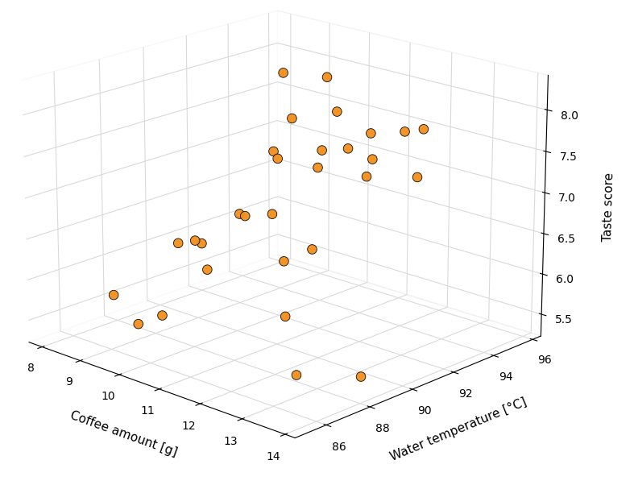
Problem: Optimizing Coffee Quality → Objective: Maximize Taste Score
DESIGN VARIABLES: Coffee amount, Water temperature, Brewing time
DESIGN OF EXPERIMENTS
EXPERIMENTS
DESIGN VARIABLES: Coffee amount, Water temperature, Brewing time
DESIGN OF EXPERIMENTS
3) EXPERIMENTS
→ Definition of taste score
Attribute | Score range
Aroma | 0–10
Acidity | 0–10
Aftertaste | 0–10
DATASET
$$TasteScore = 0.40∗Aroma + 0.40∗Acidity + 0.20∗Aftertaste$$
Coffee | Temp | Time | Aroma | Acidity | Aftertaste | Taste score
11.2 g | 92 °C | 27 s | 8.4 | 7.8 | 8.0 | 8.08
Next step: Training the Surrogate Model
4) SURROGATE MODEL

Slide 9
Problem: Optimizing Coffee Quality → Objective: Maximize Taste Score
DESIGN VARIABLES: Coffee amount, Water temperature, Brewing time
DESIGN OF EXPERIMENTS
EXPERIMENTS
4) SURROGATE MODEL
Used to assess predictive accuracy.
Used to adjust model hyperparameters.
TRAINING:
Used to fit the surrogate model.

Slide 10

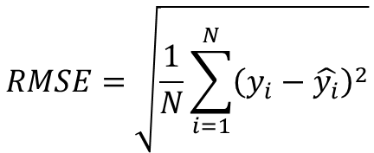

Problem: Optimizing Coffee Quality → Objective: Maximize Taste Score
DESIGN VARIABLES: Coffee amount, Water temperature, Brewing time
DESIGN OF EXPERIMENTS
EXPERIMENTS
SURROGATE MODEL
DESIGN VARIABLES: Coffee amount, Water temperature, Brewing time
DESIGN OF EXPERIMENTS
EXPERIMENTS
4) SURROGATE MODEL
TRAINING:
approximate the relationship between the design variables ($x$) and the objective function $f(x)$
VALIDATION:
tune the hyperparameters of the surrogate model
$$f(x)=TasteScore$$
$$x=(coffee amount,temperature,brewing time)$$
TEST:
evaluate the predictive performance of the model
$$RMSE=\sqrt{\frac{1}{N}\sum_{i=1}^{N}{{\left(y_{i}−\hat{y_{i}}\right)}^{2}}}$$
Where:
N → number of samples
$y_{i}$ → true value
$\hat{y_{i}}$ → model prediction
Next step: Optimisation
The model learns from input–output data by adjusting its parameters to minimize prediction error.
REFINEMENT STRATEGY
5) OPTIMISATION

Slide 11
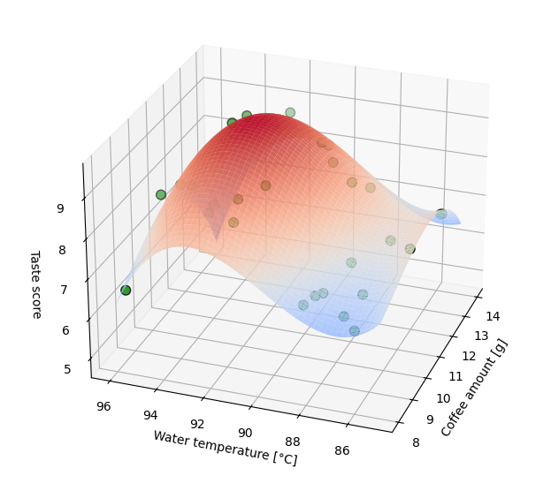
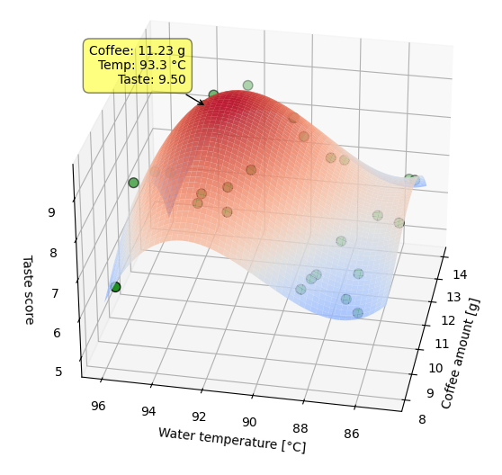


Problem: Optimizing Coffee Quality → Objective: Maximize Taste Score
DESIGN VARIABLES: Coffee amount, Water temperature, Brewing time
DESIGN OF EXPERIMENTS
EXPERIMENTS
SURROGATE MODEL
5) OPTIMISATION
$$x^{∗}=\arg{\max_{x}{f\left(x\right)}}$$
$$x=\left(coffee amount, temperature, brewing time\right)$$
$$f\left(x\right)≈TasteScore$$
From Concept to Application

Slide 12
OUTLINE
Introduction & Motivation
Introduction & Motivation
CEASIOMpy Framework
Surrogate Modelling – Intuition
Surrogate Modeling Toolbox (SMT)
Validation Case: ONERA M6 Wing
Application: UAV Winglet Optimisation
Conclusions and future work
From Concept to Application

Slide 13



From Concept to Application
Surrogate Modeling Toolbox
An open-source Python library providing tools to build and implement surrogate models.

Slide 14
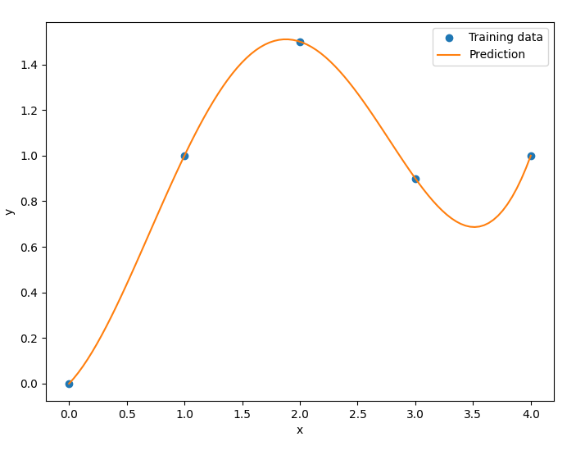
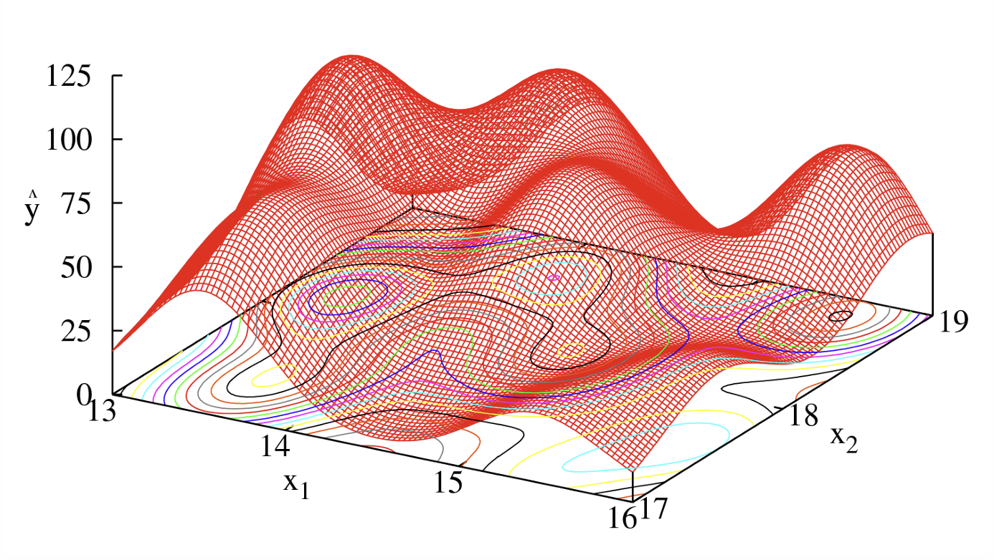
Radial Basis Function (RBF) surrogate model :
Interpolation method that approximates unknown values from known data points;
Uses radial kernels centered on training samples to build a smooth surrogate model;
Notes:
Interpolation method that approximates unknown values from known data points; Uses radial kernels centered on training samples to build a smooth surrogate model; Typically fast to train and evaluate;
🟢 No probabilistic assumptions required for the model
🟢 Works well with moderate to large datasets
🔴 Does not directly provide uncertainty estimates (unlike Kriging)

Slide 15
OUTLINE
Introduction & Motivation
Introduction & Motivation
CEASIOMpy Framework
Surrogate Modelling – Intuition
Surrogate Modeling Toolbox (SMT)
Validation Case: ONERA M6 Wing
Application: UAV Winglet Optimisation
Conclusions and future work
Validation case - ONERA M6
Validation case - ONERA M6

Slide 16
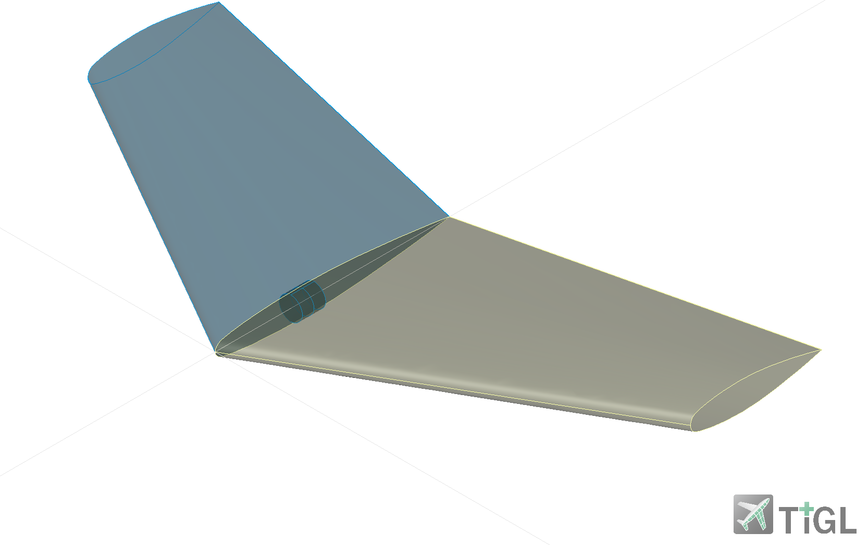
Validation case - ONERA M6
extensively used for CFD validation
available experimental and numerical reference data
DESIGN VARIABLES | VALUE
Sweep angle | 30°
Tip chord | 0.459 m
Semi-span | 0.595 m
Twist | 0°
Parameter | Value
Mach number | 0.84
Angle of attack | 0° – 5° (typical test range)
Notes:
The ONERA M6 wing is a classical benchmark configuration used in aerodynamic studies. It is widely adopted to validate numerical methods and surrogate modeling approaches.

Slide 17
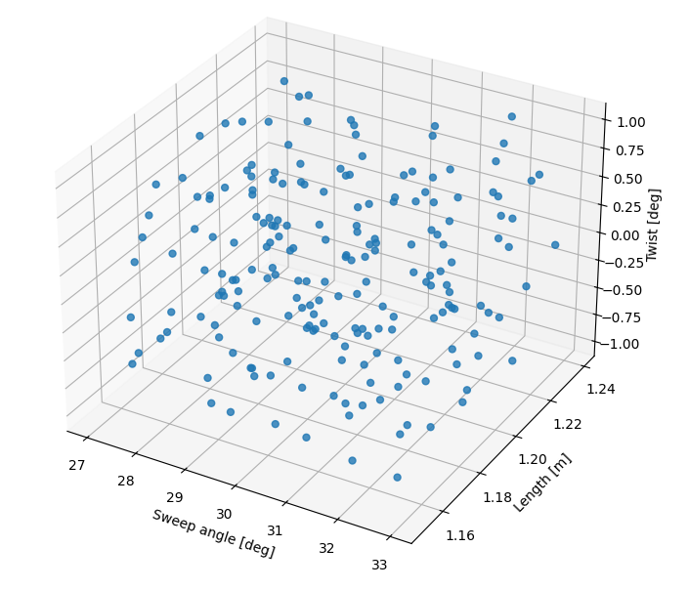
Validation case - ONERA M6
Design Of Experiments
SIMULATIONS
DESIGN VARIABLES | VALUE
Sweep angle | 30°
Tip chord | 0.459 m
Semi-span | 0.598 m
Twist | 0°
LATIN HYPERCUBE SAMPLING (LHS)
→ 200 SAMPLES
RANGE
27 – 33 [°]
0.436 – 0.482 [m]
0.575 - 0.620 [m]
(-1) ­– 1 [°]

Slide 18
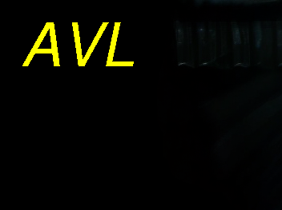
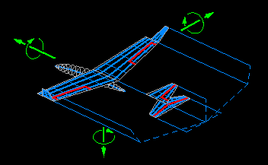
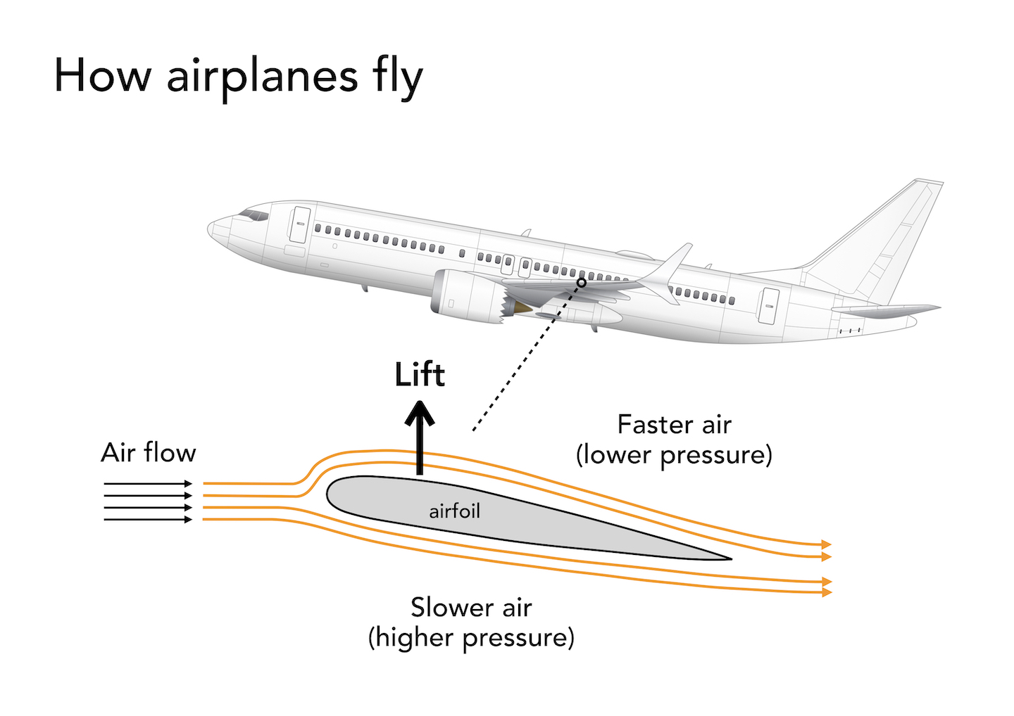
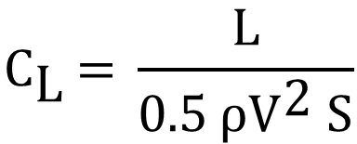

Validation case - ONERA M6
SIMULATIONS
ATHENA VORTEX LATTICE
Vortex Lattice Method:
Represents the lifting surfaces as a vortex surfaces,
Neglects profile thickness and fluid viscosity.
ATHENA VORTEX LATTICE
$${\text{C}}_{\text{L}}\text{ = }\frac{\text{L}}{\text{0.5 }\text{ρ}{\text{V}}^{\text{2}} \text{S}}$$
Objective:
LIFT COEFFICIENT ($C_{L}$)

Slide 19
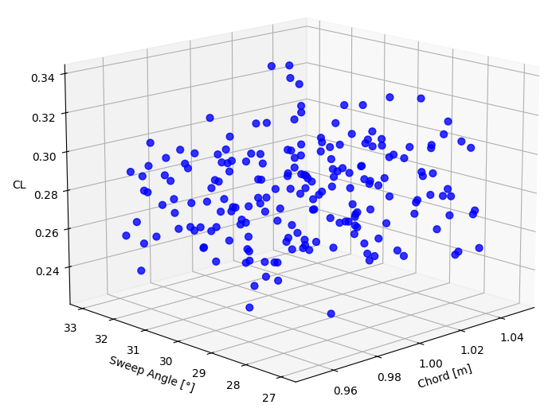
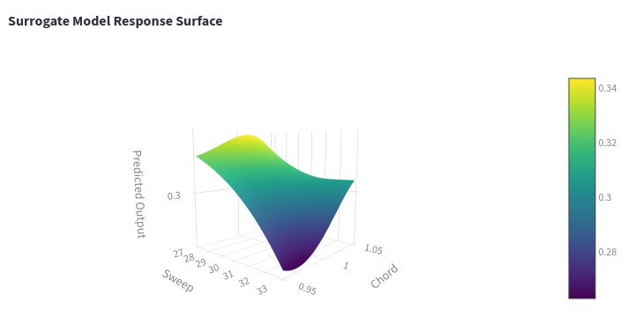

Validation case - ONERA M6
RBF SURROGATE MODEL
AVL simulations results
Split dataset and generate the model
$$\text{\sim }\text{ 400 }\text{sec}$$
OPTIMISATION: Powell Algorithm
BEST CONFIGURATION

Slide 20
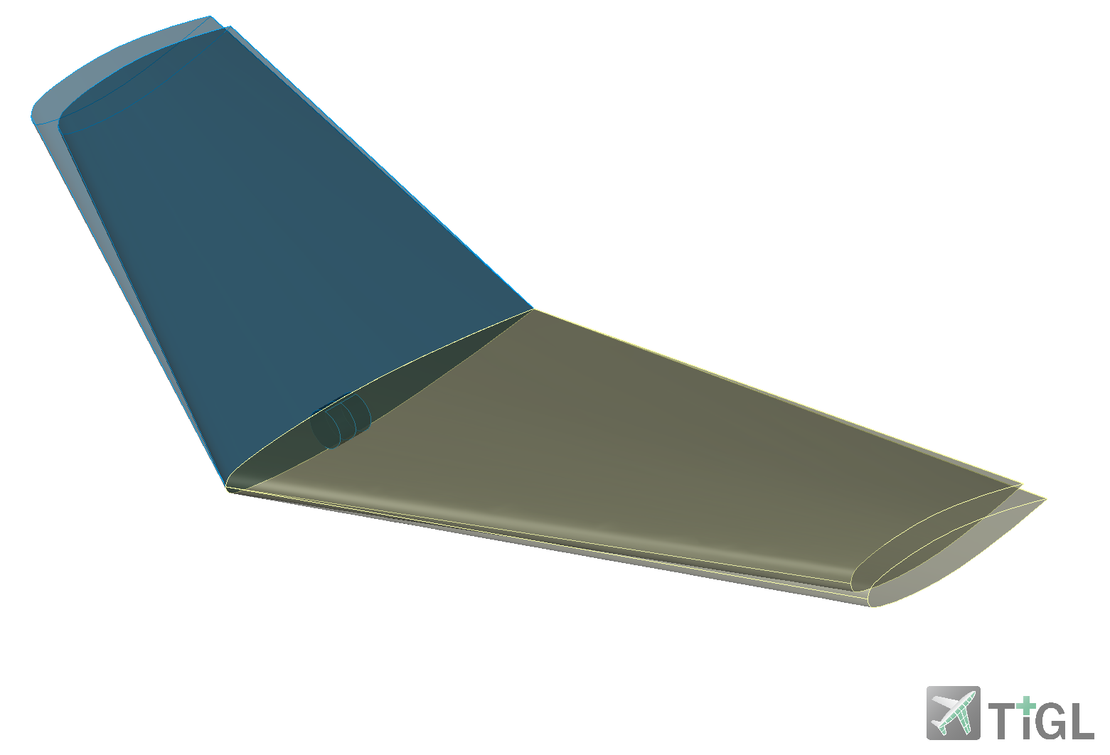
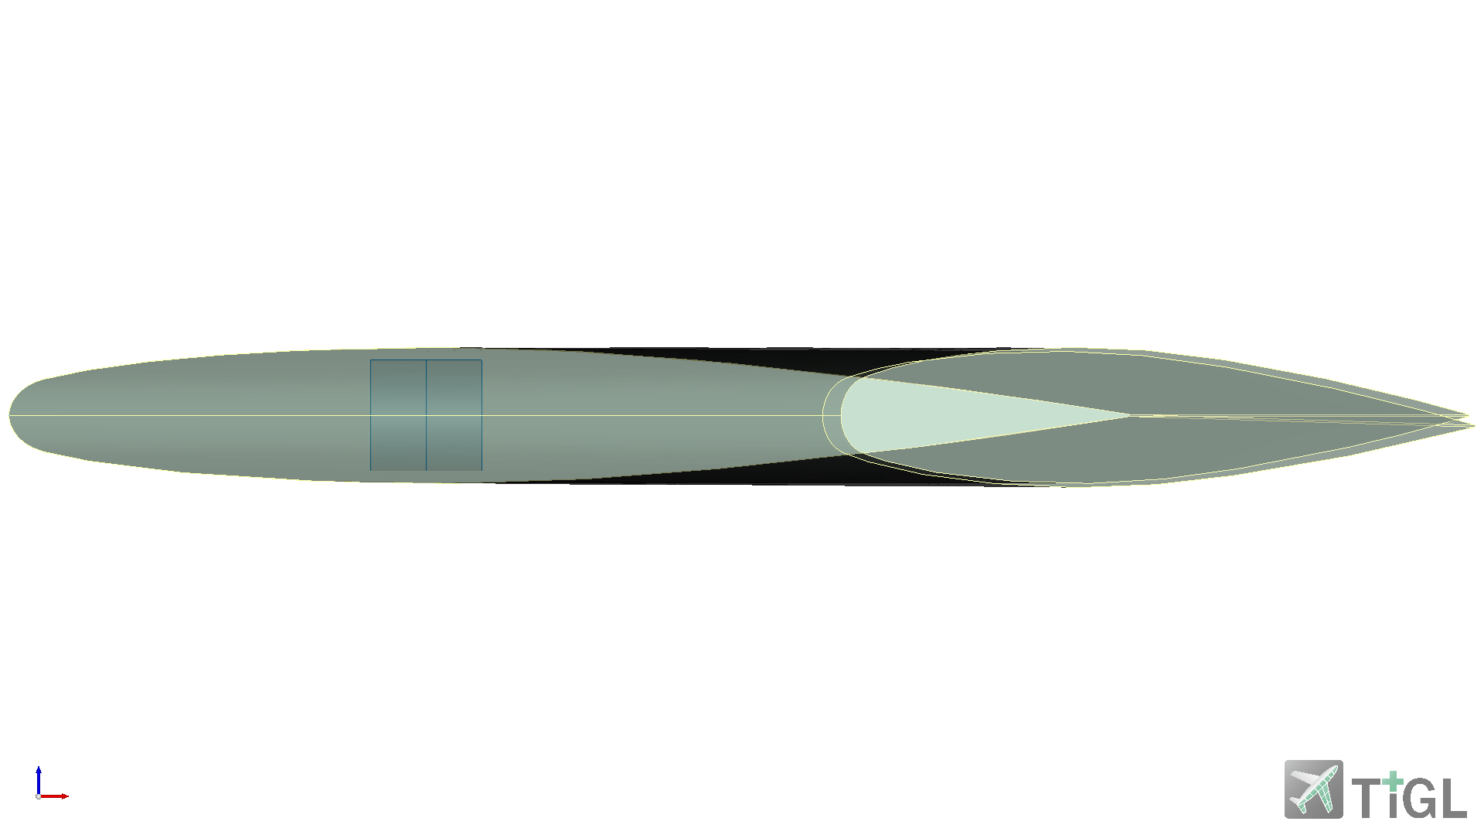
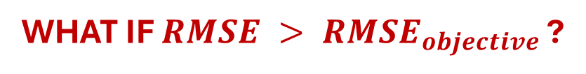
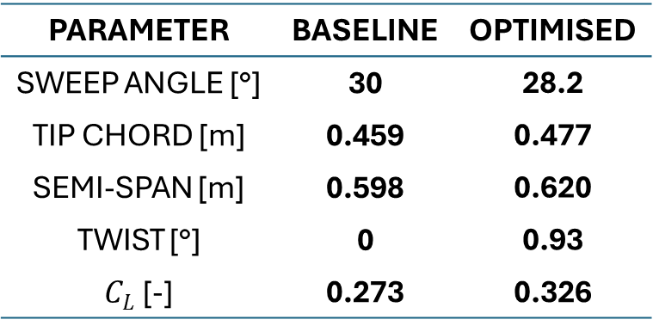
Validation case - ONERA M6
BEST CONFIGURATION
PARAMETER | BASELINE | OPTIMISED
SWEEP ANGLE [°] | 30 | 28.2
TIP CHORD [m] | 0.459 | 0.477
SEMI-SPAN [m] | 0.598 | 0.620
TWIST [°] | 0 | 0.93
$C_{L}$ [-] | 0.273 | 0.326
RMSE
0.021962
+19%
WHAT IF $RMSE > {RMSE}_{objective}$ ?
REFINEMENT STRATEGY

Slide 21

REFINEMENT STRATEGY
TRAIN SURROGATE MODEL
$RMSE > {RMSE}_{objective}$?
NO
YES
RESULTS
GENERATE AND EVALUATE NEW HIGH-FIDELITY POINTS
UPDATE TRAINING DATASET

Slide 22
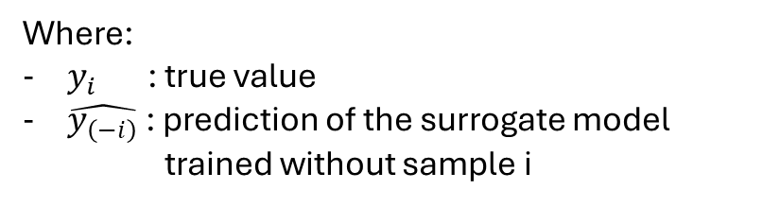

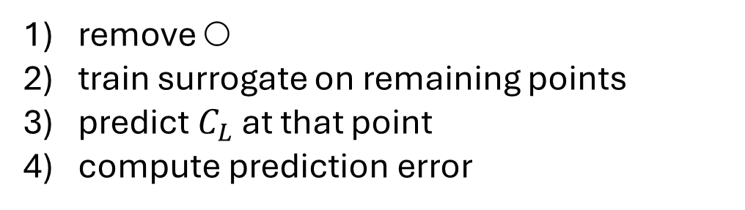
GENERATE AND EVALUATE NEW HIGH-FIDELITY POINTS
Leave-One-Out (LOO) Error
Design points
○ ● ● ● ●
● ○ ● ● ●
● ● ○ ● ●
● ● ● ○ ●
● ● ● ● ○
LOO evaluation
remove ○
train surrogate on remaining points
predict $C_{L}$ at that point
compute prediction error
$$LOO_{i}=\left|y_{i}−\hat{y_{\left(−i\right)}}\right|$$
Where:
$y_{i}$ : true value
$\hat{y_{\left(−i\right)}}$ : prediction of the surrogate model trained without sample i

Slide 23
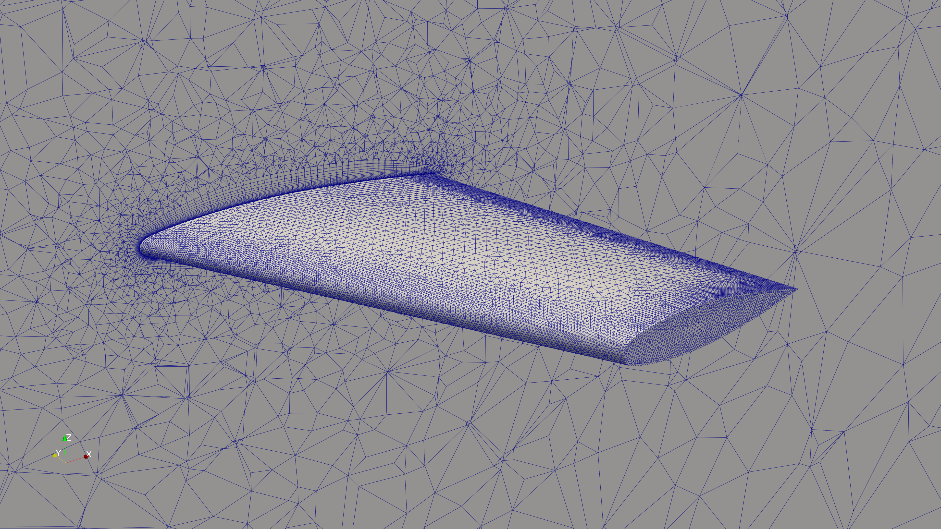
GENERATE AND EVALUATE NEW HIGH-FIDELITY POINTS
Adaptive Sampling
Select points with highest LOO error
High-fidelity evaluations
GMSH Module:
Unstructured 3D Mesh with 1.5 millions of elements
SU2 Module: CFD Simulations with RANS’s Method
Considering viscous effects
Simulation time ~ 2 hours for 2000 iterations

Slide 24


GENERATE AND EVALUATE NEW HIGH-FIDELITY POINTS
Adaptive Sampling
Select points with highest LOO error
High-fidelity evaluations
Augment dataset
Retrain Surrogate Model
RMSE < $RMSE_{objective}$
NO
SET $RMSE_{objective} = 0.015$
YES
RESULTS

Slide 25
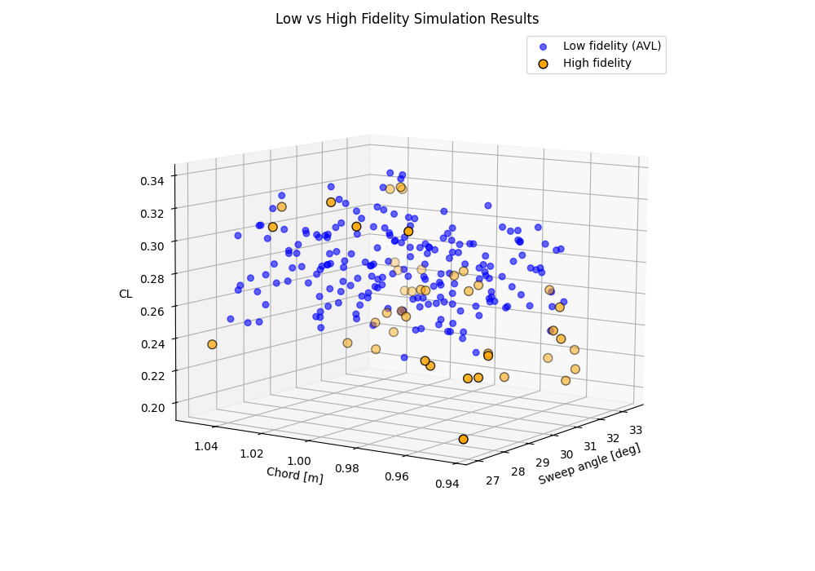
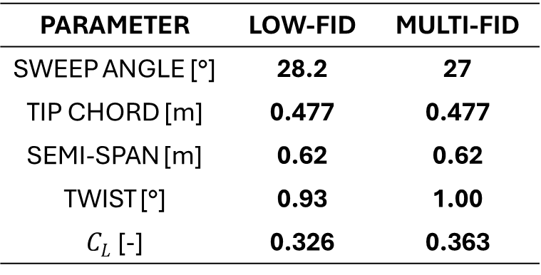
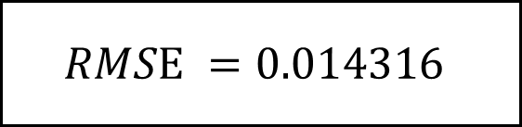
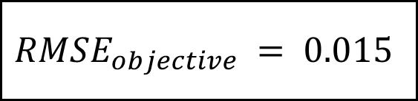
$$RMSE_{objective} = 0.015$$
42 NEW HIGH FIDELITY POINTS
Computational time: ~ 4 days
$$RMSE =0.014316$$
PARAMETER | LOW-FID | MULTI-FID
SWEEP ANGLE [°] | 28.2 | 27
TIP CHORD [m] | 0.477 | 0.477
SEMI-SPAN [m] | 0.62 | 0.62
TWIST [°] | 0.93 | 1.00
$C_{L}$ [-] | 0.326 | 0.363
AVL VALIDATION: 0.352
RANS VALIDATION: 0.368

Slide 26
OUTLINE
Introduction & Motivation
Introduction & Motivation
CEASIOMpy Framework
Surrogate Modelling – Intuition
Surrogate Modeling Toolbox (SMT)
Validation Case: ONERA M6 Wing
Application: UAV Winglet Optimisation
Conclusions and future work
Winglet optimisation for the UAV configuration

Slide 27
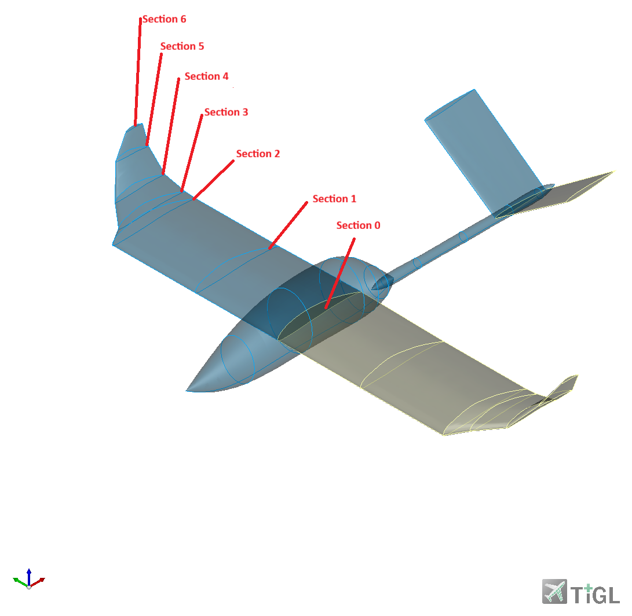
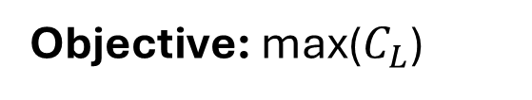
Winglet optimisation for the UAV configuration
Design variables:
• Dihedral ↑ towards tip
• Chord ↓ towards tip
• Twist → local variation allowed
• Sweep → non-uniform bounds
Objective: max($C_{L}$)

Slide 28
Winglet optimisation for the UAV configuration
RBF MODEL
70/20/10 split
Progressively larger set of samples
SAMPLES | RMSE
1000 | 0.038291
3000 | 0.031280
5000 | 0.027561
SAMPLES | RMSE
1000 | 0.038291
3000 | 0.031280
5000 | 0.027561
SAMPLES | RMSE
5000 | 0.027561

Slide 29
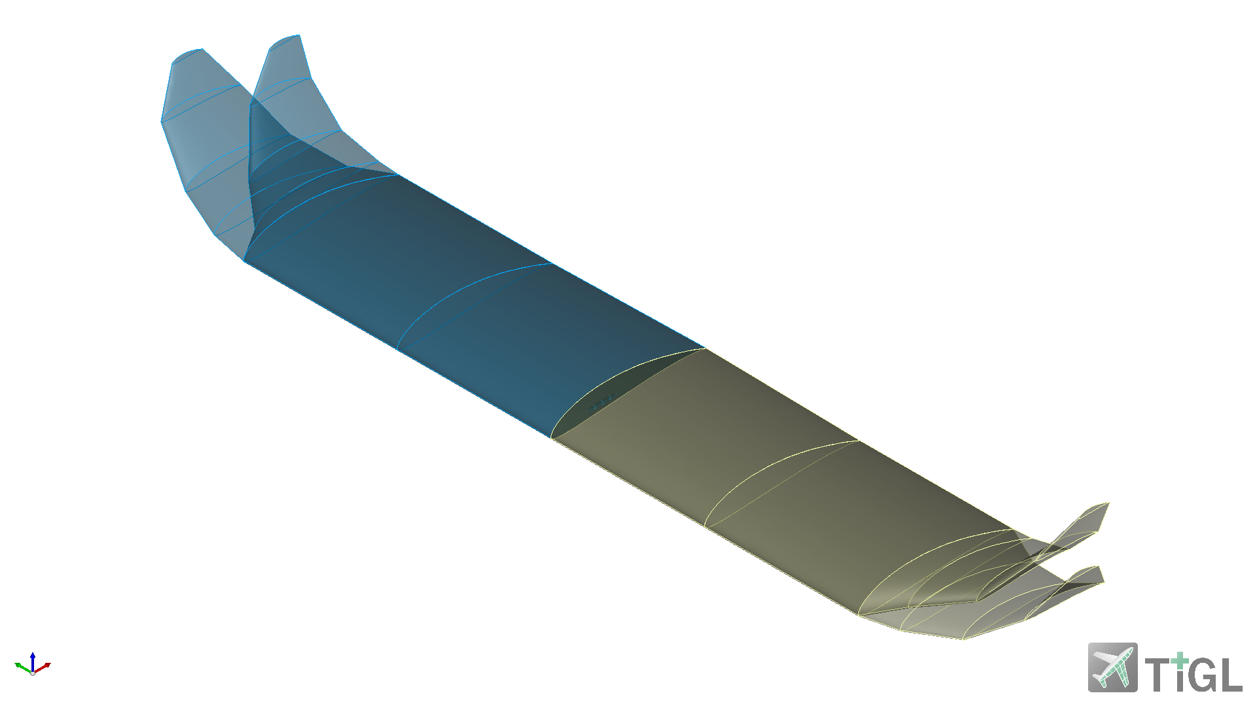
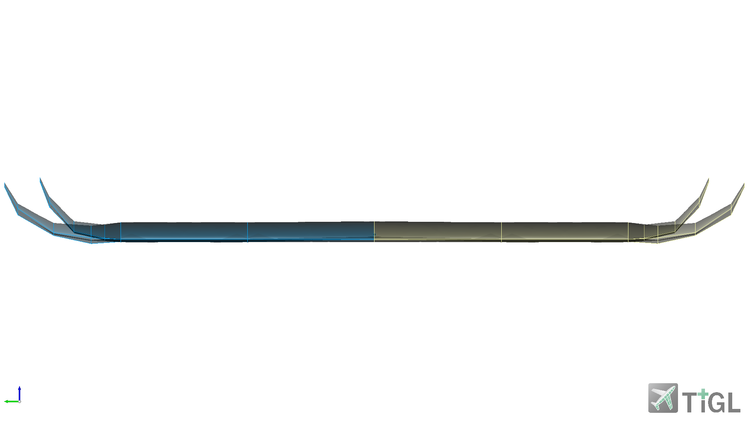
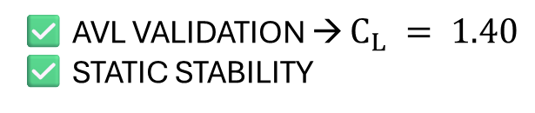
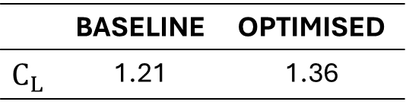
Winglet optimisation for the UAV configuration
SAMPLES | RMSE
5000 | 0.027561
 | BASELINE | OPTIMISED
$$C_{L}$$ | 1.21 | 1.36
↓ DIHEDRAL ANGLE
↓ SWEEP ANGLE
↑ CHORD
↑ TWIST
✅ AVL VALIDATION → $C_{L} = 1.40$
✅ STATIC STABILITY

Slide 30
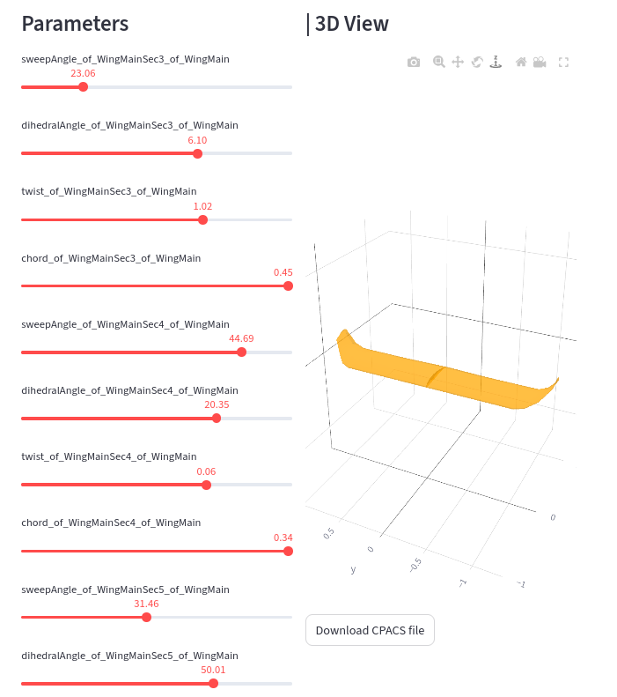

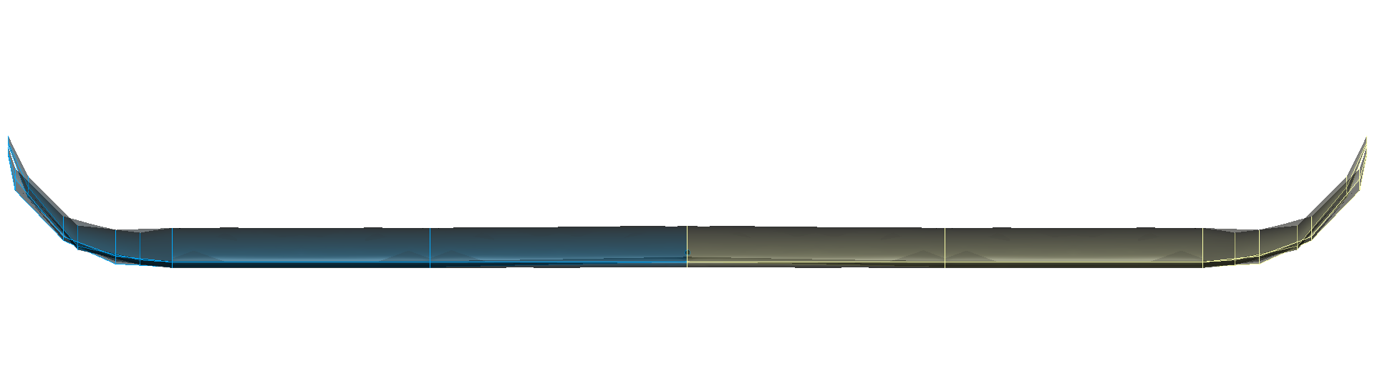
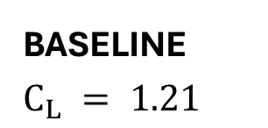
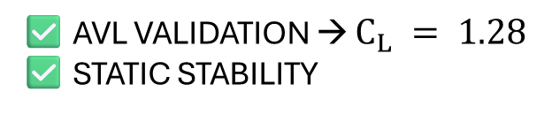

Winglet optimisation for the UAV configuration
BASELINE
$$C_{L} = 1.21$$
✅ AVL VALIDATION → $C_{L} = 1.28$
✅ STATIC STABILITY
+6%
… other sections
PREDICTED VALUE: $C_{L} = 1.25$

Slide 31
OUTLINE
Introduction & Motivation
Introduction & Motivation
CEASIOMpy Framework
Surrogate Modelling – Intuition
Surrogate Modeling Toolbox (SMT)
Validation Case: ONERA M6 Wing
Application: UAV Winglet Optimisation
Conclusions and future work
Conclusions and Perspectives

Slide 32
Conclusions and Perspectives
Key Contributions
Development of a surrogate-based optimisation workflow in CEASIOMpy
Integration of:
Direct control and variation of geometric design parameters defined in CPACS
Machine learning surrogate models (RBF)
Adaptive multi-fidelity refinement (AVL + SU2)
Demonstration of:
Accurate trend prediction (low-fidelity)
Improved quantitative accuracy (multi-fidelity)

Slide 33
Conclusions and Perspectives
Future work
Integration of constraint-aware optimisation
inclusion of geometric and regulatory constraints within the loop
Extension to multi-objective optimisation
lift, drag, stability, mission requirements
Development of multidisciplinary optimisation (MDO)
coupling with structures, propulsion, mission analysis

Slide 34
Thank you for your attention
Questions?

