Slide 1
Tip clearance CFD models to improve the aerodynamic characterization of heavy duty gas turbine transonic axial compressors
Candidate: Luca Ottonello
Supervisor Prof. Ing. Alessandro Bottaro
Co-Supervisor: Ing. Savino Depalo

Slide 2
Index
Objective
Importance of compressor stability
Method of investigation:
  Flow chart
Methodology
Compressor 1 results
  Numerical convergence & mass flow analysis
  Speedlines
  Speedlines for most critical stages
  Streamlines for row “C”
Compressor 2 results
  Numerical convergence & mass flow analysis
  Speedlines
  Speedlines for most critical stages
  Streamlines for row “B”
Results summary
Conclusions

Slide 3
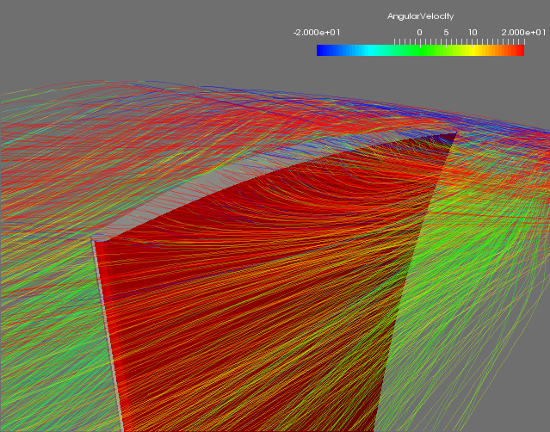
Objective
Main goal: better understanding of tip clearance flow, updating CFD calculation setup on turbo-axial compressors for more reliable surge margin detection.
New clearance model to improve the mass flow conservation between SS and PS of every blade:
NEW OPENTIP
H-PINCH
SBLOCK

Slide 4
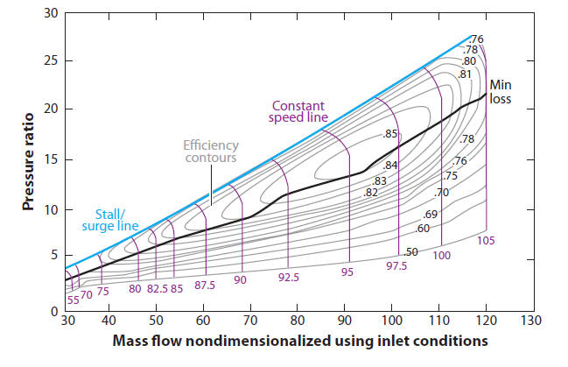
Importance of compressor stability
IGV Fixed
TG Efficiency;
Operating range (Over/under-frequencies, ambient temperature variation and partial load);
Surge Margin & Surge line.

Slide 5
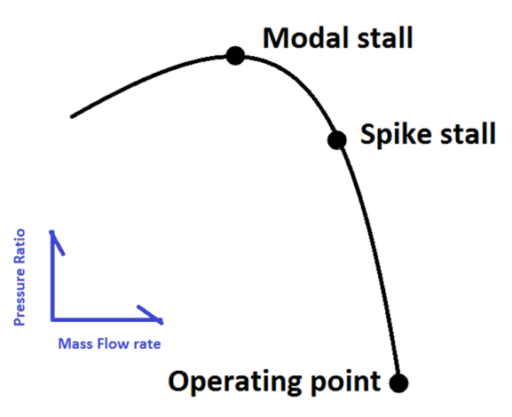
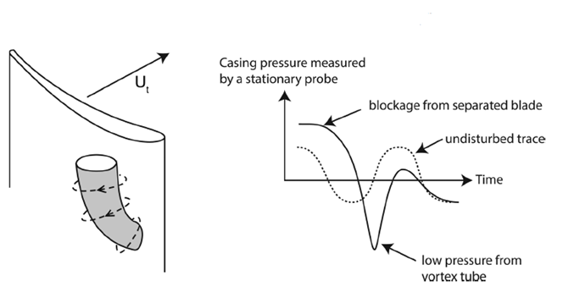
Importance of compressor stability
Two different phenomena contribute to reduce the compressor operating range:
Modal stall
Long length scale disturbance that extend axially through the compressor, which evolves until it becomes a fully developed stall cell.
Spike stall
Short length scale disturbance marked by the formation of three dimensional, finite amplitude disturbances, localized to the tip region of just one rotor of a multistage compressor.

Slide 6
Method of Investigation
Flow chart
Compressor 1
Test case
Compressor 2
Test case
Setup F
Baldwin – Lomax turbulence model
NRBC mixing plane
Ideal gas
H-Mesh type
CFD
Clearance model analysis
Old Opentip
New Opentip
Sblock
H-Pinch
Results
&
discussion

Slide 7
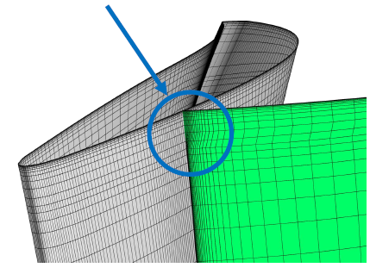
Methodology
All the models take advantage of “morphed” mesh: local warp to better discretize the clearance region profile:
L.E.
T.E.
The clearance region is not computed;
Periodicity model through the imposition of a periodic boundary condition.
Old Opentip

Slide 8


Methodology
New simplified model developed applying a correction on the BC ;
Correction applied to the velocity magnitude value in the phantom cells;
Performed through the “clear.bat” file.
New Opentip
Enforcing BC as in the previous model
Updating ρE_{t} and p using the modified velocity field
Evaluating mass Flow Unbalance (∆$\dot{m}$)
Modifying Velocity Magnitude on phantom Cells to enforce ∆$\dot{m}$

Slide 9
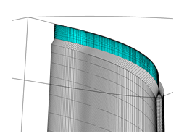
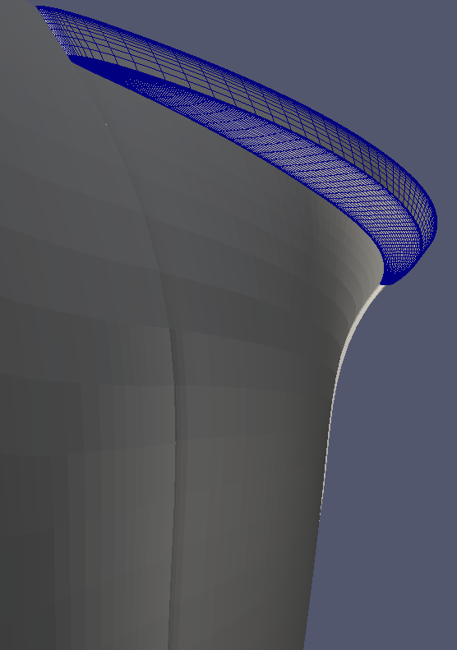
Methodology
Blade tip pinched geometry mismatch w.r.t. actual one;
Avoid the application of conservation law through geometrical expedient to make a correspondence between SS and PS;
Performed running the “Pinch code”.
H-Pinch
The only model which allows to mesh clearance;
Fully solving of clearance flow field and preserve the mass flow between inlet and outlet of every row;
Performed running “Sblock code”.
Sblock

Slide 10
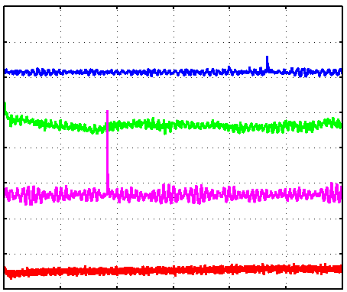
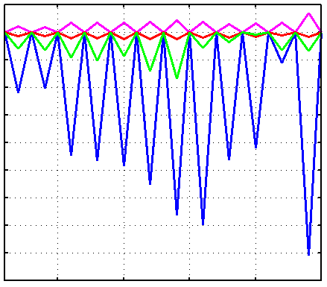

Compressor 1 results
Numerical convergence & mass flow analysis
Avg error [-]
Mass flow error [Kg/s]
-5.2
0.2
Old Opentip
-5.4
0
New Opentip
-0.2
H-Pinch
-5.6
Sblock
-0.4
-5.8
-0.6
-6
-0.8
-6.2
-1
-6.4
-1.2
-1.4
-6.6
-1.6
-6.8
-1.8
0 500 1000 1500 2000 2500 3000
20 25 30 35 40 45
Iteration [-]
#Row
Improvement in term of average error for all models;
Improvement in mass flow conservation for all new clearance models.
 | Old Opentip | New Opentip | H-Pinch | Sblock
Eq Time w.r.t. Old model (%) | 100 | 72.6 | 25.5 | 26.5

Slide 11
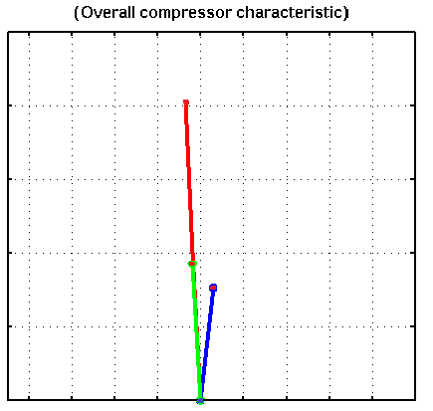


Compressor 1 results
Speedlines
1.025
Old Opentip
1.02
H-Pinch
New Opentip
∆SM [-]
1.015
Sblock
1.01
WP
SP
1.005
$$∆SM= \frac{{PR}_{SP}− {PR}_{SP Old Opentip}}{{PR}_{SP Old Opentip}}$$
1
0.9992 0.9994 0.9996 0.9998 1 1.0002 1.0004 1.0006 1.0008 1.001
MF [-]
All the models show a choked characteristic;
Old Opentip and New Opentip models are aligned, other models underline an higher SM;
Old Opentip is the model showing the smallest surge margin.

Slide 12
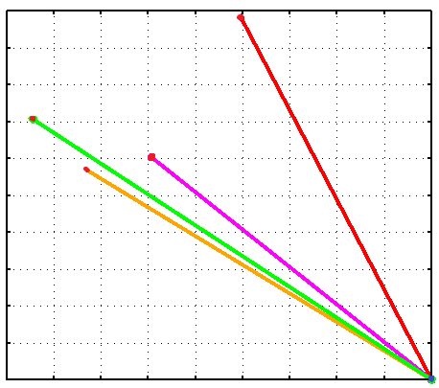
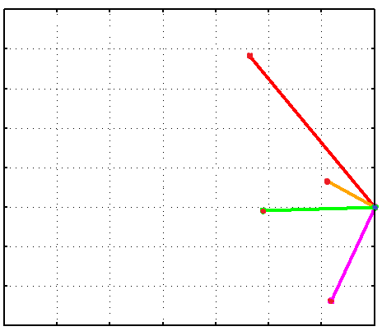
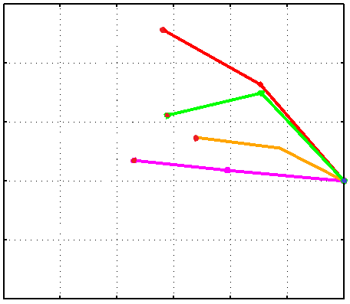

Compressor 1 results
Speedlines for most critical stages
New Opentip
Sblock
Pinch
STG-A
STG-B
∆SM [-]
∆SM [-]
STG-C
∆SM [-]
STG-D
WP
SP
M* [-]
M* [-]
M* [-]
Critical stages detected where the ∆SM–M* characteristic become flattering :
B stage;
C stage;
D stage.

Slide 13
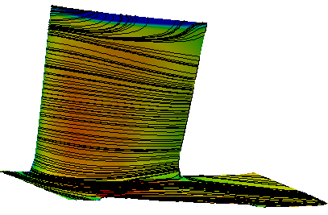
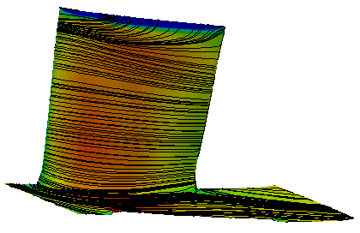
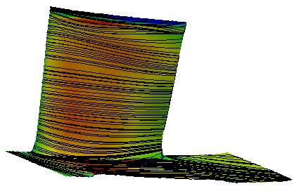
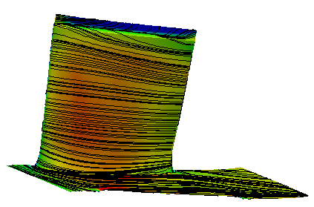

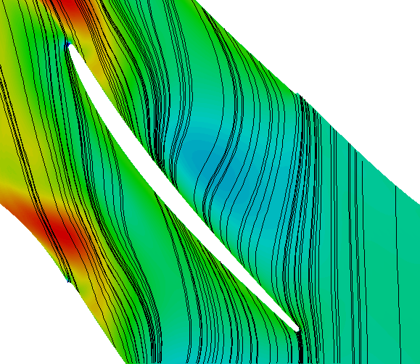
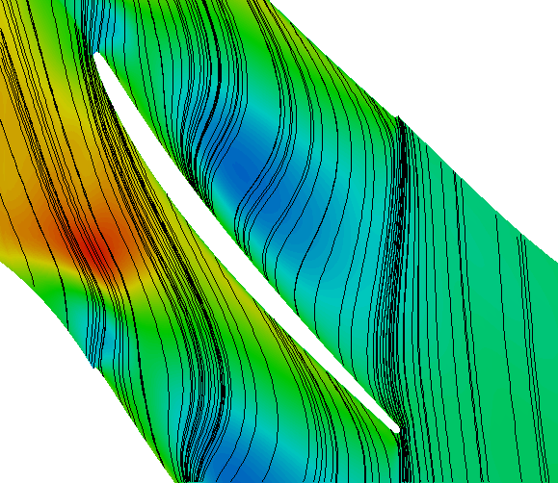
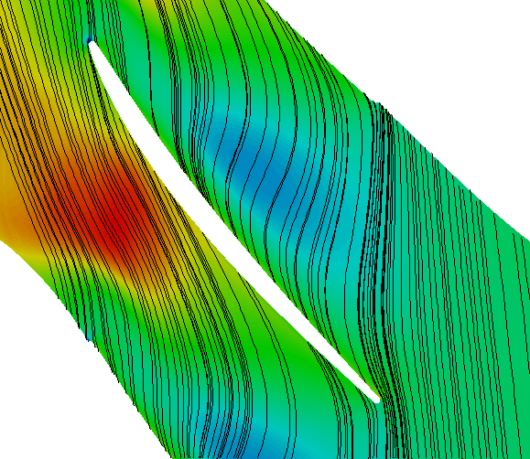
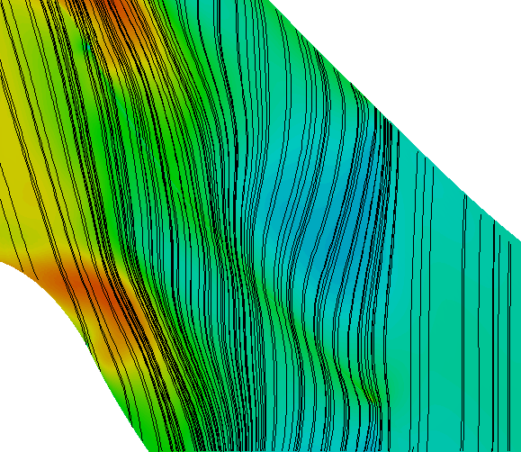
Compressor 1 results
Streamlines for row “C”:
Old Opentip
New Opentip
Sblock
H-Pinch
FLOW

Slide 14
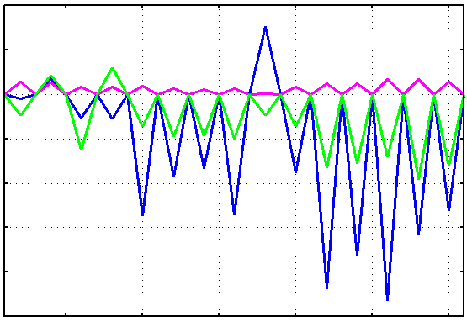
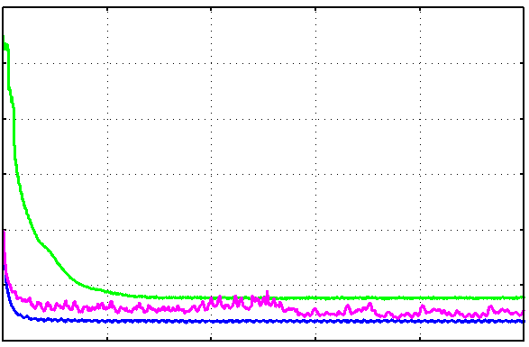

Compressor 2 results
Numerical convergence & mass flow analysis
Mass flow error [Kg/s]
Avg error [-]
0.2
-2
Old Opentip
0.1
-3
New Opentip
Sblock
0
-4
-0.1
-5
-0.2
-6
-0.3
-0.4
-7
-0.5
-8
10 5 10 15 20 25 30
0 1000 2000 3000 4000 5000
#Row
Iteration [-]
Improvement in mass flow conservation for all new models tested;
Increasing in average error for Sblock and New Opentip model w.r.t. the Old Opentip one.
 | Old Opentip | New Opentip | Sblock
Eq Time w.r.t. Old model (%) | 100.0 | 72.7 | 68.0

Slide 15
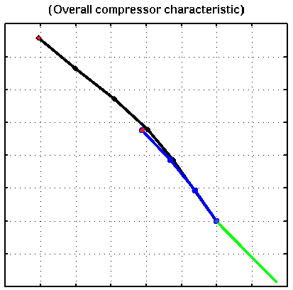


Compressor 2 results
Speedlines
1.12
Old Opentip
1.1
New Opentip
1.08
Sblock
∆SM [-]
1.06
WP
1.04
SP
1.02
1
$$∆SM= \frac{{PR}_{SP}− {PR}_{SP Sblock}}{{PR}_{SP Sblock}}$$
0.98
0.96
0.988 0.99 0.992 0.994 0.996 0.998 1 1.002 1.004
MF [-]
Sblock is the model showing the smallest surge margin, with the aim to offer a better visualization, were performed two point to the choke;
New Opentip is the model closest to Old Opentip from the surge margin point of view.

Slide 16
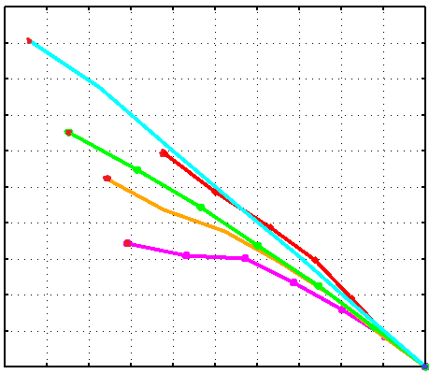
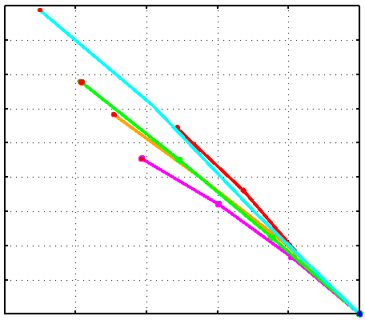
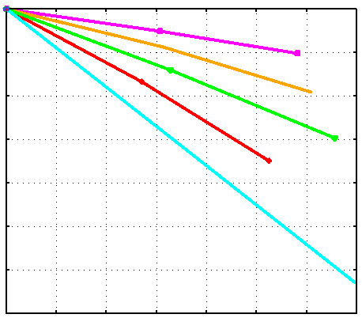

Compressor 2 results
Speedlines for most critical stages
Old Opentip
New Opentip
Sblock
∆SM-M*
STG-A
STG-B
∆SM [-]
∆SM [-]
∆SM [-]
STG-C
STG-D
STG-E
WP
SP
M* [-]
M* [-]
M* [-]
Critical stages detected where the ∆SM–M* characteristic become flattering :
B

Slide 17
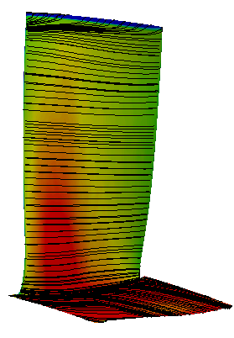
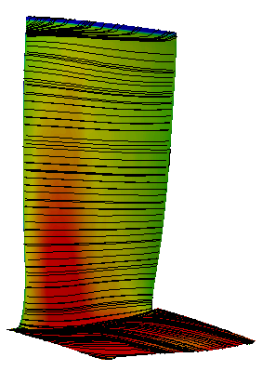
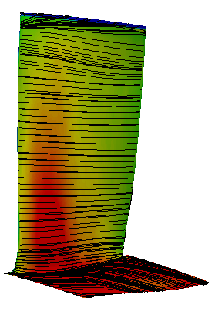
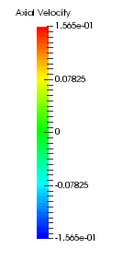
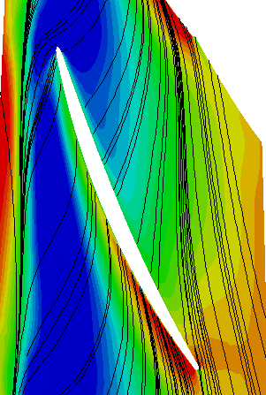
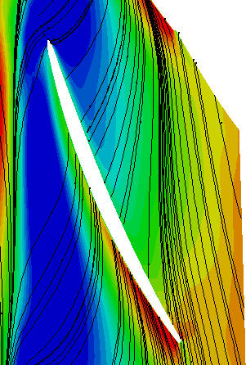
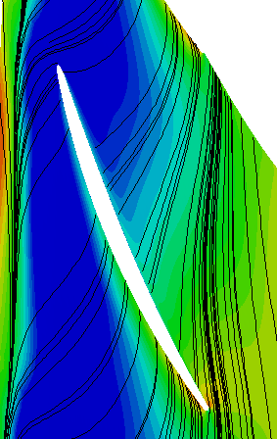
Compressor 2 results
Streamlines for row “B”:
Old Opentip
New Opentip
Sblock
FLOW

Slide 18


Results Summary
Compressor 1
Compressor 2
 | New Opentip | Sblock | H-Pinch
∆MF Inlet (kg/s) | -0.10 | -0.10 | -1.20
∆T out (K) | 0.80 | 2.50 | 4.20
∆SM (%) | 0.30 | 2.90 | 1.90
∆η_pol – overall (%) | -0.07 | -0.23 | -0.35
 | New Opentip | Sblock
∆MF Inlet (kg/s) | -0.60 | 2.69
∆T out (K) | 0.53 | 1.09
∆SM (%) | -6.30 | -12.3
∆η_pol – overall (%) | -0.06 | -0.17
          $$SM= \frac{\left({{PR}_{SURGE}}/{{MF}_{SURGE} }\right) − \left({{PR}_{WP}}/{{MF}_{WP} }\right)}{\left({{PR}_{WP}}/{{MF}_{WP} }\right)}$$

Slide 19
Conclusions
Compressor operative range influenced by secondary fluxes
More reliable results through new clearance models
TG stability
Sblock: best progress in term of clearance analysis, and when it is possible, can be applied, providing the best and more accurate results;
New Opentip: the simplest model, natural evolution of the Old model, a good numerical convergence together with a better mass flow conservation can be achieved, it can be applied as an alternative to Sblock model, because of its peculiar robustness;
H-Pinch: represents the most problematic model as a consequence of the different secondary fluxes modelling caused by the particularly way of treating the clearance region, it is not recommended to apply it, with the exclusion of special cases.

Slide 20


Thank you for your attention

Slide 21
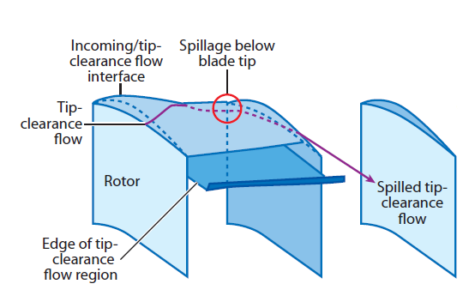
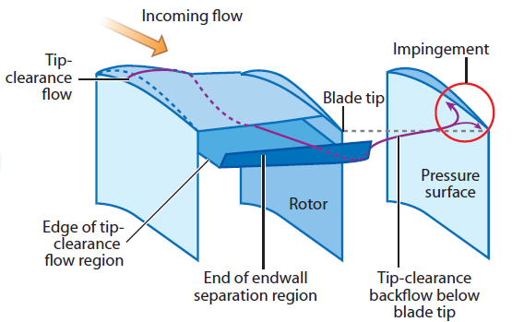
The importance of clearance flow
Spike stall is the problem that determines, more than anything else, the malfunctioning of the compressor and it is localized at the clearance, phenomenon strongly related to two flow events:
1) Leading-edge tip-clearance flow spillage below the blade tip
2) Back flow of tip-clearance fluid below the blade tip

Slide 22
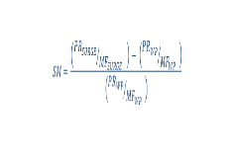
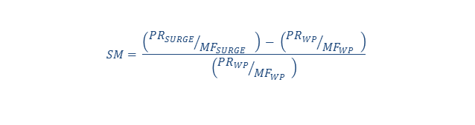
Results Summary
Compressor 1
Compressor 2
 | New Opentip | Sblock | H-Pinch
∆MF Inlet (kg/s) | -0.10 | -0.10 | -1.20
∆T out (K) | 0.80 | 2.50 | 4.20
∆SM (%) | 0.30 | 2.90 | 1.90
∆η_pol – overall (%) | -0.07 | -0.23 | -0.35
 | New Opentip | Sblock
∆MF Inlet (kg/s) | -0.60 | 2.69
∆T out (K) | 0.53 | 1.09
∆SM (%) | -6.30 | -12.3
∆η_pol – overall (%) | -0.06 | -0.17
          $$SM= \frac{\left({{PR}_{SURGE}}/{{MF}_{SURGE} }\right) − \left({{PR}_{WP}}/{{MF}_{WP} }\right)}{\left({{PR}_{WP}}/{{MF}_{WP} }\right)}$$

