Slide 1
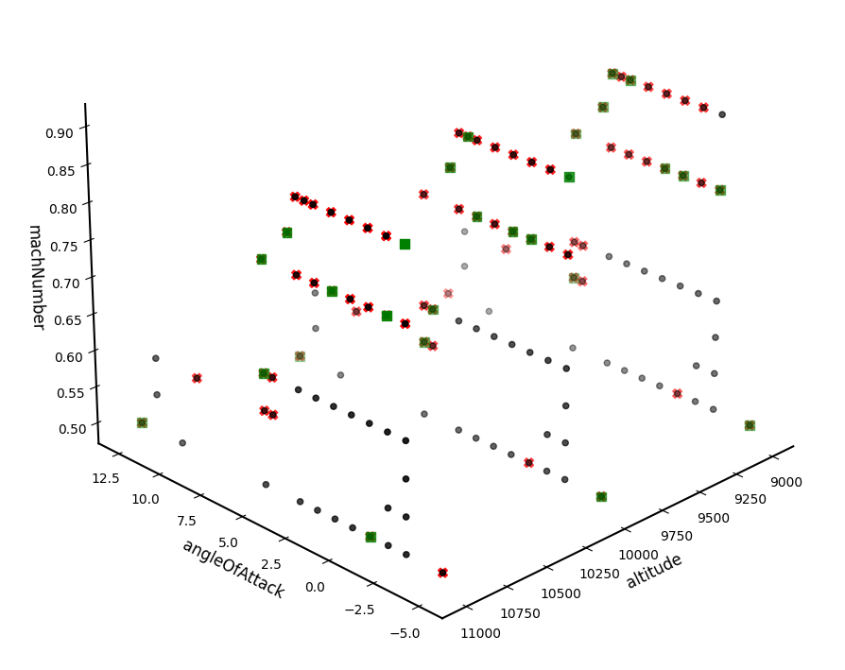

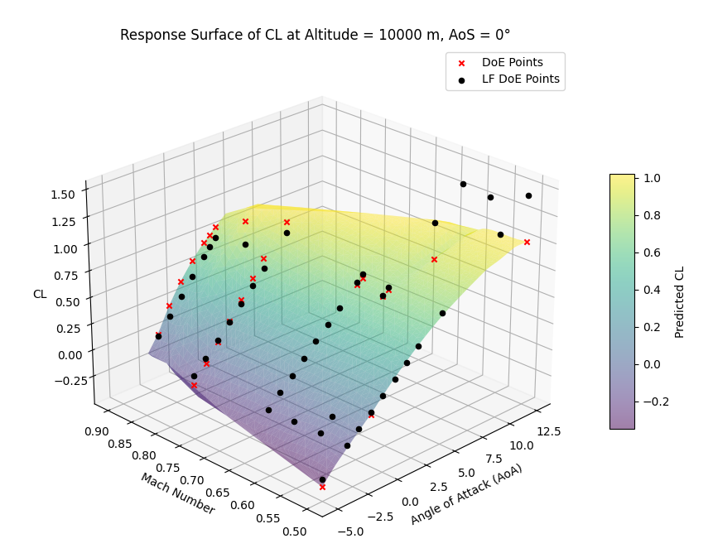

Implementation of a Surrogate Model in CEASIOMpy using a Multi-Fidelity strategy for aerodynamic coefficients prediction
Student:
Giacomo Gronda
Supervisors:
Prof. Alessandro Bottaro
Dr. Ing. Jan Vos
Dr. Giacomo Benedetti
March 2025

Slide 2

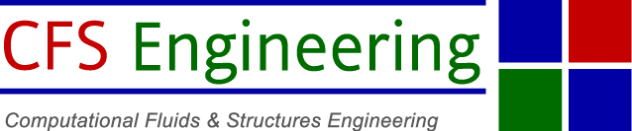


Slide 3
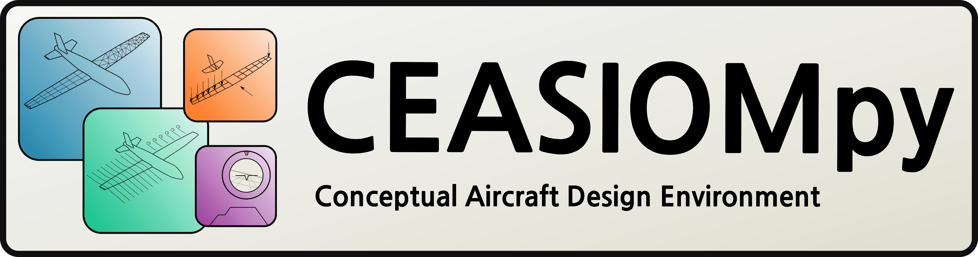
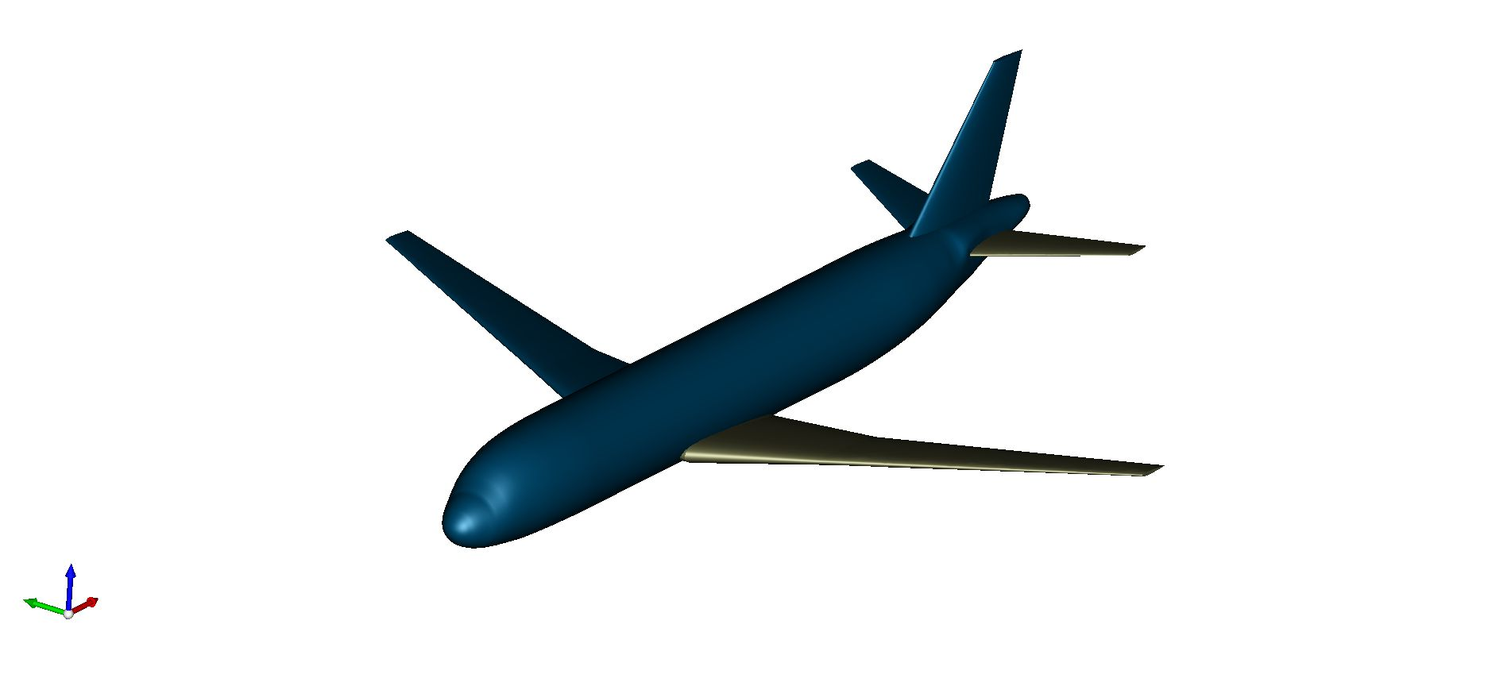
Objectives
Brief Introduction to CEASIOMpy
Explanation of the two modules
and the theory behind them
Application case with results and
model errors
SMTrain
SMUse

Slide 4
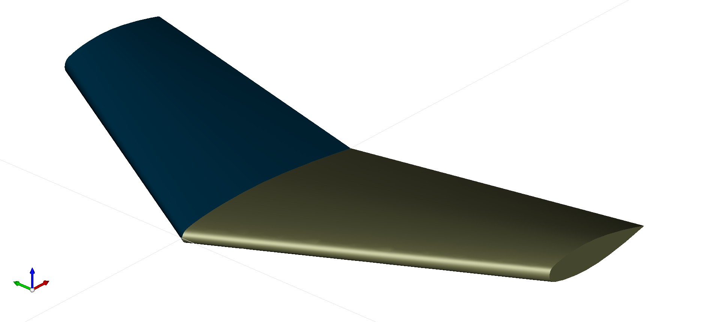
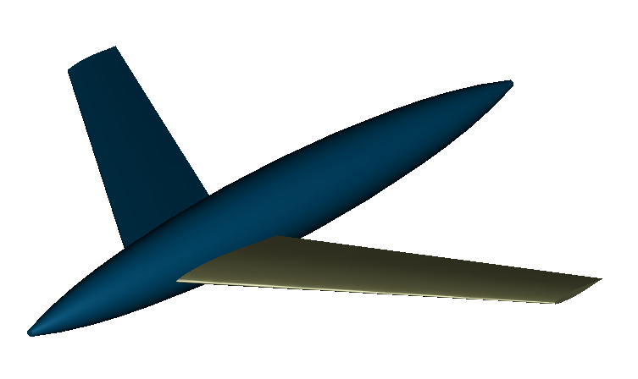
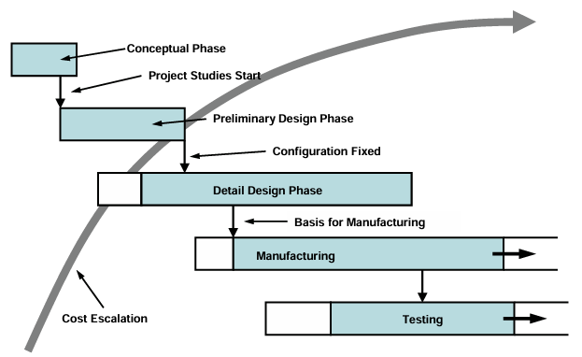
Conceptual Design Phase of an Aircraft
The process of aircraft design is a very complex engineering task
The focus is on exploring multiple solutions and
narrowing them down to a few promising concepts for further analysis
Cost escalation

Slide 5

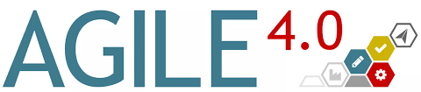

Brief Introduction of CEASIOMpy
Open-source Conceptual Aircraft Design Environment
Mostly written in Python
Tools for Various Aircraft Design Disciplines

Slide 6
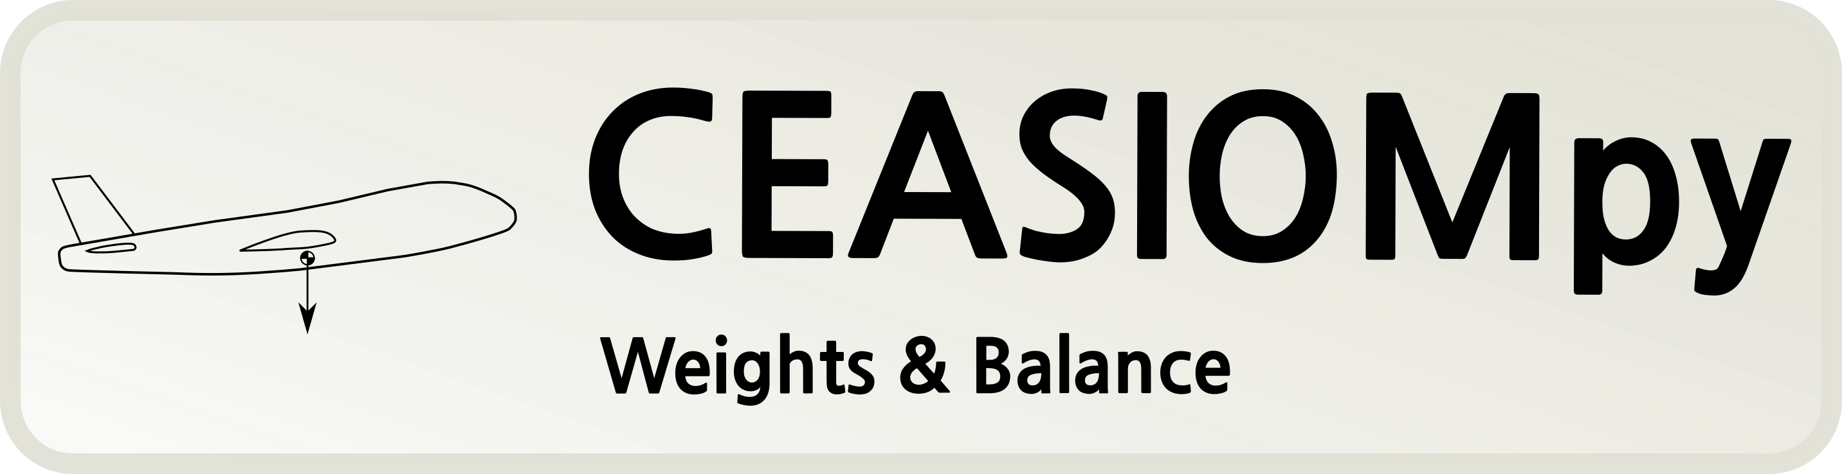
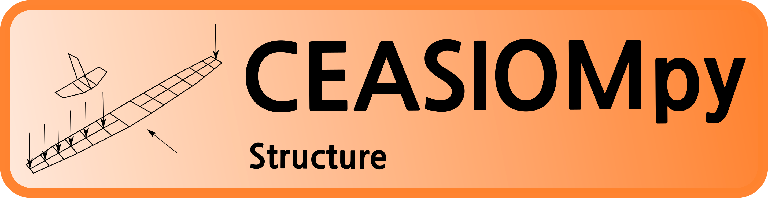
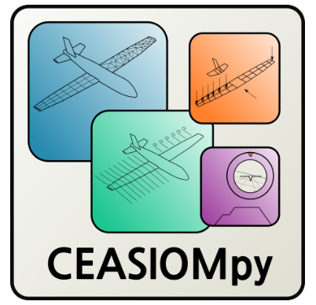
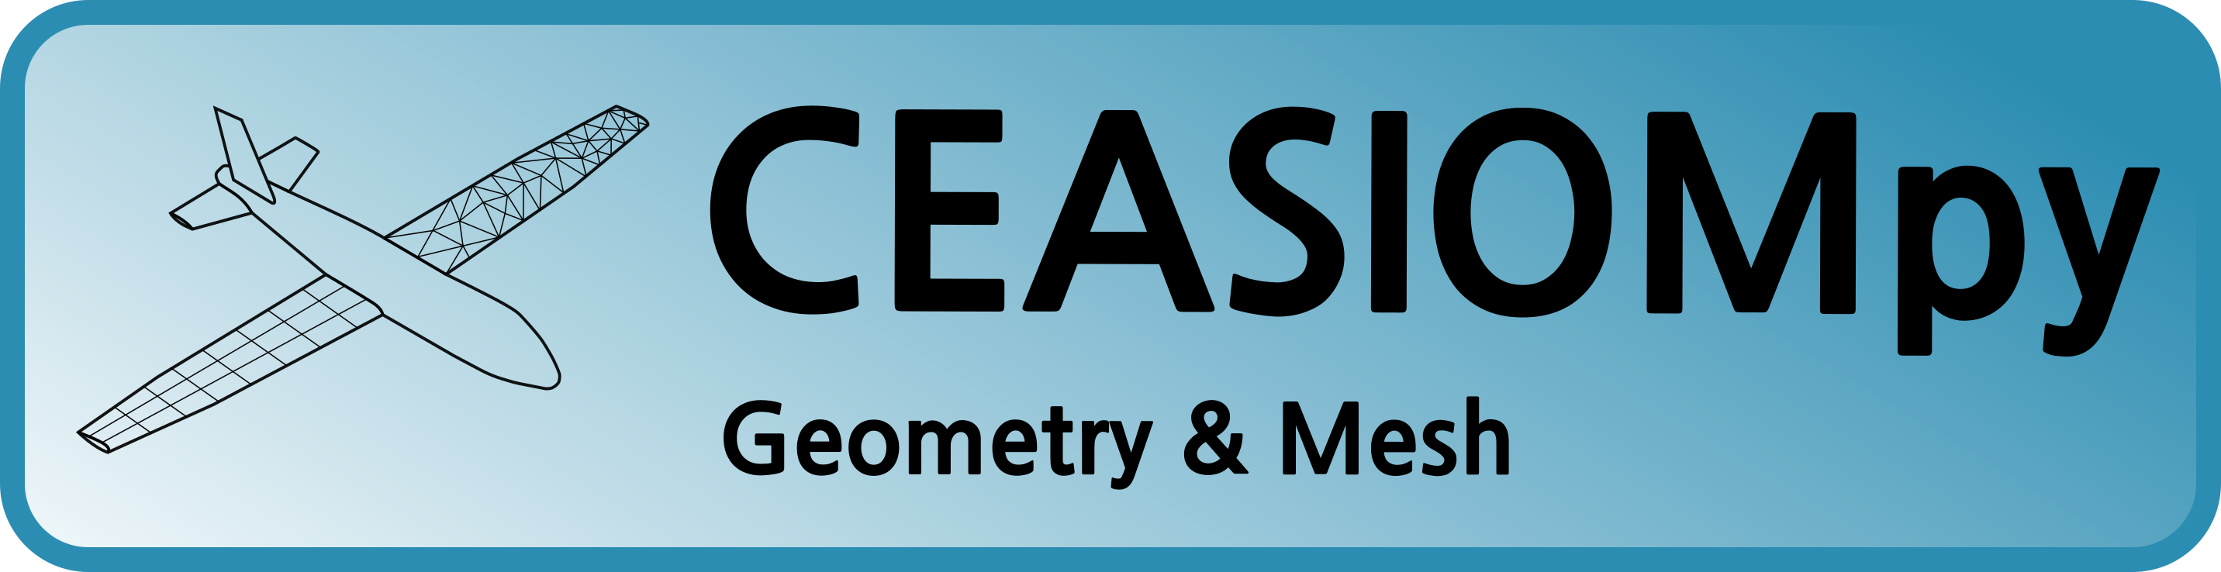
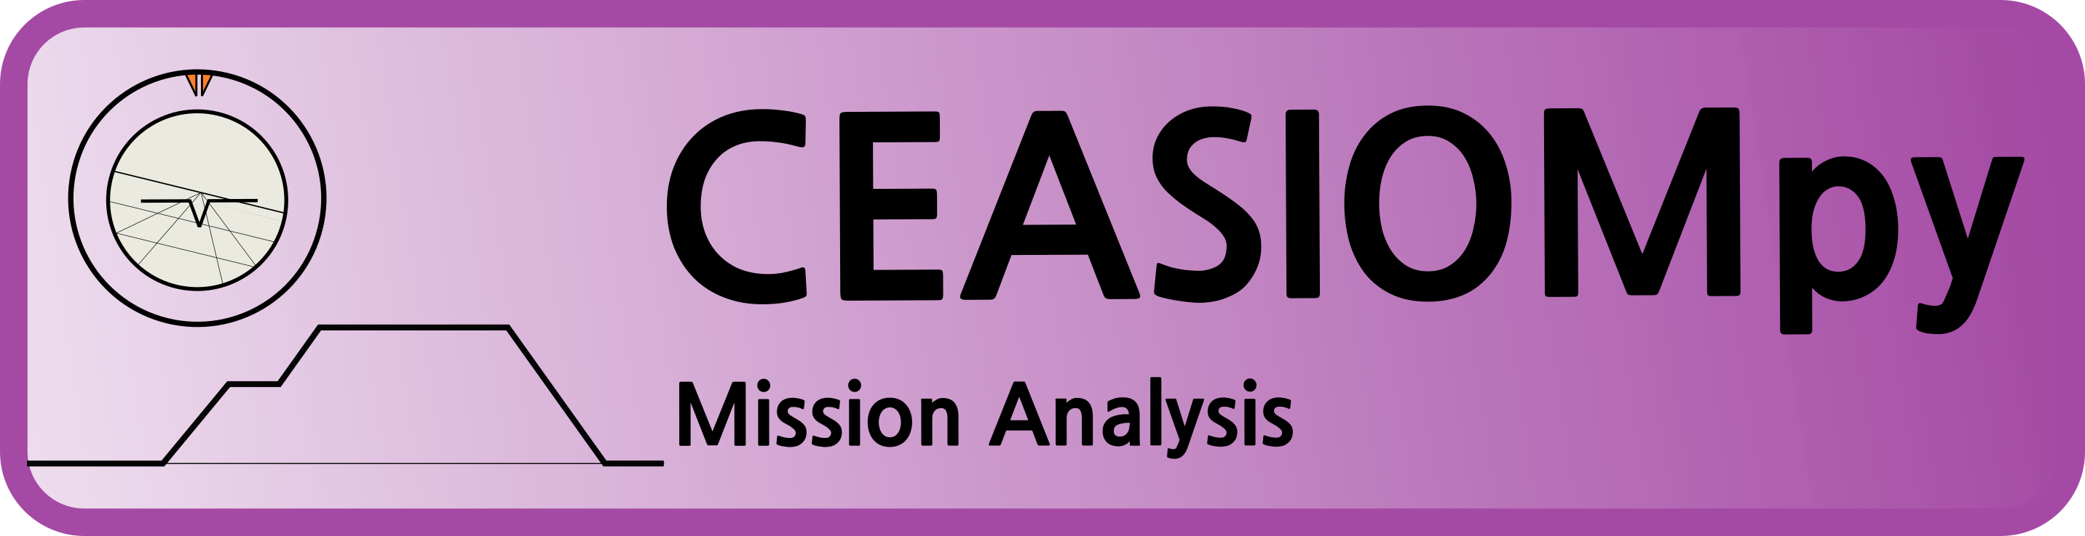

Brief Introduction of CEASIOMpy

Slide 7
Brief Introduction of CEASIOMpy
SMTrain
SMUse

Slide 8


Modules & Theory
Train a Multi-Fidelity Surrogate Model
Suggest New Design Points
Predict Aerodynamic Coefficients using the trained Surrogate Model
SaveAeroCoeff
Plot Response Surfaces
Plot Graphs of the Aerodynamic Coefficients against the parameters of interest
Designed to fit into a workflow with other modules
SMTrain
SMUse

Slide 9
Modules & Theory
SMTrain
Surrogate Model:
Surrogate models are simple representations of complex systems with a trade-off between accuracy and computational efficiency
Used in aerospace engineering alongside CFD simulations to accelerate design exploration with limited simulation data
Geometry
Design of Experiments
Training
New Points
Results

Slide 10
Modules & Theory
SMTrain
Kriging Model :
Statistical interpolation method that predicts unknown values from known data points
Provides not only predictions but also uncertainty estimates (variance)
Multi-Fidelity strategy:
  Populate aerodynamic database with dense, low-fidelity data samples
  Correct the data using the sparse high-fidelity samples
Geometry
Design of Experiments
Training
Less points required than other Machine Learning models
New points for new simulations to improve the model
New Points
Allows to combine multiple levels of fidelity
Requires nested points
Results

Slide 11
Modules & Theory
Application Case
SMTrain
Geometry
Defined by a CPACS File
D150
Regional jet-liner
Design of Experiments
Training
New Points
Results

Slide 12
Modules & Theory
SMTrain
Geometry
Defined by a CPACS File
Design of Experiments
Systematic methodology for collecting Data by selecting specific input parameters
Training
New Points
Results

Slide 13
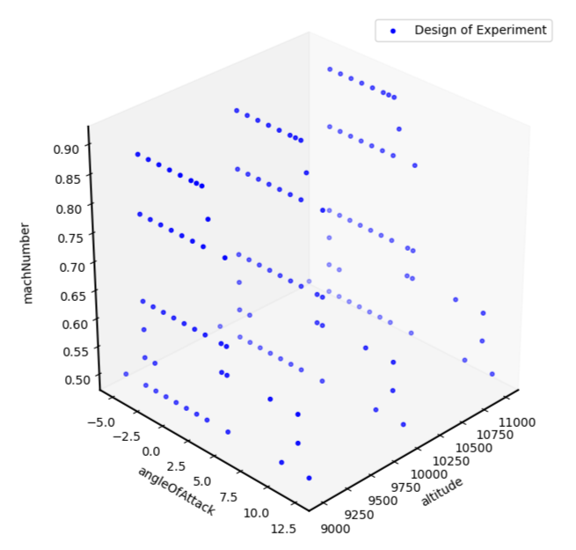
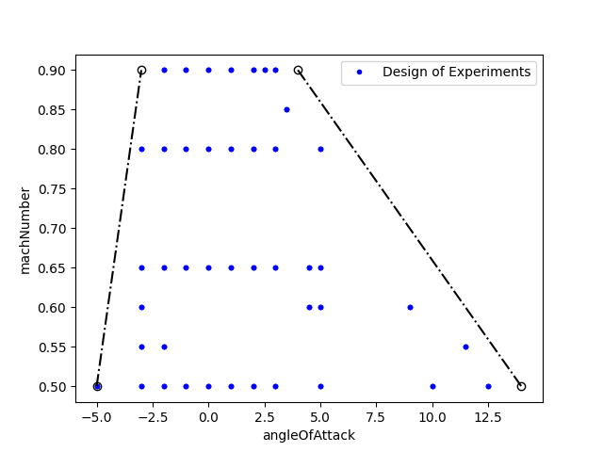
Application Case
Modules & Theory
SMTrain
4 input parameters:
  Altitude
  Mach Number
  Angle of Attack
  Angle of Sideslip
Geometry
Design of Experiments
3 input parameters:
  Altitude: from 9000 m to 11000
  Mach Number: from 0.5 to 0.9
  Angle of Attack: from -5° to 15°
  Angle of Sideslip: 0°
Physical Domain
135 Points
Training
New Points
Results

Slide 14
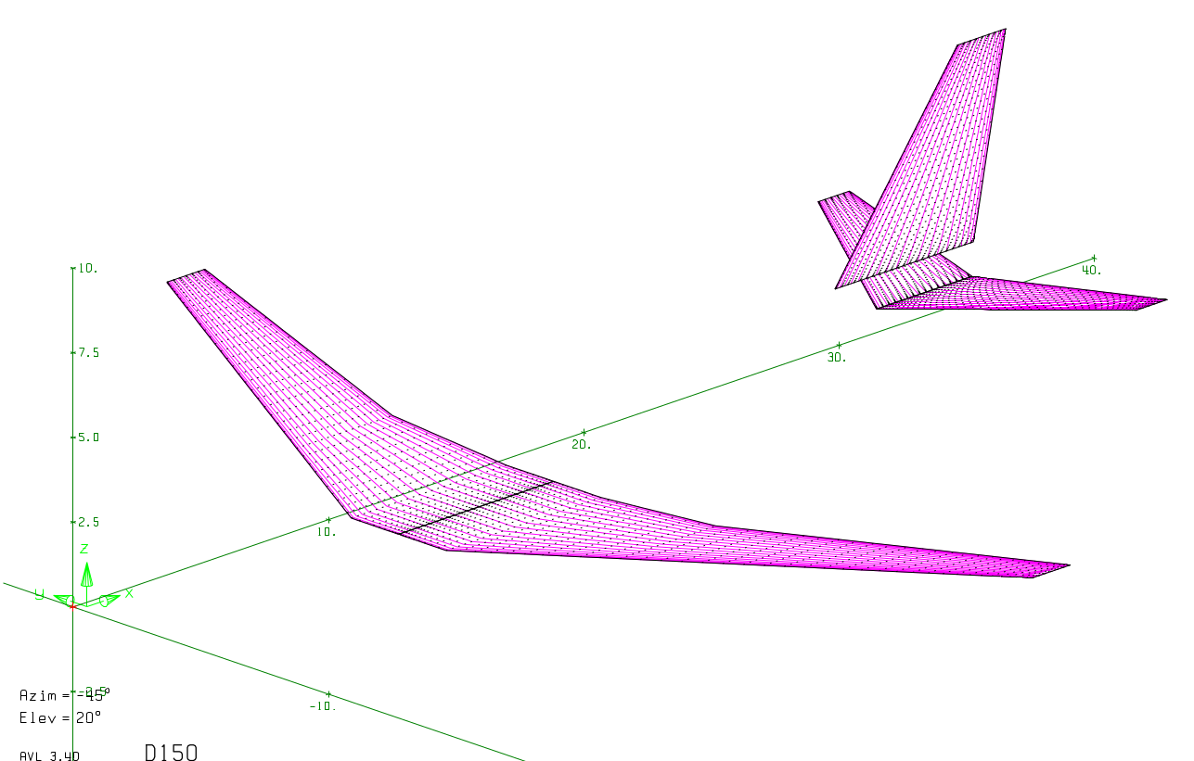
Application Case
SMTrain
PyAVL Module
Vortex Lattice Method:
  Represents the lifting surfaces as a vortex surfaces
  Neglects profile thickness and fluid viscosity.
Output:
Geometry
Design of Experiments
Training
Aerodynamics Coefficients
New Points
Training Dataset = Inputs + Outputs
Results

Slide 15
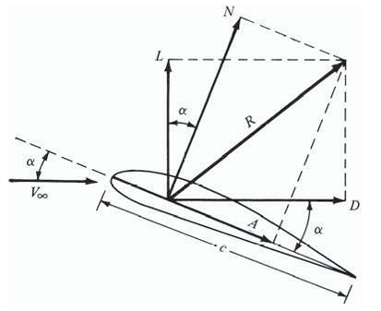
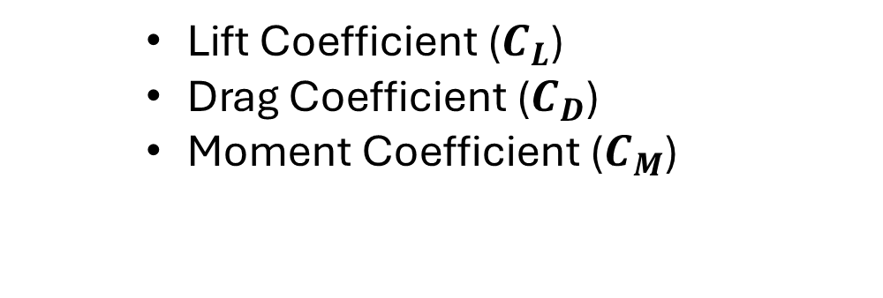
Modules & Theory
SMTrain
Aerodynamics Coefficients
Geometry
    Lift Coefficient ($C_{L}$)
    Drag Coefficient ($C_{D}$)
    Moment Coefficient ($C_{M}$)
Design of Experiments
L
Training
New Points
V∞
D
M
Results

Slide 16
Modules & Theory
SMTrain
Geometry
Defined by a CPACS File
Design of Experiments
Systematic methodology for collecting Data by selecting specific input parameter values
Training
Teaching it to learn from input and output data and adjusting its internal parameters to minimize the error
New Points
Results

Slide 17
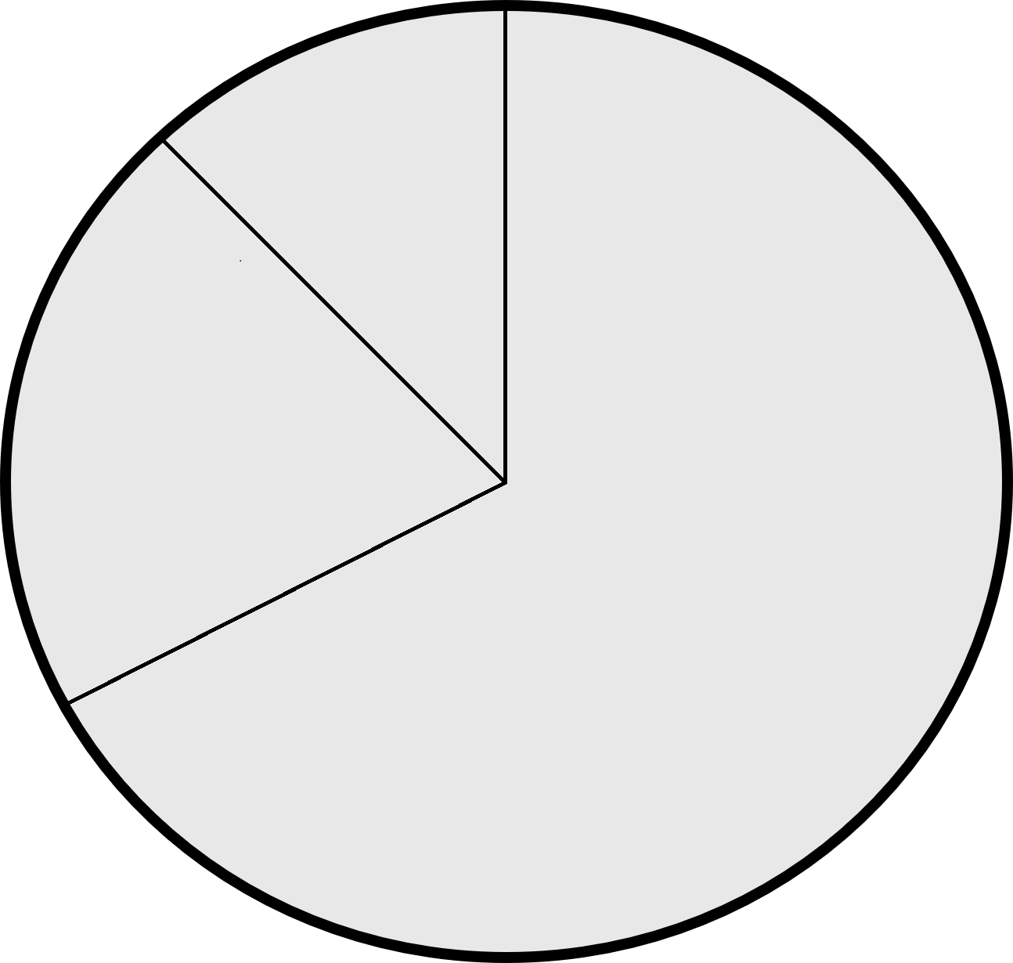
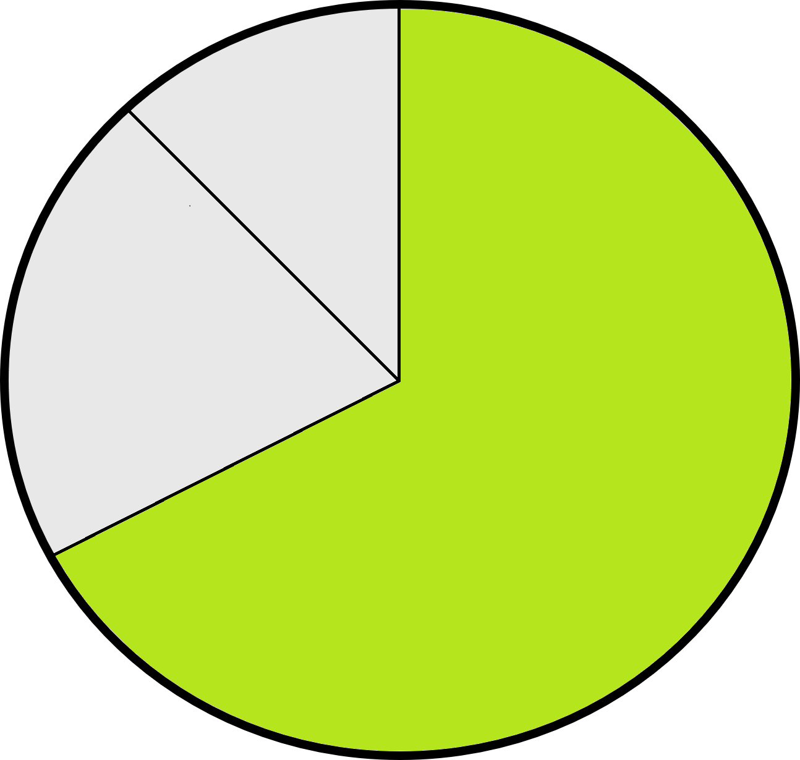
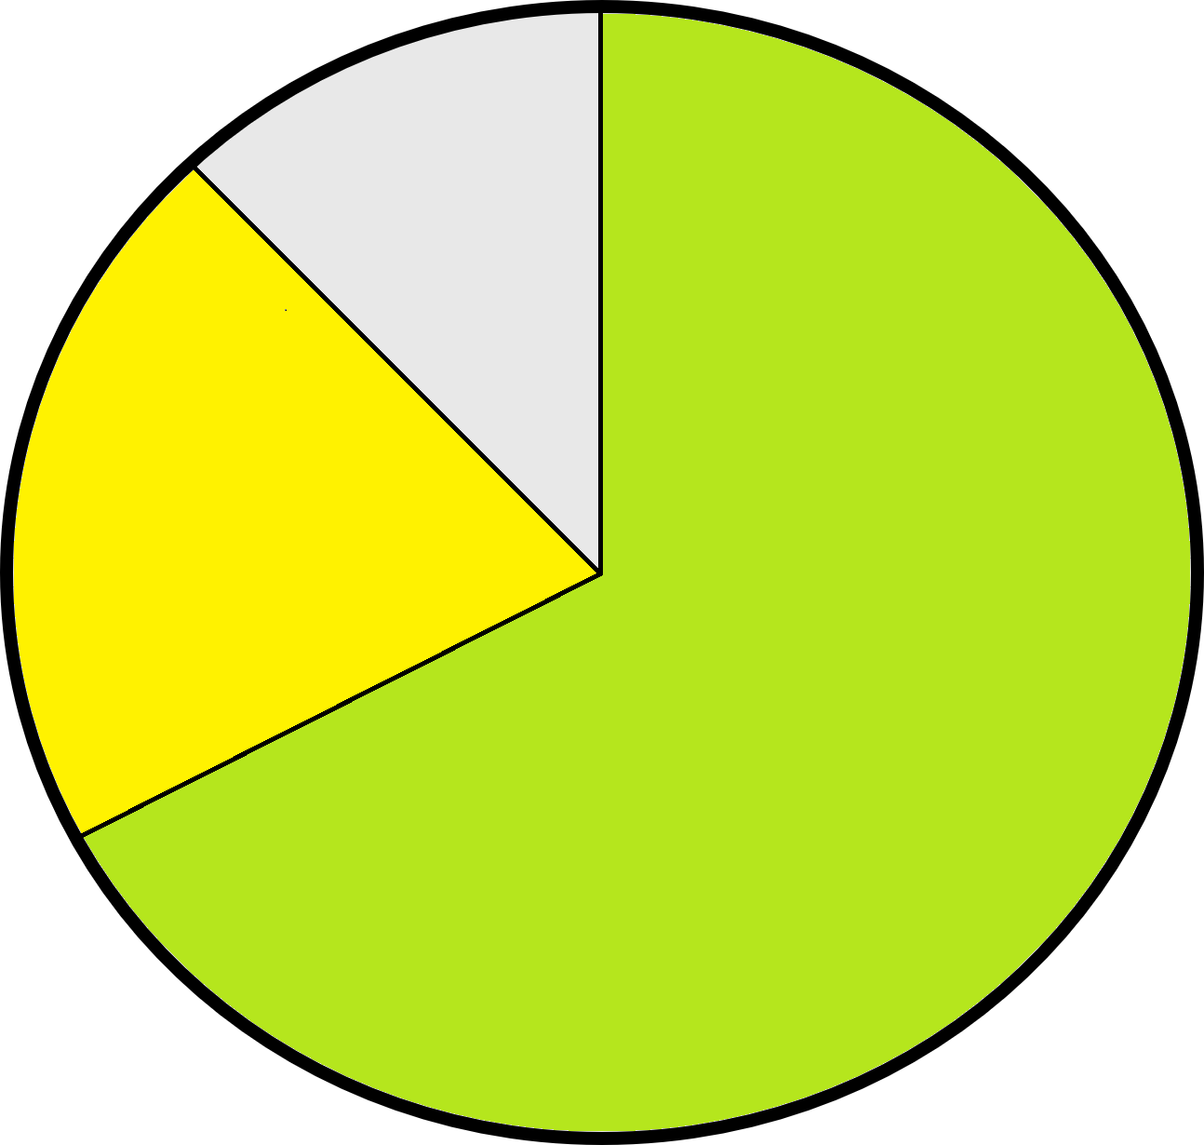
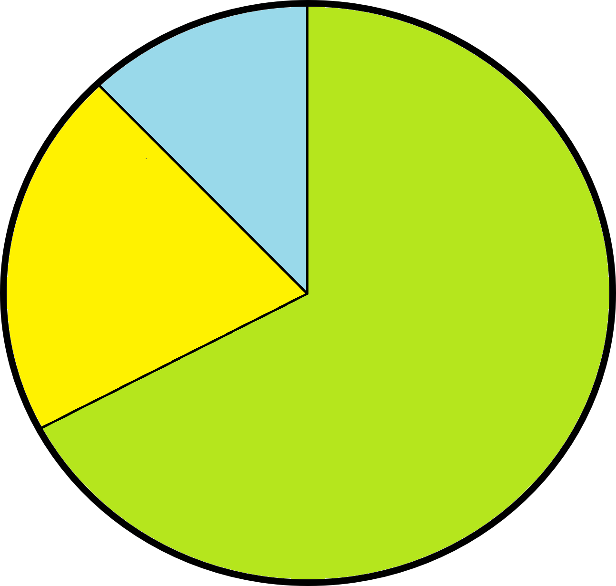
Modules & Theory
SMTrain
  Training, Validation and Test Sets
Test Set:
Evaluate prediction error and avoid overfitting
Geometry
Validation Set:
Optimization of the hyperparameters
  Initial Dataset:
  Inputs
  Outputs
Design of Experiments
10%
20%
Training
70%
New Points
Training Set:
Adjust the internal
parameters
Results

Slide 18
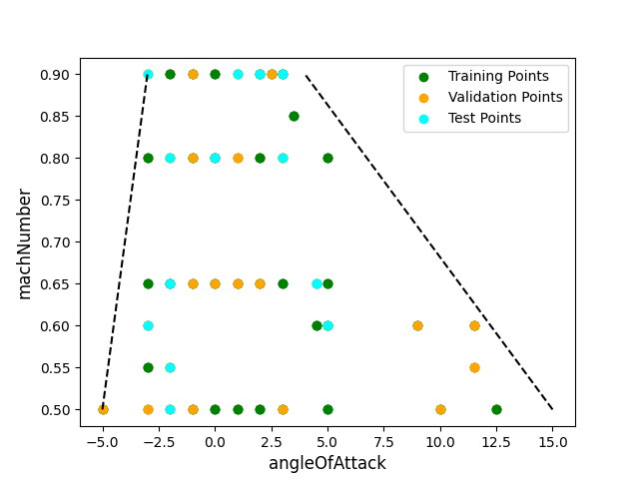
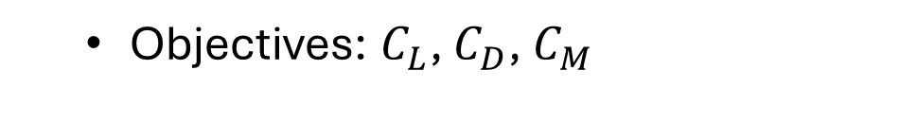
Application Case
SMTrain
  Training, Validation and Test Data
Geometry
10%
Design of Experiments
20%
70%
Training
New Points
  Objectives: $C_{L}$, $C_{D}$, $C_{M}$
Results

Slide 19
Modules & Theory
SMTrain
Geometry
Defined by a CPACS File
Design of Experiments
Systematic methodology for collecting Data by selecting specific input parameter values
Training
Teaching it to learn from input and output data and adjusting its internal parameters to minimize the error
New Points
Based on the predictions of the first model, new points are suggested to refine the next model
Results

Slide 20
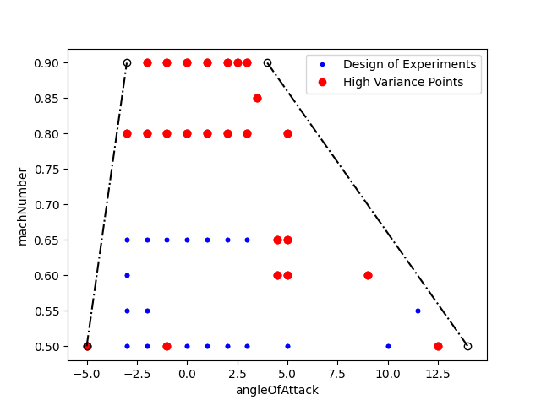


Modules & Theory
Application Case
SMTrain
Adaptive Sampling:
    Based on variance of the predictions
    Extreme Points
    Mach Number $≥0.7$
    72 New Points
Geometry
Design of Experiments
Training
SU2Run
New Points
$$RMSE<{RMSE}_{threshold}$$
Results

Slide 21
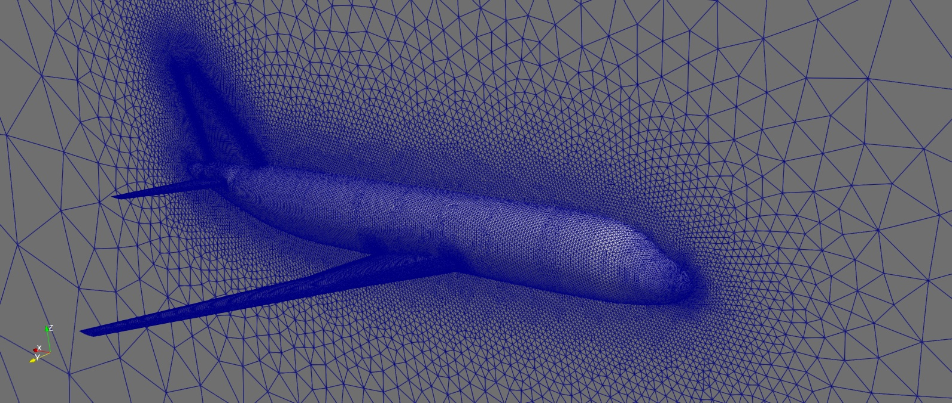
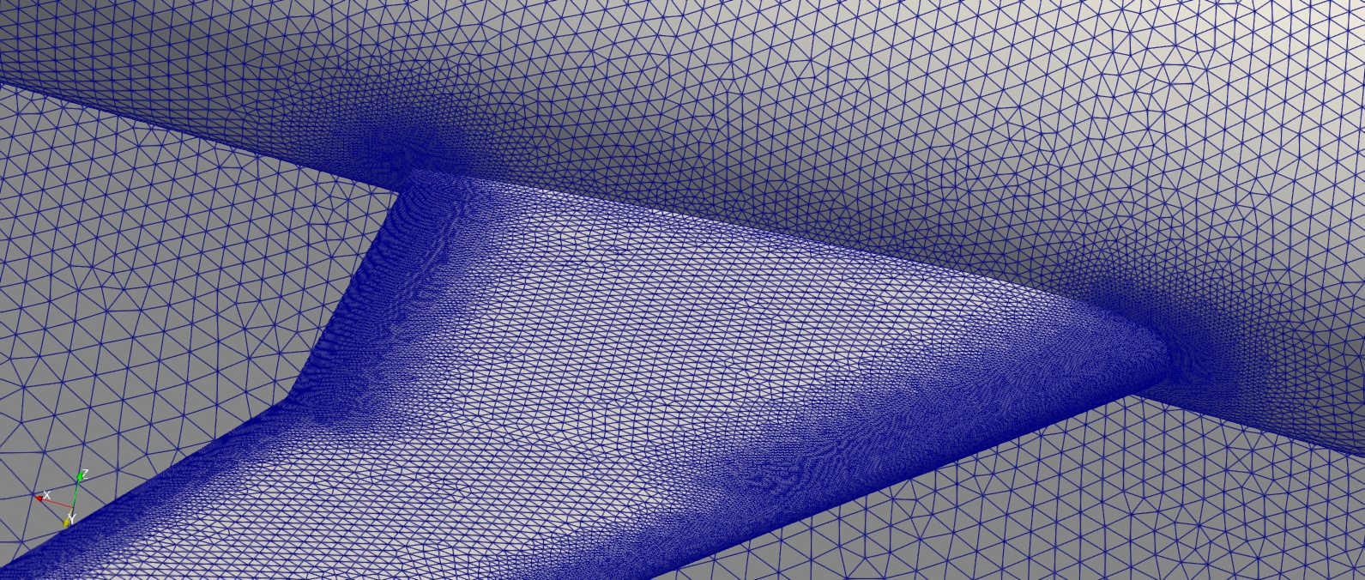
Application Case
SMTrain
GMSH and SU2 Modules
  Unstructured 3D Mesh with
  4.2 millions of elements
CFD Simulations with Euler’s Method:
  No viscous effects
Geometry
Design of Experiments
Training
New Points
Results

Slide 22
Modules & Theory
SMTrain
Geometry
Defined by a CPACS File
Design of Experiments
Systematic methodology for collecting Data by selecting specific input parameter values
Training
Teaching it to learn from input-output data by adjusting its internal parameters to minimize the error
New Points
Based on the predictions of the initial model, new points are suggested to refine the next model
Results
Final Surrogate Model

Slide 23
Modules & Theory
SMUse
Predictions Dataset
SaveAeroCoeff
Results & Plots

Slide 24
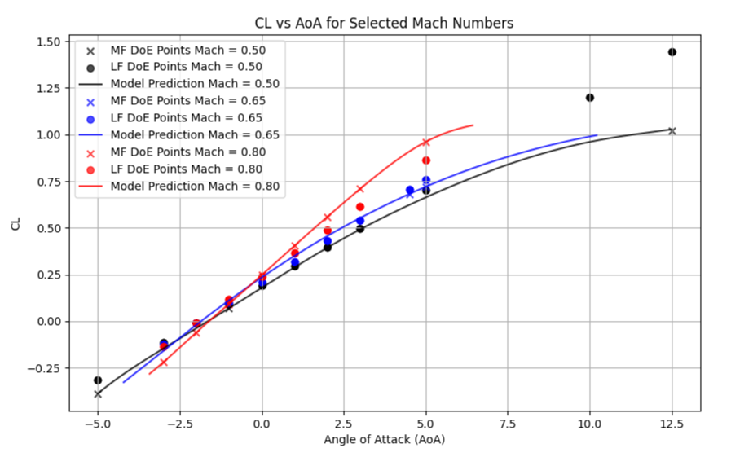
Application Case
Lift Coefficient:
RMSE: 0.00121 (<< 5%)
Well predicted AoA and Mach dependencies
Accounts for flow separation for high AoA
SaveAeroCoeff
LF Sampling
MF Sampling
Results & Plots

Slide 25
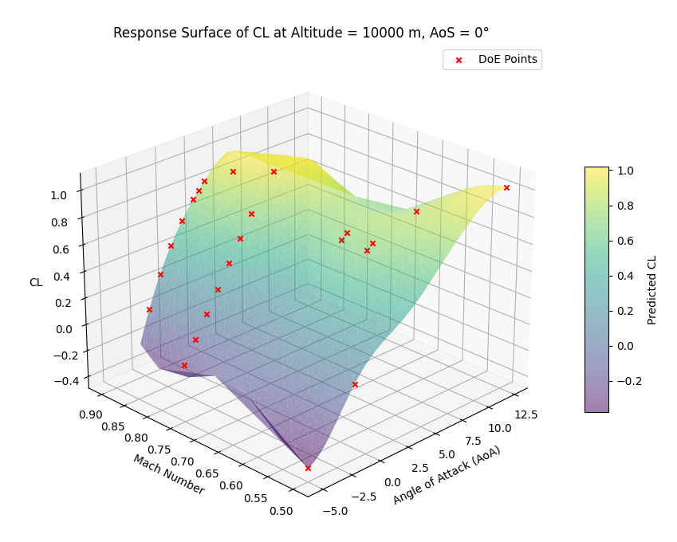
Application Case
SaveAeroCoeff
Simple Kriging:
1 Level of Fidelity (Euler)
No Hyperparameters Optimization
Results & Plots
LF Sampling
MF Sampling

Slide 26
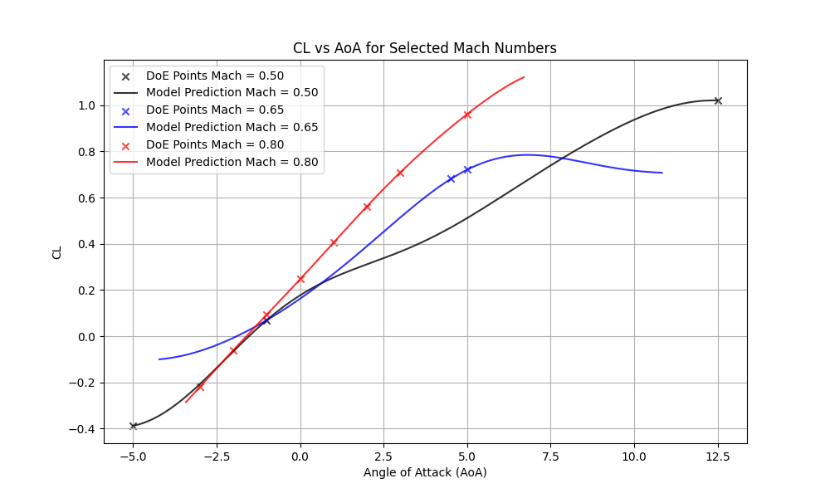
Application Case
SaveAeroCoeff
Simple Kriging:
1 Level of Fidelity (Euler)
No Hyperparameters Optimization
Results & Plots

Slide 27
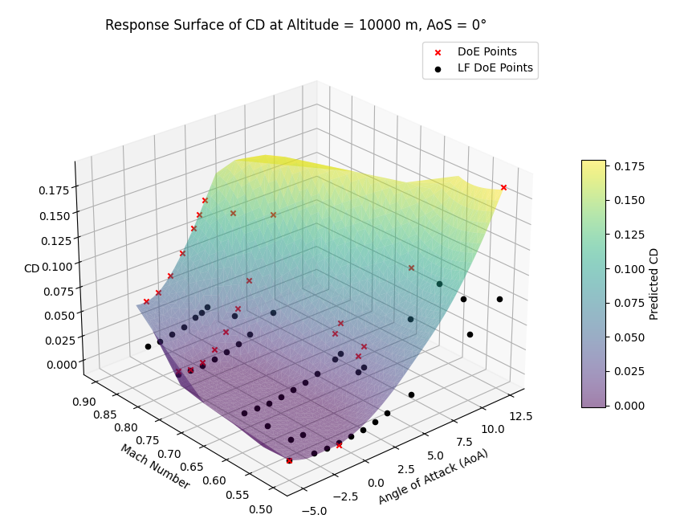
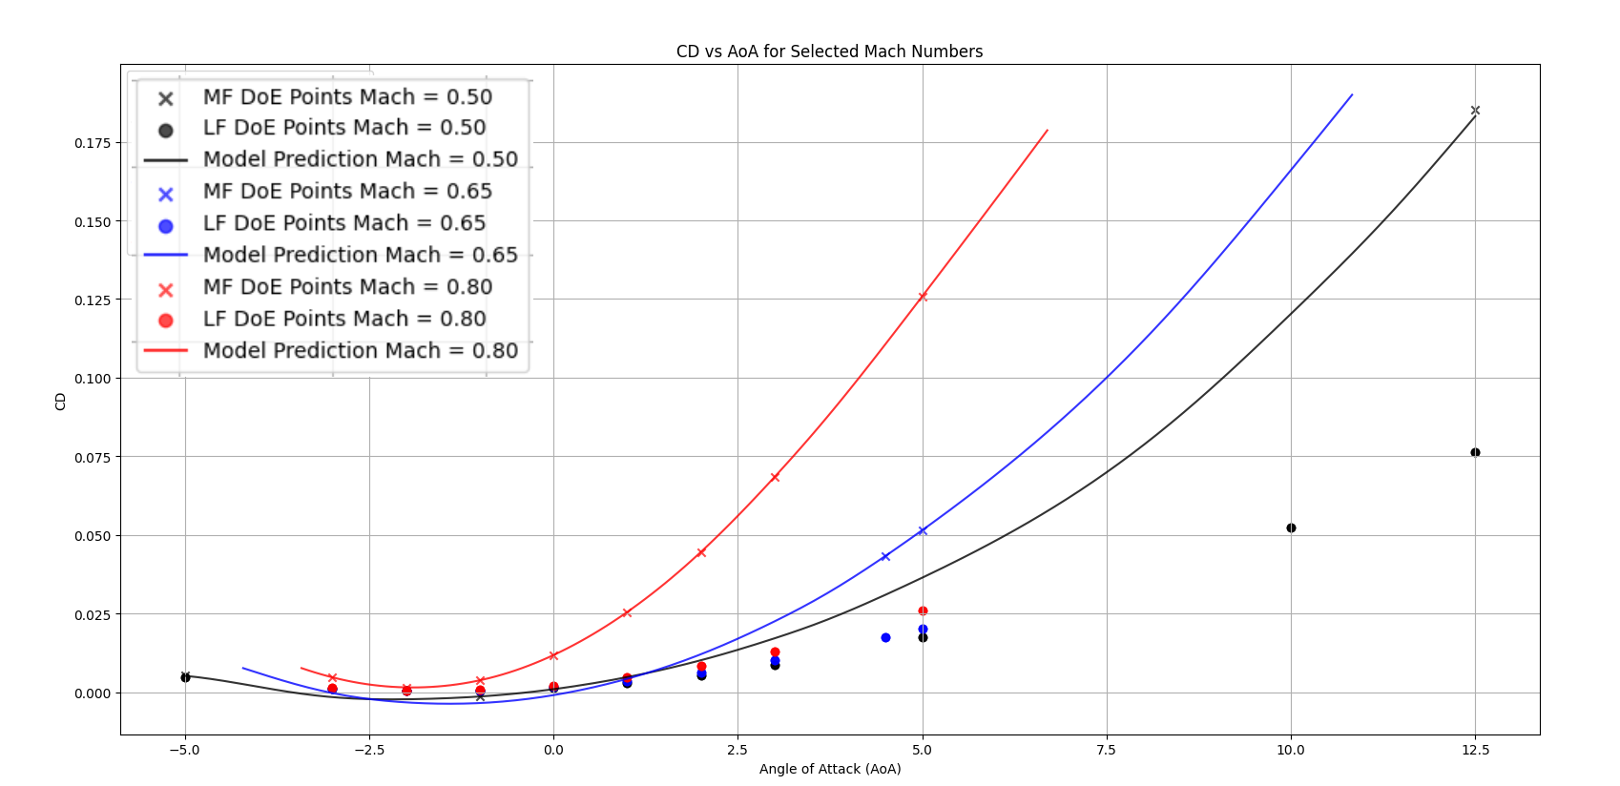
Application Case
SaveAeroCoeff
Drag Coefficient:
RMSE: 0.00231 (<< 5%)
Well predicted AoA and Mach dependencies
Accounts for compressibility effects
Results & Plots
LF Sampling
MF Sampling

Slide 28
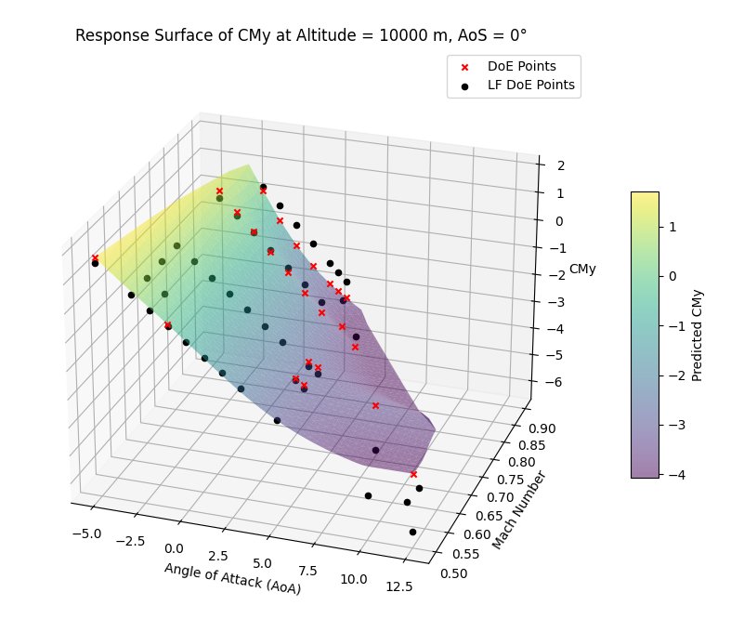
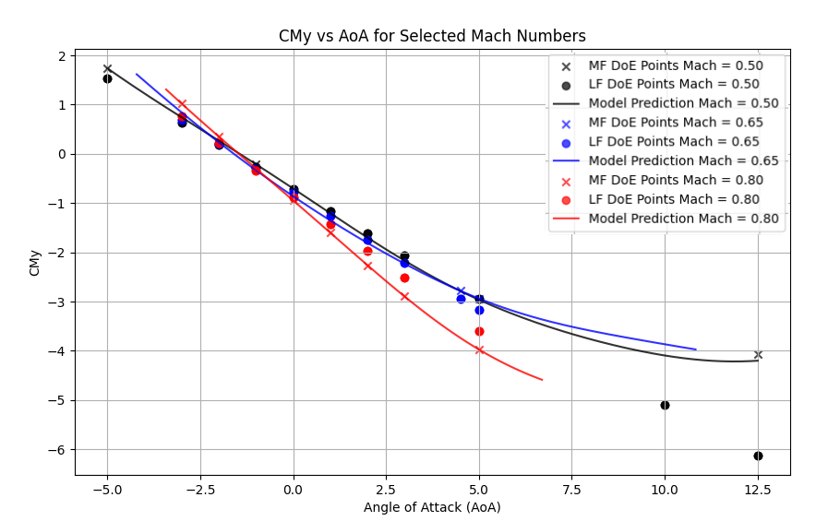
Application Case
SaveAeroCoeff
Moment Coefficient:
RMSE: 0.0403 (<5%)
Less accuracy due to major sensibility to small variations in
flow conditions
Well predicted AoA and Mach dependencies
Results & Plots
LF Sampling
MF Sampling

Slide 29

Conclusions and Future Directions
Implementation of two modules to train and use a surrogate model, integrating them into a workflow with the others CEASIOMpy Modules
Showed the strategies and results
Explore Co-Kriging algorithm
Advanced adaptive sampling strategy
Optimization Module
THANK YOU FOR YOUR
ATTENTION!

