Slide 1
Investigation of thermoacoustic instabilities in a simple model of a gas turbine combustor
Supervisor: Students:
Prof. Alessandro Bottaro Lorenzo Carrattieri
Giulia Innocenti

Slide 2
What is thermoacoustic instability?
Necessity to reduce NOx emissions
New combustion techniques:
LP combustion
Thermoacoustic Instability
Thermoacoustic instability is an unsteady phenomenon and occurs at well-defined frequencies.
A loud sound develops in the combustion chamber (humming).

Slide 3
Unsteady combustion generates acoustic waves, which alter the inlet flow rates of fuel and air. At lean premixed conditions, this leads to a significant unsteady heat release rate. If the phase relationship is suitable, self-excited oscillations will grow in a confined space.
Unsteady combustion
Acoustics
This is the basic idea of positive feedback.

Slide 4
Structure of the thesis
This work aims to investigate the thermoacoustic behavior of the premixed combustor model described by Dowling and Stow [1].
Linear
TALOM*
Approach
Nonlinear
Ansys Fluent
*(Thermo-Acoustic Low-Order Modelling)
[1] Acoustic Analysis of Gas Turbine Combustors, Journal of propulsion and power, 19(5):751–764, 2003.

Slide 5
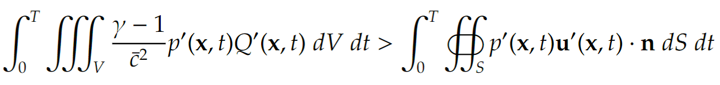
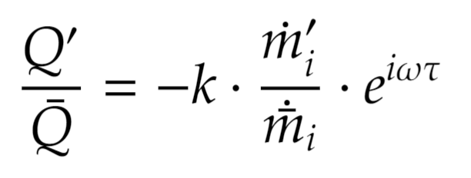
The Rayleigh criterion
Acoustic driving
Acoustic damping
If the acoustic driving is greater than the damping effect over a time interval, then thermoacoustic instabilities will set in: self-excited oscillations.
Crocco’s flame model [2] :
TALOM approach
[2] T. C. Lieuwen. Unsteady combustor physics. Cambridge University Press, 2012.

Slide 6
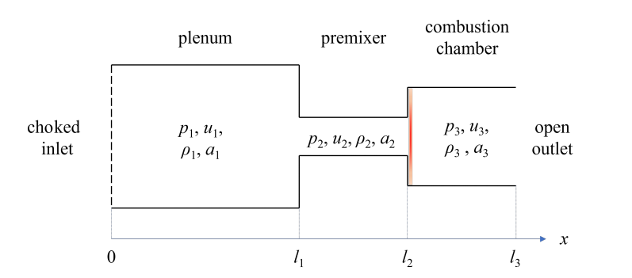
The TALOM approach, linear analysis
The evolving flow is considered to be one-dimensional, inviscid, and mean flow parameters uniform in each of the three ducts.
The inlet is choked (ṁ_{in}=0.05 kg/s, T_{in}= 300 K).
The outlet is defined as a pressure outlet (p_{atm} = 1.01 x 10⁵ Pa).
Compact flame with a temperature of 2000 K.

Slide 7
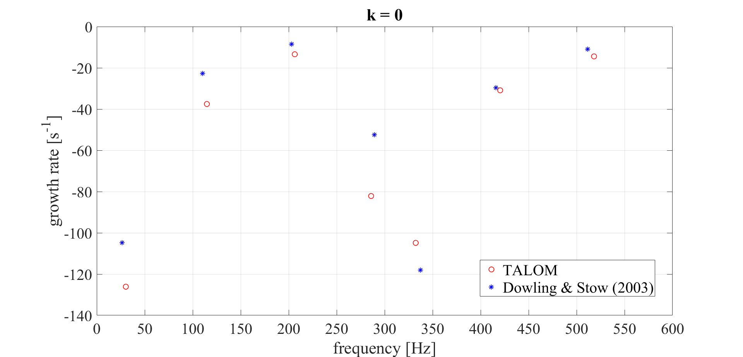
Linear analysis: results
The perturbed system is solved as an eigenvalue problem in the complex domain (asymptotic behavior).
Whose real part corresponds to the frequency of the oscillation and the negative imaginary part represents the growth rate.
For k=0 no unsteady heat release rate is provided.

Slide 8
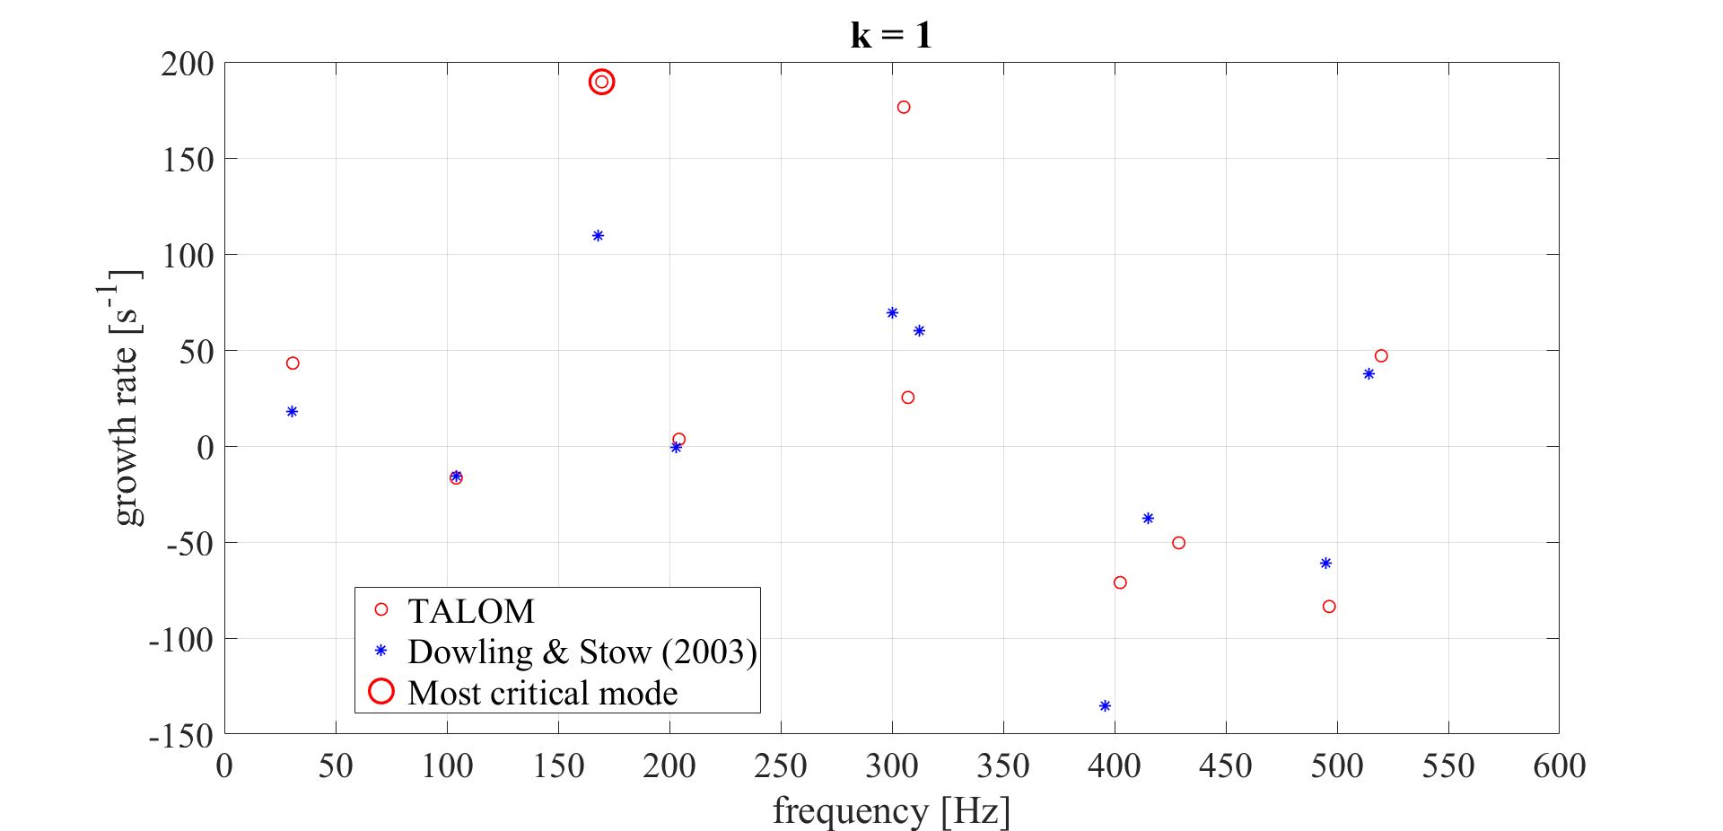
Linear analysis: results
For k=1 an unsteady heat release rate is provided.
The time lag τ (fuel convection time from injection to its combustion) is set equal to 6 milliseconds.
The mass flow rate fluctuation is sampled in the premixer.

Slide 9
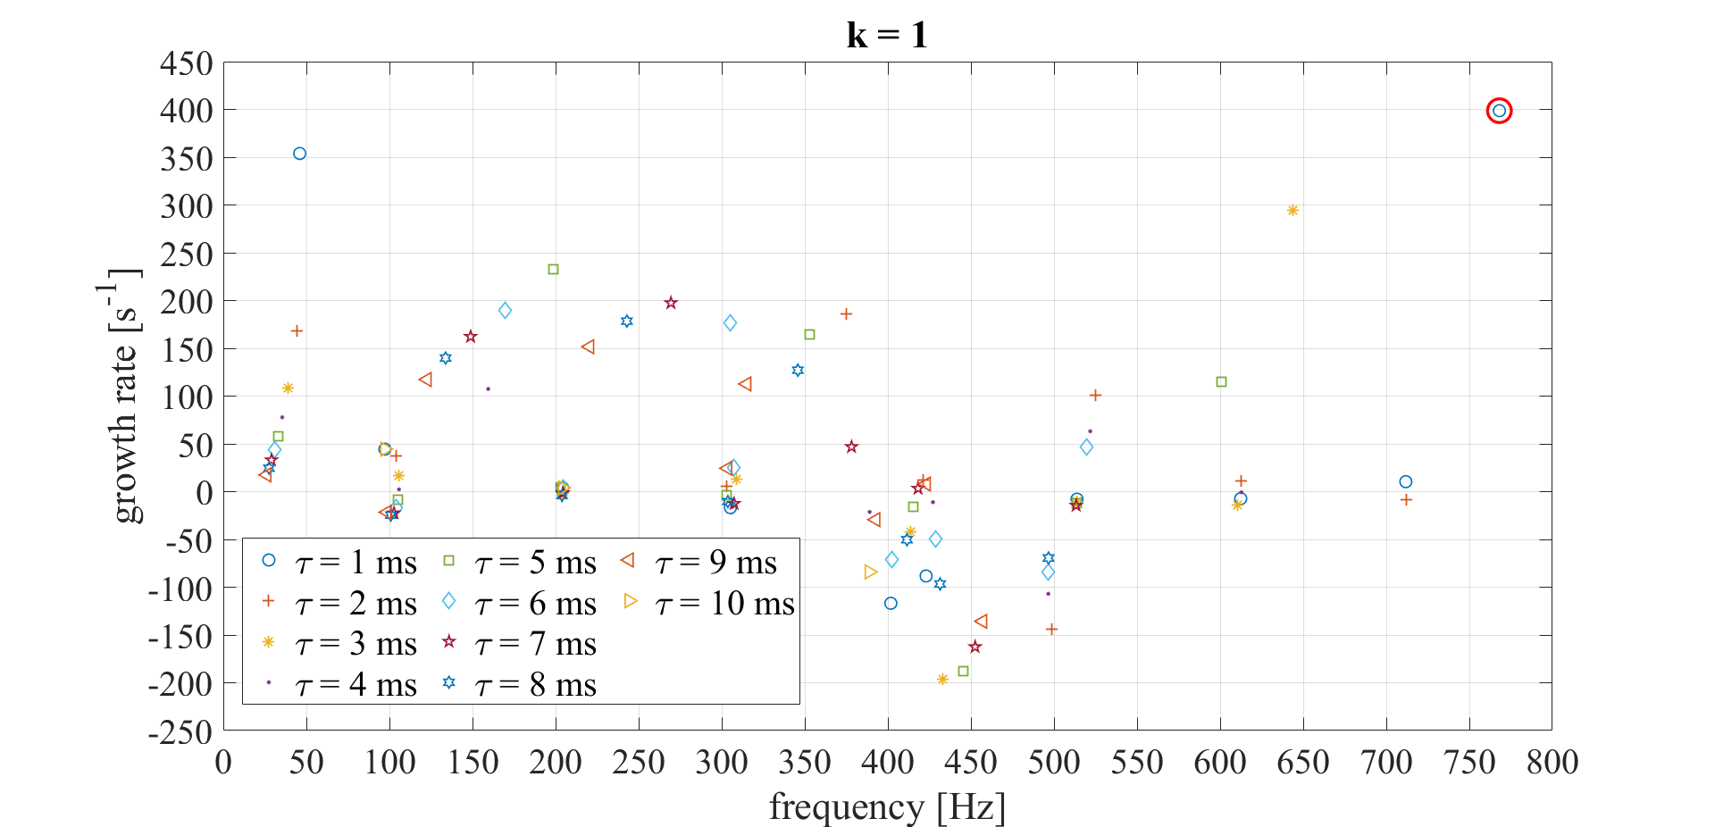
Variation of the time lag τ
We see a strong variability of the resulting modes, which are greatly dependent on the time lag τ.

Slide 10
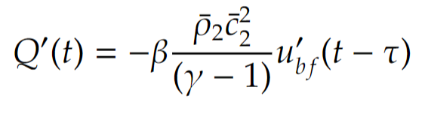
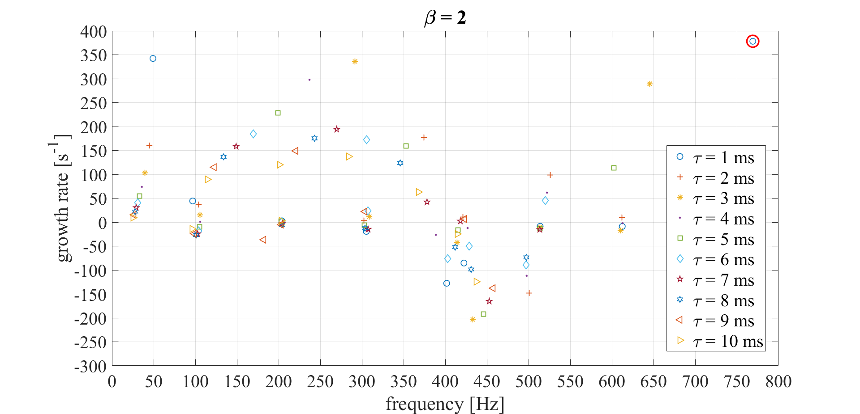
Variation of the flame model
New flame model:
Mode trajectories are similar to the previous case. Again, there is a strong variability of the resulting modes.

Slide 11
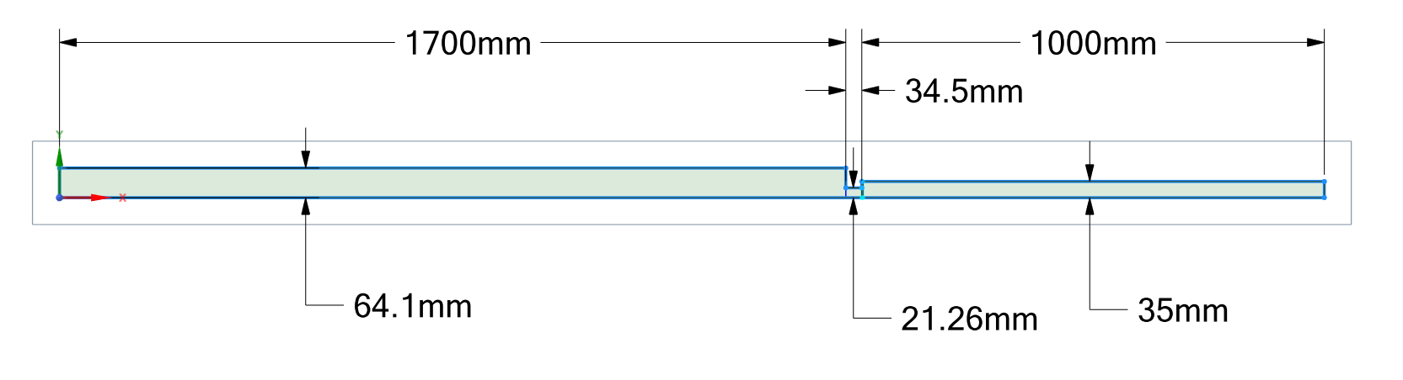
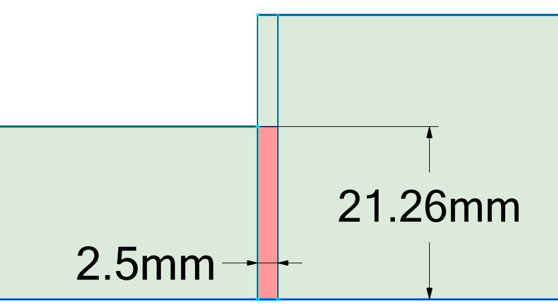
Ansys, nonlinear analysis
No combustion model was implemented. Control of the source term of the flame energy eq.
Given the dimensions of the control volume, its thickness has been set equal to 2.5 millimeters, so that it can be considered adequately thin.
Flame

Slide 12
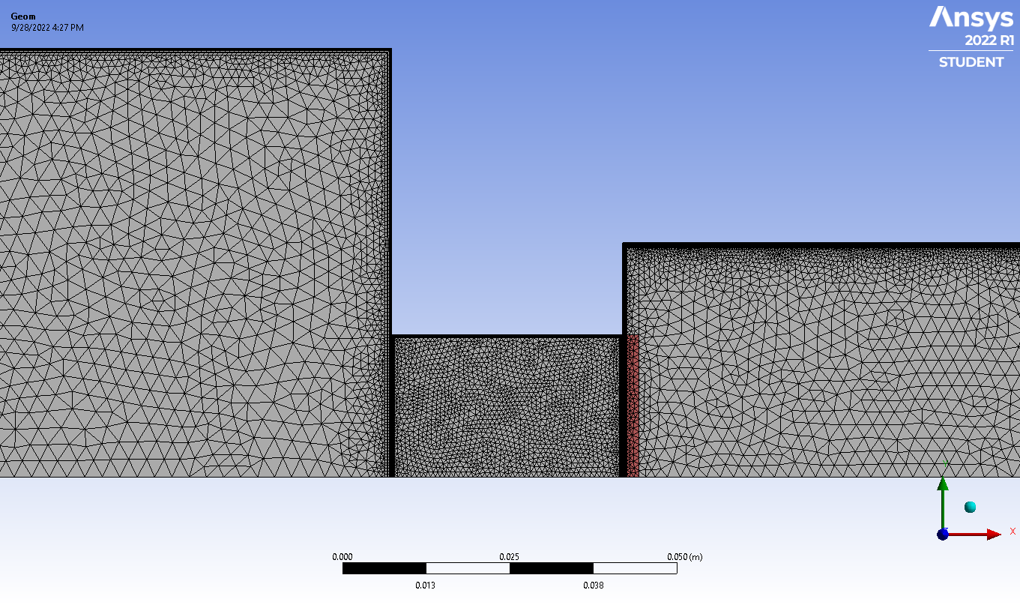
Mesh

Slide 13
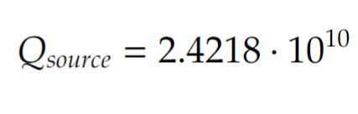
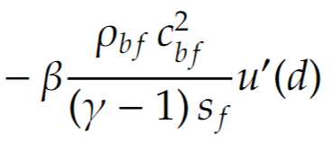
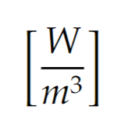
Setup of the simulation
Evolving fluid: air
2D axisymmetric simulation (RANS-URANS)
Turbulence model: k-ω SST
Energy equation: active
Mass flow rate inlet: 0.05 kg/s (300 K)
Pressure outlet: 1.01 x 10⁵ Pa
Adiabatic walls
Control of the energy source term for the flame zone:
Q
Q’
15 cases in total
d = 5, 17, 20 mm from the flame location (premixer)
β = 1, 1.5, 1.6, 1.7, 2

Slide 14
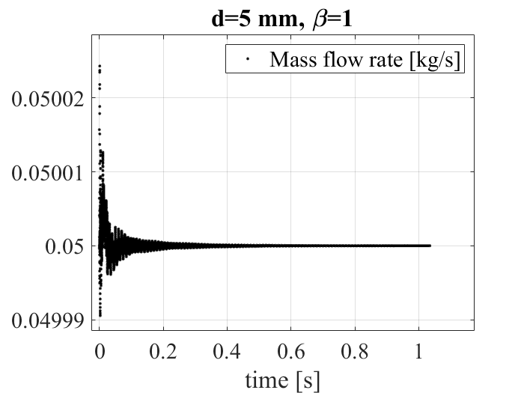
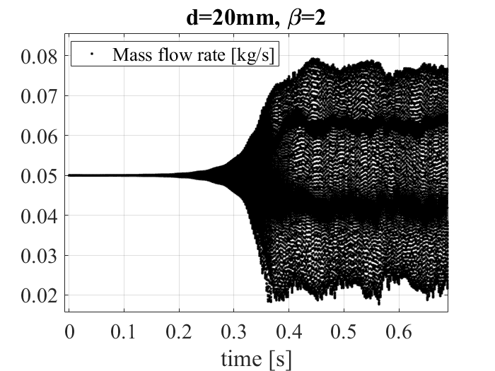
Unsteady heat addition
Stable cases | Unstable cases
d=5 mm, β=1, 1.5, 1.6 | d=5 mm, β=1.7, 2
d=17 mm, β=1, 1.5 | d=17 mm, β=1.6, 1.7, 2
d=20 mm, β=1, 1.5 | d=20 mm, β=1.6, 1.7, 2
Limit cycle
Decay

Slide 15


Example of a limit cycle state
d=20 mm, β=2
Axial velocity [m/s]
Static temperature [K]

Slide 16
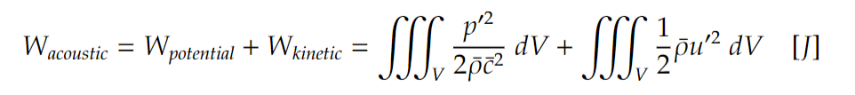
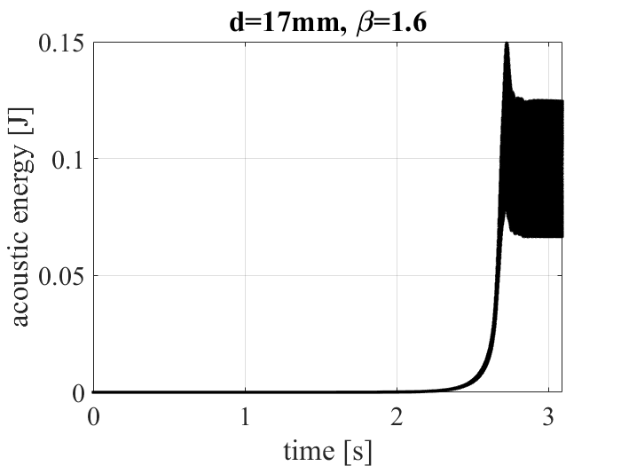
Acoustic energy
Limit cycle amplitude
Exponential growth

Slide 17
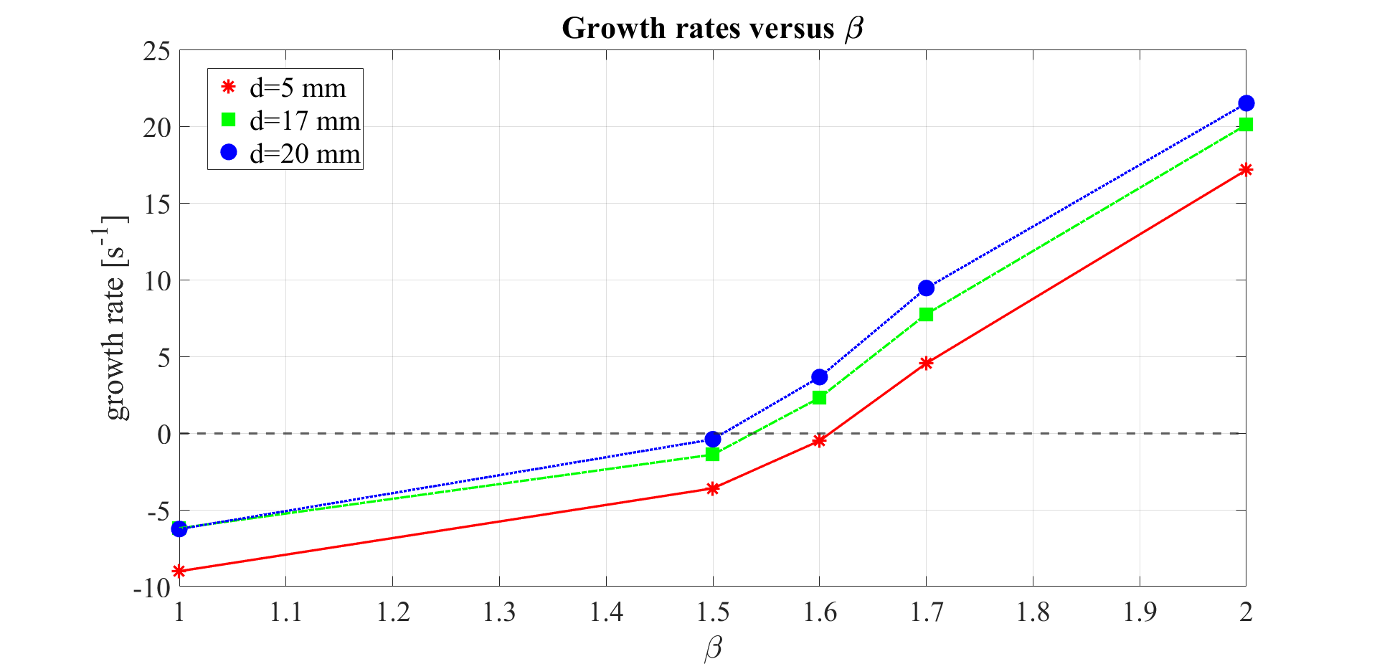
Acoustic energy growth rates

Slide 18
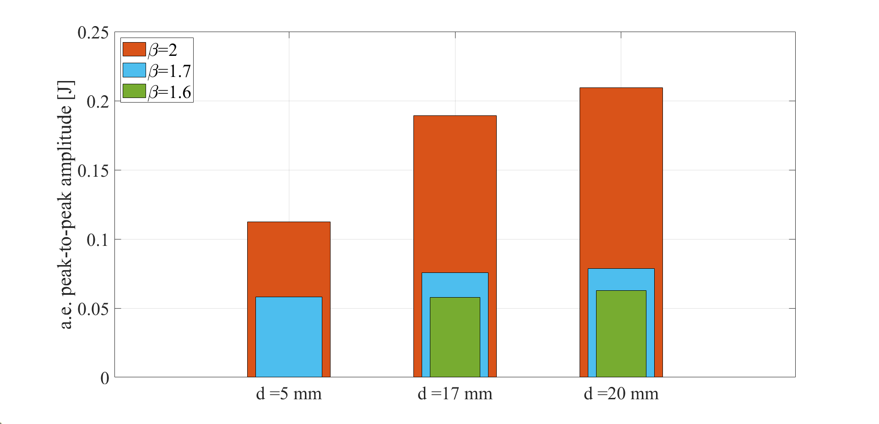
Acoustic energy limit cycles

Slide 19
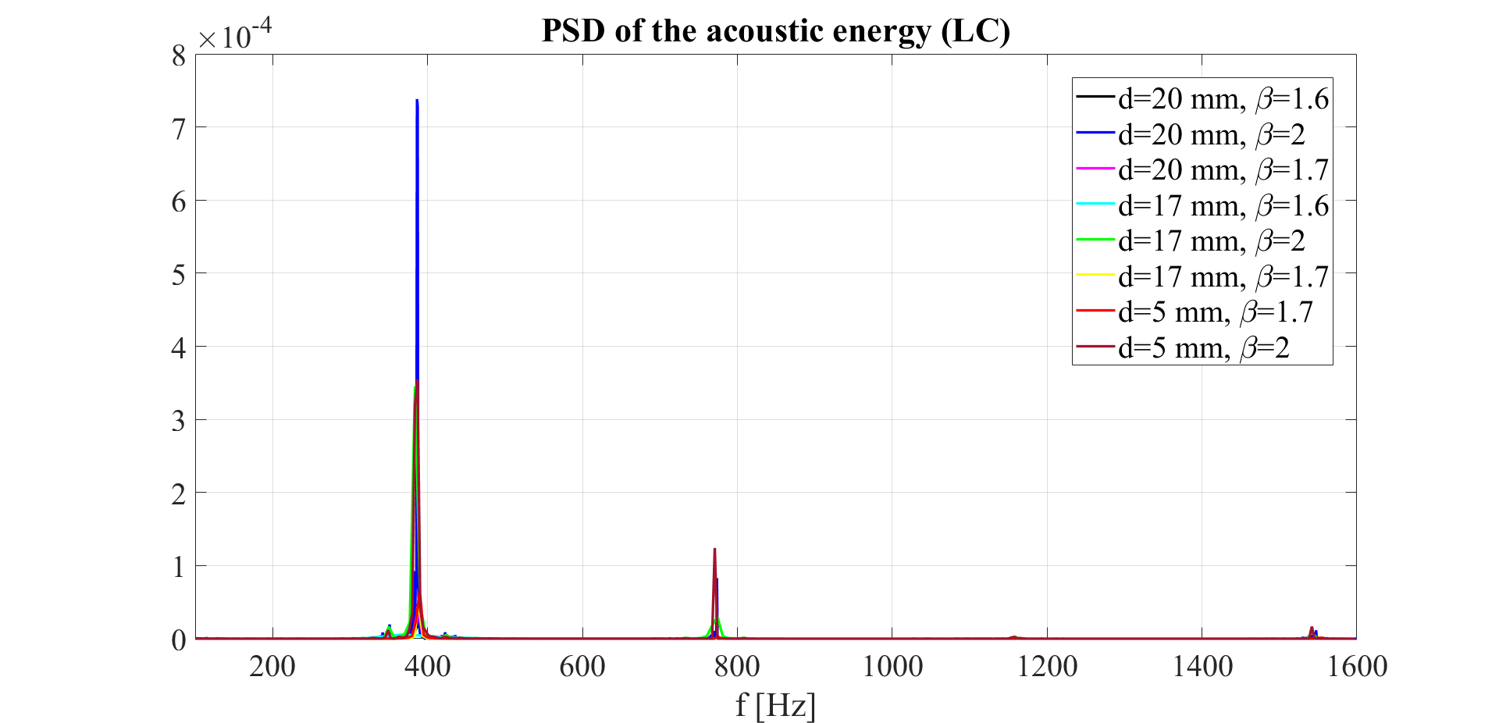
Acoustic energy limit cycles

Slide 20
How to reduce thermoacoustic instabilities?
Thermoacoustic instability occurs in the feedback between combustor acoustics fluctuations and the heat release fluctuations through a coupling mechanism.
This coupling must be broken to control or even eliminate thermoacoustic instabilities.
Unsteady heat release fluctuations Q ̍
Acoustic fluctuations p ̍, u ̍

Slide 21
How to reduce thermoacoustic instabilities?
The thermoacoustic instabilities can be controlled through two main techniques:
Active control
Passive control
The aim is to design an actuator, such as a loudspeaker, to produce antisound in order to damp the thermoacoustic instabilities.
COMBUSTOR DAMPING (resistive devices)
ACOUSTIC ENERGY (reactive devices)

Slide 22
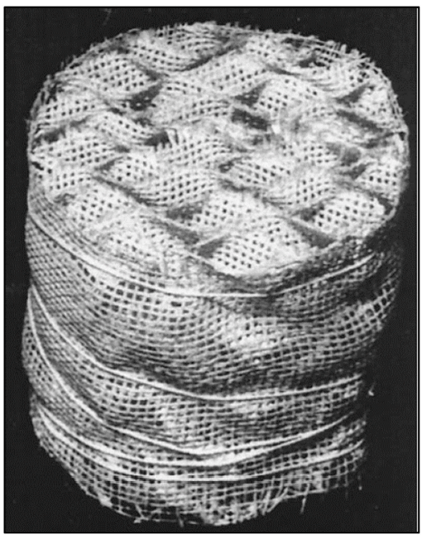
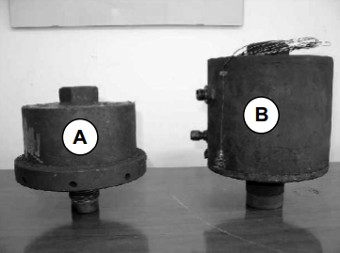
How to reduce thermoacoustic instabilities?
In this study, passive control has been implemented through the following damper devices:
resistive devices → porous membranes → porous medium
reactive devices → acoustic cavities → Helmholtz resonator
Porous medium
Helmholtz resonators

Slide 23
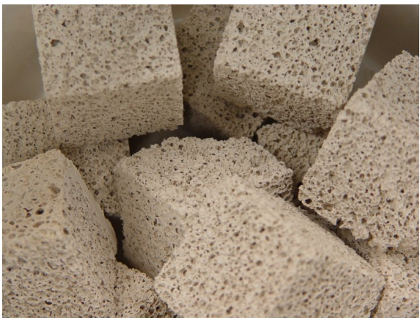


Porous media
Porous media are solid and heterogeneous materials having voids, called pores, in their microstructure and they can be traversed by the fluids.
Porosity [-]
$$ε= \frac{V_{P}}{V_{TOT}}$$
$$\text{P}\text{ermeability}\text{ [}\text{m}\text{2}\text{]}$$
$k= Φ_{s}$ · $\frac{ε^{3} · D_{p}^{2}}{150 ·(1−ε)}$
Porous medium before the flame
2 cases in total
Porous medium after the flame

Slide 24
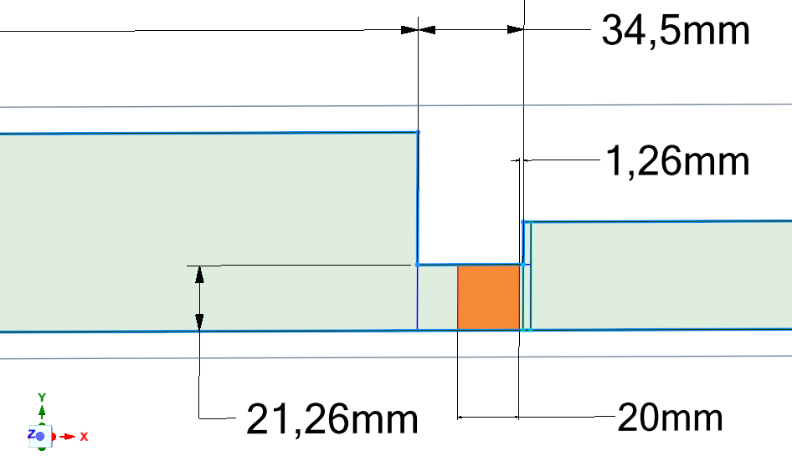
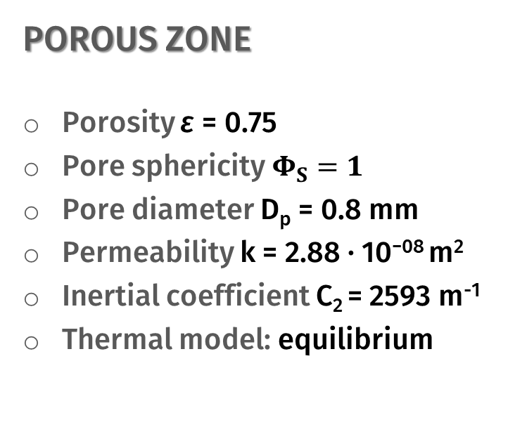
Porous medium before the flame
Geometry
Setup of the simulation
POROUS ZONE
Porosity ε = 0.75
Pore sphericity$Φ_{S}=1$
Pore diameter D_{p} = 0.8 mm
Permeability k = 2.88 · 10⁻⁰⁸ m²
Inertial coefficient C₂ = 2593 m⁻¹
Thermal model: equilibrium

Slide 25

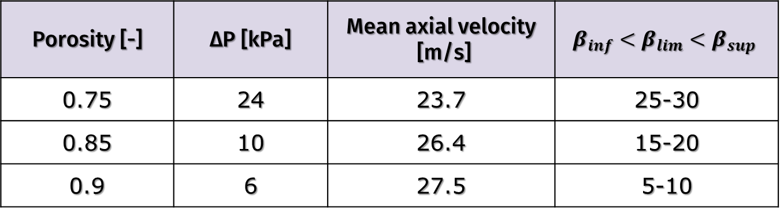


Porous medium before the flame: results
The next table shows the results by varying porosity.
Porosity [-] | ∆P [kPa] | Mean axial velocity [m/s] | $$β_{inf}<β_{lim}<β_{sup}$$
0.75 | 24 | 23.7 | 25-30
0.85 | 10 | 26.4 | 15-20
0.9 | 6 | 27.5 | 5-10
ε
$∆P$
$$\overline{u}$$
$$β_{lim}$$

Slide 26
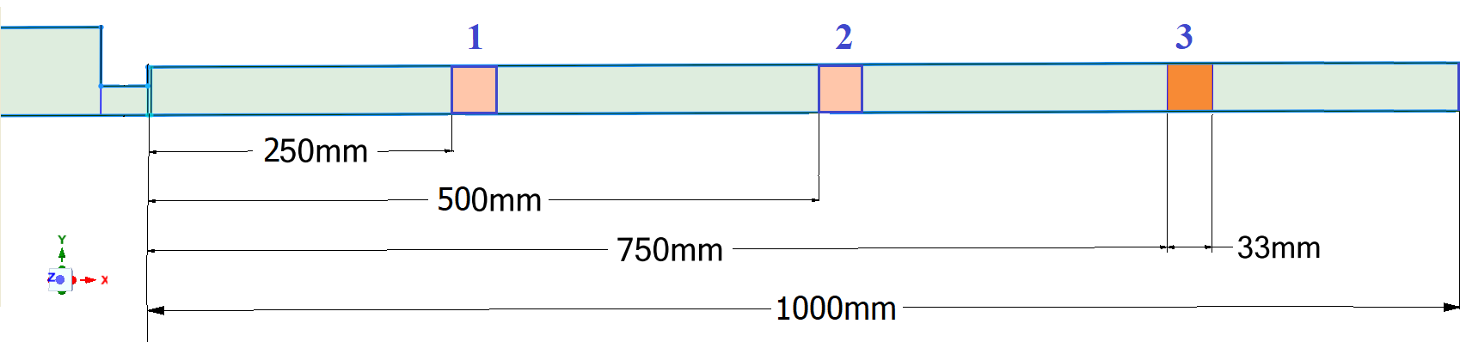
Porous medium after the flame
Geometry
It is located after the flame in three different positions in order to investigate the influence of the porous medium’s location on the thermoacoustic instability.

Slide 27
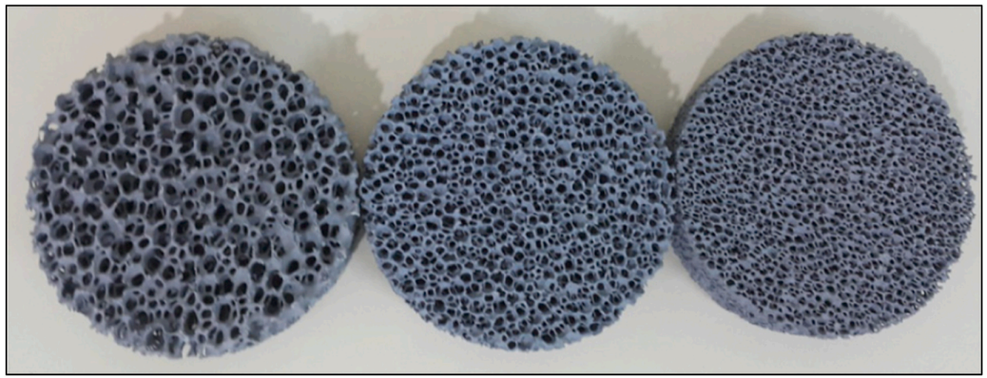

Porous medium after the flame
Setup of the simulation
β = 2 and d = 20 mm (most critical case investigated);
Porous zone parameters are the same of the previous case;
Thermal model: non-equilibrium additional source term in the energy conservation equation:
A solid zone is defined, and silicon carbide is the selected material to simulate the porous zone.
$${\dot{Q}}_{source}{= h}_{fs}∙ A_{fs}∙(T_{s}−T_{f})$$

Slide 28
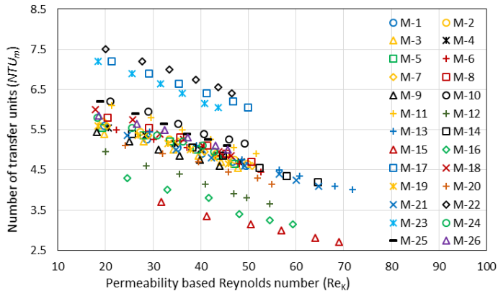


Porous medium after the flame
Setup of the simulation
The porous medium is considered as a black box and, as a measure of the amount of energy transferred from the fluid to the solid matrix, it is taken into account the Number of Transfer Units NTU [3].
$${Re}_{K}=\frac{ρ_{f}∙V_{f}∙ \sqrt{K}}{μ_{f}∙ε}$$
$$h_{fs}=\frac{NTU∙\dot{m_{f}} ∙C_{f}}{A_{fs}}$$
[3] Abuserwal A.F., Pressure Drop and Forced Convective Heat Transfer in Porous Media,
Doctoral dissertation - University of Sheffield, 2012.

Slide 29
Porous medium after the flame: results
Configurations 1 and 2 reach a limit cycle state.
Instead, the last porous medium configuration decays, reaching a stable condition.
Case | AE limit cycle amplitude [J]
Without porous medium | 2.1 · 10⁻¹
Configuration 1 (250 mm from the flame) | 1.3 · 10⁻³
Configuration 2 (500 mm from the flame) | 4.8 · 10⁻⁴
Configuration 3 (750 mm from the flame) | 0
Although the first two setups develop a thermoacoustic instability, the limit cycle amplitude results are 2-3 orders of magnitude smaller than the reference case.

Slide 30



Steps of the simulation
Acoustic fluctuations [4]
RANS
Constant heat source
URANS
Constant heat source
URANS
Unsteady heat addition
$$\overline{p}$$
$$\overline{p}$$
$$\overline{p}$$
Mean flow
Mean flow
+
Turbulence fluctuations
+
Acoustic fluctuations
Mean flow
+
Unsteady, turbulent fluctuations
p_{t} ̍̍̍
p_{t} ̍̍̍
p_{a} ̍̍̍
[4] S. Hubbard, A. P. Dowling. The triple decomposition of a fluctuating velocity field in a
multiscale flow. Physics of Fluids, 2015.

Slide 31
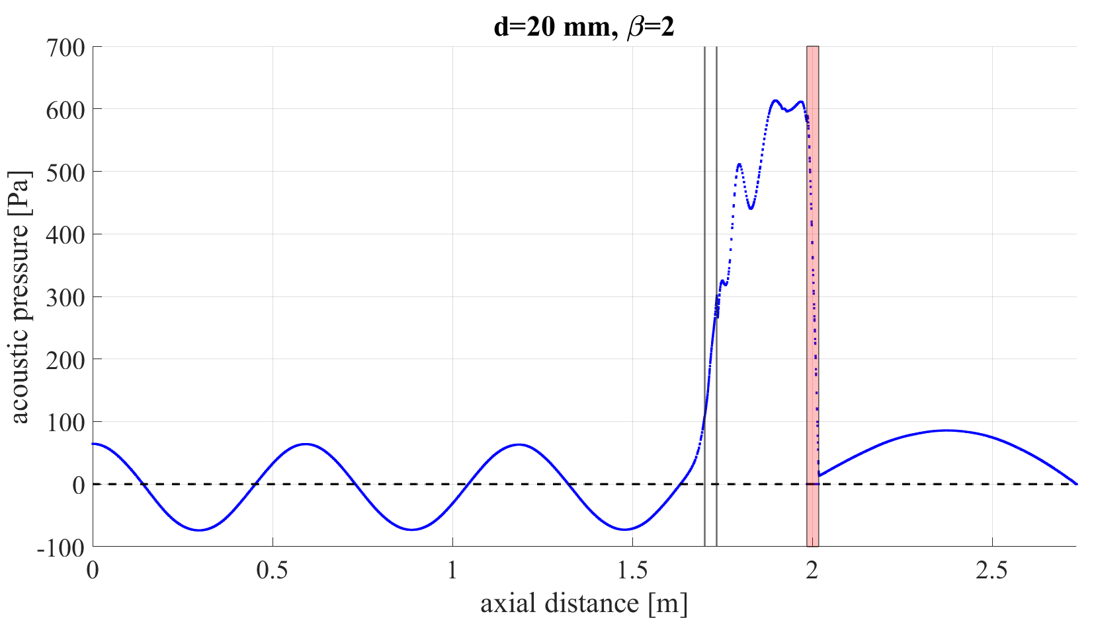
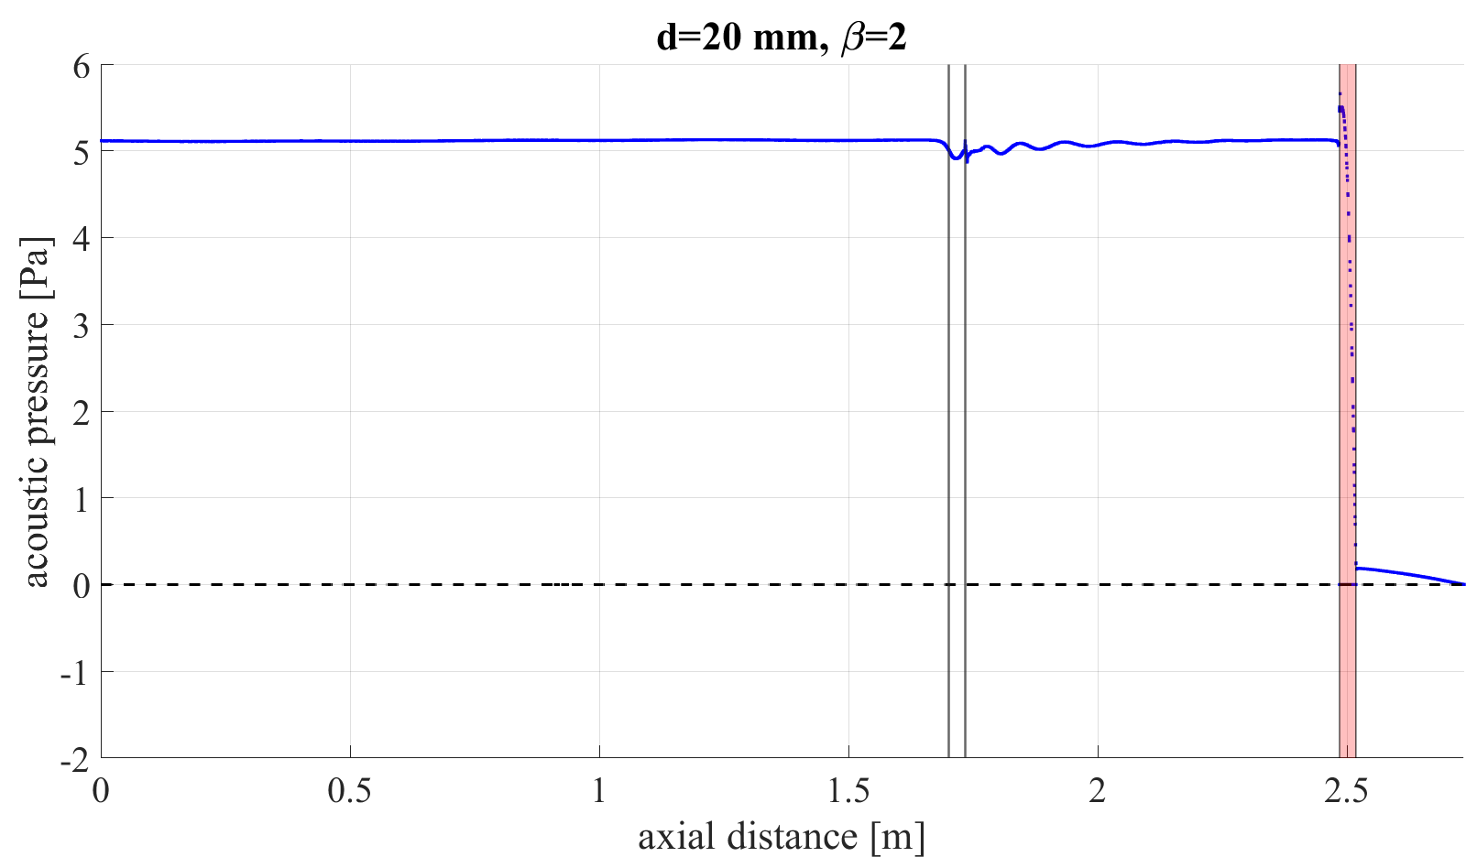

Acoustic pressure $p_{a}^{̍}$: results
UNSTABLE CASE
CONFIGURATION 1
STABLE CASE
CONFIGURATION 3

Slide 32
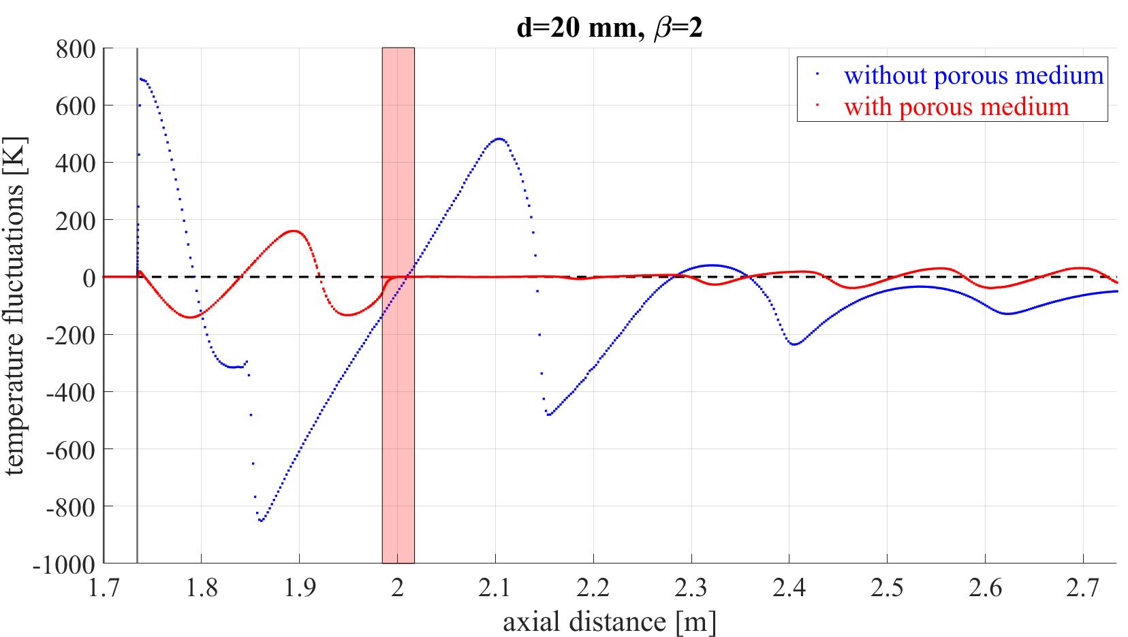
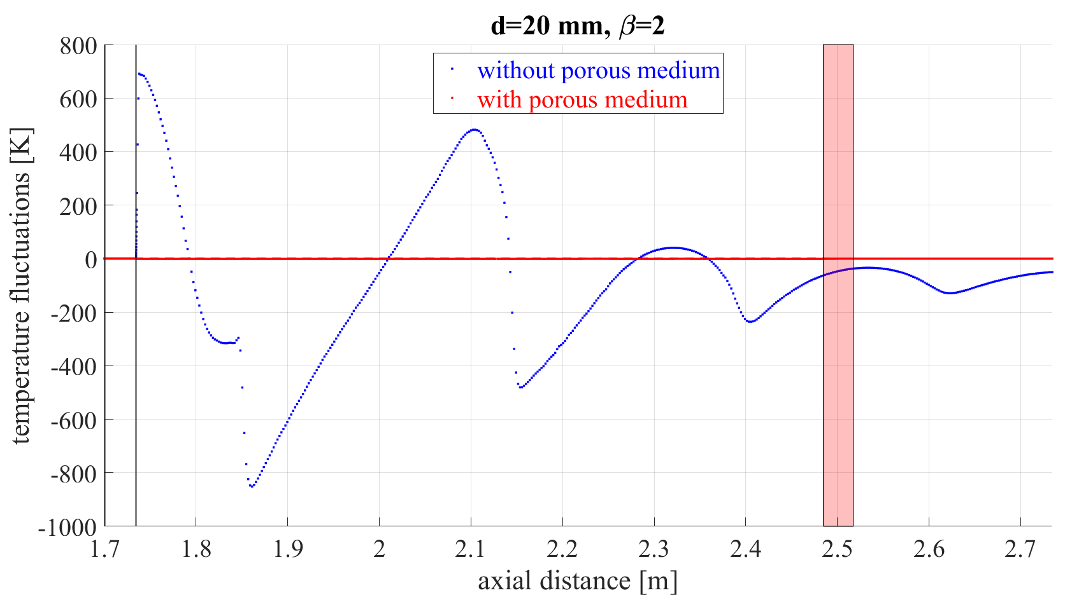

Acoustic temperature $T_{a}^{̍}$: results
UNSTABLE CASE
CONFIGURATION 1
STABLE CASE
CONFIGURATION 3

Slide 33
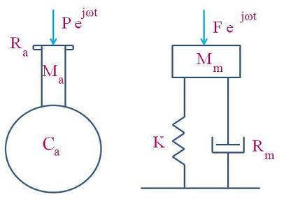
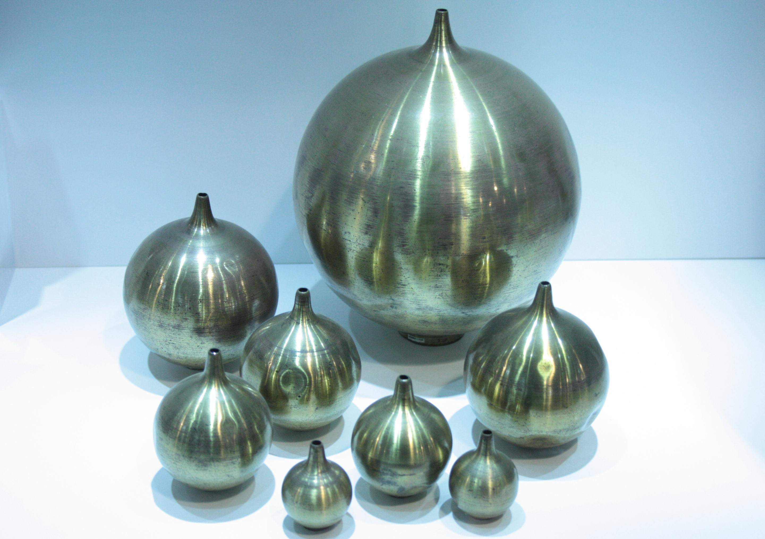
Helmholtz resonator
Our annular Helmholtz resonator is composed of two main parts:
a cavity, of circular cross-section;
a neck that communicates with the outside through a small opening.

Slide 34

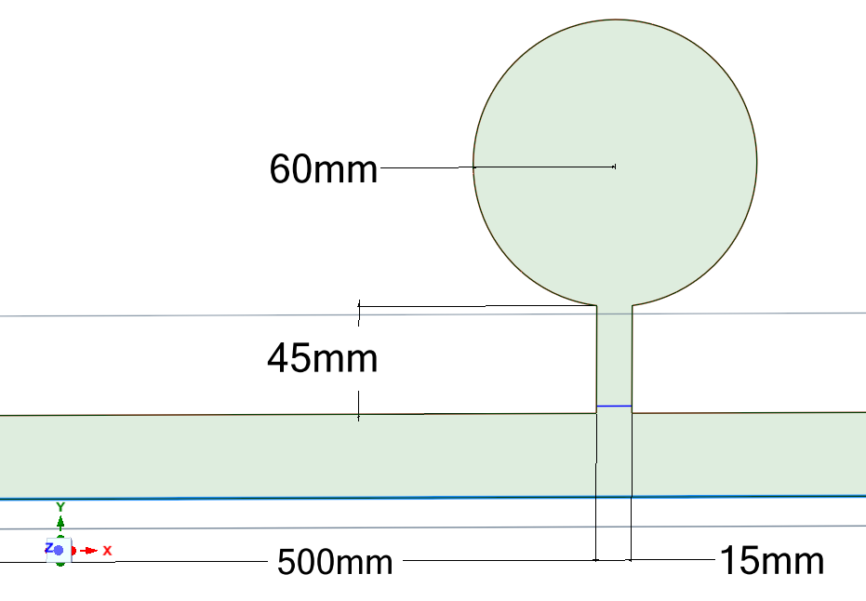
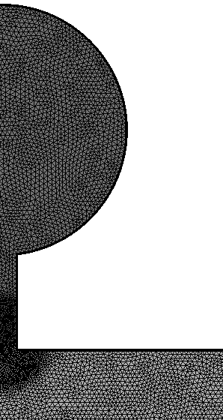
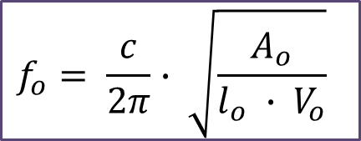
Helmholtz resonator
Geometry
385 Hz
$$f_{o}= \frac{c}{2π}∙ \sqrt{\frac{A_{o}}{l_{o} ∙ V_{o}}}$$
[5]
5 cases in total
3 cases: varying resonator’s geometry and fixing its position
2 cases: fixing resonator’s geometry and varying its position
[5] S. Hubbard, A. P. Dowling. Acoustic resonances of an industrial gas turbine combustion
system. ASME Journal of Engineering for Gas Turbines and Power, 123:766–773, 2001.

Slide 35
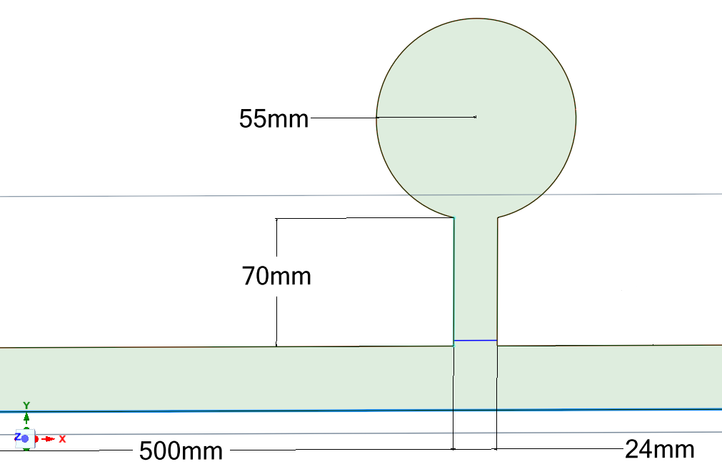
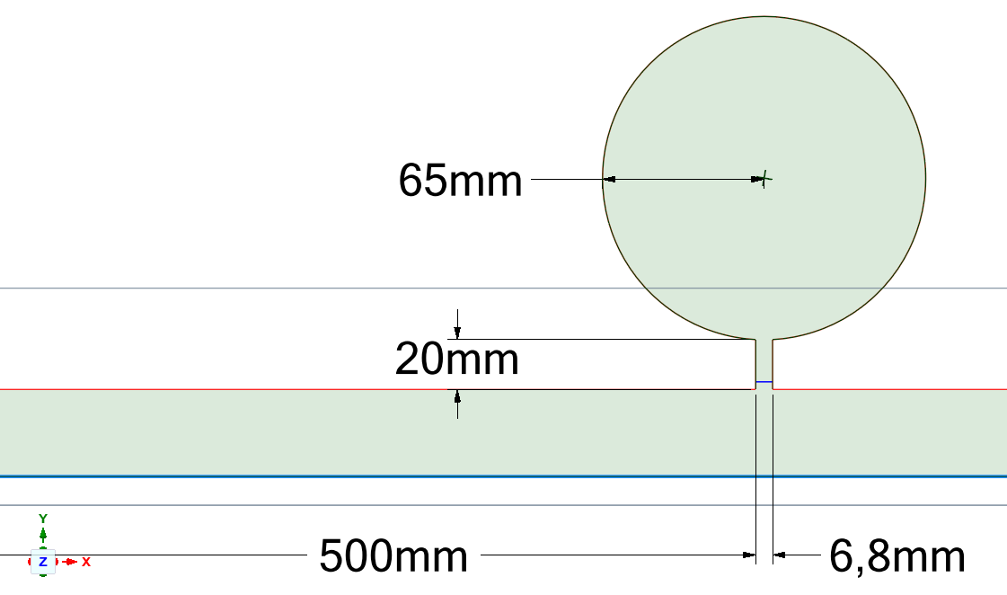
Helmholtz resonator: results
I
II
III
Case | Geometry | Distance from the flame [mm] | Results
1 | I | 500 | stable
2 | II | 500 | stable
3 | III | 500 | stable
4 | II | 250 | unstable
5 | II | 750 | unstable

Slide 36
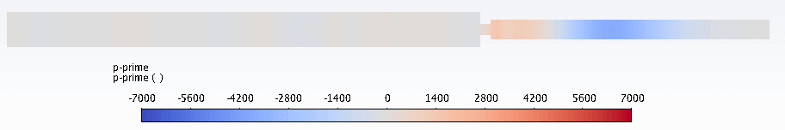
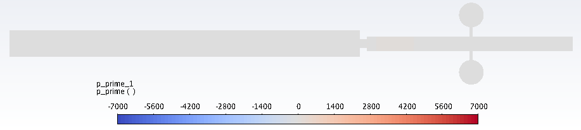
Damping of the resonator
β=2, d=20 mm
Acoustic pressure [Pa]
without resonator
Acoustic pressure [Pa]
with resonator

Slide 37
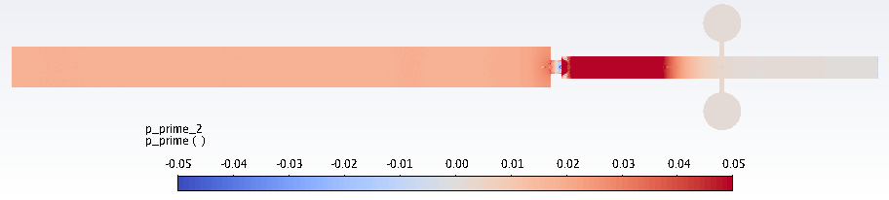
Damping of the resonator
β=2, d=20 mm
Acoustic pressure [Pa]
without resonator
Acoustic pressure [Pa]
with resonator

Slide 38
Conclusions
Once dealt with two different approaches, linear and nonlinear, but the physics suggests to employ a nonlinear approach.
As concerns thermoacoustic damping:
Porous media before the flame successfully damp thermoacoustic instabilities for many parametric conditions;
A porous diaphragm after the flame is very effective, particularly when its position is carefully chosen;
Helmholtz resonators are characterized by much smaller pressure losses than porous media and, provided a careful selection of their sizing and position is made, they prove to work very well.

Slide 39
Thank you for your attention
Lorenzo Carrattieri
Giulia Innocenti

