Slide 1

An Experimental and Numerical Investigation on the Propagation of Compositional Waves
Supervisor: Prof. Alessandro Bottaro
Co-Supervisor: Prof. Simone Hochgreb
Andrea Busseti
Genova, 27 March 2018

Slide 2
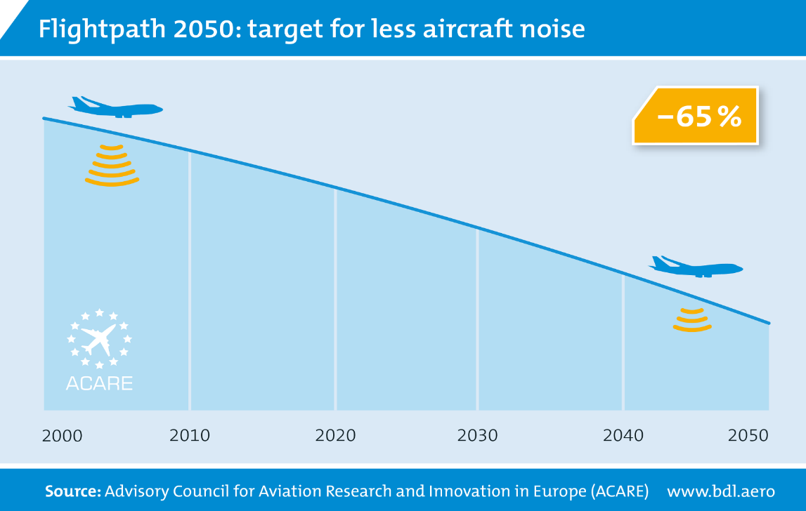
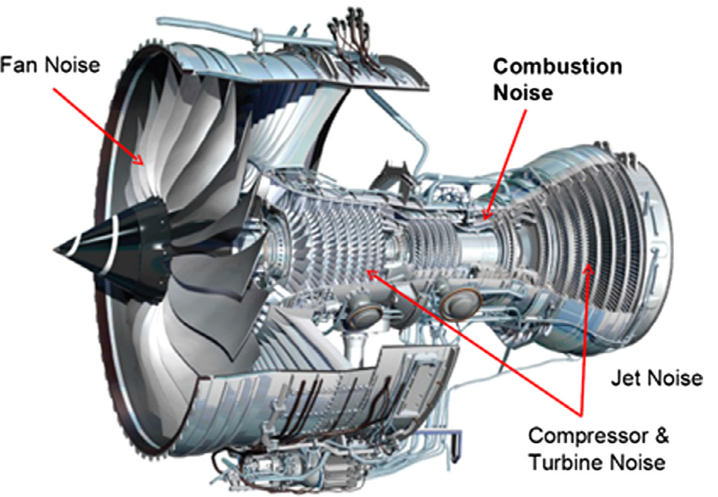
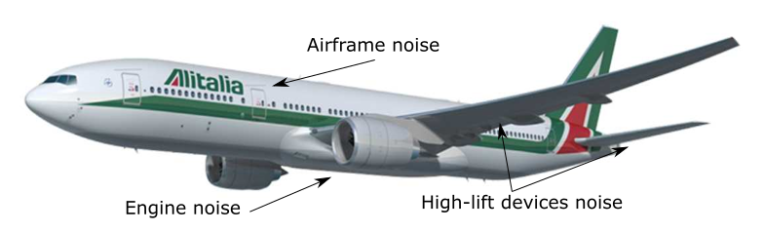

Motivation
Aircraft noise
Introduction
Motivation
Background
Experiments
LITGS overview
Employed set-up
Measurements
CFD simulations
Procedure
Resulting flow-field
Comparisons
Sampling methods
Low-order modelling
Formulation
Application
Conclusions
27/03/2018

Slide 3
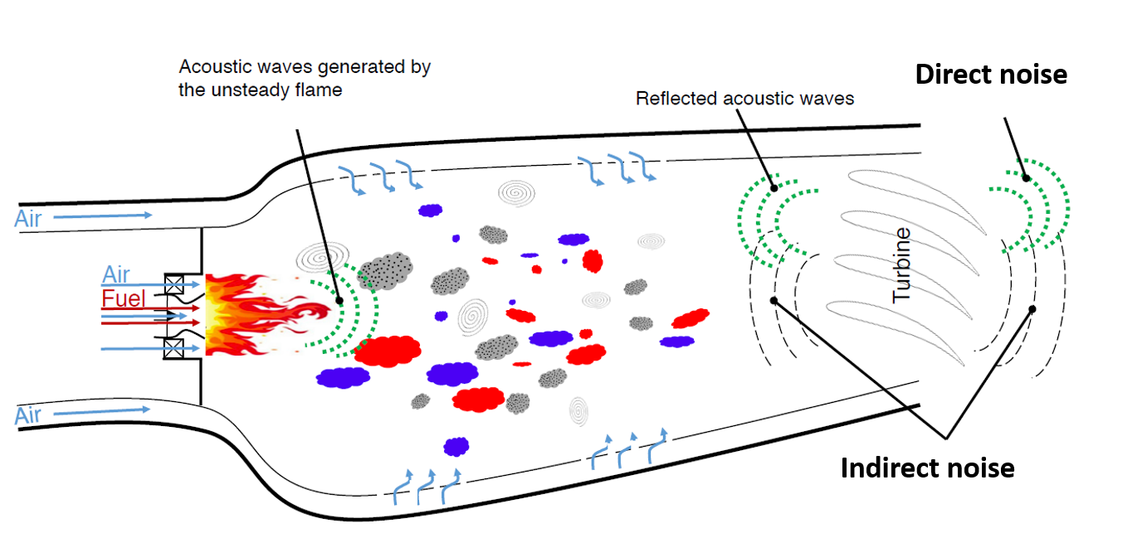
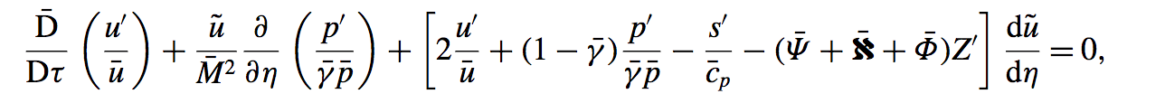
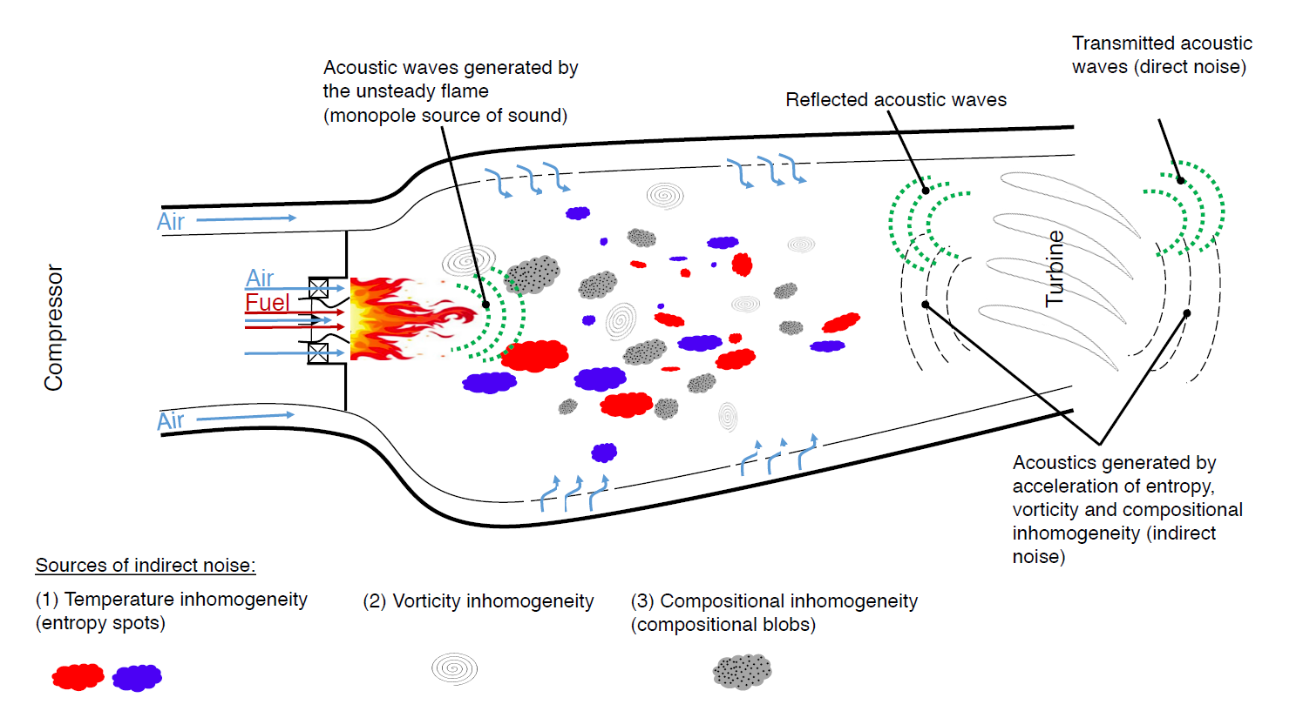
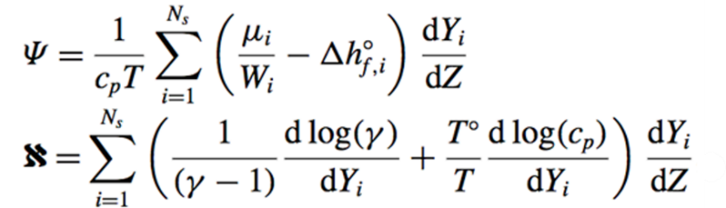
Motivation
Combustion noise
Introduction
Motivation
Background
Experiments
LITGS overview
Employed set-up
Measurements
CFD simulations
Procedure
Resulting flow-field
Comparisons
Sampling methods
Low-order modelling
Formulation
Application
Conclusions
Caused by accelerated inhomogeneities:
Temperature
Vorticity
Magri et al. (2017)
Composition
27/03/2018
Notes:
Chemical potential function - Heat-capacity factor

Slide 4
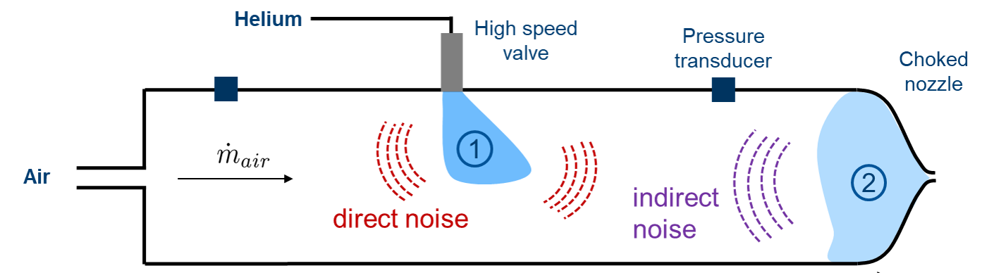
Background
Experiments on compositional noise - Rolland et al. (2017)
Introduction
Motivation
Background
Experiments
LITGS overview
Employed set-up
Measurements
CFD simulations
Procedure
Resulting flow-field
Comparisons
Sampling methods
Low-order modelling
Formulation
Application
Conclusions
Objectives:
Development of a flexible experimental set-up
Measurements aimed to verify (or not) the novel theory in simplified configurations
Validate one-dimensional acoustic models
Need to quantify the strength and amplitude of compositional perturbations before they reach a flow discontinuity
27/03/2018
Notes:
Chemical potential function - Heat-capacity factor

Slide 5
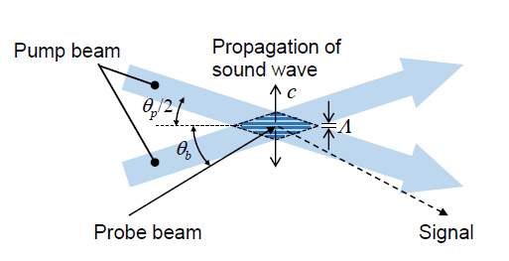
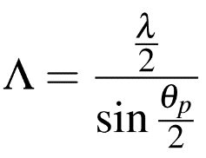
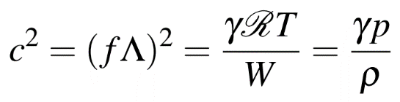
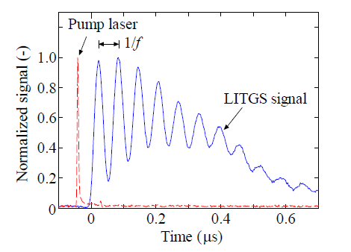
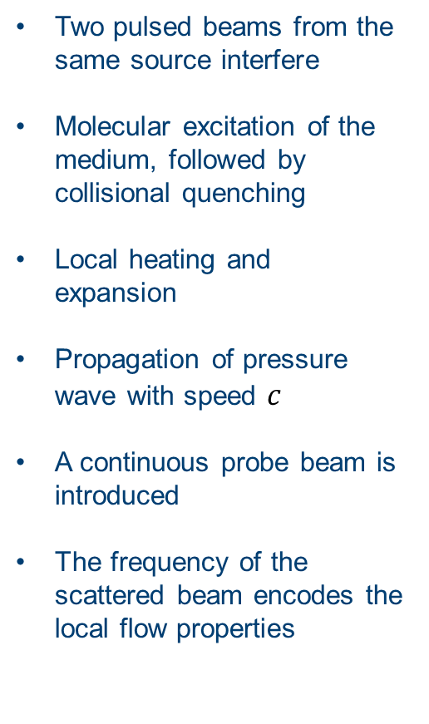
Detection of compositional waves with LITGS
Overview of the technique
Introduction
Motivation
Background
Experiments
LITGS overview
Employed set-up
Measurements
CFD simulations
Procedure
Resulting flow-field
Comparisons
Sampling methods
Low-order modelling
Formulation
Application
Conclusions
Two pulsed beams from the same source interfere
Molecular excitation of the medium, followed by collisional quenching
Local heating and expansion
Propagation of pressure wave with speed $c$
A continuous probe beam is introduced
The frequency of the scattered beam encodes the local flow properties
27/03/2018

Slide 6
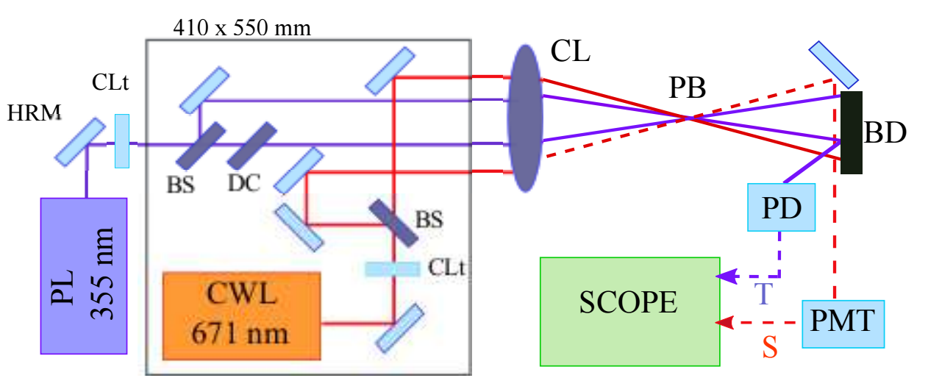
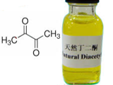
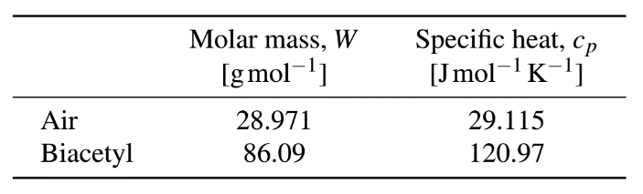
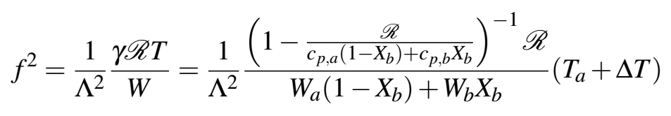
Detection of compositional waves with LITGS
Optical set-up
Introduction
Motivation
Background
Experiments
LITGS overview
Employed set-up
Measurements
CFD simulations
Procedure
Resulting flow-field
Comparisons
Sampling methods
Low-order modelling
Formulation
Application
Conclusions
355 nm laser wavelength
Biacetyl as absorber
LITGS is slightly intrusive
27/03/2018

Slide 7
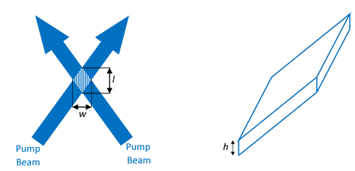
Detection of compositional waves with LITGS
Optical set-up
Introduction
Motivation
Background
Experiments
LITGS overview
Employed set-up
Measurements
CFD simulations
Procedure
Resulting flow-field
Comparisons
Sampling methods
Low-order modelling
Formulation
Application
Conclusions
Signal
1 GHz bandwidth
10 Gs/s
Acquisition window = 1 μs
Pump laser:
  0.5 mJ per pulse
  λ = 355 nm
Probe volume estimation
LITGS is slightly intrusive
Biacetyl as absorber
w = 1mm
l = 30 mm
h = 1 mm
Θ = 2.3°
Θ
27/03/2018

Slide 8
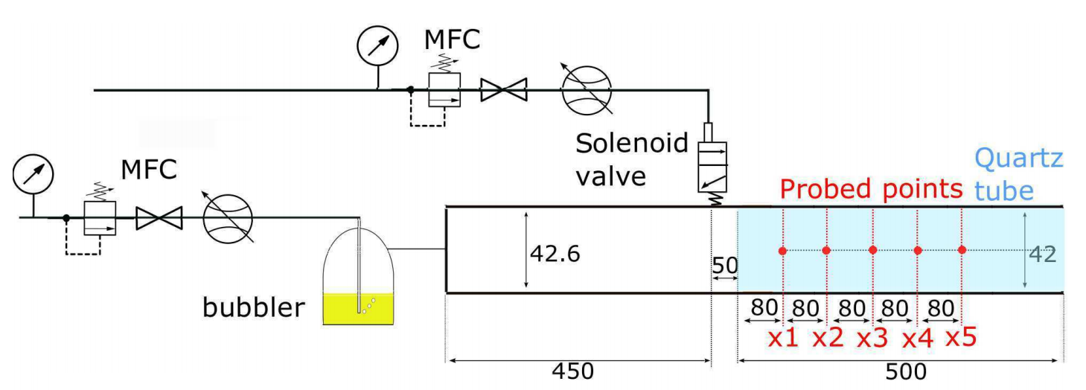
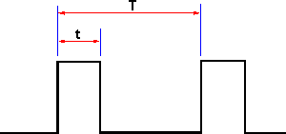

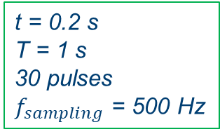
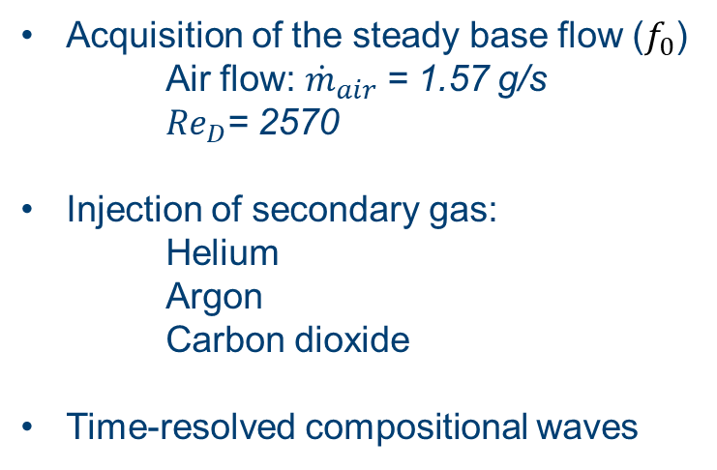
Detection of compositional waves with LITGS
Experimental set-up
Introduction
Motivation
Background
Experiments
LITGS overview
Employed set-up
Measurements
CFD simulations
Procedure
Resulting flow-field
Comparisons
Sampling methods
Low-order modelling
Formulation
Application
Conclusions
$$He, {CO}_{2}, Ar$$
Dimensions in mm, not to scale
air
Acquisition of the steady base flow ($f_{0}$)
Air flow:${ \dot{m}}_{air}$ = 1.57 g/s
${Re}_{D}$= 2570
Injection of secondary gas:
    Helium
    Argon
    Carbon dioxide
Time-resolved compositional waves
t = 0.2 s
T = 1 s
30 pulses
$f_{sampling}$ = 500 Hz
27/03/2018

Slide 9
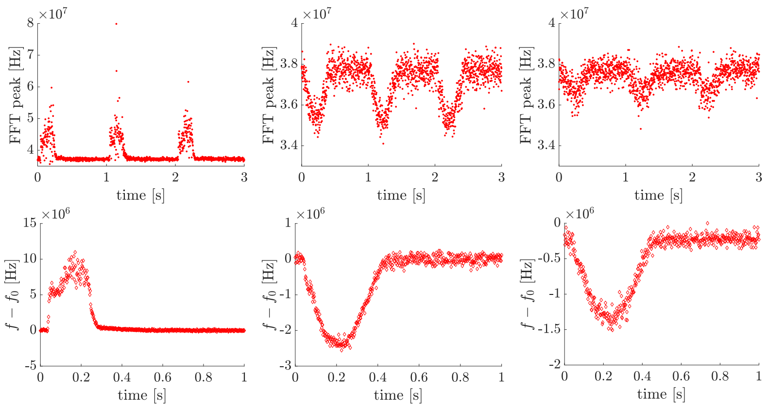



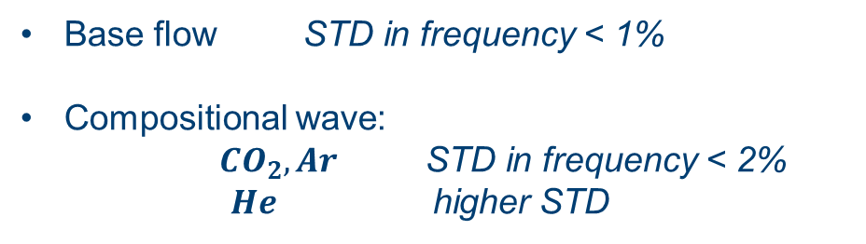
Detection of compositional waves with LITGS
Processing steps
Introduction
Motivation
Background
Experiments
LITGS overview
Employed set-up
Measurements
CFD simulations
Procedure
Resulting flow-field
Comparisons
Sampling methods
Low-order modelling
Formulation
Application
Conclusions
$$He$$
$${CO}_{2}$$
$$Ar$$
Base flow STD in frequency < 1%
Compositional wave:
  ${CO}_{2}, Ar$ STD in frequency < 2%
      $He$ higher STD
27/03/2018
Notes:
He - thermal conductivity one order of magnitude higher than air and other gases

Slide 10
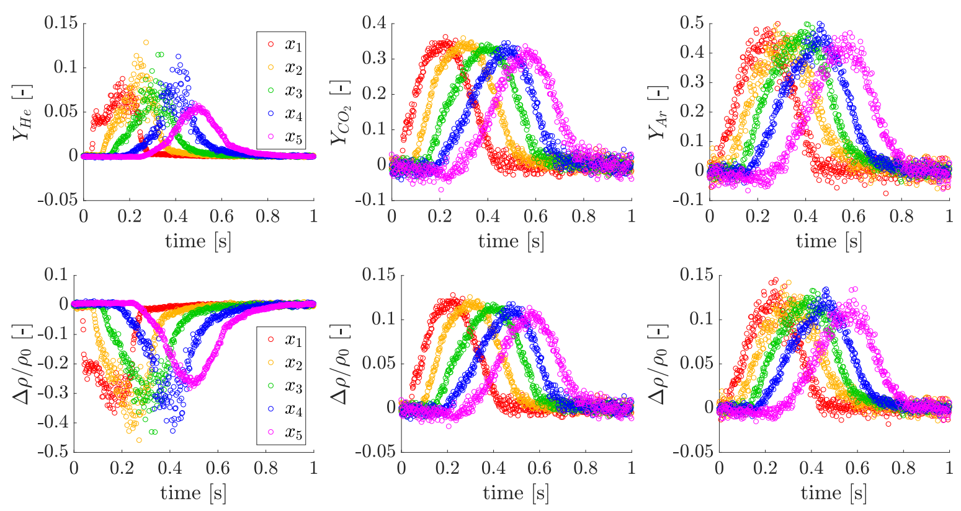
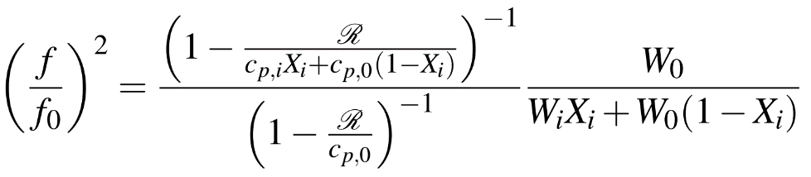
Detection of compositional waves with LITGS
Ensemble-averaged results (30 cycles)
Introduction
Motivation
Background
Experiments
LITGS overview
Employed set-up
Measurements
CFD simulations
Procedure
Resulting flow-field
Comparisons
Sampling methods
Low-order modelling
Formulation
Application
Conclusions
$$He$$
$${CO}_{2}$$
$$Ar$$
27/03/2018

Slide 11
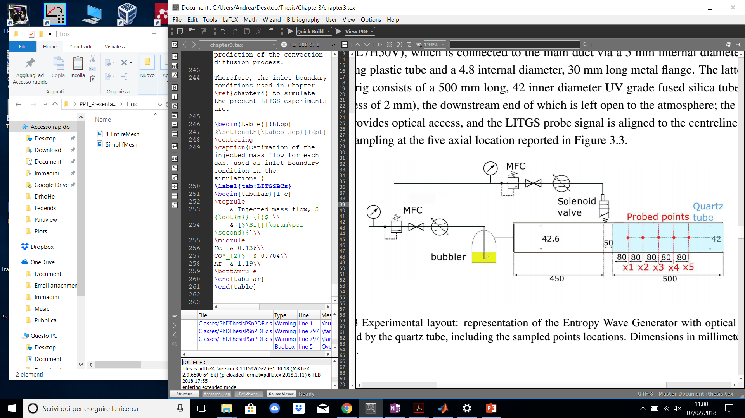
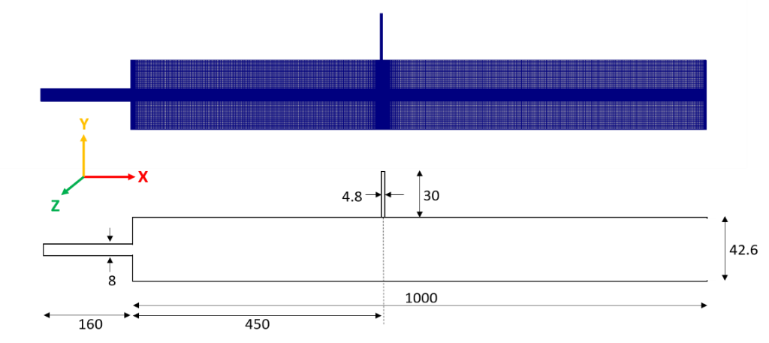
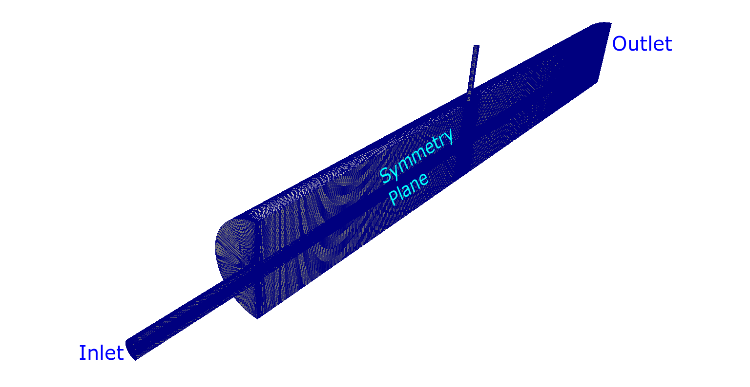
CFD simulations
Computational domain
Introduction
Motivation
Background
Experiments
LITGS overview
Employed set-up
Measurements
CFD simulations
Procedure
Resulting flow-field
Comparisons
Sampling methods
Low-order modelling
Formulation
Application
Conclusions
Geometry:
Autodesk Inventor
Mesh:
Ansys ICEM
CFD software:
OpenFOAM 4.x
URANS approach:
k-ω SST model
scalable wall functions
Dimensions in mm, not to scale
27/03/2018

Slide 12
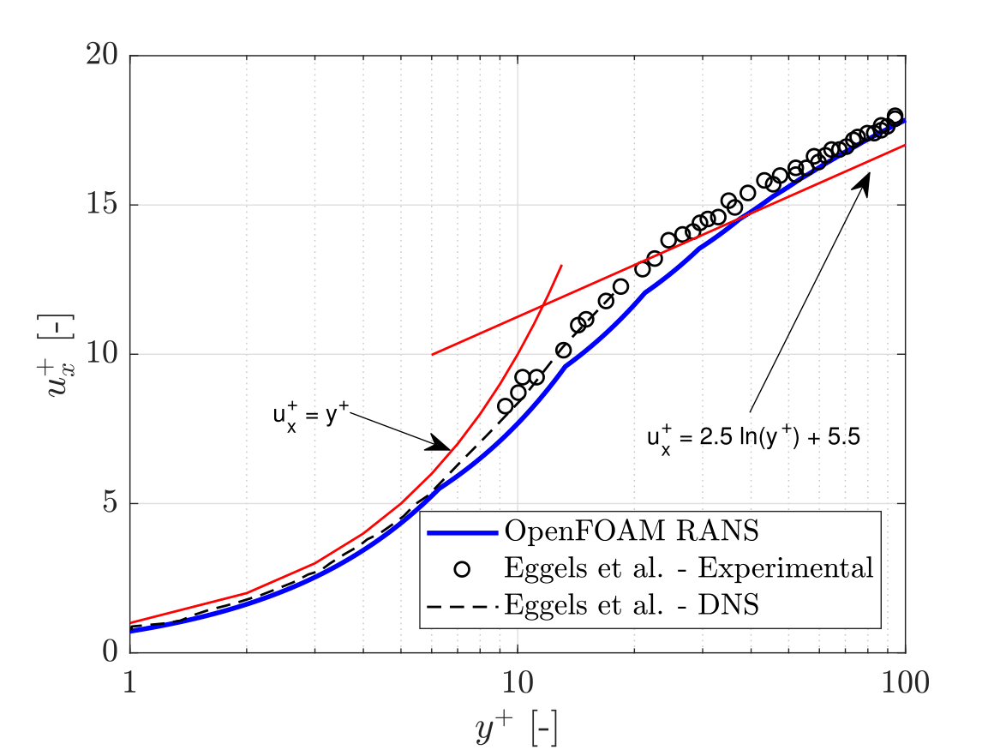
CFD simulations
Computational domain
Introduction
Motivation
Background
Experiments
LITGS overview
Employed set-up
Measurements
CFD simulations
Procedure
Resulting flow-field
Comparisons
Sampling methods
Low-order modelling
Formulation
Application
Conclusions
Geometry:
Autodesk Inventor
Mesh:
Ansys ICEM
CFD software:
OpenFOAM 4.x
URANS approach:
k-ω SST model
scalable wall functions
27/03/2018

Slide 13
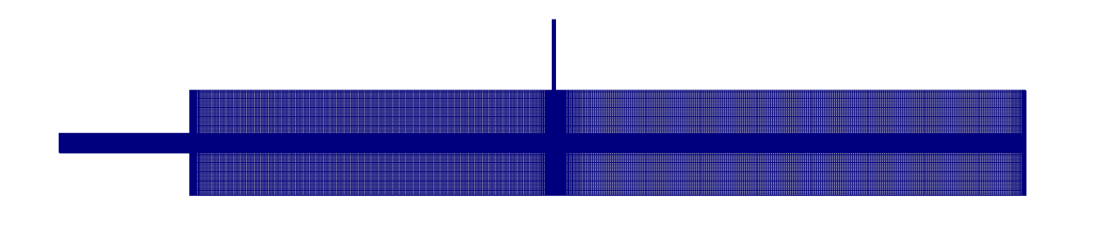
CFD simulations
Procedure
Introduction
Motivation
Background
Experiments
LITGS overview
Employed set-up
Measurements
CFD simulations
Procedure
Resulting flow-field
Comparisons
Sampling methods
Low-order modelling
Formulation
Application
Conclusions
Steady simulation of the main flow of air (1.57 g/s) in the entire geometry [rhoSimpleFoam]
air
27/03/2018

Slide 14
CFD simulations
Procedure
Introduction
Motivation
Background
Experiments
LITGS overview
Employed set-up
Measurements
CFD simulations
Procedure
Resulting flow-field
Comparisons
Sampling methods
Low-order modelling
Formulation
Application
Conclusions
Steady simulation of the main flow of air (1.57 g/s) in the entire geometry [rhoSimpleFoam]
Domain reduction
air
27/03/2018

Slide 15
CFD simulations
Procedure
Introduction
Motivation
Background
Experiments
LITGS overview
Employed set-up
Measurements
CFD simulations
Procedure
Resulting flow-field
Comparisons
Sampling methods
Low-order modelling
Formulation
Application
Conclusions
Steady simulation of the main flow of air (1.57 g/s) in the entire geometry [rhoSimpleFoam]
Domain reduction
New inlet boundary conditions, extracted from the previous solution
air
Sampled fields: u, k, ω
27/03/2018

Slide 16
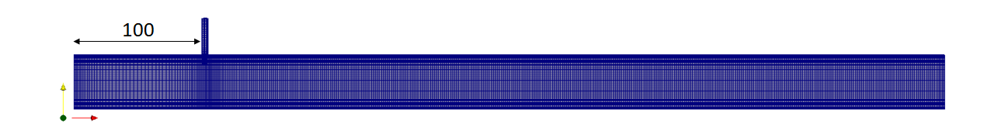
CFD simulations
Procedure
Introduction
Motivation
Background
Experiments
LITGS overview
Employed set-up
Measurements
CFD simulations
Procedure
Resulting flow-field
Comparisons
Sampling methods
Low-order modelling
Formulation
Application
Conclusions
Steady simulation of the main flow of air (1.57 g/s) in the entire geometry [rhoSimpleFoam]
Domain reduction
New inlet boundary conditions, extracted from the previous solution
Steady simulation of the simplified geometry [rhoSimpleFoam]
Air:
New BCs
27/03/2018

Slide 17
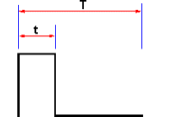
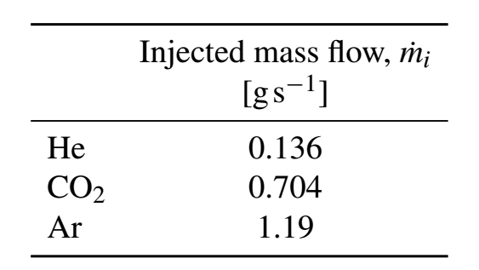

CFD simulations
Procedure
Introduction
Motivation
Background
Experiments
LITGS overview
Employed set-up
Measurements
CFD simulations
Procedure
Resulting flow-field
Comparisons
Sampling methods
Low-order modelling
Formulation
Application
Conclusions
Steady simulation of the main flow of air (1.57 g/s) in the entire geometry [rhoSimpleFoam]
Domain reduction
New inlet boundary conditions, extracted from the previous solution
Steady simulation of the simplified geometry [rhoSimpleFoam]
Transient injection of compositional spots [reactingFoam]
$$He, {CO}_{2}, Ar$$
t = 0.2 s
T = 1 s
Air:
New BCs
27/03/2018

Slide 18
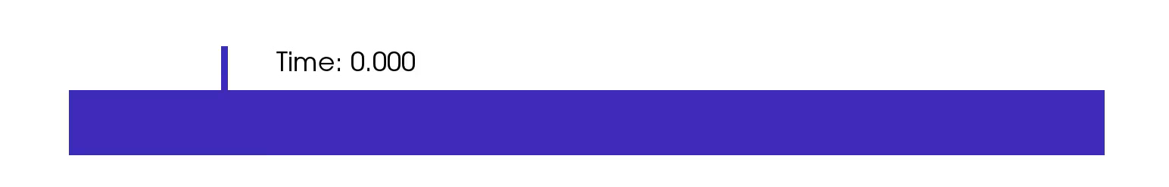
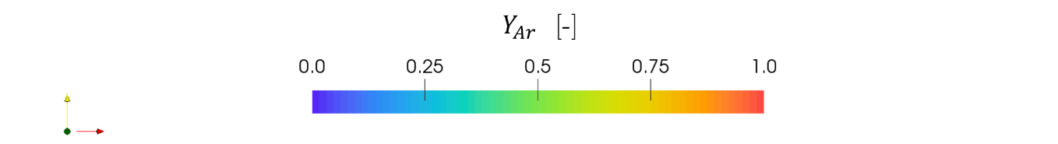
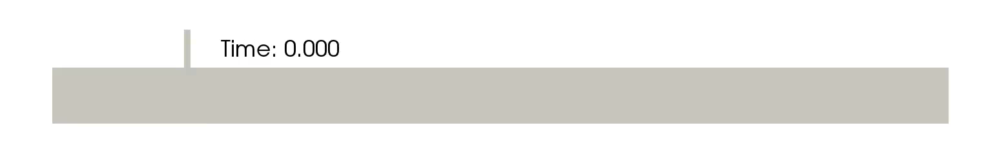
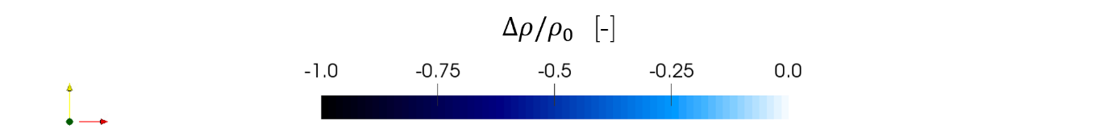


CFD simulations
Resulting flow-field: spot advection
Introduction
Motivation
Background
Experiments
LITGS overview
Employed set-up
Measurements
CFD simulations
Procedure
Resulting flow-field
Comparisons
Sampling methods
Low-order modelling
Formulation
Application
Conclusions
$$Ar$$
(Mass fraction)
$$He$$
(Density variation)
27/03/2018

Slide 19
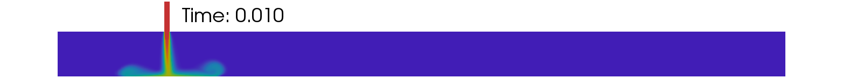
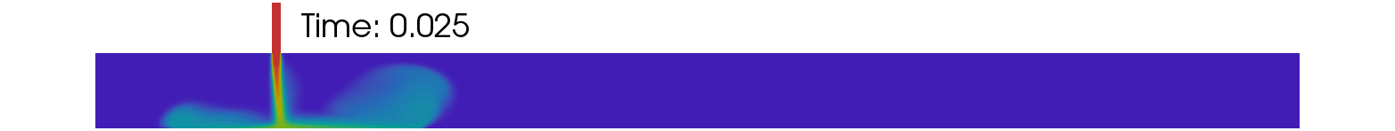
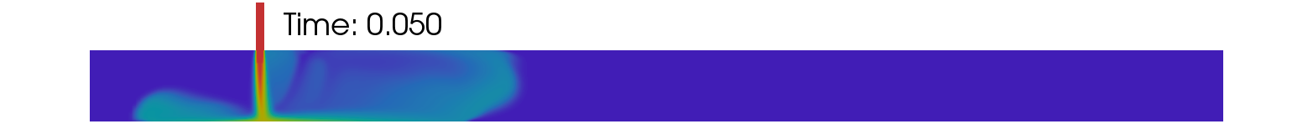
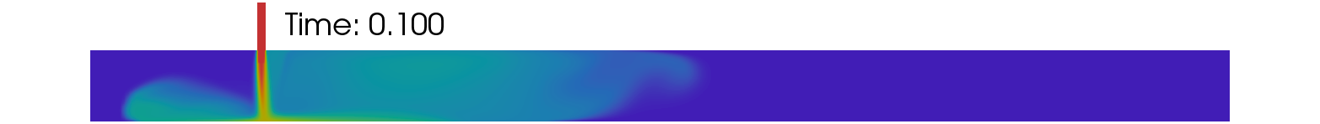
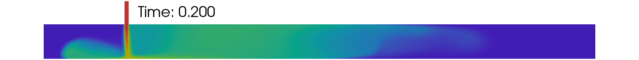
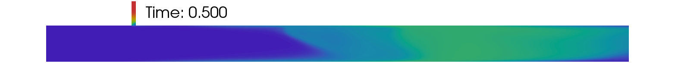
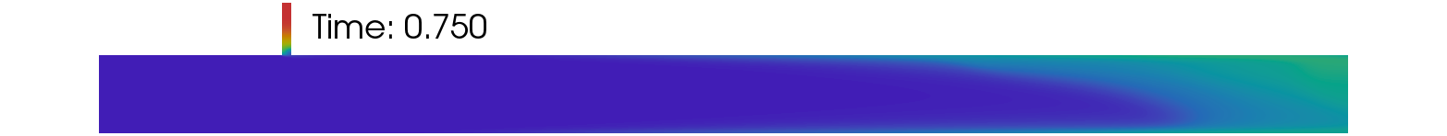
CFD simulations
Resulting flow-field: Argon wave advection
Introduction
Motivation
Background
Experiments
LITGS overview
Employed set-up
Measurements
CFD simulations
Procedure
Resulting flow-field
Comparisons
Sampling methods
Low-order modelling
Formulation
Application
Conclusions
27/03/2018

Slide 20
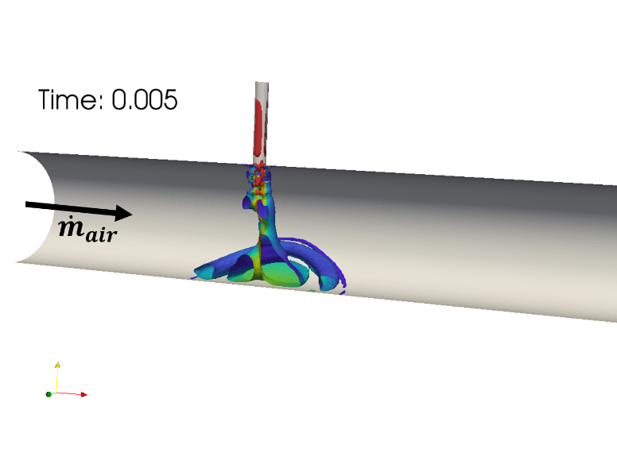
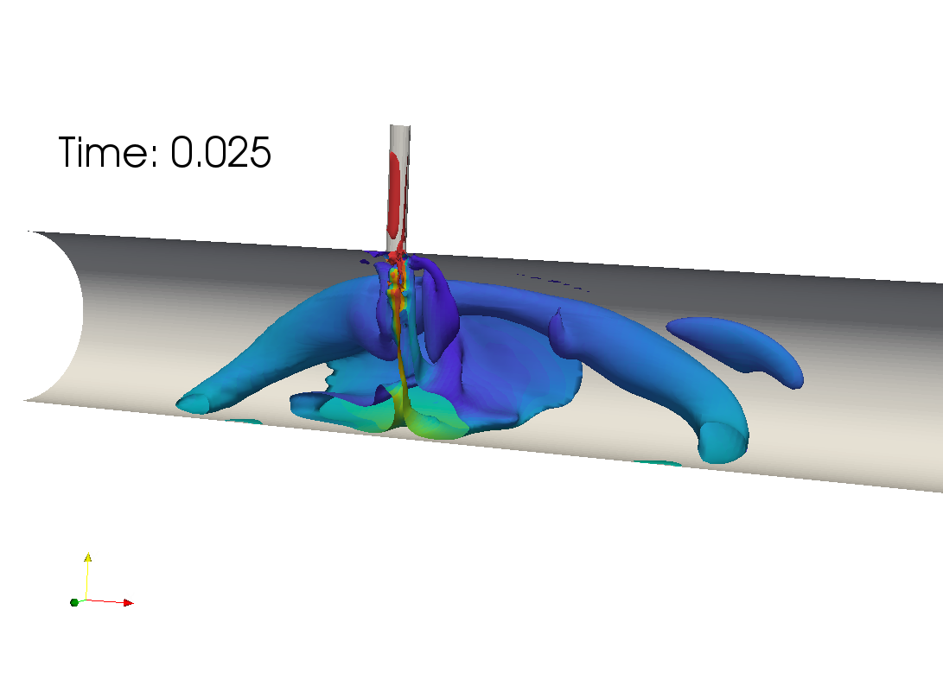
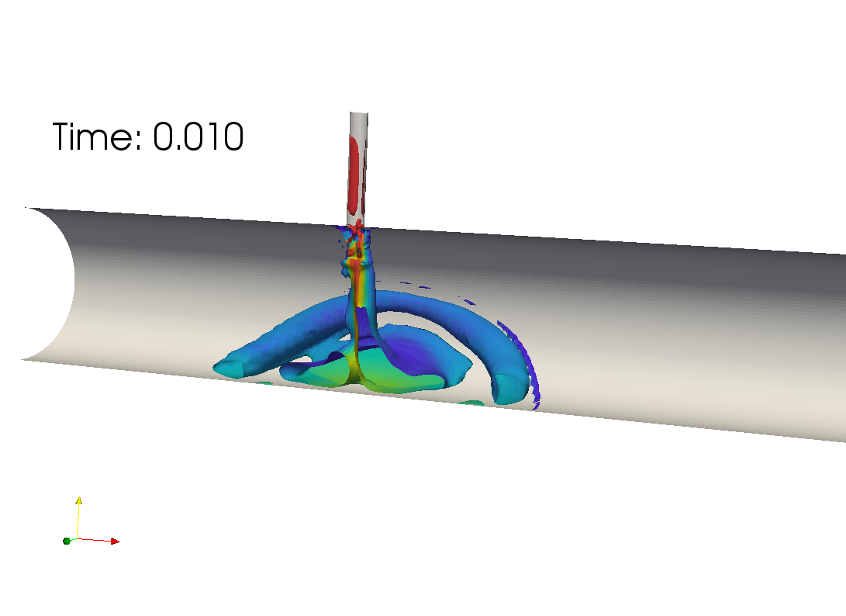
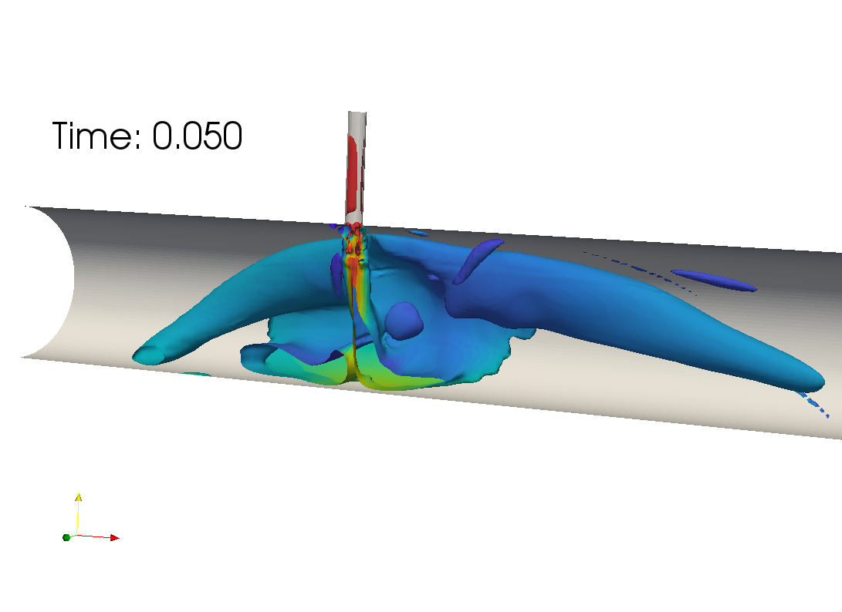
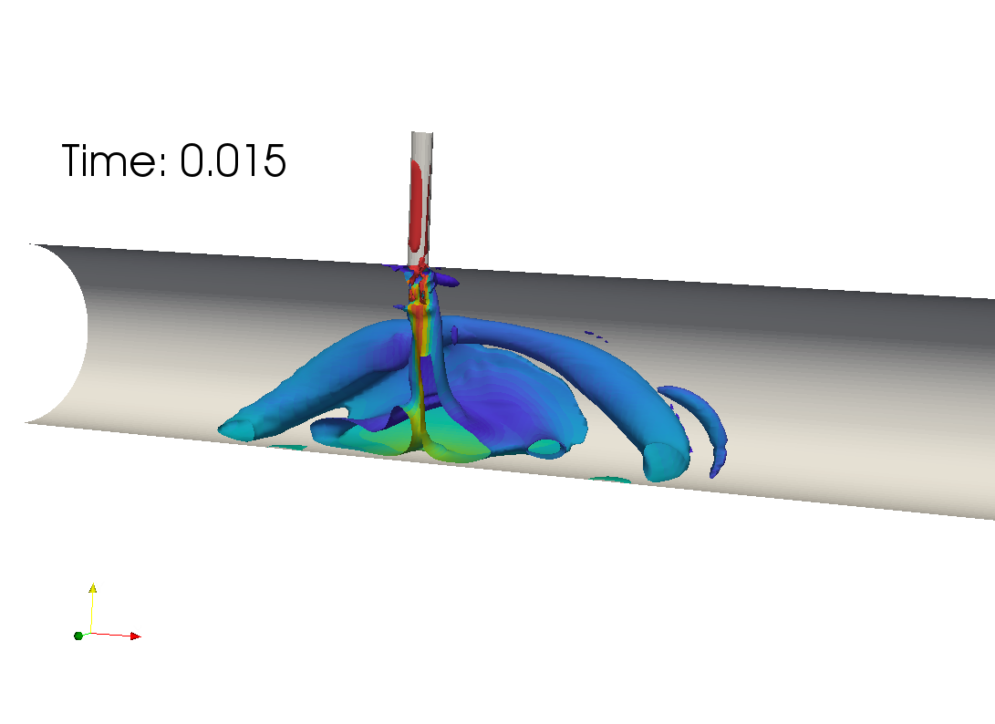

CFD simulations
Resulting flow-field: focus on the injection
Introduction
Motivation
Background
Experiments
LITGS overview
Employed set-up
Measurements
CFD simulations
Procedure
Resulting flow-field
Comparisons
Sampling methods
Low-order modelling
Formulation
Application
Conclusions
Iso-Q criterion surfaces (50000 $s^{−2}$) coloured by Ar mass fraction
Wall vortex expands and gets convected
Vortex breaking
27/03/2018

Slide 21




CFD simulations
Schmidt number modification in reactingFoam
Introduction
Motivation
Background
Experiments
LITGS overview
Employed set-up
Measurements
CFD simulations
Procedure
Resulting flow-field
Comparisons
Sampling methods
Low-order modelling
Formulation
Application
Conclusions
reactingFoam species equation:
Implicit assumption of unitary Schmidt numbers (laminar and turbulent)
Modified-reactingFoam species equation:
From binary diffusion coefficients with respect to air
Wolfram (2017). Wolfram CDF Player. https://www.wolfram.com/cdf-player/.
${Pr}_{turb}$ = 0.7
27/03/2018

Slide 22



CFD simulations
Comparison with LITGS
Introduction
Motivation
Background
Experiments
LITGS overview
Employed set-up
Measurements
CFD simulations
Procedure
Resulting flow-field
Comparisons
Sampling methods
Low-order modelling
Formulation
Application
Conclusions
$${CO}_{2}$$
Radial impingement effect
( ) standard reactingFoam
( ) modified reactingFoam
( dots ) LITGS
No differences between the two solvers
Agreement in shape
Slight mismatch in peak values
The convection-diffusion process is well captured
27/03/2018

Slide 23



CFD simulations
Comparison with LITGS
Introduction
Motivation
Background
Experiments
LITGS overview
Employed set-up
Measurements
CFD simulations
Procedure
Resulting flow-field
Comparisons
Sampling methods
Low-order modelling
Formulation
Application
Conclusions
$$Ar$$
( ) standard reactingFoam
( ) modified reactingFoam
( dots ) LITGS
Every characteristic of the wave is well predicted
27/03/2018

Slide 24



CFD simulations
Comparison with LITGS
Introduction
Motivation
Background
Experiments
LITGS overview
Employed set-up
Measurements
CFD simulations
Procedure
Resulting flow-field
Comparisons
Sampling methods
Low-order modelling
Formulation
Application
Conclusions
$$He$$
Minimal differences in diffusion appear
( ) standard reactingFoam
( ) modified reactingFoam
( dots ) LITGS
Worst agreement of the set
Not due to the diffusion model
27/03/2018

Slide 25


CFD simulations
Effects of the sampling method
Introduction
Motivation
Background
Experiments
LITGS overview
Employed set-up
Measurements
CFD simulations
Procedure
Resulting flow-field
Comparisons
Sampling methods
Low-order modelling
Formulation
Application
Conclusions
Why? LITGS spatial resolution
Spatial average of CFD results along radial direction
mm
mm
27/03/2018

Slide 26

CFD simulations
Effects of the sampling method: reactingFoam results for Ar
Introduction
Motivation
Background
Experiments
LITGS overview
Employed set-up
Measurements
CFD simulations
Procedure
Resulting flow-field
Comparisons
Sampling methods
Low-order modelling
Formulation
Application
Conclusions
$$Ar$$
( ) punctual
( ) average on 15 mm
Radial impingement effects are reduced
The traces overlap LITGS resolution is not affecting results
27/03/2018

Slide 27


CFD simulations
Effects of the sampling method: reactingFoam results for Ar
Introduction
Motivation
Background
Experiments
LITGS overview
Employed set-up
Measurements
CFD simulations
Procedure
Resulting flow-field
Comparisons
Sampling methods
Low-order modelling
Formulation
Application
Conclusions
$$Ar$$
( ) punctual
( ) mass flow average
( ) average on radius
( ) area average
The problem can be approximated as one-dimensional, but…
…the differential convection cannot be neglected
27/03/2018

Slide 28





Low-order modelling
Formulation: 1D transport model for $Y_{i}$
Introduction
Motivation
Background
Experiments
LITGS overview
Employed set-up
Measurements
CFD simulations
Procedure
Resulting flow-field
Comparisons
Sampling methods
Low-order modelling
Formulation
Application
Conclusions
CFD proved that neither molecular nor turbulent diffusion are relevant
Inclusion of differential convection effects in a cylindrical duct (axisymmetric)
Considered in the frequency domain
The BC is constant over the radius
Mass flow average
27/03/2018

Slide 29
Low-order modelling
Formulation: 1D transport model for $Y_{i}$
Introduction
Motivation
Background
Experiments
LITGS overview
Employed set-up
Measurements
CFD simulations
Procedure
Resulting flow-field
Comparisons
Sampling methods
Low-order modelling
Formulation
Application
Conclusions
27/03/2018

Slide 30

Low-order modelling
Formulation: 1D transport model for $Y_{i}$
Introduction
Motivation
Background
Experiments
LITGS overview
Employed set-up
Measurements
CFD simulations
Procedure
Resulting flow-field
Comparisons
Sampling methods
Low-order modelling
Formulation
Application
Conclusions
Extracted from steady simulations
The first LITGS trace is used as input for the model
Differential convection
27/03/2018

Slide 31







Low-order modelling
Application and comparison with LITGS
Introduction
Motivation
Background
Experiments
LITGS overview
Employed set-up
Measurements
CFD simulations
Procedure
Resulting flow-field
Comparisons
Sampling methods
Low-order modelling
Formulation
Application
Conclusions
$$He$$
$Y_{i,0}$ = First LITGS signal (smoothed)
( ) mass flow average
( ) area average
$${CO}_{2}$$
$$Ar$$
27/03/2018

Slide 32

Conclusions
Introduction
Motivation
Background
Experiments
LITGS overview
Employed set-up
Measurements
CFD simulations
Procedure
Resulting flow-field
Comparisons
Sampling methods
Low-order modelling
Formulation
Application
Conclusions
LITGS was successfully applied to detect unsteady compositional waves
Further work on the experimental set-up is advised to improve accuracy ($He$case)
OpenFOAM, and specifically the solver reactingFoam, produced results in good agreement with experiments for the $Ar$ and ${CO}_{2}$ cases
CFD results show that the spatial resolution of LITGS did not affect the measurements
CFD results also suggest that the wave diffusion is governed by the shear dispersion mechanism
This is confirmed by a 1D transport model
27/03/2018

Slide 33
Thanks for your attention

