Slide 1


Physical analysis of the electroactive morphing effects around a supercritical wing at high Reynolds number by means of High-Speed PIV
Supervised by:
Prof. Alessandro Bottaro
Dr. Marianna Braza (IMFT)
Dr. Johannes Scheller (IMFT)
Author:
Marco Tonarelli

Slide 2
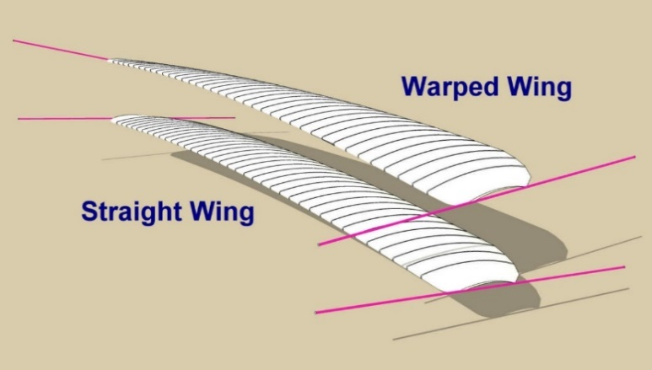
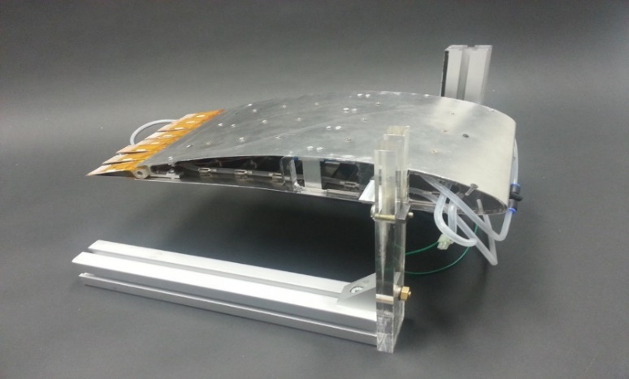

Introduction
Next-generation electroactive morphing wing design
  Today fixed-wings are designed with discrete control surfaces like flaps and slats, with poor aerodynamic performances
  The idea of morphing wing is far from new. In 1903, the Wright brothers developed the idea of wing warping, which used pulleys and cables to warp the fabric of the wings to provide roll control
  The technique was then abandoned as soon as metals substituted fabric
  Today the develop of morphing wing is possible by using Smart Material

Slide 3
Next-generation electroactive morphing wing design
Morphing wing goals
  Reduction of drag & noise
  Real-time control of lift to drag ratio
Control of the wing shape in function of the mission profile
  Low frequency large amplitude actuation via SMAs
  Modification of the higher frequency aerodynamic phenomena
  High frequency low amplitude actuation via MFCs

Slide 4
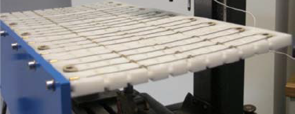

Smart Material
Shape memory alloys (SMAs)
Class of metallic materials with the ability to recover their original shape after being heated
They are characterized by thermo-mechanical coupling in which heating induces a phase transformation of the crystalline structure of the materials
(solid state phase transformation Austenite → Martensite)
Nichel-Titanium SMA wires allow 200 MPa stress and 10% strain

Slide 5
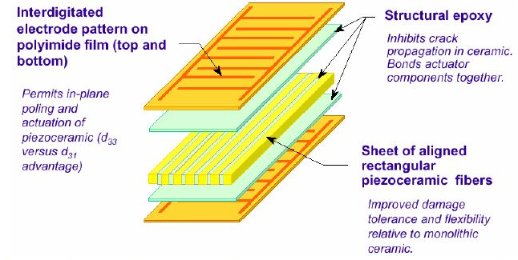
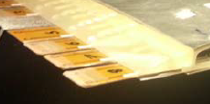
Smart Material
Piezoelectric materials
Deformation of the material when exposed to an electric field
Macro Fiber composite (MFC), rectangular piezo ceramic rods sandwiched between layers of adhesive, electrodes and polyimide film
Offering high performance, flexibility and reliability

Slide 6
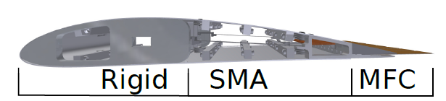
Hybrid airfoil design
Rigid leading edge
Surface embedded SMAs wires
MFCs trailing edge
Airflow
Quasi-static real-time camber control
High frequency vibrating trailing edge (up to 100 Hz)
Electroactive materials
Shape memory alloy SMA – NiTi wires
Piezoelectric macro fibre composite MFC

Slide 7
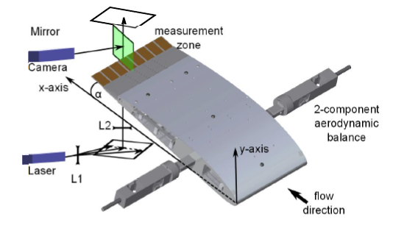
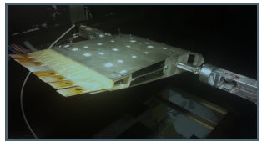
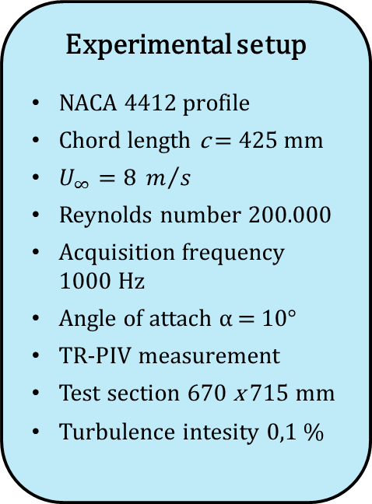
Experimental setup
Experimental setup
NACA 4412 profile
Chord length c = 425 mm
$U_{∞}=8 m/s$
Reynolds number 200.000
Acquisition frequency 1000 Hz
Angle of attach α = 10°
TR-PIV measurement
Test section 670 x 715 mm
Turbulence intesity 0,1 %
Surface embedded
SMAs
MFCs trailing edge
Aerodynamic balance

Slide 8
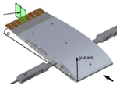
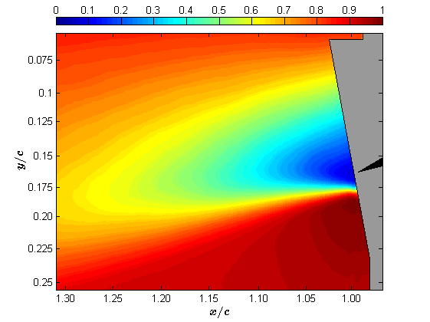
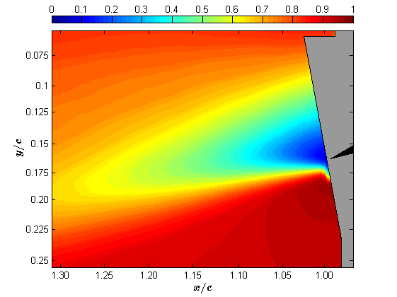
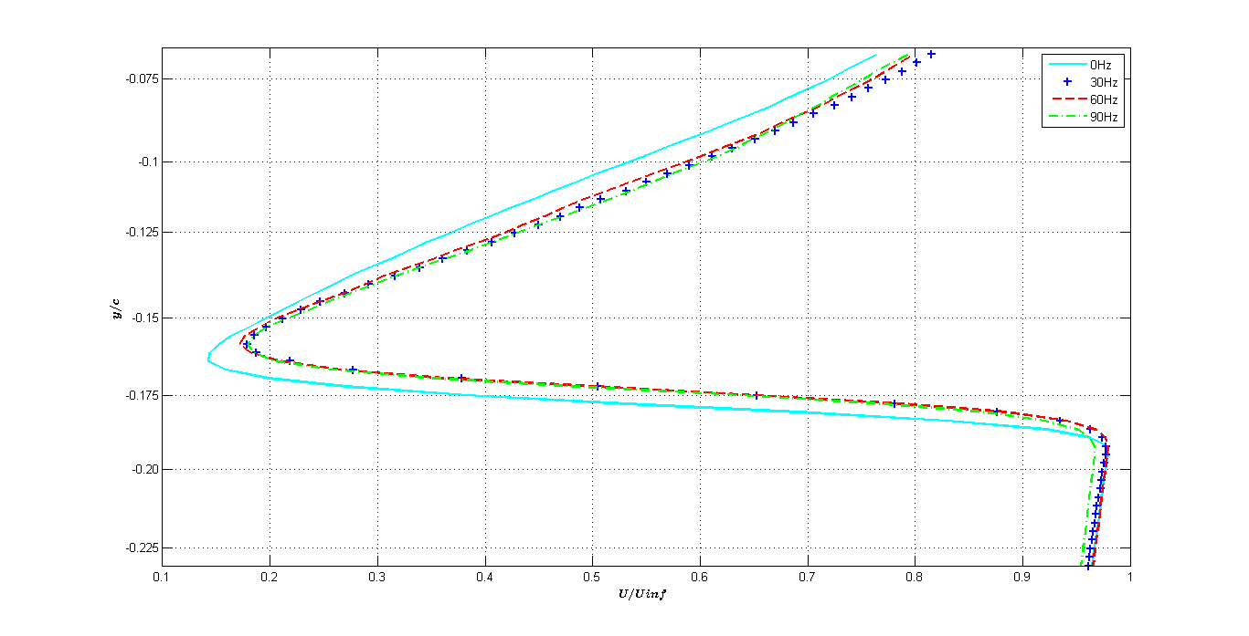
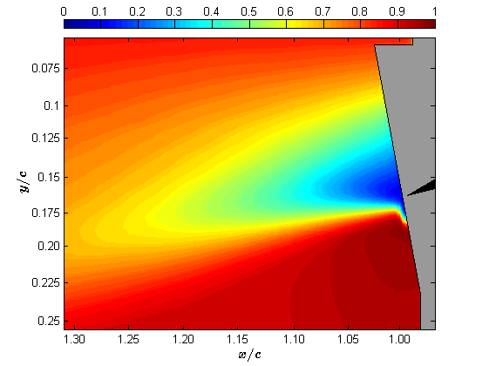
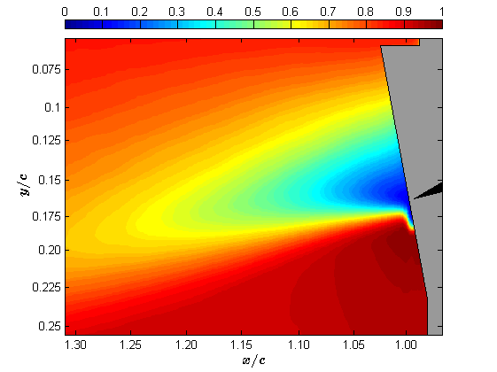
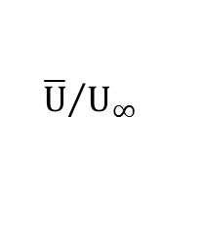
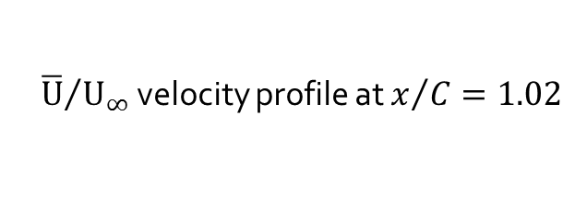
High frequency trailing edge actuation
Time average of the longitudinal U velocity components
normalized by the freestream velocity
0 Hz
30 Hz
$${\overline{U}}/{U_{∞}}$$
60 Hz
90 Hz
${\overline{U}}/{U_{∞}}$ velocity profile at $x/C=1.02$

Slide 9
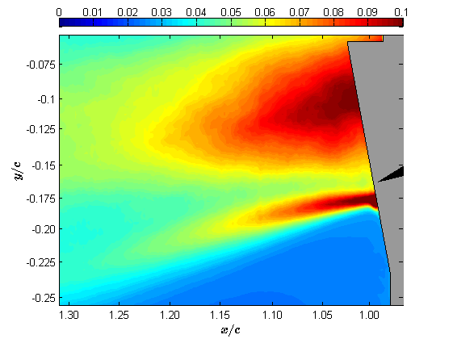
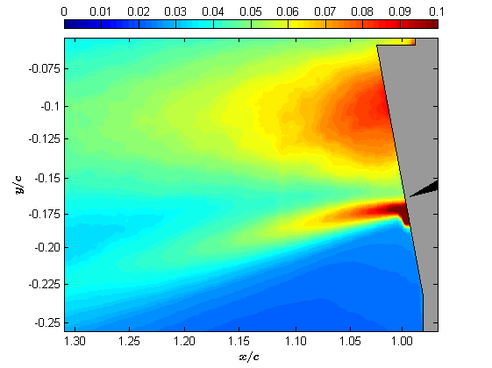
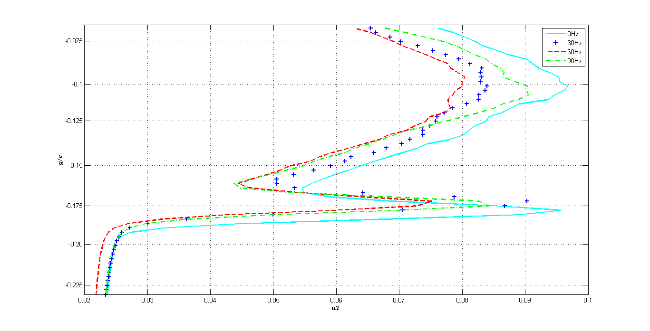
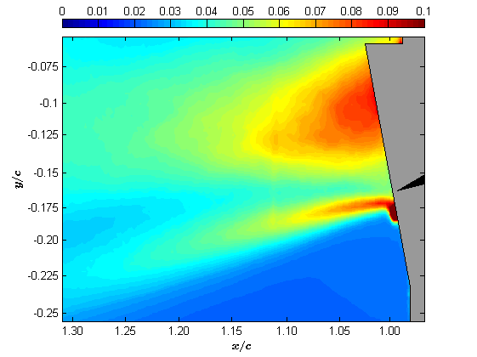
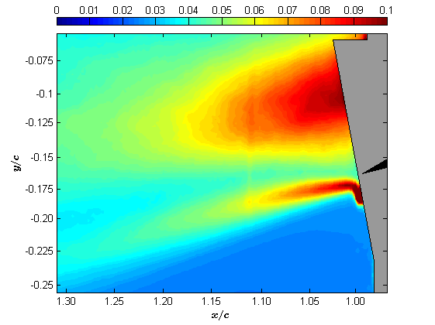
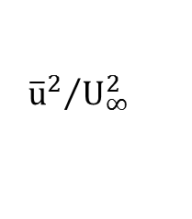
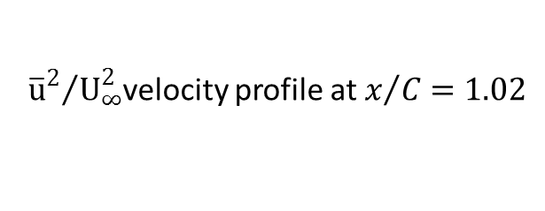
High frequency trailing edge actuation
Time-averaged Reynold stress field of the u² component
0 Hz
30 Hz
$${{\overline{u}}^{2}}/{U_{∞}^{2}}$$
60 Hz
90 Hz
${{\overline{u}}^{2}}/{U_{∞}^{2}}$velocity profile at $x/C=1.02$

Slide 10
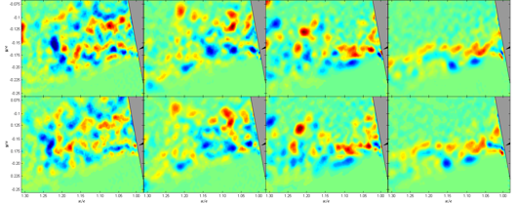
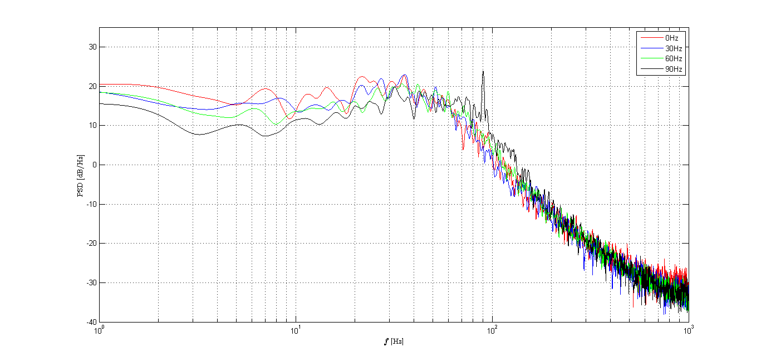
High frequency trailing edge actuation
Sequence of instantaneous vortex motion ∆t=0.005
Vortical structures are reduced with the increasing of actuation frequency
The overall energy density level is reduced for the actuation frequencies 30 Hz and 60 Hz whereas for 90 Hz actuation the energy level is increased

Slide 11


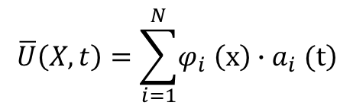
High frequency trailing edge actuation
Proper orthogonal decomposition (POD) method:
POD is a procedure for extracting a basis for a modal decomposition from an ensemble of signals
decompose the flow in coherent structures embedded within the flow or events containing the majority of the information describing the physics of the flow
reduce a large number of interdependent variables to a much smaller number of uncorrelated variables
$$\overline{U}\left(X,t\right)=\sum_{i=1}^{N}{\left.φ_{i} \left(x\right)∙a_{i} (t\right)}$$
$$φ_{i}=spatial modes$$
$$a_{i}=temporal modes$$

Slide 12
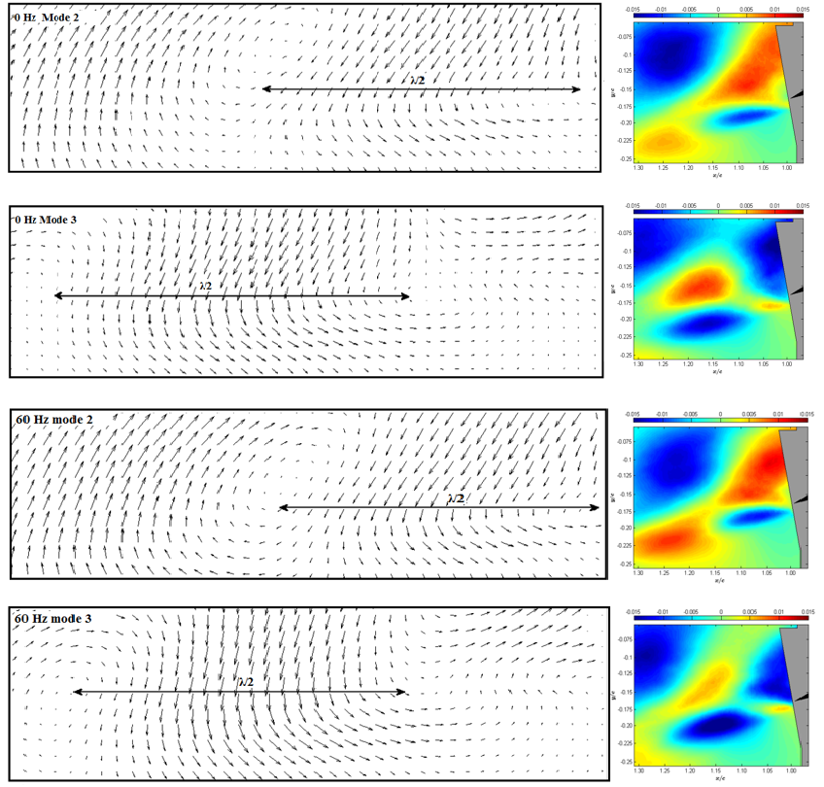
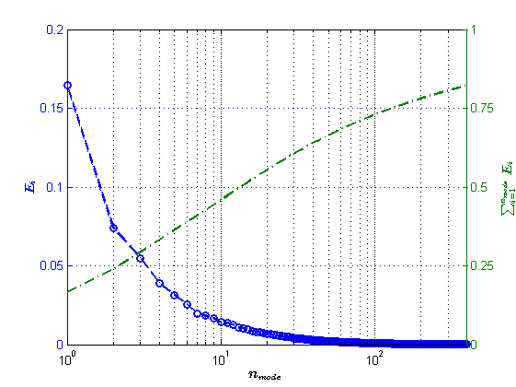
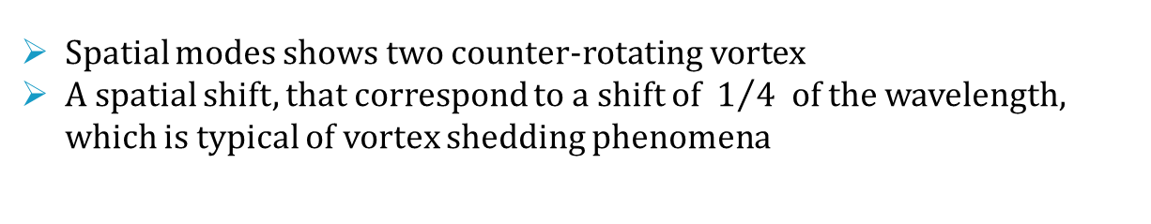
High frequency trailing edge actuation
Proper orthogonal decomposition (POD) analysis
Comparing of the second and third POD modes vector field (0 Hz top, 60 Hz bottom)
Energy of POD modes
Spatial modes shows two counter-rotating vortex
A spatial shift, that correspond to a shift of $1/4$ of the wavelength, which is typical of vortex shedding phenomena

Slide 13
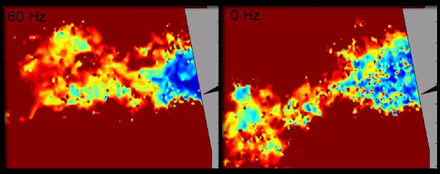
High frequency trailing edge actuation
Instantaneous velocity field
Wake size reduction
Vortex breakdown

Slide 14
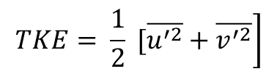
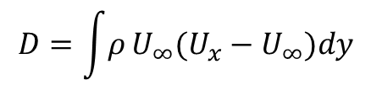
Results
High frequency trailing edge actuation
Actuation frequency | 30 Hz | 60 Hz | 90 Hz
Shape Drag reduction compared to the static case | 17% | 20 % | 10 %
TKE reduction compared to the static case | 12 % | 16 % | 10 %
Shape drag by calculating the momentum loss in the wake
$$D=\int{ρ}U_{∞}(U_{x}−U_{∞})dy$$
Turbulent kinetic energy
$$\left.TKE= \frac{1}{2} [\overline{u^{′2}}+\overline{v^{′2}}\right]$$

Slide 15
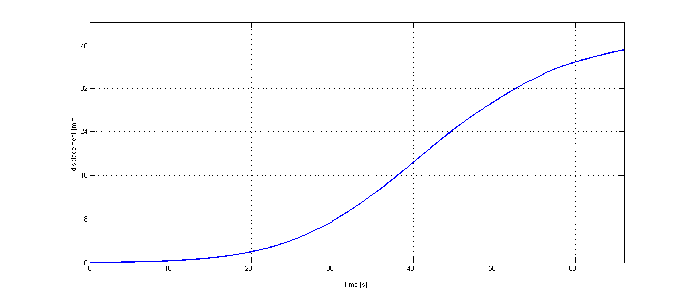
Low frequency camber actuation
SMA large-amplitude actuation with trailing edge at 60 Hz
Trailing edge displacement
The trailing edge displacement is tracked by PIV image
SMAs are activated via Joule effect, using a 8A current pulse triggered at the beginning of the measurement
Trailing edge displacement up to 40 mm after ≈ 60 s

Slide 16
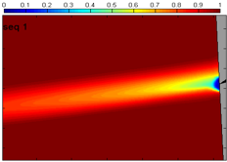
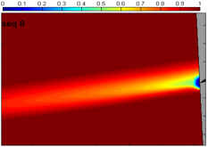
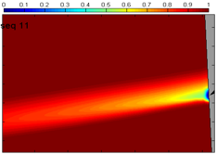
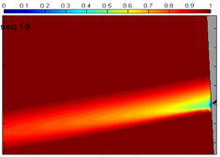
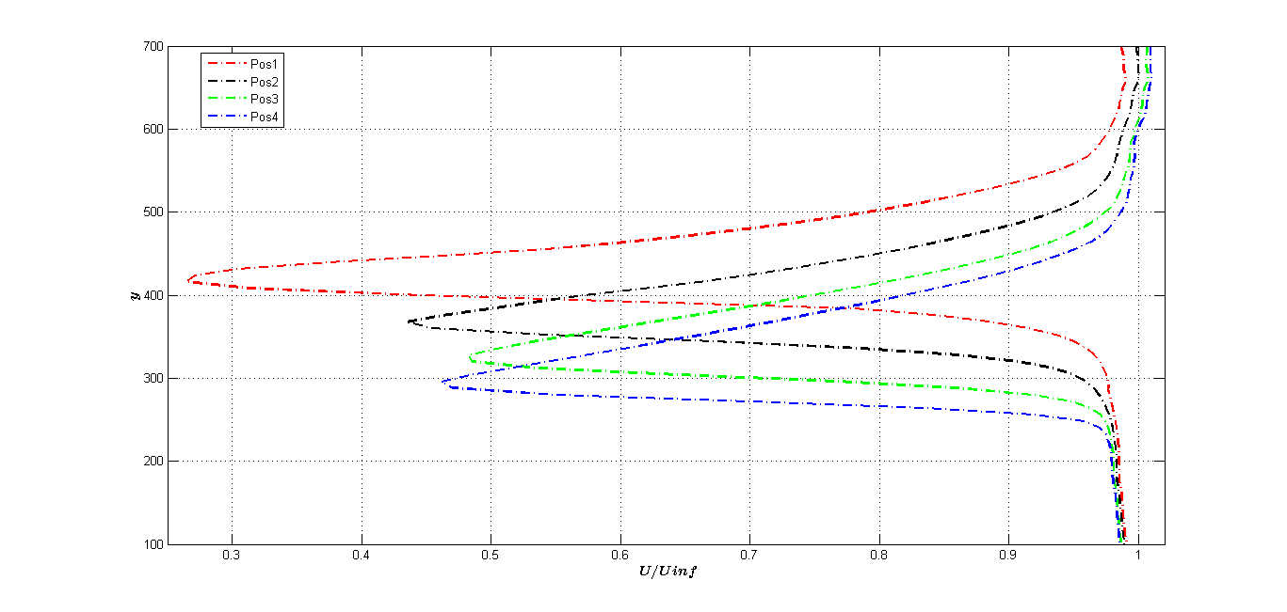
Low frequency camber actuation
SMA large-amplitude actuation with trailing edge at 60 Hz
Phase-averaged longitudinal U velocity components normalized by the freestream velocity
Wake size reduction caused by dynamic actuation of the trailing edge

Slide 17
Conclusions
Actuation performance evaluation
  An optimum trailing edge actuation frequency has been identified at 60 Hz for Reynolds number 200,000
  Possibility to simultaneously actuate the prototype at low frequencies (order of ≈ 0.1 Hz by SMAs) and higher frequency vibration (order of ≈ 100 Hz by MFCs)
  Deformation abilities of the low frequency SMAs actuation under realistic aerodynamic loads was demonstrated

Slide 18
Conclusions
Electroactive morphing wing prototype goals
Wake size reduction
Shape drag reduction
Reduction of the overall energy
density and TKE
Reduction of the aerodynamic noise
Real-time camber control
under aerodynamic forces
Real time lift control

Slide 19
Grazie per l’attenzione

