Slide 1

Characterization of Secondary Air Circuits in a Gas Turbine Engine
In Collaboration with
Valerio Lanata
29/03/2019

Slide 2
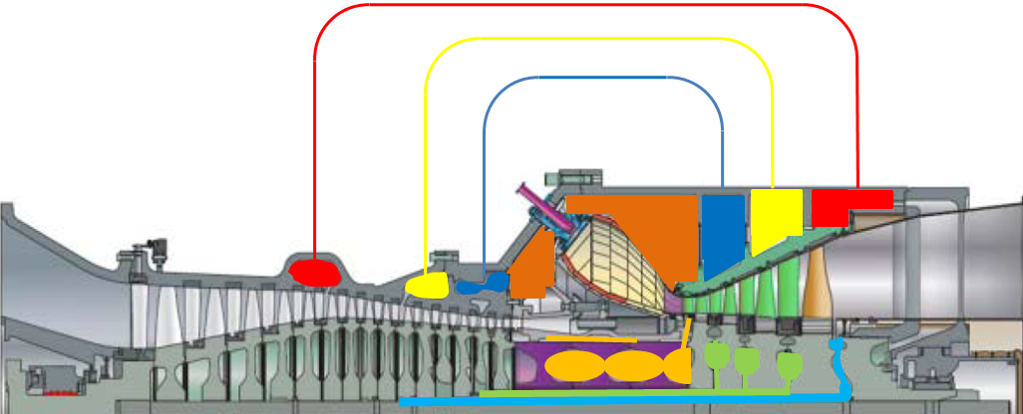
Secondary Air System
Characterization of Secondary Air Circuits in a Gas Turbine
Under the name of Secondary Air System goes all those flows that do not actively take part in producing useful work
These air flow rates are used to perform different tasks such as the cooling of turbine and combustion chamber elements, sealing, clearance controls.
EC3
EC3
EC2
EC1
EC4
EC1
EC2
IC1
IC2
IC3
Valerio Lanata - DIME

Slide 3
Similarity Theory
Characterization of Secondary Air Circuits in a Gas Turbine
Given two circuits geometrically similar, the similarity theory:
permits to reduce the number of parameters that control the problem
characterize the dependence of the system on particular combinations of the original dimensional parameters
For the same value of the reduced parameters, similarity rules and the solution of a geometrically similar problem can be rescaled from a known solution
Valerio Lanata - DIME

Slide 4
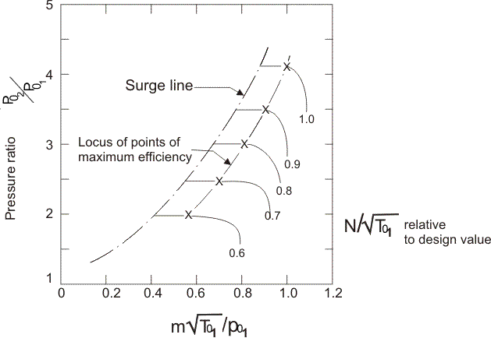
The Characteristic Curve
Characterization of Secondary Air Circuits in a Gas Turbine
Applying the similarity theory it is possible to derive an analytical relation between the dimensionless parameters involved in the problem solution
This function, that allows to correlate the performances of the machine, also in operating conditions different from the nominal one, is called characteristic curve
Valerio Lanata - DIME

Slide 5
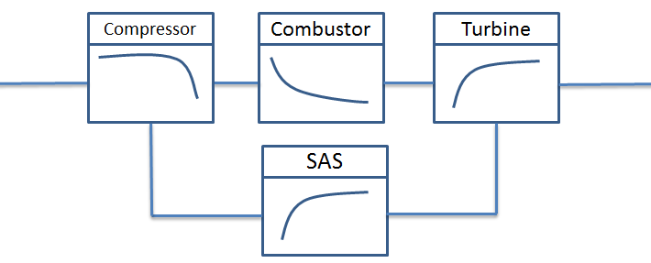
Characteristics’ Method Application
Characterization of Secondary Air Circuits in a Gas Turbine
The SAS characteristic curves have to be matched with the compressor and turbine curves because these components govern the boundary conditions of the SAS circuits
To generate the characteristic curves a 0D fluid network has been used to obtain the values of mass flow rate, pressure and temperature along the SAS circuit, for a fixed set of boundary conditions
Valerio Lanata - DIME

Slide 6

Characteristics’ Method Application
Characterization of Secondary Air Circuits in a Gas Turbine
The values of mass flow rate, pressure and temperature for 6 different sets of boundary conditions have been used to generate the dimensionless values of mass flow rate and pressure ratio:
${\dot{m}}_{adim}≡\frac{\dot{m}}{p_{i}}\frac{\sqrt{RT_{i}^{ }}}{A_{i}}$ $β_{ }≡\left(\frac{p_{i}}{p_{j}}\right)$
Valerio Lanata - DIME

Slide 7
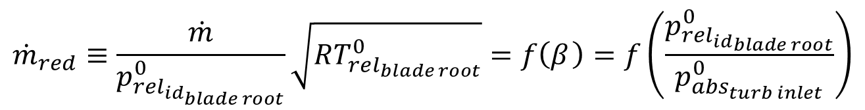
Characteristics’ Method Application
Characterization of Secondary Air Circuits in a Gas Turbine
The reference pressures and temperatures for the scaling have been selected to obtain values of reduced mass flow rate and pressure ratio univocally defined from the compressor and turbine working points
$${\dot{m}}_{red}≡\frac{\dot{m}}{p_{rel_{id_{blade root}}}^{0}}\sqrt{RT_{rel_{blade root}}^{0}}=f\left(β_{ }\right)=f\left(\frac{p_{re{l_{id}}_{blade root}}^{0}}{p_{abs_{turb inlet}}^{0}}\right)$$
Valerio Lanata - DIME

Slide 8
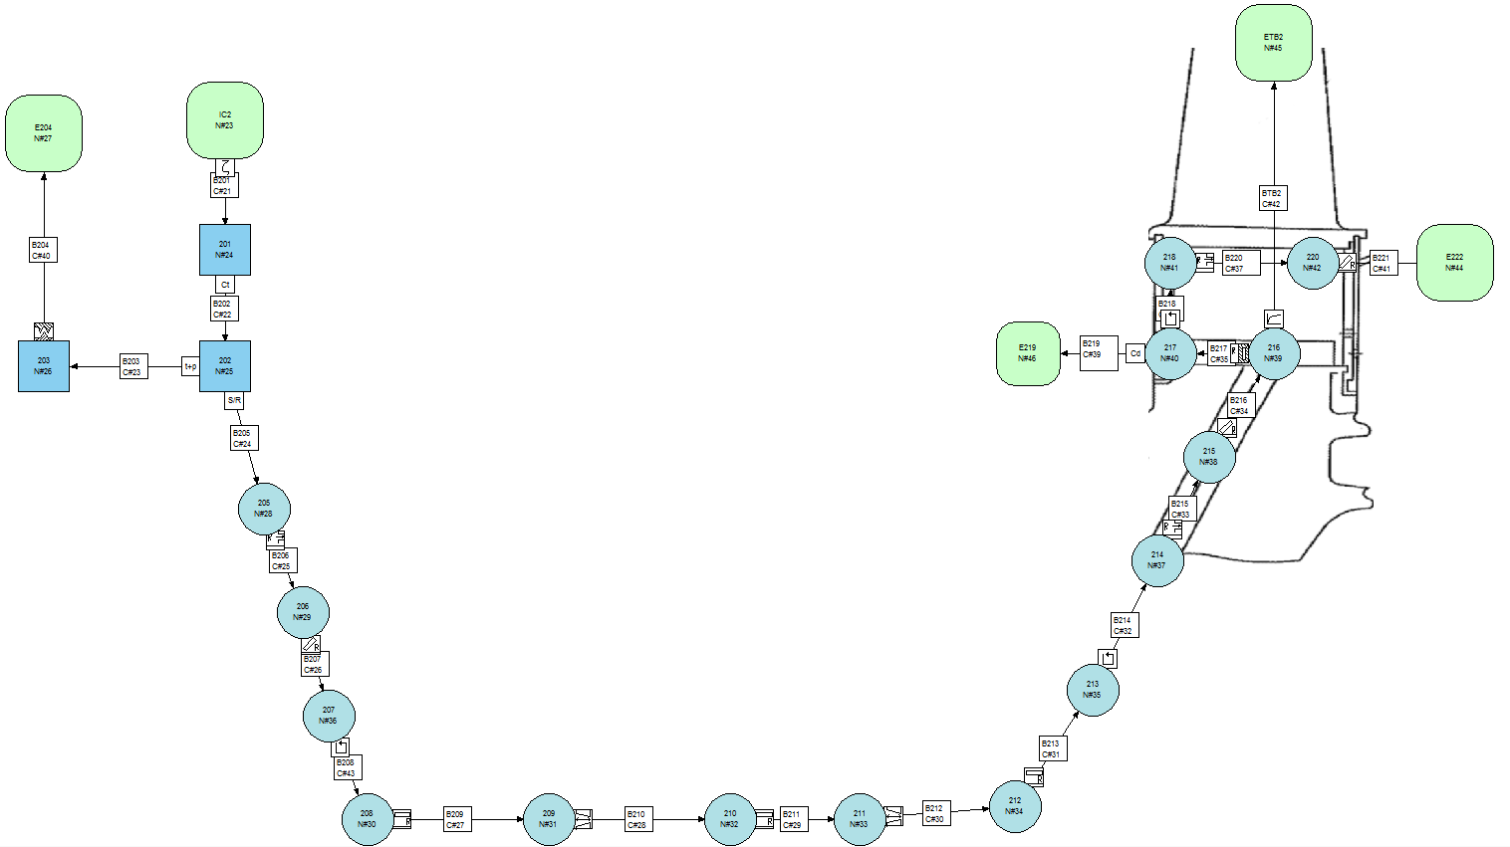
Internal Air Circuit
Characterization of Secondary Air Circuits in a Gas Turbine
COMPRESSOR
TURBINE
Valerio Lanata - DIME

Slide 9

Boundary conditions setup
Characterization of Secondary Air Circuits in a Gas Turbine
Every pressure boundary condition has been referred to two pressure values, according to their positions: the total pressure value at the compressor exit and the total pressure value at the turbine inlet
These ratios are obtained from a realistic pressure distribution inside the engine in the base testing point (TP1) and are kept constant in every other test conditions
Valerio Lanata - DIME

Slide 10
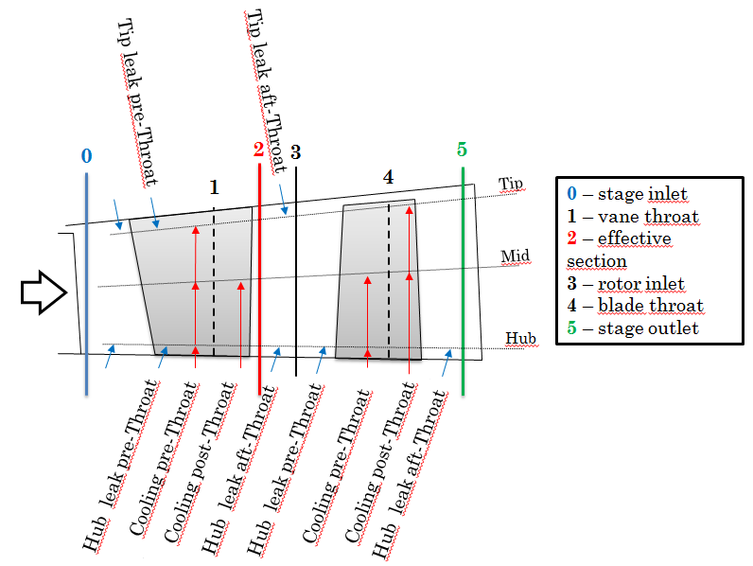
Characteristic curves nomenclature
Characterization of Secondary Air Circuits in a Gas Turbine
IC2_TB2_COOL_PRE_MID
Valerio Lanata - DIME

Slide 11
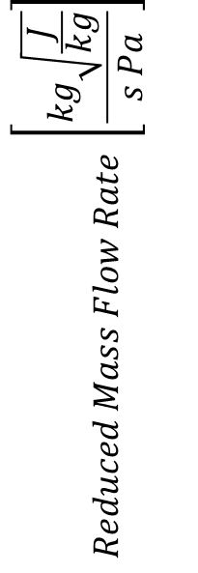
Characteristic curves of Cooling flow
Characterization of Secondary Air Circuits in a Gas Turbine
$$Reduced Mass Flow Rate \left[\frac{kg\sqrt{\frac{J}{kg}}}{s Pa}\right]$$
Valerio Lanata - DIME

Slide 12

Characteristic curves of Cooling flow
Characterization of Secondary Air Circuits in a Gas Turbine
$$Reduced Mass Flow Rate [\%]$$
Valerio Lanata - DIME

Slide 13
Characteristic curves of Leakage flow
Characterization of Secondary Air Circuits in a Gas Turbine
$$Reduced Mass Flow Rate \left[\frac{kg\sqrt{\frac{J}{kg}}}{s Pa}\right]$$
Valerio Lanata - DIME

Slide 14
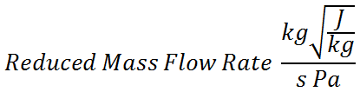
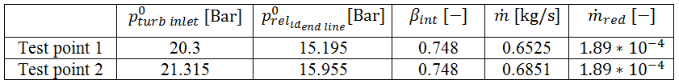
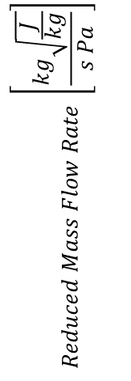
Superposition of TP1 and TP2
Characterization of Secondary Air Circuits in a Gas Turbine
$$Reduced Mass Flow Rate \left[\frac{kg\sqrt{\frac{J}{kg}}}{s Pa}\right]$$
Valerio Lanata - DIME

Slide 15
Conclusions
Characterization of Secondary Air Circuits in a Gas Turbine
The SAS circuits have been modelled in a 0D fluid network via some simplifications
Many simulations have been carried on this net, with different boundary conditions, to obtain the values of mass flow rate, pressure and temperature along the circuit
By the similarity theory the behaviour of the circuit in every reasonable working conditions has been evaluated from the starting simulation runs
The system designed is fast, light and integrated in the Gas Turbine engine model
Valerio Lanata - DIME

Slide 16
Thank you for your attention
Characterization of Secondary Air Circuits in a Gas Turbine
Valerio Lanata - DIME

