Slide 1

A Weight and Balance evaluation software for conventional and unconventional aircraft design
Stefano Piccini
Supervisors: Prof. A. Bottaro
Dr. Jan B. Vos
Co-supervisor: Eng. A. Jungo
Genova, 29/03/2019
Corso di Laurea Magistrale in Ingegneria Meccanica – Energia ed Aeronautica
Curriculum Aeronautica, A.A 2017/2018
Master Thesis Defense

Slide 2



A Weight and Balance evaluation software for conventional and unconventional aircraft design
Partners
CFS (Computational Fluid and Structure) Engineering
DLR (Deutsches Zentrum für Luft-und Raumfahrt)
Project Related
Aircraft 3rd Generation MDO for Innovative Collaboration of Heterogeneous Teams of Experts
Stefano Piccini
Notes:
Sviluppata presso CFS → Spin-off EPFL
→ DLR (Agenzia spaziale Tedesca)
coordinatore progetto AGILE
Scopo → Nuova generazione di softwares
per la progettazione concettuale
e preliminare
→ Nuova generazione di velivoli

Slide 3
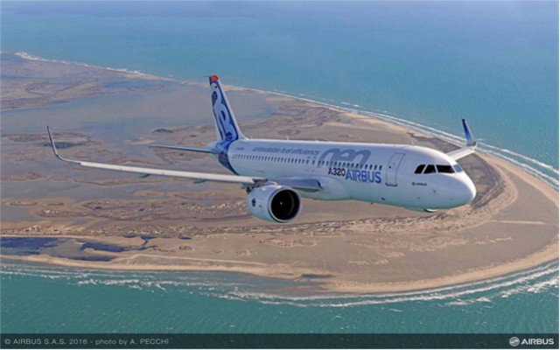
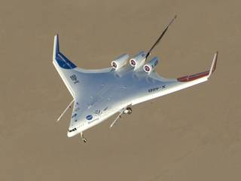
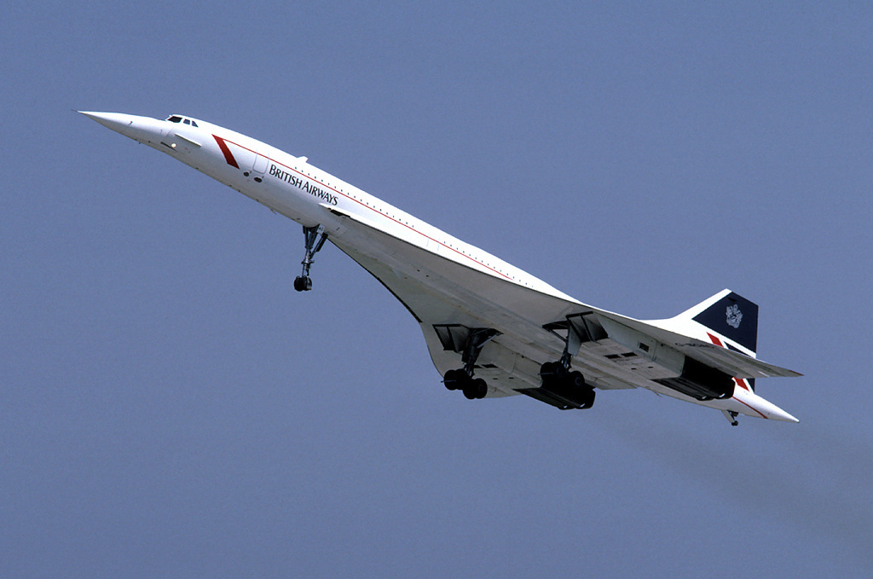
A Weight and Balance evaluation software for conventional and unconventional aircraft design
Conventional and Unconventional Aircraft
Airbus A320-neo ®
(www.airbus.com)
Concorde®
Blended Wing Body
(www.nasa.gov/centers/dryden/research/X-48B)
(www.airliners.net)
Stefano Piccini
Notes:
A380 A320-neo\ ratio fuse 9.5 e ratio wings 3.4,
Concorde delta wing not conventional Mach 2
X-48B, Eduard Marmet prototype by NASA and Boeing

Slide 4
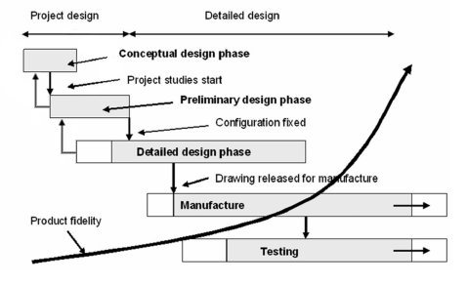
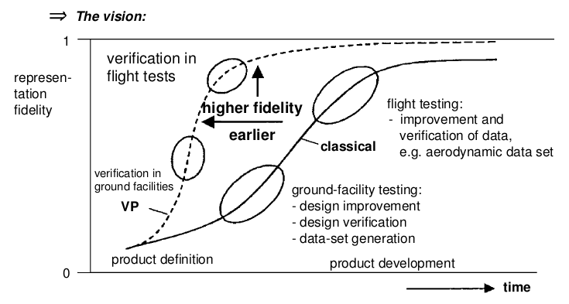
A Weight and Balance evaluation software for conventional and unconventional aircraft design
Design Process
Virtual Product (VP): a high-fidelity mathematical/numerical representation of the physical properties and the function of the product
Multidisciplinary Design Optimization (MDO)
Stefano Piccini
Notes:
1) TLAR: Top Level Aircraft Requirements (performance/cost/range/pass..)
2) Concettuale + Preliminare + Dettagliato
3) Preliminary+dettagli (dim sedili)
4) Detailed + componenti vere
4) MDO: + Speed, modelli matematici e numerici (VP)
→ Ottimizzo su aerodinamica, aeroelasticità
Conceptual Design 90% del costo senza conoscere il prodotto.
Il vecchio sistema costoso, VP riduce costi e rischi
Fidelity = Accuratezza

Slide 5
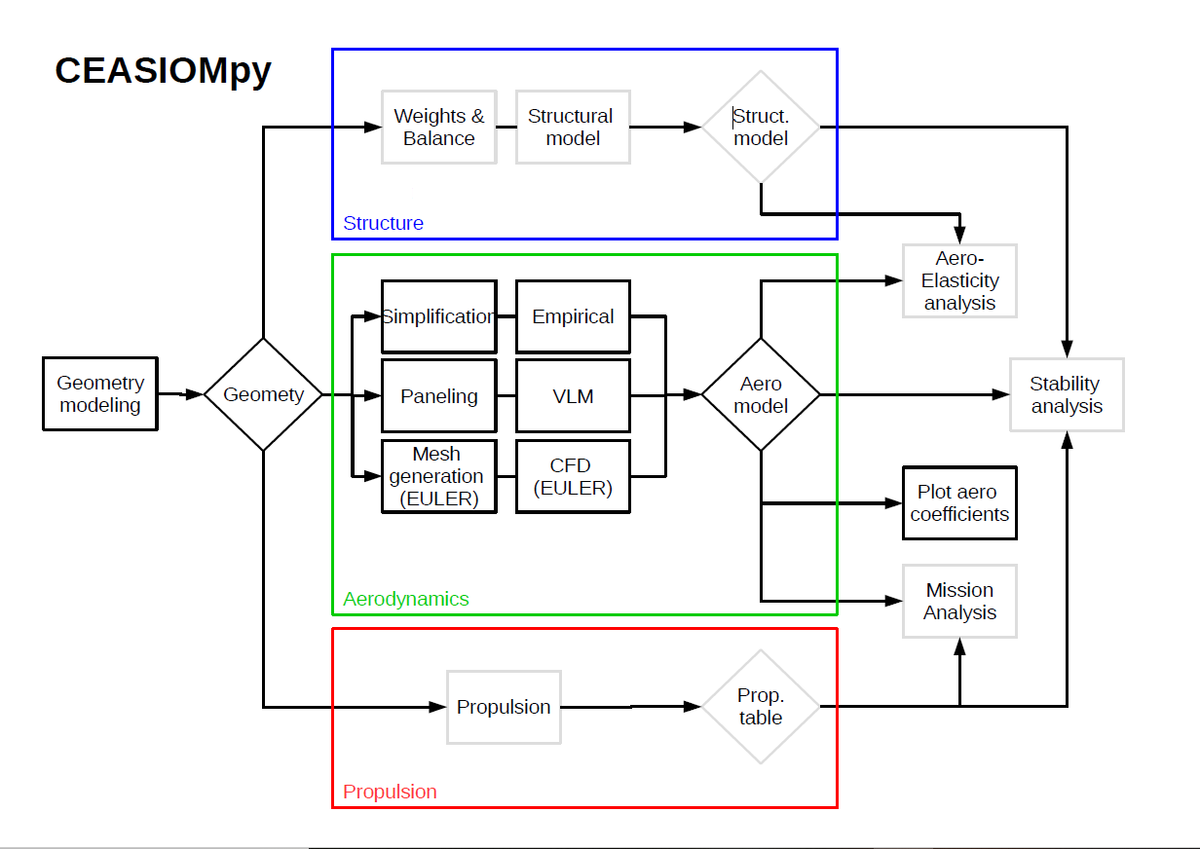
A Weight and Balance evaluation software for conventional and unconventional aircraft design
CEASIOMpy
(Computerised Environment for Aircraft Synthesis and Integrated Optimisation Methods)
CPACS
(Common Parametric Aircraft Configuration Scheme)
Stefano Piccini
Notes:
Software di supporto per il design preliminare e concettuale
CEASIOMpy is in python language → open source.
Usa MDO basandosi su una multi-fidelity analysis
→ dell’aerodinamica e della stabilità del velivolo
MODULI Tutti Interconnessi
→ Geometria CPACS + Aerodynamica + WB
→ TODO Propulsion, Mission analysis and strutturale
→ permettono l’analisi di stabilità ed aeroelastica

Slide 6
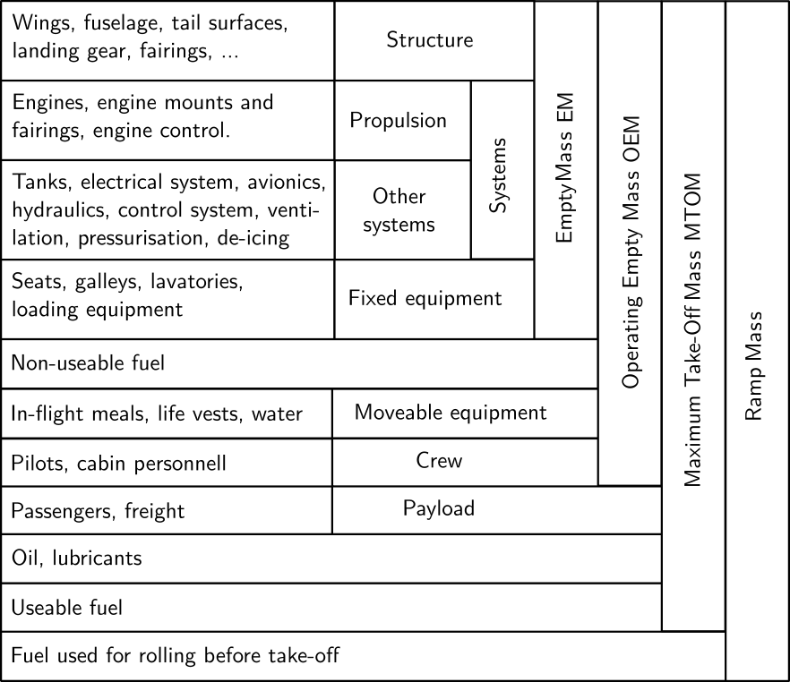
A Weight and Balance evaluation software for conventional and unconventional aircraft design
Aircraft Masses
Stefano Piccini
Notes:
Masse Velivolo Descrizione veloce
Ramp + MTOM + OEM + EM
Ricordare ZFM, ZPM!!!

Slide 7
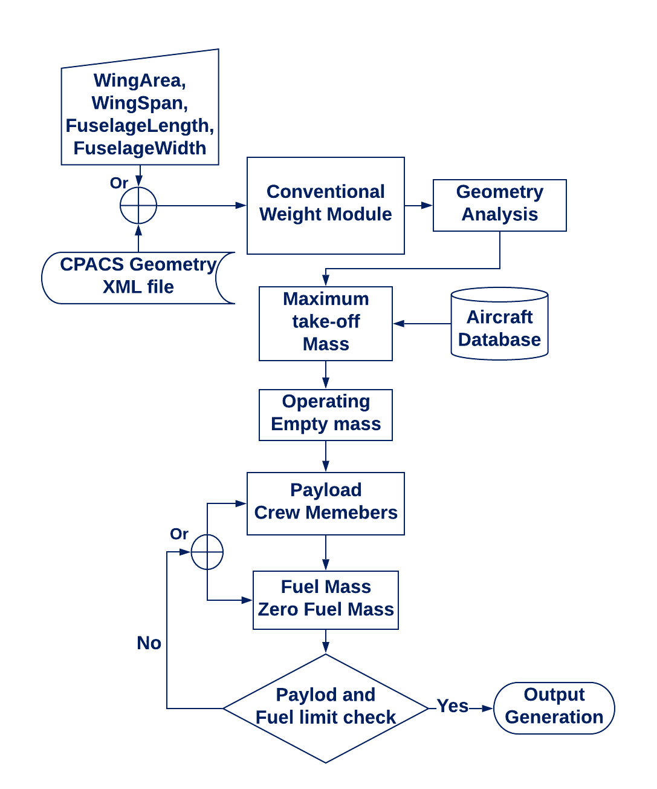
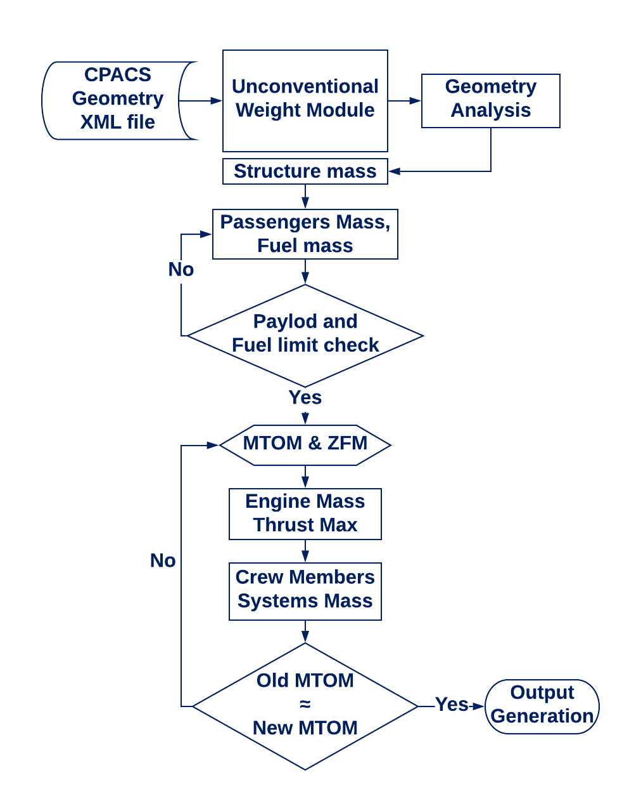
A Weight and Balance evaluation software for conventional and unconventional aircraft design
Weight analysis
D.P. Raymer [18]
Beltramo (1977) [37]
Omran Al-Shamma (2013) [38]
Stefano Piccini
Notes:
1) Conventional BlackBox → fitting aircraft Database
2) Conv Processo → Inizia solo con le 4 dim fondamental
→ Dim sedili + propone disposizione sedili
3) Unconventional + dettagliato possibile fitting per aereo specifico
→ Elevata interazione utente → Pensato per ottimizzazione
→ Pass surf Density + virtual thickness and density
→ Specify MTOM cycle (Inizia dal Wing Loading 600kgm2)
→ Motori definiti dall’utente

Slide 8
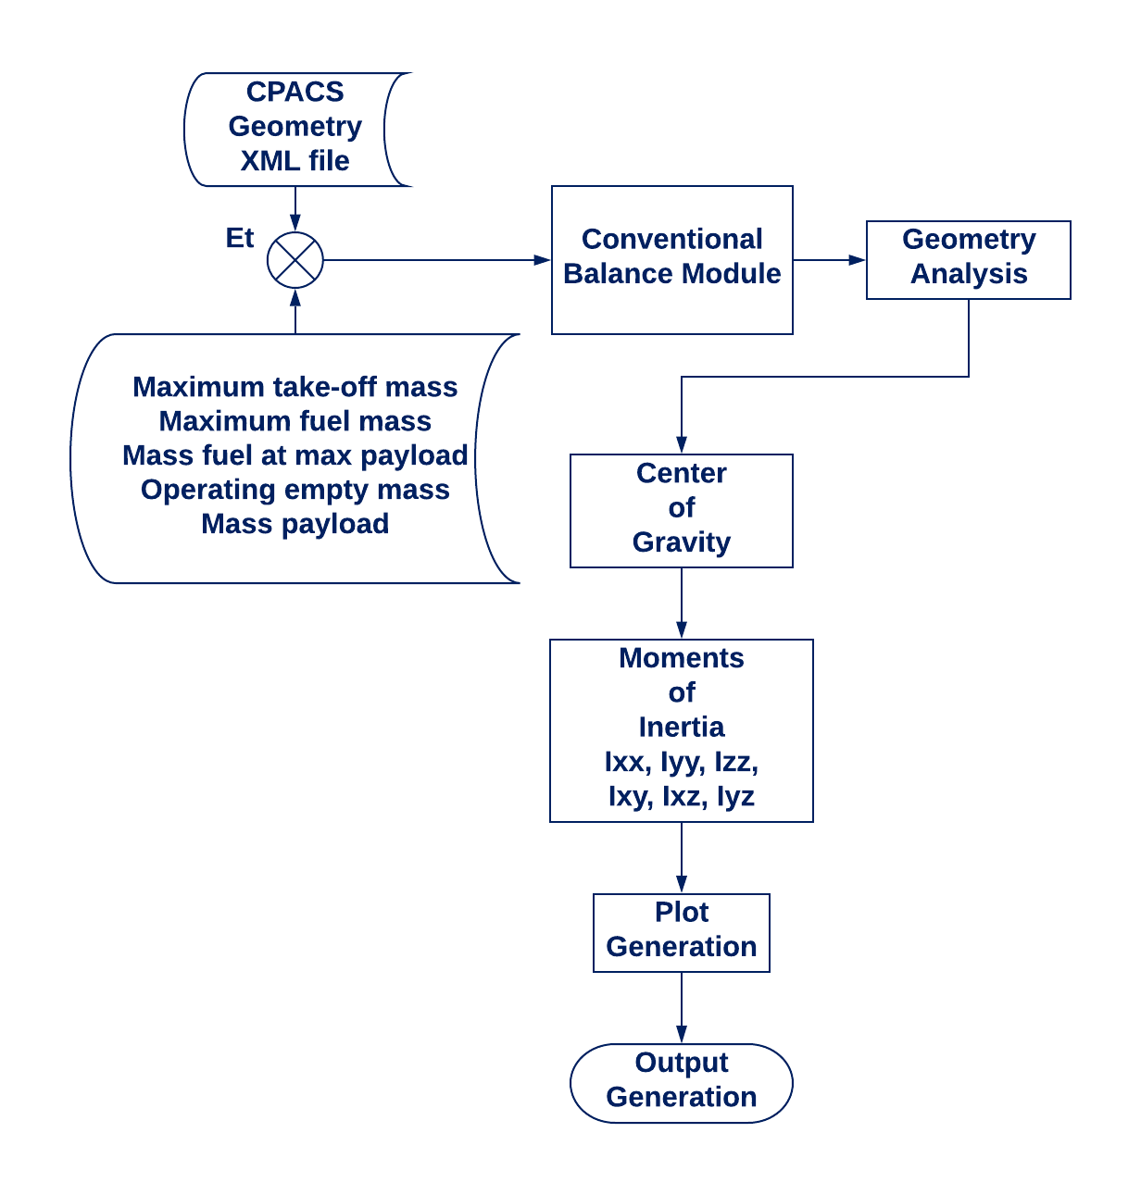
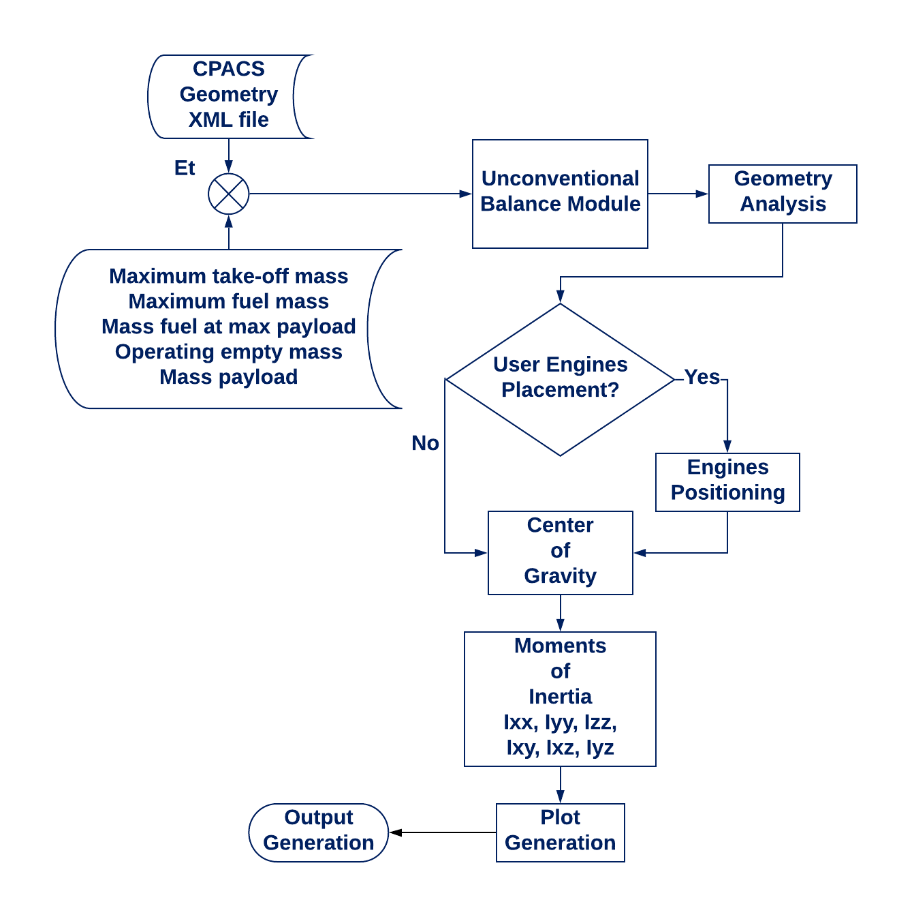
A Weight and Balance evaluation software for conventional and unconventional aircraft design
Balance analysis
Stefano Piccini
Notes:
Processo a Masse Concentrate
Differenti masse per COG and MOI
Processo identico, ma UNC
→ posizionamento motori
→ differente valutazione geometria

Slide 9
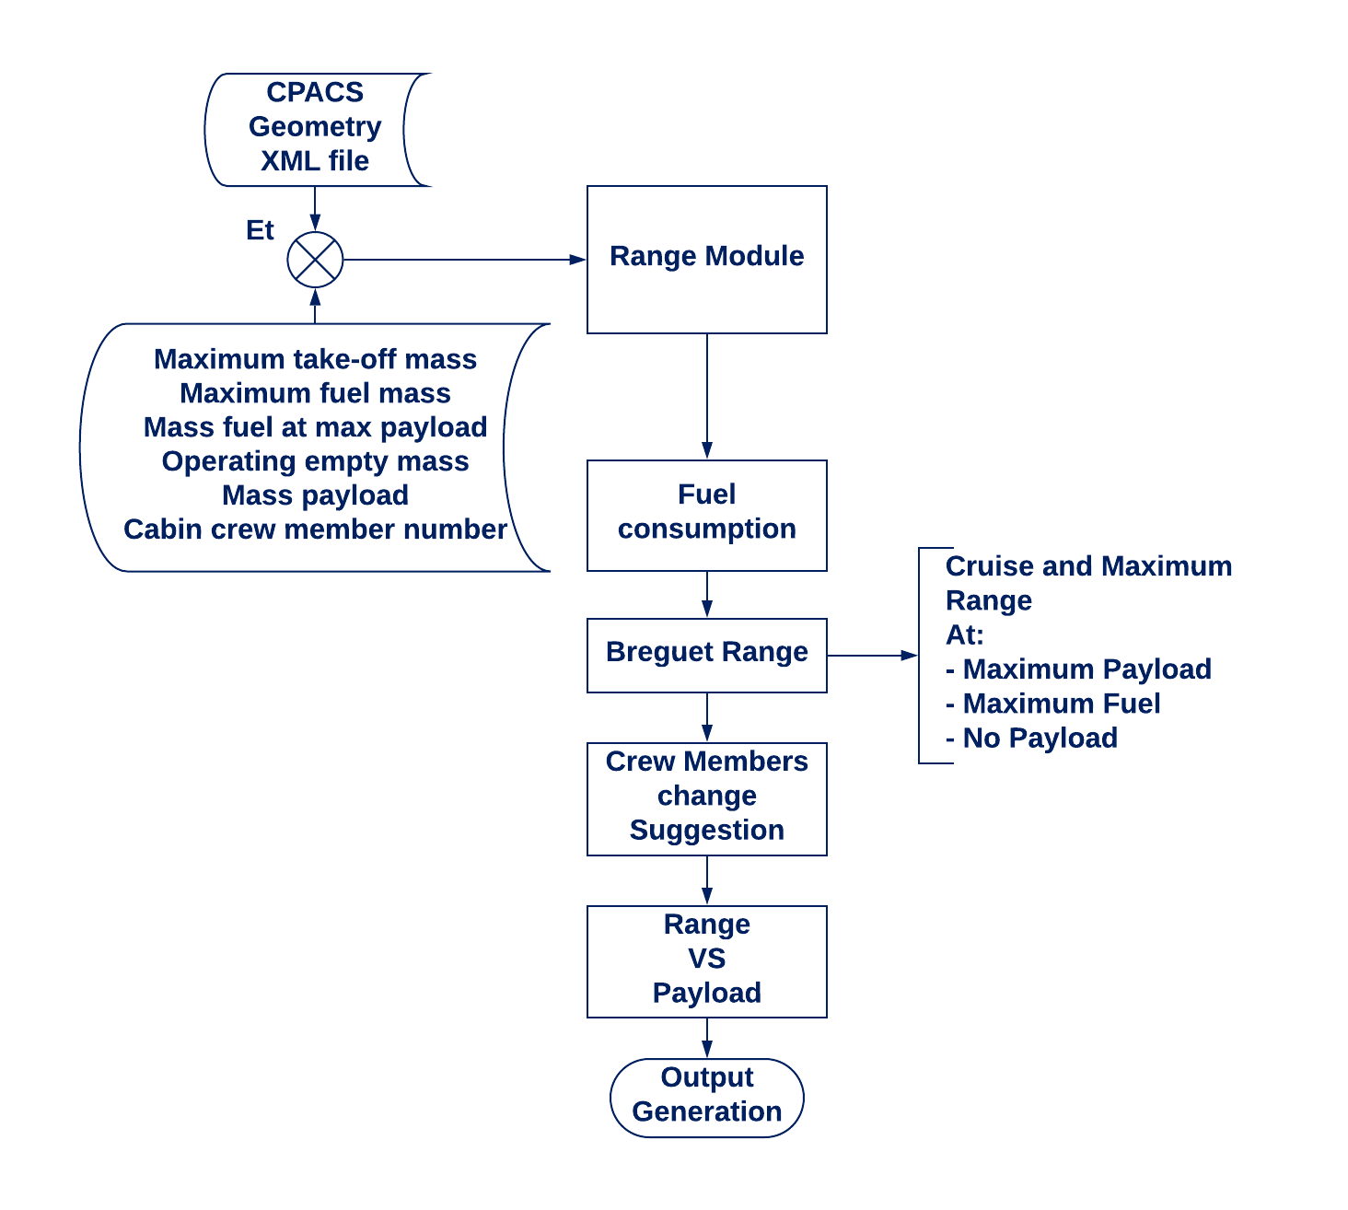
A Weight and Balance evaluation software for conventional and unconventional aircraft design
Range analysis
Stefano Piccini
Notes:
No a Full Mission Analysis
Aiuta a controllare l’output del modulo WB
Semplificherà la connessione con il modulo di Mssion Analysis
Leggere WF
INPUT TP/WINGLET/Vcru/TSFC

Slide 10
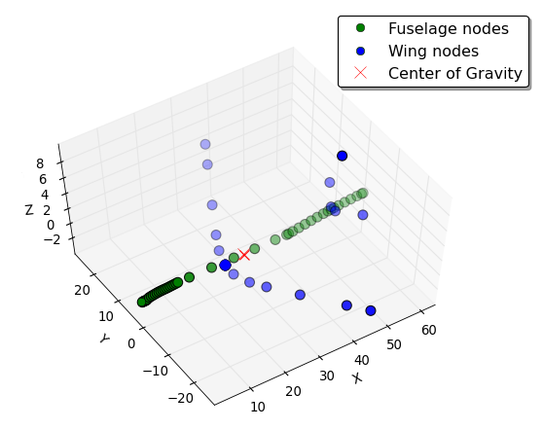
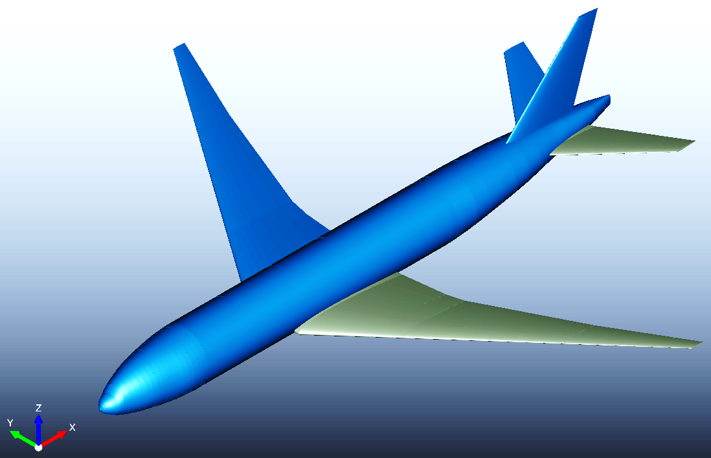
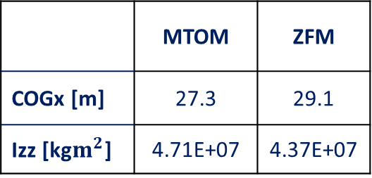
A Weight and Balance evaluation software for conventional and unconventional aircraft design
B777®
 | MTOM [tons] | OEM [tons] | Fuel Max [tons] | Pax. Nb
Real [32] | 348 | 145 | 146 | 440
Estimated (Error %) | 344 (≈1) | 145 (-) | 146 (-) | 441 (<1)
 | MTOM | ZFM
COGx [m] | 27.3 | 29.1
Izz [kg$m^{2}$] | 4.71E+07 | 4.37E+07
Aisles: 2, Abreasts: 3+3+3, Rows: 49, Cabin Crew + Pilots: 9 + 2
Stefano Piccini
Notes:
Conventional Module
(Sulla Tesi comparazione Conv/Unc e anche slide extra)
L=63.7m, b=64,8m , Sw=436,8m2
MOSTRO SOLO MASSE PRINCIPALI, extra slide per approfondimenti

Slide 11
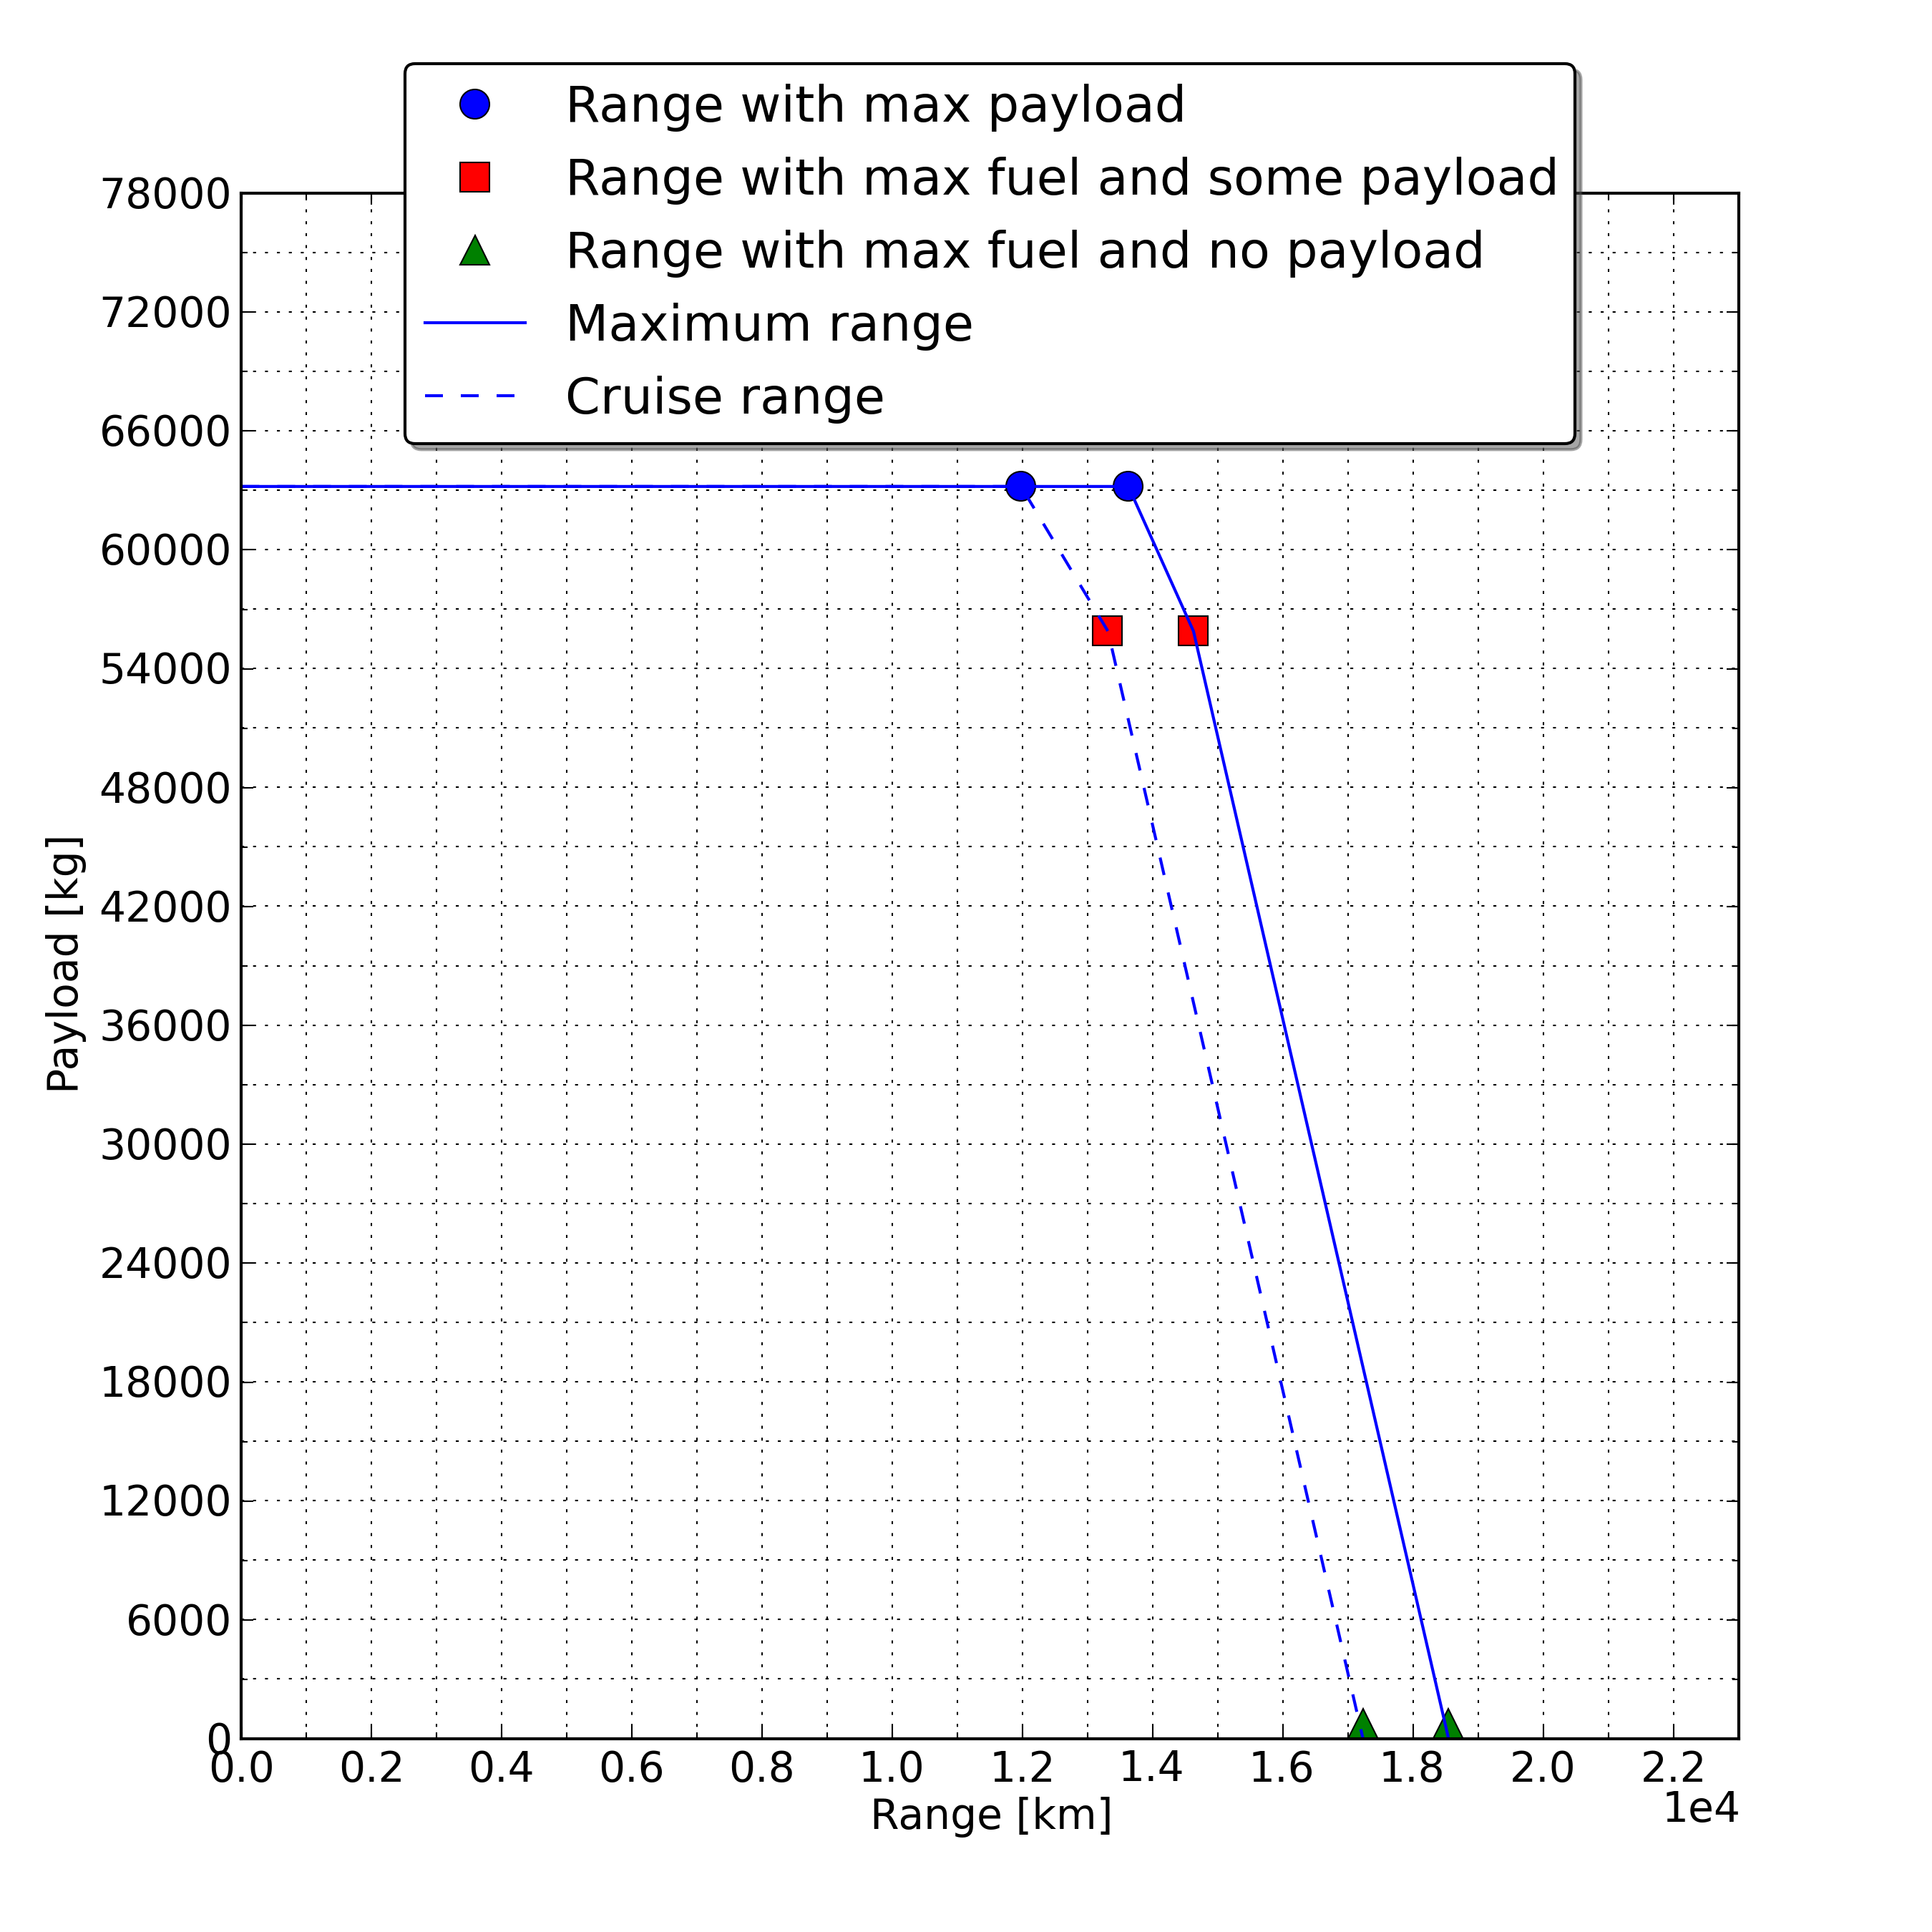
A Weight and Balance evaluation software for conventional and unconventional aircraft design
B777®
 | Range* [km] | Cabin Crew + Pilots
Real [32] | 13900 | -
Estimated (Error %) | 14400 (≈1) | 10 + 3
*Range at 95% of Fuel
Stefano Piccini
Notes:
Range → 95% Fuel
→ Max Comb \circ Max Pay
→ Max Range 19000 km (Record 21000km)
Crew Updated

Slide 12
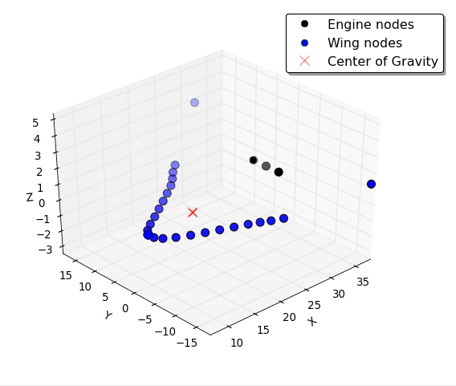
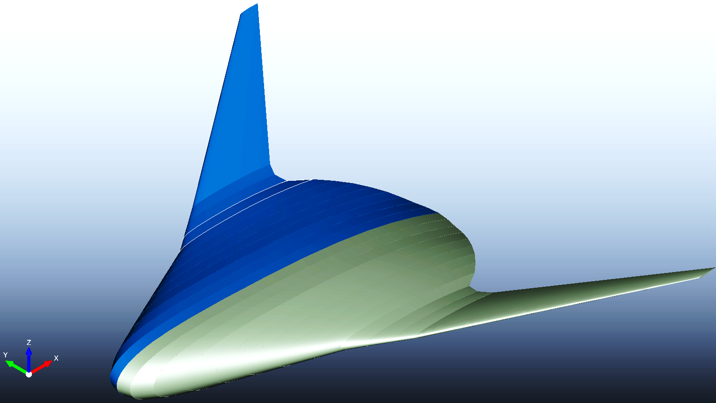
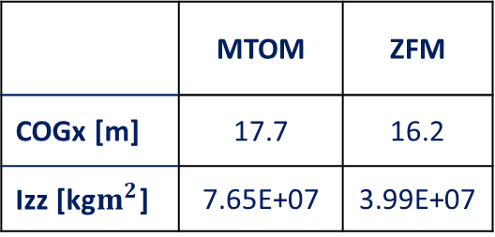
A Weight and Balance evaluation software for conventional and unconventional aircraft design
BWB
 | MTOM [tons] | OEM [tons] | Fuel Max [tons] | Pax. Nb | Cabin Crew + Pilots
Estimated | 415 | 186 | 216 | 540 | 11 + 2
 | MTOM | ZFM
COGx [m] | 17.7 | 16.2
Izz [kg$m^{2}$] | 7.65E+07 | 3.99E+07
Stefano Piccini
Notes:
Dimensions b 56,4m, L 39,6m,
Sw 863,3m^2 & Sc 319,2m^2
Pass 800 with 2 floors
Enginesx3 a 32 m → 20tons tot
Variazione COG

Slide 13
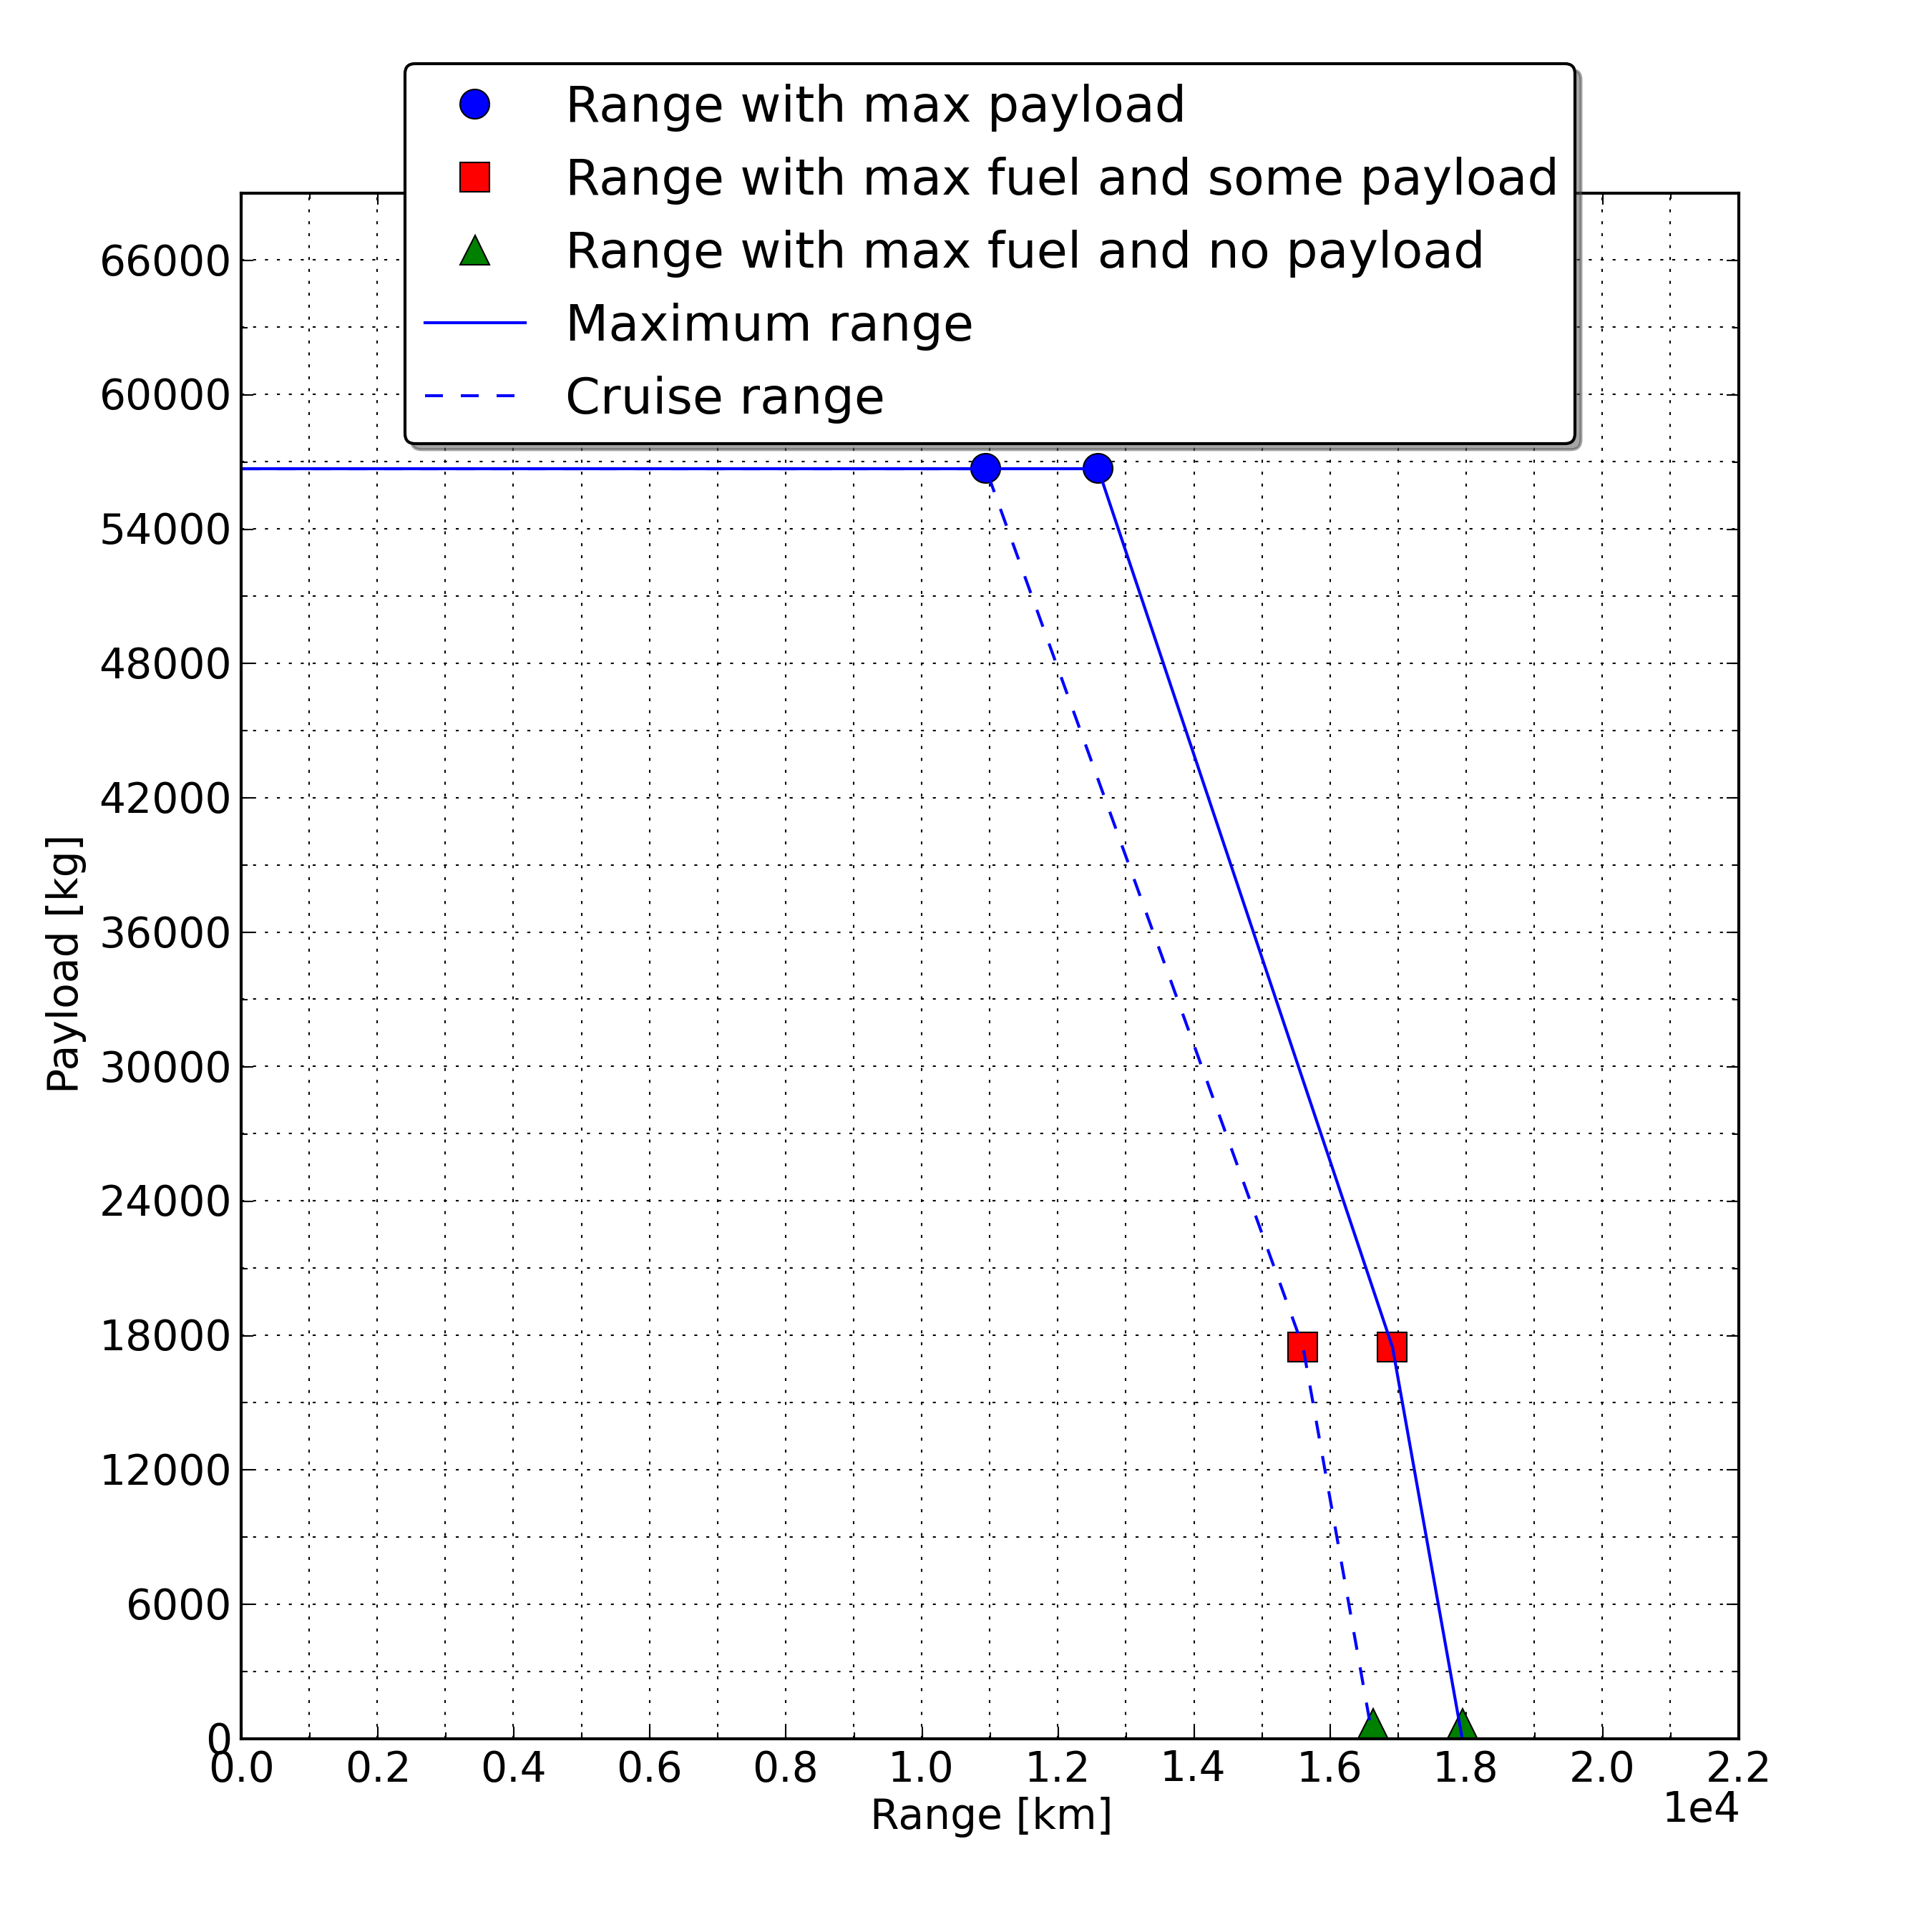
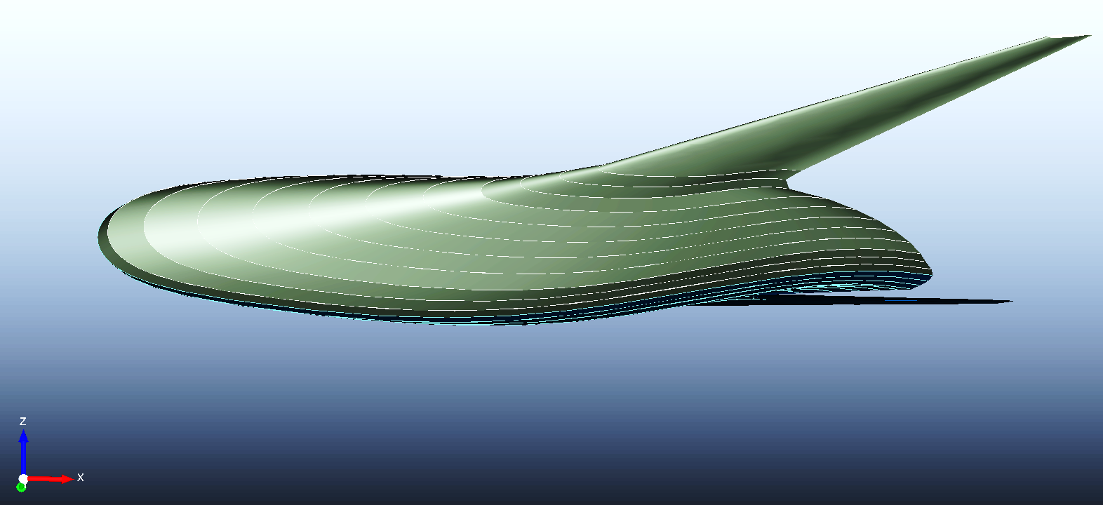
A Weight and Balance evaluation software for conventional and unconventional aircraft design
BWB
 | Range* [km] | Cabin Crew + Pilots
Estimated | 14300 | 12 + 3
*Range at 80% of Fuel
Stefano Piccini
Notes:
Range Good Max Payload 80% of max fuel
How to FPM

Slide 14
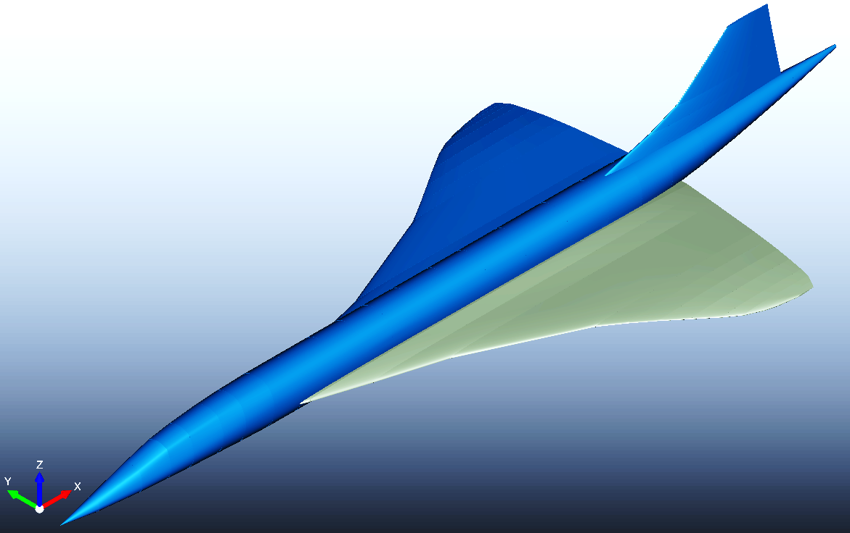
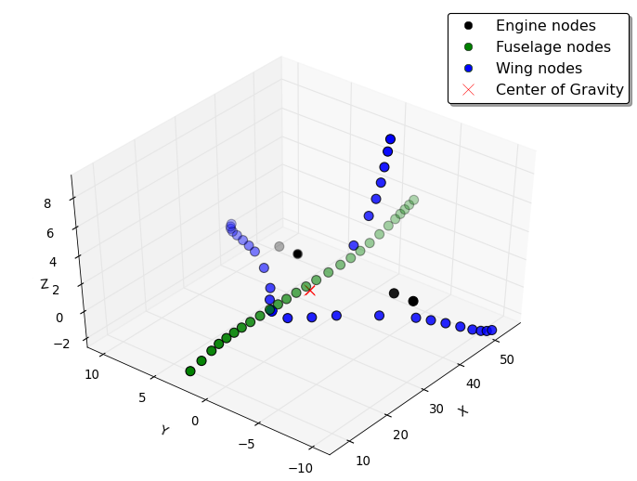
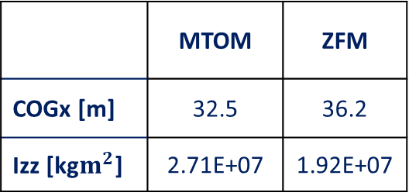
A Weight and Balance evaluation software for conventional and unconventional aircraft design
Concorde®
 | MTOM [tons] | OEM [tons] | Fuel Max [tons] | Pax. Nb | Cabin Crew +Pilots
Real [43] | 185 | 79 | 96 | 120 | 3+3
Estimated (Error %) | 184 (≈1) | 80 (≈1) | 97 (≈1) | 120 (-) | 3+3 (-)
 | MTOM | ZFM
COGx [m] | 32.5 | 36.2
Izz [kg$m^{2}$] | 2.71E+07 | 1.92E+07
Stefano Piccini
Notes:
Concorde L 61,3m, b 25,2m, Sw 414m2
→ Speed 600 m/s and 2160 km/h
→ Parigi/NY meno di 4 ore
Ridotta passDens poiché solo business
4 × Rolls-Royce/Snecma Olympus 593 → 3 tons & 170kN
COG variation IMP TRIM

Slide 15
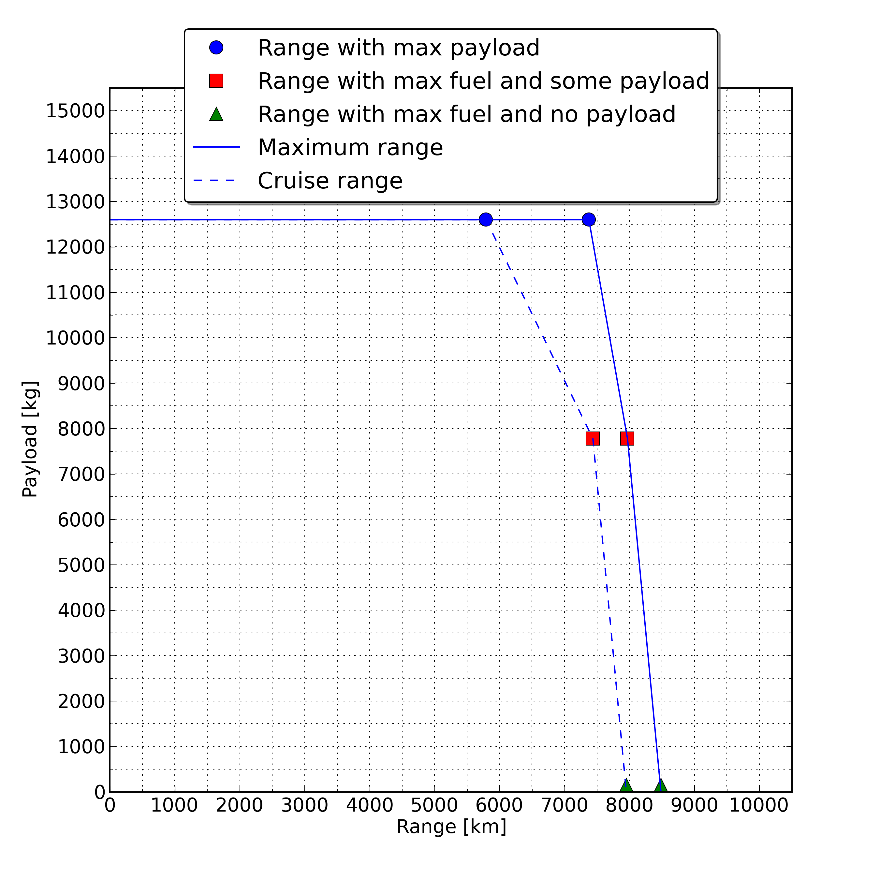
A Weight and Balance evaluation software for conventional and unconventional aircraft design
Concorde®
 | Range* [km]
Real [43] | 7300
Estimated (Error %) | 7400 (≈2)
*Range at 95% of Fuel
Stefano Piccini
Notes:
Nice Range SLOPE.
LD = 5,5, real between 12,5/3,5
→ Normal aircraft 15/17

Slide 16
A Weight and Balance evaluation software for conventional and unconventional aircraft design
Conclusions
Accurate Weight and Balance estimation
for conventional and unconventional aircraft
Reliable range and fuel consumption evaluation
Flexible and designed for optimization process
Perspectives
Larger and more detailed conventional aircraft database
Propulsion and Mission analysis
Structural, aeroelasticity and stability analysis
Stefano Piccini
Notes:
Read

Slide 17
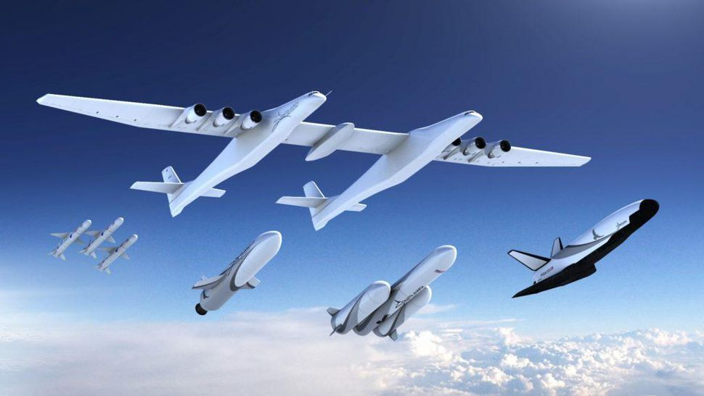
A Weight and Balance evaluation software for conventional and unconventional aircraft design
Thanks for your attention
stefano.piccini94@gmail.com
Stefano Piccini
Notes:
GG LVL UP

Slide 18
A Weight and Balance evaluation software for conventional and unconventional aircraft design
Bibliography
[18] Daniel P. Raymer. Aircraft Design: A Conceptual Approach, Fourth Edition. AIAA
American Institute of Aeronautics & Ast., 2006. ISBN: 978-1563478291.
[32] Boeing Commercial Airplanes. 777-200LR/-300ER/-Freighter Airplane Characteristics
for Airport Planning. Tech. rep. D6-58329-2, REV. E. 2015.
[37] B.W. Kimoto-D.P. Marsh M.N. Beltramo D.L. Trapp. “Parametric study of trans-
port aircraft systems cost and weight”. In: (1977). ASIN: B0007338WC
[38] R. Ali O. Al-Shamma. “Aircraft weight estimation in interactive design process”.
In: Procs 72nd Annual International Conference on Mass Properties Engineering.
2013.
[43] Federal Aviation Administration Department of Transportation. TYPE CERTIFICATE
DATA SHEET, Concorde Type 1. Tech. rep. NO. A45EU. 1979.
Stefano Piccini

Slide 19
A Weight and Balance evaluation software for conventional and unconventional aircraft design
EXTRA
Stefano Piccini

Slide 20
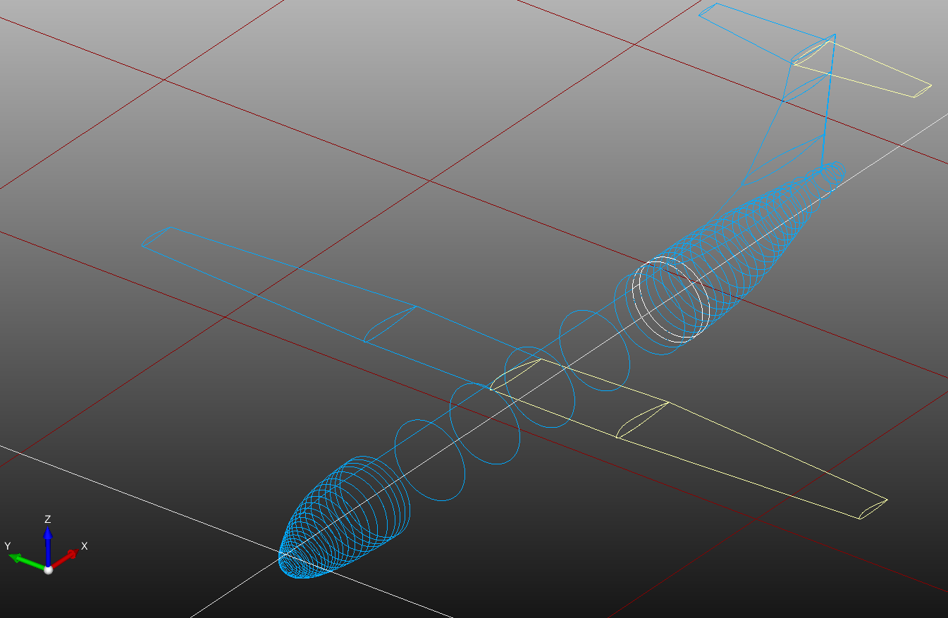
A Weight and Balance evaluation software for conventional and unconventional aircraft design
Aircraft CPACS Geometry
(Common Parametric Aircraft
Configuration Scheme)
<cpacs>
<vehicles>
<aircraft>
<model uID="">
<name> </name>
<reference> </reference>
<wings> </wings>
<fuselages> </fuselages>
<analyses>
<massBreakdown> </massBreakdown>
</analyses>
</model>
</aircraft>
<profiles> </profiles>
<engines> </engines>
</vehicles>
<toolspecific>
<CEASIOMpy> </CEASIOMpy>
</toolspecific>
</cpacs>
Stefano Piccini
Notes:
CPACS GEOMETRY:
utente definisce profili sezioni e li collega con segmenti e specchi
CPACSxml Uniforma il linguaggio geometria e salvataggio dati
provenienti da campi differenti.
(Necessario per un progetto OpenSource)
Right → Wing, Fuselage, Analysis, MBD, Profiles, TS CEASIOMp.

Slide 21
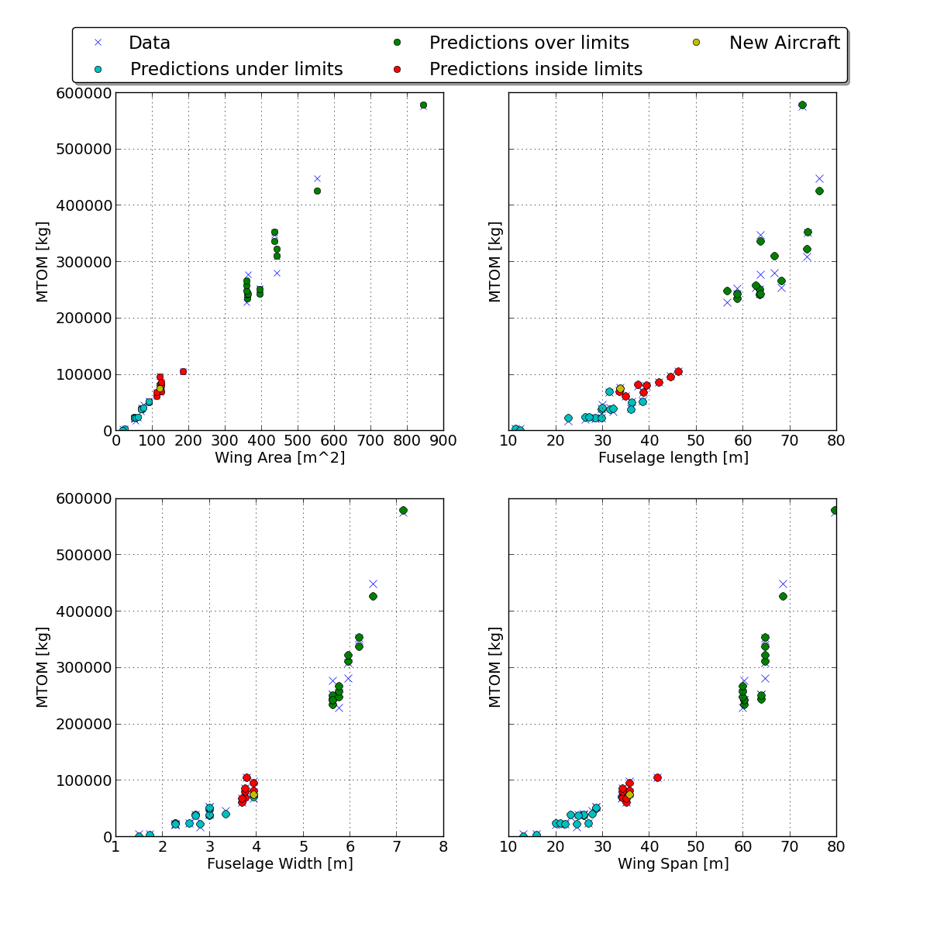
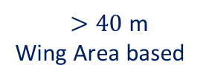
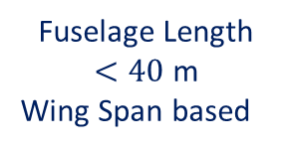
A Weight and Balance evaluation software for conventional and unconventional aircraft design
Linear Regression Method
Fuselage Length
$<40$m
Wing Span based
Self adjustable
LRM
$>40$ m
Wing Area based
Stefano Piccini
Notes:
3 Groups autofitting adustable LRM

Slide 22



A Weight and Balance evaluation software for conventional and unconventional aircraft design
OEM
Conventional module
KC = 1,04 Wing with variable sweep
$$OEM=a∙KC∙{\left(MTOW\right)}^{c}∙MTOM$$
0,96 < a < 1,63 = $f$($l_{fg}$, Aircraft Type)
D.P. Raymer [18]
c = -0,05 Turboprop, -0,08 Turbofan
Unconventional module
Structure Mass
$${M_{str}=ρ}_{mvrt}t_{mvrt}{\left(A_{w}+A_{t}\right)}^{1,63}$$
Systems Mass
$M_{sys}=f(MTOM, ZFM, OEM, A_{w},{Nb}_{pax},$ ${Nb}_{e}, T_{max})$
Beltramo (1977) [37]
Omran Al-Shamma (2013) [38]
Engine Mass
$M_{sys}=f(MTOM,$ ${Nb}_{e}, T_{max}, LD)$
Stefano Piccini
Notes:
t = 1.4E-04
rho = 2700 kg/m3
READ equations

Slide 23
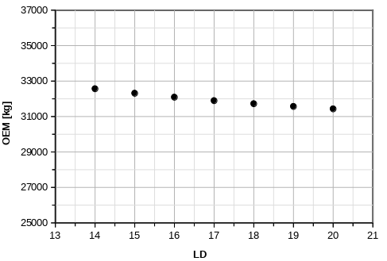
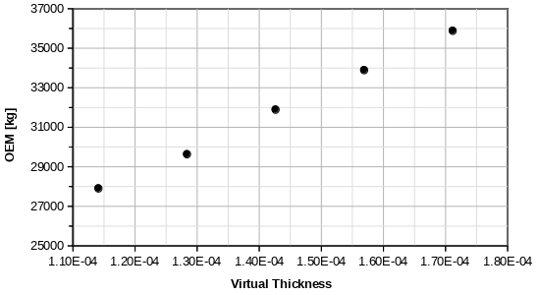
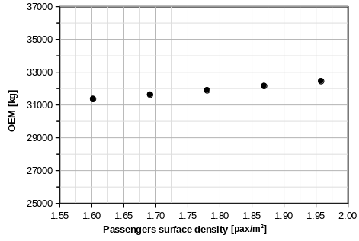

A Weight and Balance evaluation software for conventional and unconventional aircraft design
Unconventional OEM Parameters Influence
OEM vs LD
OEM vs Virtual Thickness
OEM vs Pax Surface Density [kg/$m^{2}$]
Stefano Piccini
Notes:
Effect on parameters

Slide 24
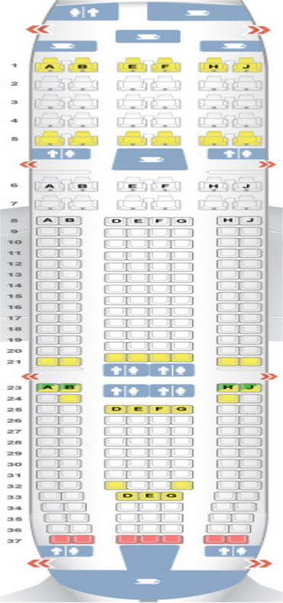
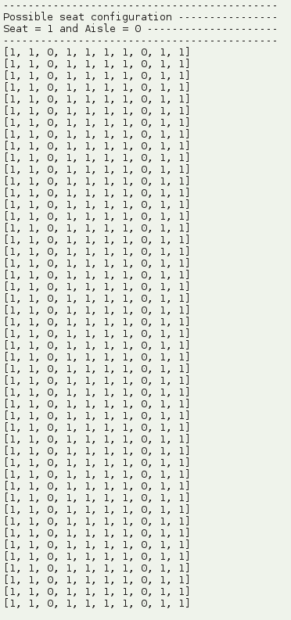
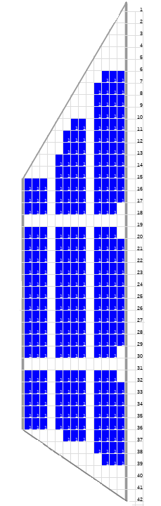

A Weight and Balance evaluation software for conventional and unconventional aircraft design
Passengers Evaluation
Conventional Seat Disposition
Unconventional Module
Passenger Surface Density
[pax/$m^{2}$]
Nose
BWB
Half Cabin
Manual
Test
Tail
Stefano Piccini
Notes:
Passengers Nice
Tal about Exit Passnegers
Remeber to mention the central aisle in the BWB

Slide 25
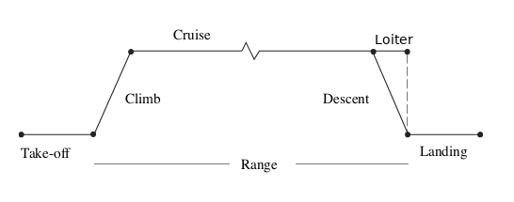
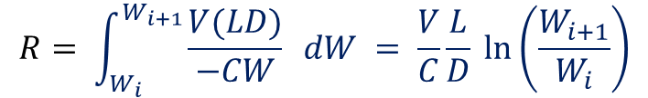
A Weight and Balance evaluation software for conventional and unconventional aircraft design
Flight Phases & Breguet Range
$$R= \int_{W_{i}}^{W_{i+1}}{\frac{V(LD)}{−CW} dW} = \frac{V}{C}\frac{L}{D} ln⁡\left(\frac{W_{i+1}}{W_{i}}\right)$$
C = Specific Fuel Consumption (SFC) [1/h]
V = Aircraft cruise Speed [km/h]
L/D = Lift over Drag coefficient
W = Aircraft Weight [N]
Typical Jet SFC’s [1/hr] | Cruise
High-bypass turbofan | 0.5
Turboprop | 0.7
Stefano Piccini
Notes:
Range Braguett
Brake Horse Power and propeller efficiency

Slide 26
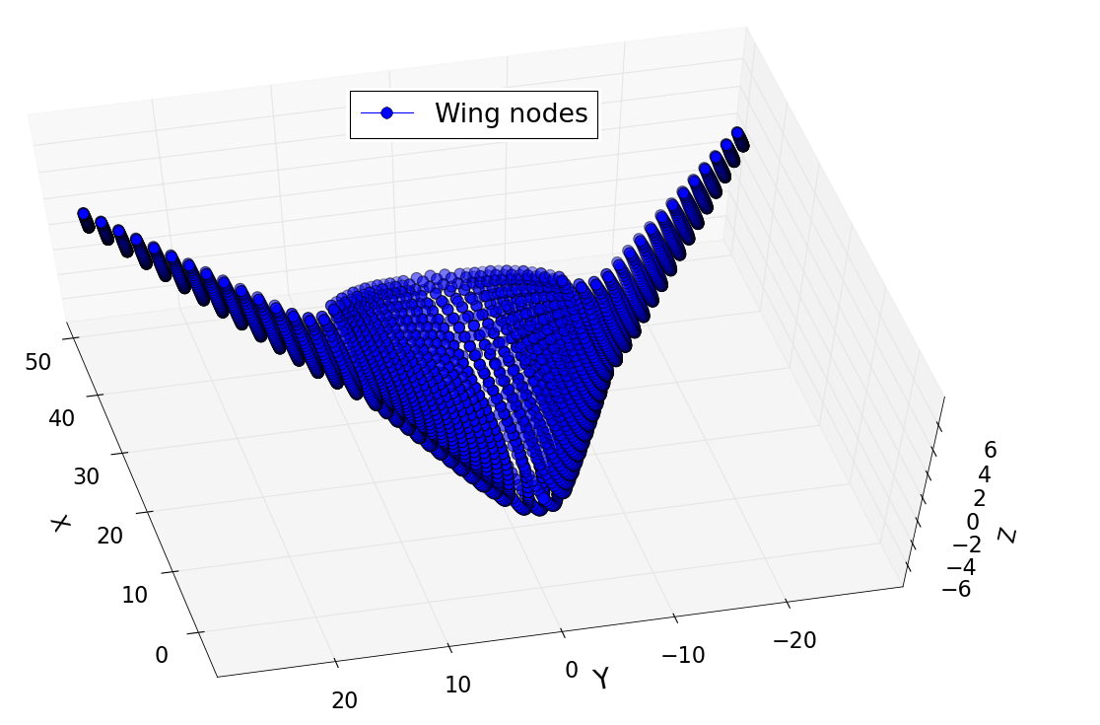
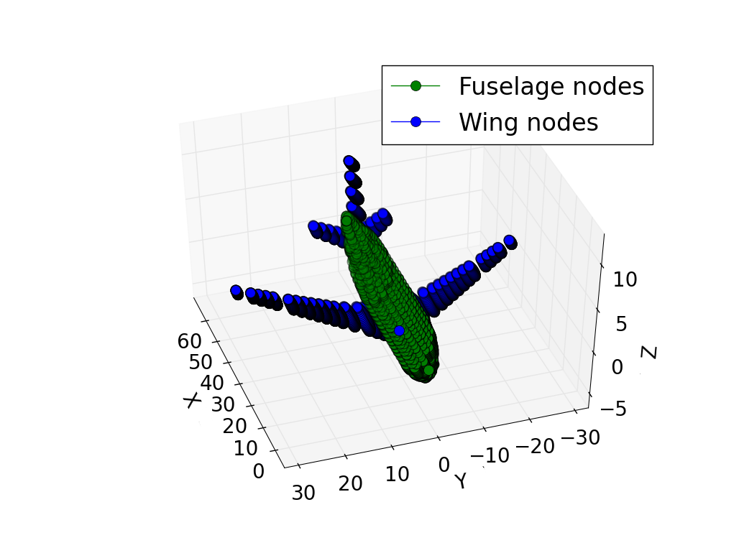
A Weight and Balance evaluation software for conventional and unconventional aircraft design
Aircraft Balance – Lumped Masses
Centre of Gravity
Moments of Inertia
Stefano Piccini
Notes:
Ogni nodo ha massa diversa in relazione alla sua posizione
Spacing tra nodi, scelto ottimale
(TEST cilindro pieno Hp corpo rigido)
ma può essere definito dall’utente

Slide 27
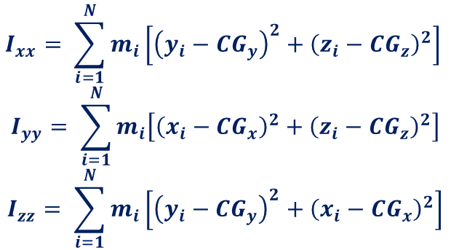
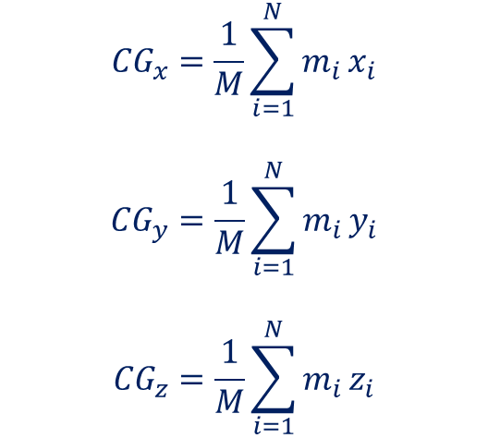
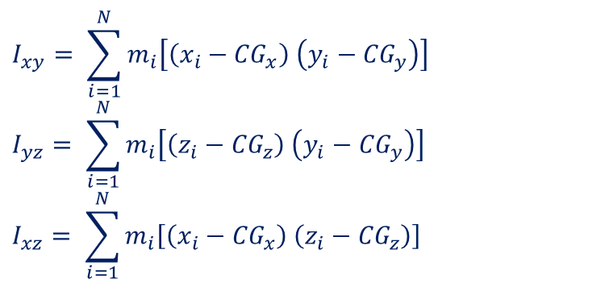
A Weight and Balance evaluation software for conventional and unconventional aircraft design
Aircraft Balance
Centre of Gravity and Moments of Inertia
$$I_{xx}= \sum_{i=1}^{N}{m_{i}\left[{\left(y_{i}−{CG}_{y}\right)}^{2}{+ \left(z_{i}−{CG}_{z}\right)}^{2}\right]}$$
$$I_{yy}= \sum_{i=1}^{N}{m_{i}\left[{\left(x_{i}−{CG}_{x}\right)}^{2}{+ \left(z_{i}−{CG}_{z}\right)}^{2}\right]}$$
$$I_{zz}= \sum_{i=1}^{N}{m_{i}\left[{\left(y_{i}−{CG}_{y}\right)}^{2}{+ \left(x_{i}−{CG}_{x}\right)}^{2}\right]}$$
$${CG}_{x}=\frac{1}{M}\sum_{i=1}^{N}{m_{i}}x_{i}$$
$${CG}_{y}=\frac{1}{M}\sum_{i=1}^{N}{m_{i}}y_{i}$$
$${CG}_{z}=\frac{1}{M}\sum_{i=1}^{N}{m_{i}}z_{i}$$
$$I_{xy}= \sum_{i=1}^{N}{m_{i}\left[\left(x_{i}−{CG}_{x}\right) \left(y_{i}−{CG}_{y}\right)\right]}$$
$$I_{yz}= \sum_{i=1}^{N}{m_{i}\left[\left(z_{i}−{CG}_{z}\right) \left(y_{i}−{CG}_{y}\right)\right]}$$
$$I_{xz}= \sum_{i=1}^{N}{m_{i}\left[\left(x_{i}−{CG}_{x}\right) \left(z_{i}−{CG}_{z}\right)\right]}$$
Stefano Piccini
Notes:
Roll, Pitch and Yaw Moments
Symmetry someone zero

Slide 28
A Weight and Balance evaluation software for conventional and unconventional aircraft design
Database test
for conventional aircraft
Aircraft inside Database: Avg. Error = 3%
Small aircraft (Fuselage Length < 40m): Max. Error < 3%
Boeing 747 and Airbus A380: Max. Error 3% and 5%
Aircraft not inside Database: Avg. Error < 6%
Passengers nb.: Error < 10% (with Default)
Exact Passengers nb. if precise seat dimensions
Stefano Piccini
Notes:
Speed Read
DATI VELIVOLI REALI OTTENUTI DA:
Certificazioni FAA, ICAO, EASA
Manual for airport planning

Slide 29
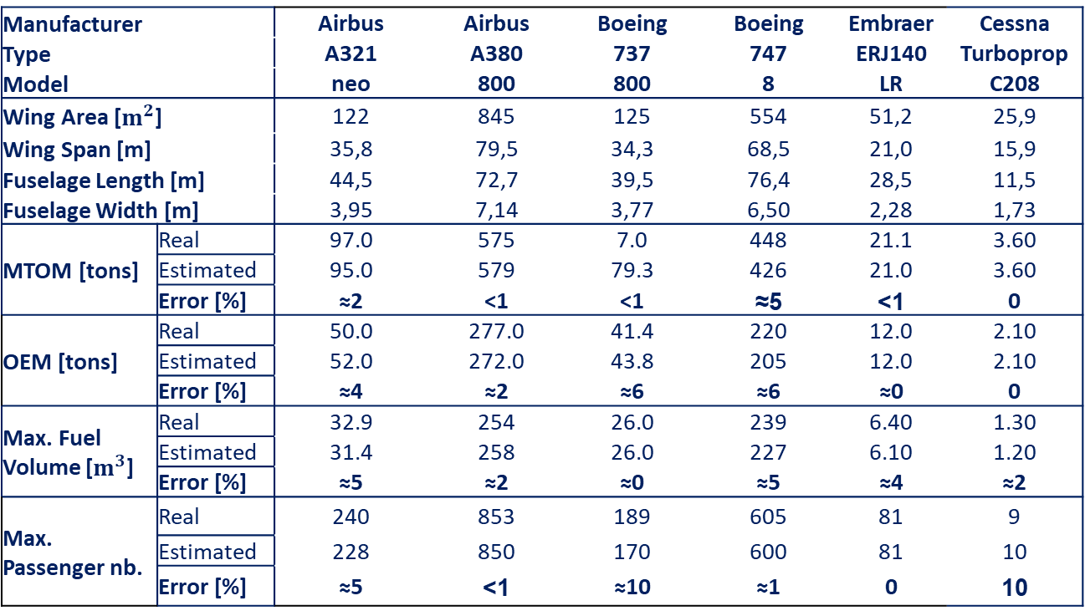
A Weight and Balance evaluation software for conventional and unconventional aircraft design
Database Test
Manufacturer |  | Airbus | Airbus | Boeing | Boeing | Embraer | Cessna
Type |  | A321 | A380 | 737 | 747 | ERJ140 | Turboprop
Model |  | neo | 800 | 800 | 8 | LR | C208
Wing Area [$m^{2}$] |  | 122 | 845 | 125 | 554 | 51,2 | 25,9
Wing Span [m] |  | 35,8 | 79,5 | 34,3 | 68,5 | 21,0 | 15,9
Fuselage Length [m] |  | 44,5 | 72,7 | 39,5 | 76,4 | 28,5 | 11,5
Fuselage Width [m] |  | 3,95 | 7,14 | 3,77 | 6,50 | 2,28 | 1,73
MTOM [tons] | Real | 97.0 | 575 | 7.0 | 448 | 21.1 | 3.60
 | Estimated | 95.0 | 579 | 79.3 | 426 | 21.0 | 3.60
 | Error [%] | ≈2 | <1 | <1 | ≈5 | <1 | 0
OEM [tons] | Real | 50.0 | 277.0 | 41.4 | 220 | 12.0 | 2.10
 | Estimated | 52.0 | 272.0 | 43.8 | 205 | 12.0 | 2.10
 | Error [%] | ≈4 | ≈2 | ≈6 | ≈6 | ≈0 | 0
Max. Fuel Volume [$m^{3}$] | Real | 32.9 | 254 | 26.0 | 239 | 6.40 | 1.30
 | Estimated | 31.4 | 258 | 26.0 | 227 | 6.10 | 1.20
 | Error [%] | ≈5 | ≈2 | ≈0 | ≈5 | ≈4 | ≈2
Max. Passenger nb. | Real | 240 | 853 | 189 | 605 | 81 | 9
 | Estimated | 228 | 850 | 170 | 600 | 81 | 10
 | Error [%] | ≈5 | <1 | ≈10 | ≈1 | 0 | 10
Stefano Piccini
Notes:
Error lower than 6 percent for masses
Error higher for passengers because of the defualt value for seast
Can be adjusted easly
Remeber Exit Passengers

Slide 30
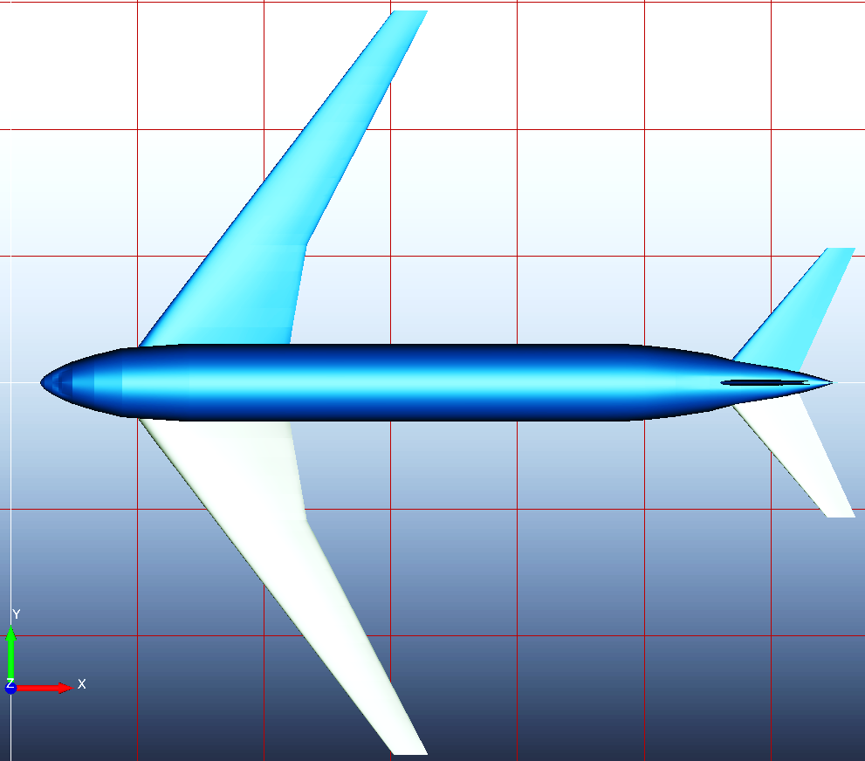
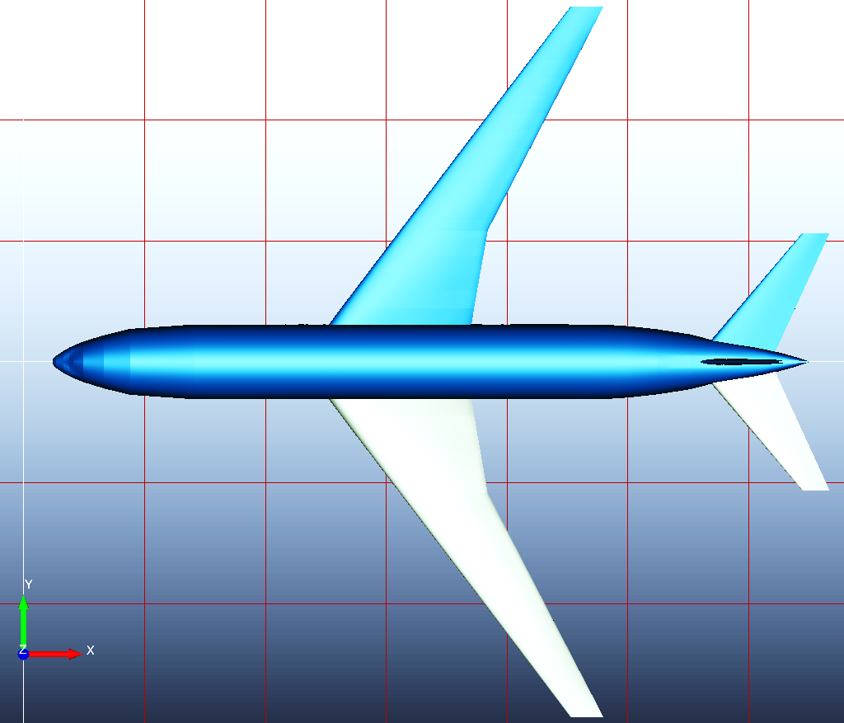
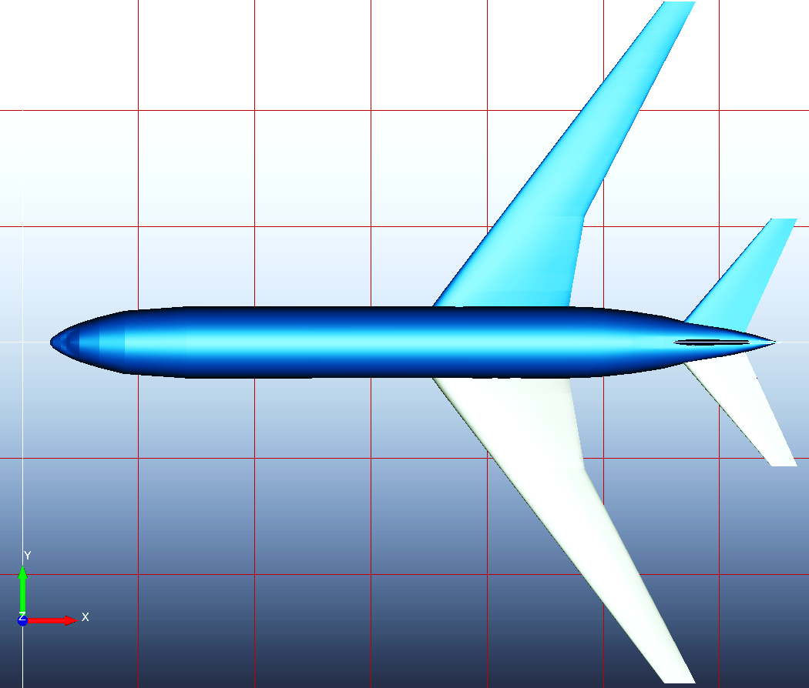
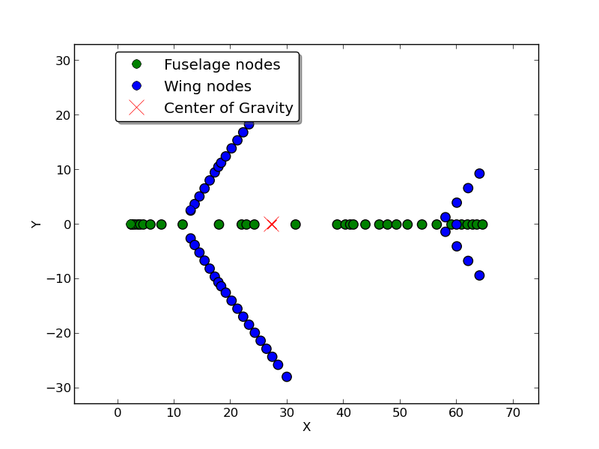
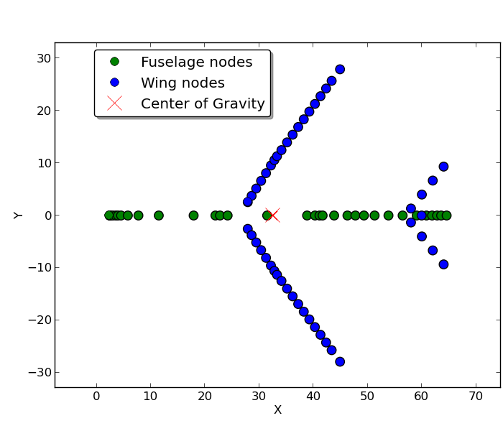
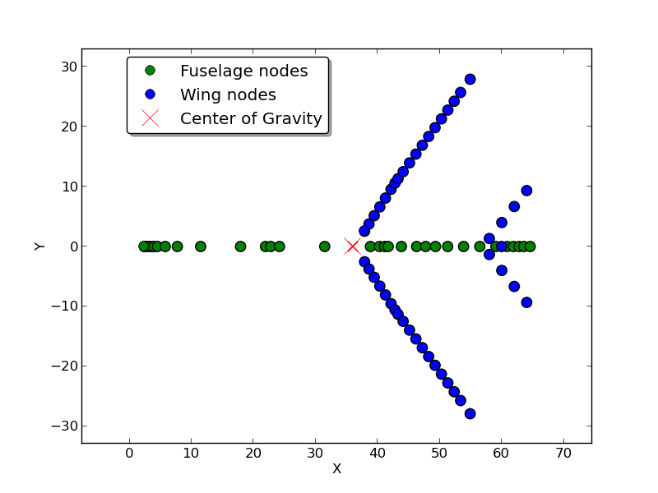
A Weight and Balance evaluation software for conventional and unconventional aircraft design
Balance Test
Stefano Piccini
Notes:
Front - 15m
Back + 10m

Slide 31

A Weight and Balance evaluation software for conventional and unconventional aircraft design
Balance Test
Max Payload (MTOM) |  | MOI [kg$m^{2}$]
Wing Placement (x, y, z) [m] | COG (x, y, z) [m] | $$I_{xx}$$ | $$I_{yy}$$ | $$I_{zz}$$ | $$I_{xy}, I_{yz}$$ | $$I_{xz}$$
L) (9.5, 0.0, 4.4) | (27.3, 0.0, 5.3) | 1.12E+07 | 6.04E+07 | 7.07E+07 | 0 | 2.20E+06
C) (24.5, 0.0, 4.4) | (32,5, 0.0, 5.3) | 1.12E+07 | 4.51E+07 | 5.51E+07 | 0 | 1.03E+06
R) (34.5, 0.0, 4.4) | (36, 0.0, 5.3) | 1.12E+07 | 5.00E+07 | 6.00E+07 | 0 | 2.56E+05
Mass [tons]
MTOM | 269
OEM | 124
FUEL | 96
L
C
R
Stefano Piccini
Notes:
COG varia
Inerzia CRESCE → distanza relativa dal COG CRESCE
Ixz DECRESCE COG davanti ala
Combustibile maggior elemento di influenza
Test No combustibile COG quasi costante

Slide 32




A Weight and Balance evaluation software for conventional and unconventional aircraft design
Box-Wing
 | MTOM [tons] | OEM [tons] | ZFM [tons] | Pax. Nb | Cabin Crew+ Pilots | Range* [1000 km]
Estimated | 62 | 32 | 51 | 180 | 4+2 | 5.3
 | MTOM
COGx [m] | 17.2
Izz [kg$m^{2}$] | 4.35E+06
Stefano Piccini

Slide 33




A Weight and Balance evaluation software for conventional and unconventional aircraft design
ATR72®
 | MTOM [tons] | OEM [tons] | ZFM [tons] | Pax. Nb | Cabin Crew+ Pilots | Range* [1000 km]
Real | 23 | 13 | 21 | 70 | 2+2 | 1.5
Estimated (Error %) | 23 (-) | 13 (-) | 21 (-) | 72 (≈+2) | 2+2 (-) | 1.4 (-3,27)
 | MTOM
COGx [m] | 12.3
Izz [kg$m^{2}$] | 9.94E+05
Aisles: 1, Abreasts: 1+2, Rows: 24
*Range at 50% of Fuel
Stefano Piccini

Slide 34

A Weight and Balance evaluation software for conventional and unconventional aircraft design
B777® Parameters Example
Stefano Piccini

Slide 35

A Weight and Balance evaluation software for conventional and unconventional aircraft design
B777® Masses Comparison
Stefano Piccini

Slide 36


A Weight and Balance evaluation software for conventional and unconventional aircraft design
B777® Ranges and Inertia Comparison
Stefano Piccini

