Slide 1
UNIVERSITÀ DEGLI STUDI DI GENOVA
Scuola Politecnica
DIME
Ingegneria Meccanica-energia E Aeronautica
Superhydrophobic surfaces:
analysis for drag reduction
Supervisor: Alessandro Bottaro
Nicolas Mazellier
Candidate: Sofia Pavese
March 2024

Slide 2
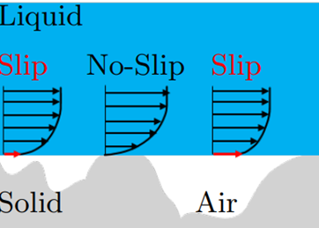
WHAT ARE THE SUPER-HYDROPHOBIC SURFACE?
SURFACE TEXTURING ​
A superhydrophobic surface is the result of the coupling between:​
Koch et al (2009)
Property: capture air/vapor within the roughness
CHEMICAL PROPERTIES
Reduction of the SKIN FRICTION : slip condition
N. Bettaieb (2022)

Slide 3
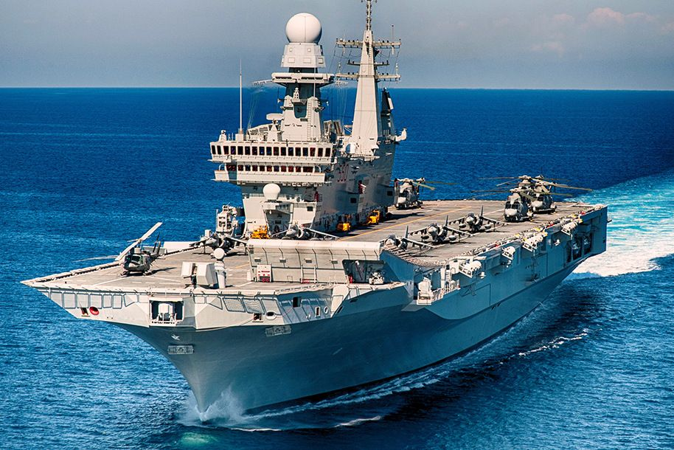
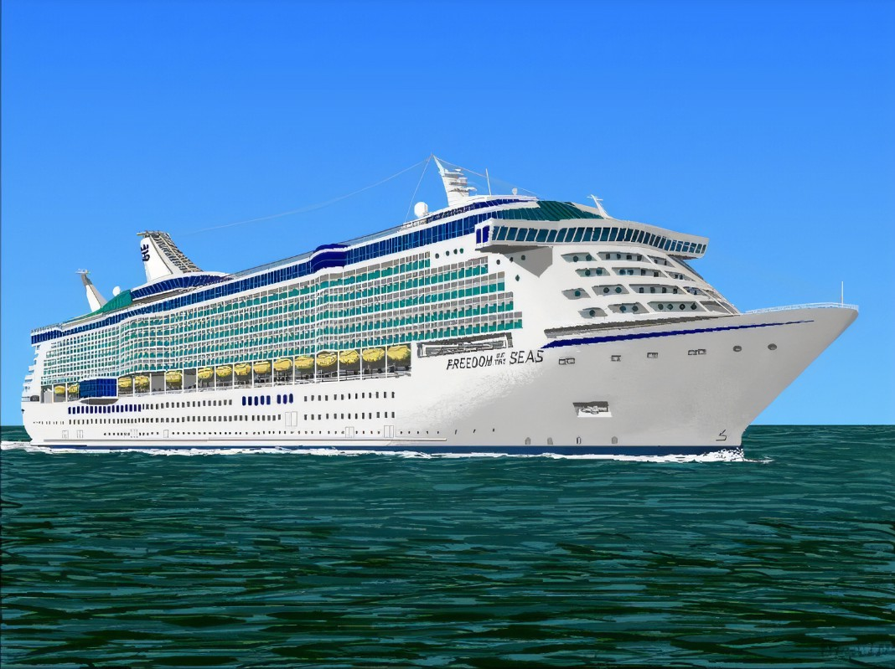
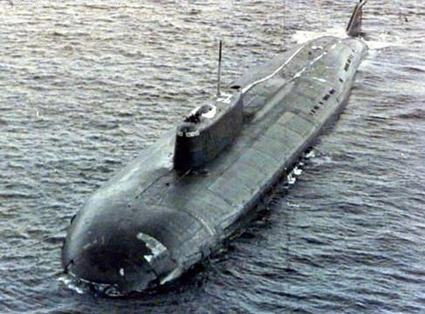
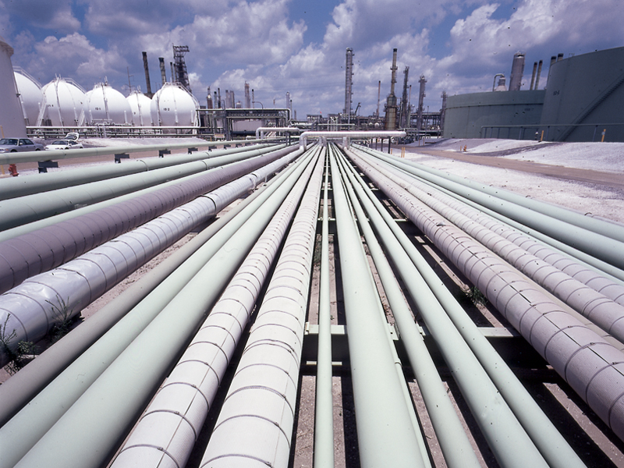
PRACTICAL APPLICATION
Military context
Civil context
DRAG REDUCTION
Fuel consumption reduction
Atmospheric pollution reduction

Slide 4
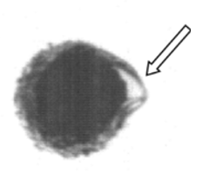
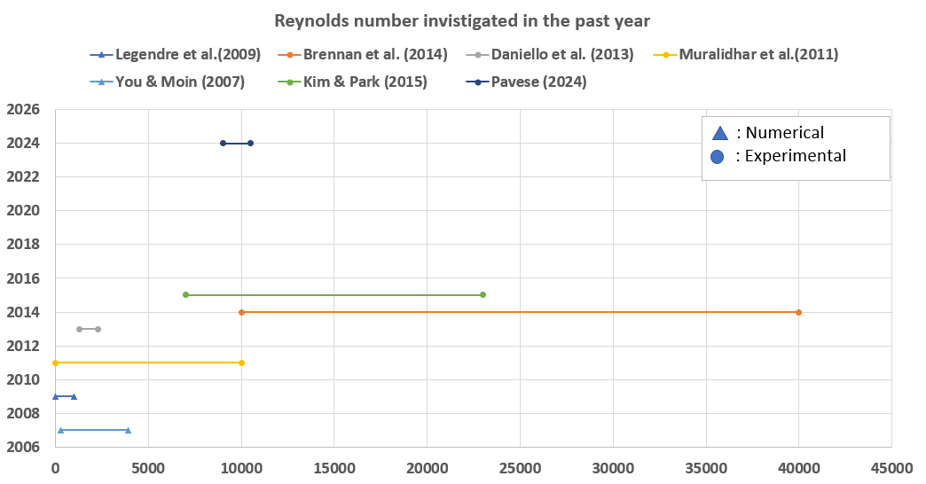
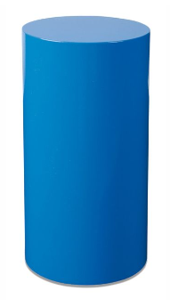
PREVIOUS STUDIES
Marco Castagna [2016-2019]
?
?
PRISME laboratory
Noura Bettaieb [2022]
?
?

Slide 5
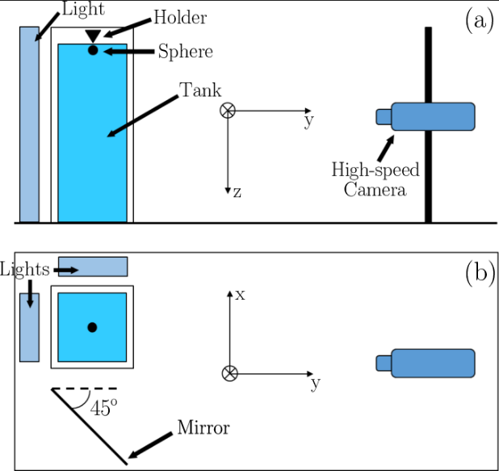
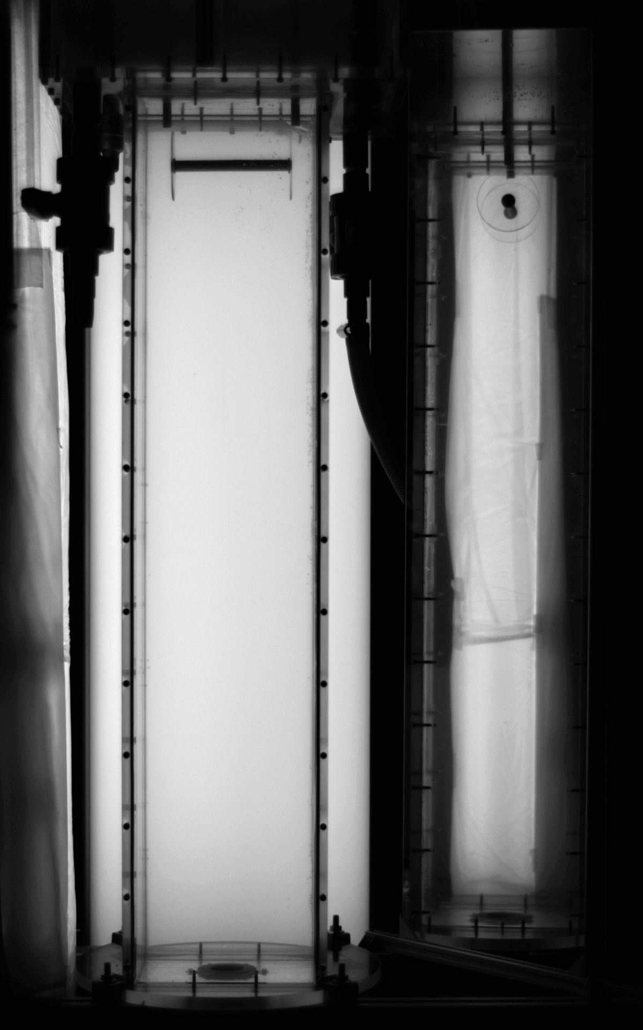
EXPERIMENTAL SET-UP
Marco Castagna (2019)
cylinder

Slide 6
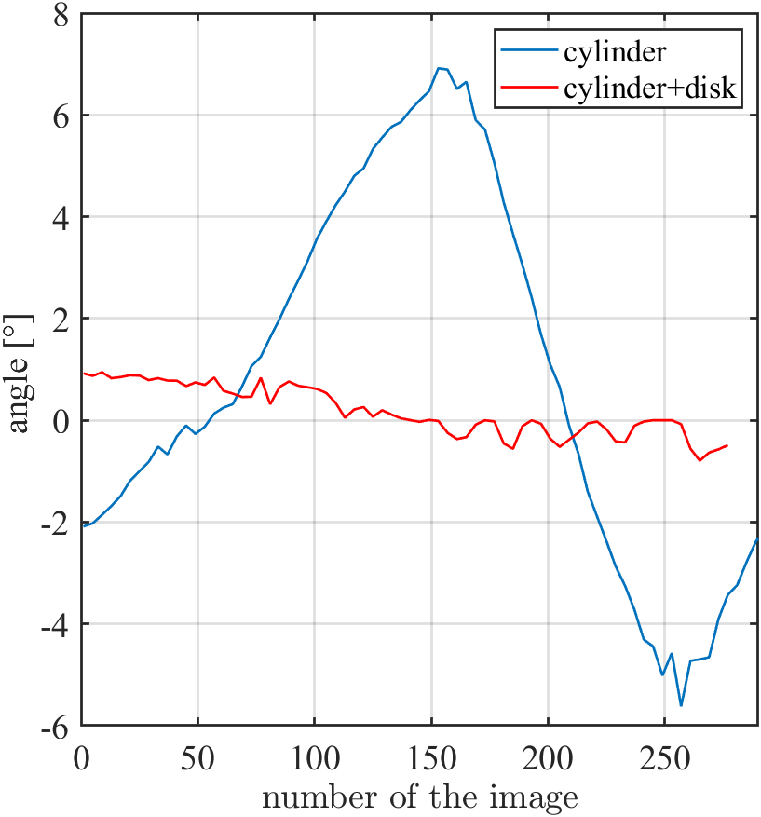
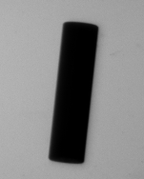
DISKS AT THE EXTREMITIES
Inspired by the experiments of Horowitz and Williamson (2010) two disks are added.
The disk are designed to stabilize the tilting movement of the cylinder
Issue for the crosscorrelation, particularly concerning the mirror section, resulting in inaccurate velocity measurements
Moreover…
Beneficial in preventing the cylinder from impacting the tank bottom→ crucial to avoid damage of the SH surface
0.1
0.2
0.3
0.4
0.5
0.6
t[s]

Slide 7
HOW CAN WE EVALUATE THE Cd?
z
Drag
Archimedes Force
$$ΣF=ma$$
Drag
$$−m_{s}g+\frac{1}{2}{\text{ρ}}_{L}DLu^{2}c_{d}+\frac{πd^{2}}{4}Lρ_{L}g=m_{s}\frac{du}{dt}+\frac{1}{2}m_{l}\frac{du}{dt}$$
Weight
Weight
Archimedes Force
Let us consider the segment wherein the final velocity is attained:
u=cost → $\frac{du}{dt}=\text{0}$
$${−m}_{s}g+\frac{1}{2}{\text{ρ}}_{L}DLu^{2}c_{d}+\frac{πd^{2}}{4}Lρ_{L}g=0$$
It is possible to control all the parameters, while building the experiments
Unknown parameter

Slide 8
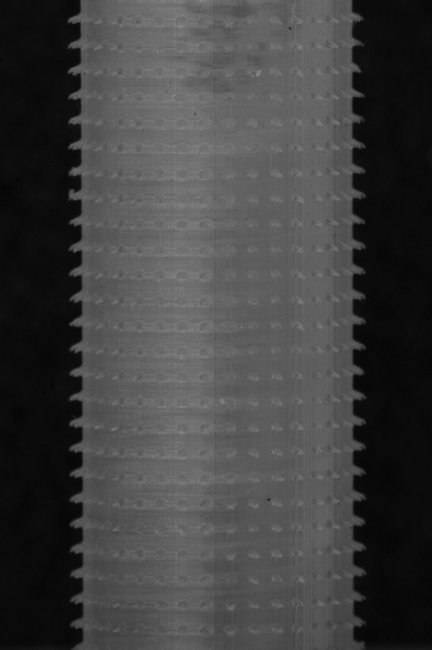
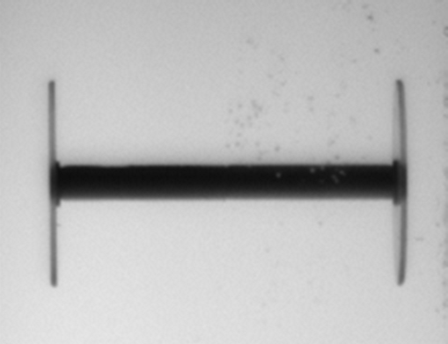
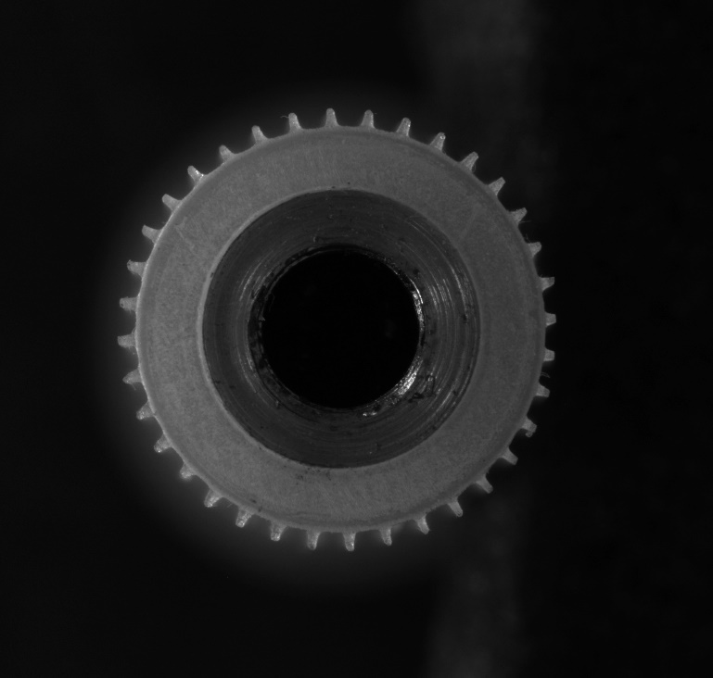
CREATION OF THE GEOMETRY
CAD image
Real cylinder

Slide 9
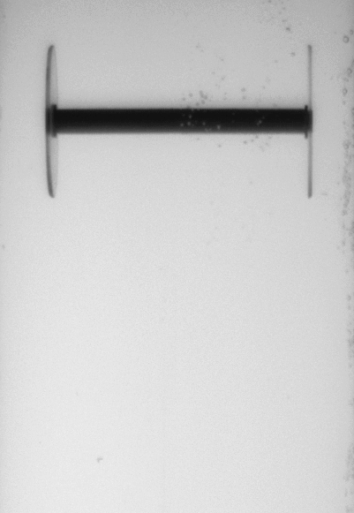
HOW DID WE CHOOSE THE SURFACE ROUGHNESS?
$${We}_{\text{λ}}=\frac{ρV^{2} \text{λ}}{γ}$$
Surface tension
λ
w
${{We}_{\text{λ}}}_{crit}$=0,3
Instability of the air layer

Slide 10
CYLINDER CHARACTERIZATION
D
 | Cylinder 1 | Cylinder 2 | Cylinder 2 | Cylinder 3 | Cylinder 4 | Cylinder5 | Cylinder6 | Cylinder7
D [mm] | 15
L [mm] | 137
Aspect Ratio (L/D) | 9.13
H(mm) | 0 |  | 0.69 |  | 0.49 |  | 0.46
λ=w [mm] | 0 |  | 0.39 |  | 0.48 |  | 0.83
λ/H | 0 |  | 0.57 |  | 0.98 |  | 1.80
Coating | no |  | yes | no | yes | no | yes | no
L
H
λ
w

Slide 11
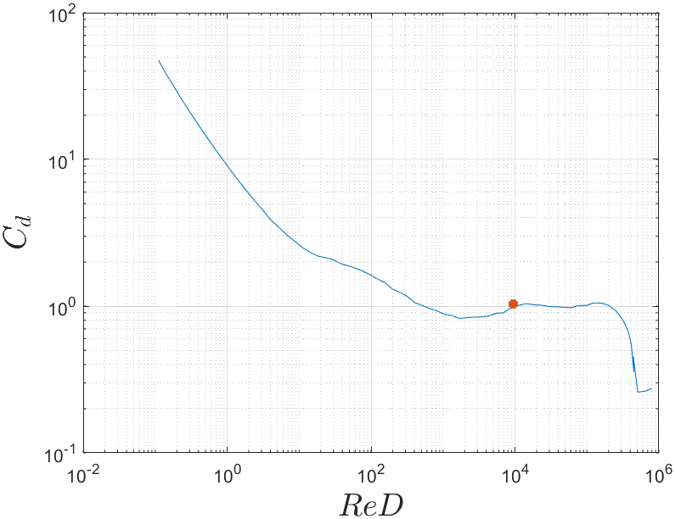
Cd REDUCTION: REFERENCE CASE
First experiment → smooth cylinder
The results align with the information documented in the literature

Slide 12
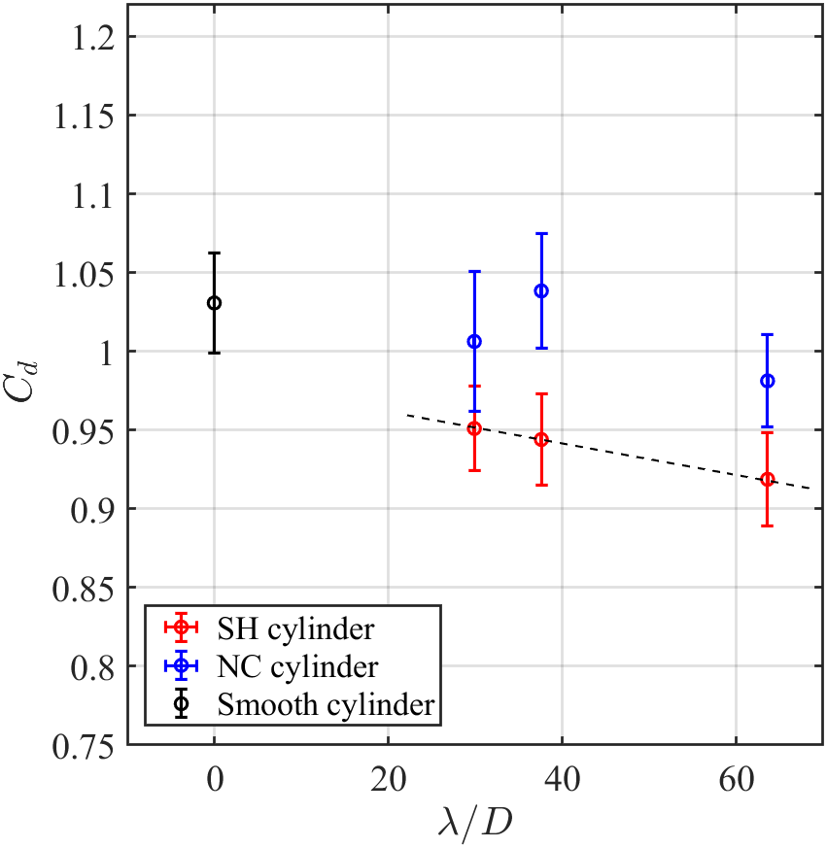
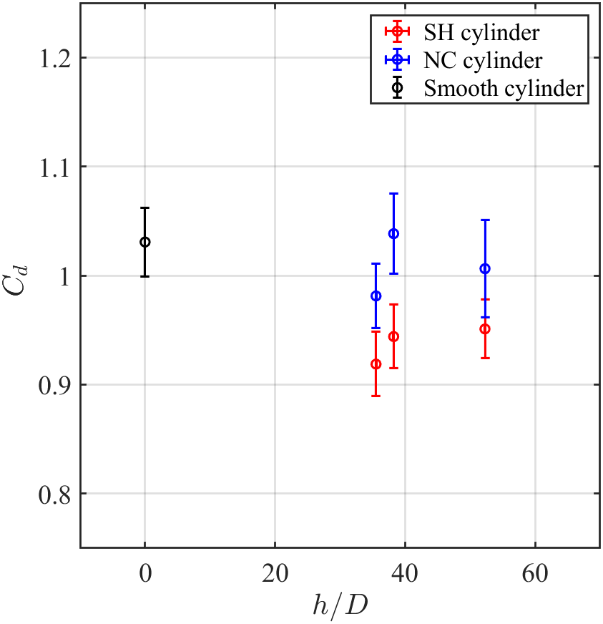
Cd REDUCTION : ROUGHNESS PARAMETER INFLUENCE

Slide 13
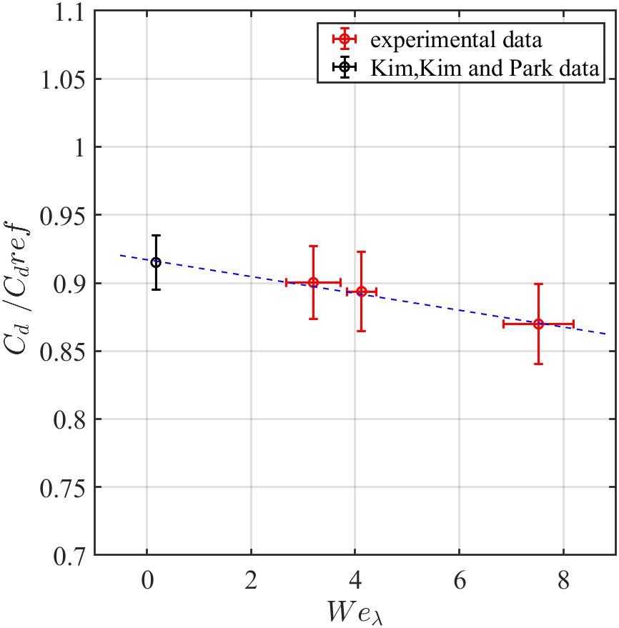
Cd REDUCTION : ROUGHNESS PARAMETER INFLUENCE
$${We}_{λ}=\frac{ρu^{2}λ}{μ}$$
The experimental data points reveal a linear interpolation
This line also fits the results reported by Kim, Kim and Park (2015)
Concluding, it is possible to state that…
$$λ exhibits the most significant influence$$

Slide 14
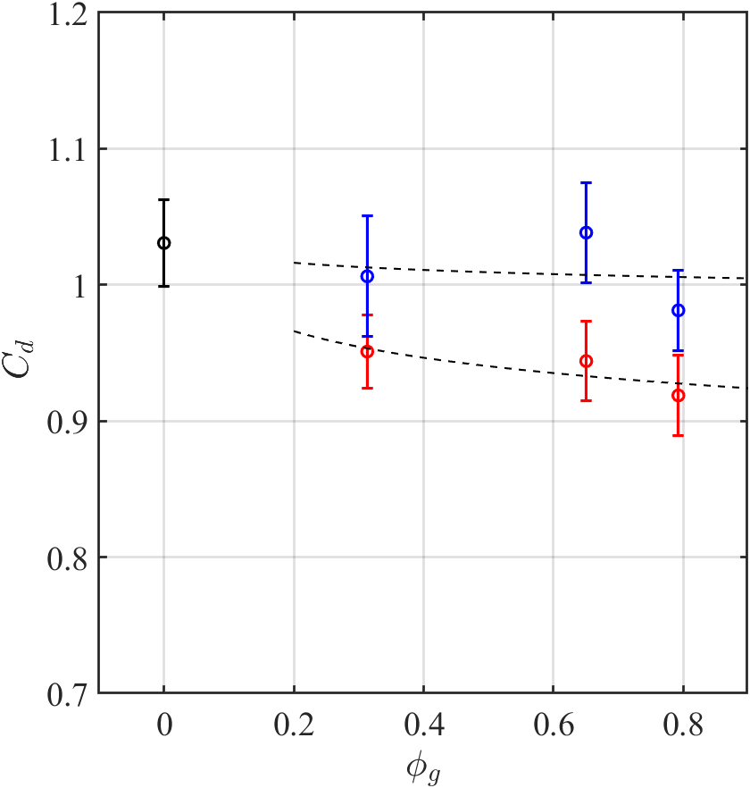
Cd REDUCTION : ROUGHNESS PARAMETER INFLUENCE
$$Φ_{g}=\frac{A_{air−water}}{A_{total}}$$
It doesn’t change just the gas fraction but also $h$and $λ$
This agrees with the paper of M.A. Samaha et al (2011):
$$C_{d} \underset{⇒}{} Φ_{g}$$

Slide 15
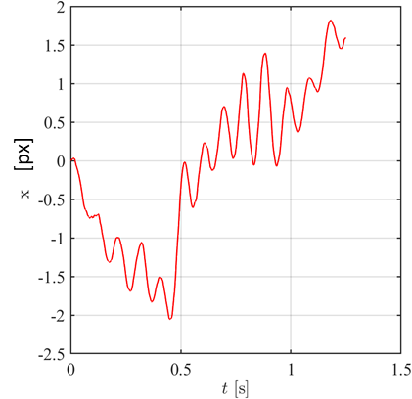
CONCLUSIONS AND PERSPECTIVE
The reduction in aerodynamic drag is primarily influenced by the parameter λ (space between two pillars). Nevertheless, it is crucial to conduct an in-depth analysis of alternative surface roughness forms to achieve a more comprehensive understanding.
Looking ahead:
- examining the impact of vortex release on the trajectory in the Y-axis.
y
- deepening the deformation of the air layer.

Slide 16
Thank you for your attention

Slide 17
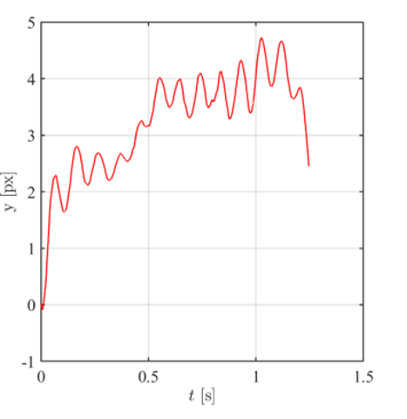
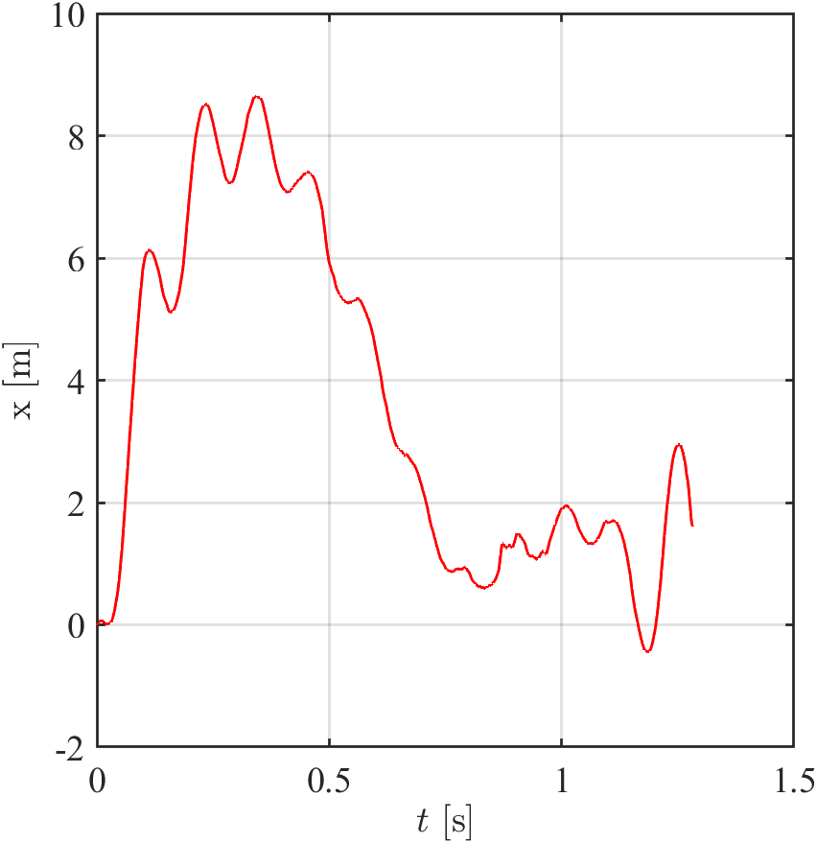
Y-CYLINDER TRAJECTORY
Cylinder 1 (reference)
Cylinder 7 (no coating)
Cylinder 6 (coating)
y [px]
y

Slide 18
Y-CYLINDER TRAJECTORY
St = 0,18 (reference)
$$St=\frac{fD}{V}$$
St = 0,20 (no coating)
St = 0,17 (coating)
The results agree with the paper of Muralidhar (2011)

