Slide 1
Reliability improvement of gas turbine performance monitoring based on online measurement data processing
Supervisor: Prof. Ing. Alessandro Bottaro
Supervisor: Dott. Ing. Cyrille Bricaud
Candidate: Diego Fancello
Genoa, 26 Marzo 2024

Slide 2
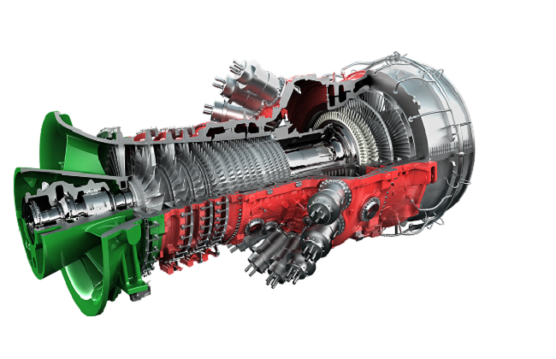
Ansaldo Energia Switzerland
GT36 Monitoring project:
Accurate evaluation of gas turbine power plant performance over life time
Monitor performance degradation to anticipate outage
Thesis target
Reliability improvement of gas turbine performance monitoring based on online measurement data processing
Secondary task: improve the automation of the monitoring process

Slide 3
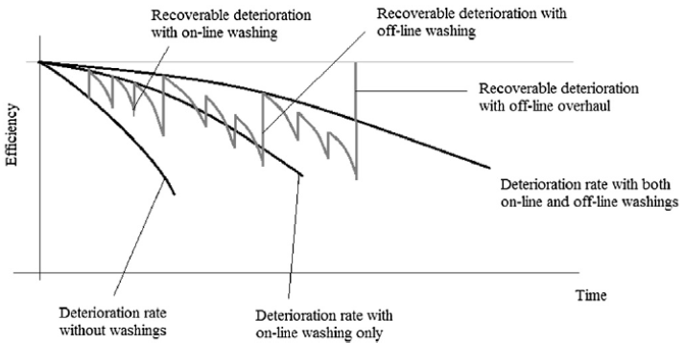
Chalenges of perfomance monitoring
Degradation detecting due to:
Compressor Fouling
Clearance change
Seal damage
Prevent outage with regular monitoring
Identify sensor degradation leading to incorrect measurements
Distinguish performance degradation and sensor degradation
A.Massardo, Impianti per l’energia, 2021

Slide 4
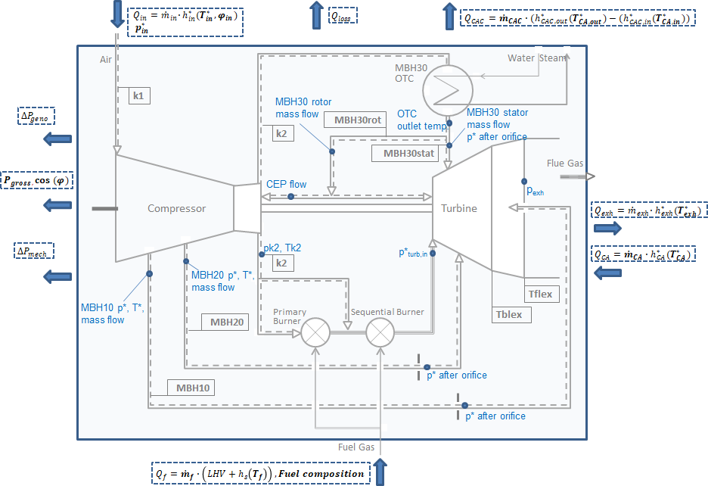
Performance evaluation
To evaluate performance, it is necessary to have:
Measurements
Performance monitoring tool suite
Outer heat balance:
Input:
Power, GT exhaust temperature, fuel massflow, fuel composition, cooling air massflow, ambient conditions
Output:
Compressor inlet massflow
Component performance analysis:
Performance model it’s needed
Input:
Compressor discharge pressure and temperature, cooling air massflow, pressure and temperature, inlet and exhaust pressure drop, VIGV position
Output:
Compressor, Turbine efficiency
Turbine Inlet temperature

Slide 5
Performance monitoring tool
Gas Turbine model:
Each component is characterised by variables, parameters, the equations describing its behaviour and libraries containing characteristic maps of the same;
The model is built at the design stage and is updated over time;
Heat balance:
Heat balances are nothing more than energy balances on control volumes;
Use measurements and assumption as input;
it is also necessary to integrate libraries containing the thermodynamic properties of the fluids flowing through each component.
Synthesis:
Are calculations that provide an estimate of how the gas turbine should perform according to the characteristics of the components;
Give a reference to compare the actual gas turbine state, ansyn factor;
Solver:
Newton Raphson metod
Flexibility in the choice of inputs

Slide 6
Ansyn factor
Definined as:
Delta: $measured\backslash calculated quantity −predicted quantity$
Ratio: $\frac{measured\backslash calculated quantity}{predicted quantity}$
Purpose:
Monitoring hardware degradation
Measurements issues
Features:
Dependent on VIGV position
Dependent on model quality
Indipendence form ambient conditions

Slide 7
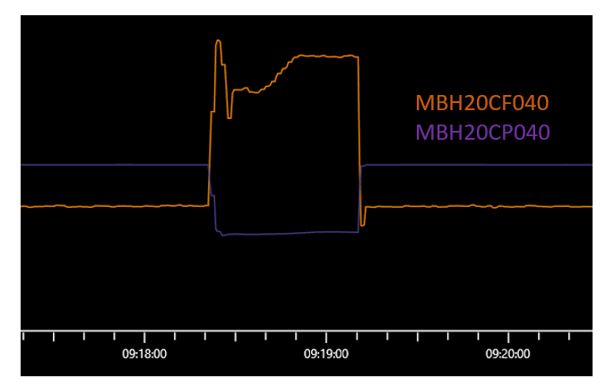
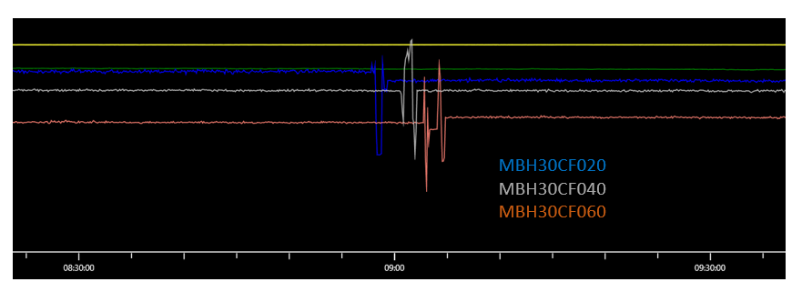
Why pre-processing is necessary
The measurements are affected by:
Sensor failure
Fouling of the sensing element
Wrong calibration
Performance degradation
Presence of electromagnetic interference
Mounting errors

Slide 8
Automated heat balance flowchart
START
Criteria for pre-processing of measurements for Heat Balance calculations
Date and Time
Stability criteria
Criteria for pre-processing of measurements for synthesis
Script compare raw measurements and prediction and save the results
Script extracts the measurements from Database and saves them
Folder Raw Data
Folder of processed measures for synthesis calculation
Folder of processed measures for Heat balances
WARNING: Replaced measures
WARNING: Replaced measures
Alpeg calculation
Alpeg calculations
Alpeg calculations
SMOOTHED HEAT BALANCES
PREDICTION
RAW HEAT BALANCES

Slide 9
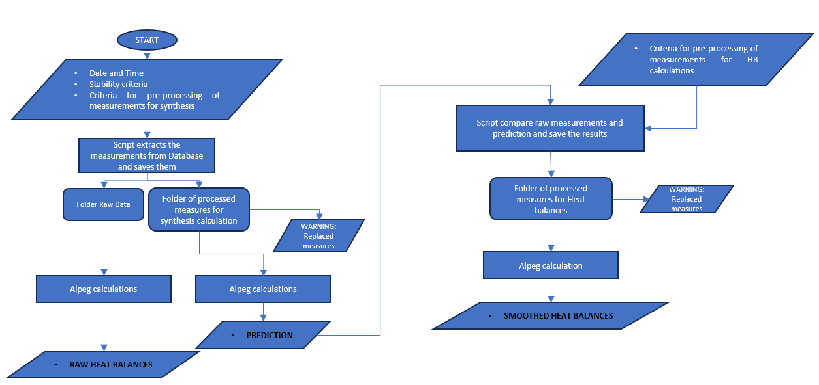
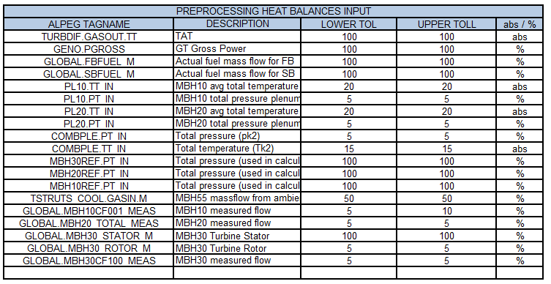
Pre-processing criteria

Slide 10
Pre-processing results

Slide 11
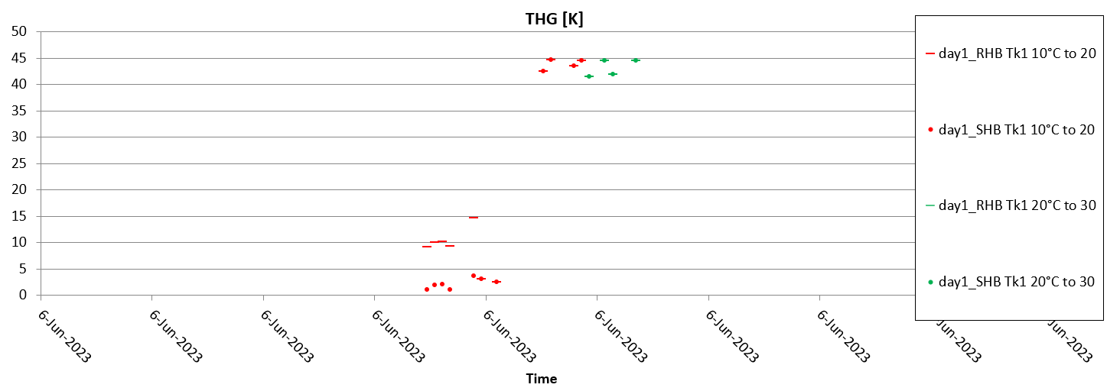
Pre-processing results

Slide 12
Conclusions
The potential of the monitoring system was demonstrated
The accuracy in detecting erroneous measurements by the processing system was demonstrated.
The effect of erroneous measurements on the results of thermal balances was demonstrated, highlighting the importance of a preprocessing system
The system allows dual monitoring of the actual state of the engine and the state of the mounted sensors.
What’s next?
Develop sensitivity on tollerances definition
Improve automation of the monitoring process
Early warnings in the event of serious damage

Slide 13
Thank you for your attention
Genoa, 26 Marzo 2024

