Slide 1


Fluid flow over slippey
surfaces
Allievo
Remo Fadda
Relatore
Prof. Alessandro Bottaro
Co-relatore
Dr. Essam Nabil Ahmed

Slide 2

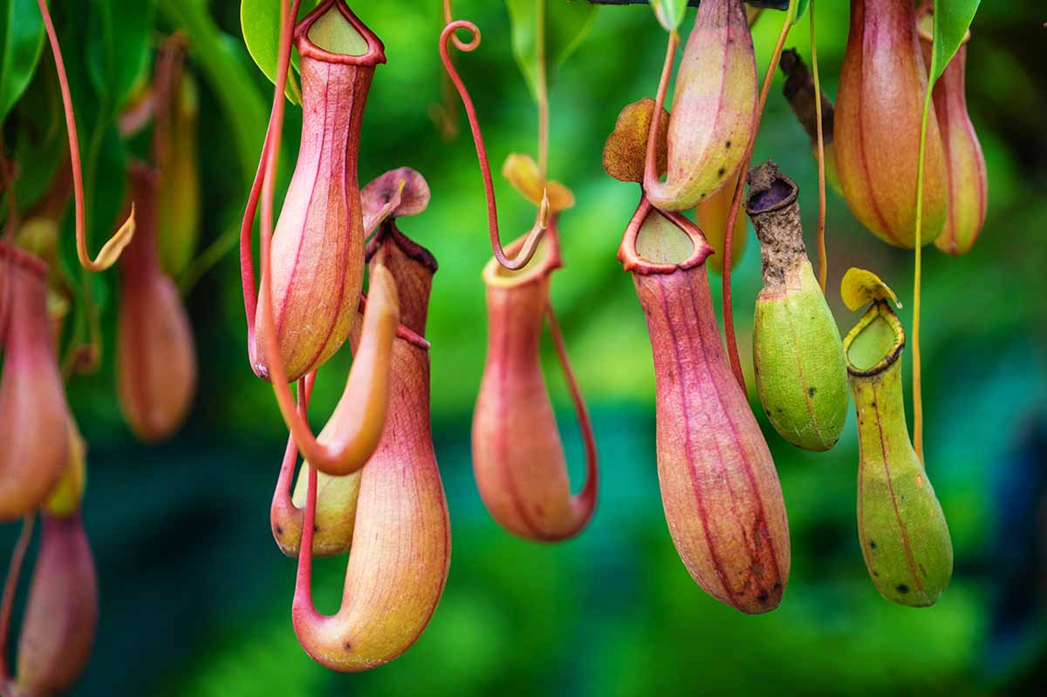
What is a slippery surface?
It is a solid surface in which the roughness is filled with some lubricant.
Superhydrophobic surfaces (SHS)
Liquid-infused surfaces (LIS)
Lotus leaf
Nephentes pitcher plants

Slide 3







What is a slippery surface?
They are capable of reducing wall friction when an external fluid flows over them.
Slippery surfaces can be obtained by chemical match between the solid wall and the lubricant.
Drag reduction framework: a finite velocity is supported at the liquid-lubricant interface, eliminating the no-slip bc where
lubricant is present.
Effective slip length ($λ)$: the equivalent slip required on a smooth surface that would produce the same flow conditions
far away from the composite surface.
Fluid 1
$$ρ_{0}$$
$$μ_{0}$$
Fluid 1
$$ρ_{0}$$
$$μ_{0}$$
$$y$$
$$u_{x}=0$$
$$y$$
$$u_{x}≠0$$
$$x$$
$$x$$
The parameters that mainly affect the performance of such surfaces are:
the viscosity ratio $μ_{R}$, the lubricant depletion $d$ and the groove’s size.
Fluid 2
$$μ_{l}$$
$$ρ_{l}$$

Slide 4
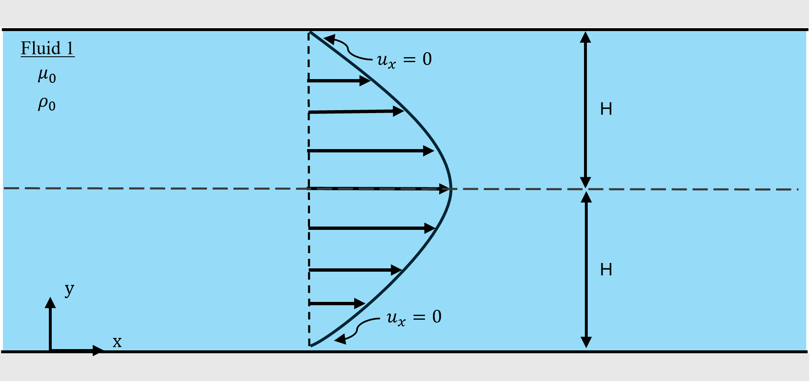
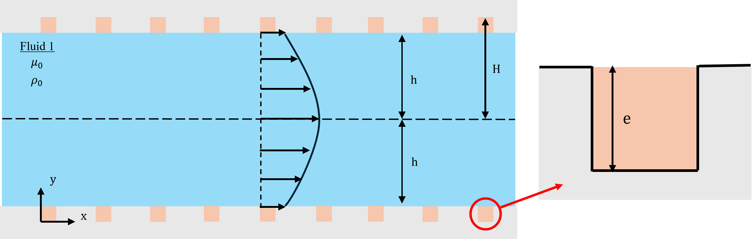


Theoretical Approach
Smooth channel
Laminar, steady, incompressible, fully developed Pouiseille flow
No-slip condition holds everywhere
Symmetric, channel with liquid-infused bc
Laminar, steady, incompressible fluid flow
Navier-slip condition:
$$\hat{y}=e →\hat{u}= {\hat{λ}}_{x} \frac{∂\hat{u}}{∂\hat{y}}$$

Slide 5
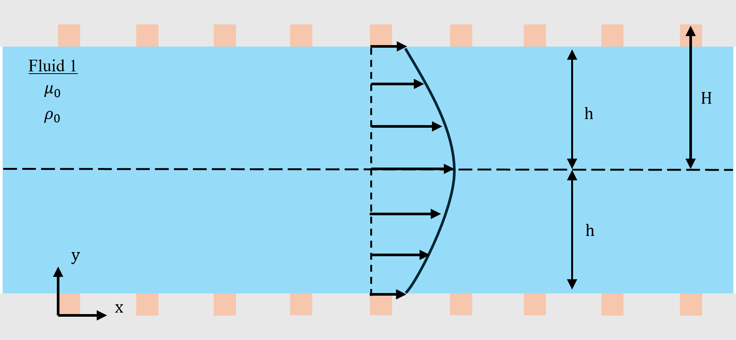
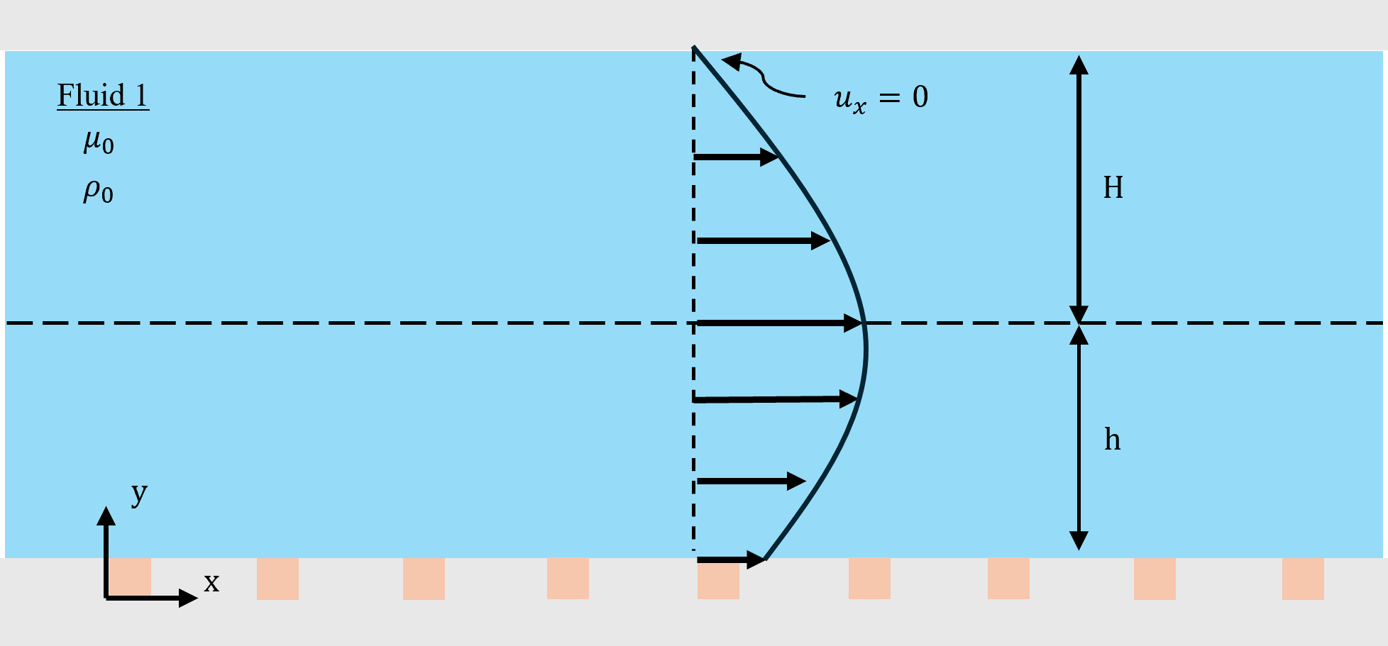
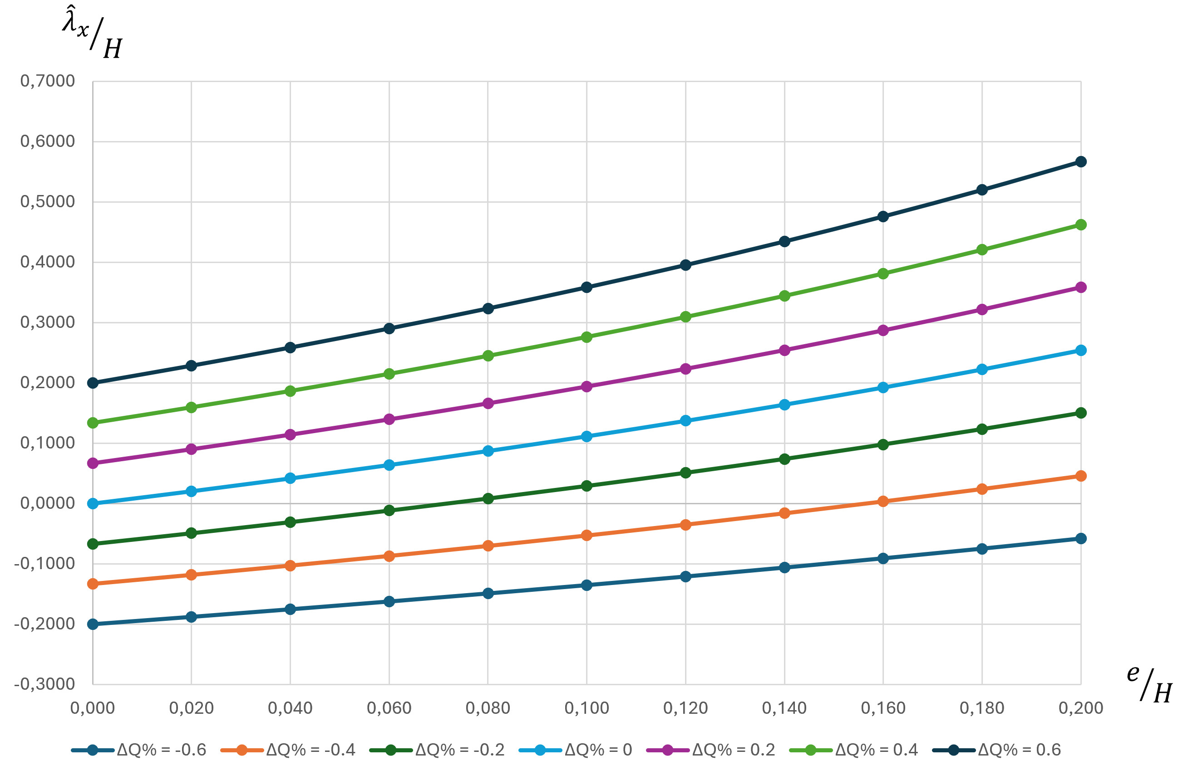
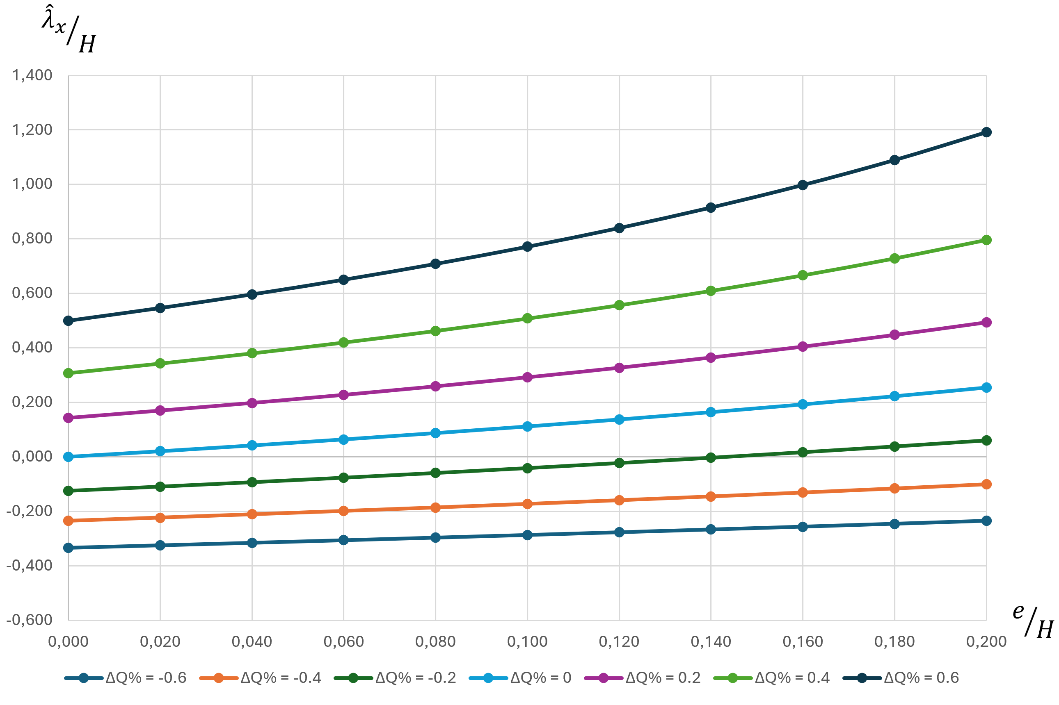
Symmetric channel
Non-symmetric channel

Slide 6

Asymptotic Homogenization
Separation of scales
Macroscopic region
Bulk flow
$$ε= \frac{l}{L}$$
Virtual plane
$$y$$
Virtual plane
$$o$$
$$x$$
Microscopic layer
Effective boundary conditions

Slide 7


Asymptotic Homogenization
Governing equations (Navier-Stokes)
Definition of appropriate scales for the two regions
Normalization of all the parameters
Dimensionless governing equations and boundary conditions:
no-slip at the solid wall
continuity of the velocity vector at the virtual plane
continuity of the traction vector at the virtual plane
Asymptotic analysis
General solution
Effective boundary conditions
$$λ$$
Navier-slip coefficient
$$k^{itf}$$
Interface permeability coefficient

Slide 8
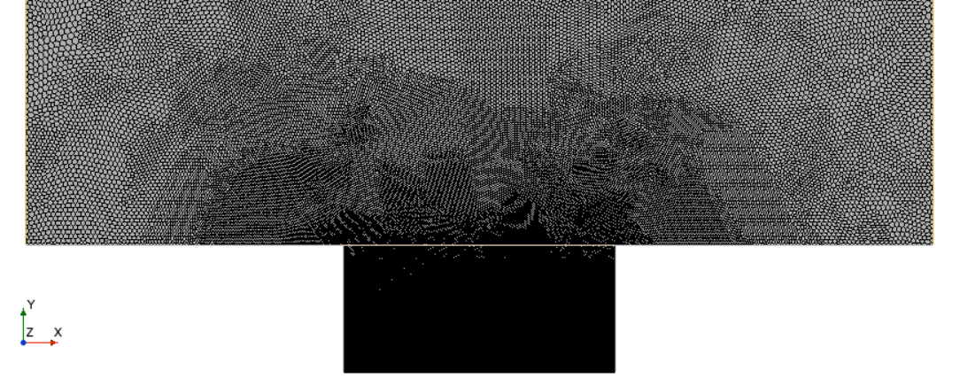
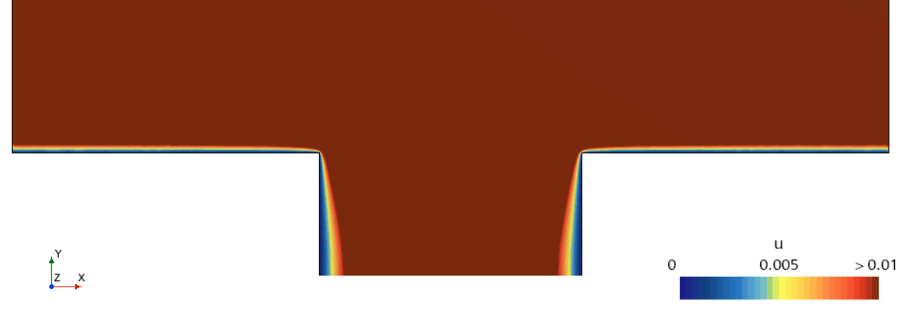


Modelling and Simulation
We adopted Star-CCM+ as CFD software for our simulations.
Sketch of the domain
Mesh and Velocity field
$$l$$
no-slip
periodic boundary
conditions
slip
$$y_{∞}$$
$$α$$
$$d$$

Slide 9
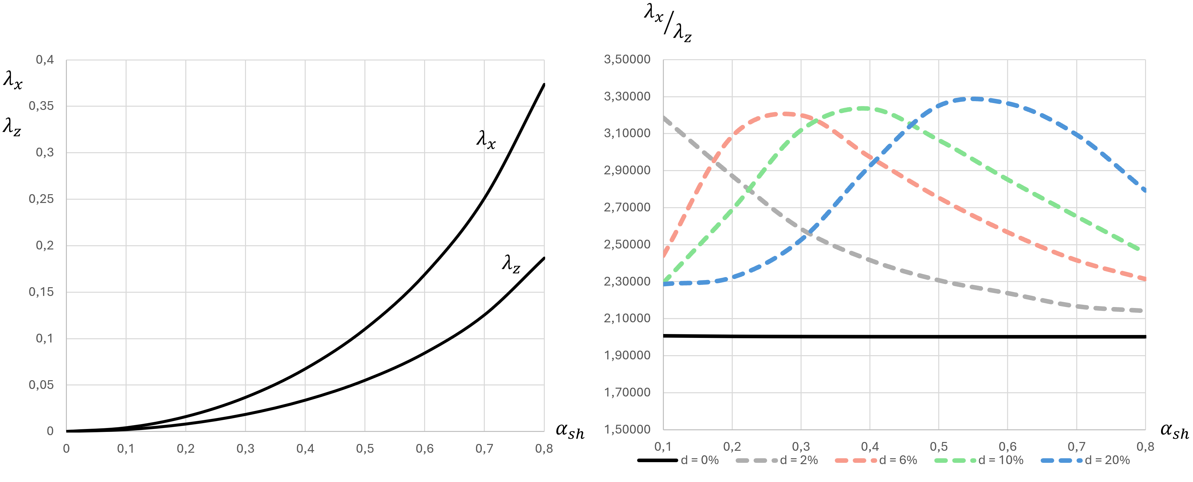

Superhydrophobic surfaces
Laminar flows over longitudinal
square grooves
$$λ_{x}=2λ_{z}= \frac{l}{π} \left\{sec\left[\frac{π}{2}(1 −α)\right]\right\}$$
Philip (1972)

Slide 10
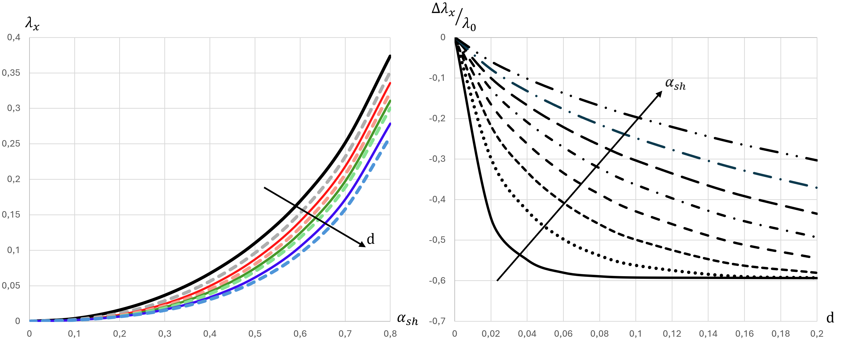
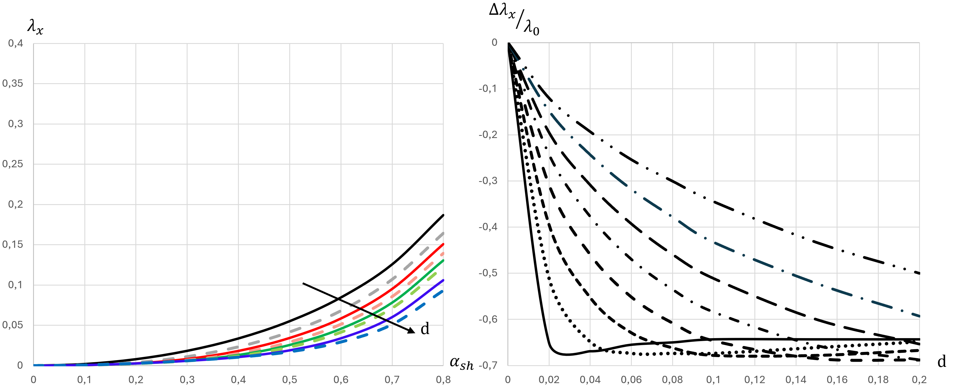
Superhydrophobic surfaces
Longitudinal configuration
Transverse configuration

Slide 11
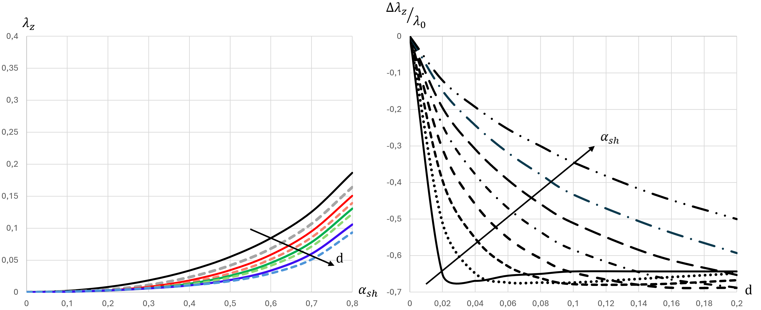
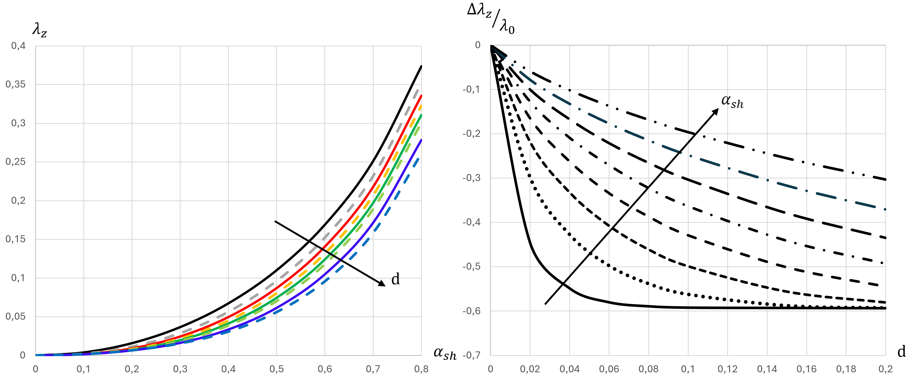
Superhydrophobic surfaces
Longitudinal configuration
Transverse configuration

Slide 12
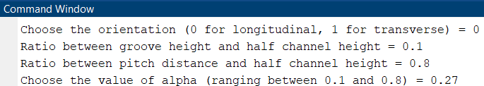
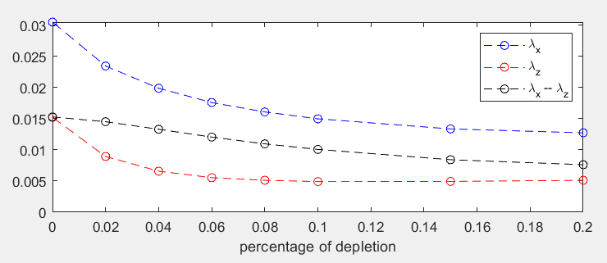
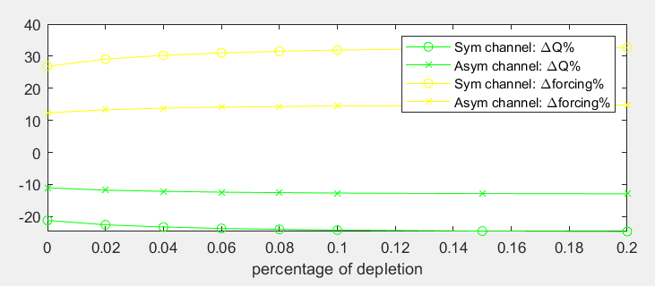
MATLAB code
By combining the theoretical approach and the results from numerical simulations, a simple MATLAB code has been developed
to create useful and concrete correlations.

Slide 13


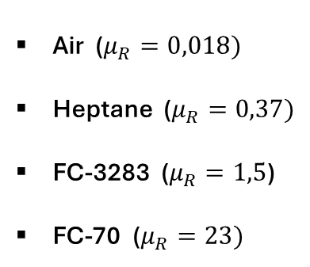
Liquid-infused surfaces
λx
Air ($μ_{R}=0,018)$
Heptane ($μ_{R}=0,37)$
FC-3283 ($μ_{R}=1,5$)
FC-70 ($μ_{R}=23)$
d = 0%
d = 10%
d = 20%
$$μ_{R}= \frac{μ_{lubricant}}{μ_{water}}$$

Slide 14
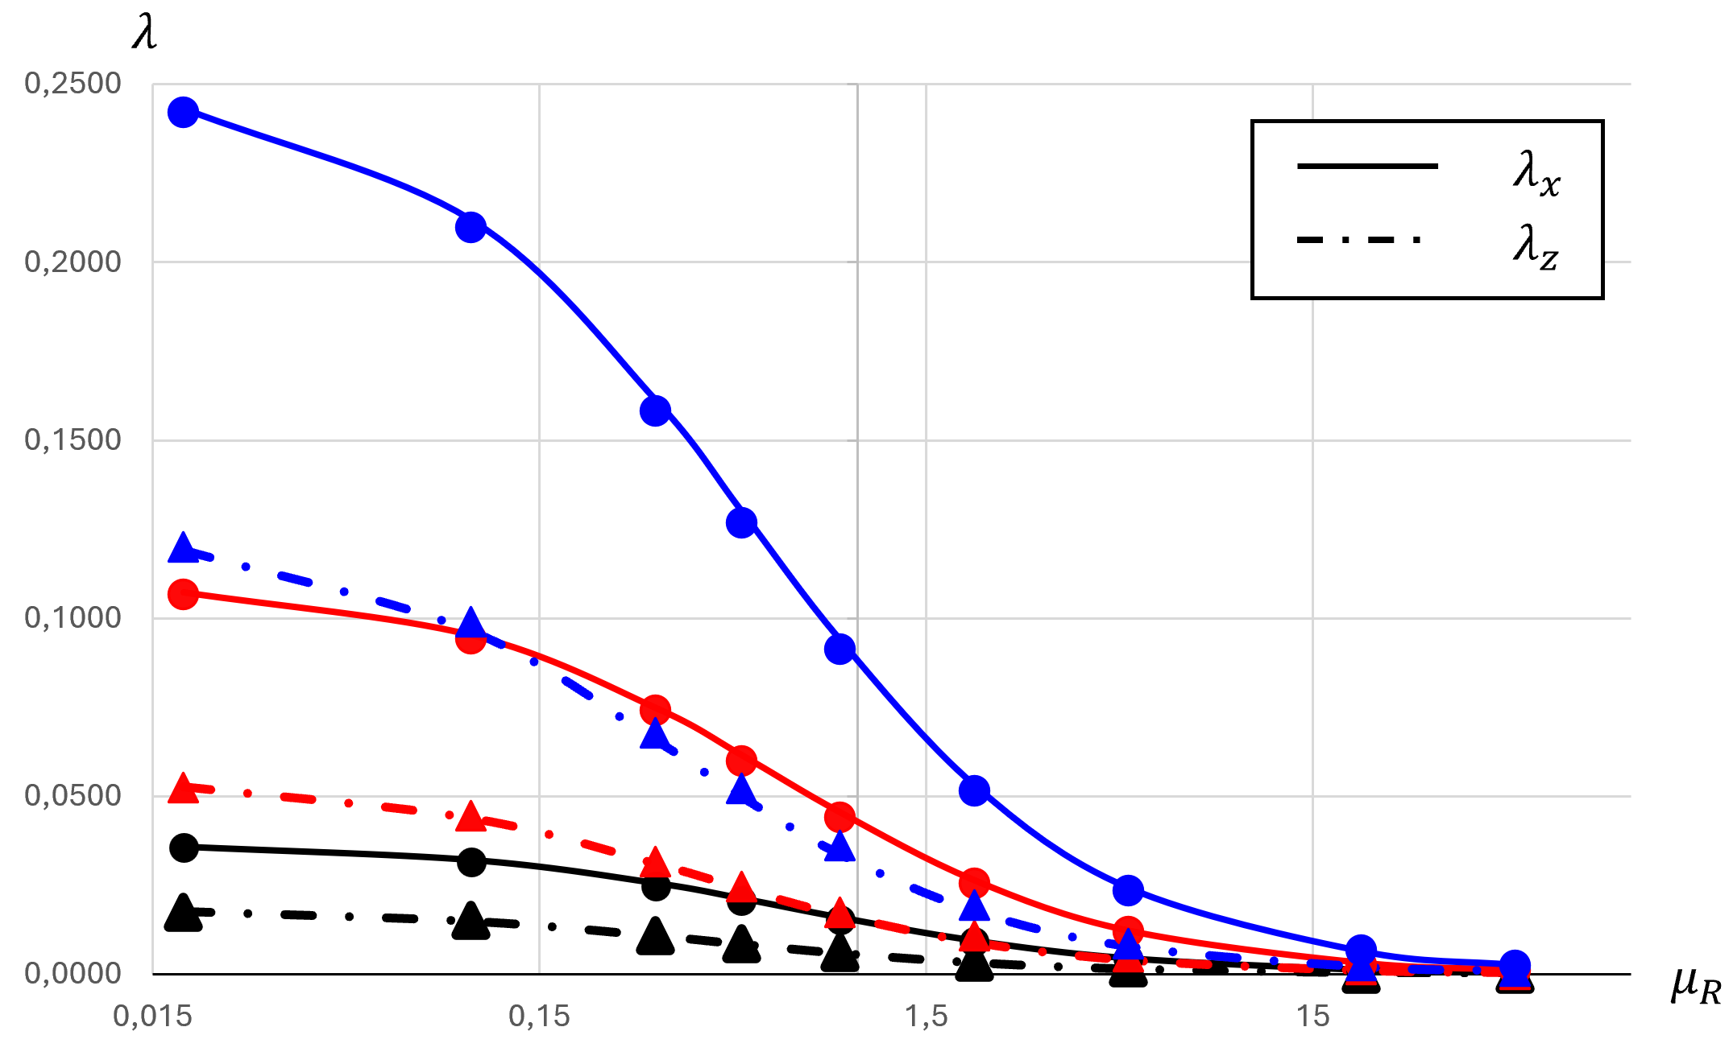
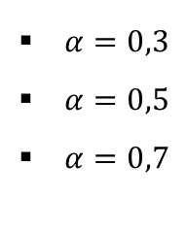
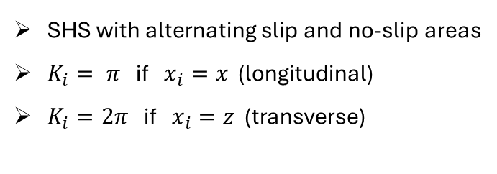
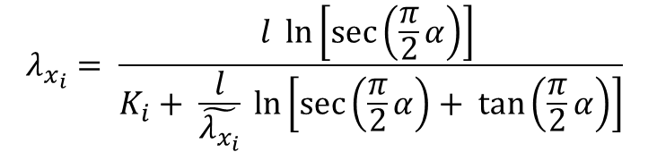
Liquid-infused surfaces
SHS with alternating slip and no-slip areas
$K_{i}= π$ if $x_{i}=x$ (longitudinal)
$K_{i}=2π$ if $x_{i}=z$ (transverse)
$$λ_{x_{i}}= \frac{l \ln\left[\sec\left(\frac{π}{2}α\right)\right] }{K_{i}+ \frac{l}{\tilde{λ_{x_{i}}}} \ln\left[\sec\left(\frac{π}{2}α\right)+ \tan\left(\frac{π}{2}α\right)\right]}$$
Belyaev & Vinogradova (2010)
$α=0,3$
$α=0,5$
$α=0,7$
&
: data from Alinovi & Bottaro (2018)

Slide 15
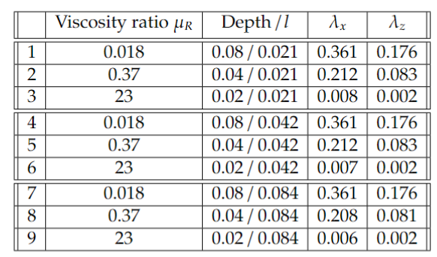

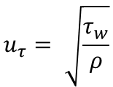

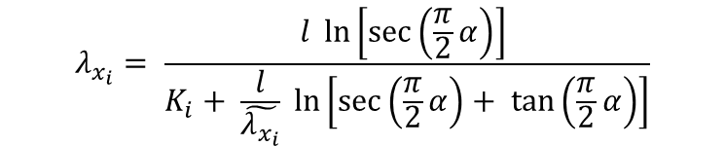


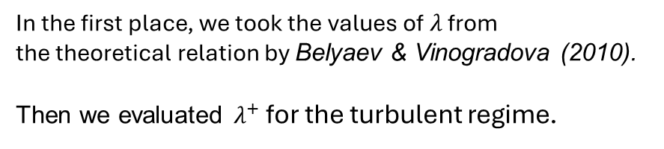
What about turbulence?
Pitch distance in wall units
$$l^{+}= \frac{ρ u_{τ} l}{μ}$$
$$l^{+}$$
$$u_{τ}= \sqrt{\frac{τ_{w}}{ρ}}$$
$$τ_{w}$$
Shear velocity
$λ_{x}^{+}= λ_{x} l^{+}$ and ${ λ}_{z}^{+}= λ_{z} l^{+}$
In the first place, we took the values of $λ$ from
the theoretical relation by Belyaev & Vinogradova (2010).
Then we evaluated $λ^{+}$ for the turbulent regime.
$$λ_{x_{i}}= \frac{l \ln\left[\sec\left(\frac{π}{2}α\right)\right] }{K_{i}+ \frac{l}{\tilde{λ_{x_{i}}}} \ln\left[\sec\left(\frac{π}{2}α\right)+ \tan\left(\frac{π}{2}α\right)\right]}$$

Slide 16
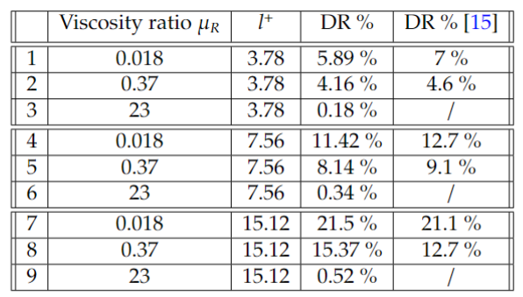


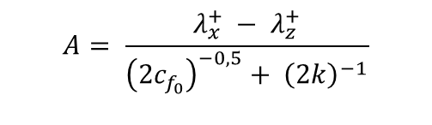
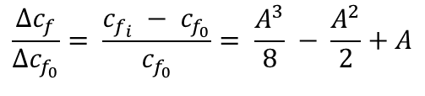


What about Turbulence?
$$\frac{Δc_{f}}{Δc_{f_{0}}}= \frac{c_{f_{i}} − c_{f_{0}}}{c_{f_{0}}}= \frac{A^{3}}{8} − \frac{A^{2}}{2}+A$$
for small values of $l^{+}$
$$A= \frac{λ_{x}^{+} − λ_{z}^{+}}{{\left(2c_{f_{0}}\right)}^{−0,5}+ {\left(2k\right)}^{−1}}$$
$$DR=− \frac{Δc_{f}}{c_{f_{0}}}$$
Percentage change in the
skin-friction coefficient, relative to
the reference case of a smooth wall.
$k=0.4$ Von-Karman constant
$\left[15\right]$ Chang et al. (2019)

Slide 17
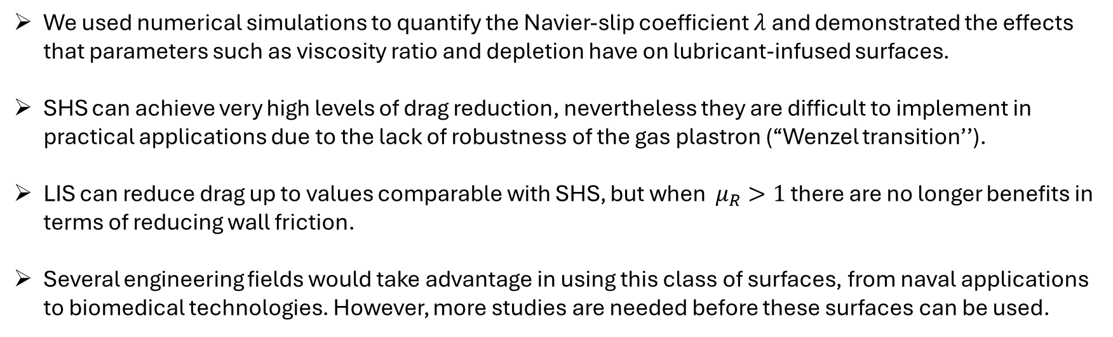
Conclusions
We used numerical simulations to quantify the Navier-slip coefficient $λ$ and demonstrated the effects that parameters such as viscosity ratio and depletion have on lubricant-infused surfaces.
SHS can achieve very high levels of drag reduction, nevertheless they are difficult to implement in practical applications due to the lack of robustness of the gas plastron (‘‘Wenzel transition’’).
LIS can reduce drag up to values comparable with SHS, but when $μ_{R}>1$ there are no longer benefits in terms of reducing wall friction.
Several engineering fields would take advantage in using this class of surfaces, from naval applications to biomedical technologies. However, more studies are needed before these surfaces can be used.

