Slide 1


Numerical investigation of broadband trailing edge noise through large eddy simulations
Candidate:
Rubens Dellepiane
Supervisors:
Alessandro Bottaro (UniGe)
Ardeshir Hanifi, Zhenyang Yuan (KTH)
March 2024

Slide 2
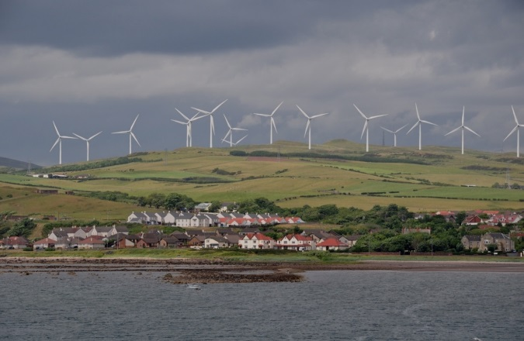

Introduction: the project

Slide 3
Thesis outline
Meshing process
Case set-up
Results analysis and post processing
Conclusions

Slide 4
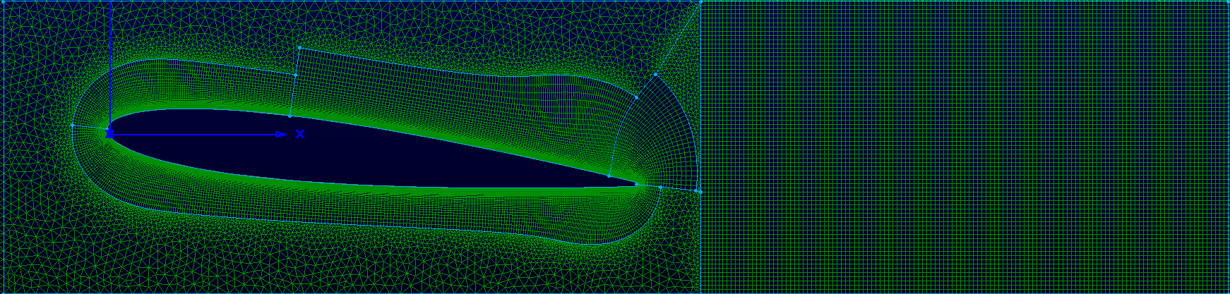
No FST
Grid points: 3’656’579
Degrees of freedom: 483’037’555

Slide 5
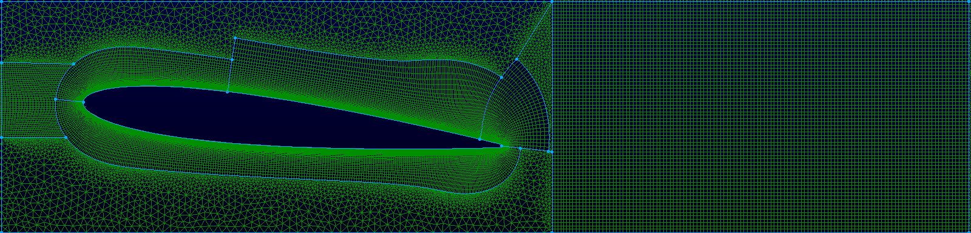
FST
Grid points: 3’867’315
Degrees of freedom: 511’977’480

Slide 6
General case set-up
Re = 200’000
Ma = 0.3
Compressible Navier-Stockes
For the FST LES
Tu = 1 %
Turbulence length scale = 1 (mm)

Slide 7
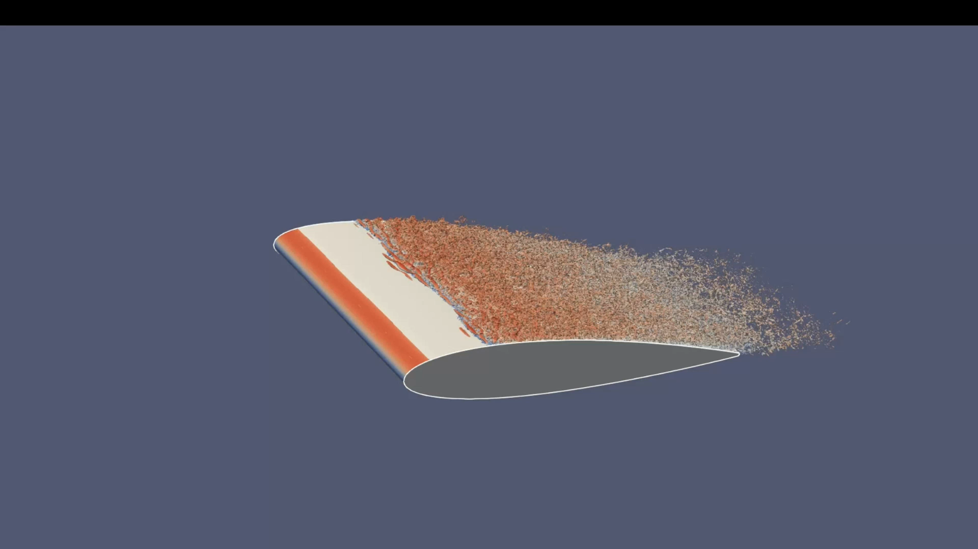
Q-criterion visualization of the FST

Slide 8
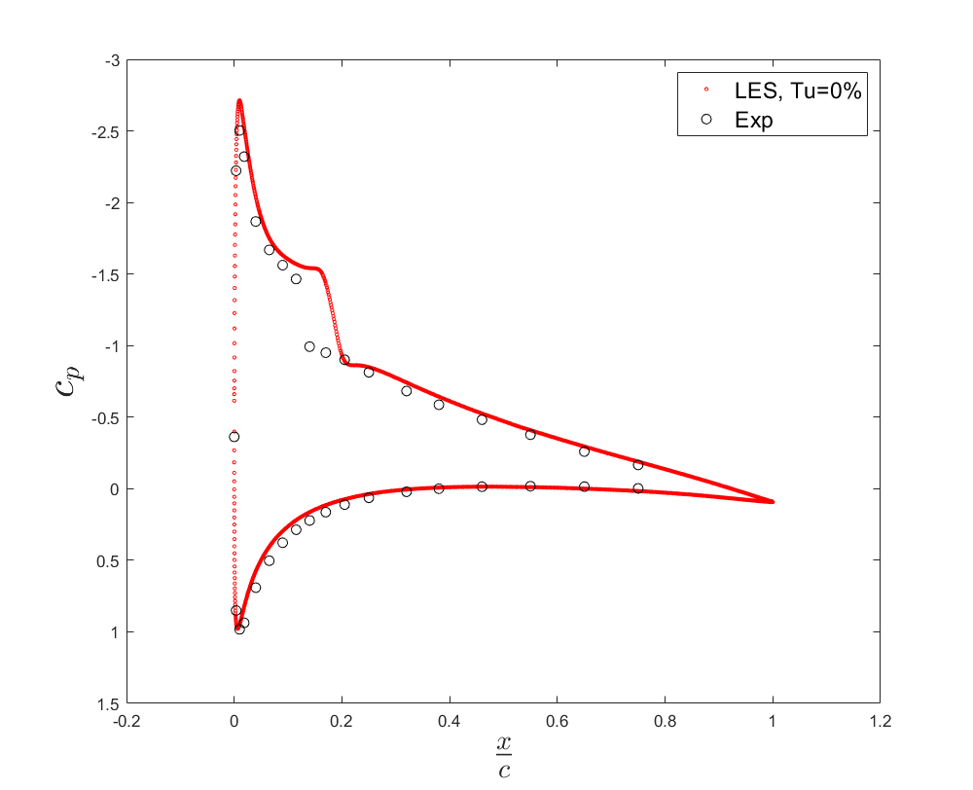
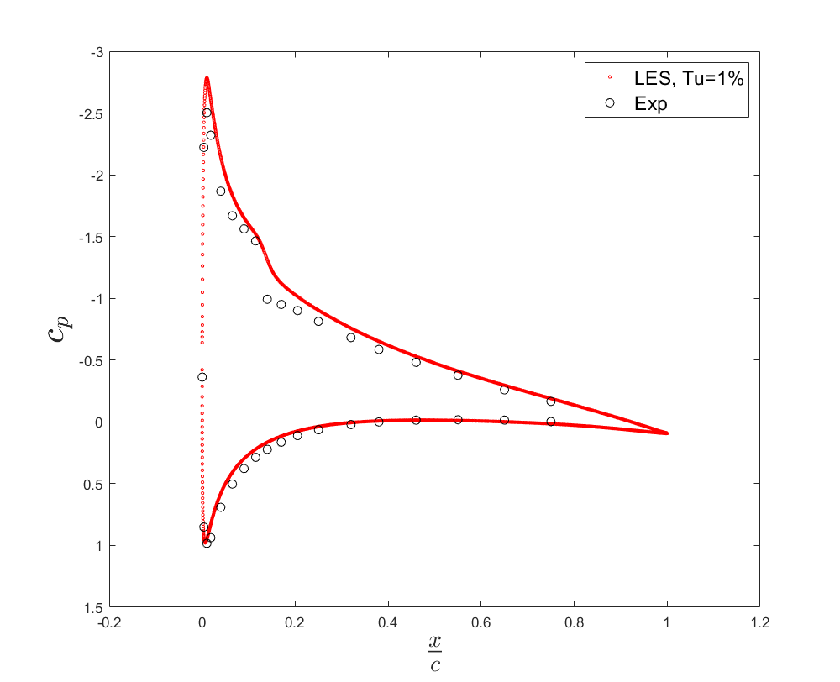
Results
Hydrodynamics
No FST
FST

Slide 9
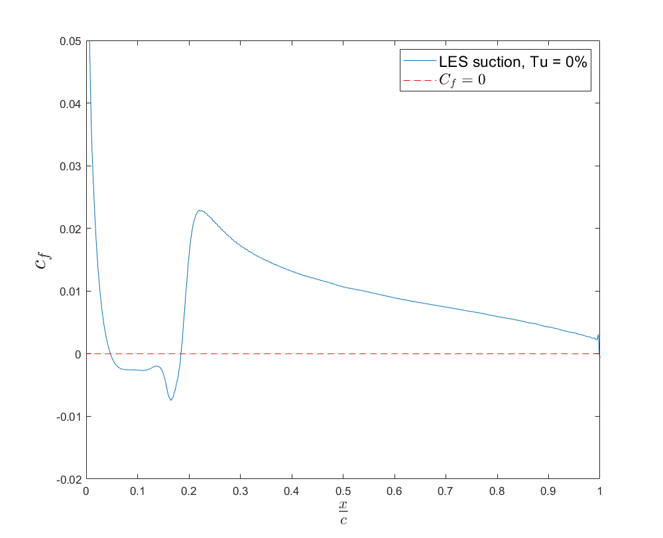
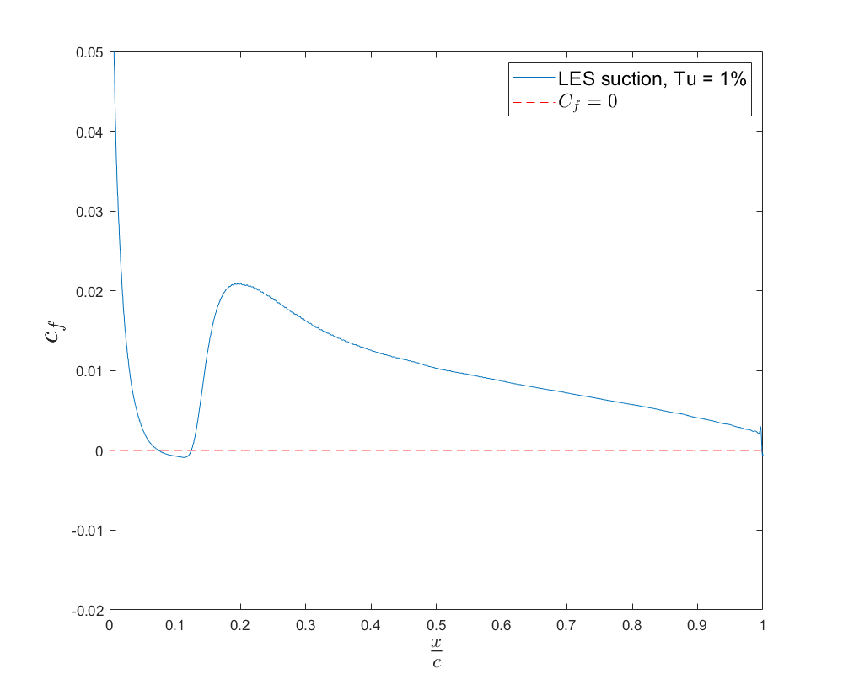
Results
Hydrodynamics
No FST
FST

Slide 10
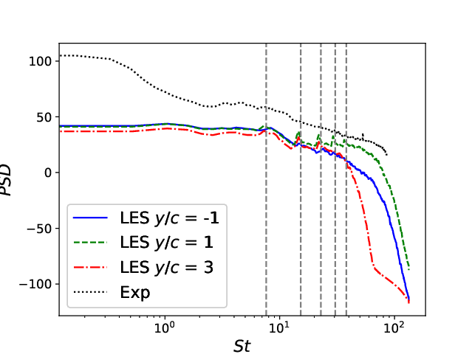
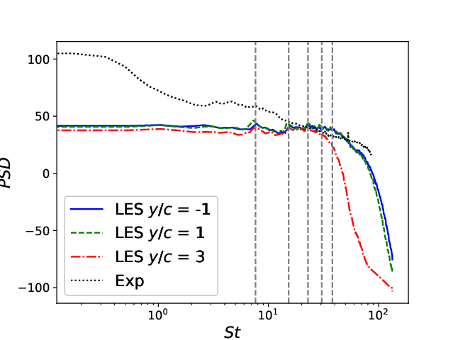
Results
Acoustics: spectral analysis
No FST
FST

Slide 11
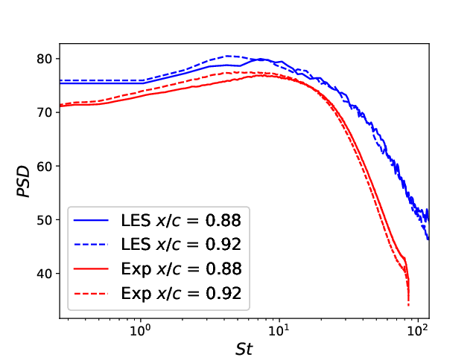

Results
Acoustics: spectral analysis
No FST
FST

Slide 12

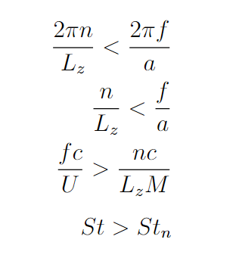
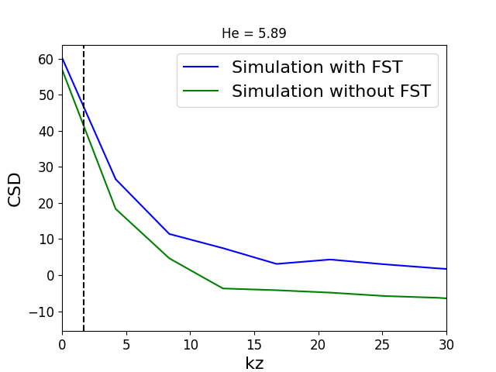
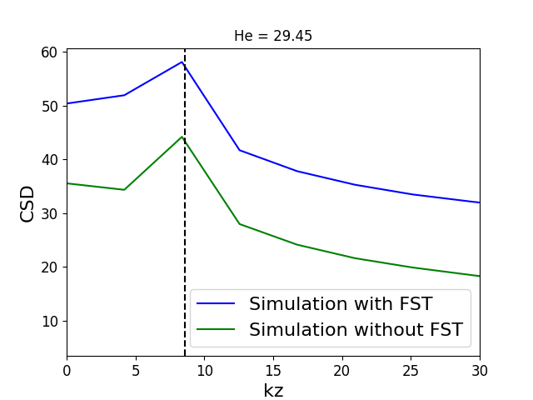
Results
Acoustics: scattering condition

Slide 13
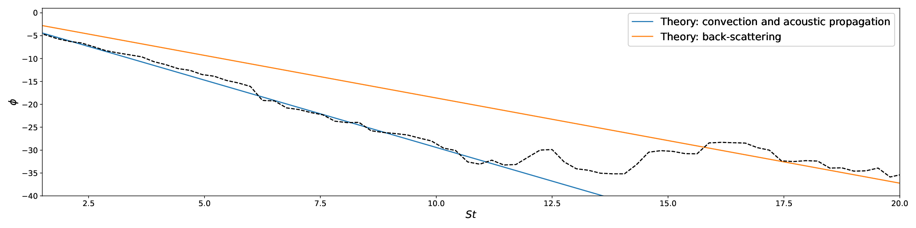
Results
Noise generation mechanism (No FST LES)

Slide 14
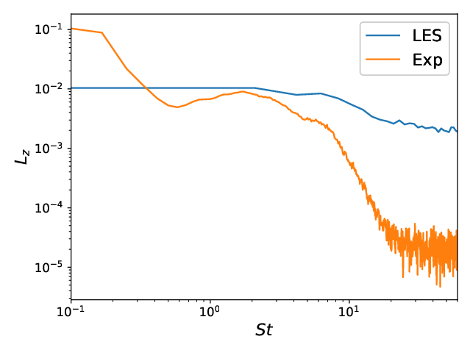
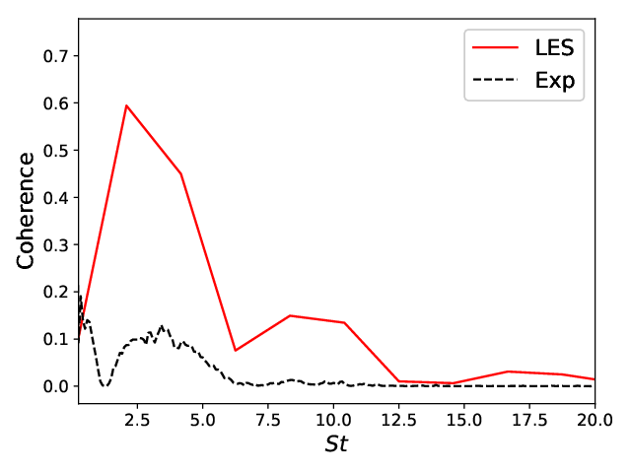
Results
Coherence analysis (No FST LES)
Coherence length in span
Acoustics-hydrodynamics coherence

Slide 15
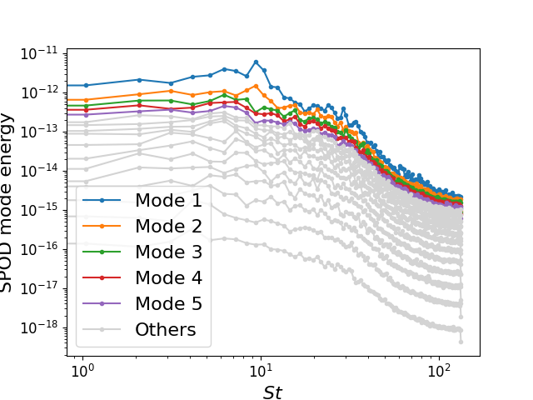
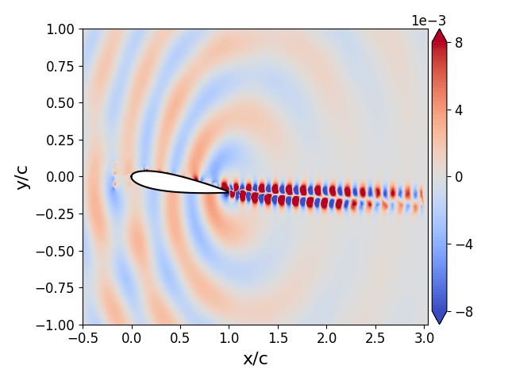
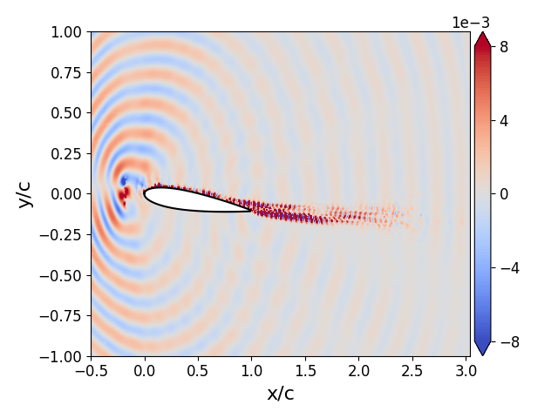
Results
SPOD (FST LES)
Energy spectrum
1° mode St = 6.25
1° mode St = 18.75

Slide 16
Future developments
Conclusions
High correlation between turbulent BL and acoustics
FST injections affects hydro more than acoustics
Acoustics are easily reconstructed with few modes
Resolvent Analysis with Reynolds stresses
More to come

Slide 17

Thanks for your attention

