Slide 1
Surface waviness tolerance identification and transition delay of boundary layer flows over swept airfoils using an adjoint-based optimization method
Master’s thesis defence
Supervisors: | Candidate:
Bottaro Alessandro, Unige | Cozzi Piero
Hanifi Ardeshir, KTH

Slide 2
Introduction

Slide 3
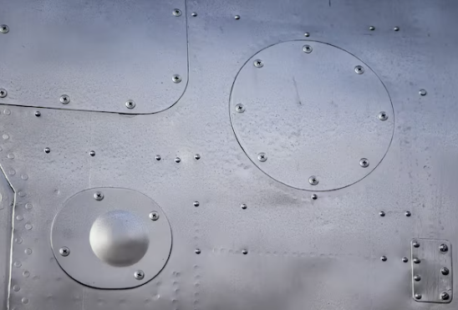
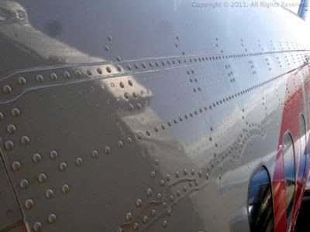
Why are boundary layer flows important?
Laminar flow control over wings can reduce drag by a few points, resulting in savings of M$/year

Slide 4
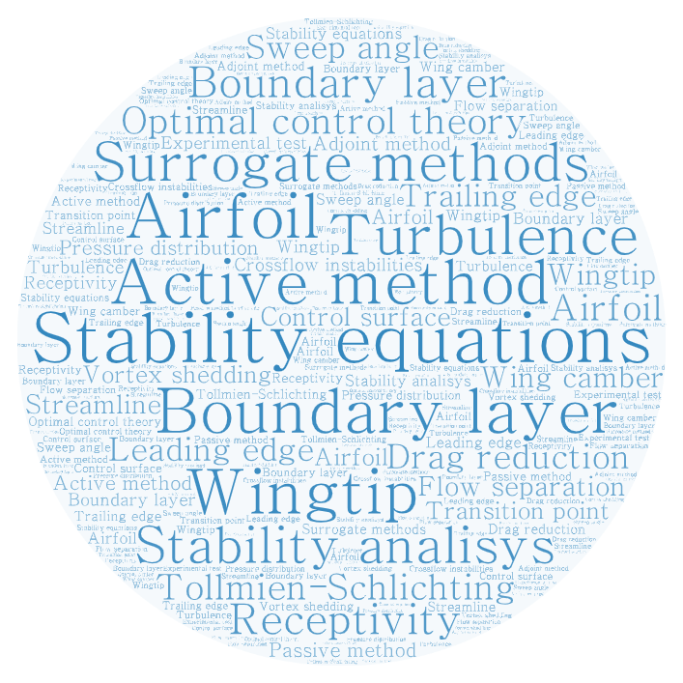
What can we do?
A lot!
What do we propose?
Examine manufacturing tolerances impact
Shape optimization for NLF baseline airfoil

Slide 5
Manufacturing tolerances study

Slide 6
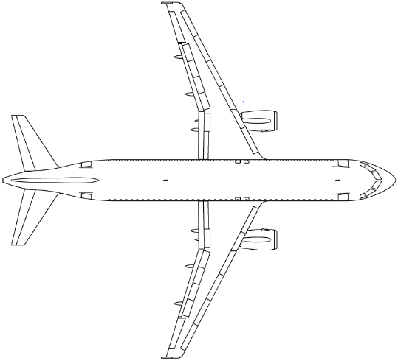
Flow case
Infinite swept wing problem
Steady state
Parametric approach (variable Re, Ma, AoA)
NLF airfoils

Slide 7
Workflow: GA approach
C_{p}
Iteration step algorithm:
∇_{z} E
Gradient projection:

Slide 8
Tolerances definition
In terms of L₂-norm:
Alternative optimization approach: SLSQP (in SciPy module)
[1] D. Kraft. A Software Package for Sequential Quadratic Programming. Deutsche Forschungs-und Versuchsanstalt für Luft-und Raumfahrt Köln: Forschungsbericht. Wiss. Berichtswesen d. DFVLR, 1988.

Slide 9
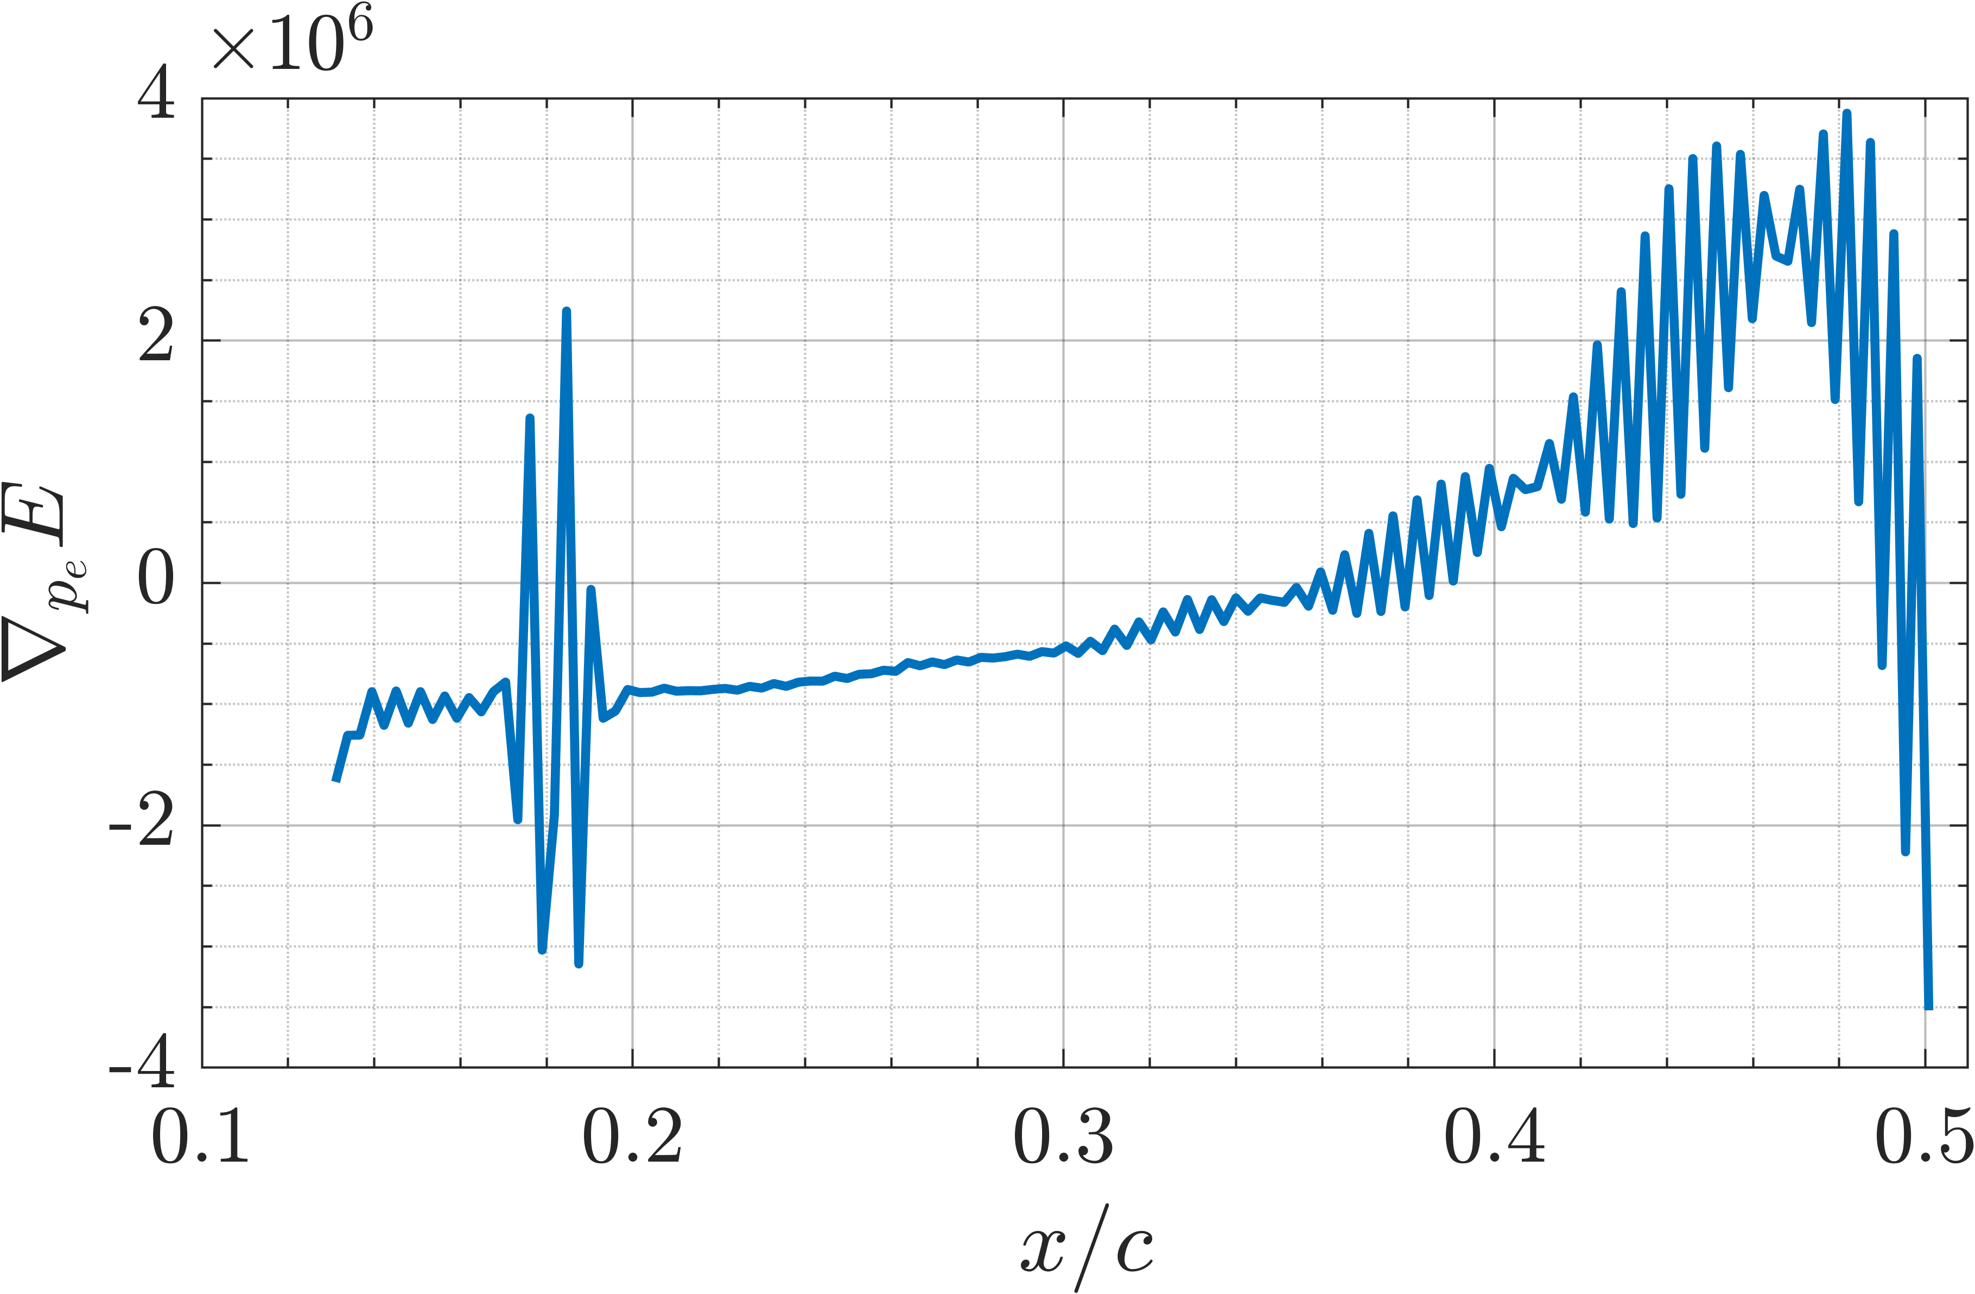
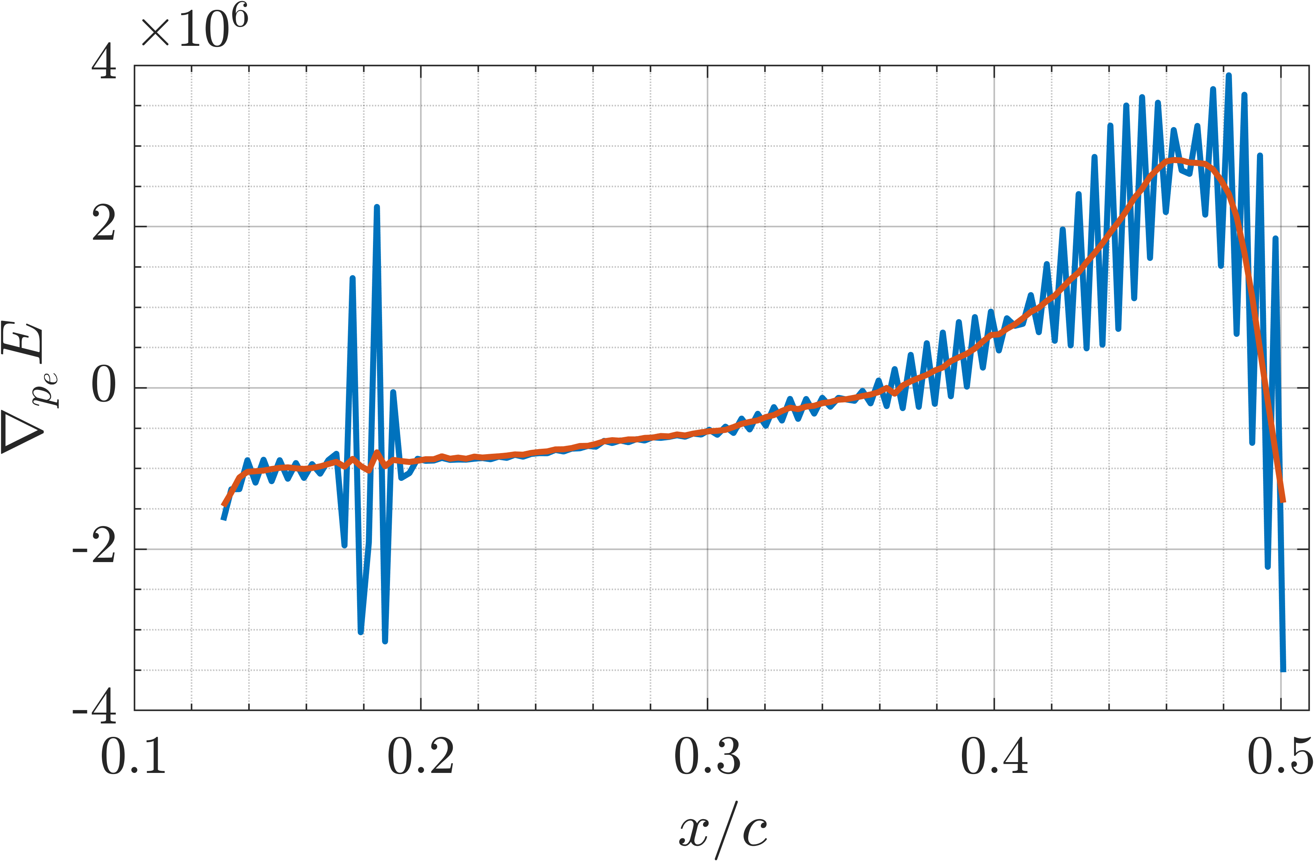
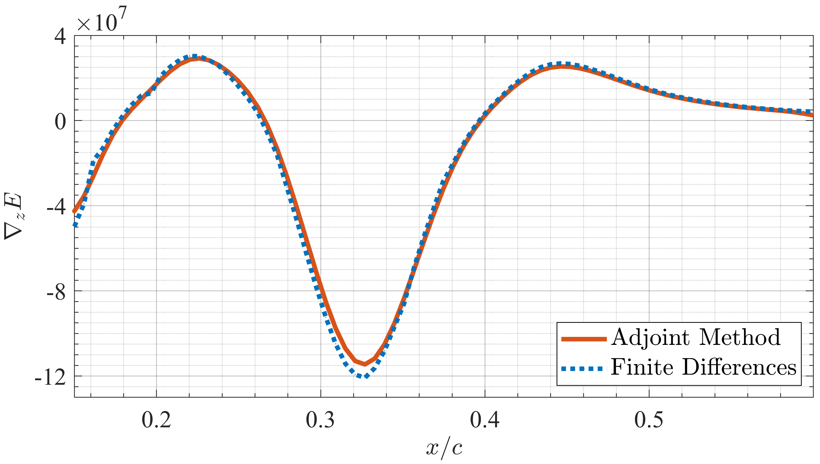
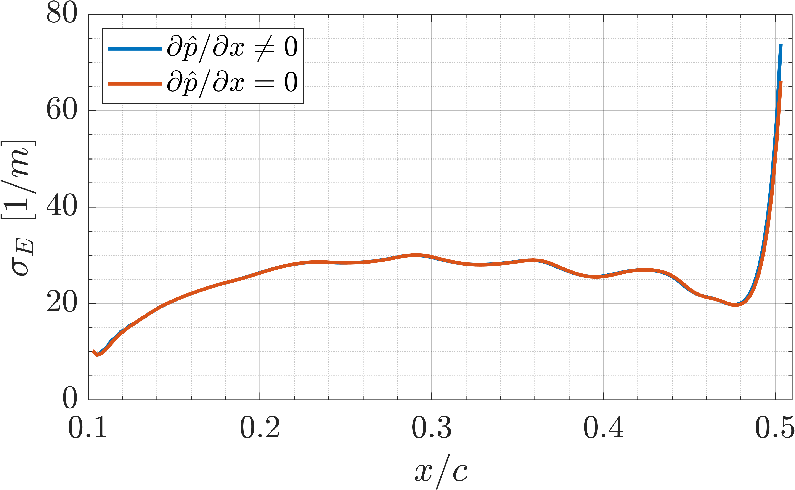
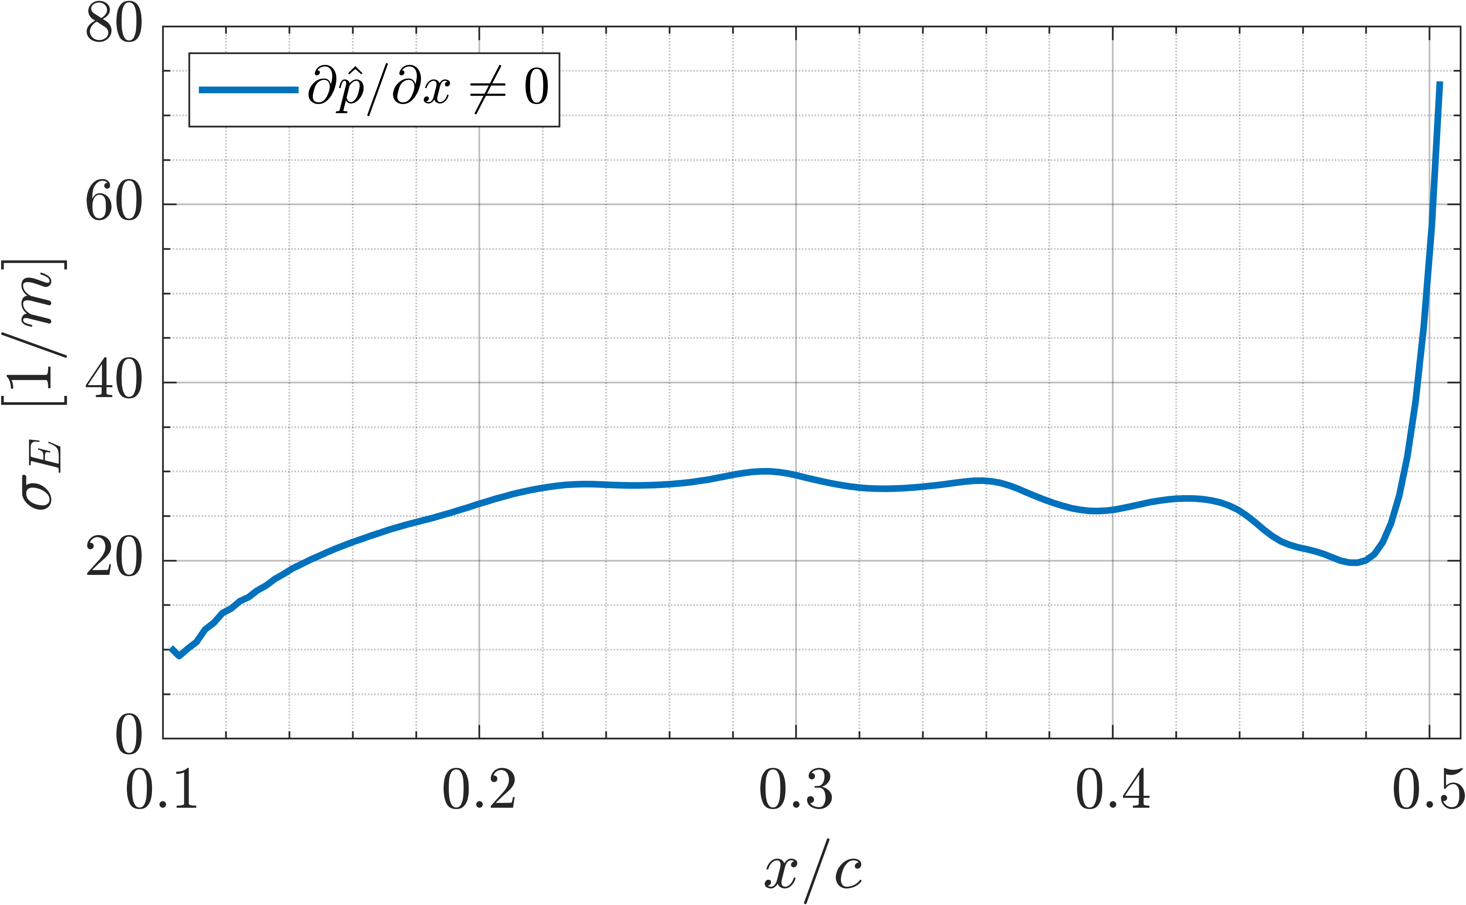
Gradient Validation: numerical instabilities
[1] Hossein Haj-Hariri. Characteristics analysis of the parabolized stability equations. Studies in Applied Mathematics, 92(1):41–53, 1994. [2] Fei Li and Mujeeb R Malik. On the nature of PSE approximation. Theoretical and Computational Fluid Dynamics, 8(4):253–273, 1996. [3] P. Andersson, D. S. Henningson, and A. Hanifi. On a stabilization procedure for the parabolic stability equations. Journal of Engineering Mathematics, 33(3):311–332, 1998.

Slide 10
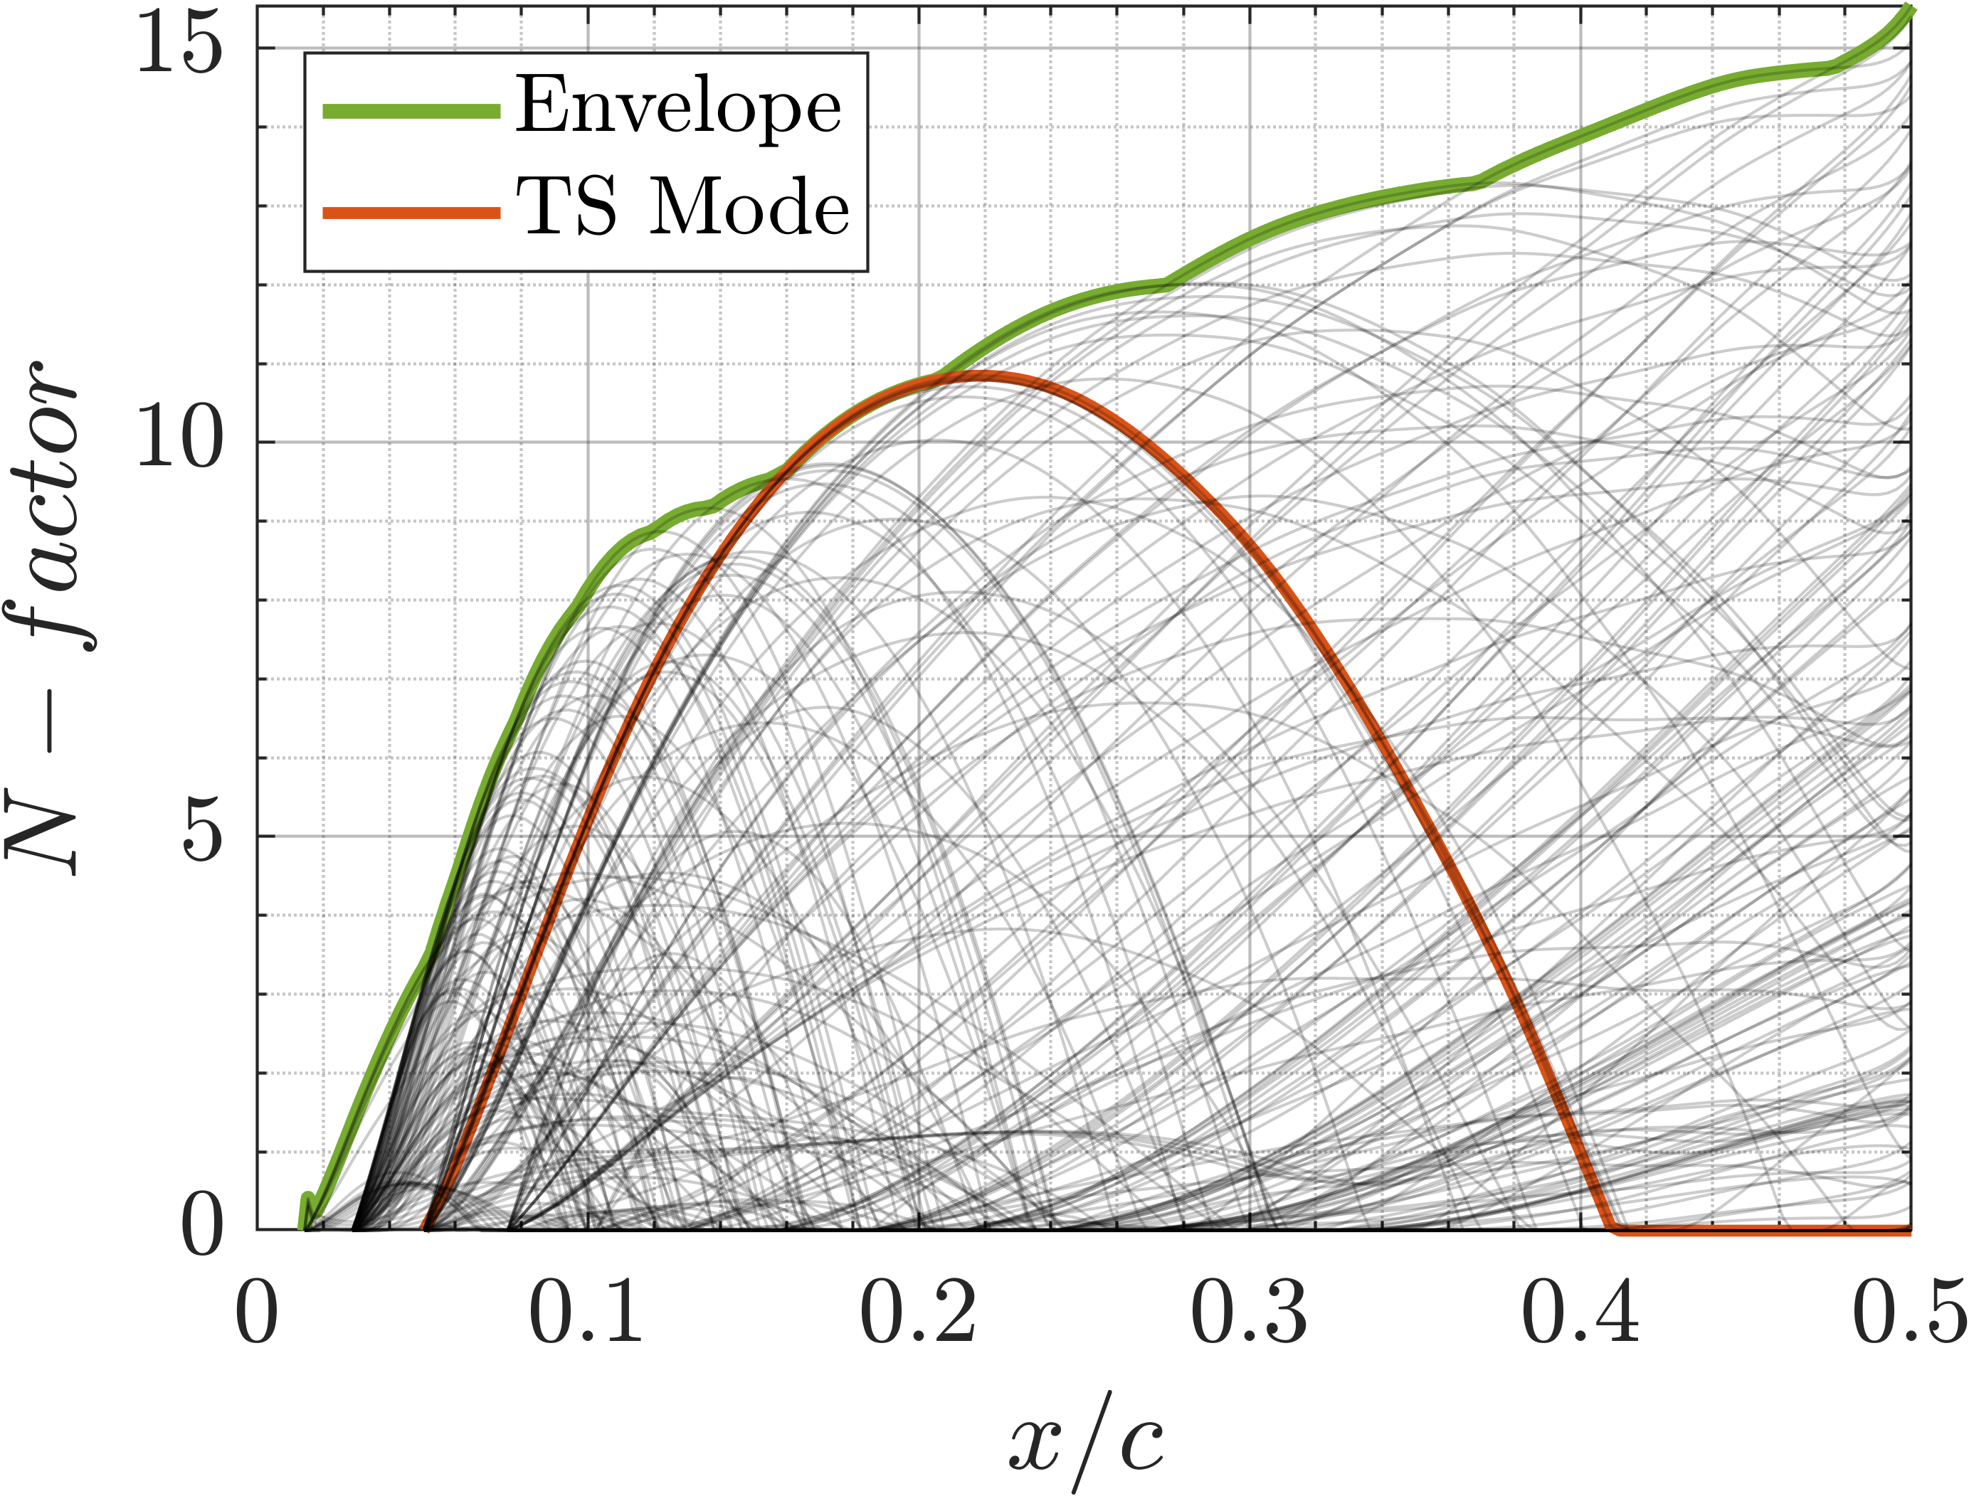
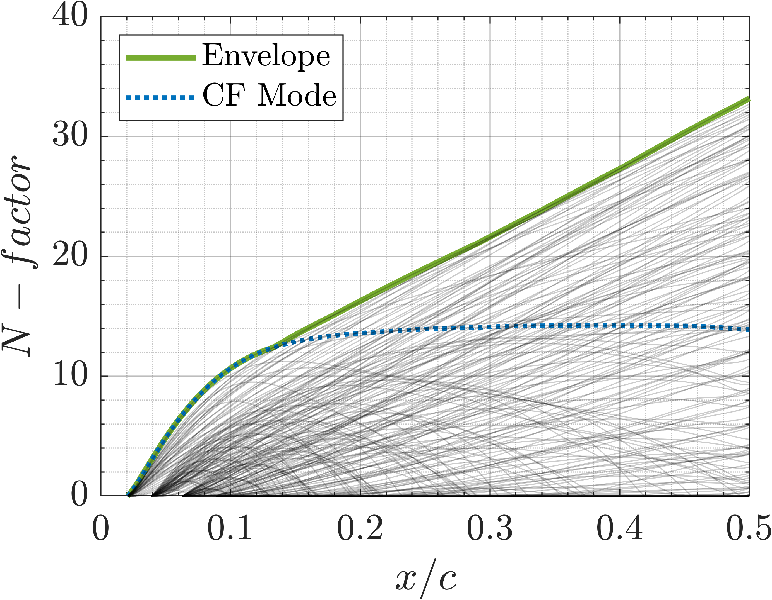
Results: types of instabilities
Flow conditions: Re=15×10⁶, Ma=0.5, Λ=45°
AoA=1.25°
AoA=-1.00°

Slide 11
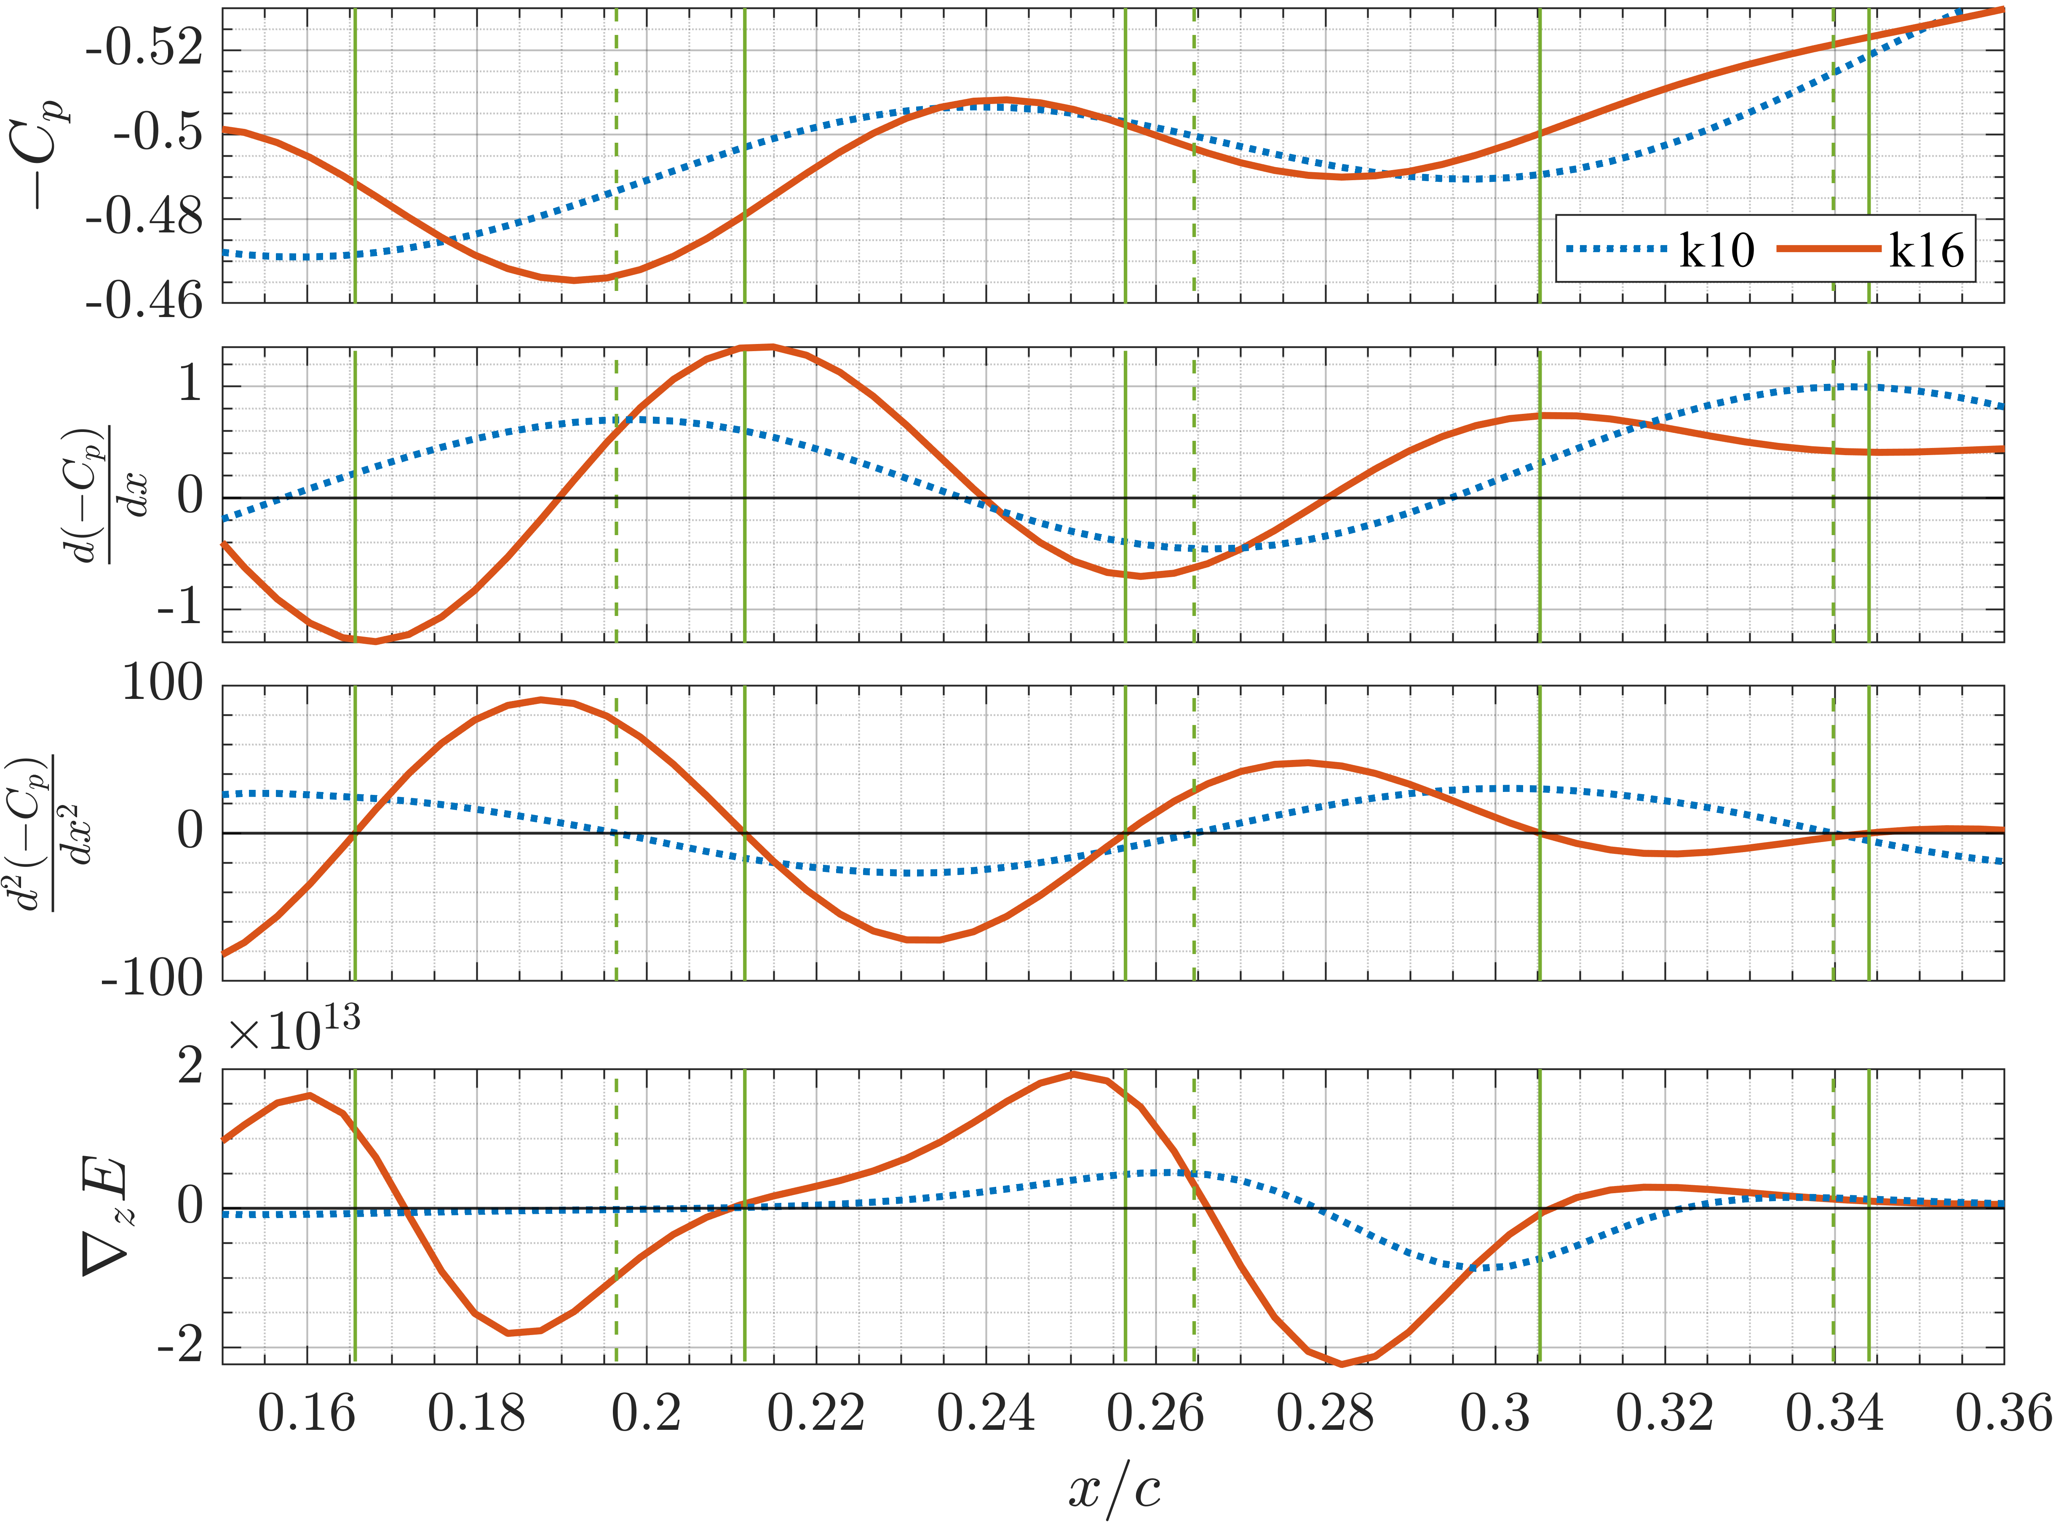
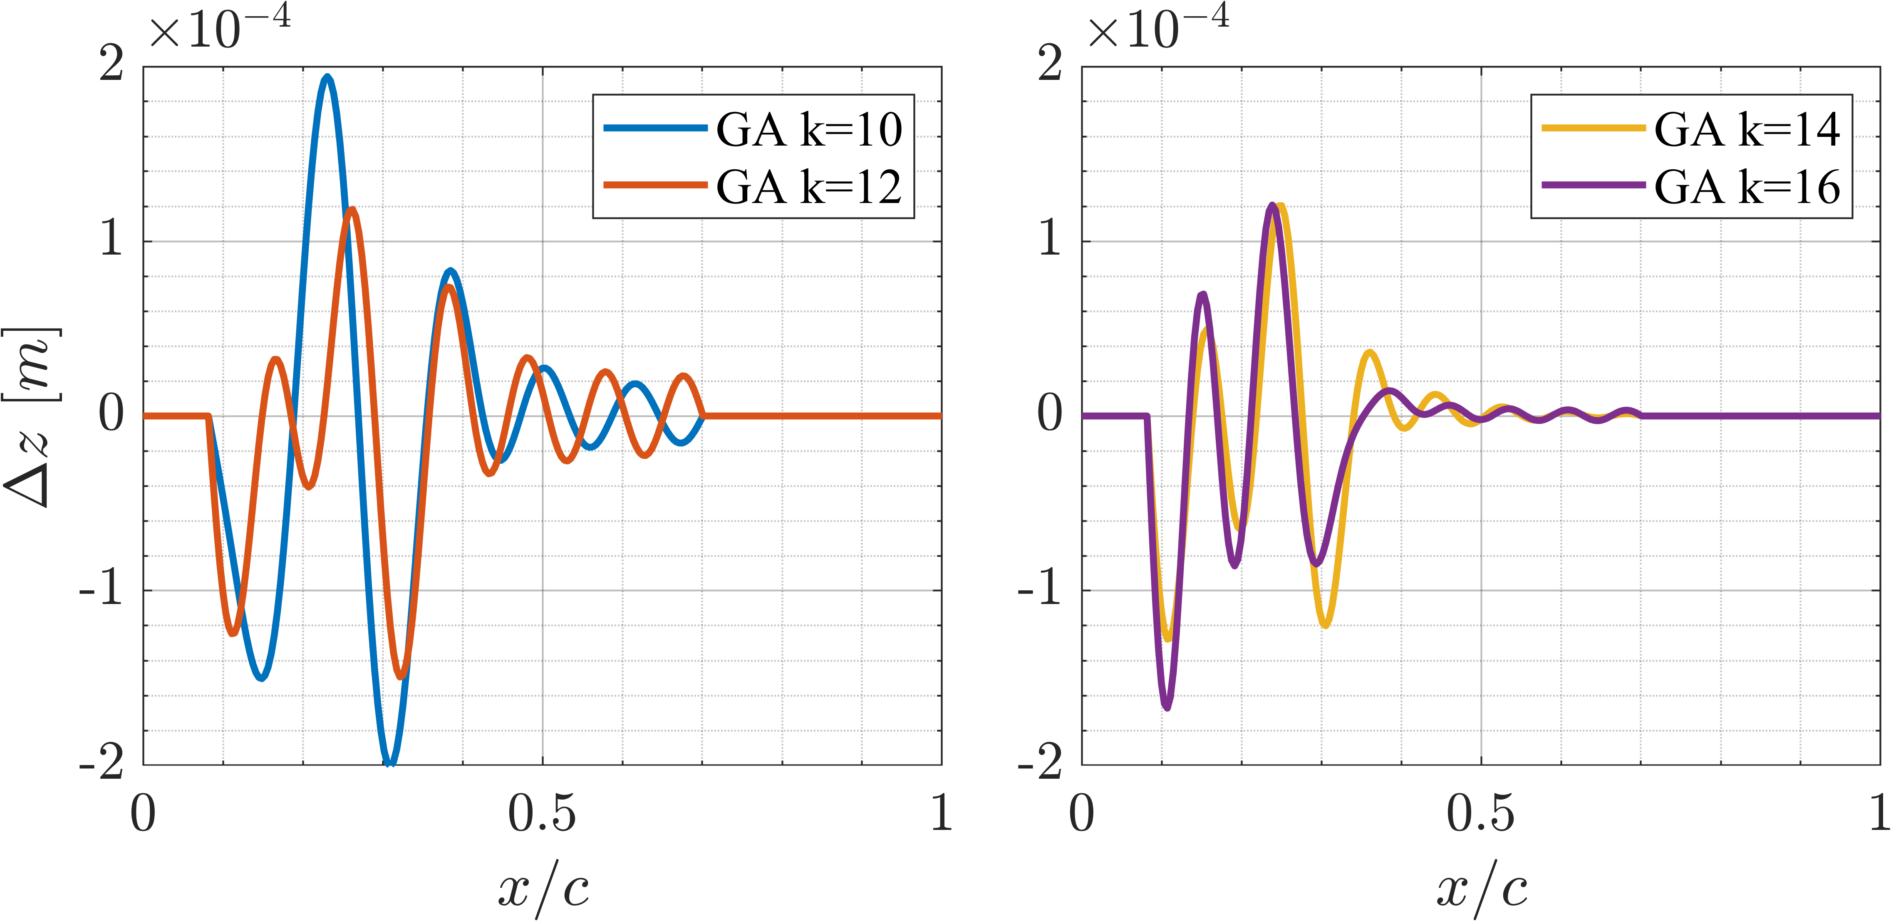
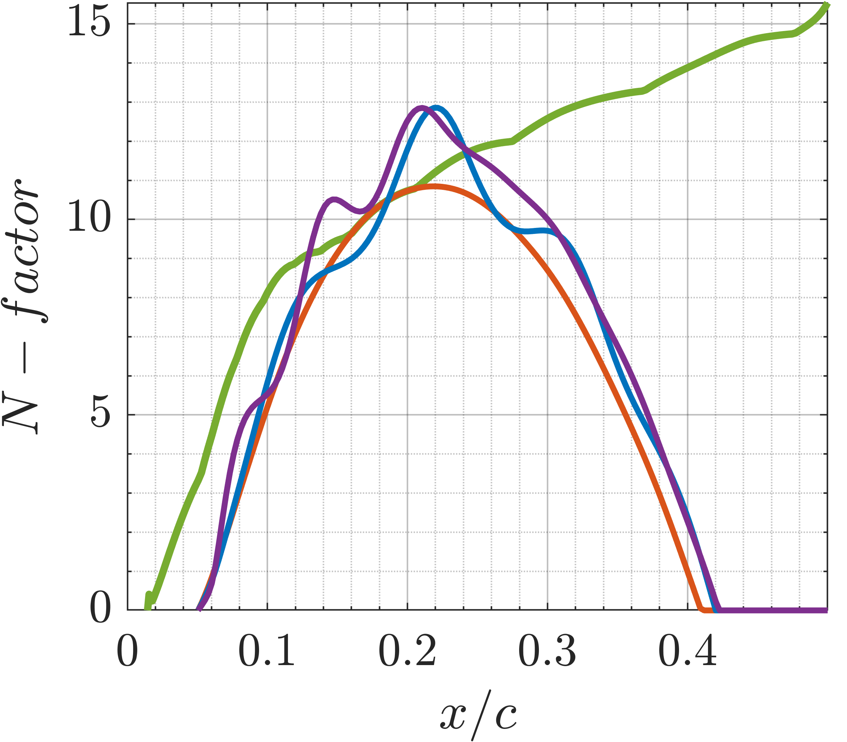
Results: largest allowable deformation profiles
Flow conditions: Re=15×10⁶, Ma=0.5,
AoA=1.25°, Λ=45°
Moving towards APG | → | ∇_{z} E>0
Moving towards FPG | → | ∇_{z} E<0

Slide 12
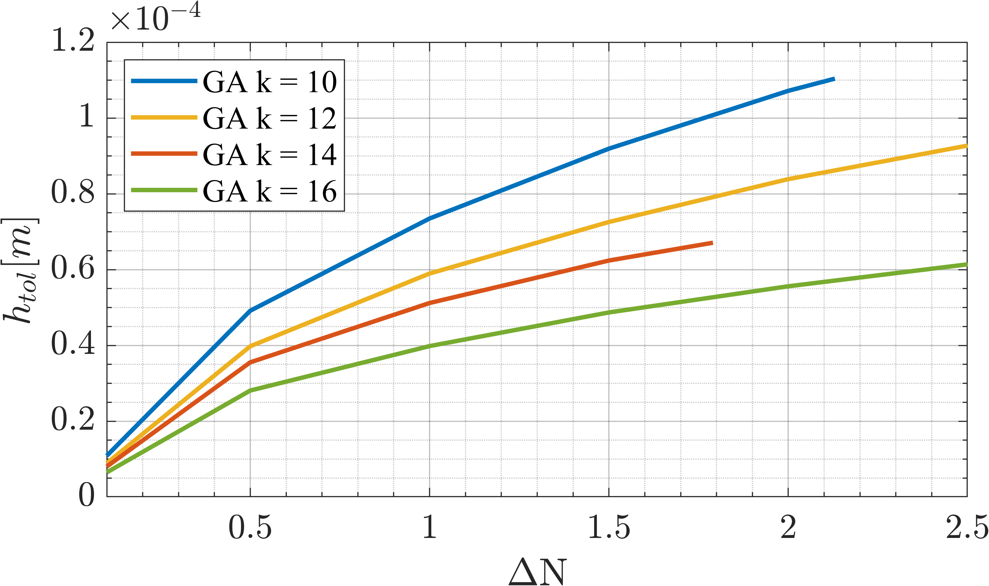
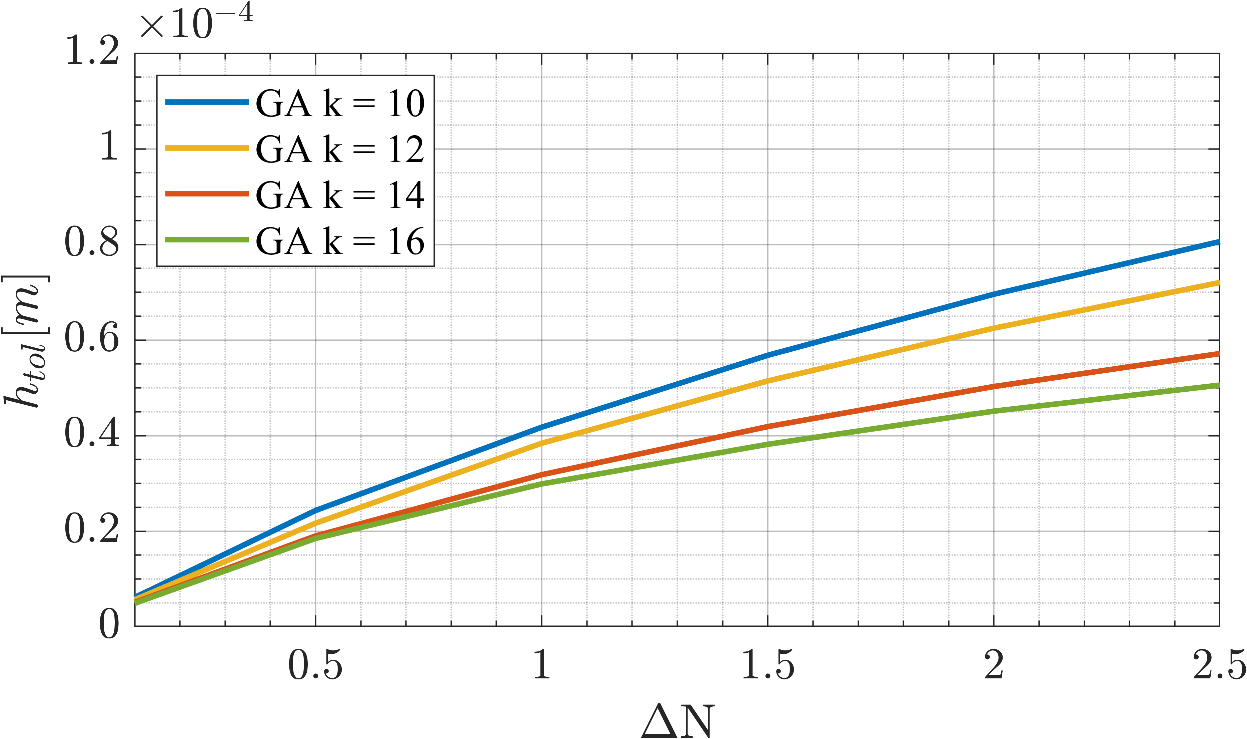
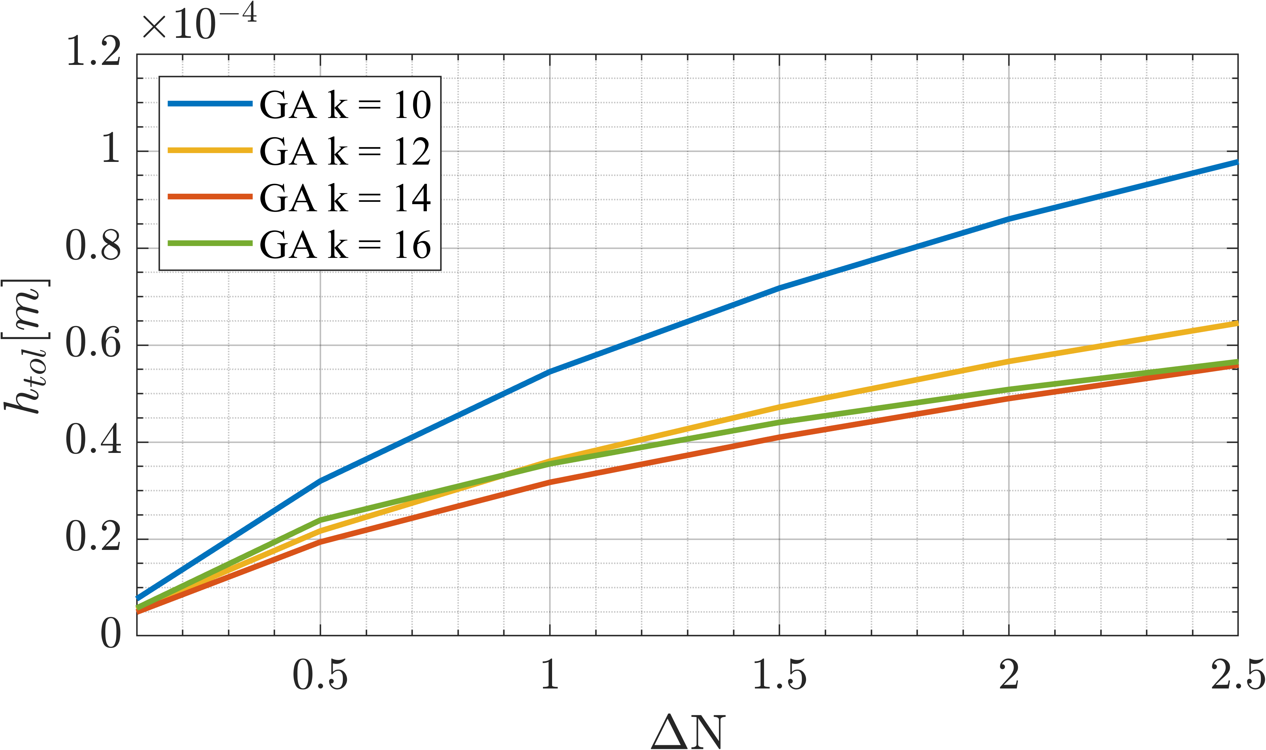
Results: effect of Reynolds number
Flow conditions: AoA=1.25°, Ma=0.5, Λ=45°
Re= 9×10⁶
Re= 12×10⁶
Re= 15×10⁶

Slide 13
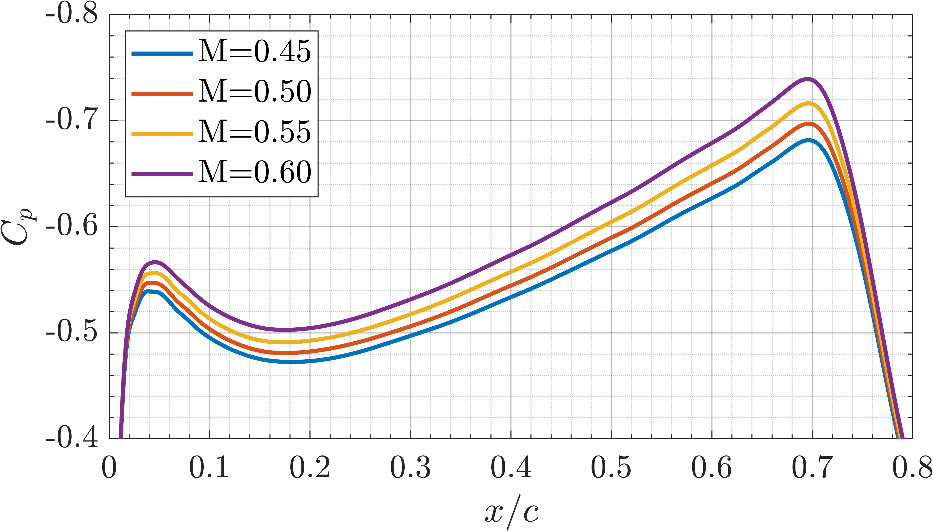
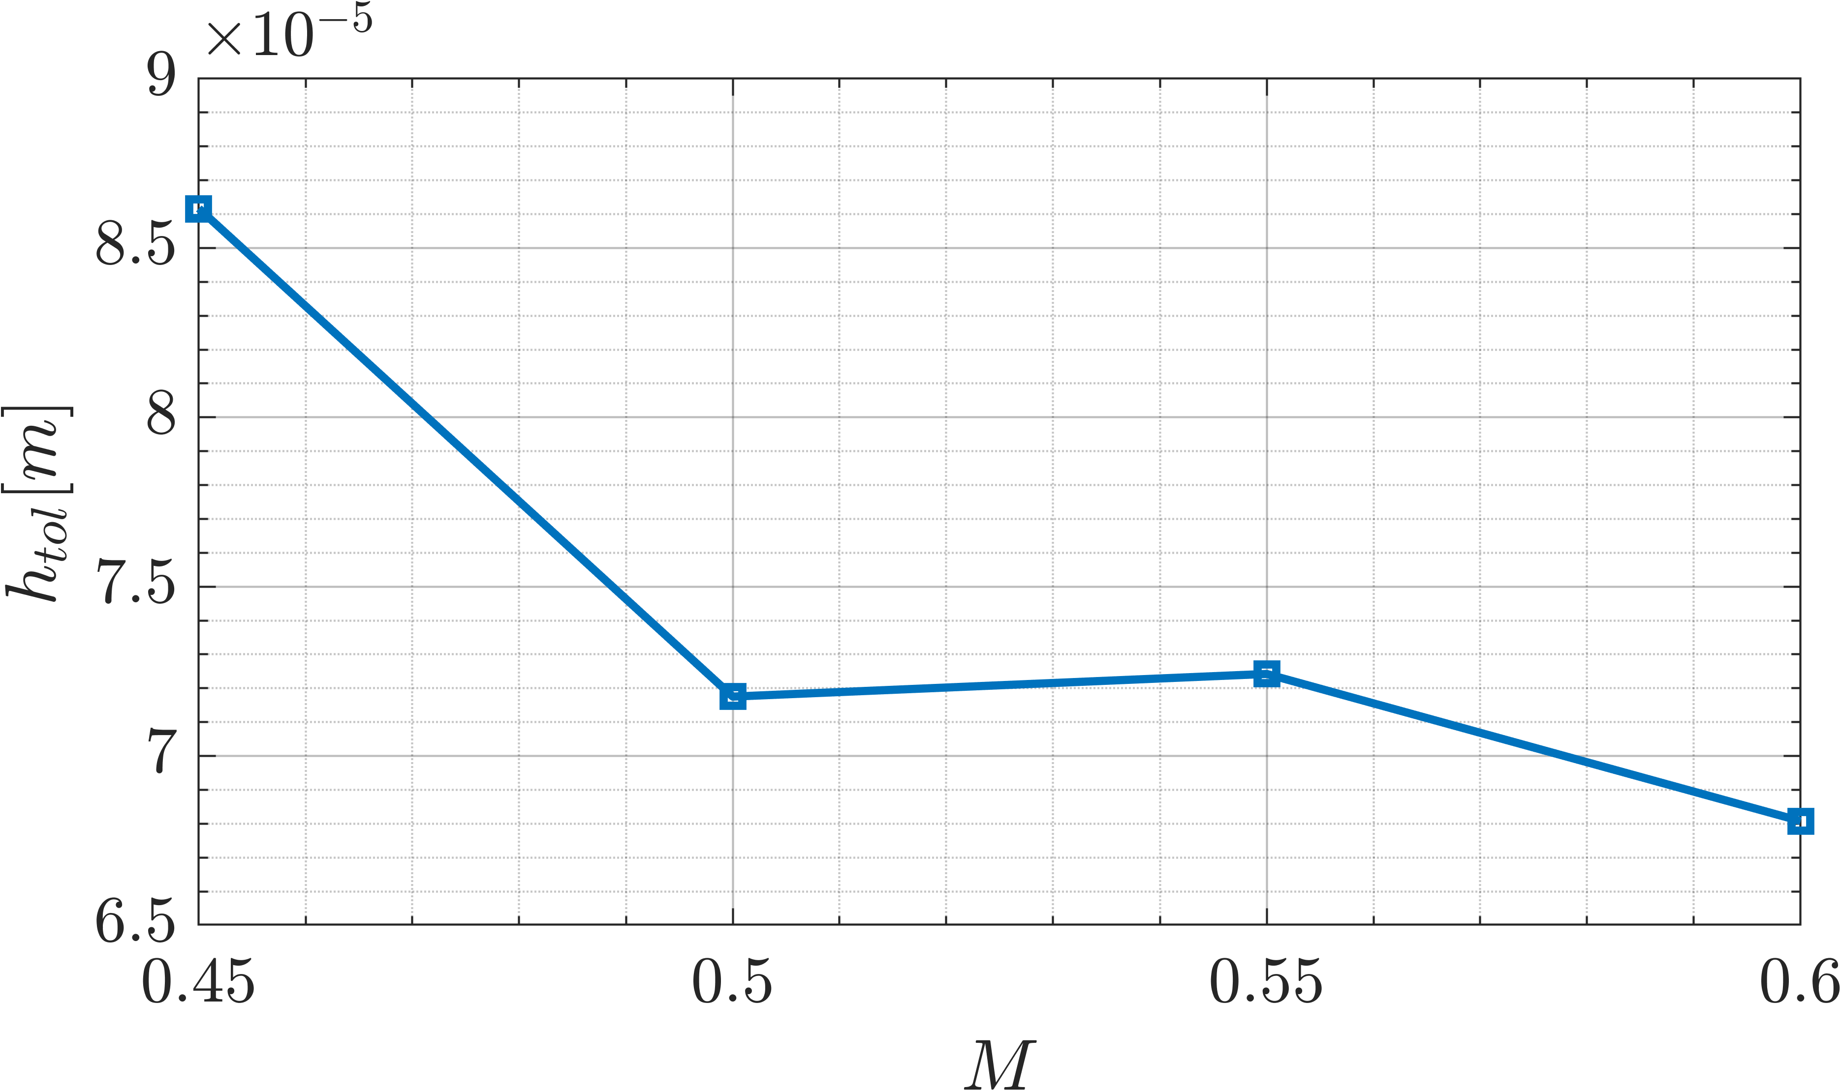
Results: effect of Mach number
Flow conditions: Re=15×10⁶, AoA=1.25°, Λ=45°
ΔN=1.5

Slide 14
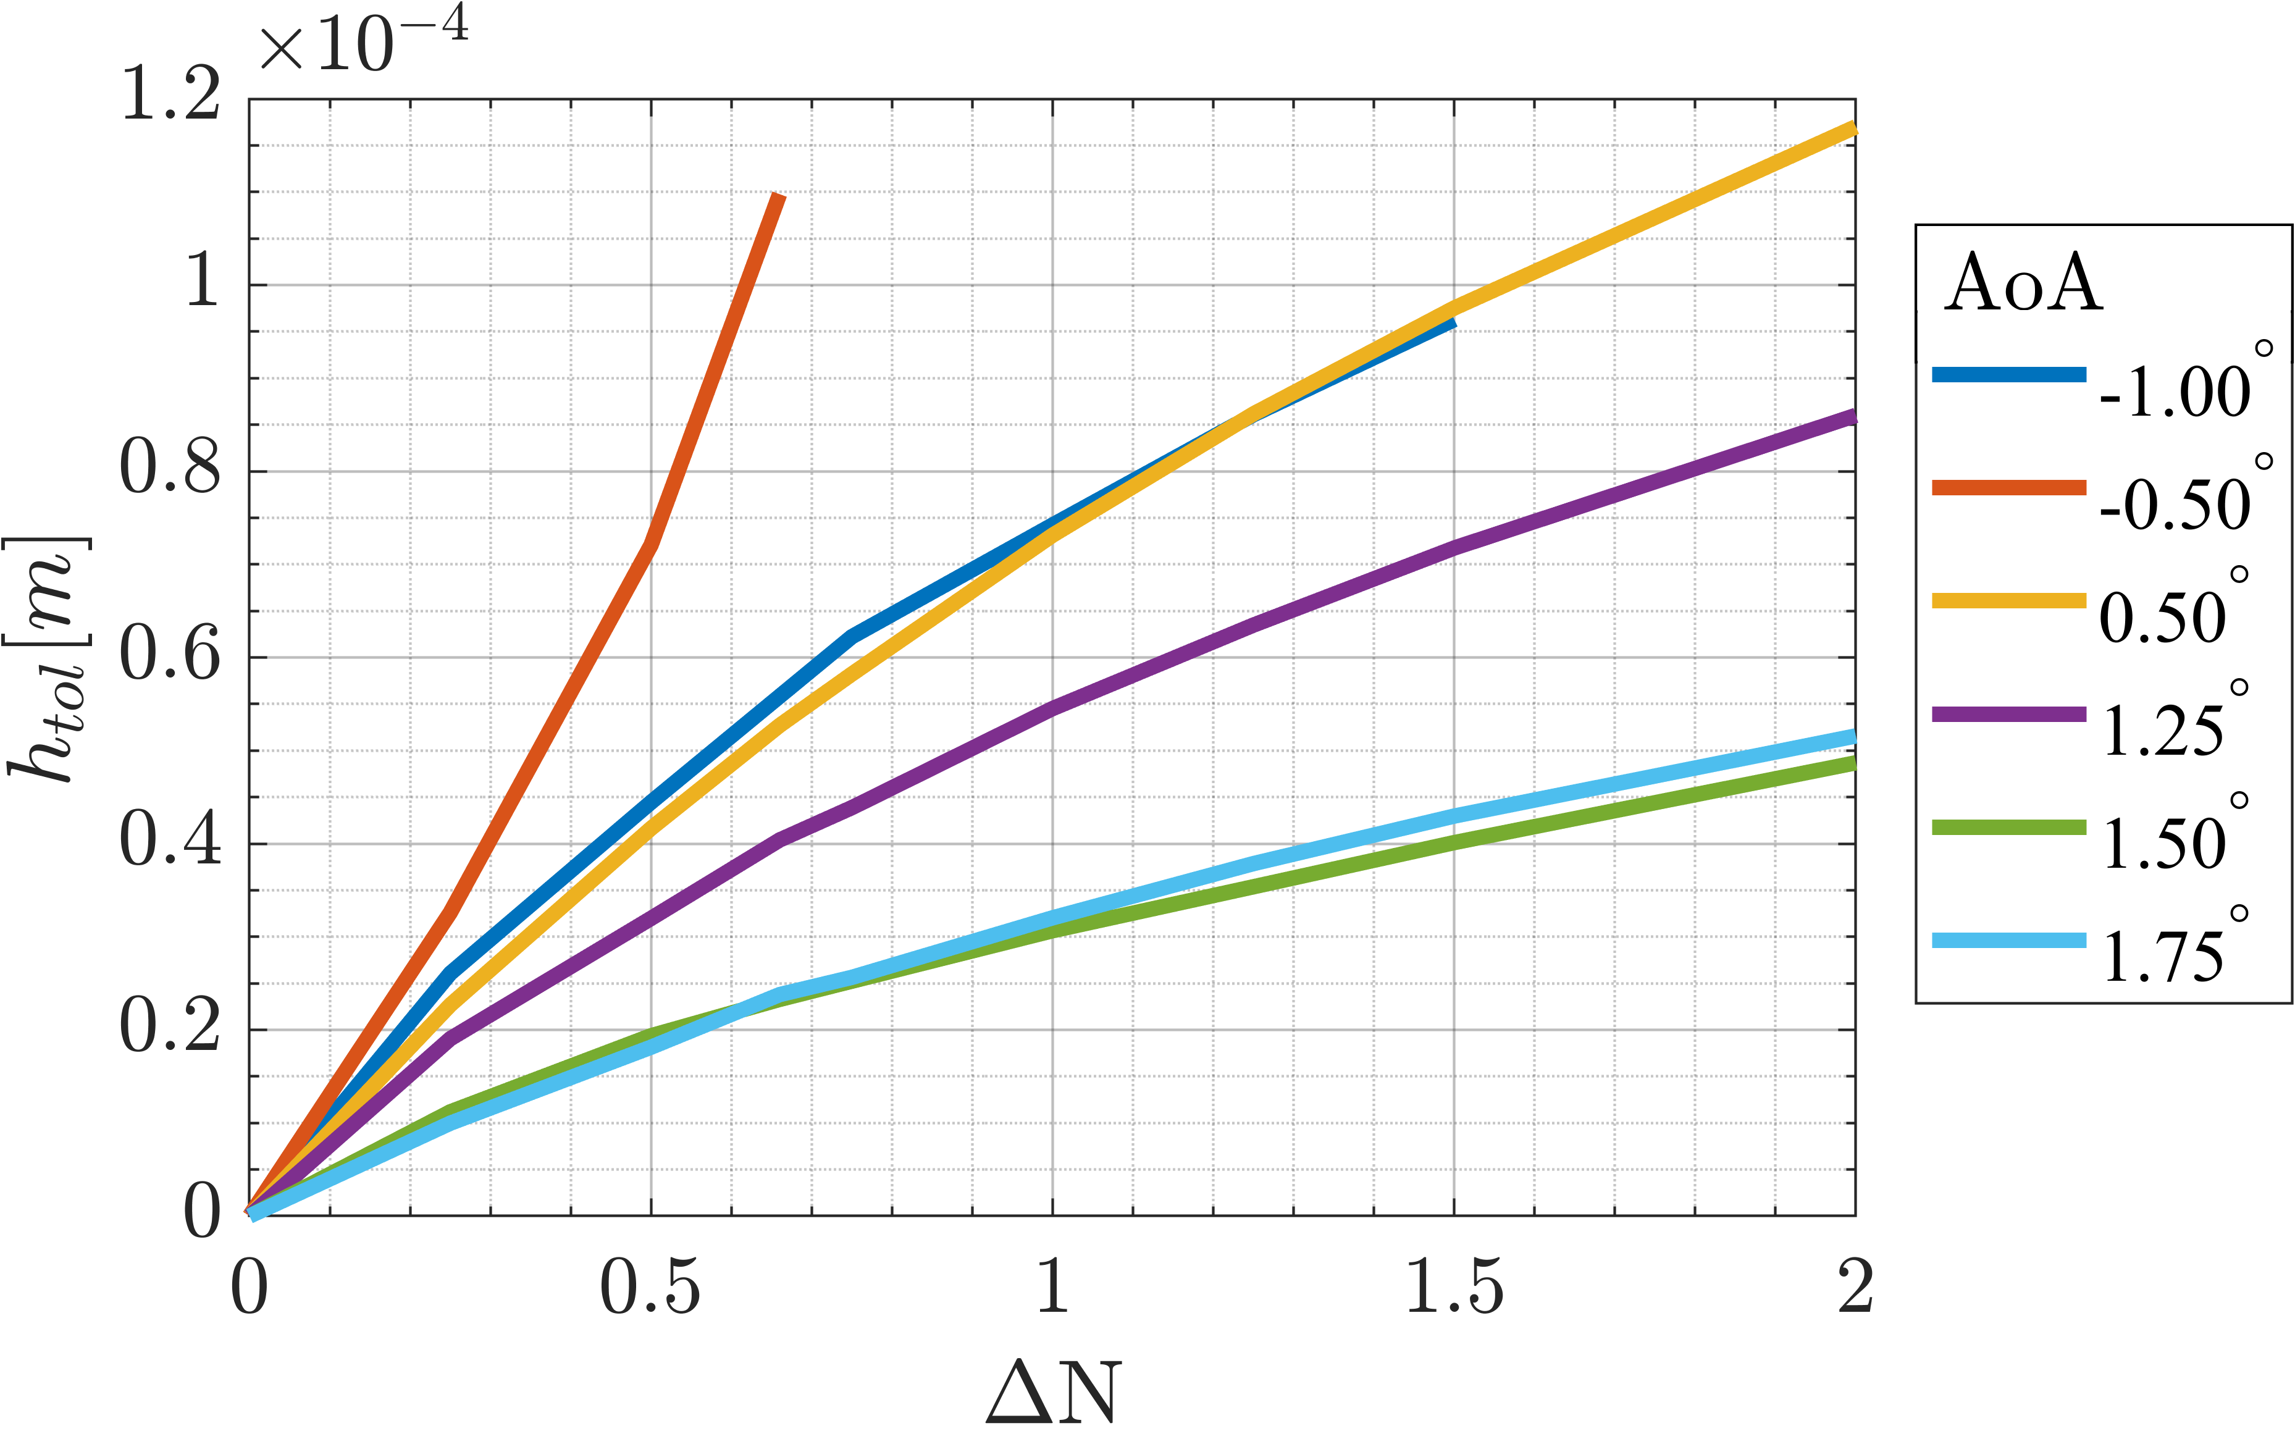
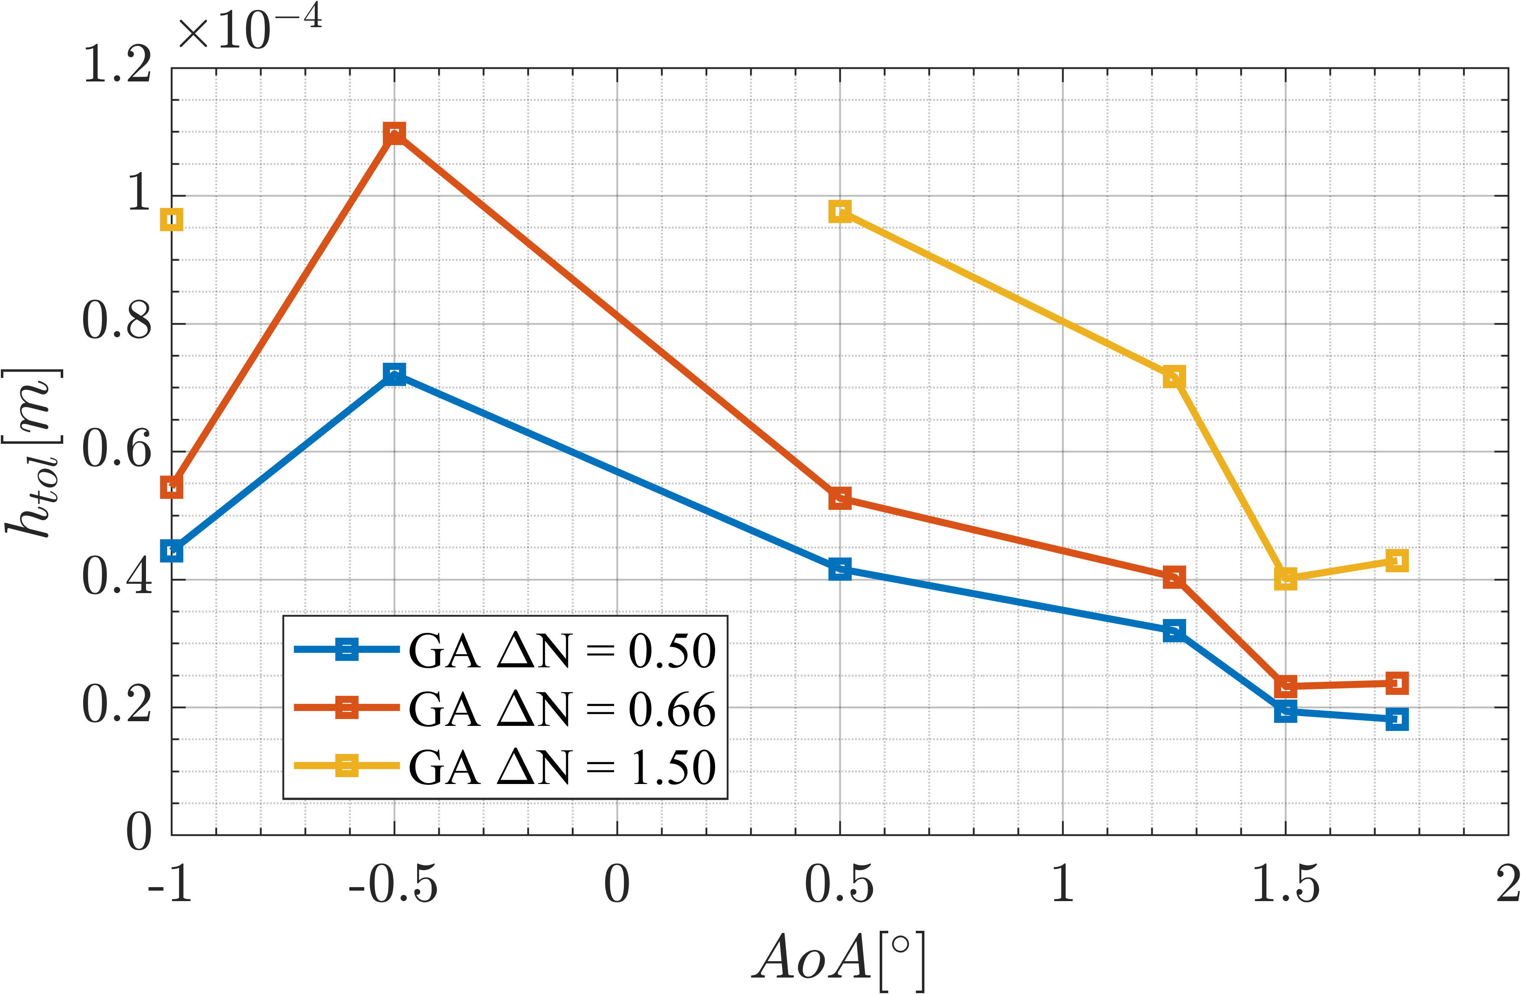
Results: effect of AoA
Flow conditions: Re=15×10⁶, Ma=0.5, Λ=45°

Slide 15
“Perfection is not attainable,
but if we chase perfection we can catch excellence.”

Slide 16
Additional slides

Slide 17
Methodology & Transformation 2.5D

Slide 18
Methodology
C_{p}
∇_{z} E
∇_{Pe} E
Numerical codes used:
Mesh generation | → | Construct2D
Flow solver | → | ADflow
BL solver | → | BL3D code
PSE solver | → | NOLOT

Slide 19
Transformation 2.5D

Slide 20
Gradient Validation: comparison
Copyright © Mohammad Moniripiri, Pedro P. C. Brito, André V. G. Cavalieri, Ney R. Sêcco, Ardeshir Hanifi
Limitation of adjoint method!

Slide 21
Transition delay study

Slide 22
Workflow: GD approach

Slide 23
Workflow: GD approach
Iteration step algorithm:
Hicks-Henne bump functions:
Gradient projection:

Slide 24
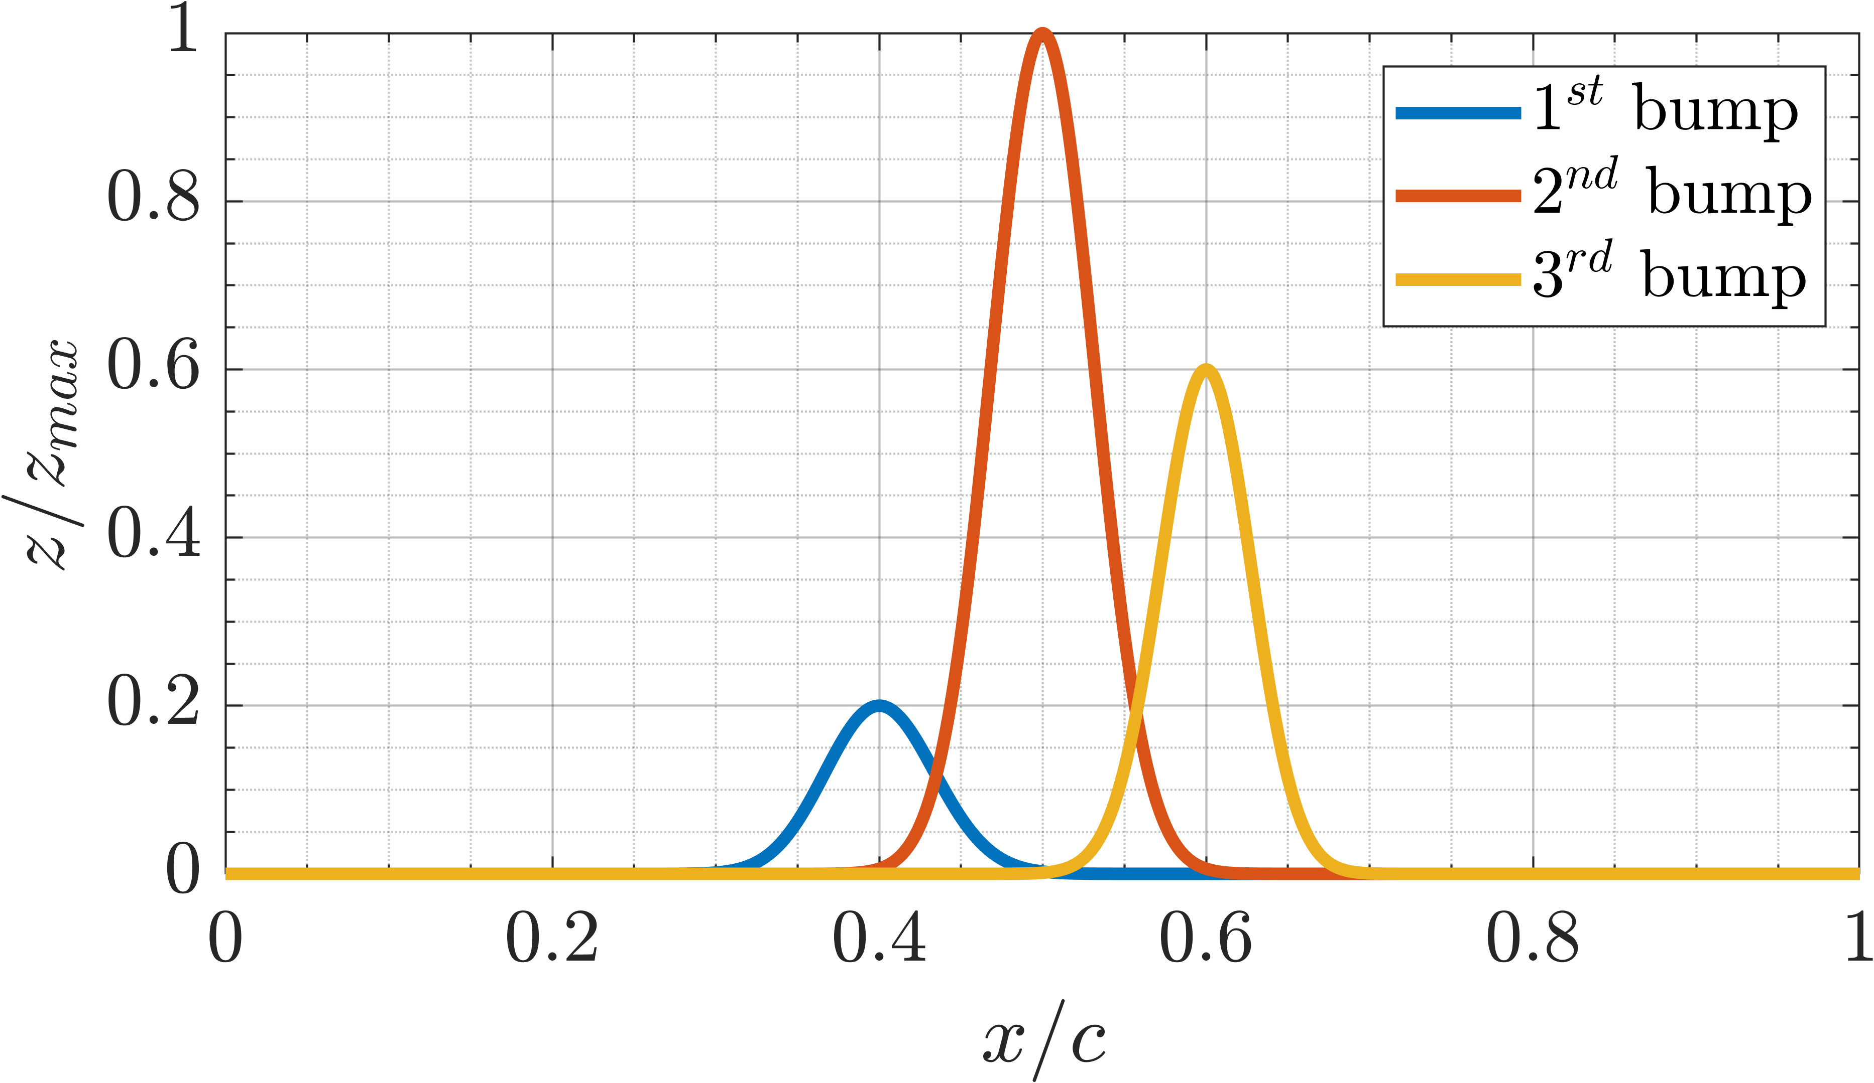
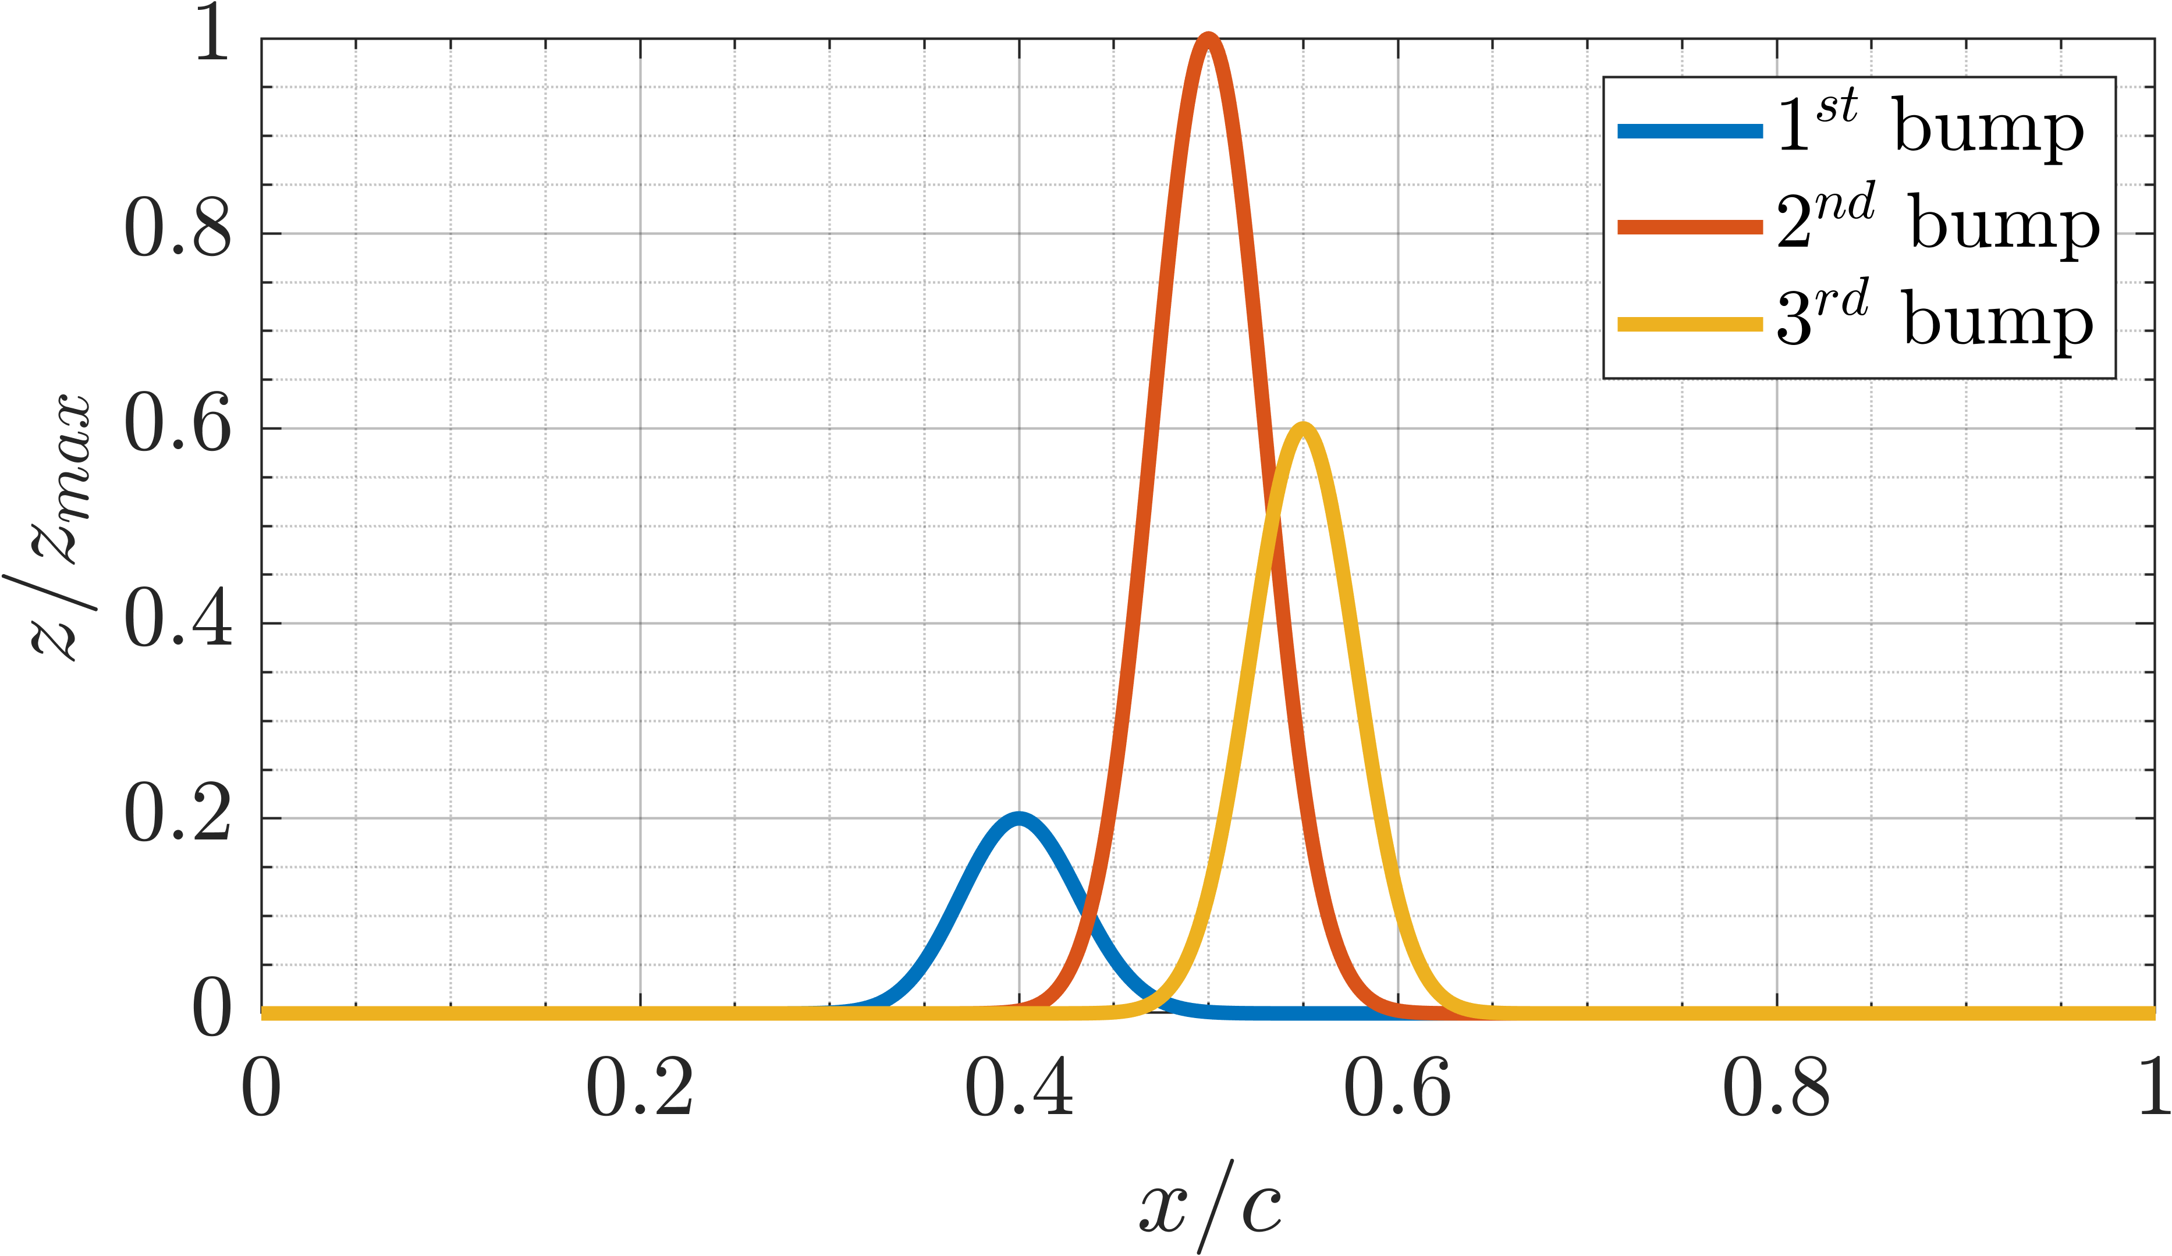
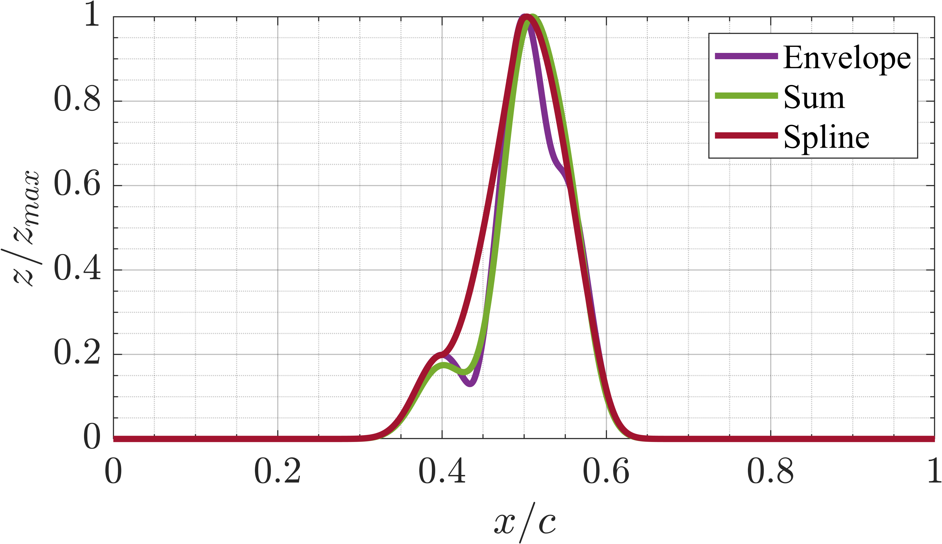
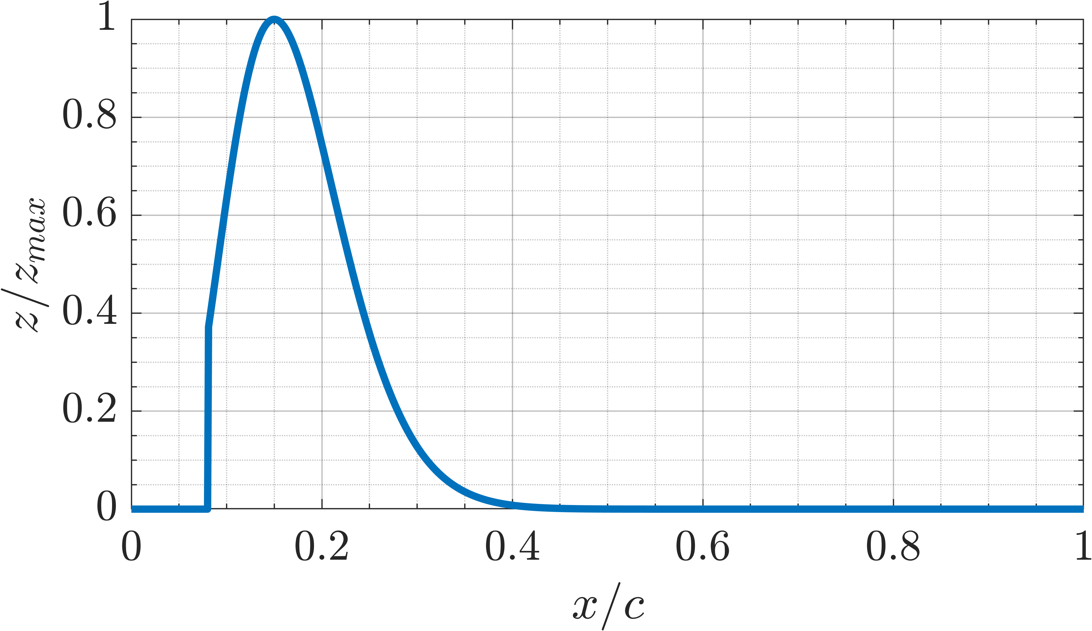
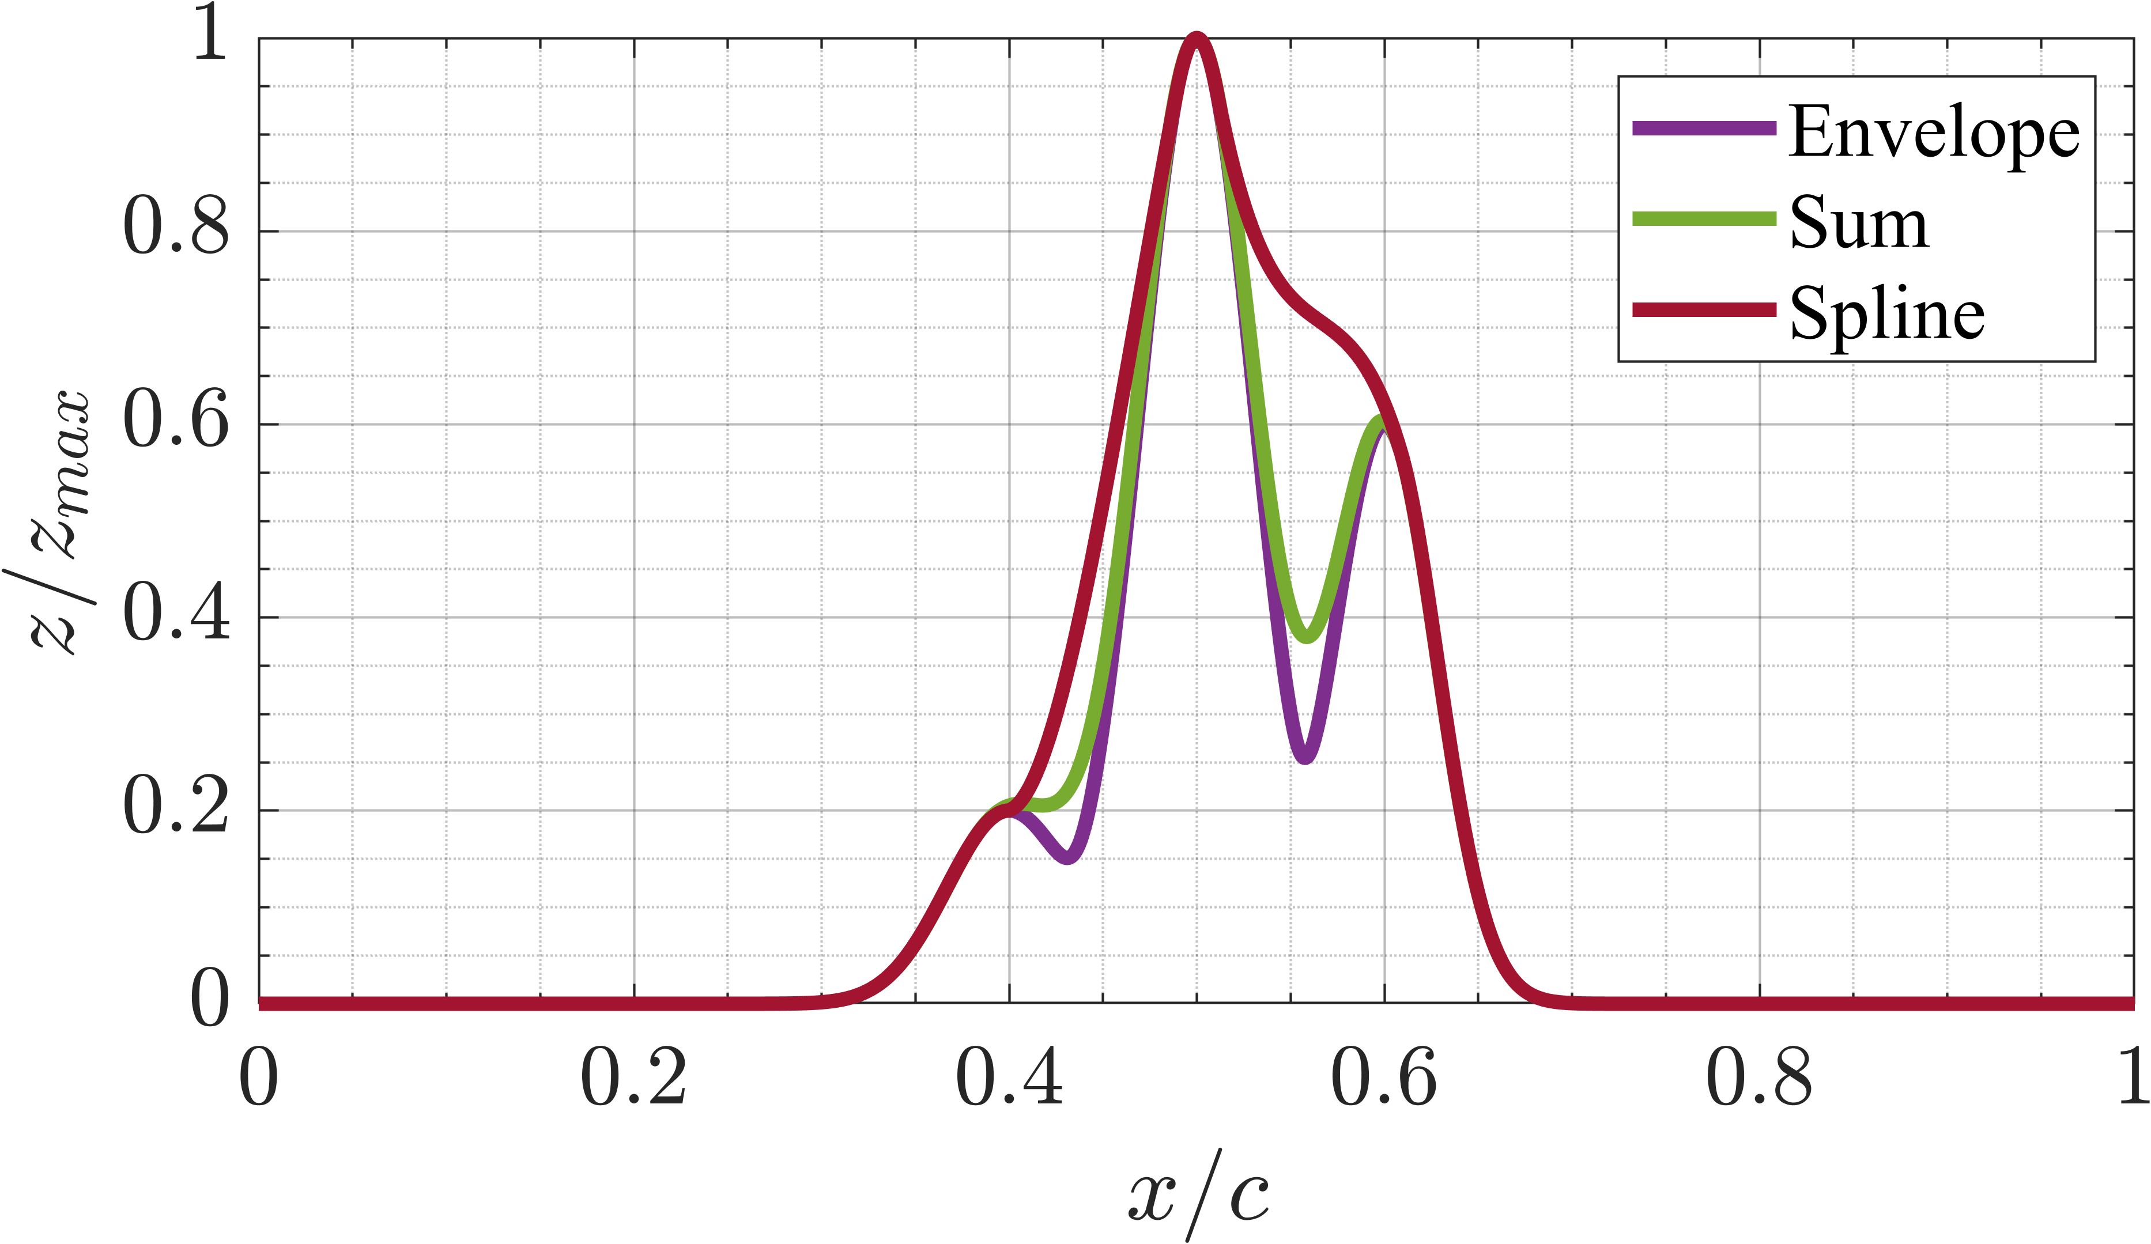
Implementation issues
Bumps position
Abrupt step

Slide 25
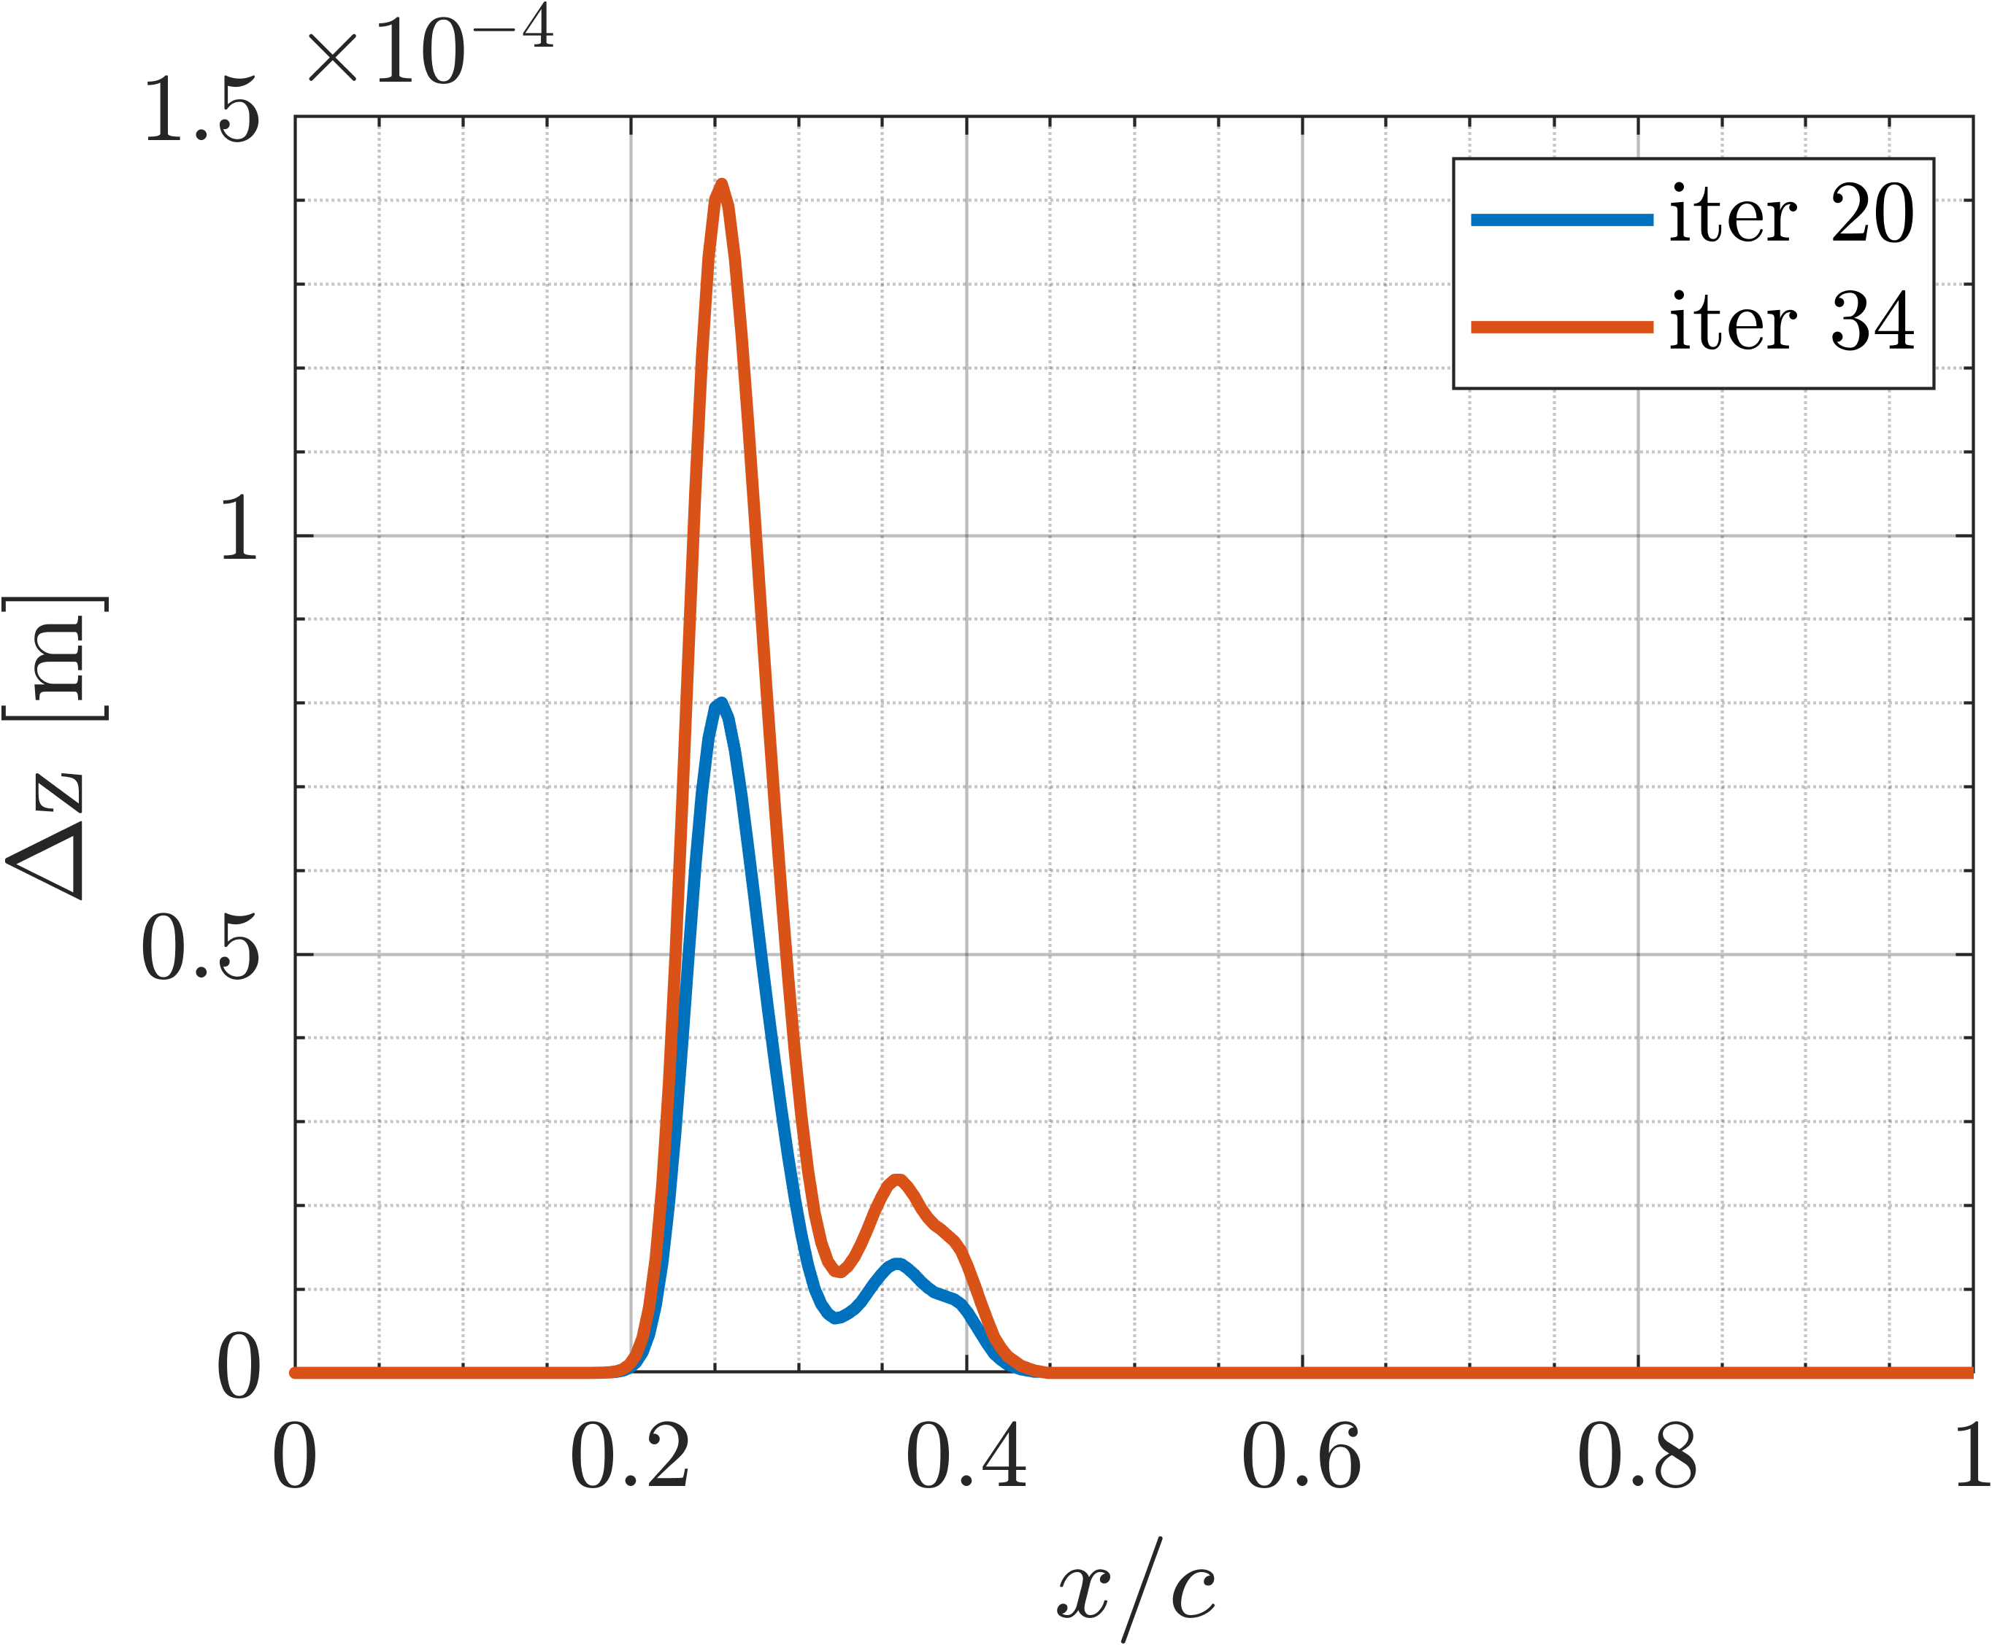
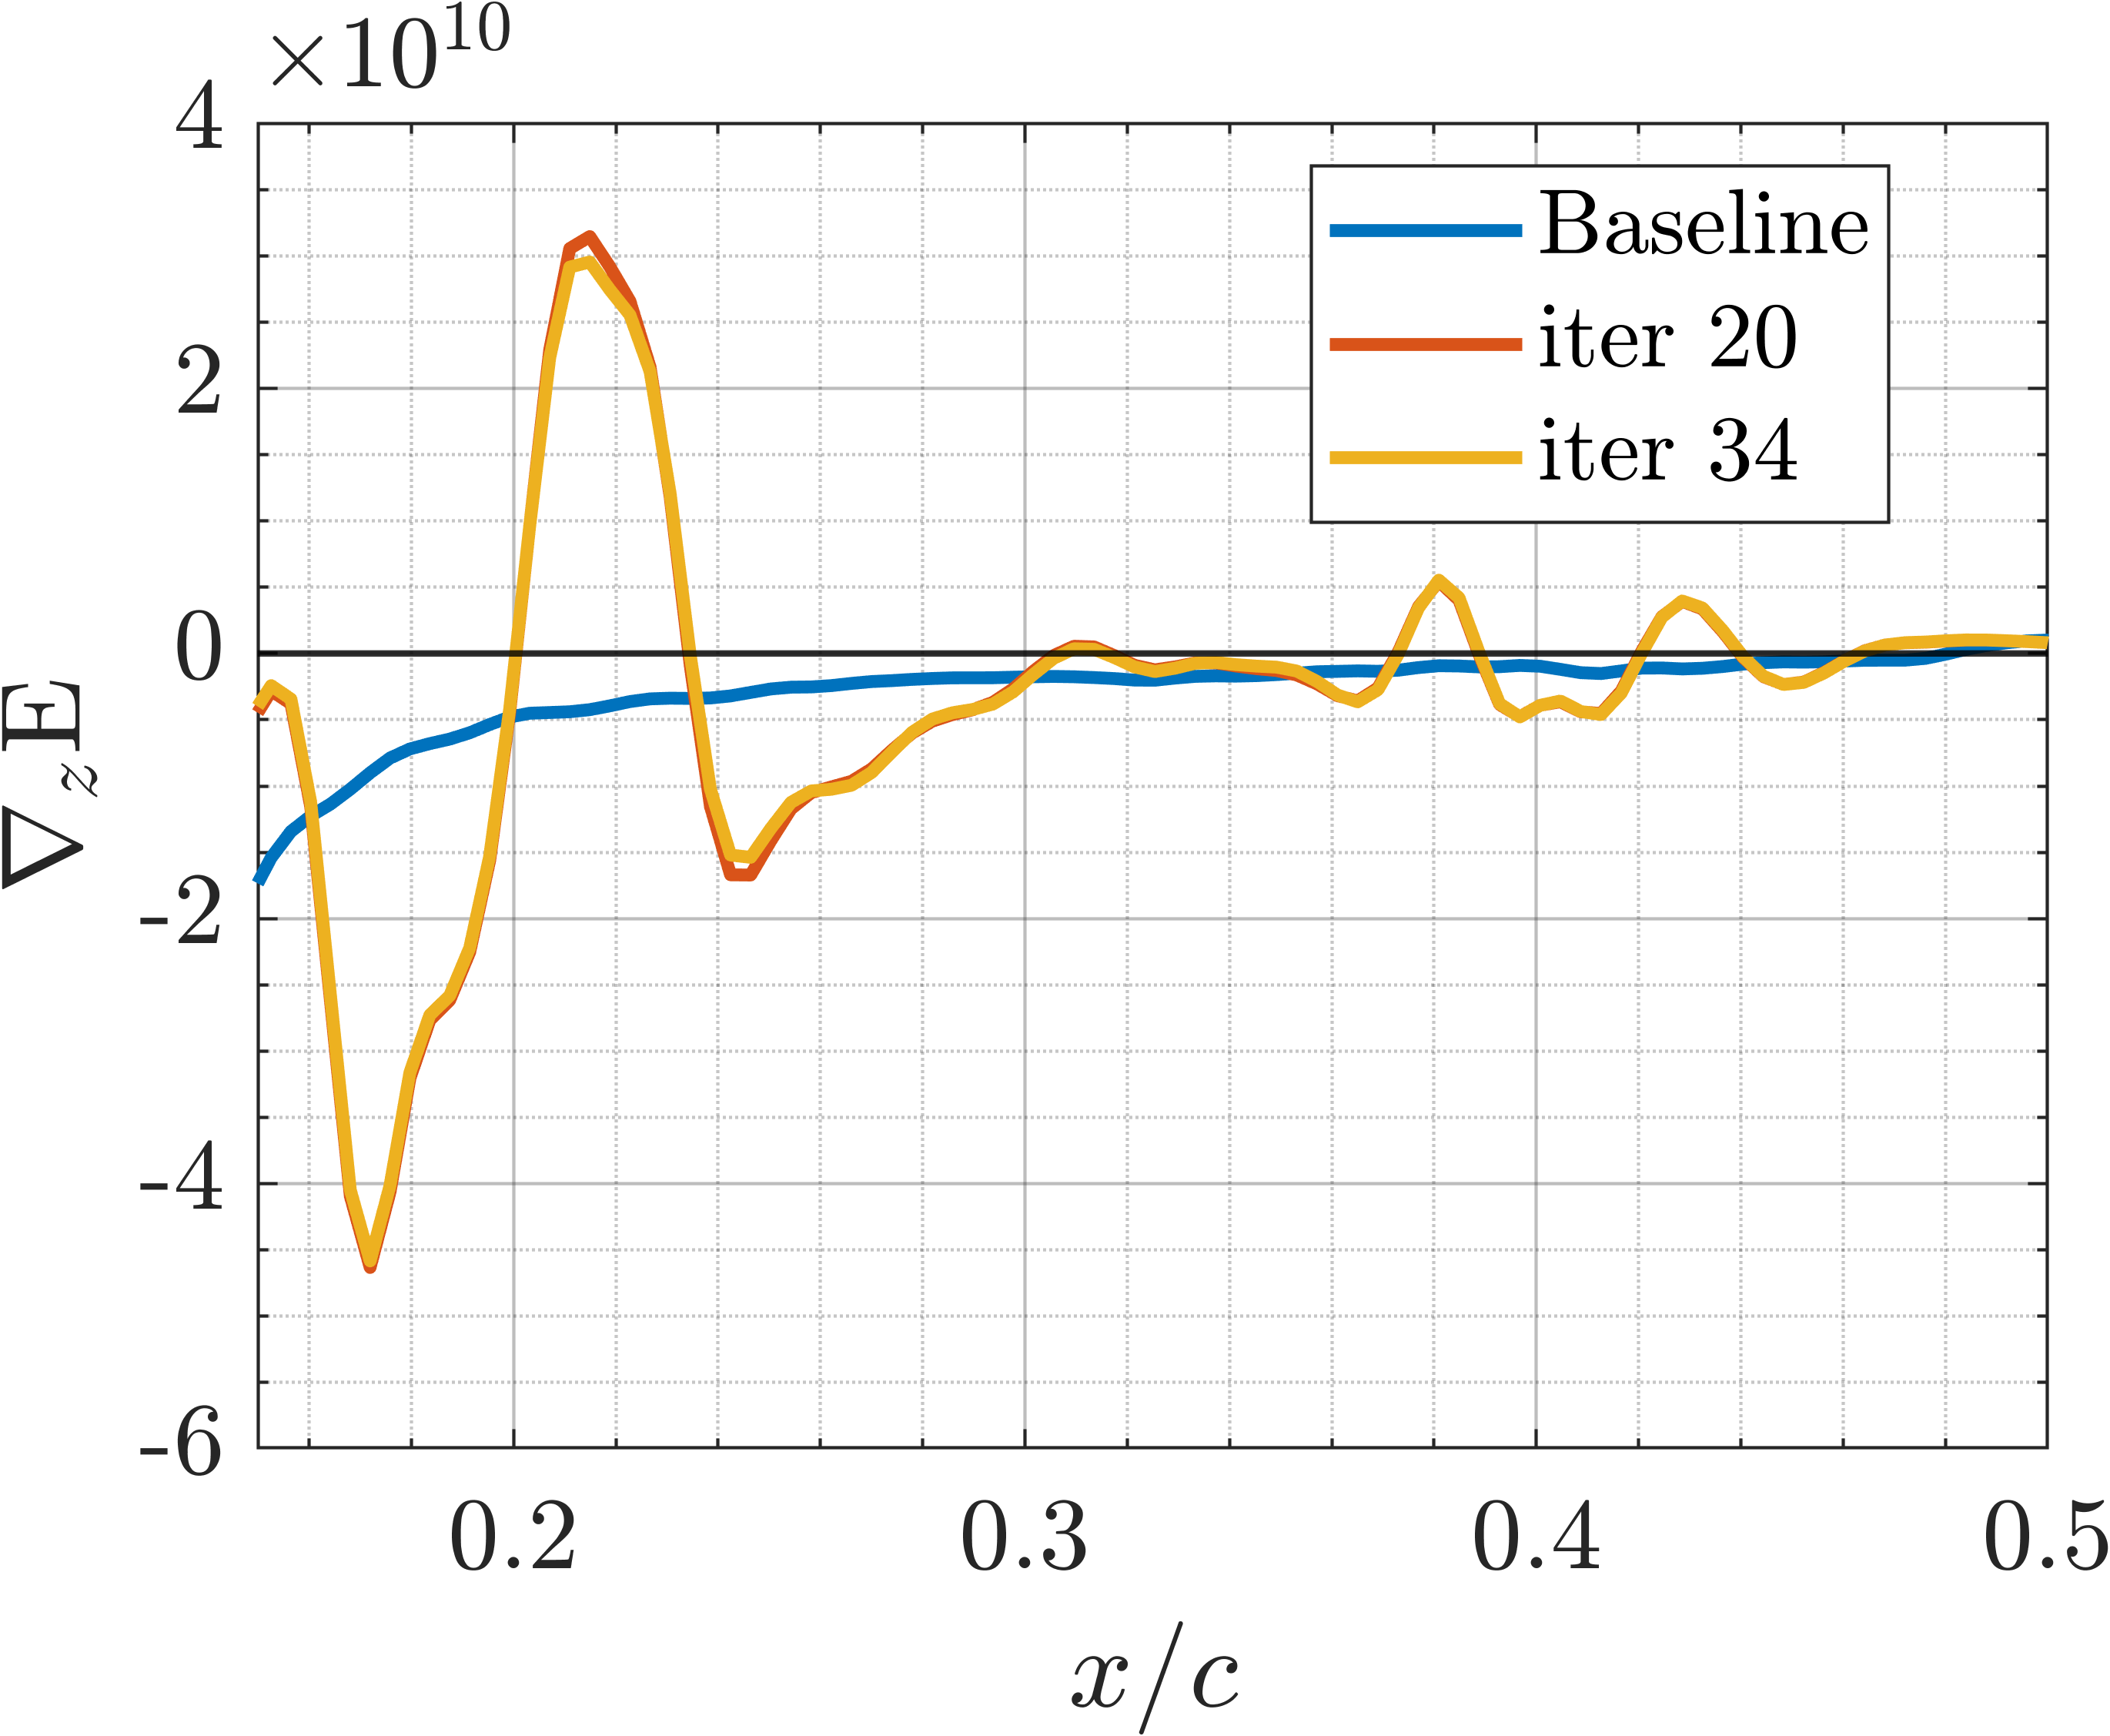
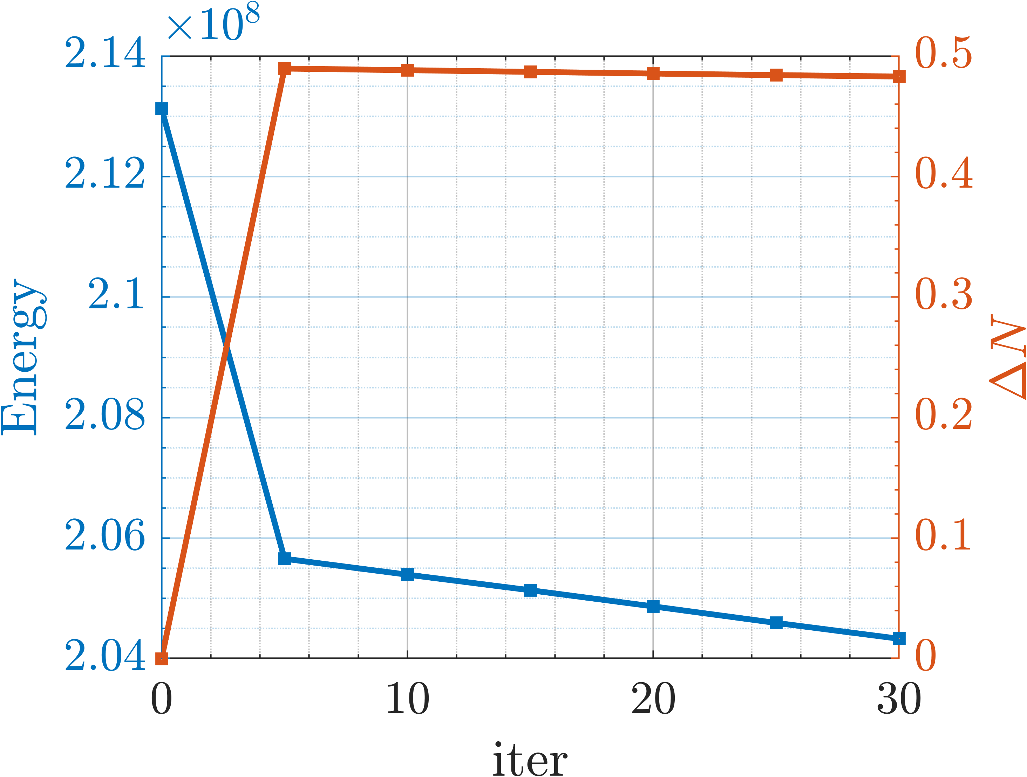
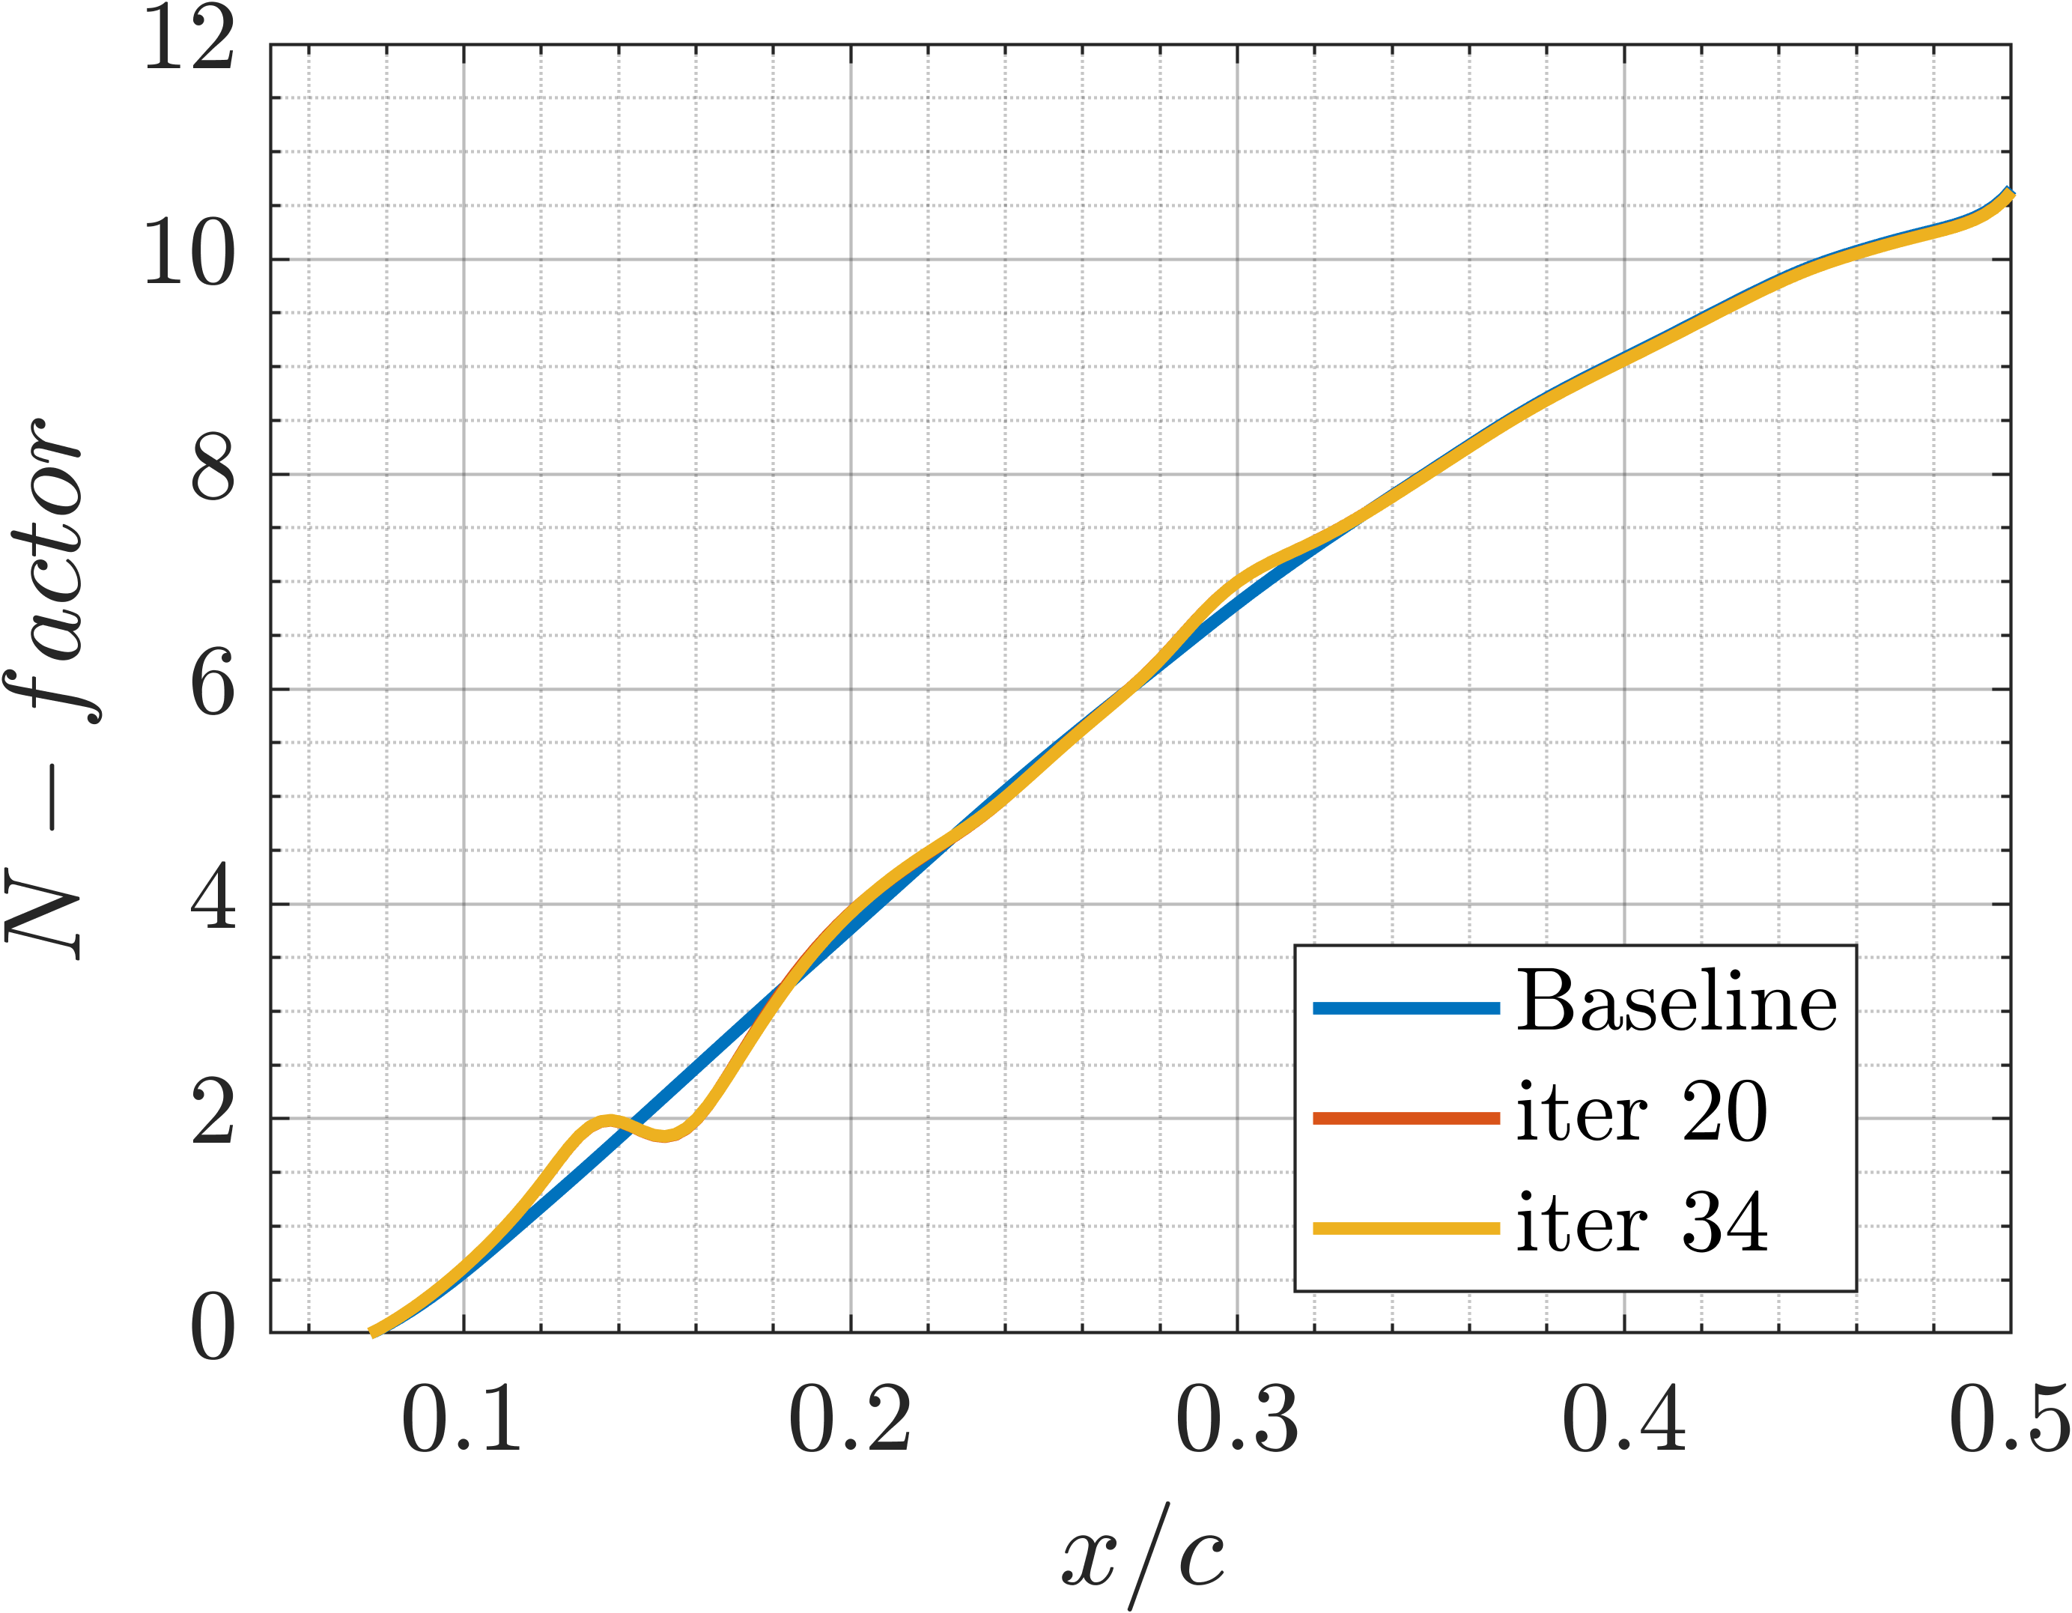
Preliminary results
Flow conditions: Re=9×10⁶, Ma=0.5, AoA=1.25°, Λ=45°
Bumps parameters: h = [0.25, 0.36, 0.40] and t = [0.30, 0.35, 0.20]

Slide 26
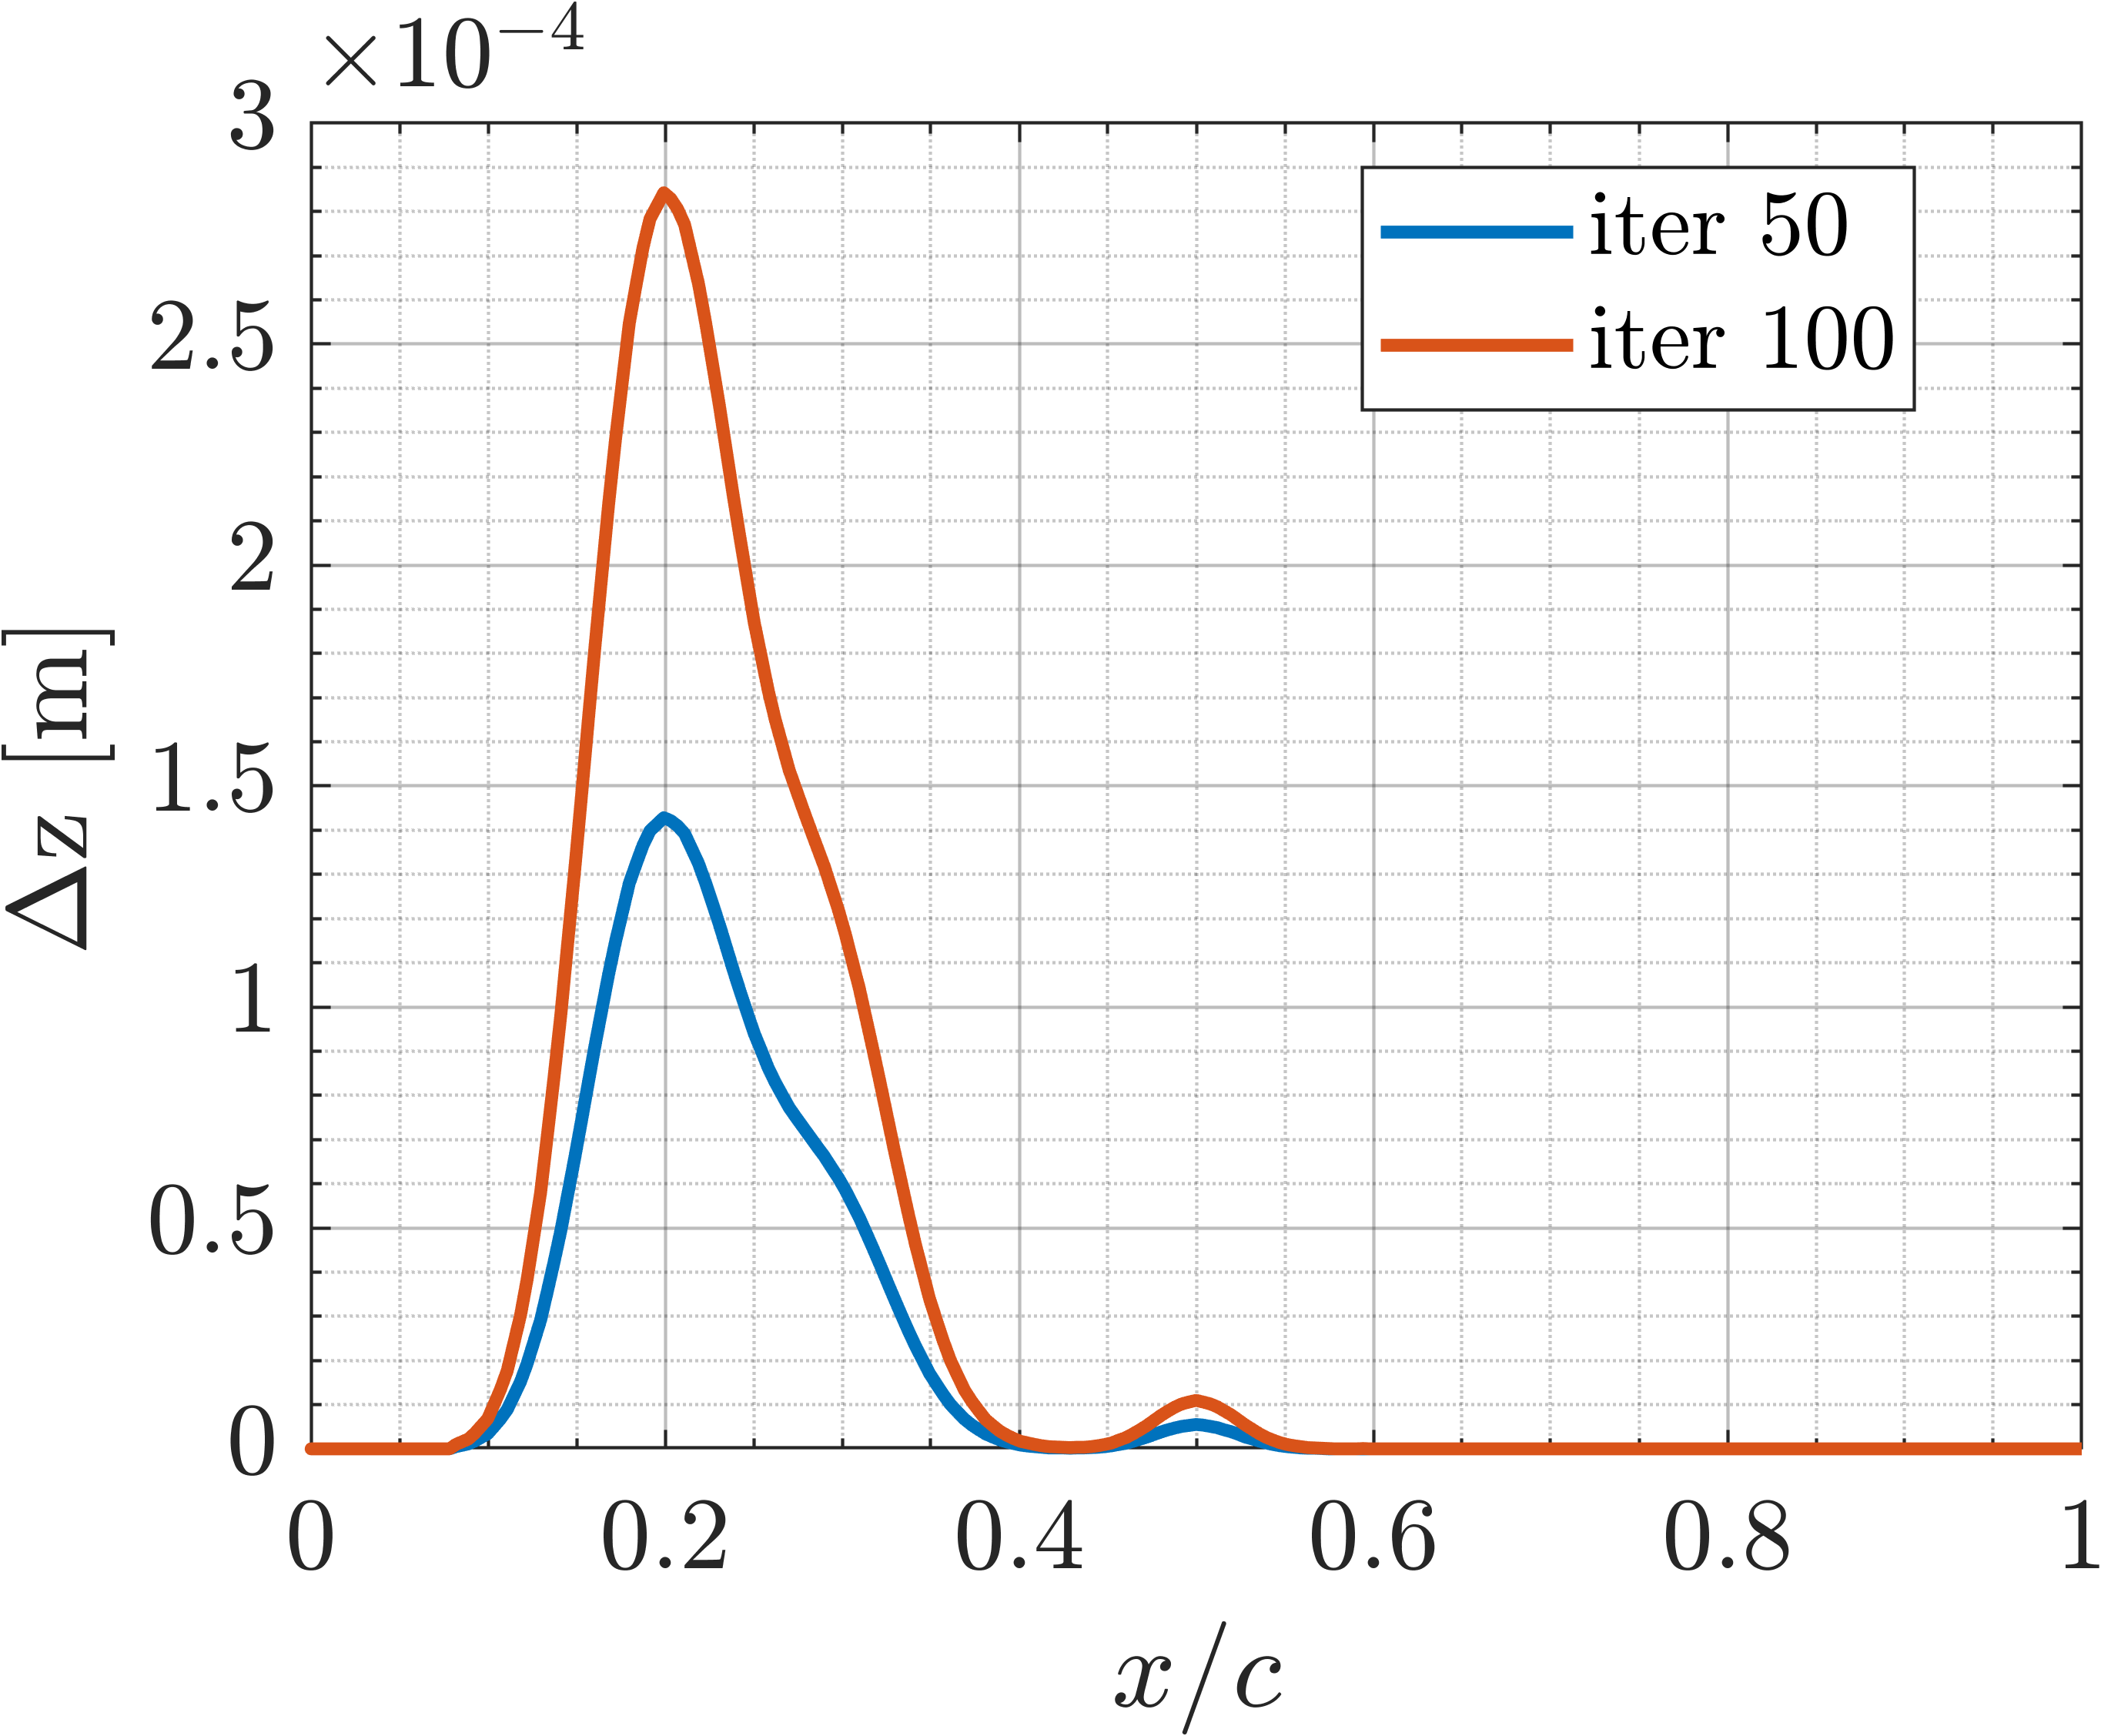
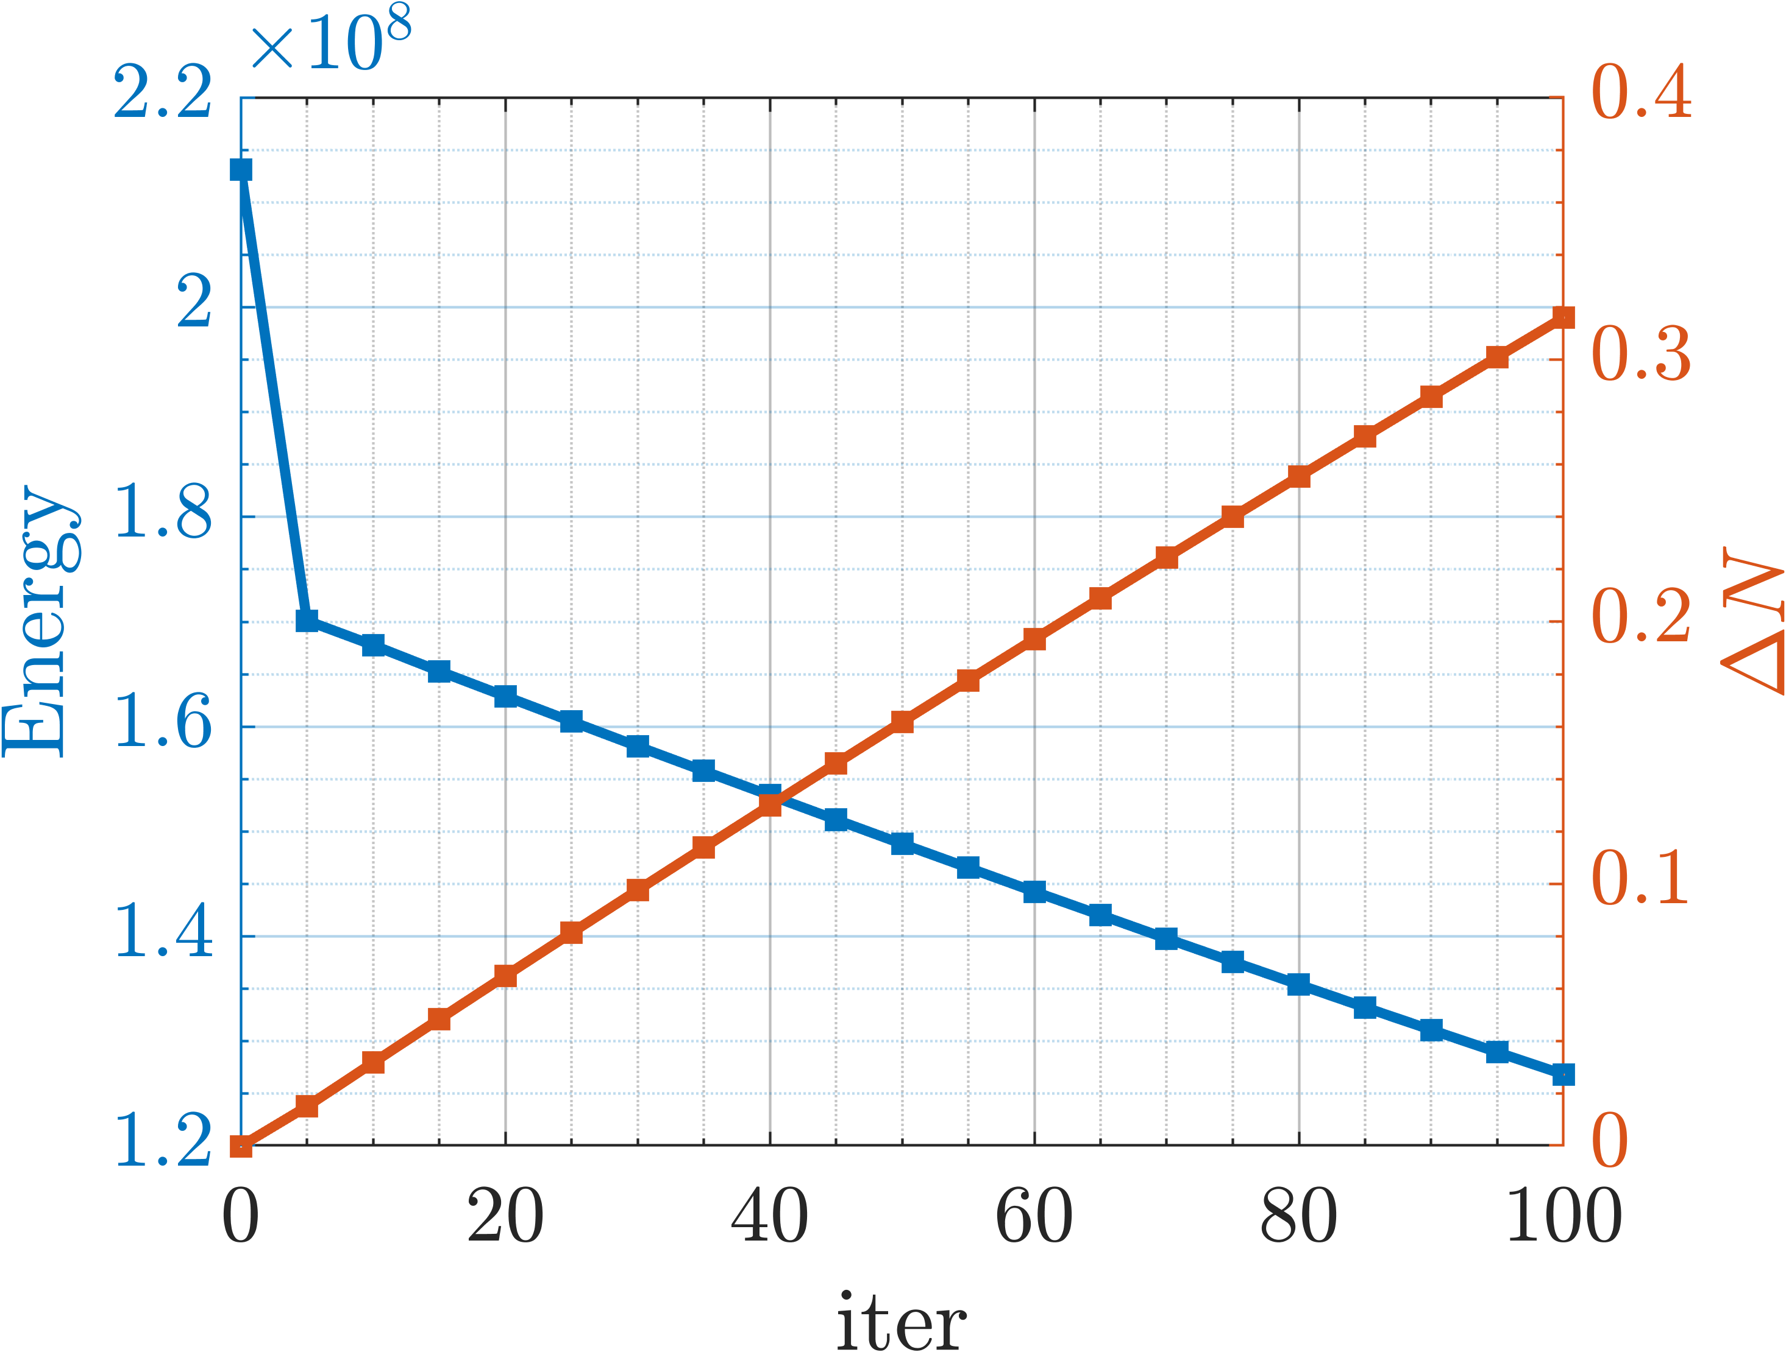
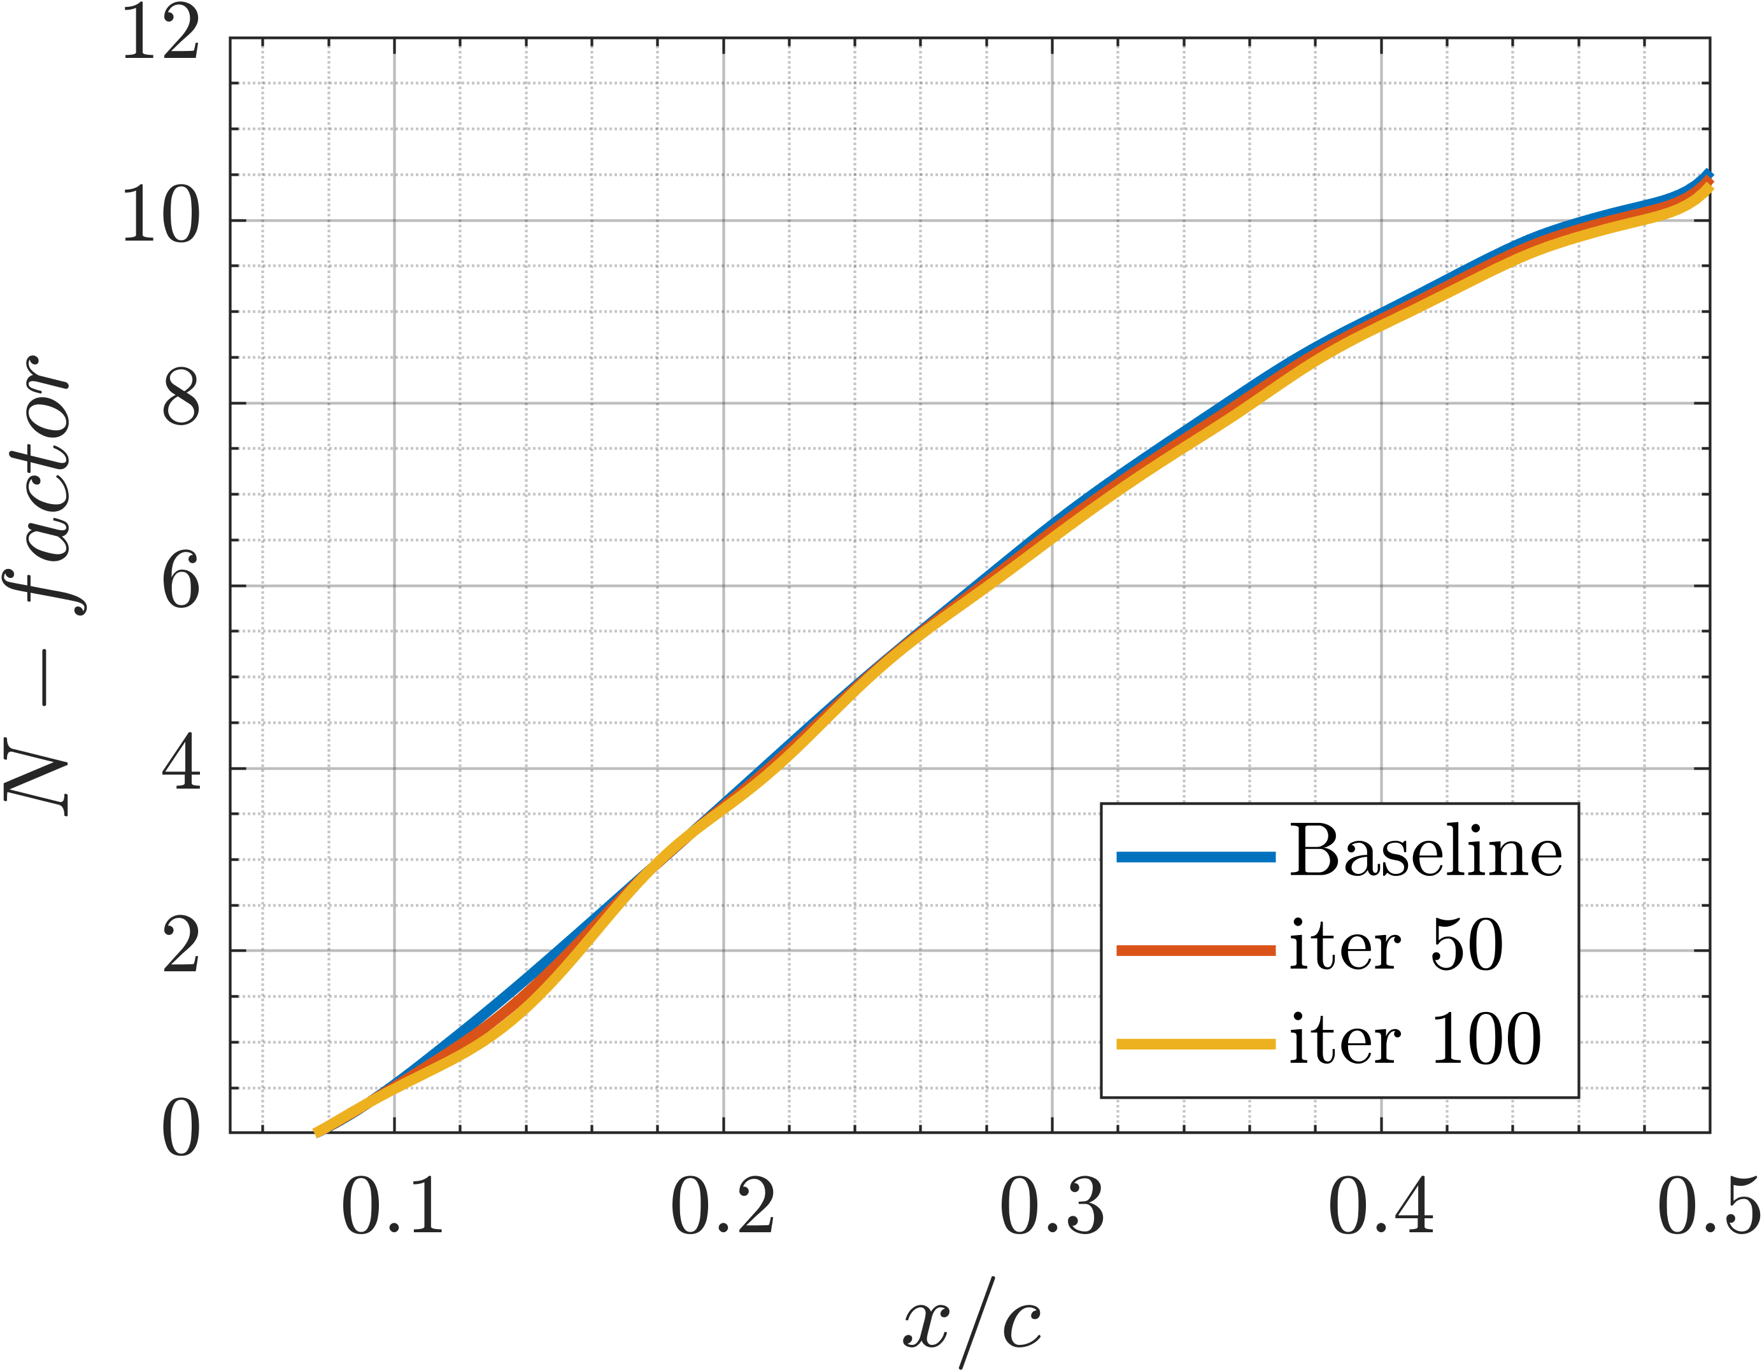
Preliminary results
Flow conditions: Re=9×10⁶, Ma=0.5, AoA=1.25°, Λ=45°
Bumps parameters: h = [0.20, 0.30, 0.50] and t = [0.30, 0.30, 0.15]

