Slide 1
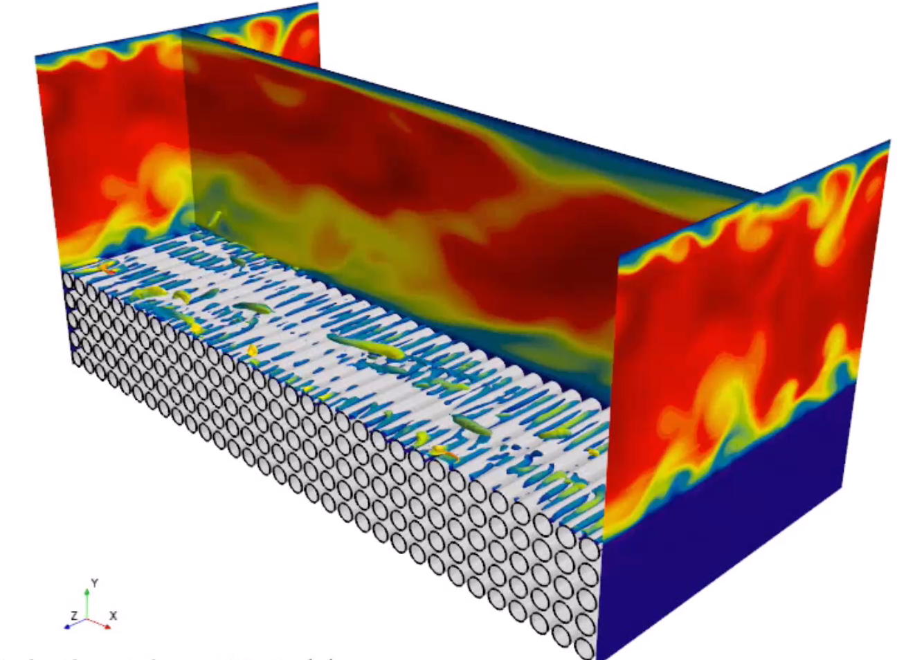
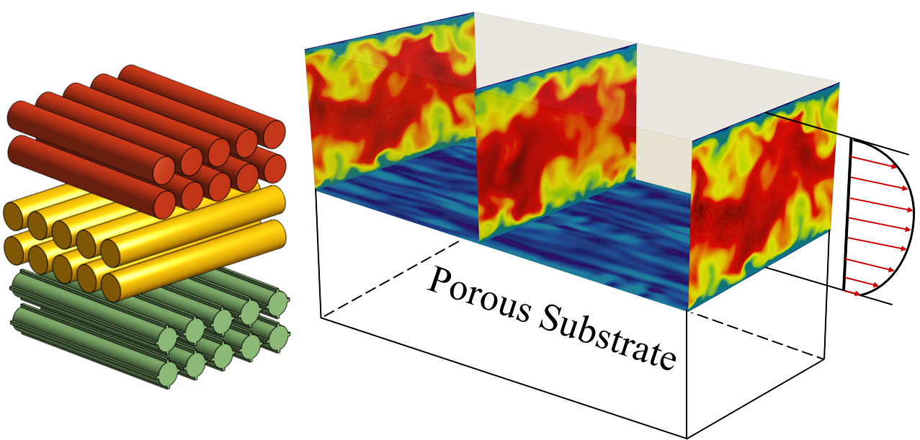
Turbulence over a microstructured porous wall
Jacques’65
Toulouse, March 27, 2024
Essam Nabil Ahmed & Alessandro Bottaro
DICCA, Università di Genova, Italy

Slide 2
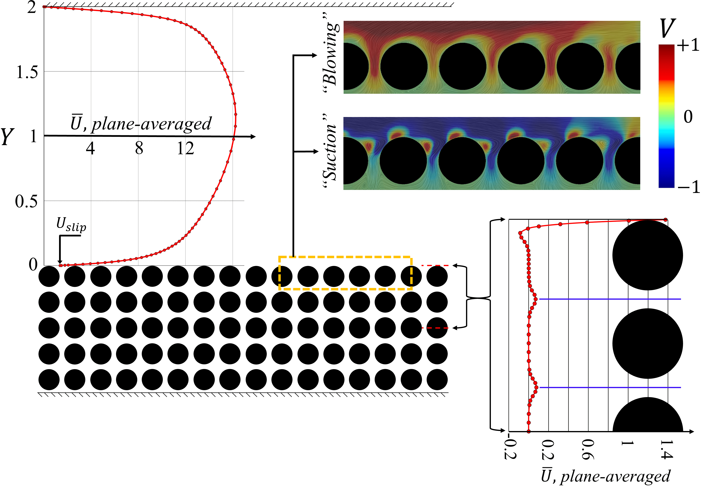




Slide 3
Can we model the presence of the permeable substrate without solving for the flow through the porous medium? Can we find effective boundary conditions at a virtual wall which
(1) can be derived rigorously and
(2) actually work (and not only in the laminar case)?!

Slide 4
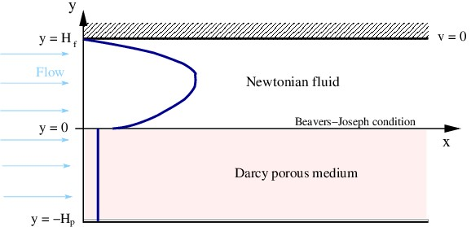




$$\hat{y}$$
2
$$2H$$
$$\hat{x}$$
Accounting for transpiration at the fictitious wall is essential

Slide 5
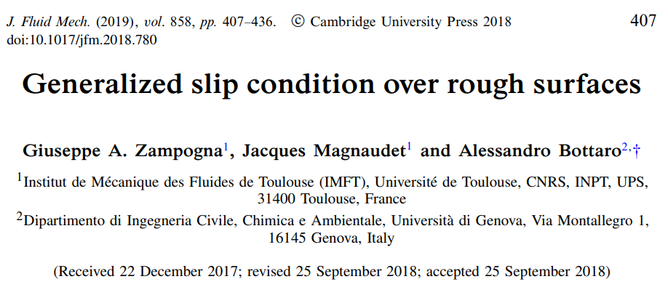

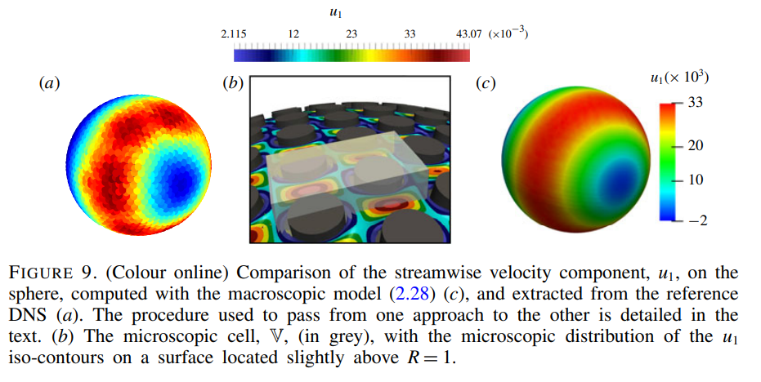

Slide 6
Can we do more?

Slide 7

Can we do more?
Extend to higher order in $ε$

Slide 8

Can we do more?
Extend to higher order in $ε$
Account for near-wall inertia and make the simplified procedure (with effective boundary conditions at the wall) work for the case of turbulent flow

Slide 9

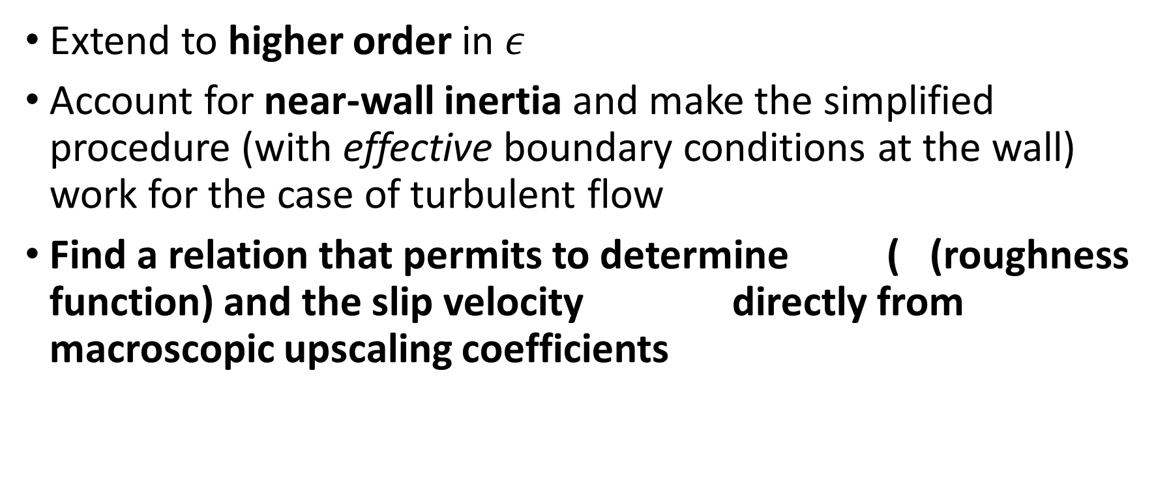
Can we do more?
Extend to higher order in $ε$
Account for near-wall inertia and make the simplified procedure (with effective boundary conditions at the wall) work for the case of turbulent flow
Find a relation that permits to determine ( (roughness function) and the slip velocity directly from macroscopic upscaling coefficients
slip

Slide 10
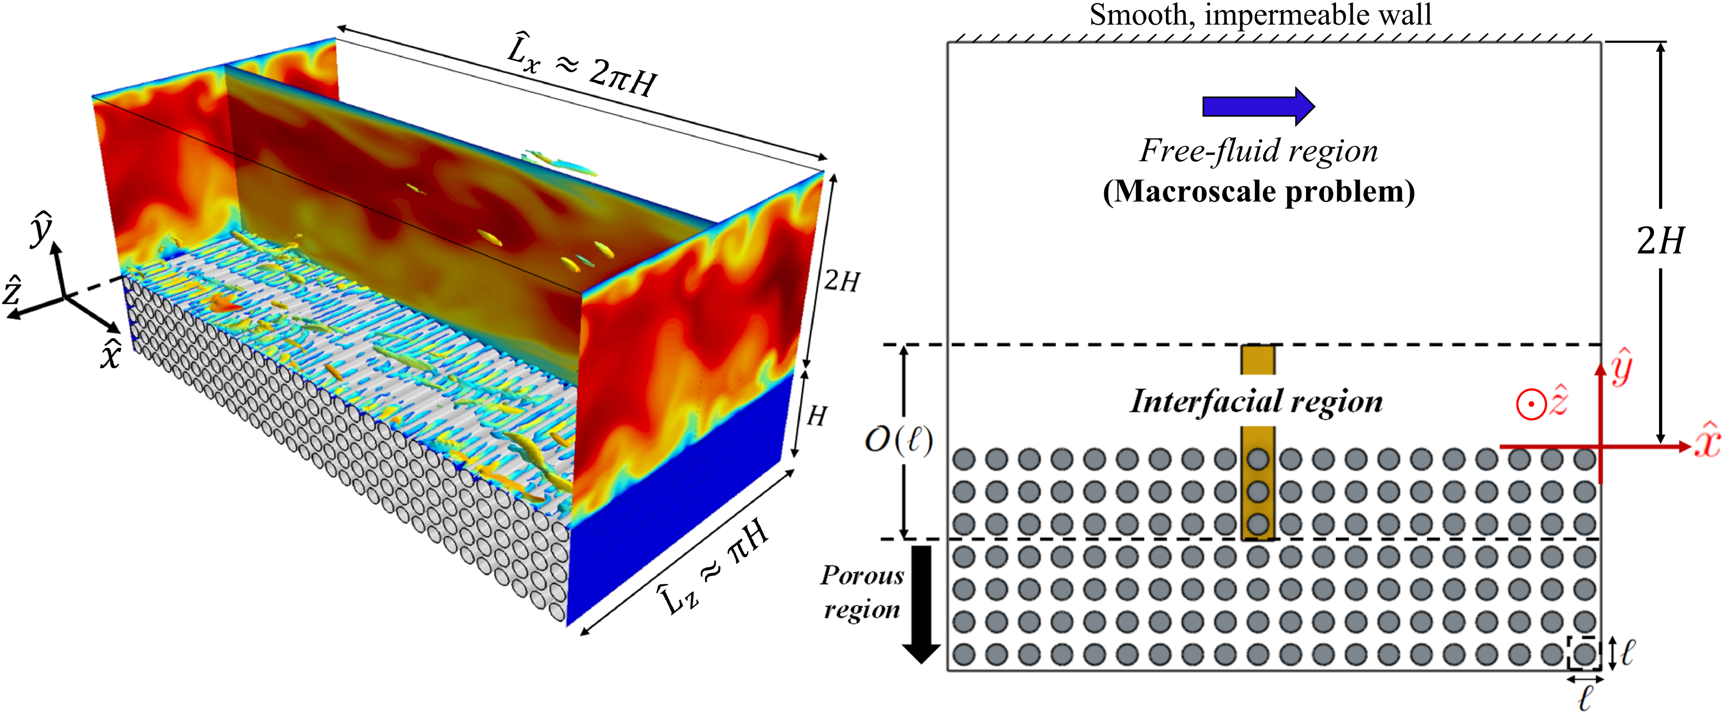
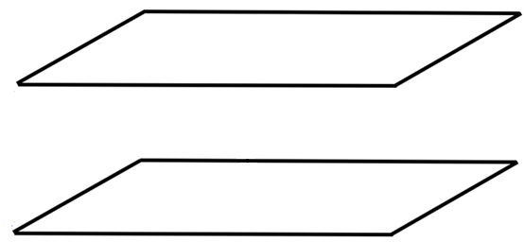
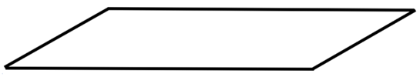


Rapidly-varying properties
(related to surface heterogeneity)
Homogenization
framework
$$ε=\frac{ℓ}{H}≪1$$
No-slip wall
$$2H$$
Channel flow
Navier-slip coefficients,
intrinsic permeability,
interfacial permeability,
etc.
Upscaled, homogeneous properties
(for effective boundary conditions)
Effective BCs
Porous substrate
(excluded)

Slide 11
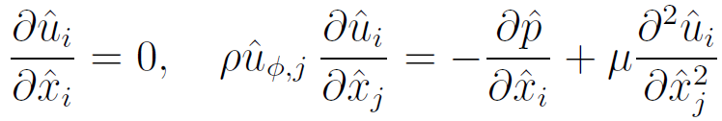
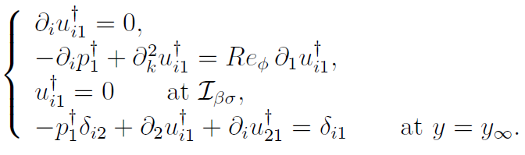
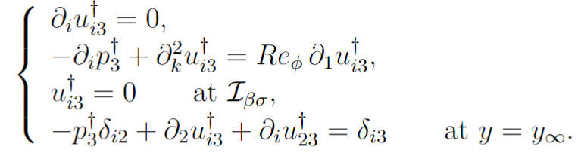


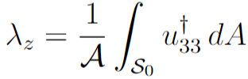

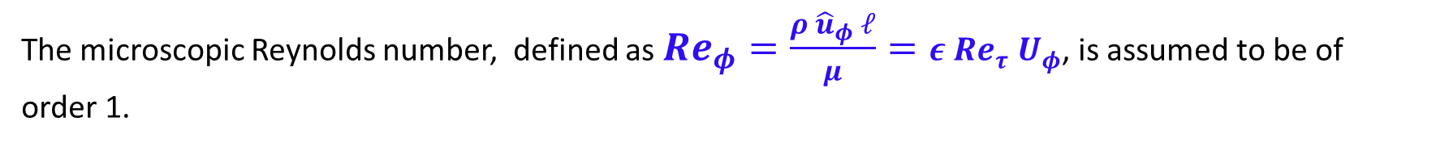
Near-wall advection modeling
An Oseen-like linearization was proposed to include the effects of near-interface advection in the homogenization scheme (Bottaro A., J. Fluid Mech. (2019), vol. 877, P1)
We define a spatially invariant velocity ${\hat{u}}_{φ,j}=\left({\hat{u}}_{φ}, 0, 0\right)$, representative of the near-wall velocity level.
Governing equations of the microscale problem:
The microscopic Reynolds number, defined as $Re_{φ}=\frac{ρ {\hat{u}}_{φ} ℓ}{μ}=ε Re_{τ}{ U}_{φ}$, is assumed to be of order 1.
+
The closure problems

Slide 12
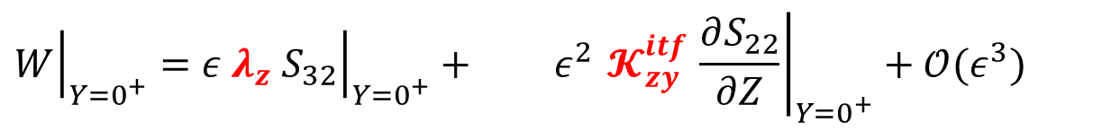
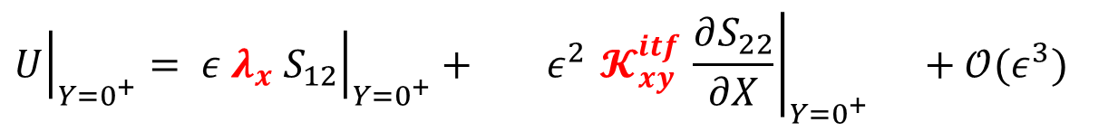
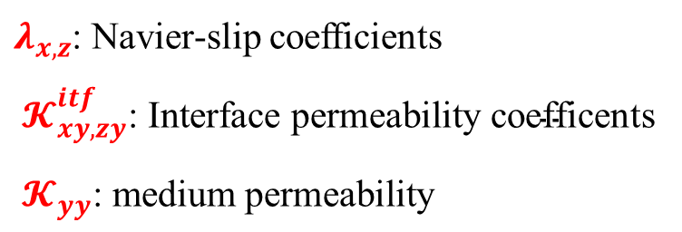

Macroscopic effective boundary conditions
$$S_{12}=\frac{∂U}{∂Y}+\frac{∂V}{∂X},$$
$${ S}_{22}=−Re P+2\frac{∂V}{∂Y},$$
$${ S}_{32}=\frac{∂W}{∂Y}+\frac{∂V}{∂Z}.$$
$${\left.U\right|}_{Y=0^{+}}= {\left.ε{ λ}_{x}{ S}_{12}\right|}_{Y=0^{+}}+ {\left.ε^{2}{ 𝓚}_{xy}^{itf} \frac{∂S_{22}}{∂X}\right|}_{Y=0^{+}} +𝒪(ε^{3})$$
Navier-slip condition
Second-order correction
$${\left.V\right|}_{Y=0^{+}}=−{\left.ε^{2}{ 𝓚}_{xy}^{itf} \frac{∂S_{12}}{∂X}\right|}_{Y=0^{+}}−{\left.ε^{2}{ 𝓚}_{zy}^{itf} \frac{∂S_{32}}{∂Z}\right|}_{Y=0^{+}}+ {\left.ε^{2}{ 𝓚}_{yy}^{} \frac{∂S_{22}}{∂Y}\right|}_{Y=0^{+}}+𝒪(ε^{3})$$
Second-order,
effect of interface permeabilities
Second-order,
effect of medium permeability
$${\left.W\right|}_{Y=0^{+}}={\left.ε{ λ}_{z}{ S}_{32}\right|}_{Y=0^{+}}+ {\left.ε^{2}{ 𝓚}_{zy}^{itf} \frac{∂S_{22}}{∂Z}\right|}_{Y=0^{+}}+𝒪(ε^{3})$$
$λ_{x,z}$: Navier-slip coefficients
$${ 𝓚}_{xy, zy}^{itf}\text{: }\text{Interface} \text{permeability} \text{coefficents}$$
$${ 𝓚}_{yy}^{}\text{: }\text{medium} \text{permeability}$$
Navier-slip condition
Second-order correction

Slide 13
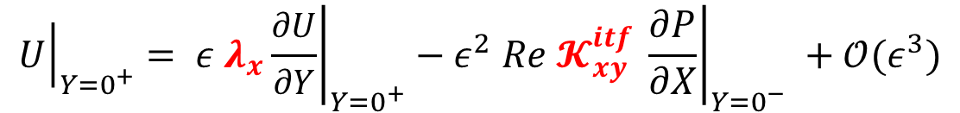
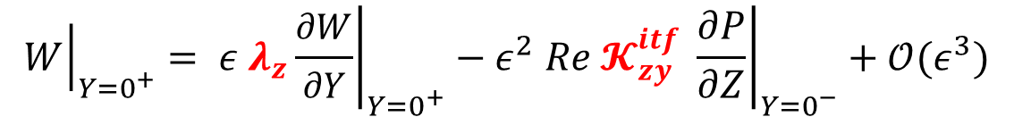
$${\left.U\right|}_{Y=0^{+}}= {\left.ε{ λ}_{x}\frac{∂U}{∂Y}\right|}_{Y=0^{+}}−{\left.ε^{2} Re{ 𝓚}_{xy}^{itf} \frac{∂P}{∂X}\right|}_{Y=0^{−}} +𝒪(ε^{3})$$
$${\left.V\right|}_{Y=0^{+}}=−{\left.ε\frac{{ 𝓚}_{xy}^{itf}}{{ λ}_{x}}\frac{∂U}{∂X}\right|}_{Y=0^{+}}−{\left.ε\frac{{ 𝓚}_{zy}^{itf}}{{ λ}_{z}}\frac{∂W}{∂Z }\right|}_{Y=0^{+}}− {\left.ε^{2}Re{ 𝓚}_{yy}^{} \frac{∂P}{∂Y}\right|}_{Y=0^{−}}+𝒪(ε^{3})$$
$${\left.W\right|}_{Y=0^{+}}={\left. ε{ λ}_{z}\frac{∂W}{∂Y}\right|}_{Y=0^{+}}−{\left.ε^{2} Re{ 𝓚}_{zy}^{itf} \frac{∂P}{∂Z}\right|}_{Y=0^{−}}+𝒪(ε^{3})$$
Extended Beavers-Joseph-Saffman conditions with NO empirical coefficients

Slide 14

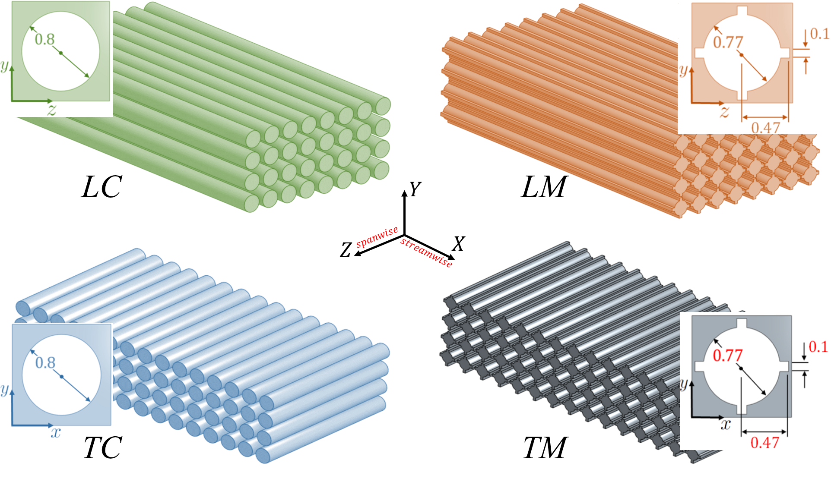


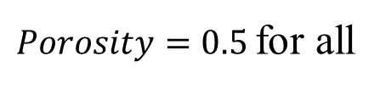
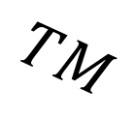
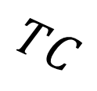

Possible drag reduction
$Porosity=0.5$for all
$$ε=0.05→0.2$$
$$Re_{τ}≈190$$
$$TC$$
$$TM$$
Drag increase

Slide 15
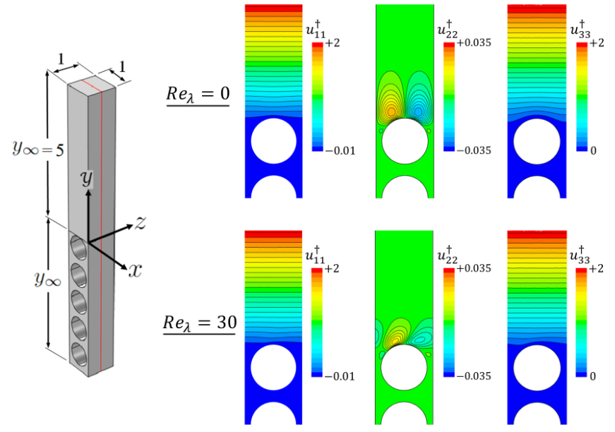
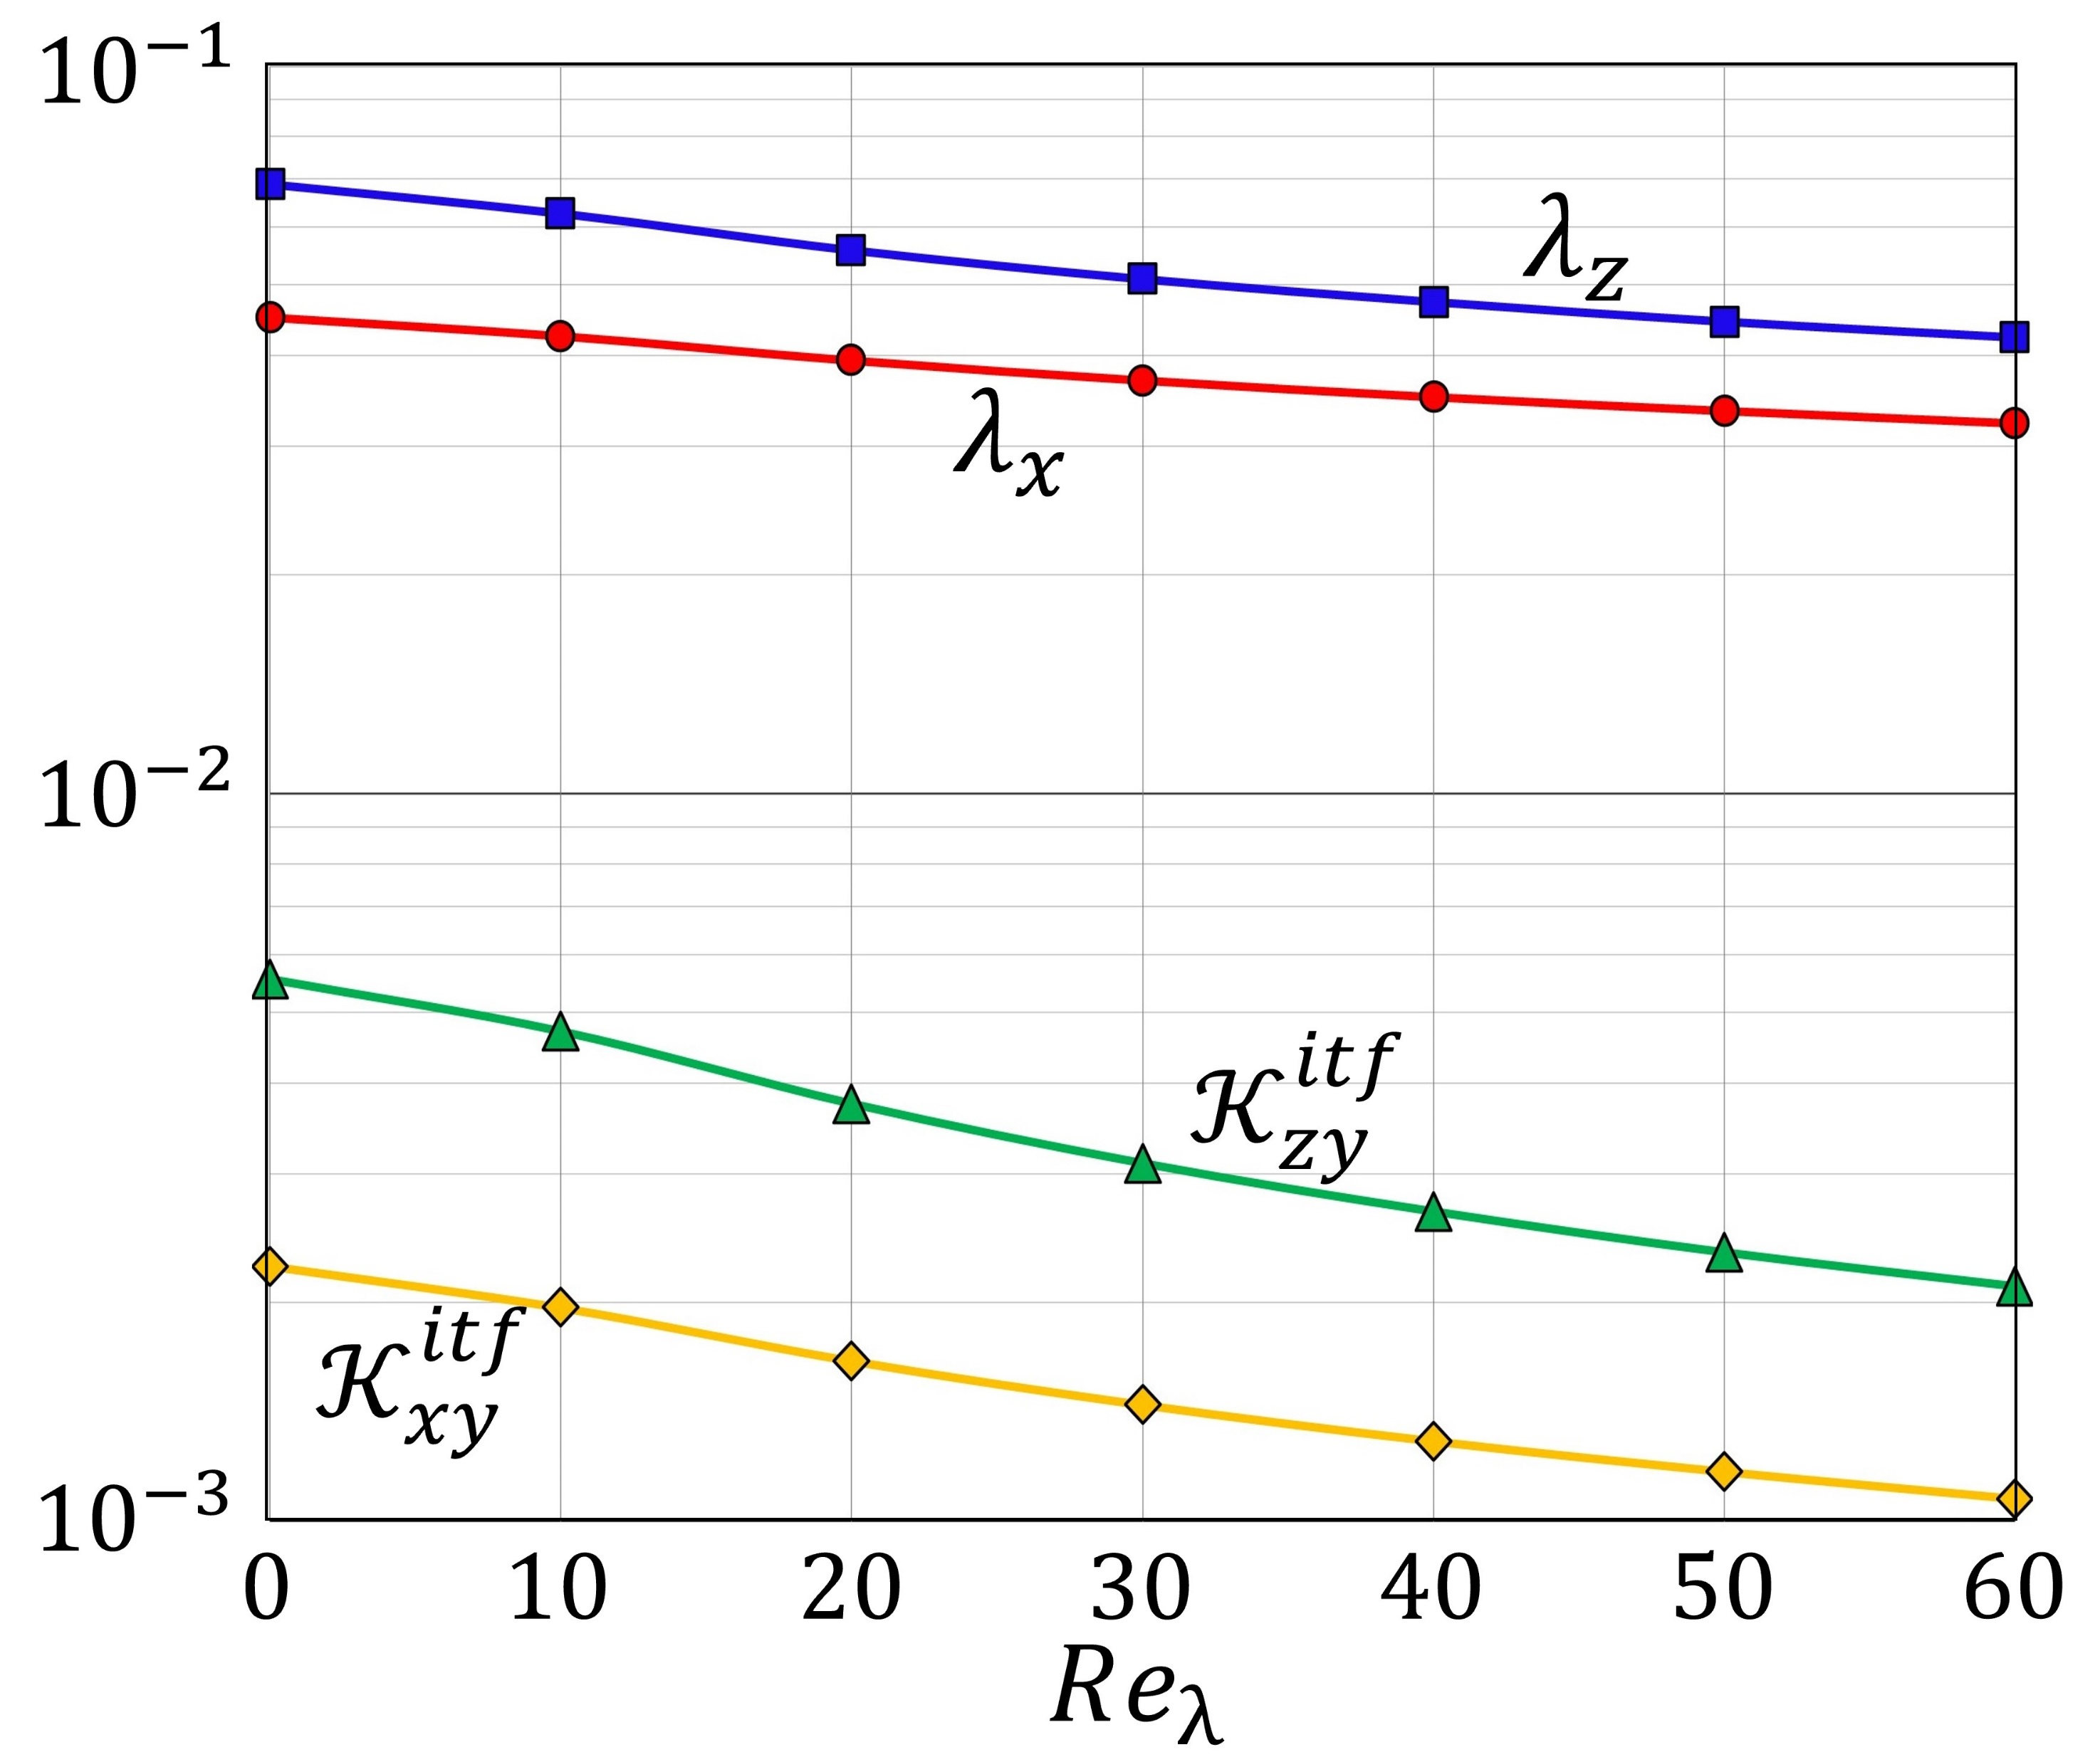




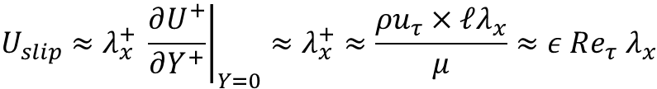

$$Re_{φ}$$
Two different virtual origins for longitudinal and transverse flow, i.e. for mean flow and for turbulence
+
$$Assume {\hat{u}}_{φ}={\hat{u}}_{slip}→Re_{φ}=εRe_{τ}U_{slip}$$
$$U_{slip}≈λ_{x}^{+} {\left.\frac{∂U^{+}}{∂Y^{+}}\right|}_{Y=0}≈λ_{x}^{+}≈\frac{ρu_{τ}×ℓλ_{x}}{μ}≈ε Re_{τ} λ_{x}$$
+
First-order:
$$∴Re_{φ}=ε^{2}Re_{τ}^{2}{ λ}_{x}$$

Slide 16
$$Re_{φ}$$
Two different virtual origins for longitudinal and transverse flow, i.e. for mean flow and for turbulence
+
$$Assume {\hat{u}}_{φ}={\hat{u}}_{slip}→Re_{φ}=εRe_{τ}U_{slip}$$
$$U_{slip}≈λ_{x}^{+} {\left.\frac{∂U^{+}}{∂Y^{+}}\right|}_{Y=0}≈λ_{x}^{+}≈\frac{ρu_{τ}×ℓλ_{x}}{μ}≈ε Re_{τ} λ_{x}$$
+
First-order:
$$∴Re_{φ}=ε^{2}Re_{τ}^{2}{ λ}_{x}$$

Slide 17
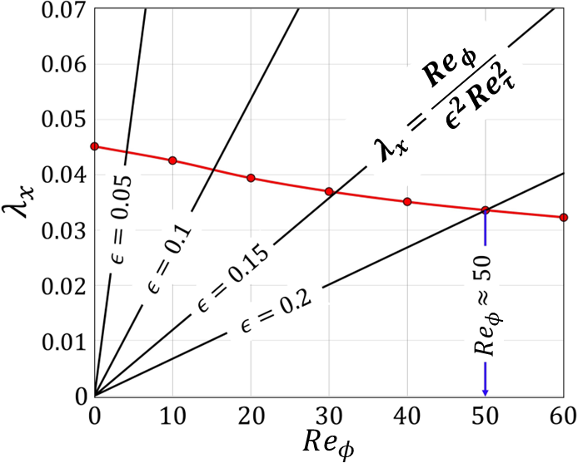
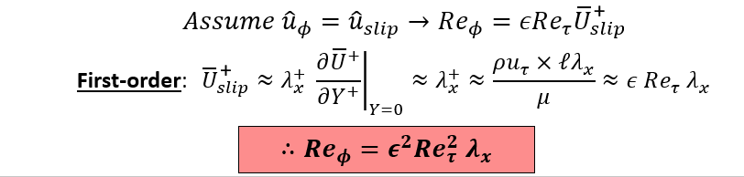
$$Re_{φ}$$
$$Assume {\hat{u}}_{φ}={\hat{u}}_{slip}→Re_{φ}=εRe_{τ}U_{slip}$$
First-order:
$$U_{slip}≈λ_{x}^{+} {\left.\frac{∂U^{+}}{∂Y^{+}}\right|}_{Y=0}≈λ_{x}^{+}≈\frac{ρu_{τ}×ℓλ_{x}}{μ}≈ε Re_{τ} λ_{x}$$
$$∴Re_{φ}=ε^{2}Re_{τ}^{2}{ λ}_{x}$$

Slide 18
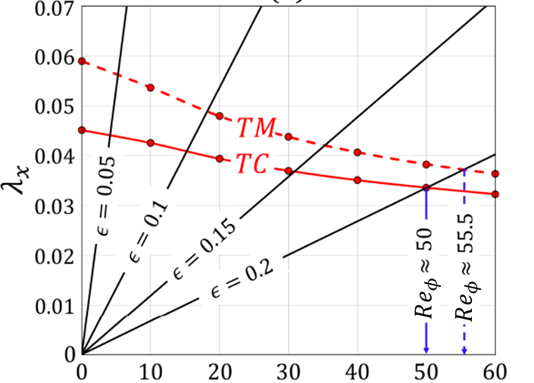
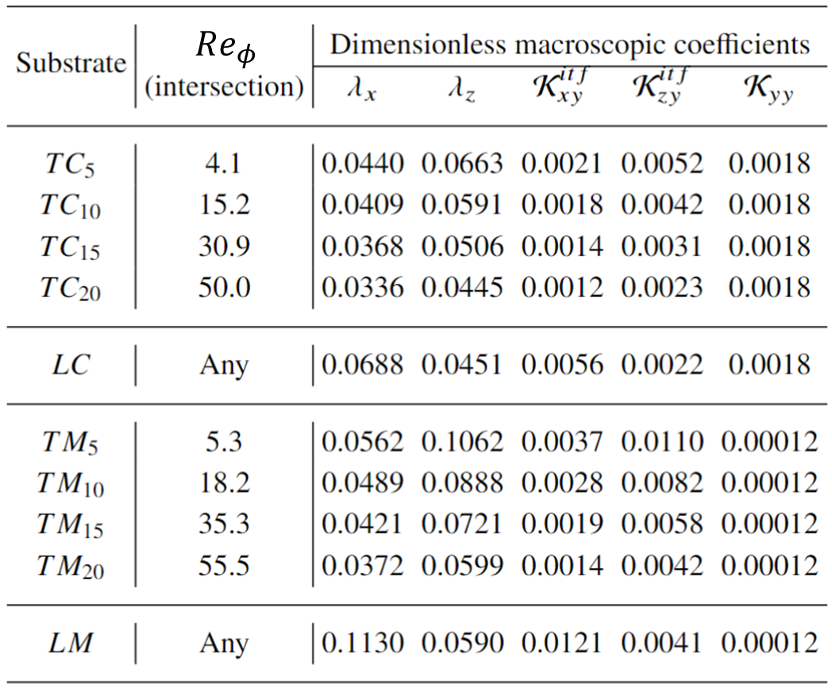
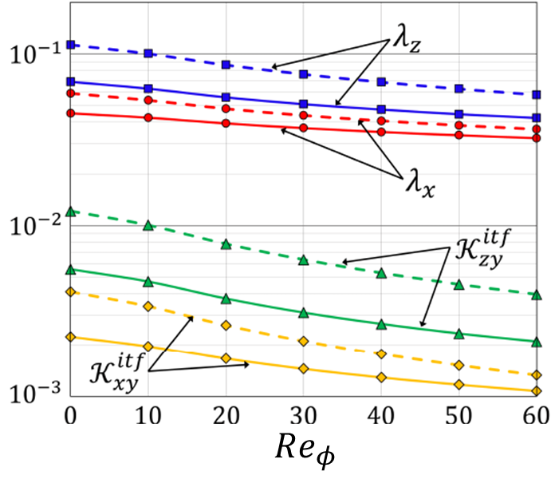

Slide 19
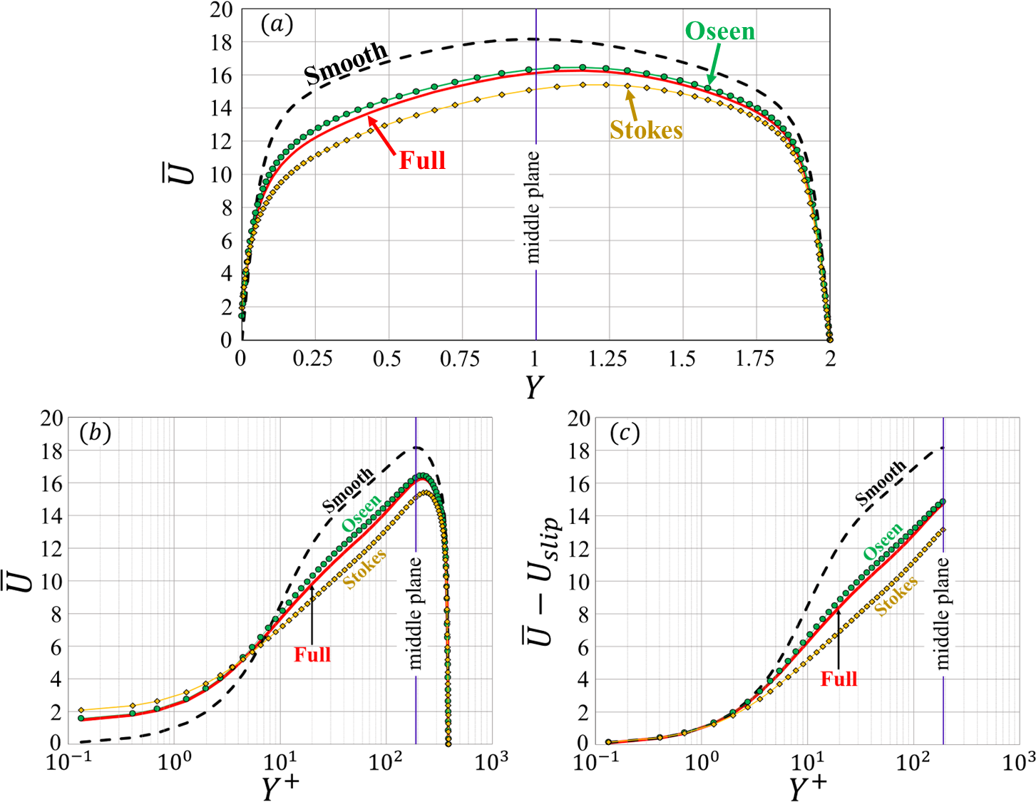

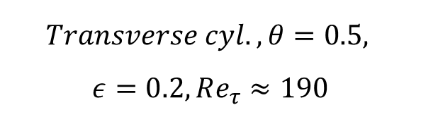
Model validation
$$Transverse cyl., θ=0.5,$$
$$ε=0.2, Re_{τ}≈190$$
* Stokes’ model over-estimates drag increase
* Oseen’s model perfectly predicts slip velocity
+
+

Slide 20
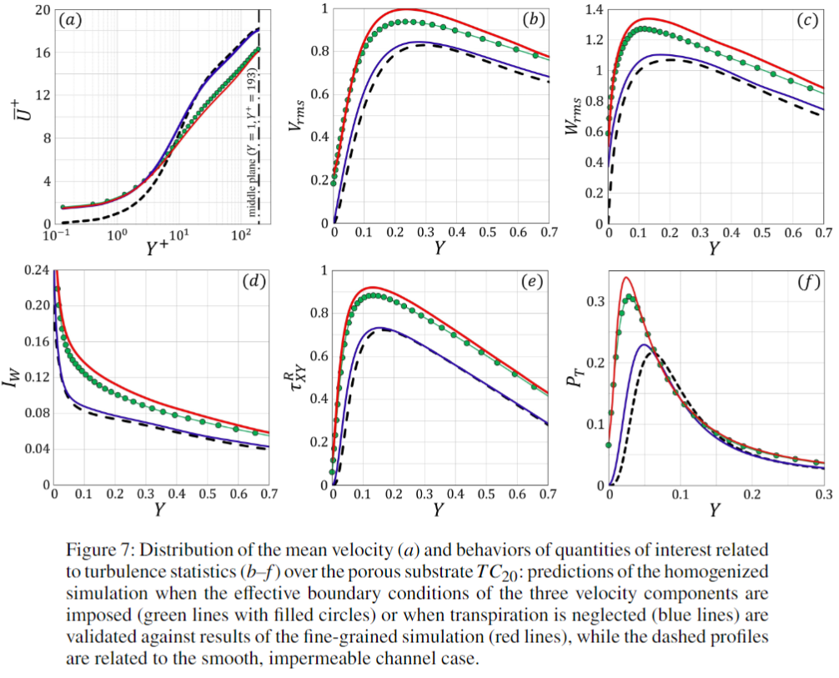

Slide 21
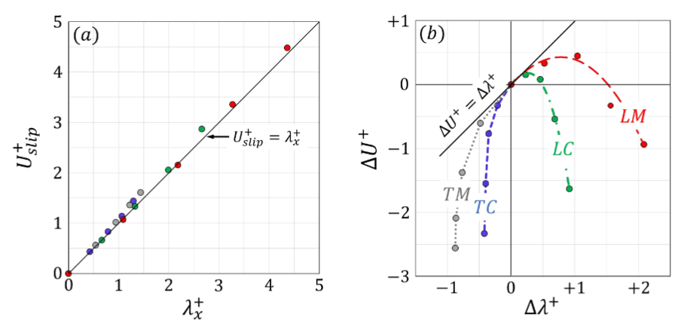

Slide 22
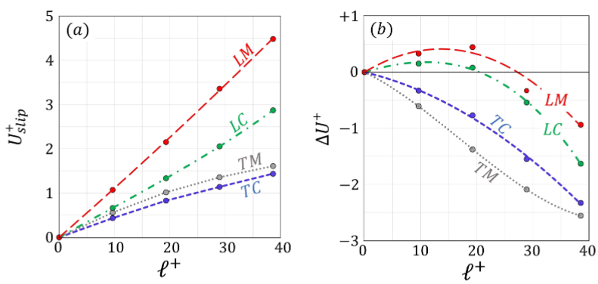
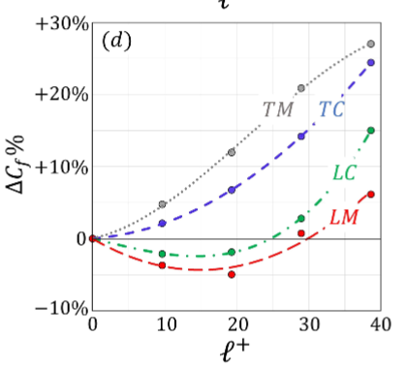

Slide 23
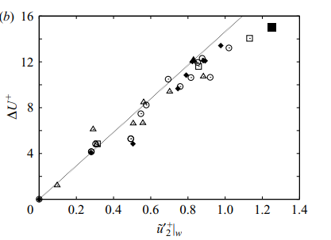
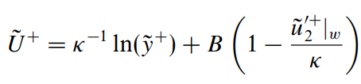
Previous work (Orlandi & Leonardi 2006, 2008) has shown that the roughness function is related to the fluctuating vertical velocity at the fictitious wall (tangent to the vertical velocity)

Slide 24
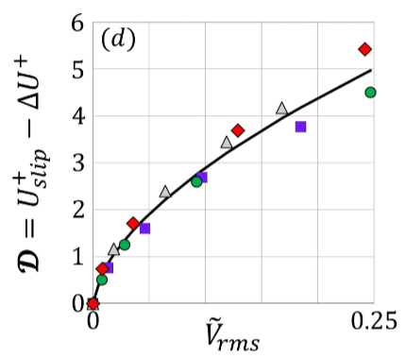


Slide 25
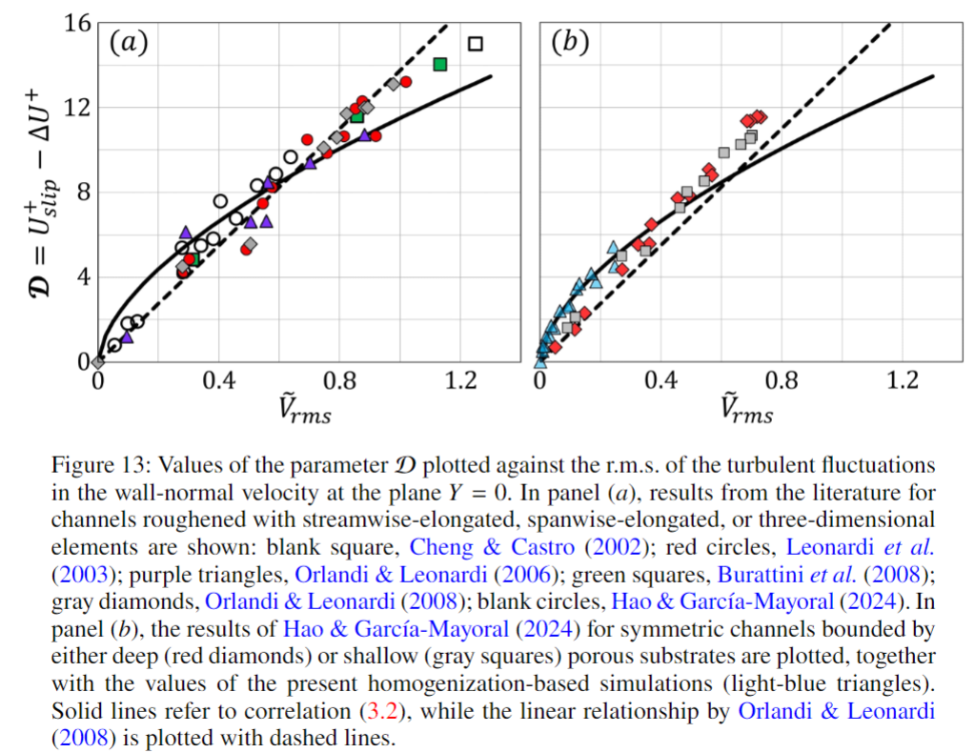

Slide 26

But … where do we get from???

Slide 27

$${\left.U\right|}_{Y=0^{+}}= {\left.ε{ λ}_{x}\frac{∂U}{∂Y}\right|}_{Y=0^{+}}−{\left.ε^{2} Re{ 𝓚}_{xy}^{itf} \frac{∂P}{∂X}\right|}_{Y=0^{−}} +𝒪(ε^{3})$$
$${\left.V\right|}_{Y=0^{+}}=−{\left.ε\frac{{ 𝓚}_{xy}^{itf}}{{ λ}_{x}}\frac{∂U}{∂X}\right|}_{Y=0^{+}}−{\left.ε\frac{{ 𝓚}_{zy}^{itf}}{{ λ}_{z}}\frac{∂W}{∂Z }\right|}_{Y=0^{+}}− {\left.ε^{2}Re{ 𝓚}_{yy}^{} \frac{∂P}{∂Y}\right|}_{Y=0^{−}}+𝒪(ε^{3})$$
$${\left.W\right|}_{Y=0^{+}}={\left. ε{ λ}_{z}\frac{∂W}{∂Y}\right|}_{Y=0^{+}}−{\left.ε^{2} Re{ 𝓚}_{zy}^{itf} \frac{∂P}{∂Z}\right|}_{Y=0^{−}}+𝒪(ε^{3})$$
Extended Beavers-Joseph-Saffman conditions with NO empirical coefficients

Slide 28
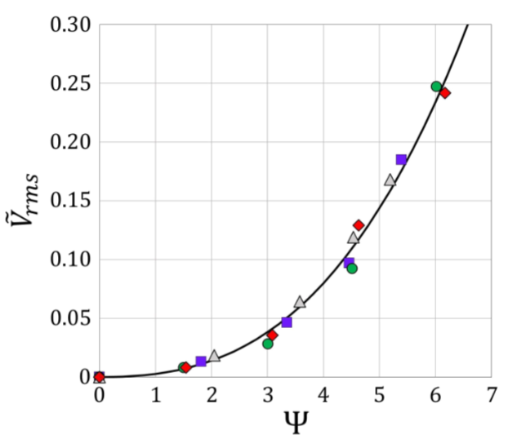
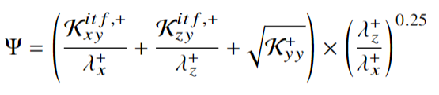
uniquely related to macroscopic upscaled coefficients, and easy to determine in either the approximations of Stokes or Oseen

Slide 29
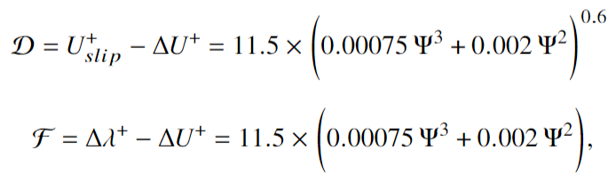
Final relation

Slide 30
Now we are in the position to make a priori predictions …

Slide 31
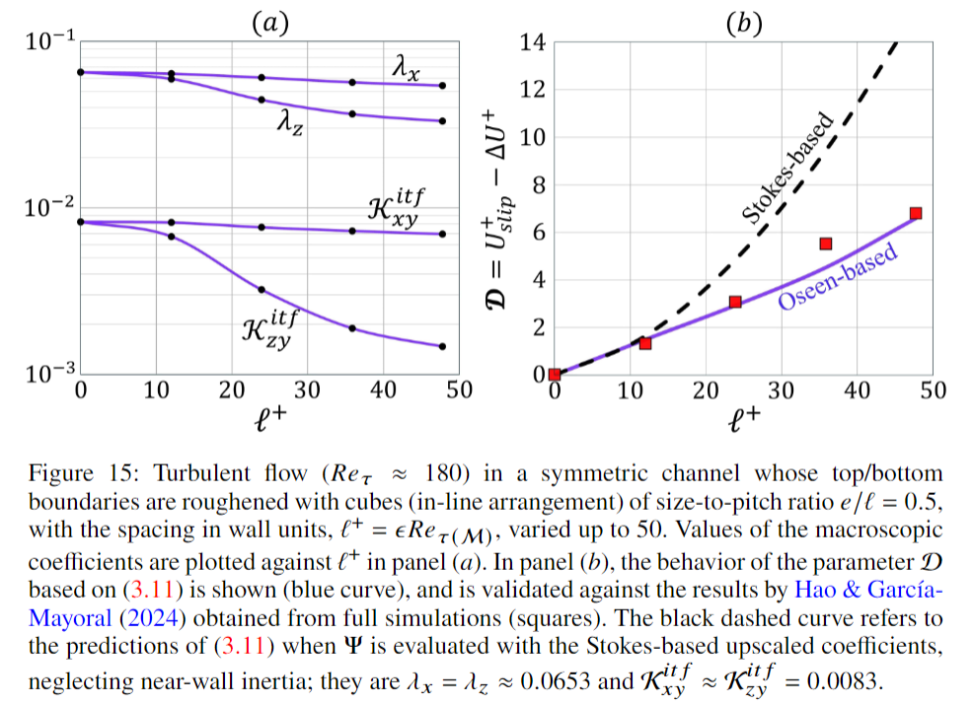

Rough wall
${ (𝒦}_{yy}^{}$= 0)

Slide 32


Riblets
${ (𝒦}_{yy}^{}$= 0)

Slide 33


Salient ideas
Homogenization theory can include advection within a linearized (Oseen-like) framework. The theory yields macroscopic upscaling coefficients
Effective wall conditions appear to mimic very well the effect of the surface/substrate
The drag-reducing/increasing effect of a porous substrate or of wall roughness can be reproduced simply by identifying the macroscopic upscaling coefficients, and then computing the characteristic function

Slide 34













Isosurfaces with $λ_{2} criterion=500$
$$Y$$
$$X$$
$$0$$
$$Z$$
$$LM_{10}$$
$$TM_{20}$$
$$U$$
$$physical time period: ΔT^{∗}=1$$
$$18$$

Slide 35








$$L_{X}=6.4$$
U
18
13.25
$$Y$$
$$2$$
$$Z$$
$$X$$
8.50
$$1$$
3.75
$$Porosity=θ=0.5,$$
$$ε=\frac{pitch distance (ℓ)}{half channel height (H)}=0.2$$
-1
$$L_{z}=3.2$$

Slide 36




Blowing events
Suction events
V
1
0
$$physical time period: ΔT^{∗}≈5$$
-1

