Slide 1
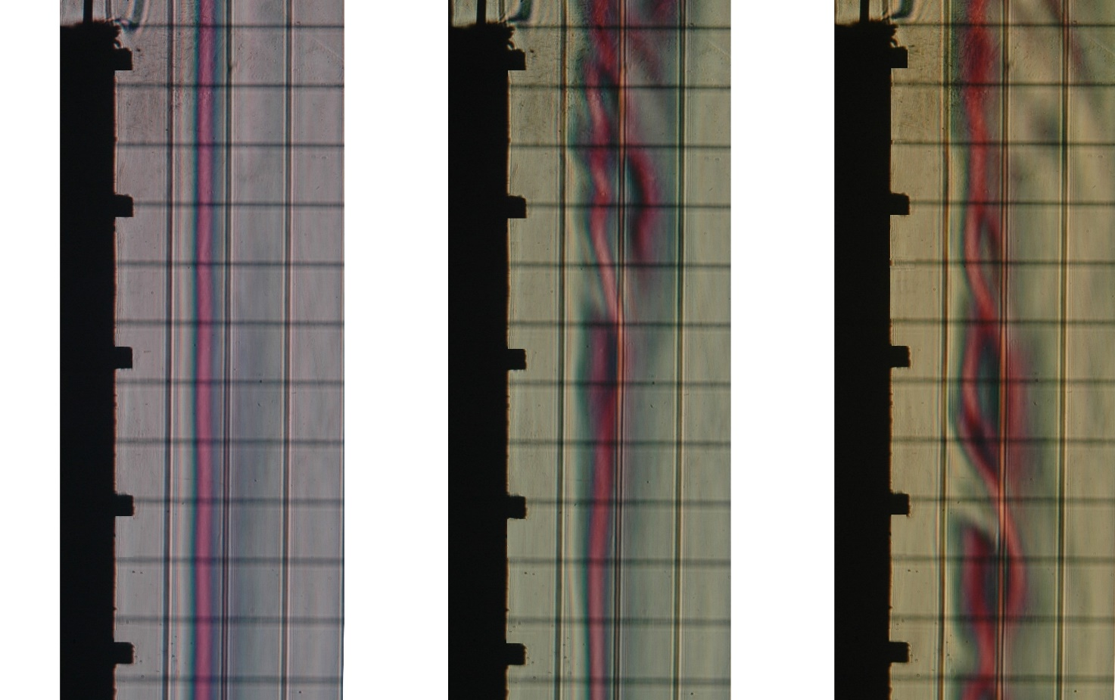
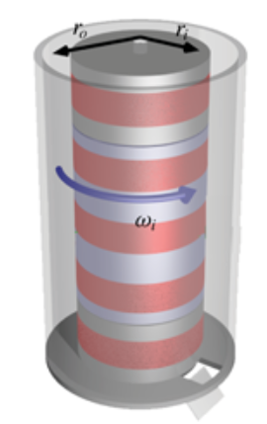
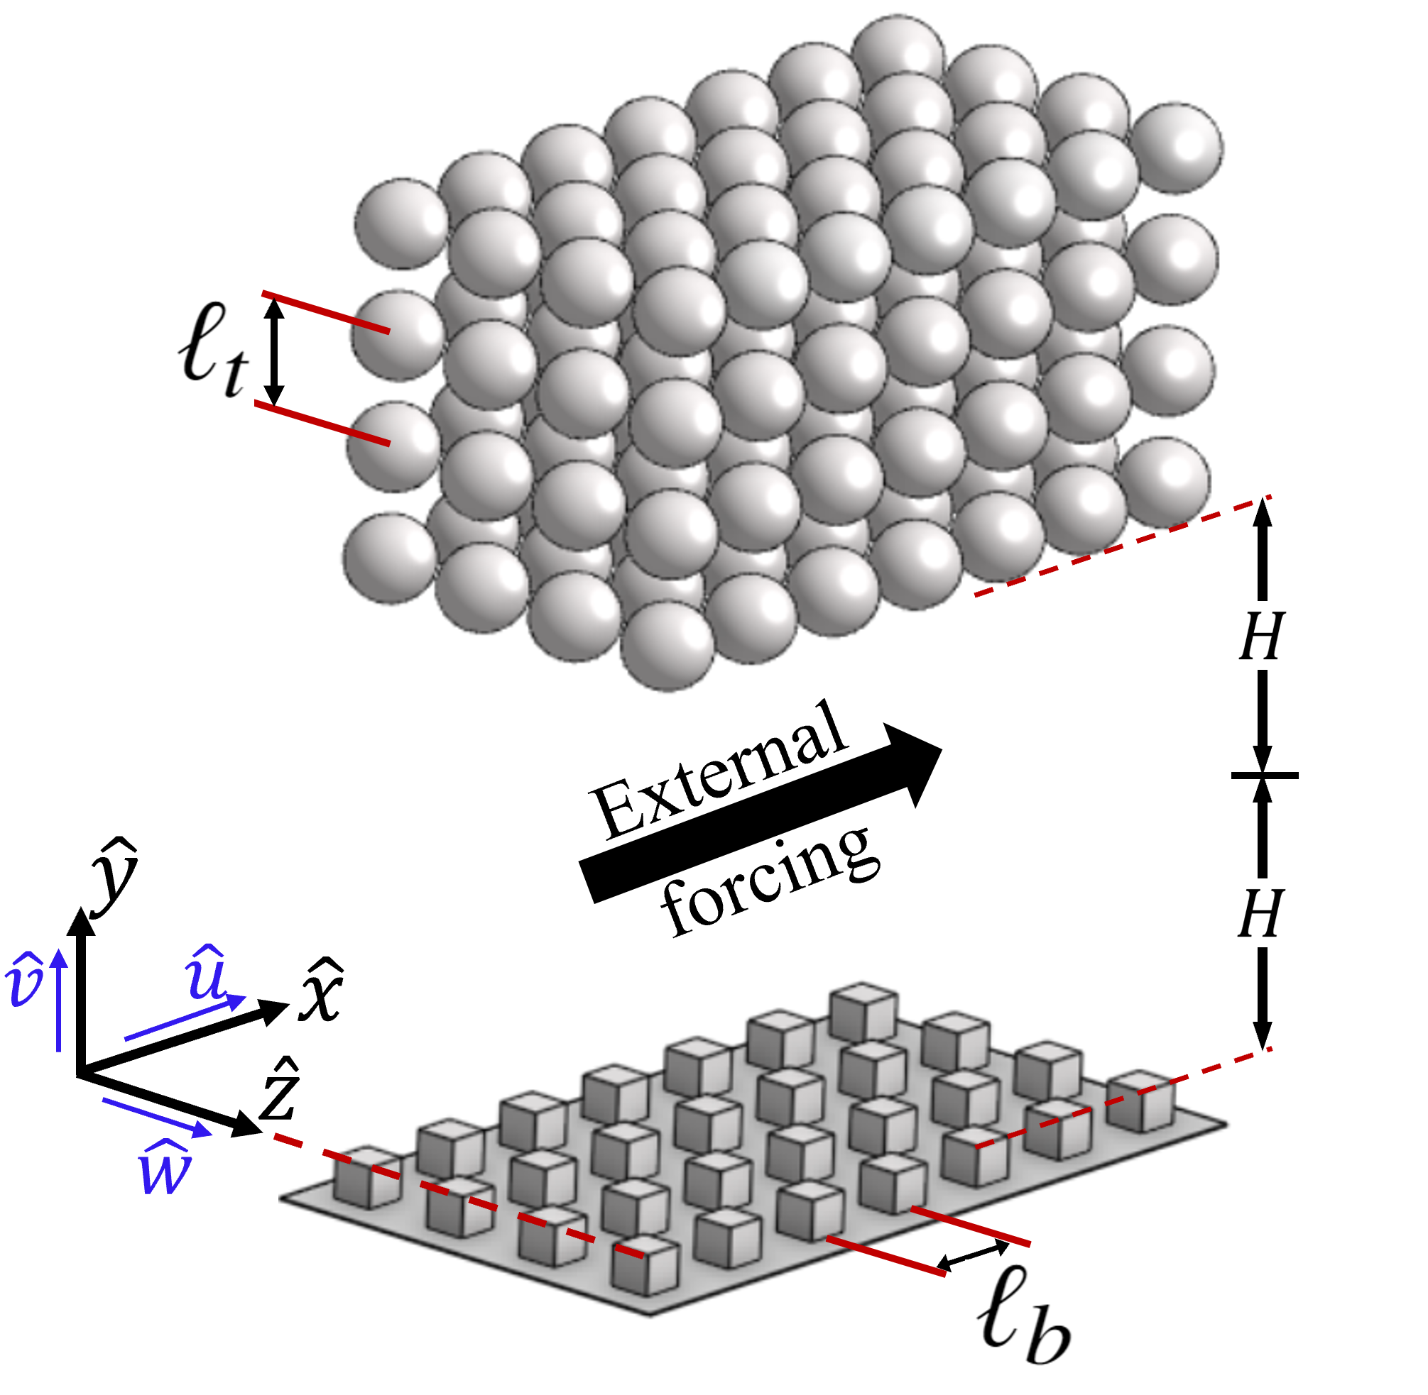
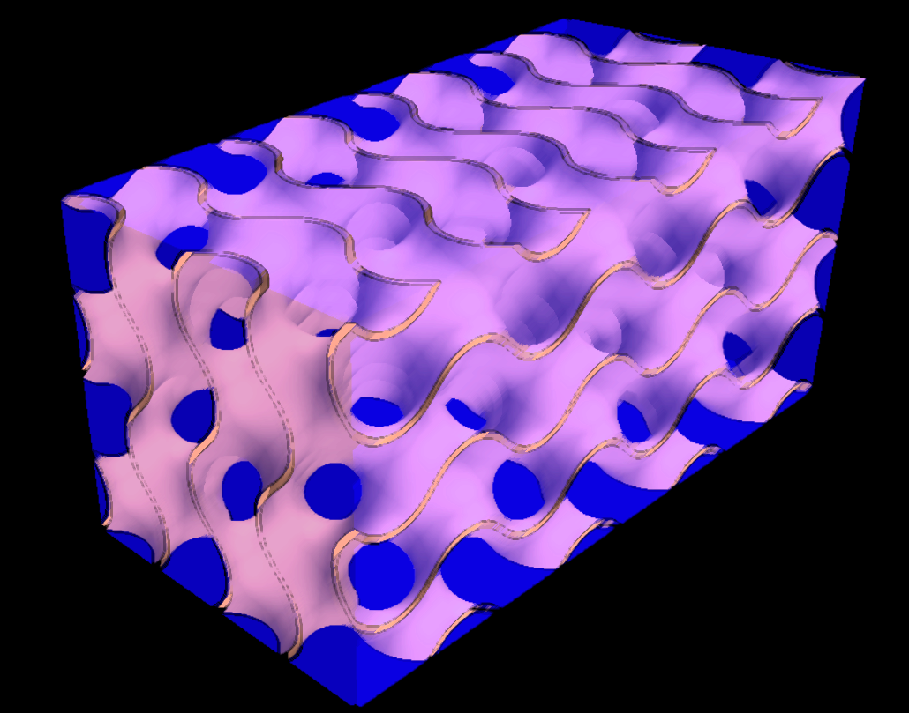





MICRO CAUSES, MACRO EFFECTS
MICROSTRUCTURED SURFACES, INSTABILITIES, AND ASYMPTOTIC HOMOGENIZATION
Implications for thermal transport and management
$$L_{3}$$
$$L_{1}$$
$$L_{2}$$
$$Heat (Q)$$
$$g$$
Alessandro Bottaro
DICCA, Polytechnic School
University of Genova, Italy

Slide 2
Why do microstructures matter?
Macroscopic transport is controlled by boundary conditions.
Boundary conditions are controlled by surface structure.
Surface structure is often microscopic.
Onset and amplification of instabilities are highly sensitive to boundary conditions.
Microscopic design can control macroscopic transport.

Slide 3
Connection to thermal management
Thermal transport at surfaces is governed by near-wall transport processes.
Heat transfer depends on:
boundary layer structure
flow stability and transition
transport coefficients
surface geometry
Microstructured surfaces modify these mechanisms.
Understanding flow over structured surfaces enables control of heat transfer.

Slide 4
Microstructures are ubiquitous in thermal systems
Examples include:
Heat sinks with fins and grooves
Microchannel cooling devices
Structured hot/cold plates
Porous and coated surfaces
Common feature: Transport is controlled by surface microgeometry.
GOAL: predict macroscopic flow without resolving microscopic details.

Slide 5
THE THEORY

Slide 6
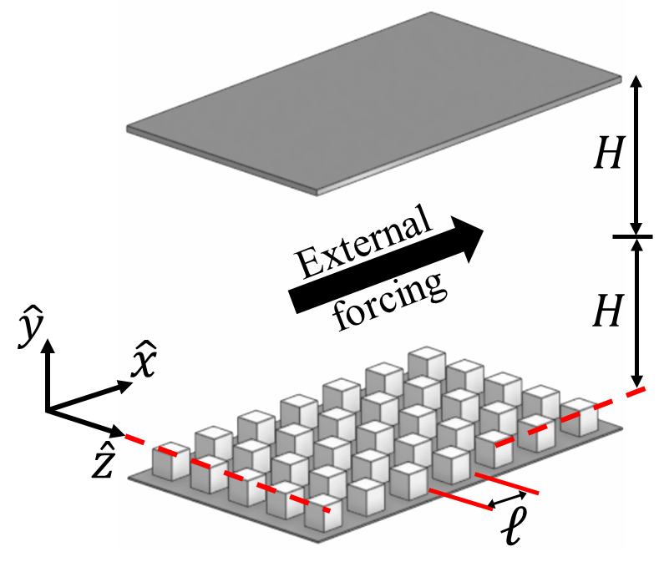
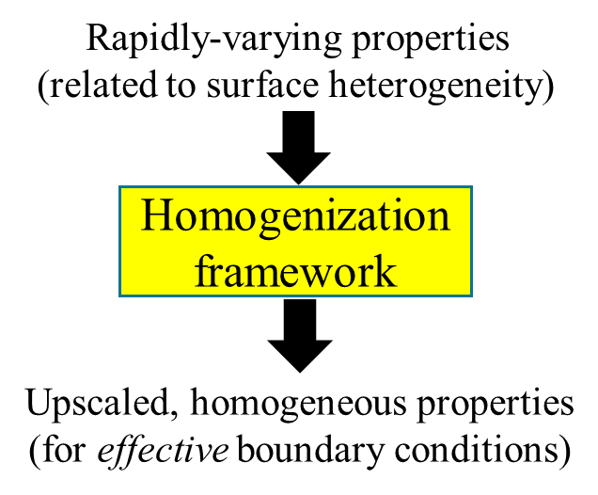
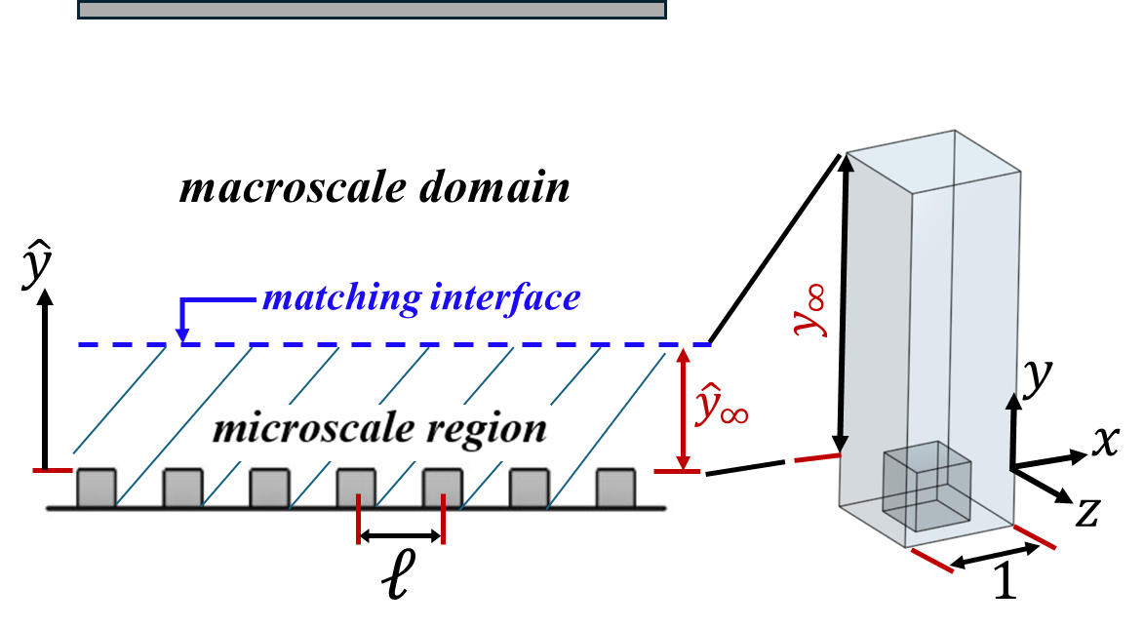
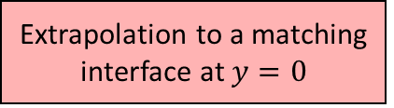
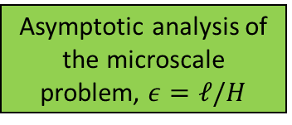

$$ε=\frac{ℓ}{𝓛}≪1$$
Physical problem in a hierarchical system
Domain decomposition
Continuity of velocity and traction vectors
Numerical solutions of the closure problems
Closure problems are defined at different orders
Asymptotic analysis of the microscale problem, $ε=ℓ/H$
Solution evaluation at the matching interface
Extrapolation to a matching interface at $y=0$
Formal expressions of effective B.Cs

Slide 7

A very quick primer
$x_{i}={\hat{x}}_{i}/ℓ$ $={\hat{x}}_{i}/(εH)$ dimensionless microscale
$u_{i}={\hat{u}}_{i}/𝒰$ dimensionless microscopic velocity scale
$X_{i}={\hat{x}}_{i}/H$ dimensionless macroscale
$U_{i}={\hat{u}}_{i}/(𝒰/ε)$ dimensionless macroscopic velocity scale
$p={\hat{p}/(μ𝒰/ℓ)}_{}$ dimensionless (viscous) pressure in microdomain
$t={\hat{t}𝒰/ℓ}_{}$ dimensionless time
$x_{i} \text{and} X_{i}$are assumed to be independent: $\frac{∂}{∂{\hat{x}}_{i}}=\frac{1}{ℓ}$ $\frac{∂}{∂x_{i}}+$ $\frac{1}{H}$ $\frac{∂}{∂X_{i}}$
All dimensionless, microscopic dependent variables are written as
$$φ\left(t, x_{i},X_{i}\right)=φ^{(0)}+εφ^{(1)}+ε^{2}φ^{(2)}+ …$$

Slide 8

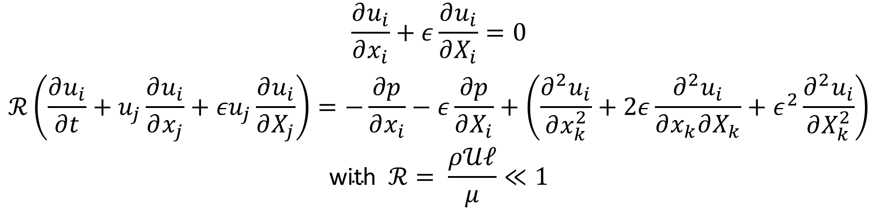
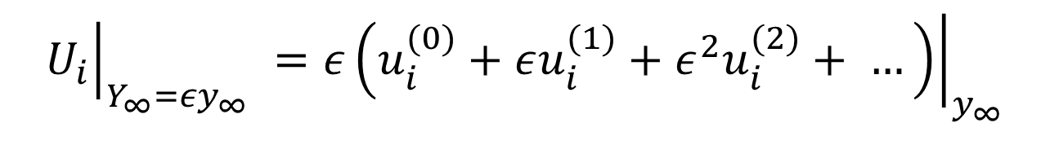
The dimensionless Navier-Stokes equations in the microscale region are:
$$\frac{∂u_{i}}{∂x_{i}}+ε\frac{∂u_{i}}{∂X_{i}}=0$$
$$ℛ\left(\frac{∂u_{i}}{∂t}+u_{j}\frac{∂u_{i}}{∂x_{j}}+{εu}_{j}\frac{∂u_{i}}{∂X_{j}}\right)=−\frac{∂p}{∂x_{i}}−ε\frac{∂p}{∂X_{i}}+\left(\frac{∂^{2}u_{i}}{∂x_{k}^{2}}+2ε\frac{∂^{2}u_{i}}{∂x_{k}∂X_{k}}+ε^{2}\frac{∂^{2}u_{i}}{∂X_{k}^{2}}\right)$$
$$\text{with} ℛ= \frac{ρ𝒰ℓ}{μ}≪1$$
Note that at $y=y_{∞}$ the macroscopic dimensionless velocity must be
$${\left.U_{i}\right|}_{Y_{∞}=εy_{∞}} =ε{\left.\left(u_{i}^{(0)}+εu_{i}^{(1)}+ε^{2}u_{i}^{(2)}+ …\right)\right|}_{y_{∞}}$$

Slide 9
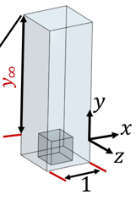

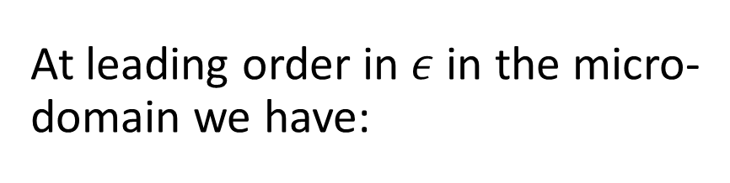
The dimensionless Navier-Stokes equations in the microscale region are:
$$\frac{∂u_{i}}{∂x_{i}}+ε\frac{∂u_{i}}{∂X_{i}}=0$$
$$ℛ\left(\frac{∂u_{i}}{∂t}+u_{j}\frac{∂u_{i}}{∂x_{j}}+{εu}_{j}\frac{∂u_{i}}{∂X_{j}}\right)=−\frac{∂p}{∂x_{i}}−ε\frac{∂p}{∂X_{i}}+\left(\frac{∂^{2}u_{i}}{∂x_{k}^{2}}+2ε\frac{∂^{2}u_{i}}{∂x_{k}∂X_{k}}+ε^{2}\frac{∂^{2}u_{i}}{∂X_{k}^{2}}\right)$$
$$\text{with} ℛ= \frac{ρ𝒰ℓ}{μ}≪1$$
At leading order in $ε$in the micro-domain we have:
$$\frac{∂u_{i}^{(0)}}{∂x_{i}}=0$$
$$−\frac{∂p^{(0)}}{∂x_{i}}+\frac{∂^{2}u_{i}^{(0)}}{∂x_{k}^{2}}=0$$

Slide 10
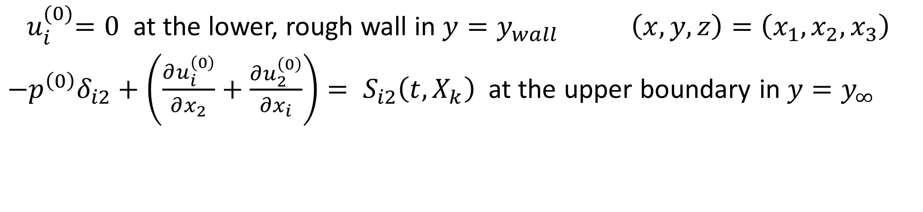
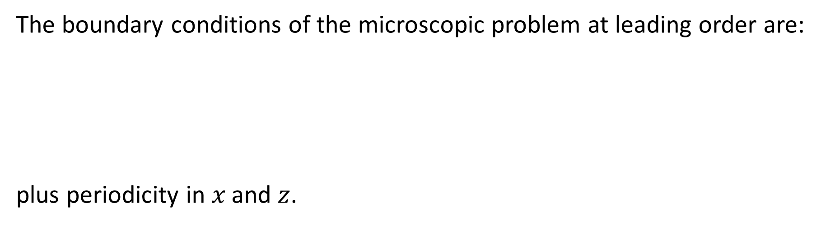
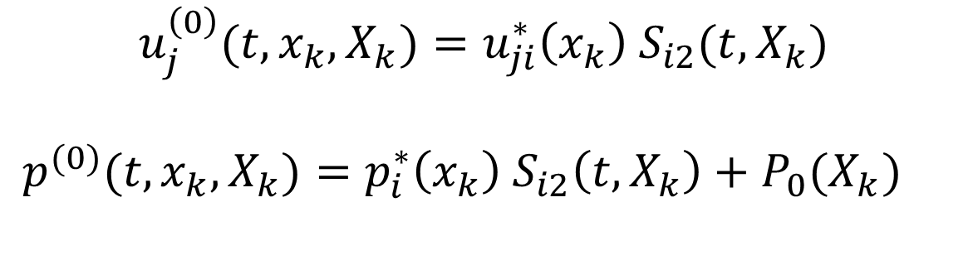
The boundary conditions of the microscopic problem at leading order are: plus periodicity in $x \text{and} z$.
${ u}_{i}^{(0)}=0$ at the lower, rough wall in $y=y_{wall}$ $\left(x,y,z\right)=\left(x_{1},x_{2},x_{3}\right)$
$−p^{\left(0\right)}δ_{i2}+\left(\frac{∂u_{i}^{\left(0\right)}}{∂x_{2}}+\frac{∂u_{2}^{\left(0\right)}}{∂x_{i}}\right)= S_{i2}\left(t, X_{k}\right)$at the upper boundary in $y=y_{∞}$
Ansatz for the leading order variables:
$$u_{j}^{\left(0\right)}(t,x_{k},X_{k})=u_{ji}^{∗}\left(x_{k}\right) S_{i2}(t, X_{k})$$
$p^{(0)}(t,x_{k},X_{k})=p_{i}^{∗}\left(x_{k}\right) S_{i2}\left(t, X_{k}\right)+P_{0}(X_{k})$

Slide 11

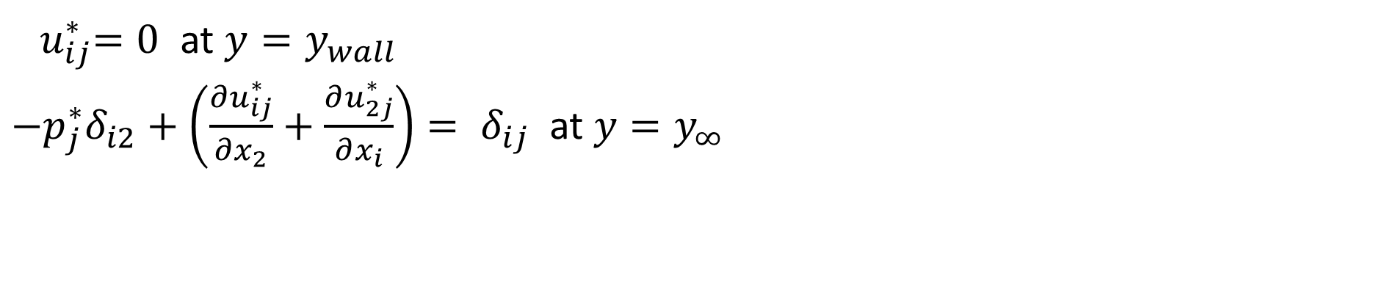
Plugging into the Stokes system, the closure problem for the variables at leading order becomes: subject to:
$$\frac{∂u_{ij}^{∗}}{∂x_{i}}=0$$
$$−\frac{∂p_{j}^{∗}}{∂x_{i}}+\frac{∂^{2}u_{ij}^{∗}}{∂x_{k}^{2}}=0$$
${ u}_{ij}^{∗}=0$ at $y=y_{wall}$
$−p_{j}^{∗}δ_{i2}+\left(\frac{∂u_{ij}^{∗}}{∂x_{2}}+\frac{∂u_{2j}^{∗}}{∂x_{i}}\right)= δ_{ij}$at $y=y_{∞}$

Slide 12
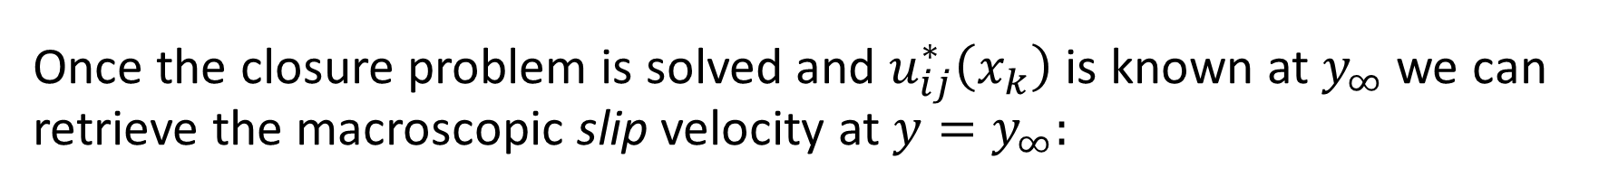
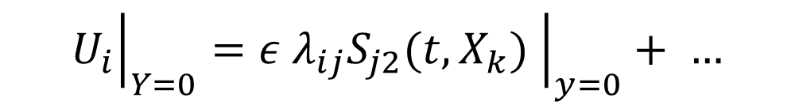

Once the closure problem is solved and $u_{ij}^{∗}\left(x_{k}\right)$ is known at $y_{∞}$we can retrieve the macroscopic slip velocity at $y=y_{∞}:$
$${\left.U_{i}\right|}_{Y_{∞}=εy_{∞}} =ε{\left.\left(u_{i}^{(0)}+…\right)\right|}_{y_{∞}}={\left.{ε u}_{ij}^{∗}\left(x_{k}\right) S_{j2}(t, X_{k}) \right|}_{y_{∞}}+ …$$
This boundary condition can then be Taylor-expanded to $y=0$, at the rims of the roughness elements, to finally obtain, at leading order:
with $λ_{ij}$the Navier slip tensor
$${\left.U_{i}\right|}_{Y=0}={\left.ε λ_{ij}S_{j2}(t, X_{k}) \right|}_{y=0}+ …$$

Slide 13

$$ε=\frac{ℓ}{𝓛}≪1$$
For simple wall micro-structures such as those considered here:
$$λ_{ij}=\left(\begin{matrix}λ_{x} & 0 & 0 \\ 0 & 0 & 0 \\ 0 & 0 & λ_{z}\end{matrix}\right)$$

Slide 14
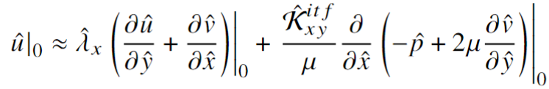
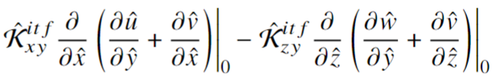

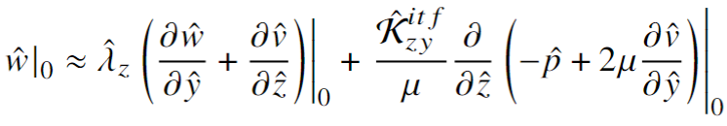

$$ε=\frac{ℓ}{𝓛}≪1$$
versatility
advance in order
Advantages
computational cost
$$−$$
simplicity
optimization studies

Slide 15
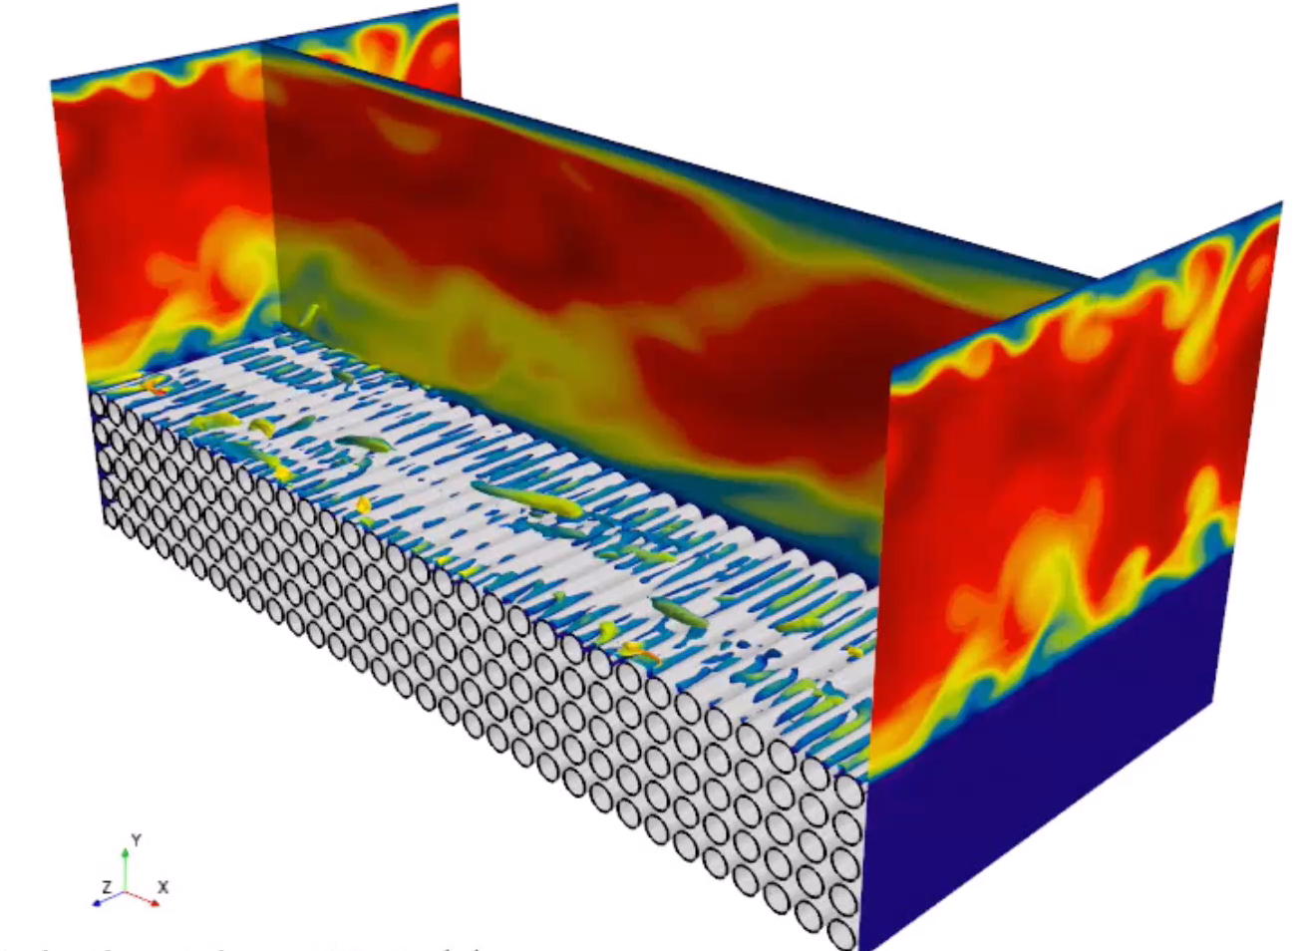

Slide 16
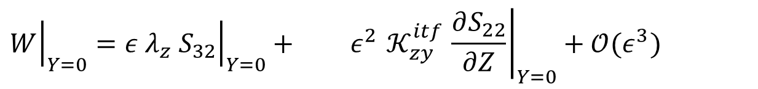
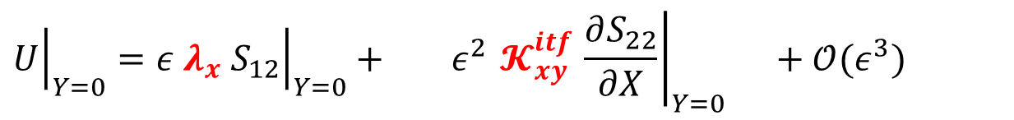
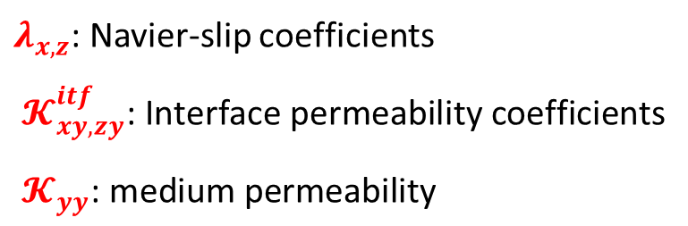

Dimensionless effective boundary conditions at a porous interface
$$S_{12}=\frac{∂U}{∂Y}+\frac{∂V}{∂X},$$
$${ S}_{22}=−Re P+2\frac{∂V}{∂Y},$$
$${ S}_{32}=\frac{∂W}{∂Y}+\frac{∂V}{∂Z}.$$
$${\left.U\right|}_{Y=0}={\left.ε{ λ}_{x}{ S}_{12}\right|}_{Y=0}+ {\left.ε^{2}{ 𝓚}_{xy}^{itf} \frac{∂S_{22}}{∂X}\right|}_{Y=0} +𝒪(ε^{3})$$
Navier-slip condition
Second-order correction
$${\left.V\right|}_{Y=0}=−{\left.ε^{2}{ 𝓚}_{xy}^{itf} \frac{∂S_{12}}{∂X}\right|}_{Y=0}−{\left.ε^{2}{ 𝓚}_{zy}^{itf} \frac{∂S_{32}}{∂Z}\right|}_{Y=0}+ {\left.ε^{2}{ 𝓚}_{yy}^{} \frac{∂S_{22}}{∂Y}\right|}_{Y=0}+𝒪(ε^{3})$$
Second-order,
effect of interface permeabilities
Second-order,
effect of medium permeability
$${\left.W\right|}_{Y=0}={\left.ε{ λ}_{z}{ S}_{32}\right|}_{Y=0}+ {\left.ε^{2}{ 𝓚}_{zy}^{itf} \frac{∂S_{22}}{∂Z}\right|}_{Y=0}+𝒪(ε^{3})$$
$λ_{x,z}$: Navier-slip coefficients
$${ 𝓚}_{xy, zy}^{itf}\text{: }\text{Interface} \text{permeability} \text{coefficients}$$
$${ 𝓚}_{yy}^{}\text{: }\text{medium} \text{permeability}$$
Navier-slip condition
Second-order correction

Slide 17
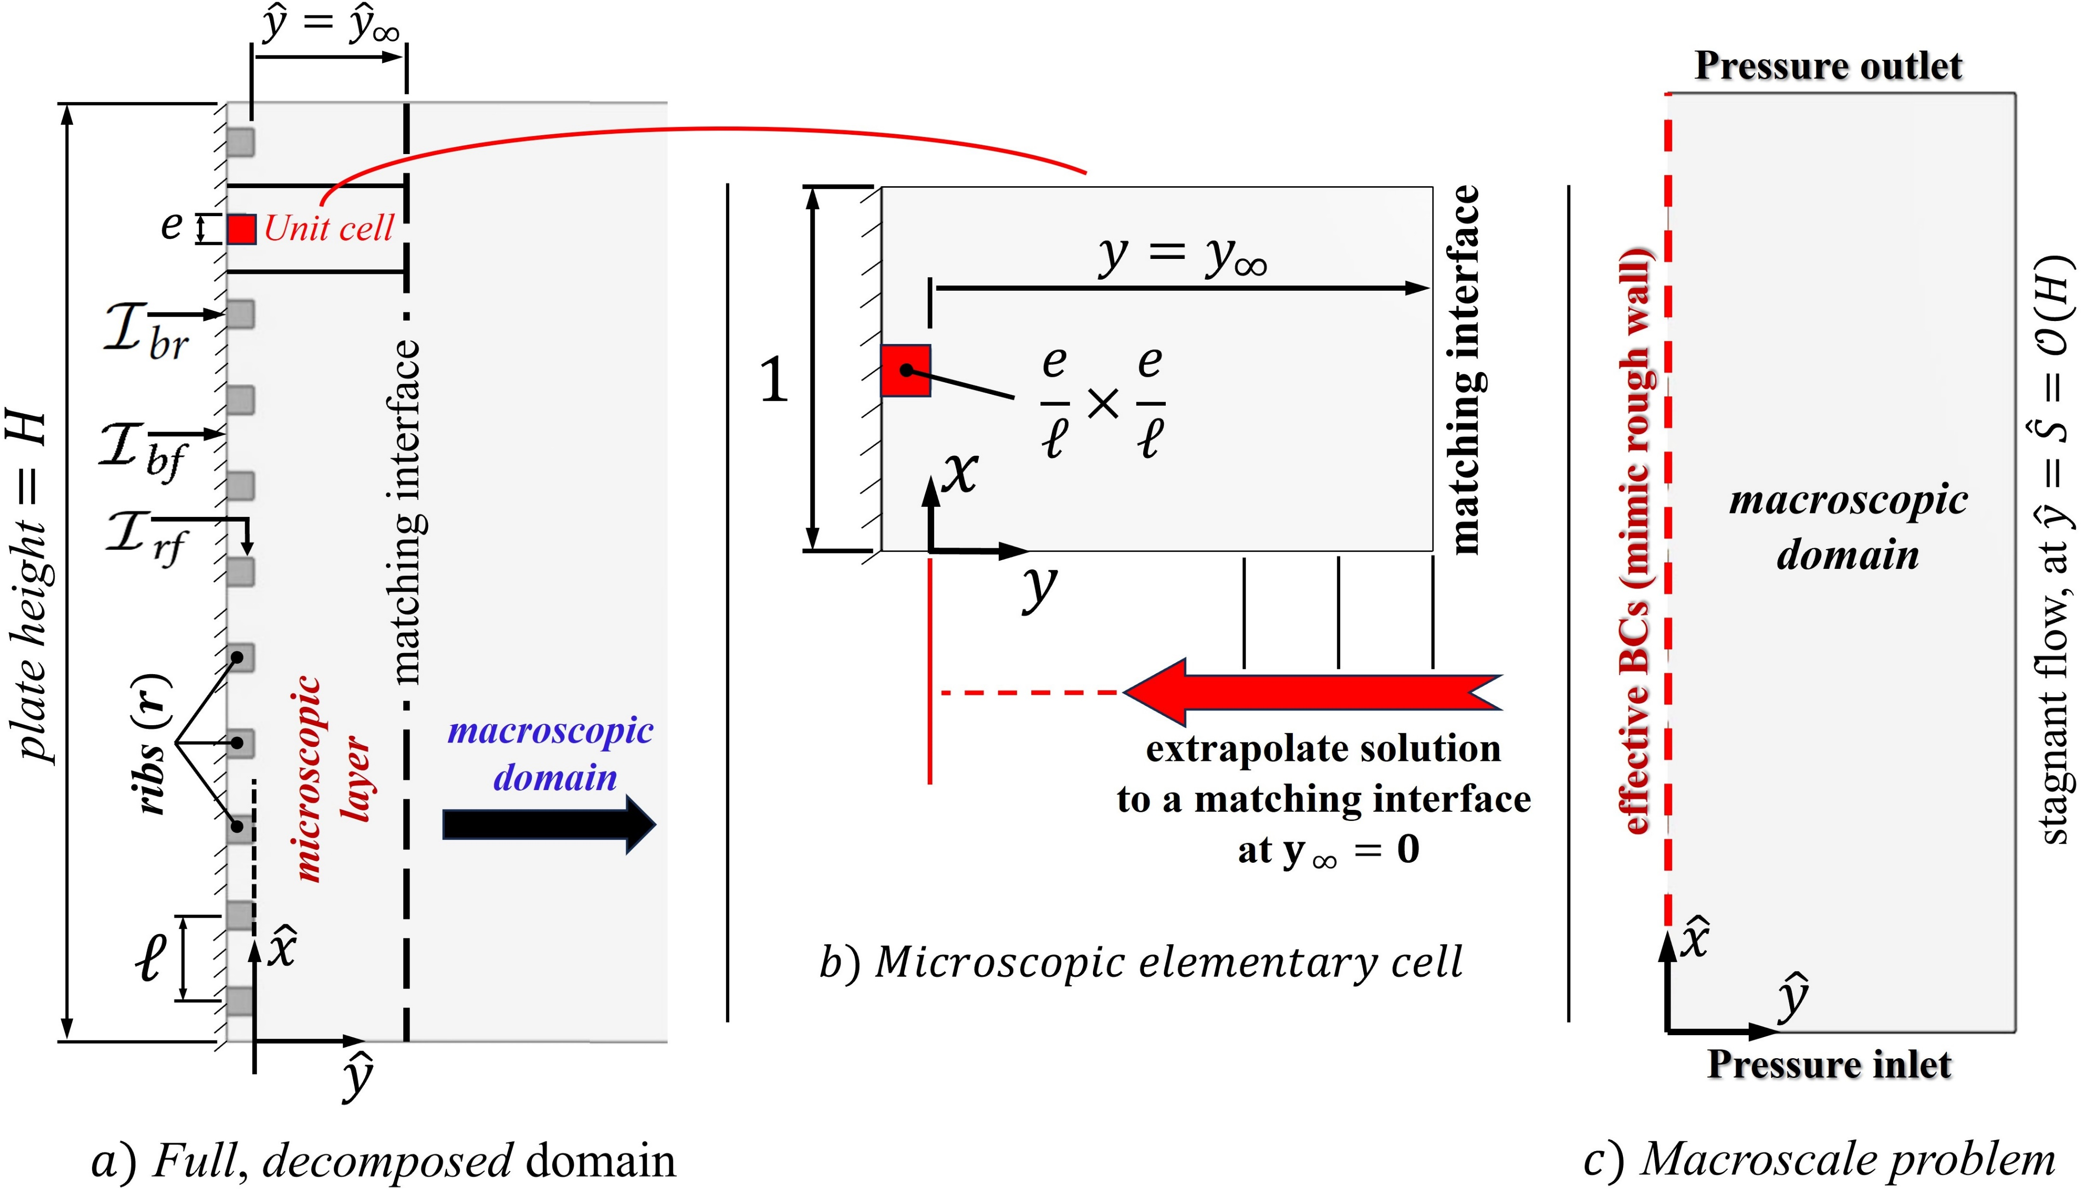
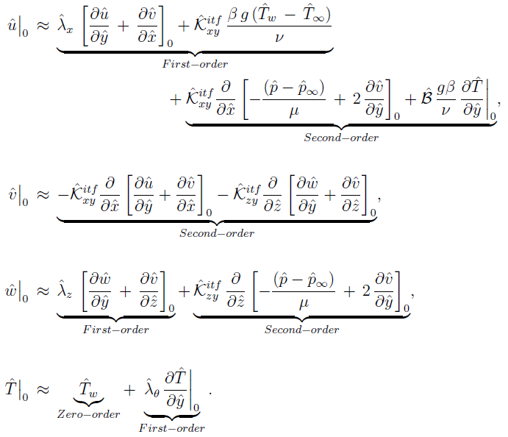

Slide 18
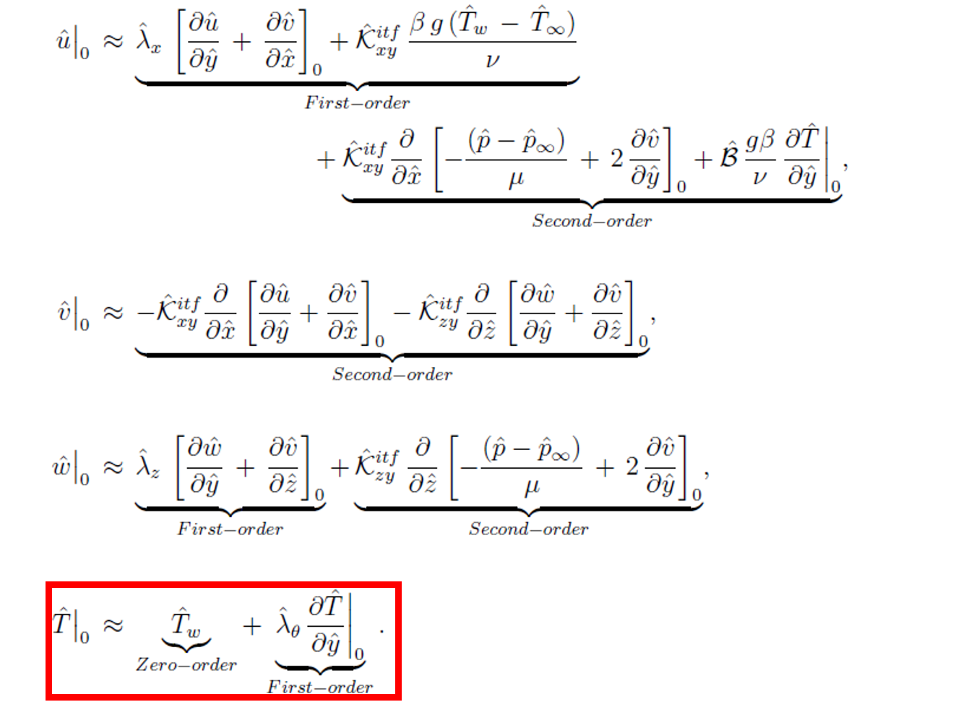

Slide 19
PROBLEM 1:
BUOYANCY-INDUCED FLOW ALONG REGULARLY RIB-ROUGHENED VERTICAL SURFACES

Slide 20
Problem 1:
Buoyancy-induced flow along regularly rib-roughened vertical surfaces

Slide 21
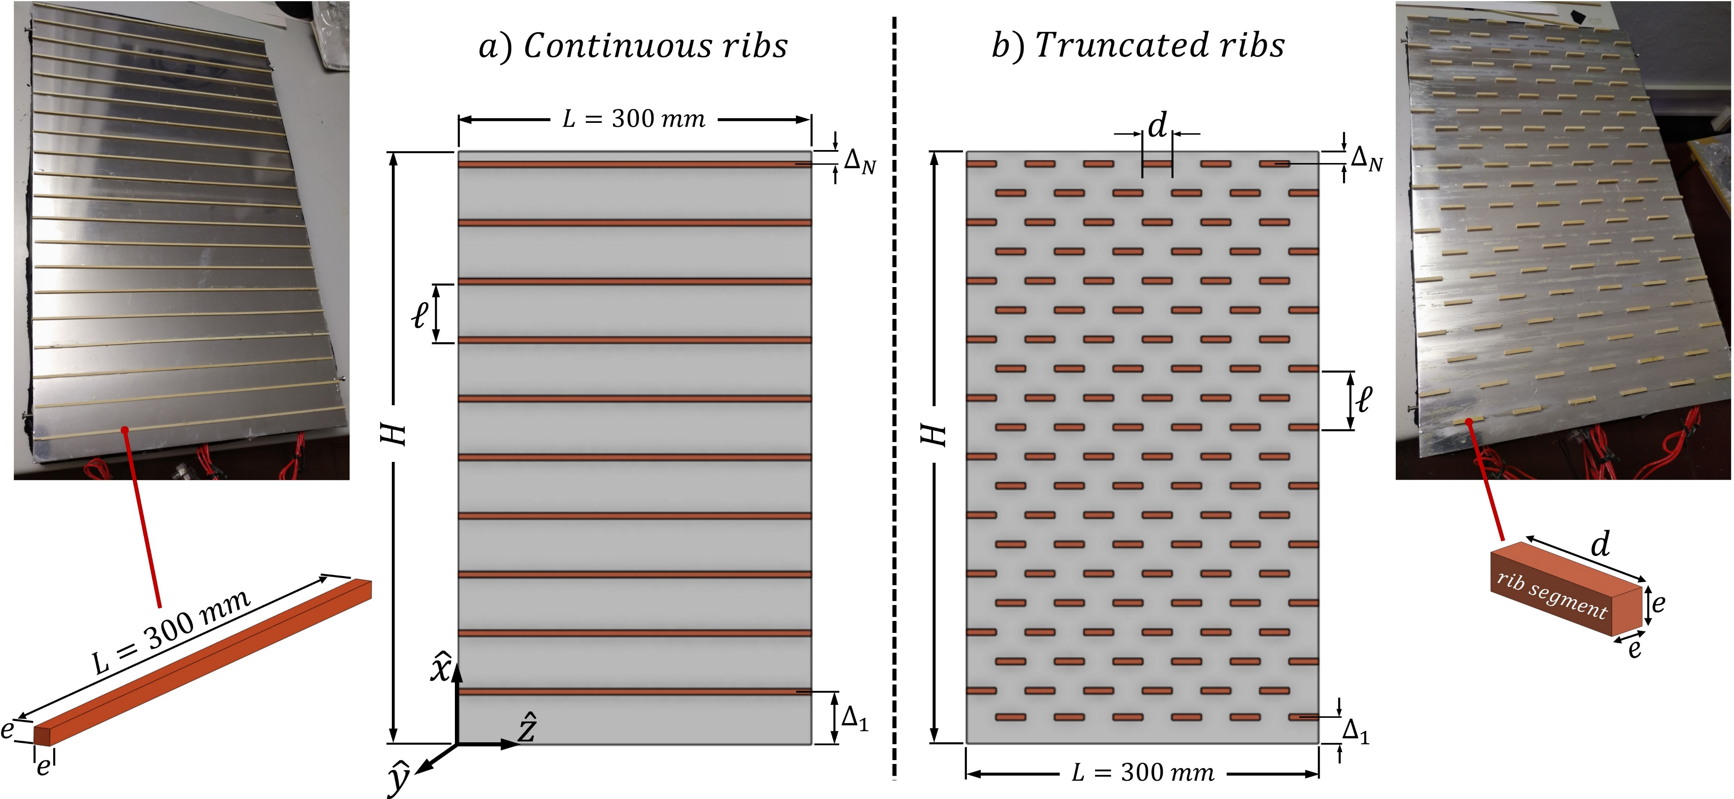
Continuous ribs (examining different rib sizes/pitches).
Truncated ribs (examining different numbers of rib segments).
Agreement between experimental results and laminar simulations.
Validation of the homogenization-based effective boundary conditions.

Slide 22
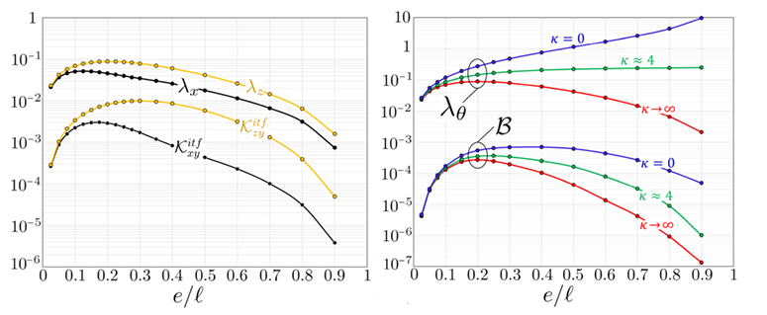
Transverse square ribs
adiabatic ribs
wooden ribs
perfectly conducting
ribs
Thermal slip coefficient and velocity-flux sensitivity parameter depend on rib-to-fluid thermal conductivity ratio

Slide 23
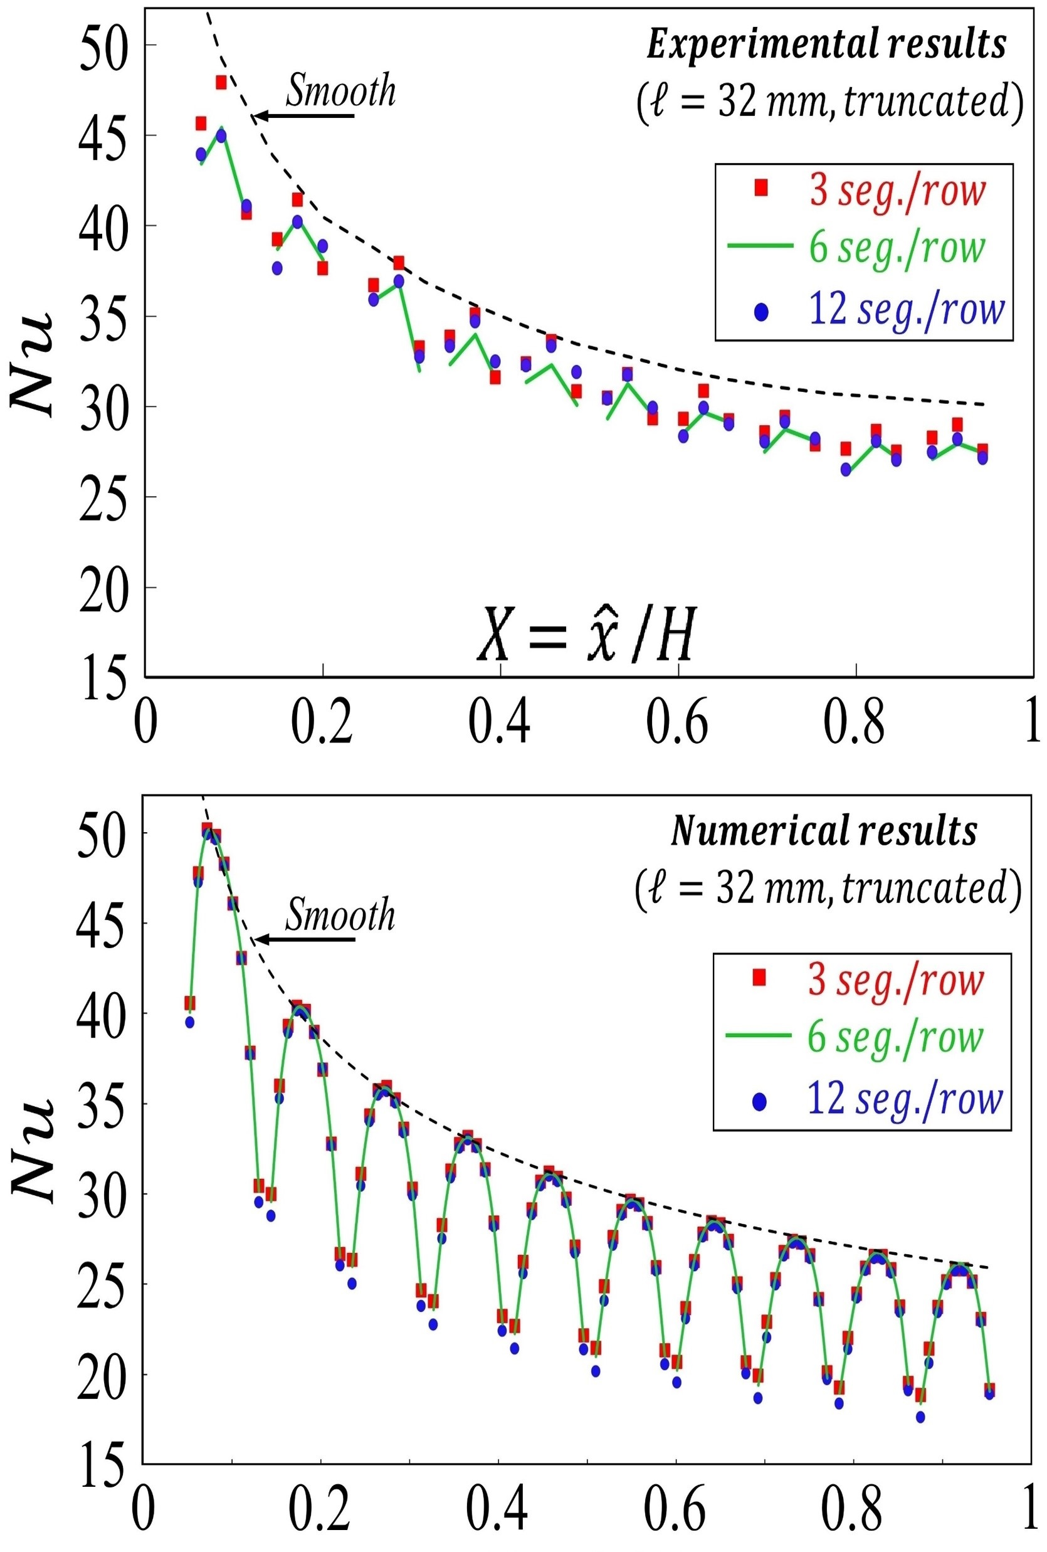
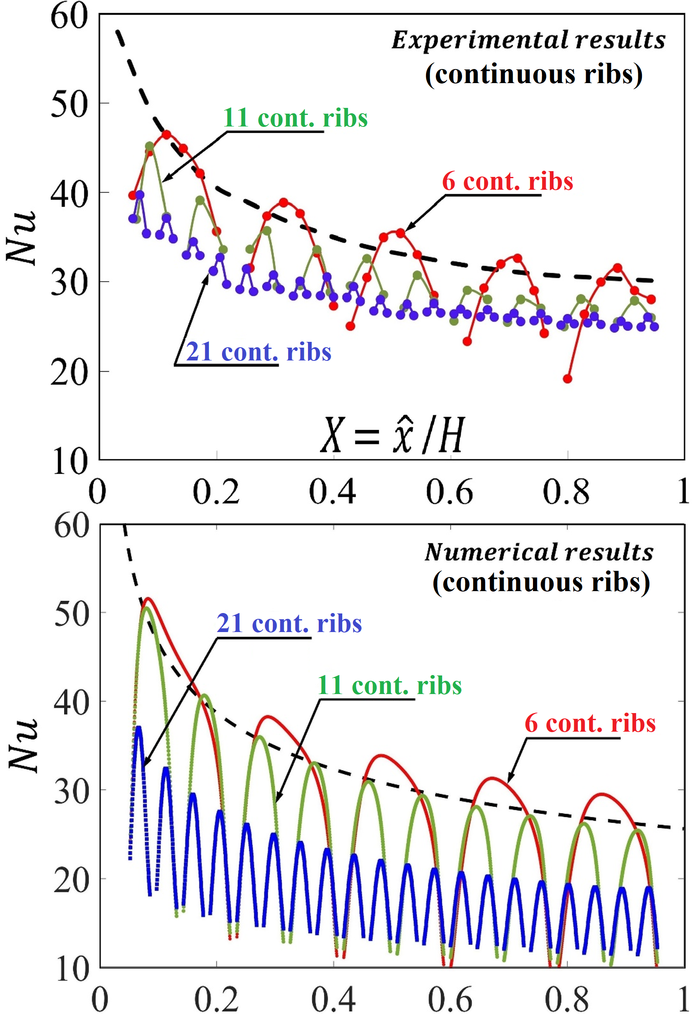
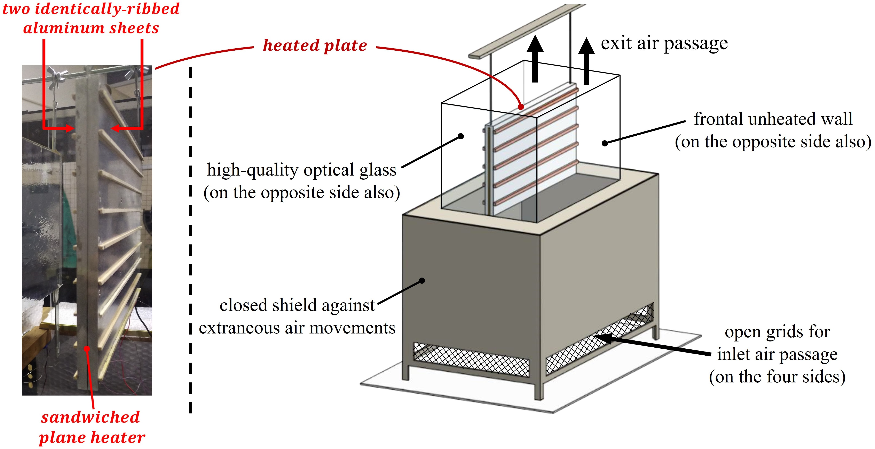


$$Ra = 1.9 × {10}^{7}$$

Slide 24
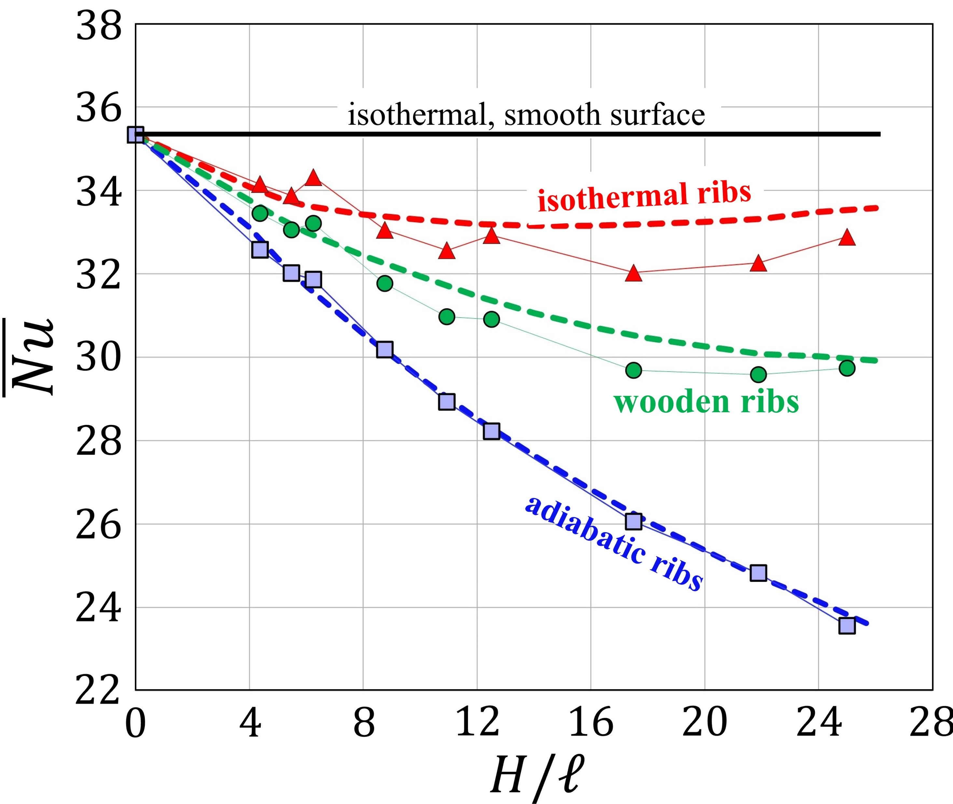
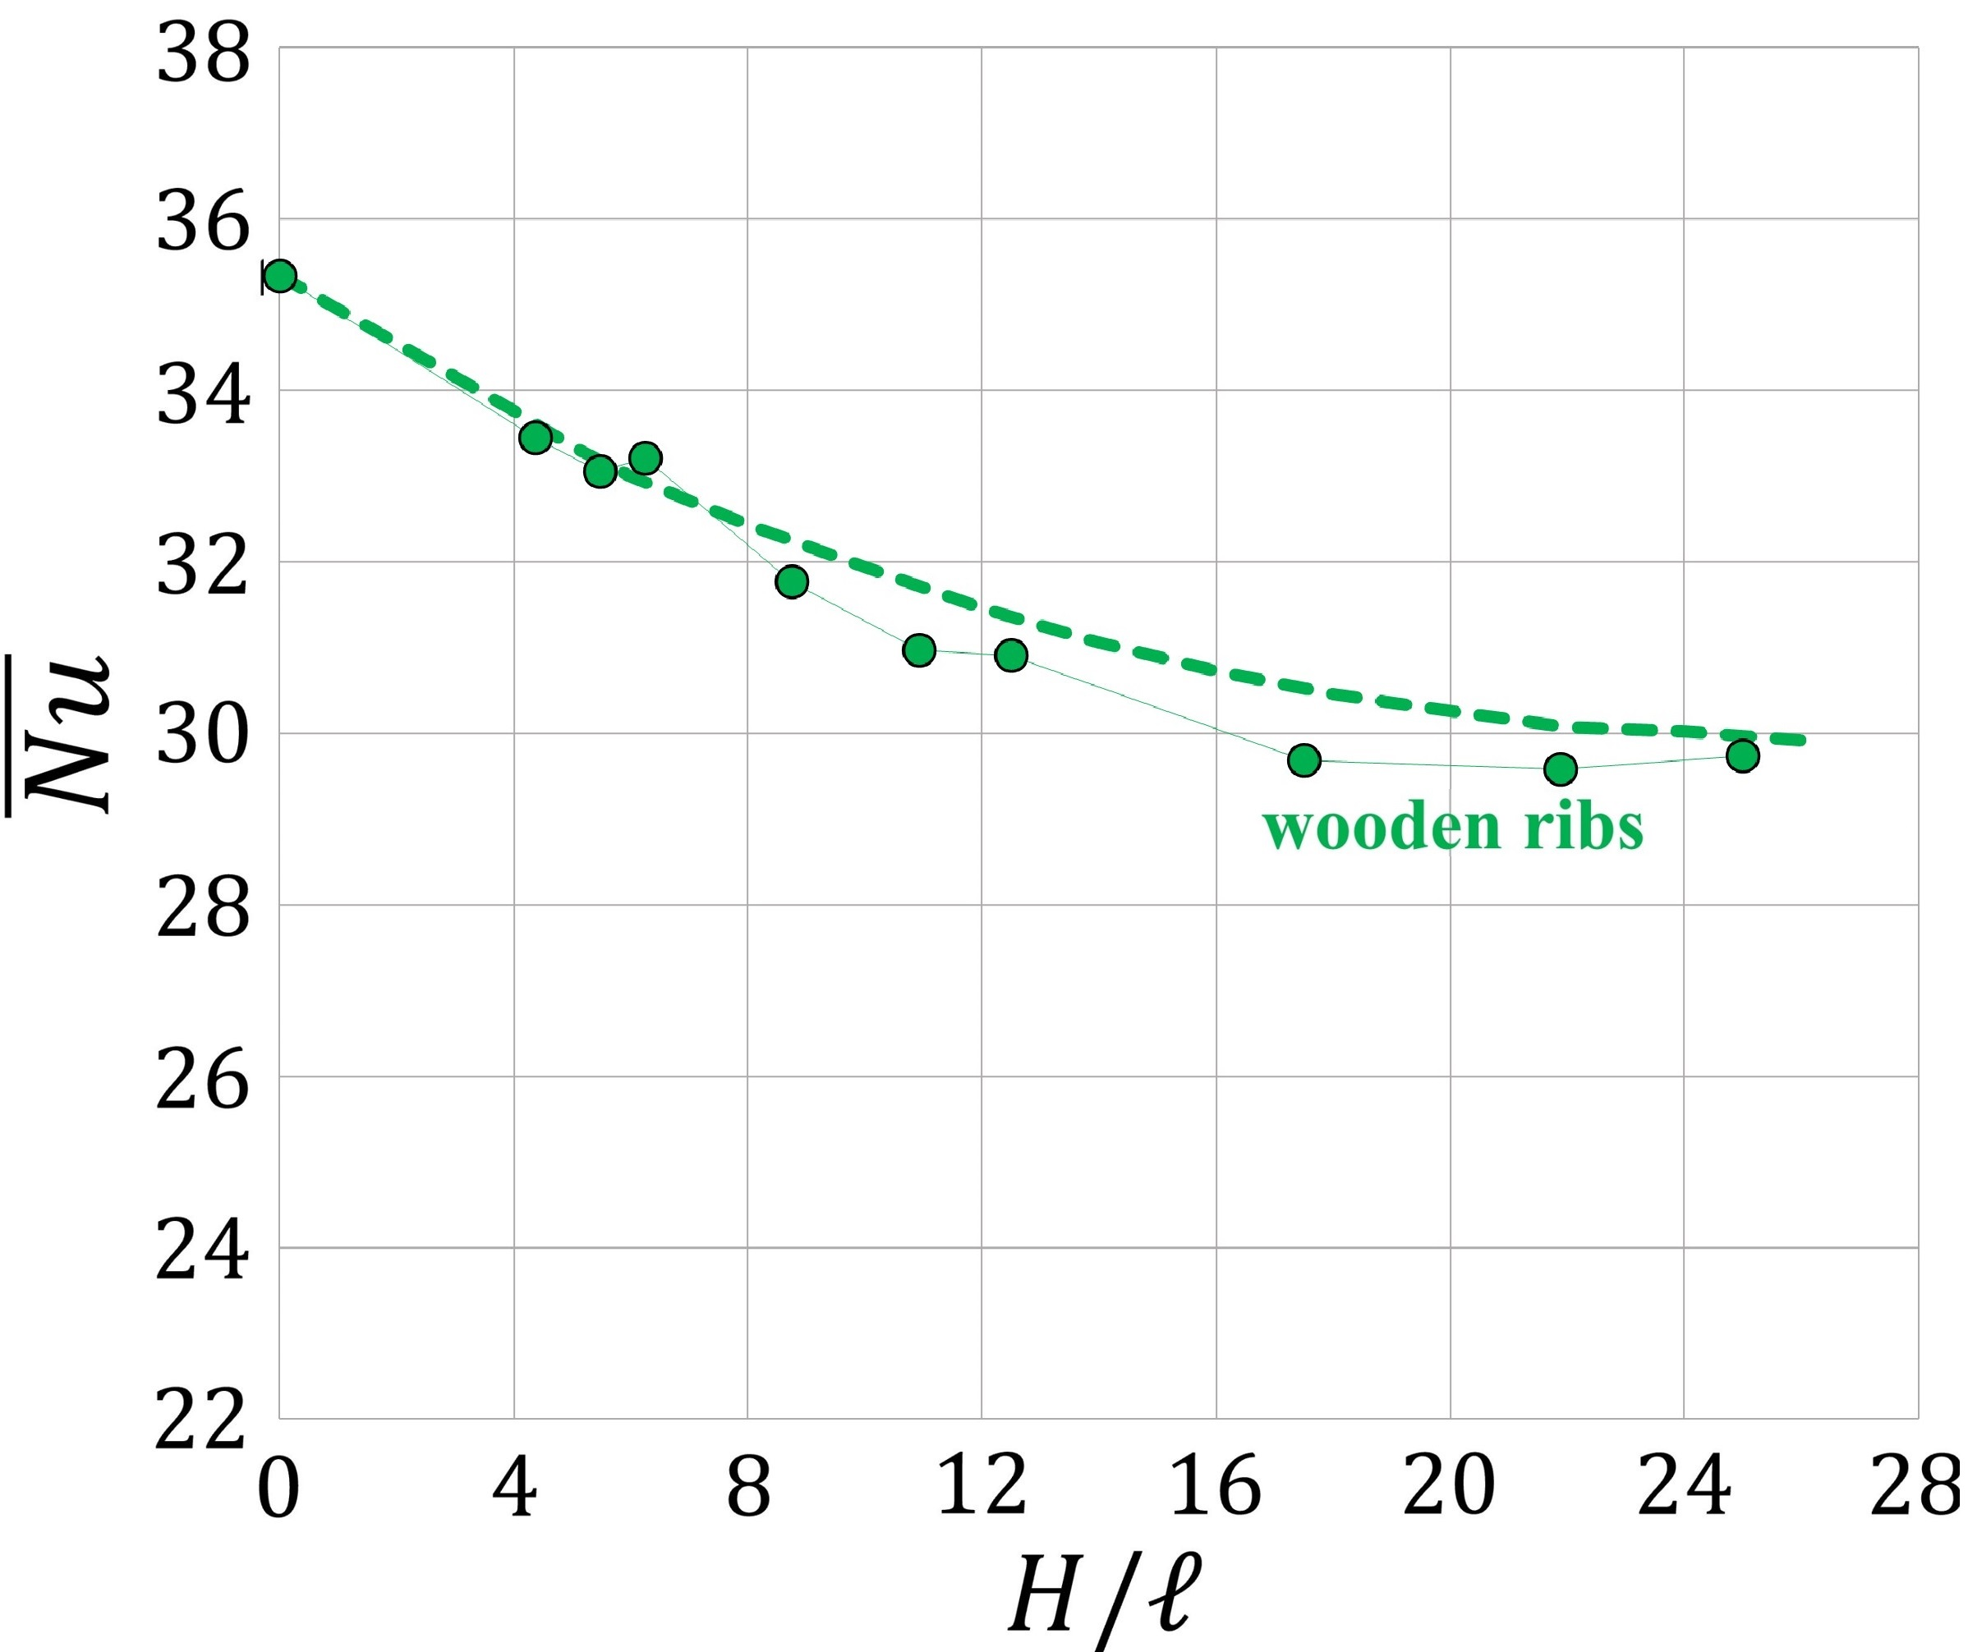

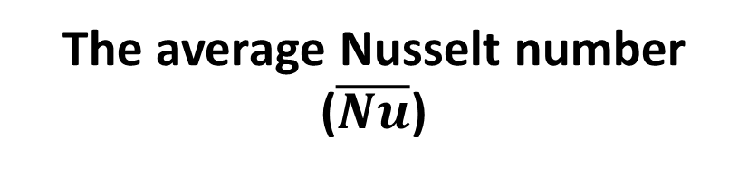
$$Ra = 1.9 × {10}^{7}$$
isothermal, smooth surface
Homogenized model (symbols)
vs.
Fully resolving sim. (dashed lines)
The average Nusselt number
($\overline{Nu}$)

Slide 25
PROBLEM 2:
TURBULENCE OVER A MICROSTRUCTURED, POROUS WALL

Slide 26
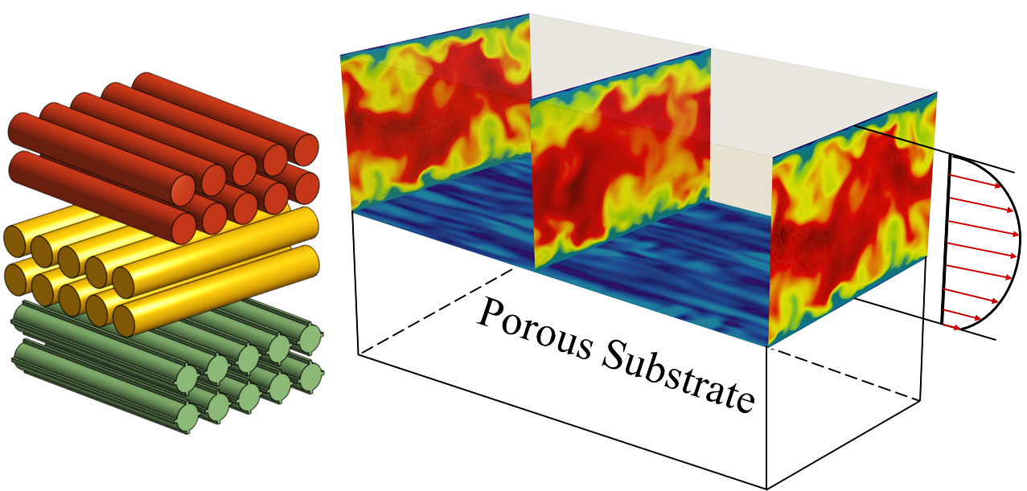
Problem 2:
Turbulence over a microstructured, porous wall

Slide 27
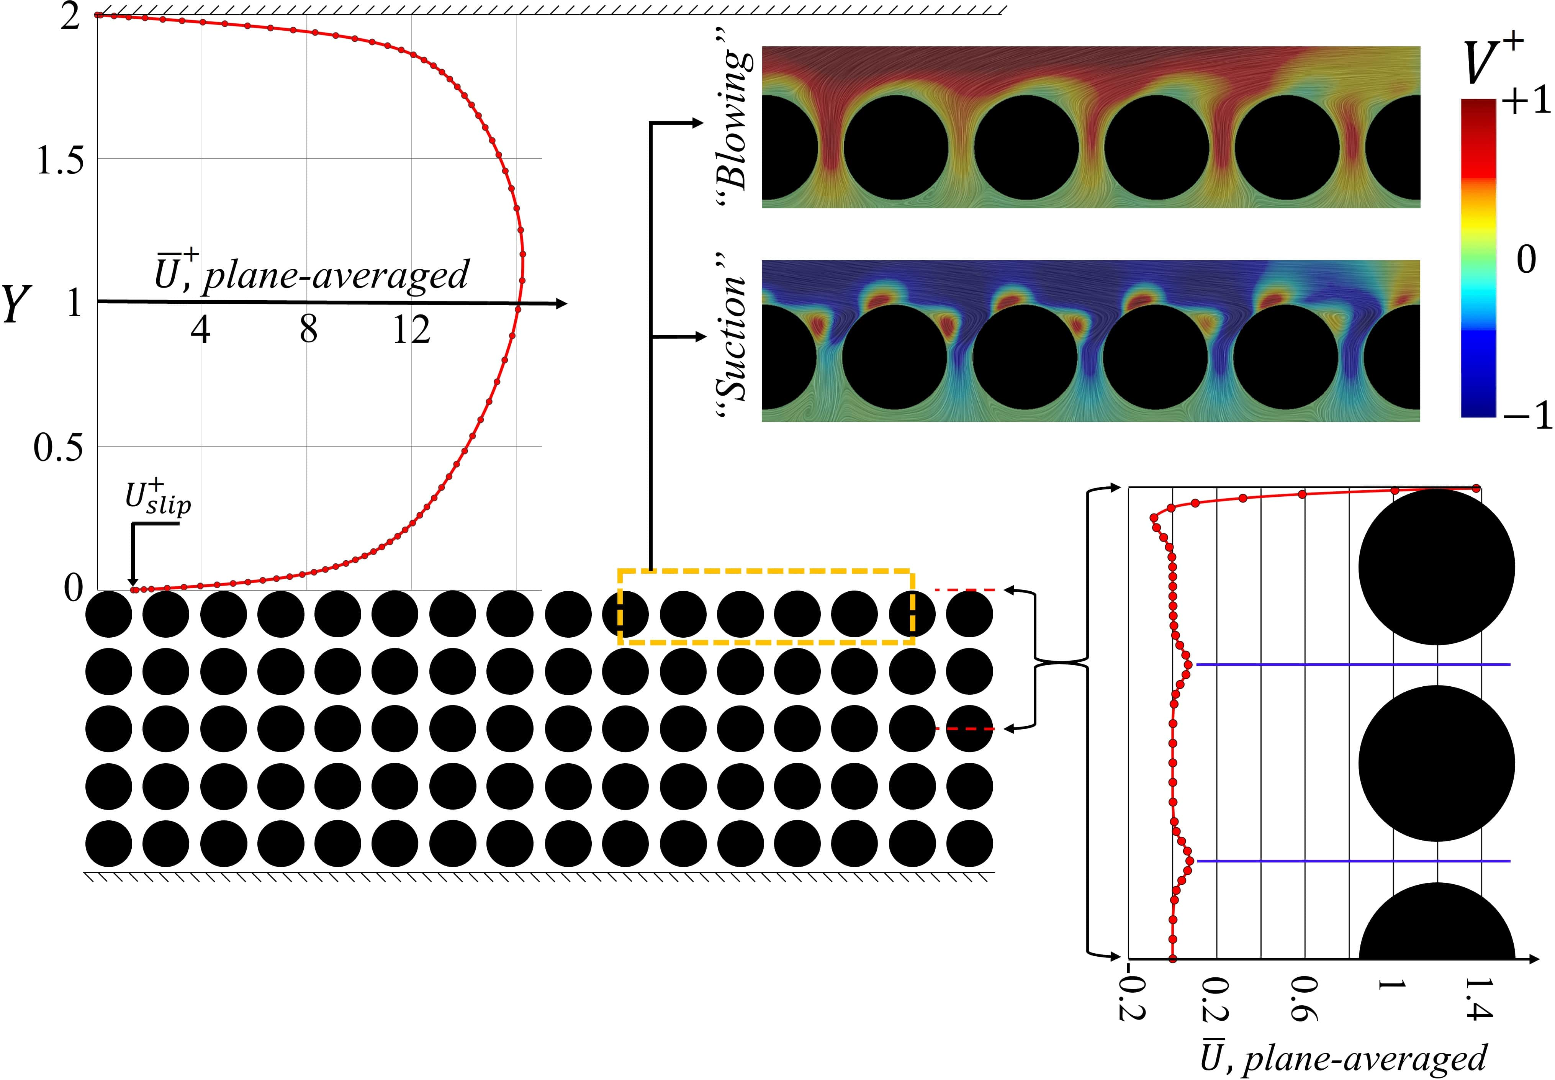
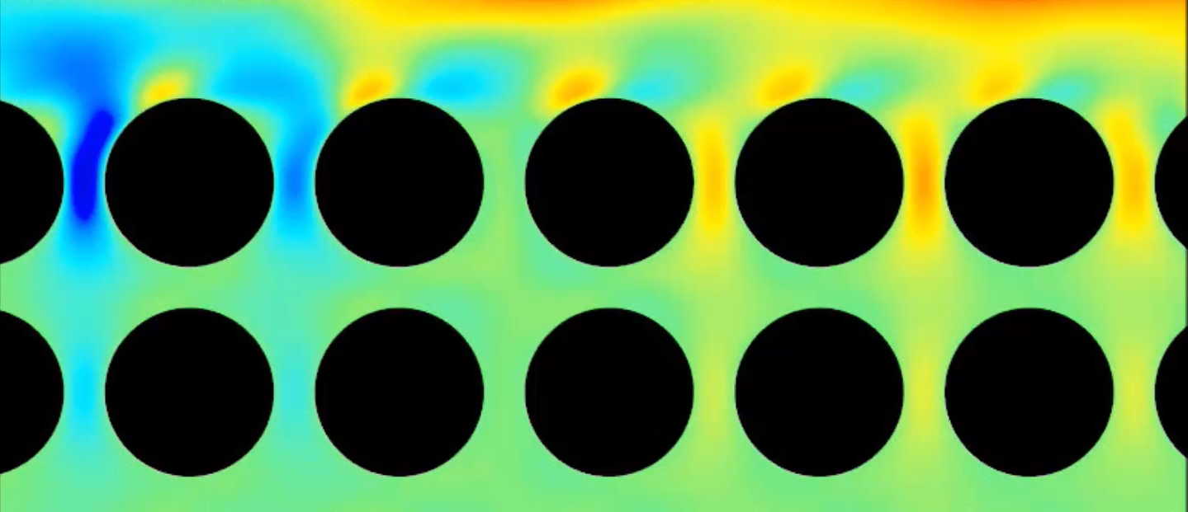

Slide 28
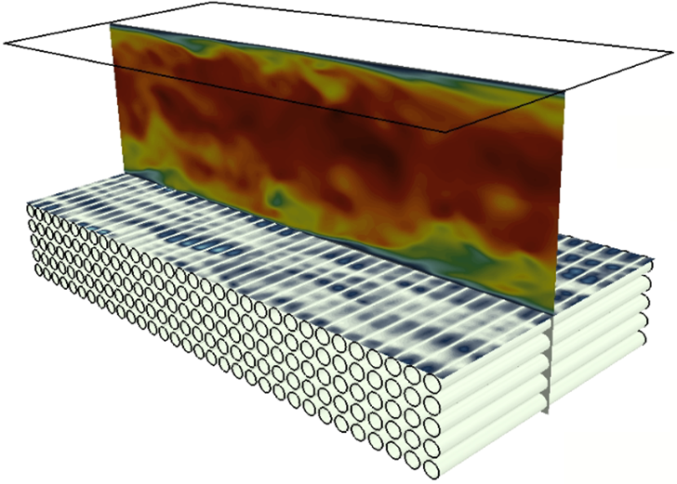




18
13.25
$$Y$$
$$Z$$
$$X$$
8.50
3.75
$$Porosity=θ=0.5,$$
$$ε=\frac{pitch distance (ℓ)}{half channel height (H)}=0.2$$
-1

Slide 29
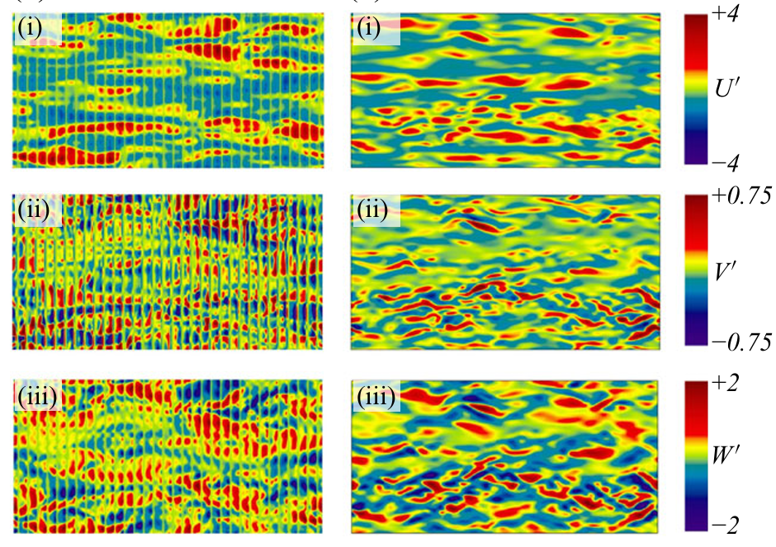

Slide 30

smooth
Smooth
model
model
fully-resolving
fully-resolving

Slide 31






Major parameters characterizing the mean velocity profile
$U_{slip}^{+}=$ mean streamwise velocity at the fluid-porous interface.
$ΔU^{+}<0→$ downward shift $→$ drag increase
$ΔU^{+}=$ the roughness function.
$ΔU^{+}>0→$ upward shift $→$ drag reduction

Slide 32
Major parameters characterizing the mean velocity profile
${NOTA BENE: if transpiration is neglected U}_{slip}^{+ } is captured$
$correctly but ΔU^{+}turns out to be equal to zero!$

Slide 33










Possible drag reduction
$Porosity=0.5$for all
$$ε=0.05→0.2$$
$$Re_{τ}≈190$$
$$TC$$
$$TM$$
Drag increase

Slide 34
PROBLEM 3:
FLOW THROUGH POROUS METAMATERIALS FORMED BY TPMS-BASED UNIT CELLS

Slide 35

Problem 3:
Flow through porous metamaterials formed by TPMS-based unit cells
Darcy’s law
Classical version
Upgraded version
Stokes’ conditions
Inertial effects
Intrinsic permeab.
(𝒦)
Effective permeab.
(𝓗)
Sensitive to
geometry
Sensitive to
geometry & Re
Metamaterials
Artificially engineered media, designed and fabricated to attain unique properties allowing them to offer novel functionalities, often unachievable by conventional materials.
TPMS
Periodic structures which locally minimize their area subject to specific boundary constraints.
TPMS-based structures
- are self-standing, highly interconnected, lightweight, and manufacturable by 3D printing
- may have unique topological, acoustic, hydrodynamic, and mechanical features.

Slide 36

TPMS-based unit cells

Slide 37














Microscopic length scale
$$ℓ$$
Macroscopic length scale
$$L$$
$$ε=\frac{ℓ}{L}≪1$$
$$x_{i}={\hat{x}}_{i}/ℓ$$
Fast spatial variables
Slow spatial variables
$$X_{i}={\hat{x}}_{i}/L$$
Macroscopic pressure gradient
$$\hat{M}$$
$$<{\hat{u}}_{i}> =−\frac{{\hat{H}}_{ij}}{μ} {\hat{M}}_{j},$$
${\hat{H}}_{ij}=H_{ij}×ℓ^{2}$,
$$H_{ij}= <ℋ_{ij}>$$
closure variable
Magnitude
$$ℳ$$
Unit vector
$$e^{M}$$
Closure problem
$$Re=\frac{ρv_{ref}ℓ}{μ}=\frac{ρℳℓ^{3}}{μ^{2}}$$

Slide 38



Effect of the medium porosity $θ$ on $H$
$(ℳ≈1.35 × {10}^{5} Pa/m$ in air for $ℓ≈{10}^{−5}m)$
Forchheimer regime

Slide 39
PROBLEM 4:
TAYLOR-COUETTE INSTABILITIES WITH RIBBED SURFACES

Slide 40






Problem 4: Taylor-Couette instability with ribbed surfaces
Air bearing
Shaft
Outer cylinder
Inner cylinder:
steel cylinder + grooved skeleton
2 shapes (Square and Trapezoidal)
3 periodicity ($ℓ$ = 1000, 800, 400 μm)
$$Ta=Re2 \frac{2d}{Ri+Ro}$$
d = gap between the cylinders
R_{i/o} = inner/outer radius

Slide 41

TAYLOR-COUETTE FLOW AND INSTABILITIES
When the slope changes,
secondary flows appear modifying
the shear stress. The corresponding
speed is called “critical”.
Determine whether specific surface patterns can delay or
anticipate the onset of the primary Taylor-Couette instability.
AIM

Slide 42


THEORETICAL APPROACH
Asymptotic homogenization theory for effective boundary conditions
Axially periodic and azimuthally invariant microgrooves
Microscopic length
$ε= \frac{ℓ}{d}≪1$
Macroscopic length
Use of
homogenization theory
Definition of
effective boundary conditions
at a virtual wall

Slide 43





In order to evaluate azimuthal slip length$λ_{x}$
and spanwise slip length${ λ}_{z}$‘realistic’ shapes
have been defined.
The azimuthal slip length defines
the virtual origin of the mean flow.
$$R_{i vrt}= R_{i}−{\hat{λ}}_{x}$$

Slide 44



EXPERIMENTAL RESULTS
…using virtual coordinates, the curves collapse in the low-Ta range!
$$CT= \frac{T}{\frac{1}{2}ρ \left(ω Rvrt\right)2 \left(2πRvrtH\right)Rvrt}$$
Trapezoidal
Square
Defect on S800

Slide 45







LINEAR STABILITY RESULTS IN VIRTUAL COORDINATES
Variations of critical parameters with respect to the no-slip case versus Δ$\hat{λ}$/d_{vrt}
$$ζ= \frac{\text{Δ}\hat{λ}}{\text{d}\text{vrt}}$$
$$Tac vrt=Tac+ζ\frac{∂Tac}{∂ζ}+θ(ζ2)$$
$$Rec vrt=Rec+ζ\frac{∂Rec}{∂ζ}+θ(ζ2)$$
Square
Trapezoidal
Stability results
Idealized shape
Realistic shape
$$ζ$$
$$ζ$$
The largest increase in critical parameters is achievable
by the use of microgrooves maximizing ∆$λ$.

Slide 46
TAKE HOME MESSAGE

Slide 47
TAKE HOME MESSAGE
Understanding the effects of microstructures enable:
Predictive design
Efficient modeling
Passive transport control
Asymptotic methods provide powerful engineering tools to model and optimize microscopic structures without heavy numerical requirements.
Microscopic structure modifies effective physics.
Effective physics determines macroscopic transport.
Micro causes, macro effects

