Slide 1

Symmetry breaking in fluid-structure interaction systems
A. Bottaro (DICCA, University of Genova)
Collaborators:
S. Bagheri (KTH, Stockholm)
A. Mazzino (DICCA, Genova)
Z. Orlando (DICCA, Genova)
DAMTP, Cambridge, October 11, 2013

Slide 2
Symmetry breaking in fluid-structure interaction systems
Goal: describe the interaction between a (single) flexible filament - in reality a plate/flag – and an unsteady shear flow and understand the reason(s) for the breaking of symmetry.
Longer term: model dense, poroelastic coatings for passive flow control applications.
DAMTP, Cambridge, October 11, 2013

Slide 3
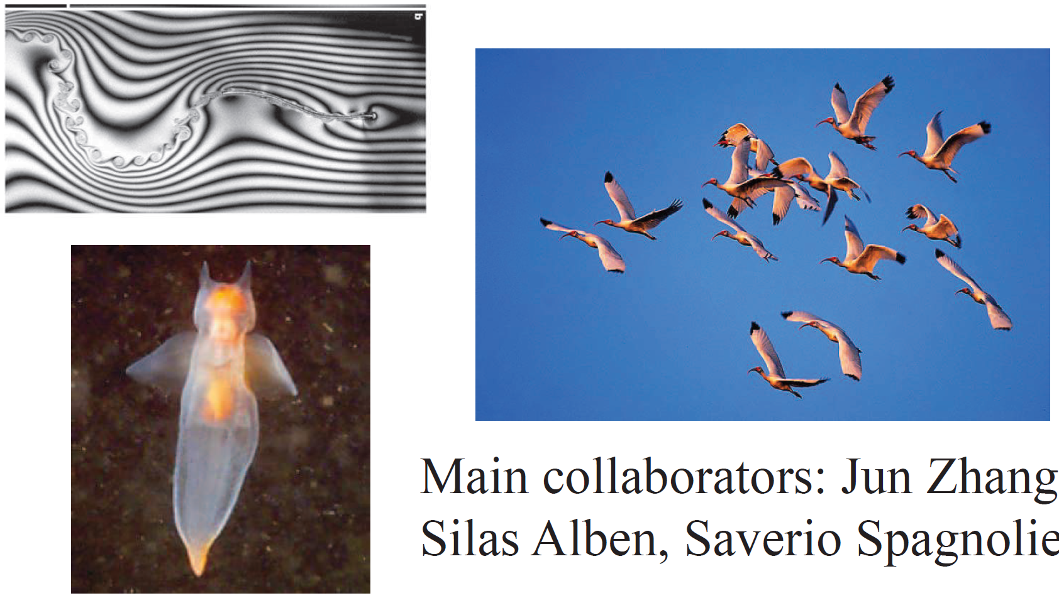
Advantage/disadvantage of passive flexible parts/appendages in animal propulsion?

Slide 4
In which Re-world do we stand?

Slide 5
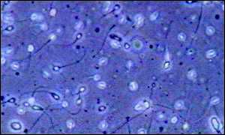
Re << 1, micro-organisms use
non-reciprocal waves to move
(no inertia → symmetry under
time reversal)

Slide 6
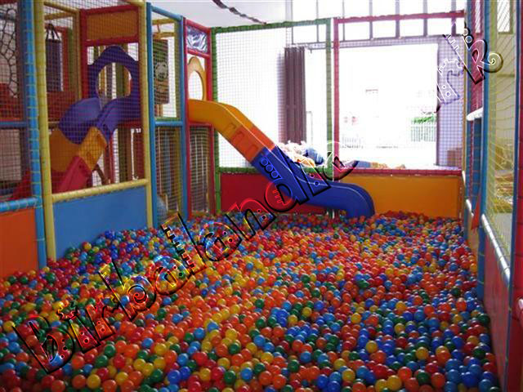
Re << 1, micro-organisms use
non-reciprocal waves to move
(no inertia → symmetry under
time reversal)

Slide 7
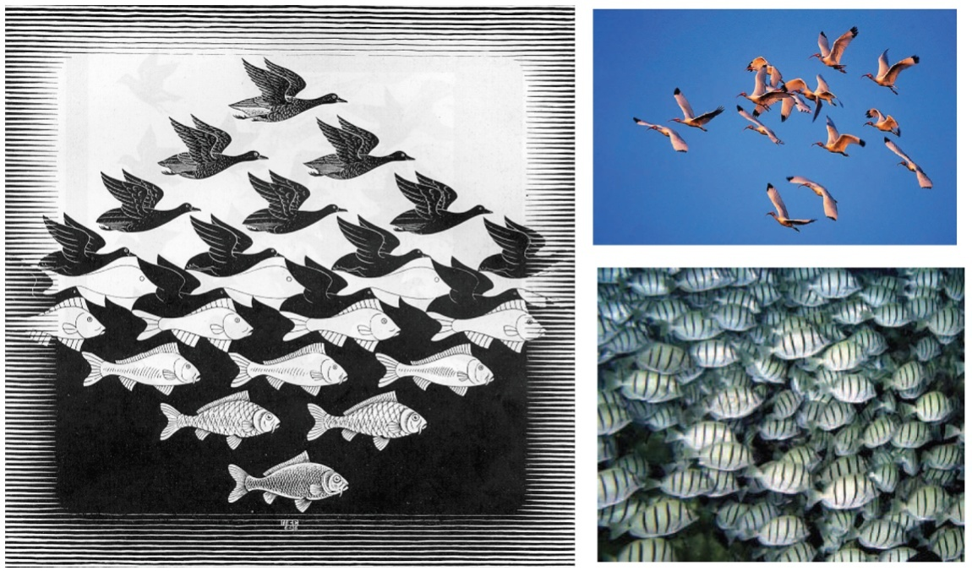
Re << 1, micro-organisms use
non-reciprocal waves to move
(no inertia → symmetry under
time reversal)
Re >> 1, birds/fish use reciprocal
flapping for lift and/or propulsion

Slide 8
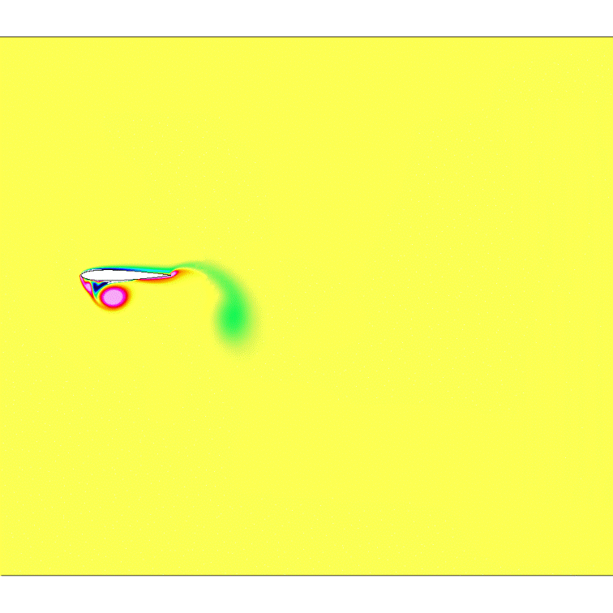
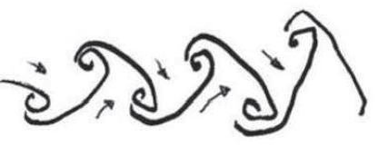
Re << 1, micro-organisms use
non-reciprocal waves to move
(no inertia → symmetry under
time reversal)
Re >> 1, birds/fish use reciprocal
flapping for lift and/or propulsion
Heaving, rigid, symmetric foil
(thrust)
(inverted von Karman vortex street)

Slide 9
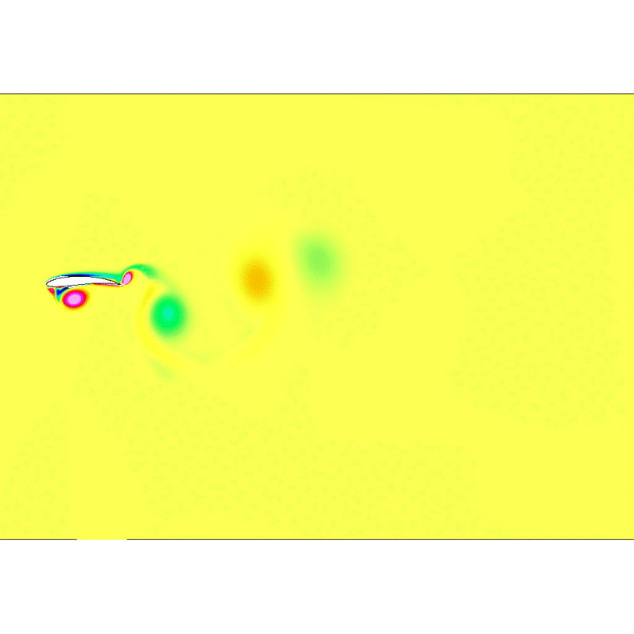
Re << 1, micro-organisms use
non-reciprocal waves to move
(no inertia → symmetry under
time reversal)
Re >> 1, birds/fish use reciprocal
flapping for lift and/or propulsion
Heaving, rigid, cambered foil
(plus lift)

Slide 10
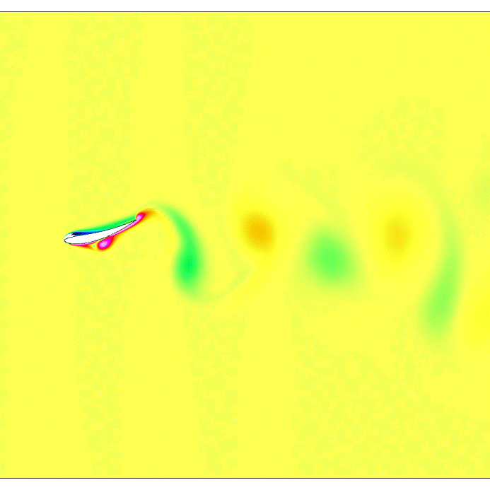
Re << 1, micro-organisms use
non-reciprocal waves to move
(no inertia → symmetry under
time reversal)
Re >> 1, birds/fish use reciprocal
flapping for lift and/or propulsion
Heaving, flexible, cambered foil
(plus …)
J. Guerrero, PhD Thesis, 2009, UNIGE

Slide 11
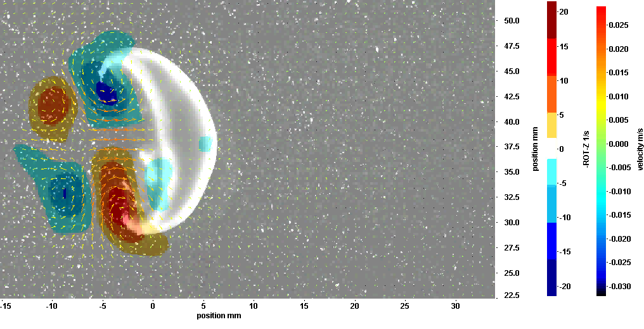
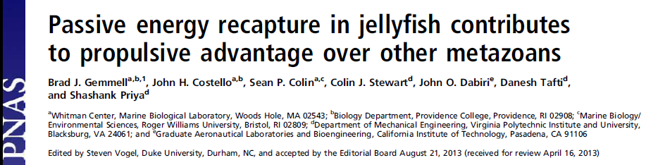
Some animals live between these worlds: Re ≈ 1 - 100
(and present flexible/elastic parts)

Slide 12
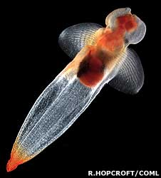
Some animals live between these worlds: Re ≈ 10 - 1000
(and present flexible appendages)
Clione Antarctica (“sea slug”), a marine
mollusc which switches mobility strategy
with adulthood:
rowing cilia → flapping wings
Childress & Dudley, JFM 2004

Slide 13
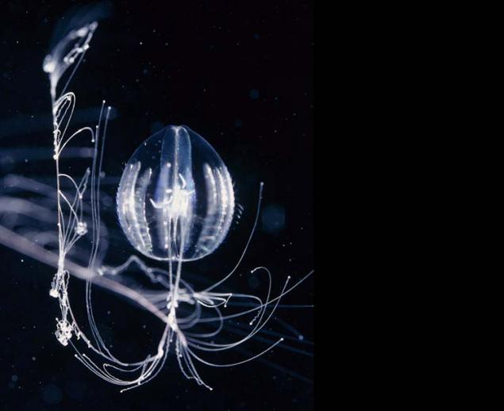
Some animals live between these worlds: Re ≈ 10 - 1000
(and present flexible appendages)
Clione Antarctica (“sea slug”), a marine
mollusc which switches mobility strategy
with adulthood:
rowing cilia → flapping wings
Childress & Dudley, JFM 2004
Pleurobrachia Pileus (comb-jelly), a
member of the Phylum Ctenophora
which moves in water thanks to the rythmic beating of eight rows of cilia.

Slide 14
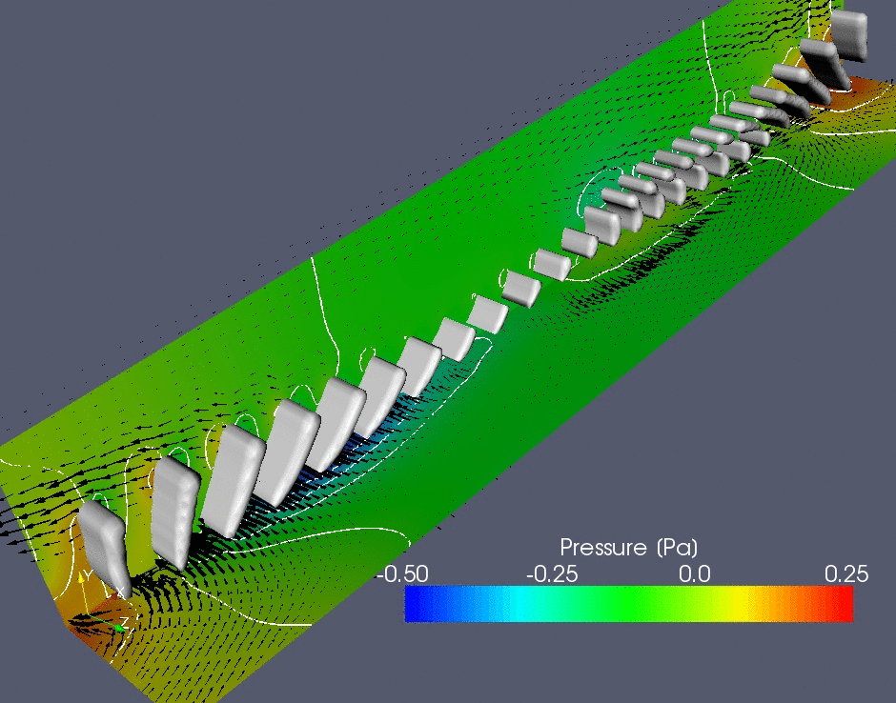
Some animals live between these worlds: Re ≈ 10 - 1000
(and present flexible appendages)
Pleurobrachia Pileus (comb-jelly), a
member of the Phylum Ctenophora
which moves in water thanks to the rythmic beating of eight rows of cilia
Long tentacles for feeding …
Dauptain, Favier & Bottaro, JFS 2008

Slide 15
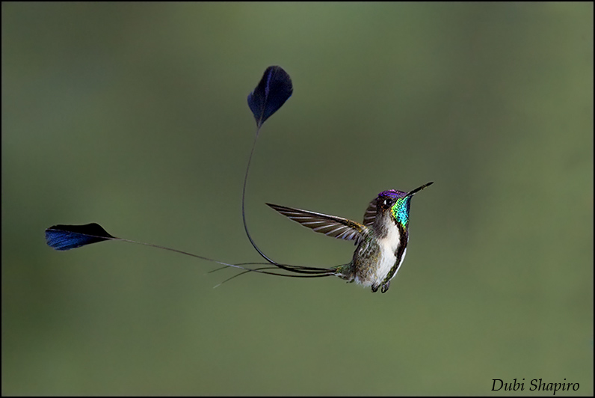
Some animals live between these worlds: Re ≈ 10 - 1000
(and present flexible appendages)
Loddigesia Mirabilis (Marvellous Spatuletail)
Re ∼ f L²/ν ∼ 2500 with f ∼ 20 Hz and L ∼ 5 cm

Slide 16
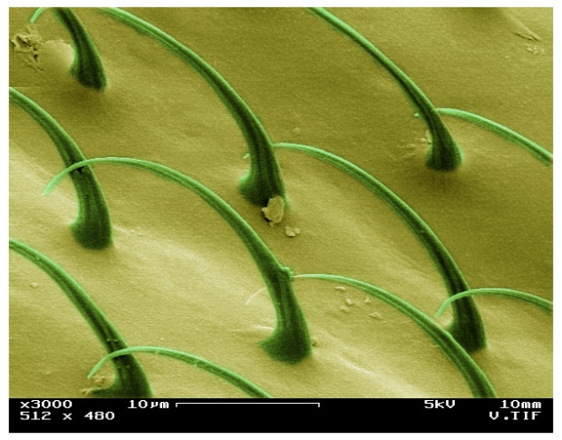
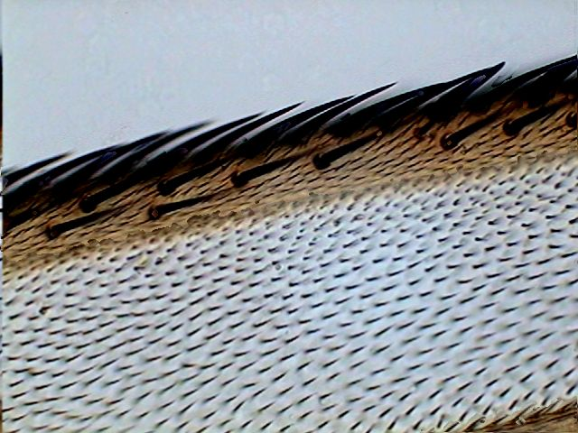
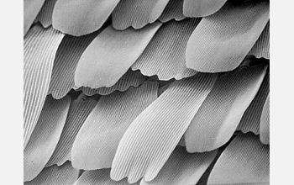
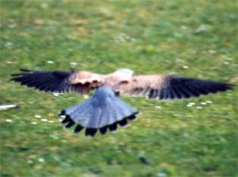
fly mosquito
butterfly “pop-up” feathers
In Nature “rough” is rule, not exception …

Slide 17
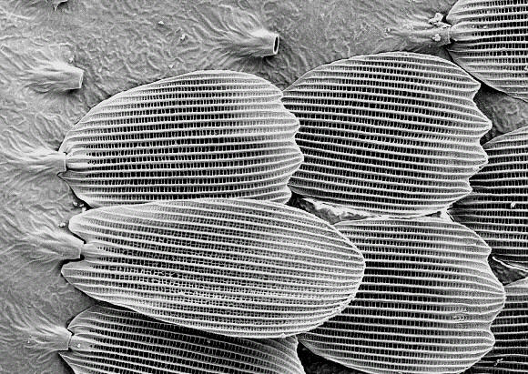
Butterfly and moth microstructure of the wings
Sharks
Penguins
Seals
Left: electron microscope image of butterfly scales. Right: perspective view (with dimensions) with details of a scale. UL: upper lamina; LL: lower lamina; T: trabecula.

Slide 18
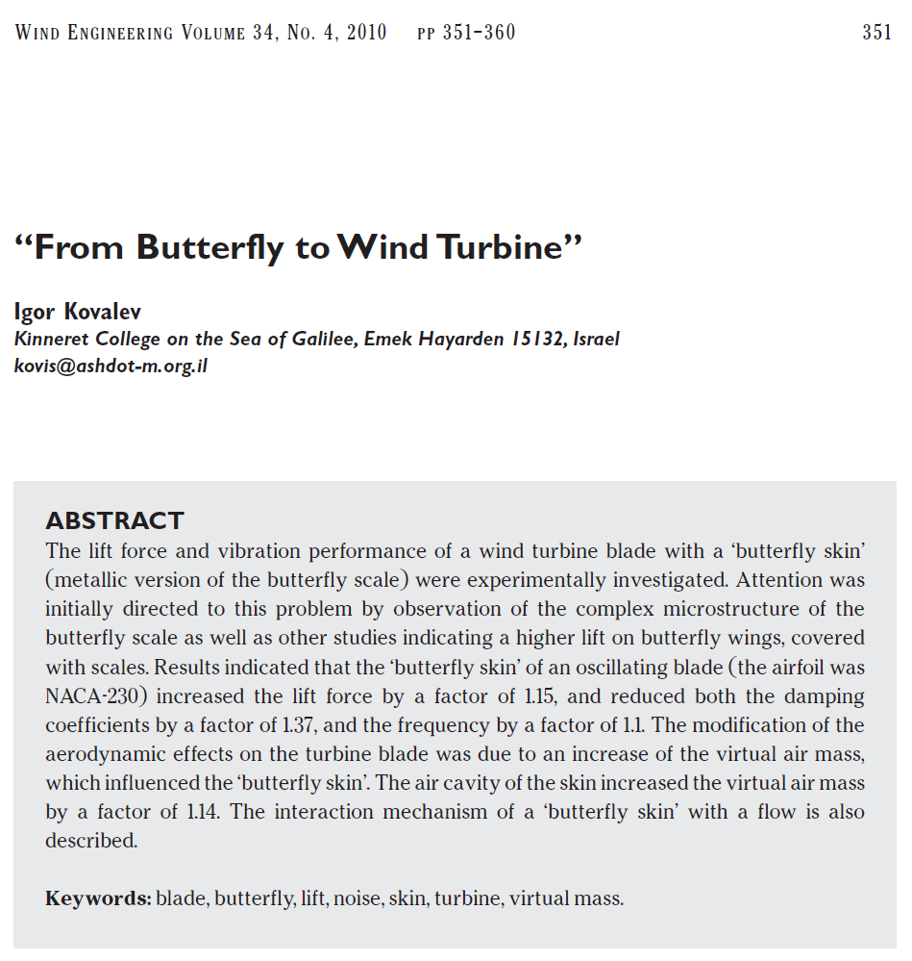
Butterfly and moth microstructure of the wings
Sharks
Penguins
Seals

Slide 19
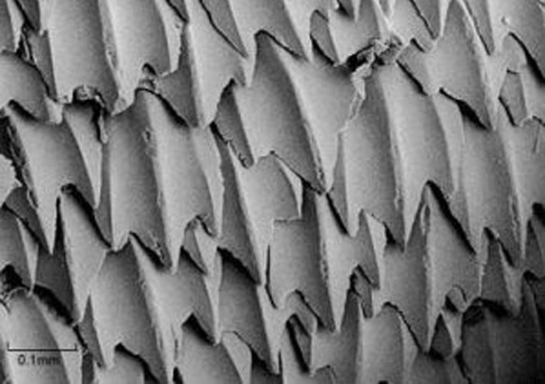
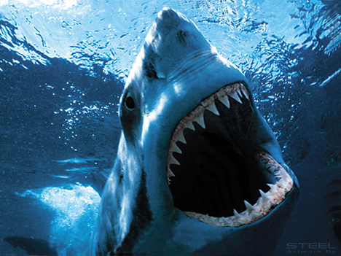
Shark skin paint!
The coating that reduces skin friction drag
(Fraunhofer, Bremen)
denticle
Sharks
Penguins
Seals

Slide 20
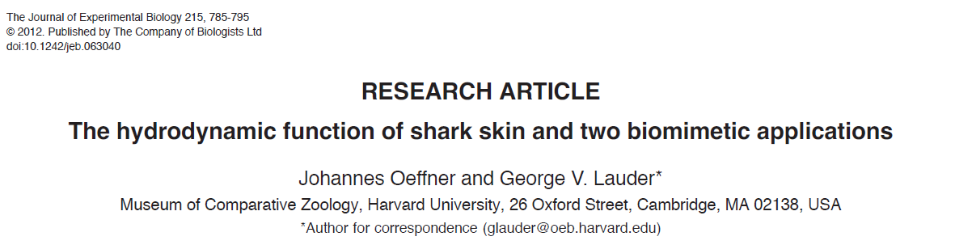
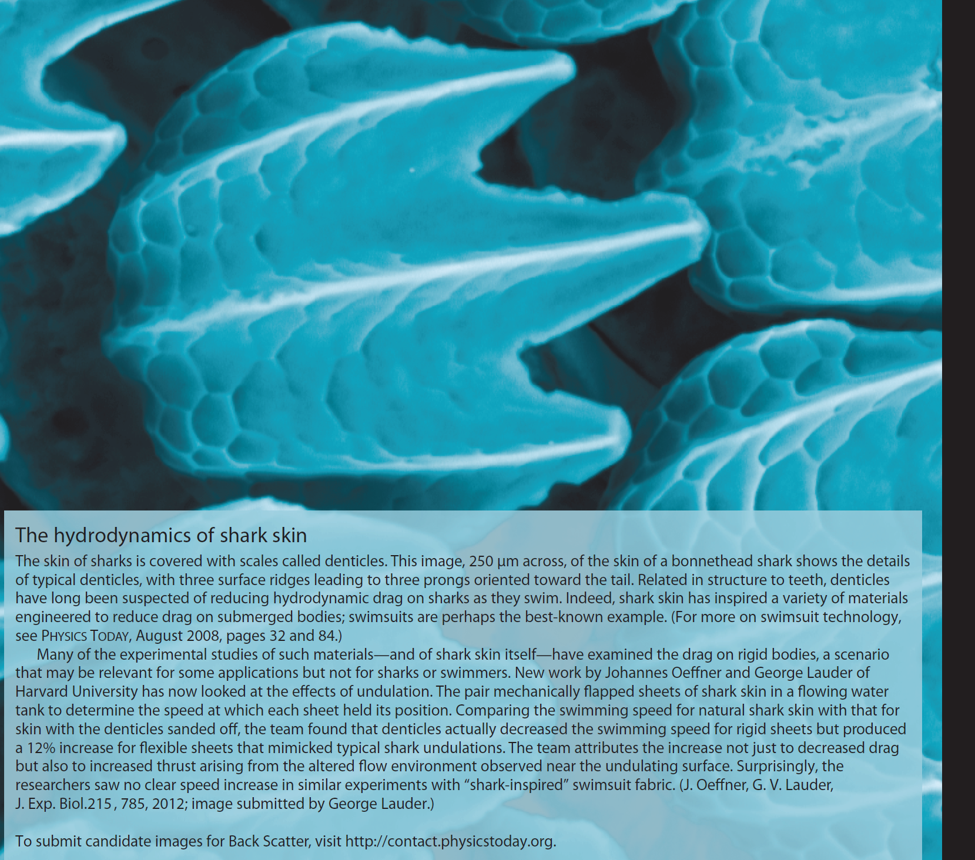
Sharks
Penguins
Seals

Slide 21
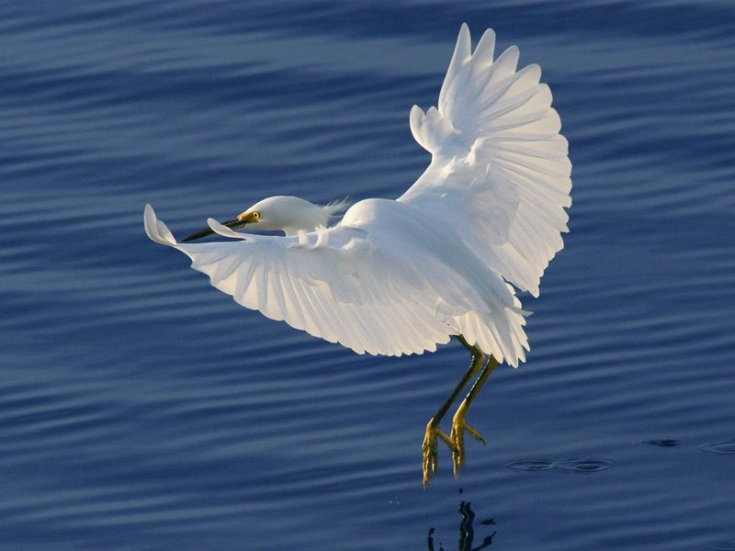
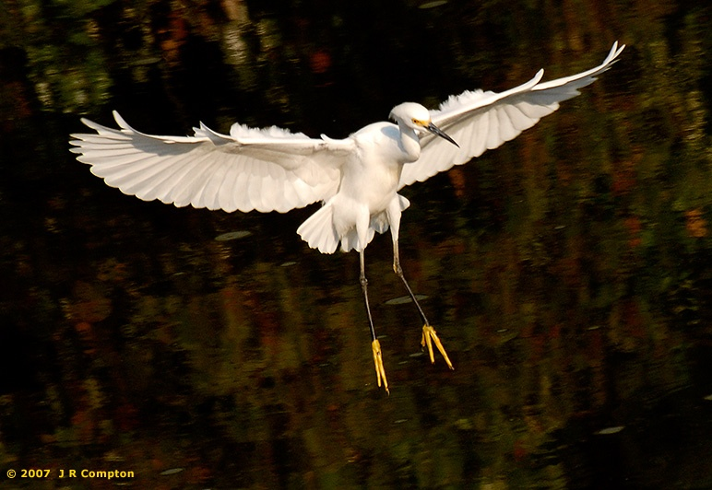
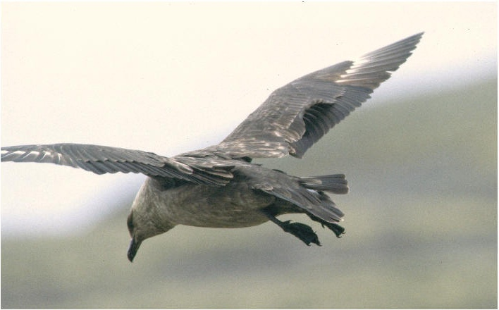
Are coverts also a passive mean to increase lift?
And reduce pressure drag?

Slide 22
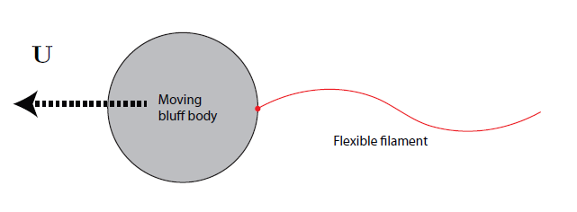
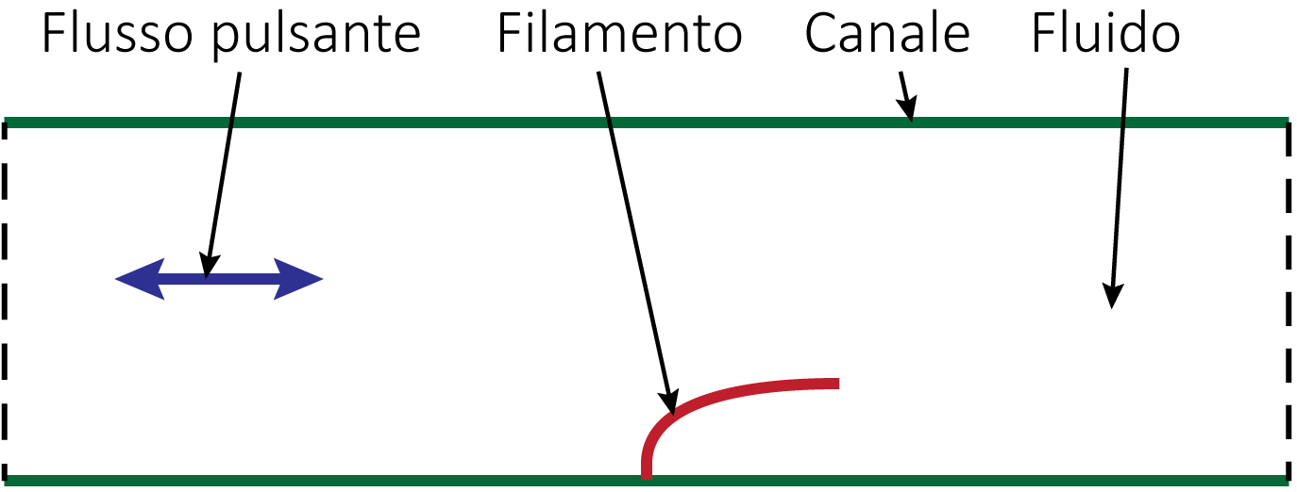
How do a “free” body and a fluid interact?
What is the role of apparently inert
filaments/cilia/tentacles/scales?
1.
2.
Pulsating pressure gradient filament channel fluid

Slide 23
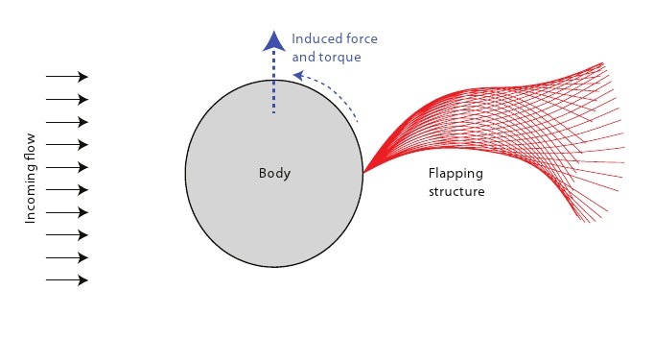
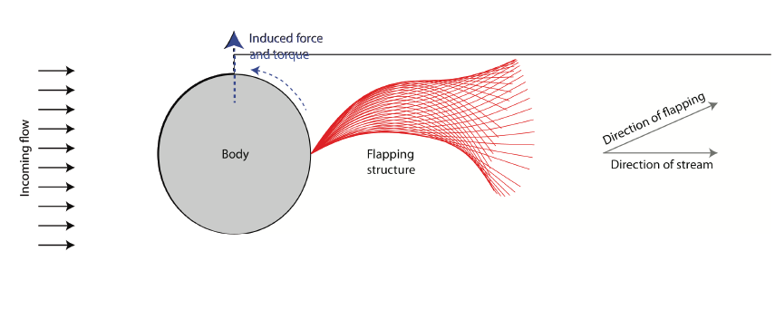
1. Symmetry breaking!
Filament might flap asymmetrically:
- induced force and torque
- reduced drag

Slide 24
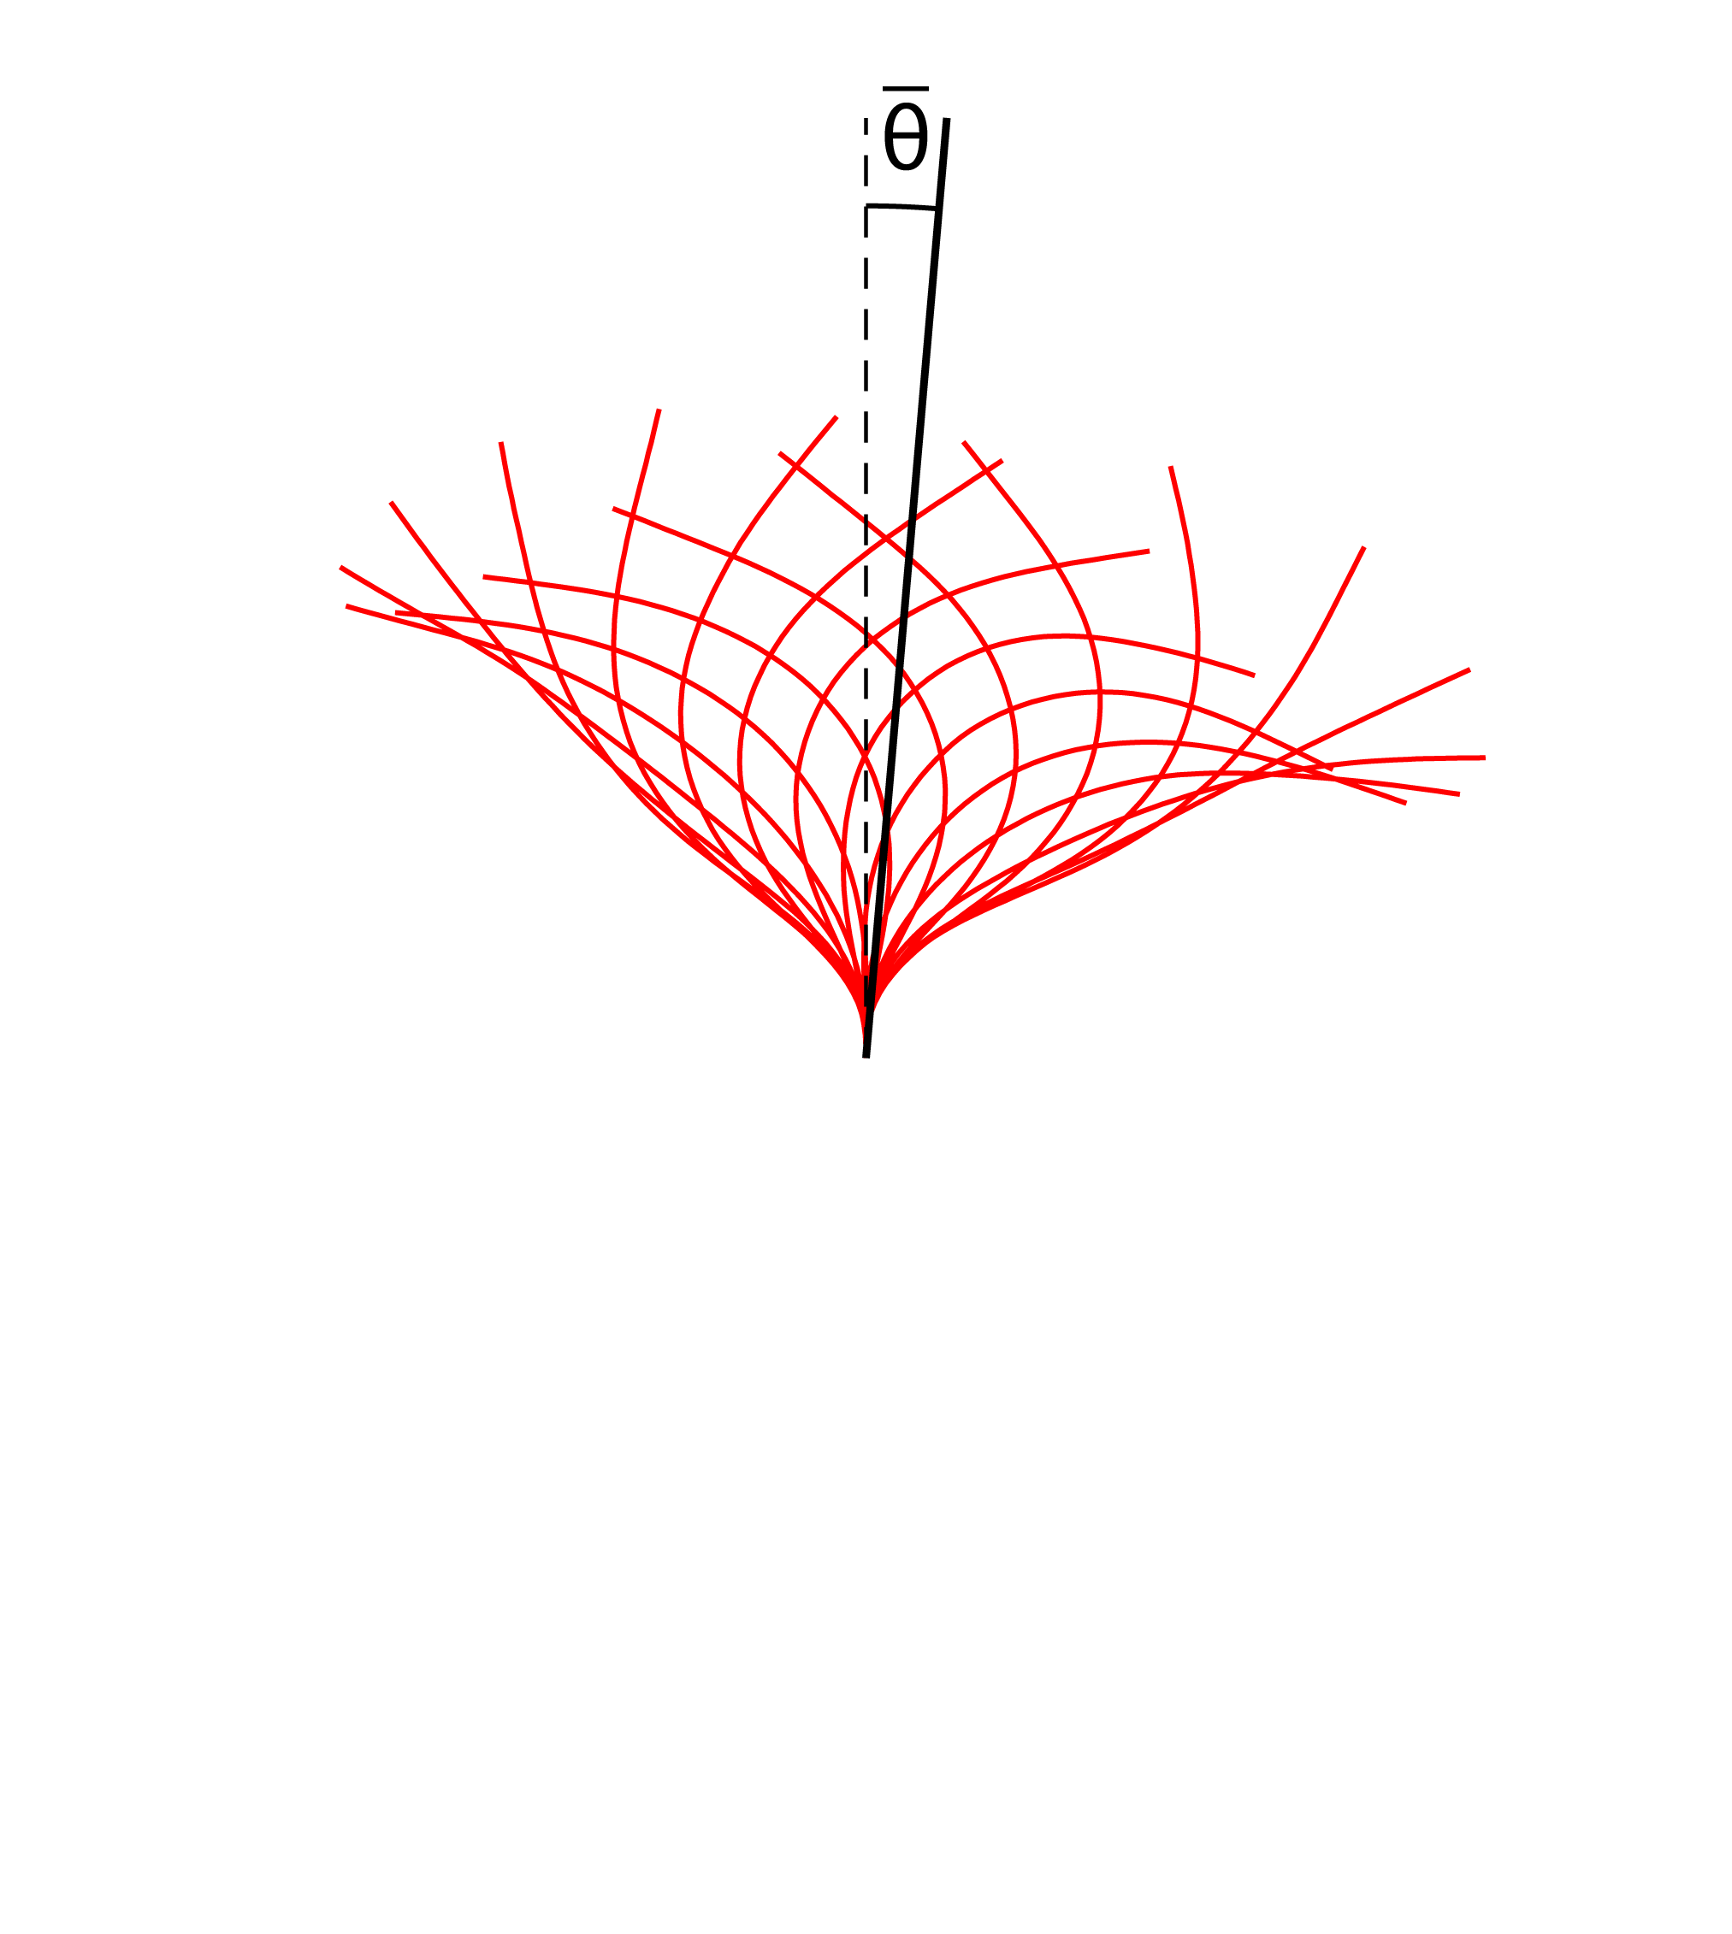
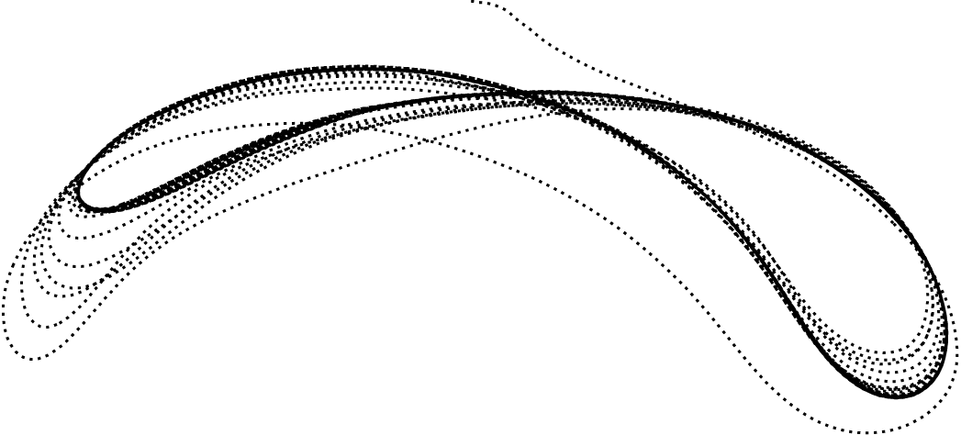
2. Symmetry breaking!
Filament might flap asymmetrically:
- induced mean drift
Pulsating p gradient
Induced mean drift
Lower wall
Asymmetric trace of the filament tip in the plane

Slide 25
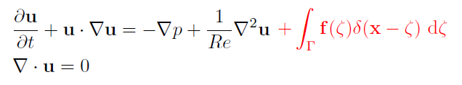
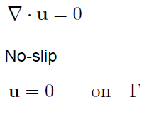
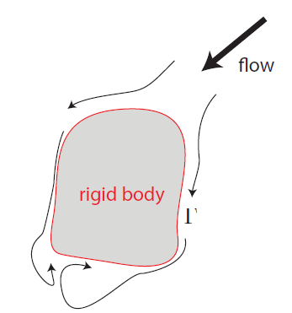
The numerical method

Slide 26
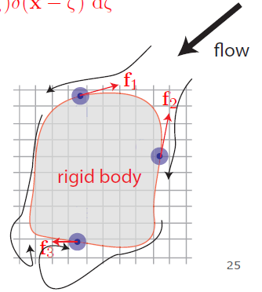
The numerical method: IBM
Flow field: Eulerian grid
Boundary: Lagrangian points
Boundary force to enforce
no-slip condition
Projection method
(Taira & Colonius, JCP 2005)

Slide 27
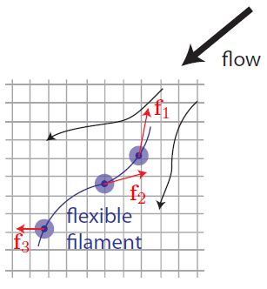

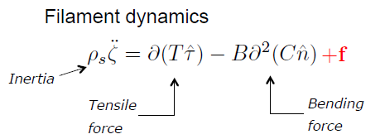
The numerical method: IBM + the flexible filament
ζ = ζ(s,t) s: arclength
: Euler-Bernoulli
: Euler-Bernoulli eq.
Peskin, Acta Numerica 2002
Kim & Peskin, PoF 2007

Slide 28
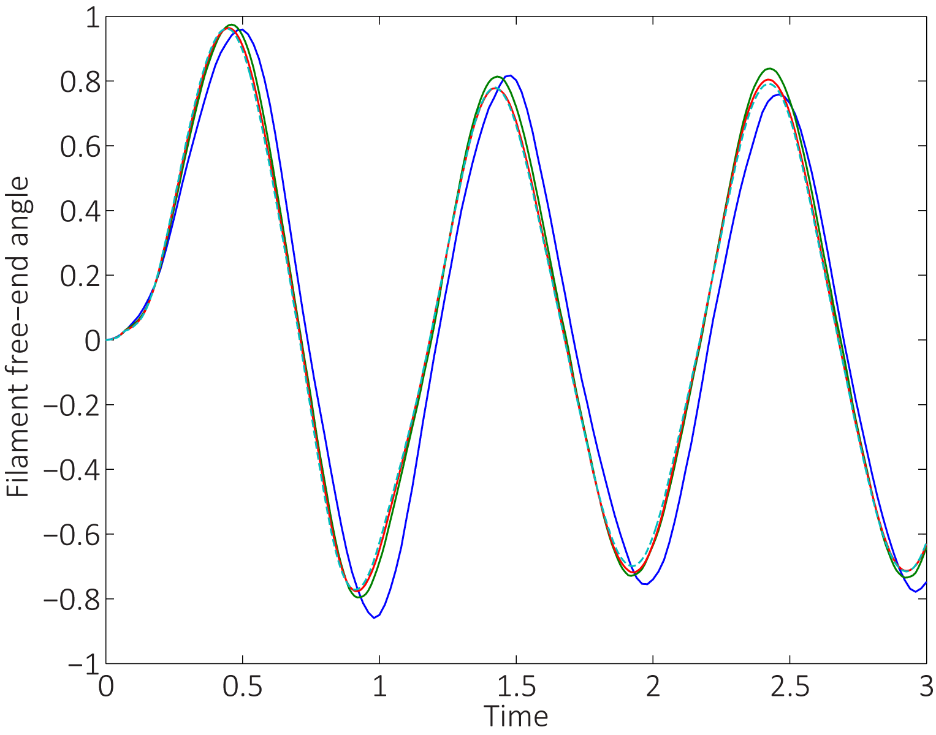
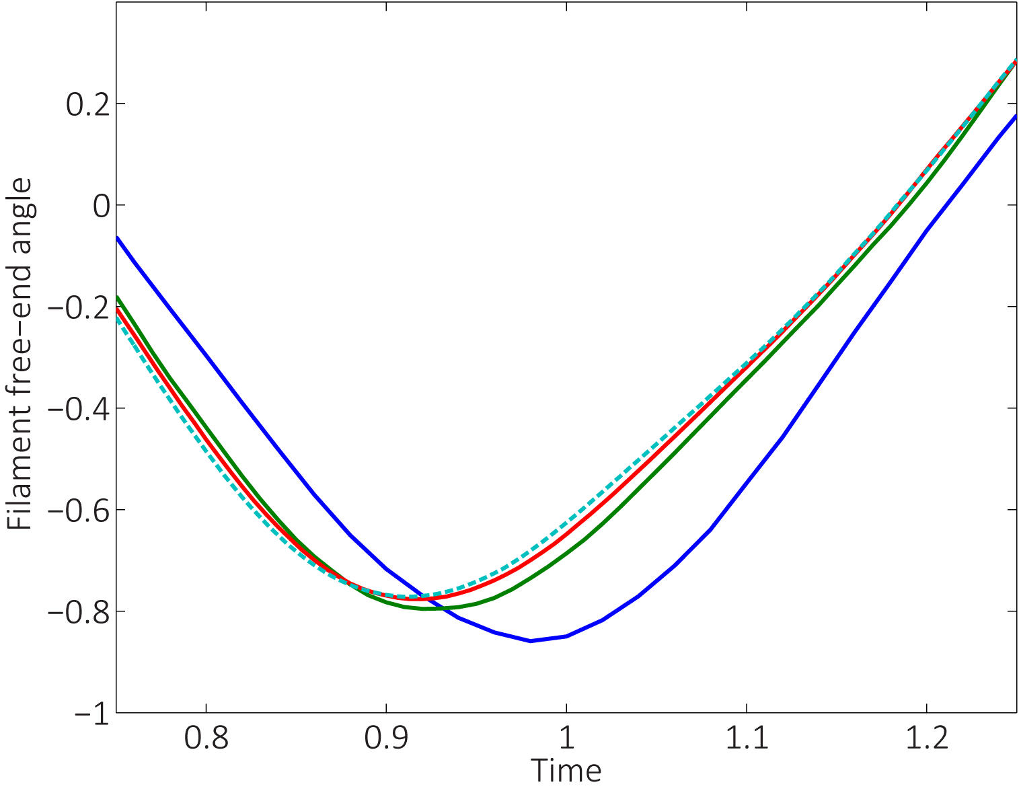
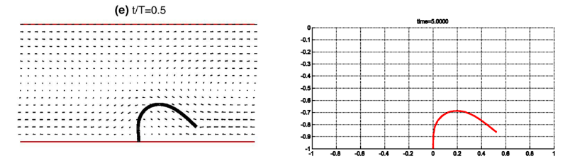
Convergence
  &
validation with previous codes
Z. Yu, JCP (2005)

Slide 29
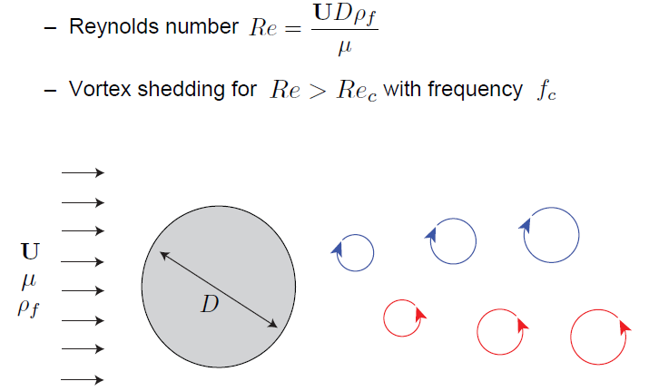
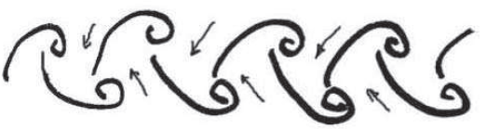
1.
The cylinder alone: symmetric wake
(classical von Karman vortex street)
Williamson, ARFM 1996

Slide 30
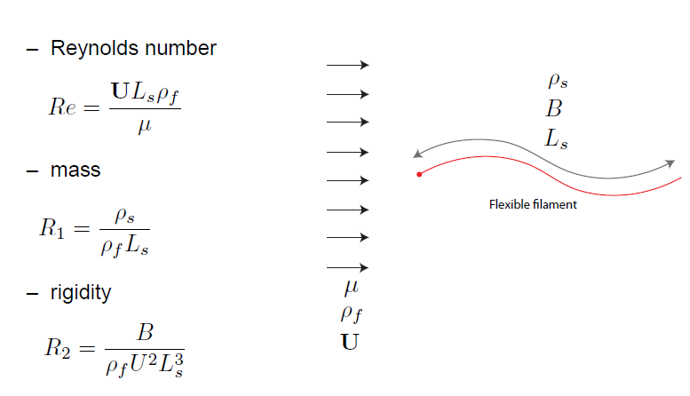
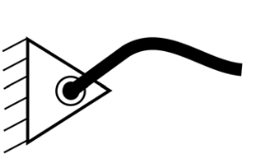
The filament alone: symmetric flapping
T = ζ _{ss} = ζ _{sss} = 0 @ s = L_{s} (filament free end)
ζ = ζ _{ss} = 0 @ s = 0 (hinged position)

Slide 31
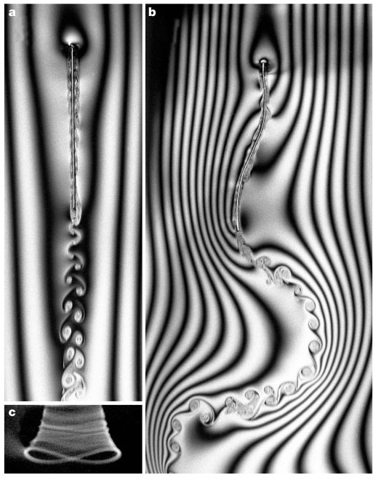
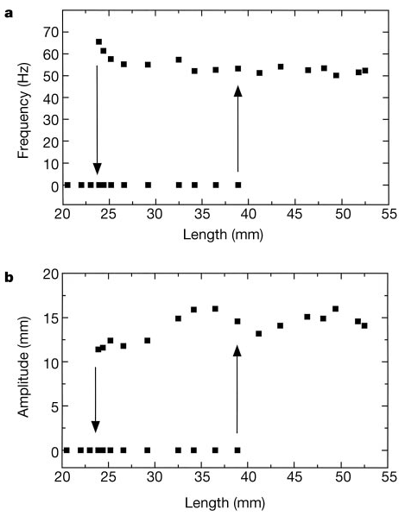
The filament alone (soap film experiments)
flapping
stretched
Zhang, Childress, Libchaber & Shelley, Nature 2000
Shelley & Zhang, ARFM 2011

Slide 32
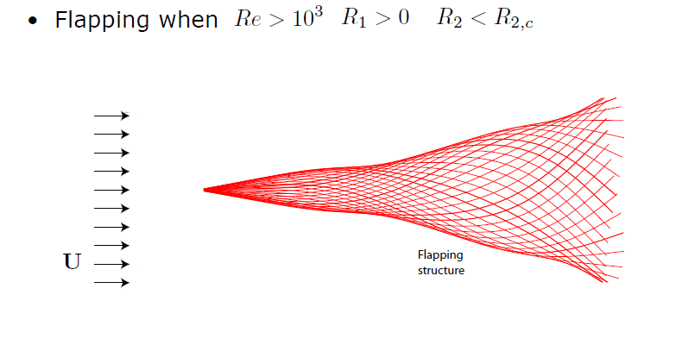
The filament alone (numerical simulations)

Slide 33
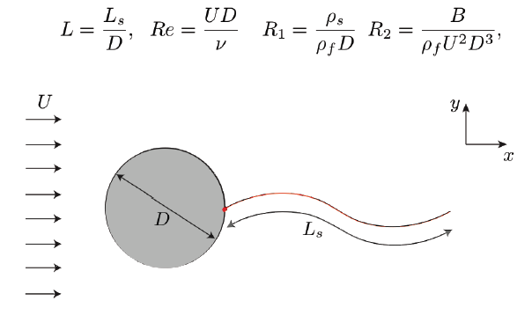
Cylinder + filament: something happens …

Slide 34


Re = 100, R₁ = 0.1, R₂ = 0.005, L = 3 and L = 1.5
Bagheri, Mazzino & Bottaro, PRL 2012

Slide 35


Slide 36

increasing R₂ → increased rigidity of the structure

Slide 37


Slide 38


Choice of observable
Rigid filament: R₂ = 0.1
Flexible filament: R₂ = 0.005

Slide 39

A symmetry-breaking bifurcation occurs when vortices and structures resonate …

Slide 40

Beam equation

Slide 41


Resonance condition
filament with slow reaction time
filament reacts instantaneously

Slide 42

ss

Slide 43

Resonance

Slide 44

Resonance
L_{r} filament L_{c}
energy

Slide 45

Can filaments increase drift?

Slide 46


Can filaments reduce drag “optimally” (thanks to their
compliance) as opposed, i.e., to the (sub-optimal)
pressure drag reduction of golf/tennis/baseball balls?
Favier et al. JFM 2009

Slide 47

However …
we do not need flexibility of the filament to explain symmetry breaking; a simple, purely hydrodynamic, model shows that symmetry can be broken also with a rigid splitter plate, hinged at the wall. Simulations have confirmed this.
Flexibility of the structure is thus a “second order” effect, which acquires importance when we are in near-resonant conditions.

Slide 48

2.
The channel with pressure gradient alone: symmetric, pulsating velocity profile
Sharks
Penguins
Seals

Slide 49
Parameters:
  Channel
    Length L
    Height 2h
  Filament
    Length L_{fil}
    Flexural rigidity B → R₂
  Periodic forcing
    Maximum value of the induced mean velocity U → Re
    Period T → St = L_{fil}/(T U)

Slide 50


Observables
Filament
  Mean angle formed between the filament’s free end and the vertical
  Traiectory of the free end
Net mean drift
  Velocity integrated over y through several periods T

Slide 51

Single filament, varying T (T = 1, T = 2.1, T = 3)
L = 8, L_{f} = 0.8, flexible filament R₂ = 0.005, Re = 200

Slide 52


Non-interacting filaments (“long” box)
  Asymmetry exists with negligible
  net mean drift around T = 2.1
Mean u

Slide 53


Varying the distance between filaments (i.e. the box length)
. For all filaments’ spacings the mean angle (i.e. asymmetry) peaks around T = 2.1
For closely spaced filaments the net mean drift increases significantly (around T = 1.5)
L = 6 green
L = 12 blue
L = 2 L = 3

Slide 54




Mean velocity fields (u e v) for T = 1.5 (L = 12 & L = 2)
isolated filament interacting filaments

Slide 55


Filaments on both sides (L = 2)
  Weak interaction between upper and lower filaments
  “Additive” effects
    Net drift up to 30% of the mean U induced by the pressure gradient

Slide 56




FTLE OF THE MEAN FIELDS
Isolated filaments (L = 12), T = 0.6, T = 1.5, T = 2.1, T = 3.6
impinging
jet
asymmetry

Slide 57




Interacting filaments (L = 2), T = 0.6, T = 1.5, T = 2.1, T = 3.6

Slide 58
Why?
Effect of the initial condition?
Symmetry breaking of a confined impinging jet?
Vortex dipole released by the filament and flow induced by Biot-Savart law?

Slide 59

A simple hydrodynamic model to explain mean drift (at least for the T = 1.5 case)
  The filaments acts by creating a jet in the fluid
  Periodicity is important
  Channel with constant, localized vertical force term

Slide 60


Single jet (L = 12), comparison with isolated filament, T = 1.5

Slide 61




Comparison for L = 6, T = 1.5

Slide 62



Comparison for L = 3, T = 1.5

Slide 63






Comparison for L = 2, T = 1.5
oscillating net drift

Slide 64
HOW CAN IT BE SO SIMPLE?
There is no oscillating pressure in this simple hydrodynamic model …
this filament has no inertia relative to the fluid (ρ_{fil} = 0 means that the densities of filament and fluid are the same), so that the characteristic filament time scale is zero → instantaneous reaction of the filament. Filament is responsible for the creation of an upward jet of fluid, but is then slaved by hydrodynamics
pressure forcing acts on a time scale T of order 1
the fluid system evolves to a (statistically) steady state over a time of order 100 → the rapid pressure oscillations trigger the flapping and the creation of a (quasi vertical) jet → then it is just hydrodynamics …

Slide 65
Small periodic box L = 2 → asymmetry with significant net mean drift around T = 1.5
Larger box (isolated filament) → symmetry can be broken or not (it breaks when T is around 2.1), no (or very weak) net drift

Slide 66
Questions we are still trying to answer:
Why does the box length (the periodicity) plays a role in breaking the symmetry? Eckhaus/sideband instability of rolls?
Is a small, periodic box a good model of the collective behaviour of a dense coating of filaments?
How to model hydrodynamically (or hydro-elastically?) the breaking of symmetry (around T = 2.1) in a periodic box of any length?

Slide 67

THANK YOU!

