Slide 1


FLOW OVER NATURAL OR ENGINEERED SURFACES
Alessandro Bottaro
Bilkent U. - April 13, 2018

Slide 2
FLOW OVER NATURAL OR ENGINEERED SURFACES
Alessandro Bottaro
Bilkent U. - April 13, 2018
With many thanks to:
Edoardo Alinovi, Alberto Lagazzo, Giuseppe Zampogna and many others!

Slide 3

‘‘Life’’ is not smooth, but anisotropic, multiscale, heterogeneous, rough, porous, flexible, etc.
CFD & Optimization
Alessandro Bottaro
DICCA, University of Genova

Slide 4
‘‘Life’’ is not smooth, but anisotropic, multiscale, heterogeneous, rough, porous, flexible, etc.
CFD & Optimization
Alessandro Bottaro
DICCA, University of Genova

Slide 5
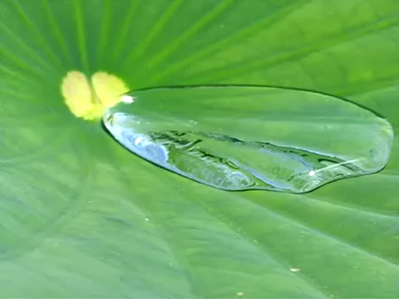
CFD & Optimization
Alessandro Bottaro
DICCA, University of Genova

Slide 6
CFD & Optimization
Alessandro Bottaro
DICCA, University of Genova

Slide 7
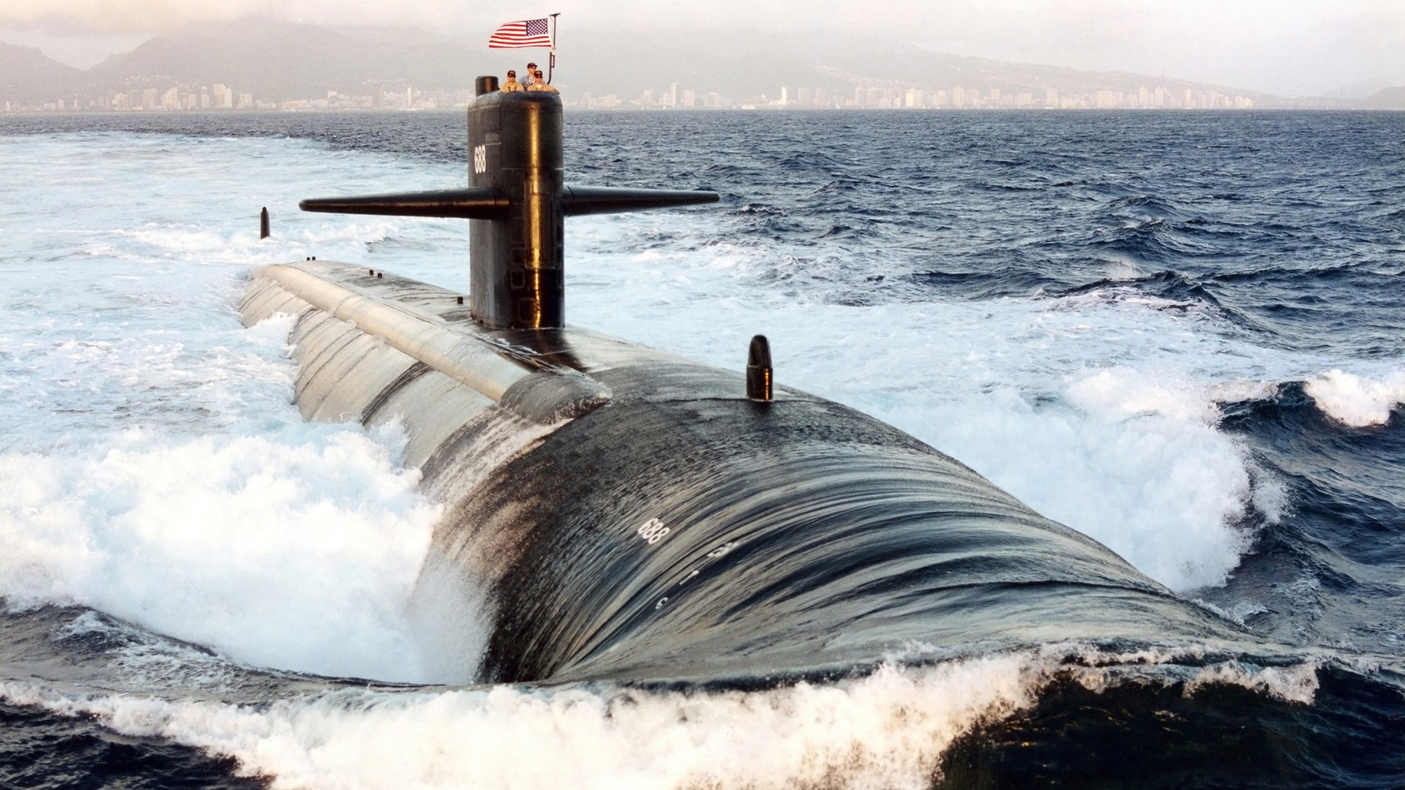

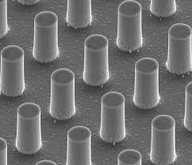
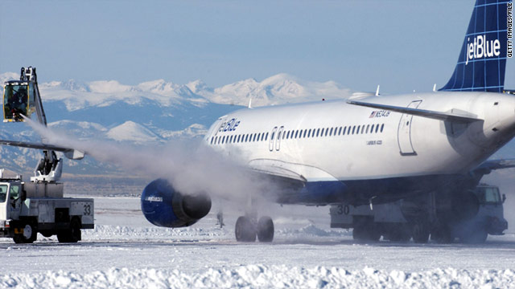
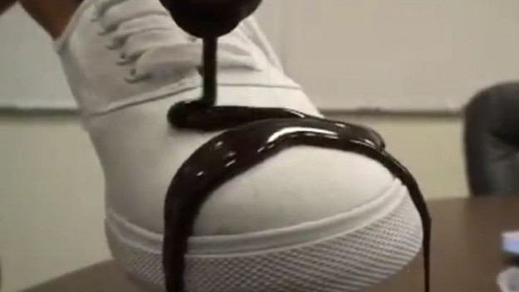
marine and underwater microfluidics
CFD & Optimization
Alessandro Bottaro
DICCA, University of Genova
anti-icing self-cleaning

Slide 8
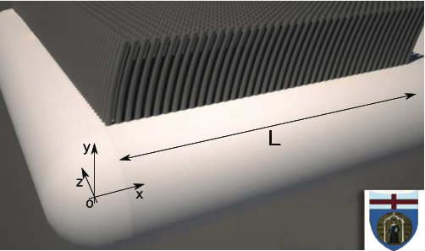
Sometimes a detailed microscopic description of the flow around such multiscale surfaces is impossible …
GOALS:
to model apparent slip over realistic surfaces, interfaces and layers (poro-elastic and poro-plastic) using the theory of homogenisation to average out the fine details around the surface/interface/layer, and
extend the macroscopic ‘‘Navier’s
slip condition’’ …
CFD & Optimization
Alessandro Bottaro
DICCA, University of Genova

Slide 9
A BIT OF HISTORY
CFD & Optimization
Alessandro Bottaro
DICCA, University of Genova
h
U(0) = U_{s}

Slide 10
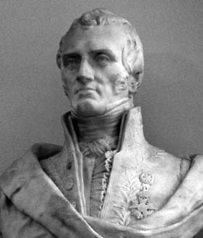
Claude Louis Marie Henri Navier (1785-1836)
CFD & Optimization
Alessandro Bottaro
DICCA, University of Genova

Slide 11
Claude-Louis Navier
CFD & Optimization
Alessandro Bottaro
DICCA, University of Genova

Slide 12

Claude-Louis Navier
CFD & Optimization
Alessandro Bottaro
DICCA, University of Genova
Sir George Gabriel Stokes
(1819-1903)

Slide 13
…..
….….

Slide 14
(″elle″ = the wall)
CFD & Optimization
Alessandro Bottaro
DICCA, University of Genova

Slide 15
In today’s terminology, Navier’s argument was that (i) there is partial slip, with
(ii) the resistance of the wall proportional to the slip velocity U_{s}:
E U_{s} = -ε dU/dy|_{y=0} → U(0) = (-ε/E) dU/dy|_{y=0} = h dU/dy|_{y=0}
h = slip length
CFD & Optimization
Alessandro Bottaro
DICCA, University of Genova
h

Slide 16

Navier’s slip condition is a first-order development around a fictitious wall (the position y = 0 is arbitrary) applicable when either
(i) the surface geometry is microstructured or
(ii) the continuum approximation breaks down.
There is a unique slip length h for U and W only in the case of isotropic (in x, z ) walls. The general (anisotropic) case requires (to first order) that:
$\left[\begin{matrix}U(x,0,z) \\ W(x,0,z)\end{matrix}\right]$ = ☹ $\frac{∂}{∂y}\left[\begin{matrix}U(x,y,z) \\ W(x,y,z)\end{matrix}\right]$_{y=0}
with L a slip tensor (plus a non-penetration condition for $V$).
CFD & Optimization
Alessandro Bottaro
DICCA, University of Genova

Slide 17
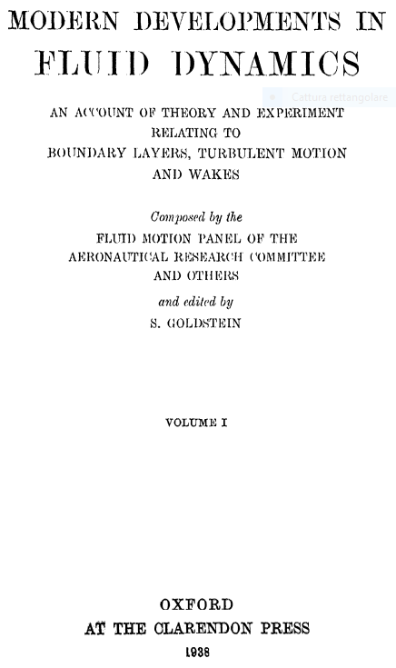
In the 18th century Daniel Bernoulli,
Du Buat and Coulomb had already
argued for partial slip or no-slip …
Later on, the situation became
somewhat confusing …
CFD & Optimization
Alessandro Bottaro
DICCA, University of Genova

Slide 18
Navier’s equations have later been re-discovered and/or extended to the compressible case by:
1828: Augustin-Louis Cauchy (1789 - 1857)
Exercises de Mathématiques, p. 187
1829: Siméon-Denis Poisson (1781 – 1840)
Journal de l’Ecole Polytechnique, XXe cahier, p. 152, 1831
1843: Adhémar Jean Claude Barré de Saint Venant (1797 -1886) Comptes Rendus de l’Academie des Sciences, v. 17, p.1243
1845: George Gabriel Stokes (1819-1903) Transactions of the Cambridge Philosophical Society, Vol VIII, 1849, p. 287
CFD & Optimization
Alessandro Bottaro
DICCA, University of Genova

Slide 19

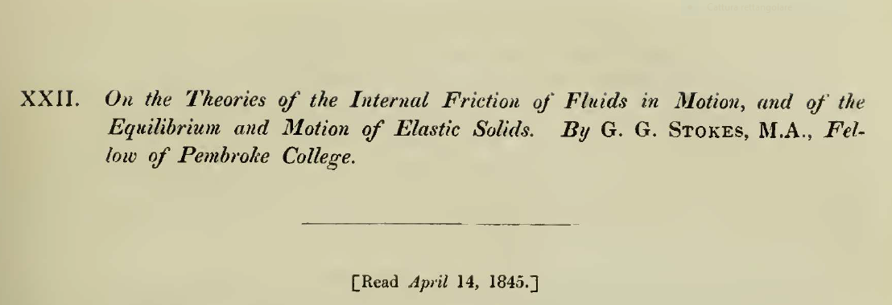
CFD & Optimization
Alessandro Bottaro
DICCA, University of Genova

Slide 20
CFD & Optimization
Alessandro Bottaro
DICCA, University of Genova

Slide 21
CFD & Optimization
Alessandro Bottaro
DICCA, University of Genova
NO SLIP?
τ_{w}  U_{s}²
(because of
surface
irregularities?)

Slide 22
CFD & Optimization
Alessandro Bottaro
DICCA, University of Genova
…
s
s

Slide 23
Later on …
1850: Stokes U_{s} = 0 ‘‘highly satisfactory’’
1879: Lamb U_{s} ≠ 0 on account of experiments by Helmholtz & Piotrowski (1860)
1890: Whetham U_{s} = 0 through accurate experiments
1895: Lamb U_{s} = 0 ‘‘... in all ordinary cases …’’
1922: Taylor U_{s} = 0!
CFD & Optimization
Alessandro Bottaro
DICCA, University of Genova

Slide 24
Later on …
1850: Stokes U_{s} = 0 ‘‘highly satisfactory’’
1879: Lamb U_{s} ≠ 0 on account of experiments by Helmholtz & Piotrowski (1860)
1890: Whetham U_{s} = 0 through accurate experiments
1895: Lamb U_{s} = 0 ‘‘... in all ordinary cases …’’
1922: Taylor U_{s} = 0! CASE CLOSED?
CFD & Optimization
Alessandro Bottaro
DICCA, University of Genova

Slide 25
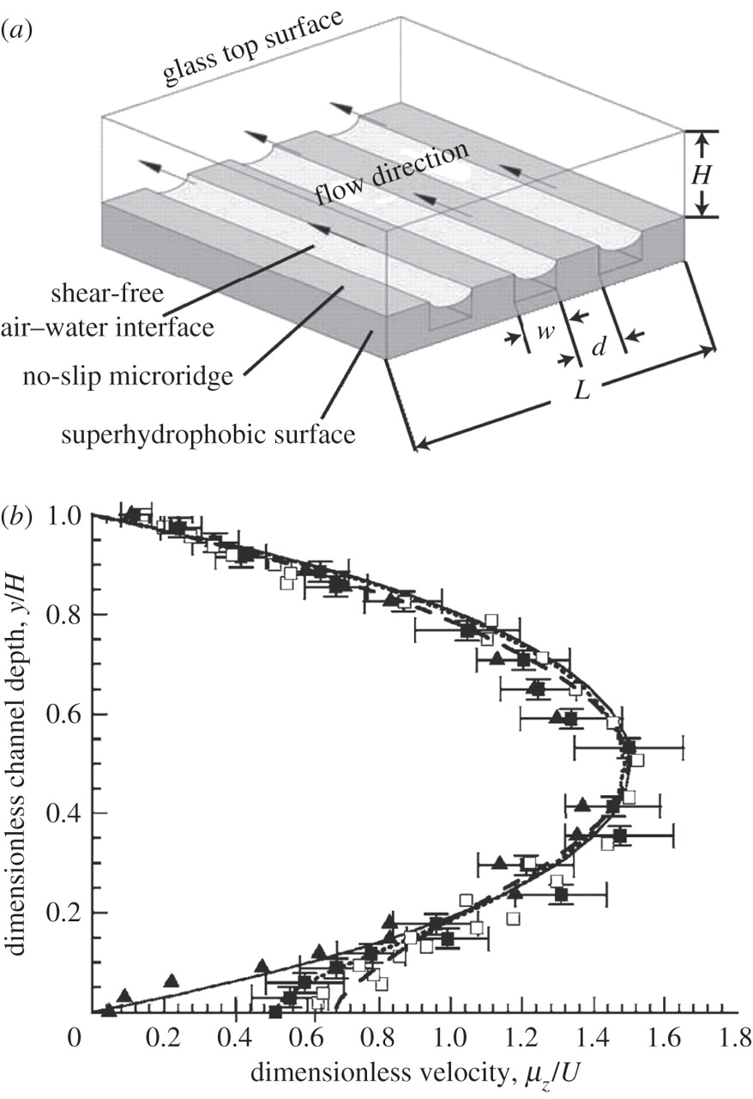
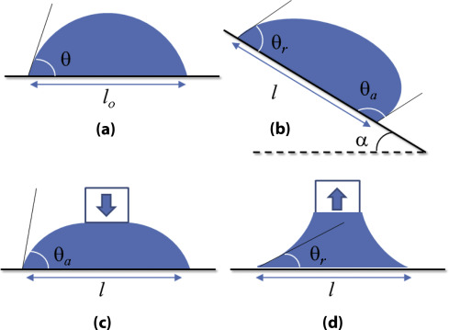
But what happens near
superhydrophobic surfaces?
And at the triple line of a
drop sliding down an incline?
CFD & Optimization
Alessandro Bottaro
DICCA, University of Genova

Slide 26

An excursion into the
microscopic world
CFD & Optimization
Alessandro Bottaro
DICCA, University of Genova

Slide 27
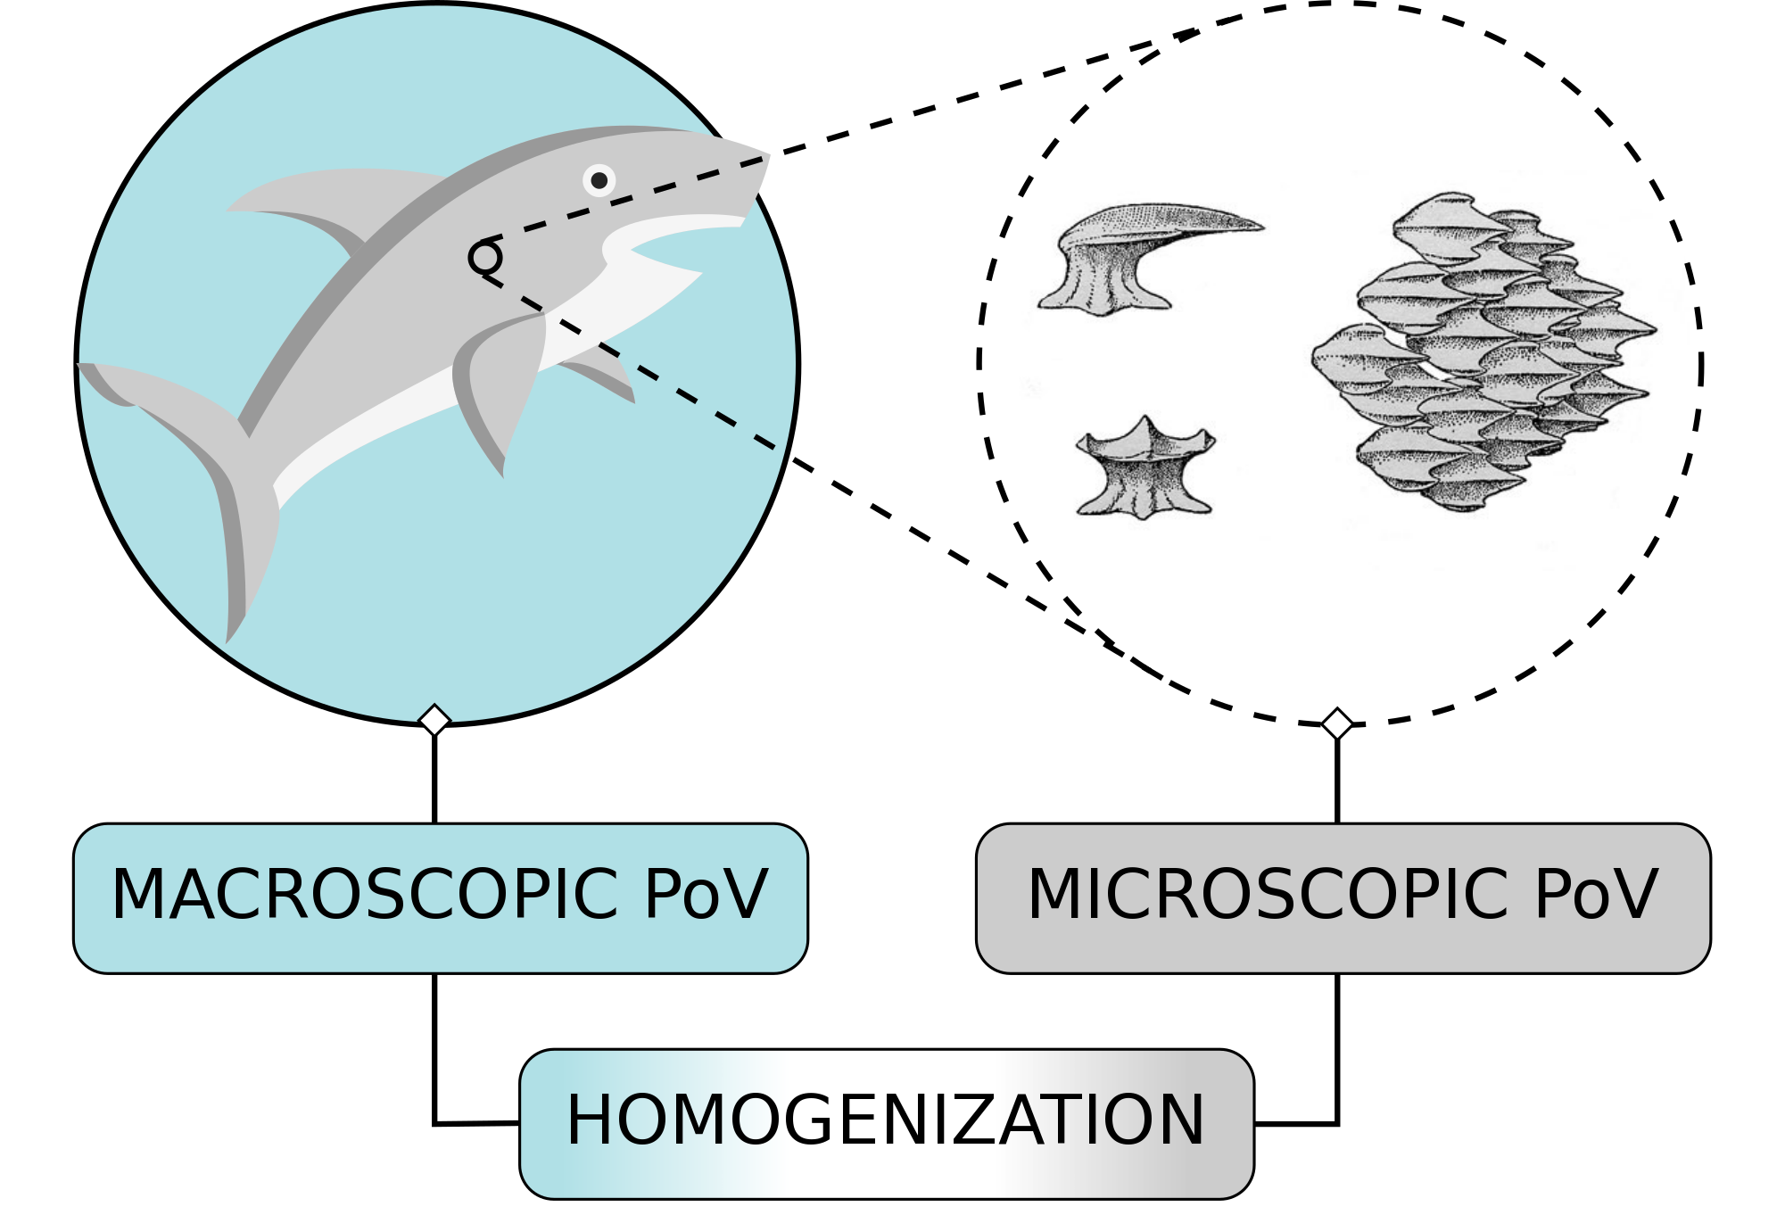
An excursion into the
microscopic world
CFD & Optimization
Alessandro Bottaro
DICCA, University of Genova
L
l

Slide 28
free fluid
CFD & Optimization
Alessandro Bottaro
DICCA, University of Genova
surface layer (eventually of zero thickness)
microscopic equations
wall (or porous or poro-elastic matrix)
macroscopic picture

Slide 29
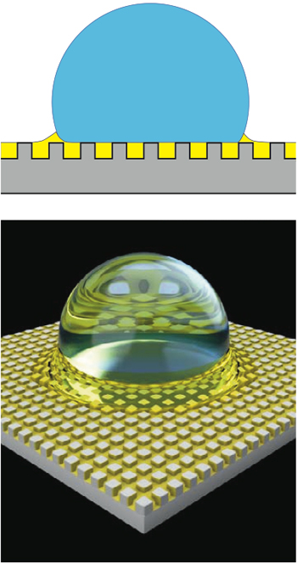
CFD & Optimization
Alessandro Bottaro
DICCA, University of Genova
porous or poroelastic material

Slide 30
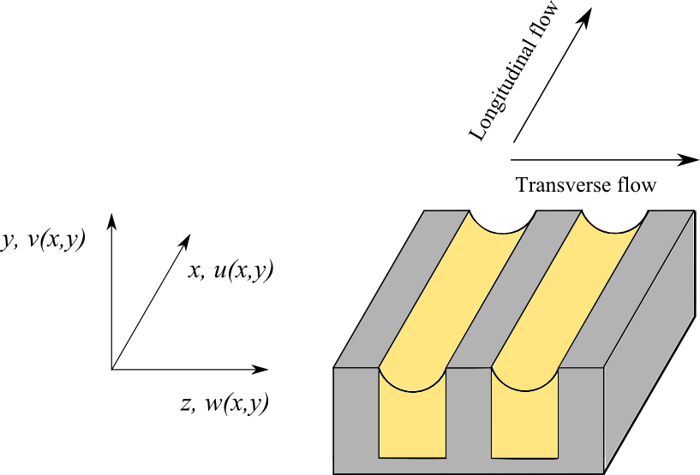
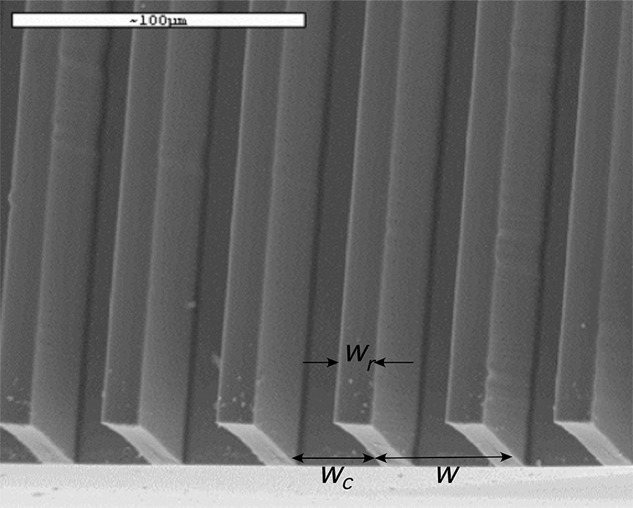
THE MICROSCOPIC PROTOTYPE PROBLEM
SHS & LIS
CFD & Optimization
Alessandro Bottaro
DICCA, University of Genova
y
x
z

Slide 31
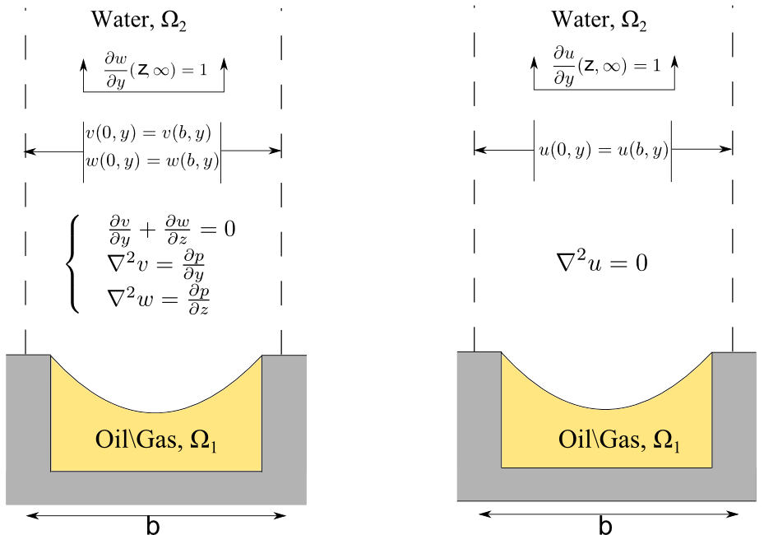

Y = ε y
Microscopic, periodic unit cell
Matched asymptotics:
$$\lim_{y →∞}{<u_{2}> =\lim_{Y →0}{ U =}}{ U}_{s}$$
$\lim_{y →∞}{<w_{2}> =\lim_{Y →0}{ W=W_{s}}}$
$$\lim_{y →∞}{<v_{2}> =\lim_{Y →0}{ V=0}}$$
CFD & Optimization
Alessandro Bottaro
DICCA, University of Genova
Water, Ω₂
y
z
l

Slide 32

Criticism:
In the unit cell (for both domains Ω₁ and Ω₂):
$∇∙u=0$
$$ρ\frac{Du}{Dt}=− ∇P+ μ ∇^{2 }u$$
plus no-slip conditions for fluid 1 at the walls, interface conditions between 1 and 2, and periodic conditions in z.
Scales: $O\left(∆P\right)=O\left(\frac{μ V_{ref} }{\text{l} }\right)$ con $V_{ref}$ velocity scale
within the near-wall region and $\frac{μ}{∆P}$ time scale
CFD & Optimization
Alessandro Bottaro
DICCA, University of Genova

Slide 33

The
The dimensionless Navier-Stokes equations become:
with $Re=$ $\frac{ρ V_{ref }\text{l}}{μ}$ = $\frac{ρ ∆P {\text{l} }^{2}}{μ^{2}}$. For a microscale Reynolds
number Re sufficiently small, the leading order equations of an
expansion in terms of ε (ε = l/L) reduce to Stokes’ equations.
CFD & Optimization
Alessandro Bottaro
DICCA, University of Genova

Slide 34
CFD & Optimization
Alessandro Bottaro
DICCA, University of Genova

Slide 35

CFD & Optimization
Alessandro Bottaro
DICCA, University of Genova
At this point the Lagrange-Green identity can be used:
$0=\int_{Ω_{}}{p^{†}\frac{∂u_{i}^{(0)}}{∂x_{i}}}$ + $u_{i}^{†}\left(− \frac{∂p^{\left(0\right)}}{∂x_{i}}+ \frac{∂^{2}u_{i}^{(0)}}{∂x_{j} ∂x_{j}}\right)$ d Ω $=$
$\int_{Ω_{}}{p^{(0)}\frac{∂u_{i}^{†}}{∂x_{i}}}$ + $u_{i}^{(0)}\left(− \frac{∂p^{†}}{∂x_{i}}+ \frac{∂^{2}u_{i}^{†}}{∂x_{j} ∂x_{j}}\right)$ d Ω +
+ “boundary terms”

Slide 36

Using the following boundary conditions for the adjoint problem:
No slip for $u_{1}^{†}$ , $v_{1}^{†}, w_{1}^{†}$ on the walls
Interface conditions on velocity and traction vectors at 1-2
Periodicity along z
$\frac{∂u_{2}^{†}}{∂y}$ = $\frac{ ∂w_{2}^{†}}{∂y}$ = 1, $v_{2}^{†}$ = 0 for $y → ∞$
“boundary terms” yields: $\lim_{y →∞}\iint_{x,z}{( u_{2}}{−} u_{2}^{†}$ $\frac{∂u_{2}}{∂y}$ ) dx dz = 0
and similar for w₂
CFD & Optimization
Alessandro Bottaro
DICCA, University of Genova

Slide 37
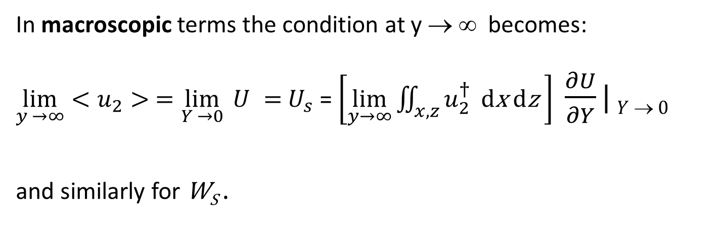
In macroscopic terms the condition at y → ∞ becomes:
$\lim_{y →∞}{<u_{2}> =\lim_{Y →0}{ U =}}{ U}_{s}$ = $\left[\lim_{y→∞}{\iint_{x,z}{u_{2}^{†}}} \text{d}\text{x} \text{d}\text{z} \right]$ $\frac{∂U}{∂Y}|$ $Y  0$
and similarly for W_{S} .
CFD & Optimization
Alessandro Bottaro
DICCA, University of Genova
NAVIER SLIP LENGTH or
PROTRUSION HEIGHT

Slide 38
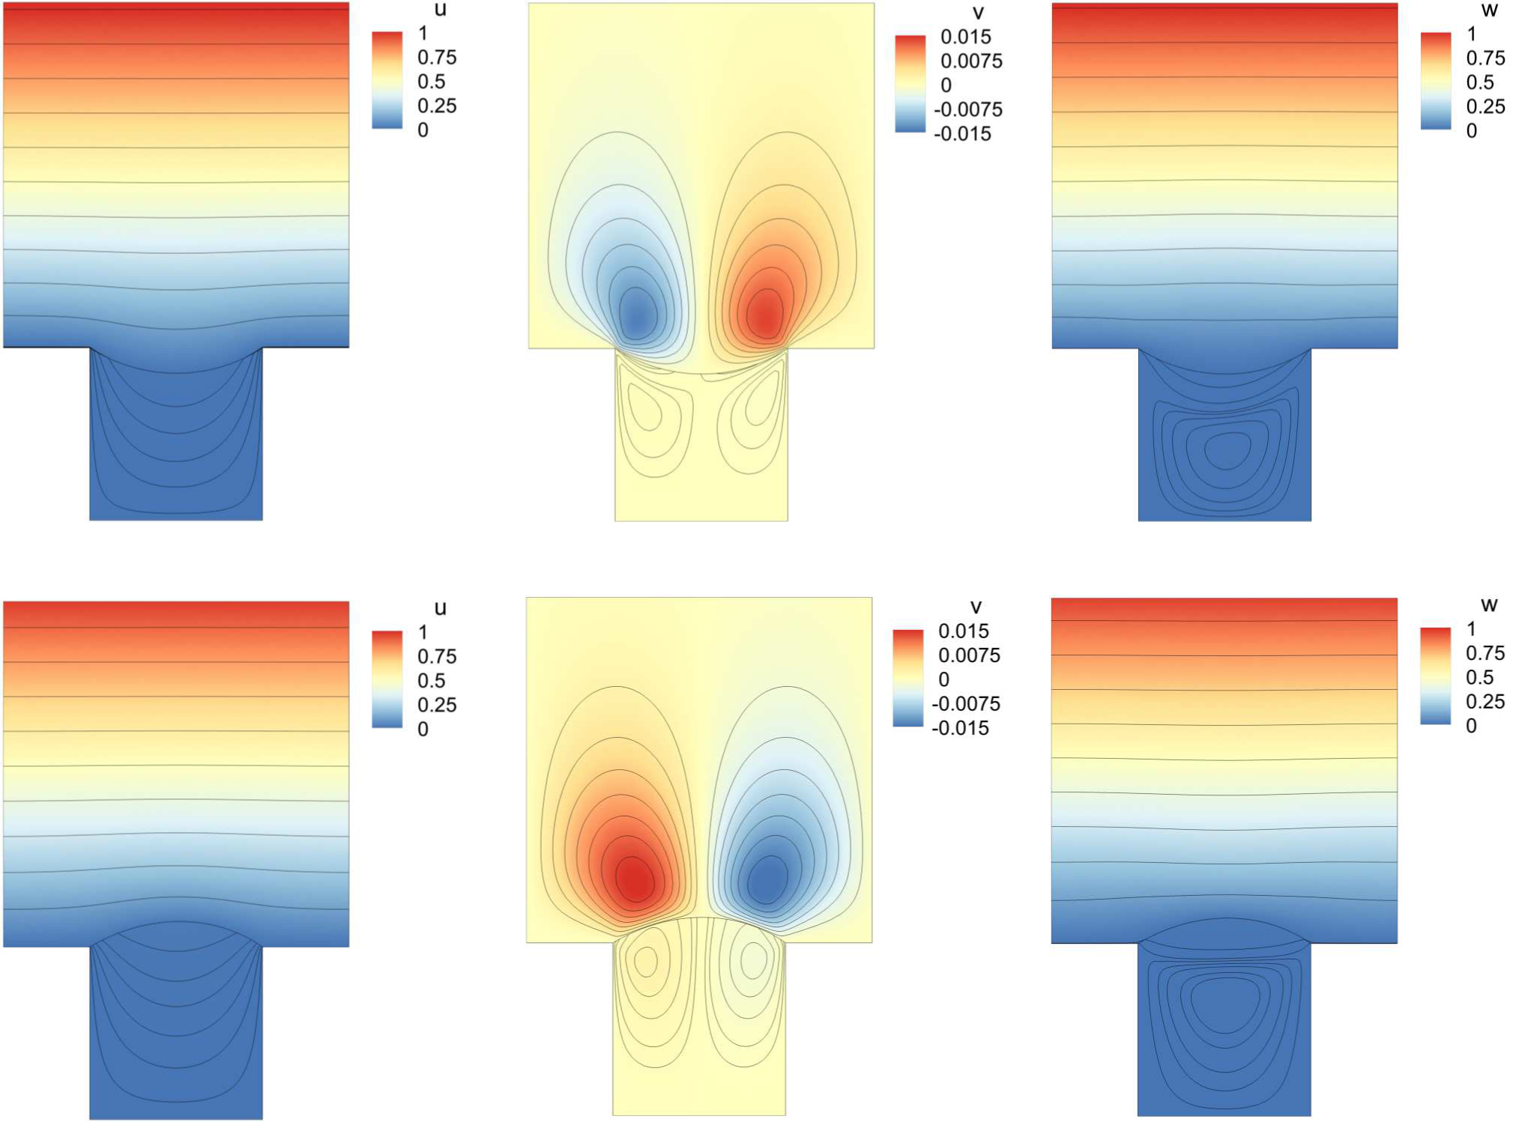
U_{s}
U_{s}
Numerical solution of the adjoint equations: mass-conserving boundary element method described in:
E. Alinovi & A. Bottaro, J. Comp.
Phys., 356 (2018) 261-281.
U_{s}
CFD & Optimization
Alessandro Bottaro
DICCA, University of Genova
y
z
l

Slide 39
l
l
A.M. Davis & E. Lauga,
Phys. Fluids 21 (2009) 0011701
SUPERHYDROPHOBIC
REFERENCE CASES (λ = 0.018)
C. Teo & B. Khoo, Microfl. & Nanofl. 9 (2010) 499-511
D. Crowdy, Phys. Fluids
22 (2010) 121703
(previous results based on free-shear conditions at the gas-liquid interface)
l
CFD & Optimization
Alessandro Bottaro
DICCA, University of Genova
l

Slide 40
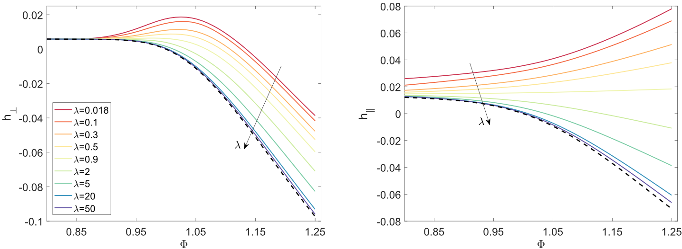
To study LIS we must vary the viscosity ratio λ
CFD & Optimization
Alessandro Bottaro
DICCA, University of Genova

Slide 41



Protrusion height difference (for c = 0.5)
$$\frac{}{}∆$$
CFD & Optimization
Alessandro Bottaro
DICCA, University of Genova
$$\frac{∆h}{\text{l} }$$
$$\text{l}$$
Even if in macroscopic simulations we must use both protrusion heights, there is a single relevant length scale Δ h which stems from the arbitrariness of the reference plane.

Slide 42
SHS & LIS
THE MACROSCOPIC PROBLEM (NUMERICS)
CFD & Optimization
Alessandro Bottaro
DICCA, University of Genova

Slide 43

U_{s}
CFD & Optimization
Alessandro Bottaro
DICCA, University of Genova
$$\frac{C_{f} − C_{f0} }{C_{f0}^{}}$$
Simulation results (red dots) with percentage skin friction drag reduction at Re_{τ} = 180, within the data base by A. Busse & N.D. Sandham, Phys. Fluids 24 (2012) 055111

Slide 44
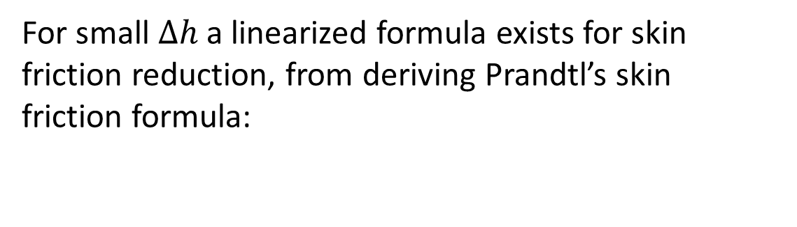
For small $∆h$ a linearized formula exists for skin friction reduction, from deriving Prandtl’s skin friction formula:
CFD & Optimization
Alessandro Bottaro
DICCA, University of Genova
P. Luchini, ECCOMAS 1996, Paris, France

Slide 45
For small $∆h$ a linearized formula exists for skin friction reduction, from deriving Prandtl’s skin friction formula:
CFD & Optimization
Alessandro Bottaro
DICCA, University of Genova
A rough wall lowers the logarithmic profile and increases C_{f} = 2 (u_{τ}/U∞)². The viscous sublayer disappears within the roughness troughs ...

Slide 46
For small $∆h$ a linearized formula exists for skin friction reduction, from deriving Prandtl’s skin friction formula:
CFD & Optimization
Alessandro Bottaro
DICCA, University of Genova
A SHS or LIS has the
opposite effect …

Slide 48
CFD & Optimization
Alessandro Bottaro
DICCA, University of Genova
spanwise vorticity
Q-criterion
Δh⁺ = 0.016 Δh⁺ = 1.566

Slide 49
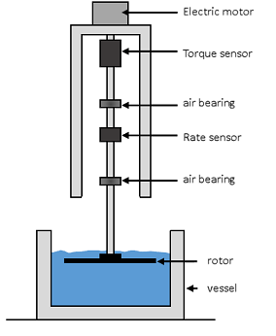
THE MACROSCOPIC PROBLEM (EXPERIMENTS)
LIS
CFD & Optimization
Alessandro Bottaro
DICCA, University of Genova

Slide 50
How do we produce the LIS?
SEM image of the surface of an
aluminum 99% disc corroded by
hydrochloric acid
Sectional view of the corroded aluminum surface

Slide 51
CFD & Optimization
Alessandro Bottaro
DICCA, University of Genova
Optical microscope image of LIS (vaseline oil)

Slide 53


Sliding drop, over a conventionally painted plate and over a treated plate

Slide 54
An improvement (on the torque coefficient C_{m}) of up to 18% can be observed at low rotation rates (Re of order 10⁵)
LIS on one side
LIS on both sides

Slide 55
LIS on one side
LIS on both sides
An improvement (on the torque coefficient Cm) of up to 18% can be observed at low rotation rates (Re of order 10⁵)
CONCEPT PROVED!

Slide 56
Issues:
Optimization of surface morphology and properties
Choice of lubricant
Durability and robustness
Production technique for application to large-scale surfaces
CONCLUSIONS

